Slide 1

Digital
Consumer Behavior
Dr. Perihan Salah
MKT713
Master of Digital Marketing
8

Slide 2

The Family and It’s Social Standing
Lecture 8
MKT713
Master of Digital Marketing

Slide 3

8
To understand the family as a consumer socialization agent.
To understand family decision-making and its members’ consumption-related roles.
To understand the role of the family life cycle in market segmentation and targeting.
To understand the consumption patterns of nontraditional families and non-family households.
To understand the impact of social stratification on consumer behavior.
To understand how to measure social class and segment consumers accordingly.
To understand the demographics, lifestyles, and consumption patterns of America’s social classes.
To understand how to employ geo-demographics to locate target markets.

Slide 4


The Family and It’s Social Standing

Slide 5
The Family and It’s Social Standing
The first part of this chapter describes the influence of the family on its members’ development as consumers (including households that fit into the family life cycle, as well as atypical and non-family living situations); how the family functions as a consumption unit; and the dynamics of family decision-making.
The second part of this chapter examines the demographics and consumption patterns of the social classes. It describes how to measure social class and segment and target consumers according to social standing. The chapter concludes with examples of how social class membership affects consumption habits, tastes, and values.

Slide 6
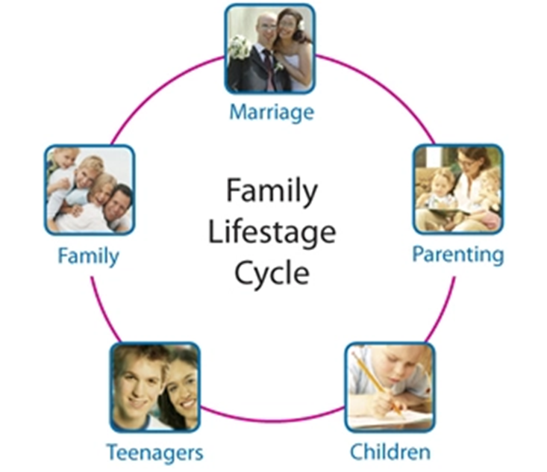
Consumer Socialization
A family is defined as two or more persons related by blood, marriage, or adoption residing together.
The family life cycle is a composite variable that combines marital status, size of family, age of family members (focusing on the age of the oldest or youngest child), and employment status of the head of household, and then classifies the family into a “typical” stage.

Slide 7

Consumer Socialization
There are three types of families:
married couples,
nuclear families, and
extended families.
A married couple and one or more children constitute a nuclear family.
The nuclear family, together with at least one grandparent or other relation living within the household, is called an extended family.

Slide 8

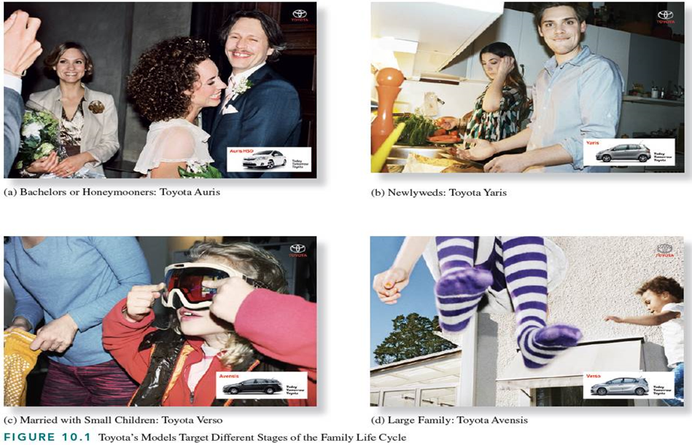
Consumer Socialization
The four ads in Figure 10.1 feature Toyota models catering to different types of families.
The Toyota Auris is a sporty hatchback with a “diffuser” and reflectors on each side that is targeted toward Bachelors or Honeymooners who do not have children and want to enjoy life.
The Yaris subcompact is promoted as a “great deal” to newlyweds who may have a child on the way.
The Verso is a seven-seater family car featuring elegant style and comfort, which is aimed at families with children who have more resources than the newlyweds.
The Avensis is available as a sedan or wagon and features a refined design and touch-screen multimedia. Assuming that the couple’s disposable income went up (e.g., the father earns more and the mother went back to work), it’s time for the Avensis, with its stylish design and built-in multimedia gear.

Slide 9


Slide 10

Consumer Socialization
Pre-adolescent (pre teenage)
  Observe parents and older siblings
  Families more reliable than advertising
Teenagers
  Peers most influential
  Like products when parents disapprove

Slide 11
Consumer Socialization
The aspect of childhood socialization that is relevant to the study of consumer behavior is consumer socialization,
Consumer socialization is defined as the process by which children acquire the skills, knowledge, attitudes, and experiences necessary to function as consumers.
The socialization of young children provides marketers with opportunities to establish relationships between children and brands very early in the children’s lives.
Very often, such connections extend into a person’s adolescence, teenage years, and adulthood.

Slide 12
Consumer Socialization
Many preadolescent children acquire their consumer behavior norms by observing their parents and older siblings, who function as role models and provide cues for learning consumption skills.
Young children perceive their families as more reliable sources of information about consumption than advertising;
Peers have the most influence on teenagers’ and adolescents’ (tween-age) consumption and they like products because their parents do not approve.

Slide 13



Slide 14
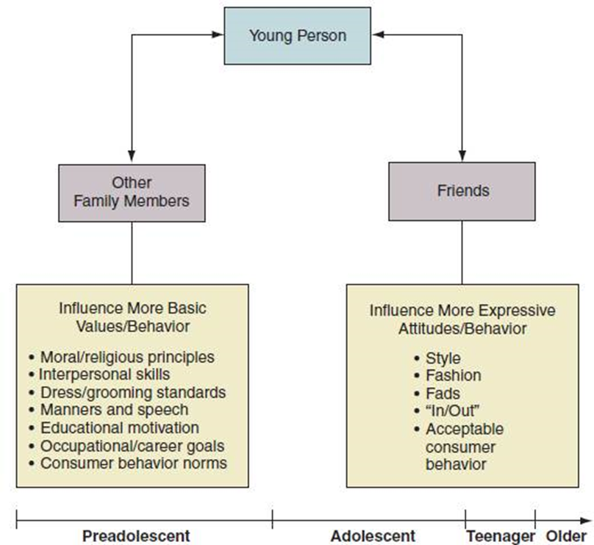
Socialization = Two Way Process
The figure illustrates the sources that influence children’s socialization over time and indicates that socialization is a two-way process. The two-directional arrows indicate that a young person is both socialized and influences those who are doing the socializing.

Slide 15


Slide 16
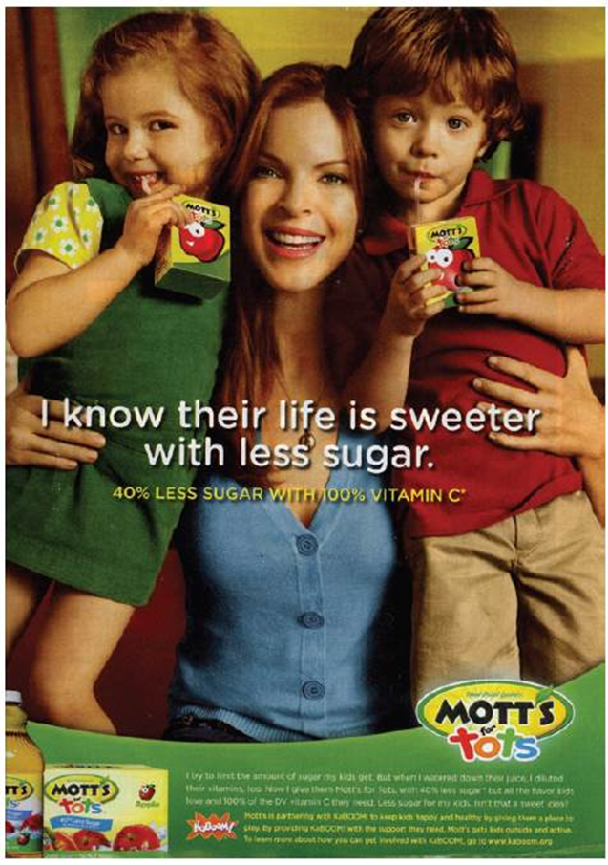

Socialization Agents
Mothers stronger socialization agents than fathers
Mothers usually:
  more involved
  control children’s exposure to commercial messages
  regulate spending
The ad for Mott’s juice depicts a mother as a socialization agent who is teaching her children that juices with less sugar are healthier.

Slide 17
Socialization Agents
The socialization agent is the person or organization involved in the socialization process because of frequency of contact with the individual and control over the rewards and punishments given to the individual.
Mothers are stronger consumer socialization agents than fathers because mothers are usually more involved with their children and often control their children’s exposure to commercial messages.
Mothers most often provide instruction in the skills needed to become consumers and regulate the amount of money children can spend and how they spend it.

Slide 18
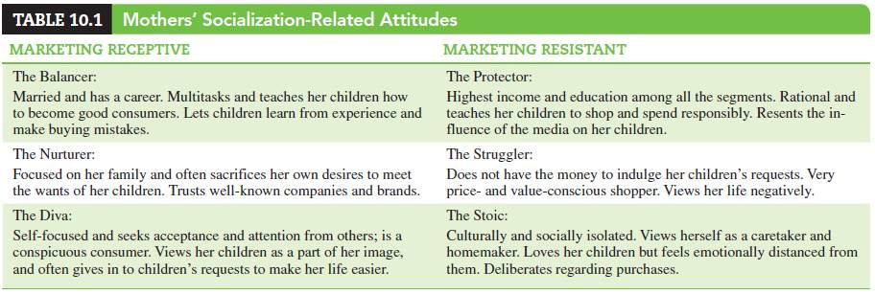
Mothers’ Socialization-Related Attitudes
Researchers identified distinct socialization styles among mothers, based on mothers’ attitudes toward marketing
المربي
و الناظره المستحمله و منعزلة

Slide 19


Slide 20


Slide 21


Slide 22


Slide 23


Slide 24


Slide 25


Slide 26


Slide 27


Slide 28


Slide 29


Slide 30
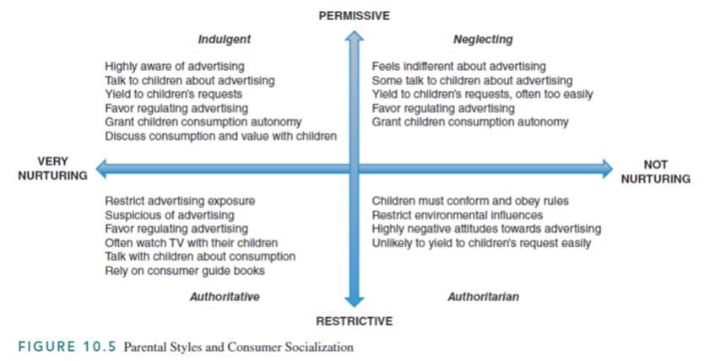
Parental Styles and Socialization
Tolerant ,forgiving
trustworthy
Autocratic

Slide 31
Parental Styles and Socialization
A classification of parental styles along two dimensions:
permissive versus restrictive and very nurturing versus non-nurturing.
Four parental styles and their respective attitudes toward advertising, consumption, and yielding to children’s buying requests.
The four parental styles include:
indulgent parents, who are very nurturing and highly permissive in respect to consumer socialization;
neglecting parents, who are very permissive, but provide their children with little or no nurturing during consumer socialization;
authoritative parents, who are very nurturing and also very restrictive with respect to consumer socialization; and lastly,
authoritarian parents, who are very restrictive and not nurturing during consumer socialization.

Slide 32


Slide 33


Slide 34


Slide 35
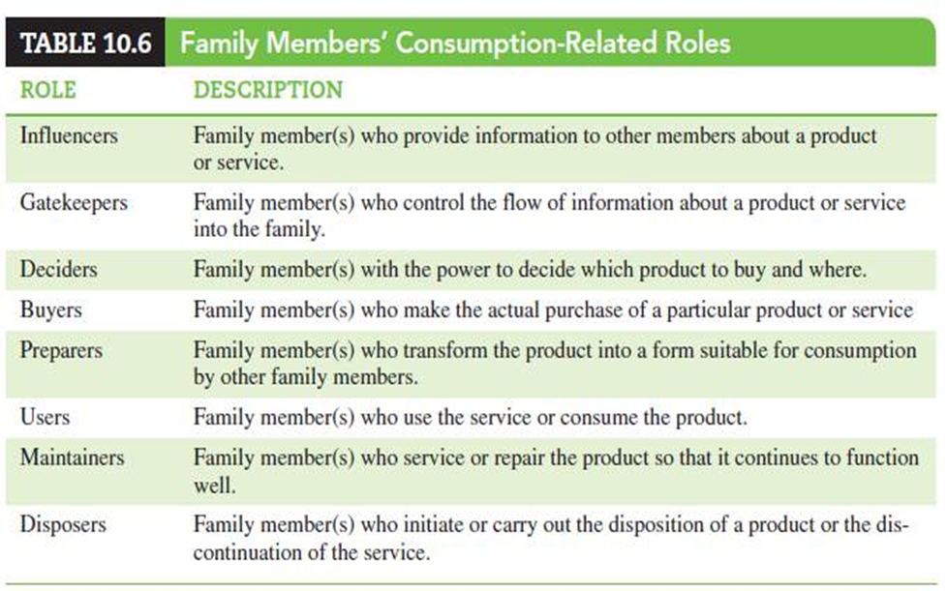
Roles

Slide 36
Roles
The family decision-making consists of identifying the roles that members play in buying decisions.
Many parents are gatekeepers, who control the information that reaches the family’s children by using the parental control features available on TVs, computers, and other communication devices.
Children might be influencers in the family’s purchase of a new car, although they are neither the deciders nor buyers of family cars.
Children from dual-income households are often the deciders, buyers, and preparers of foods, so marketers of cuisine goods must study the roles of children in the consumption of the products offered and consider them in their designs.
Because children—in the role of maintainers—often perform housekeeping chores by themselves, makers of, for example, vacuum cleaners should conduct research where they observe how children use their products and make sure they can do so safely.

Slide 37
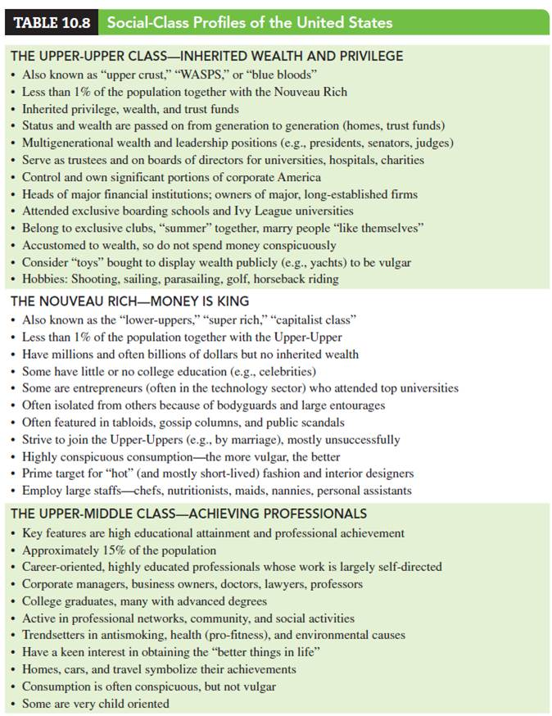
Social Class Profiles
The Upper-Upper Class.
The Nouveau Rich.
The Upper-Middle Class.

Slide 38

Social Class Profiles

Slide 39
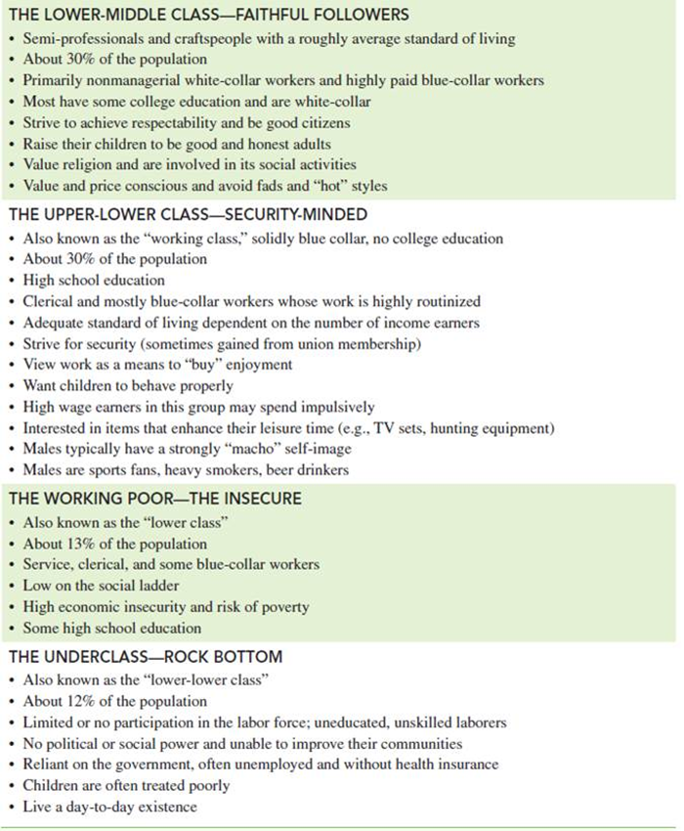
Social Class Profiles
The Lower-Middle Class.
The Upper-Lower Class.
The Working Class.
The Underclass.

Slide 40

To understand the family as a consumer socialization agent.
To understand family decision-making and its members’ consumption-related roles.
To understand the role of the family life cycle in market segmentation and targeting.
To understand the consumption patterns of nontraditional families and non-family households.
To understand the impact of social stratification on consumer behavior.
To understand how to measure social class and segment consumers accordingly.
To understand the demographics, lifestyles, and consumption patterns of America’s social classes.
To understand how to employ geo-demographics to locate target markets.
08

Slide 41


