Slide 1

The Cultures of New Media
Prepared by
Dr. Mohamed Owies
Lecture No.6
The Cultures of New Media

Slide 2


Lecture 6
The content of Lecture 5
The lecture 6 sheds light on a number of important topics, including the following:
The Frenzy of the Visible
Welcome to Selfie City
Selfies As Social Actions
Selfie Panic
Subversive Technologies of the Self

Slide 3

Lecture 6
The Frenzy of the Visible
There is sometimes talk of a visual turn in the social and cultural sciences, meaning that there has been increased interest in how images and visuals, photos and videos affect how we experience culture, and how we interact with each other.
Writer and film director Jean-Louis Comolli wrote (1980: 121) about how society is driven by representation:
If the social machine manufactures representations, it also manufactures itself from representations — the latter operative at once as means, matter and condition of sociality.

Slide 4
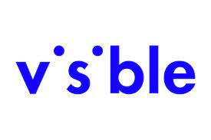
Lecture 6
The Frenzy of the Visible
This is the same point made by many theorists of the postmodern, such as sociologist Jean Baudrillard, who used concepts like hyperreality and simulation to argue that representation and reproduction were key mechanisms in postmodern society. The idea being that since the last few decades of the 20th century, there has been an explosion of visual culture, where pictures and video have assumed a dominant position. This is a consequence of the development of film and cinema, television, colour printing, advertising, video, computers, and so on.

Slide 5
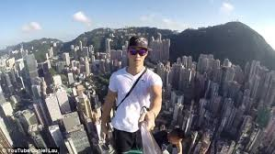
Lecture 6
Welcome to Selfie City
As discussed in previous chapters, digital society has brought along changes in how people express themselves. This development is intensified as networks sprawl and technology becomes increasingly portable. One such new form of self-expression is the selfie, a photographic self-portrait shared on social media.

Slide 6
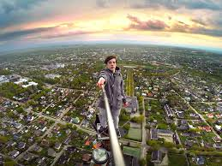
Lecture 6
Welcome to Selfie City
Selfies have rapidly become popular and ever-present in the last few years. The coming into being of the selfie is based on hardware — smartphone cameras — as well as software — social media platforms — that, sit at the centre of today’s social world.

Slide 7
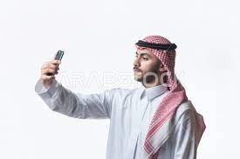
Lecture 6
Welcome to Selfie City
Visual culture researcher Brooke Wendt (2014) found that more than 130 million posts to Instagram — the most popular platform for sharing selfies — had been hashtagged with the word ‘selfie’. Adding a set of related tags (#I, #me, #myself, #self, #selfportrait), the number was as much as 439 million.

Slide 8

Lecture 6
Welcome to Selfie City
The popularity of selfies might have to do with the more general tendency towards visual fascination. It could also be interpreted as an expression of today’s culture as being individualistic, focused on identity work, superficial, or even narcissistic.
But the explosive growth of the phenomenon also has to do with the global saturation of phones with cameras, and with the large-scale introduction of front-facing cameras on such phones. In fact that feature, occurring for the first time in 2003, was originally intended for video calls but was soon adopted by users also for taking stills at arm’s length.

Slide 9
Lecture 6
Welcome to Selfie City
The first use of the word selfie is said to have been in Australia. In September 2002 a young man posted a photo of his damaged bottom lip, writing in a forum post on the site of public broadcaster ABC: ‘sorry about the focus, it was a selfie’.

Slide 10
Lecture 6
Welcome to Selfie City
Of course, self-portraits as such, are not new. People have depicted themselves through various techniques and media since the beginning of time, and, naturally, even users of the very early cameras in the 19th century sometimes turned the lens towards themselves.

Slide 11
Lecture 6
Welcome to Selfie City
But these photographic self-portraits were still mostly random events. As a recognisable and codified genre, however, the selfie is a product of digital media, and it has introduced several new elements into social interaction.

Slide 12
Lecture 6
Welcome to Selfie City
The Oxford Dictionaries named selfie as the word of the year in 2013, defining it as a photograph that one has taken of oneself, typically one taken with a smartphone or webcam and uploaded to a social media website’.
Their editorial director Judy Persall explained that ‘selfie’ had already emerged as a tag on the social photo site Flickr back in 2004, but the word became widely used in mainstream media around 2012. She also explained that the usage of the –ie suffix likely has to do with the term having been conceived in Australian English.

Slide 13
Lecture 6
Welcome to Selfie City
Communications researchers Katharina Lobinger and Cornelia Brantner (2015: 1848) argue that selfies have indeed ‘become their own genre of visual self-representation with its own conventions, representational techniques, and poses’.
Photographically speaking, the recognisable attributes of selfies — such as the often visible arm of the photographer bearing witness to how the photo was made — make their production process visible. From an art perspective, selfies have a sort of meta-character to them, as they can be compared to what happens when a comedic actor partly breaks out of character to look directly at the film or TV-camera to make a face.

Slide 14

Lecture 6
Selfies As Social Actions
Selfies are no doubt a form of social action that happens in some form of social context with some sort of intention. It is a crucial trait of selfies that they are shared through online social networks. One might therefore say that the selfie is social by definition. And as it is fundamentally social, it also has to do with people’s need for affirmation — something that can only be fulfilled in interacting with others (Ehlin 2015: 22).

Slide 15
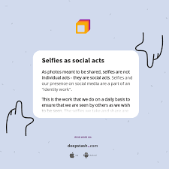
Lecture 6
Selfies As Social Actions
In comparison with traditional self-portraits, selfies are also generally much more spontaneous and casual. The latter are predominantly taken and shared by people who we would not conventionally define as artists. Selfies, therefore, are a form of folk ‘art’, in the sense that they are created by and shared among ‘ordinary’ people.

Slide 16
Lecture 6
Selfies As Social Actions
The selfie is consciously social. It is created to be viewed, in the present, and when we look at a selfie, we are aware of this intention. Internet researchers Theresa Senft and Nancy Baym (2015: 1589) write that it is part of the character of a selfie that it initiates a number of relationships.
The most obvious of these is the one between viewer and viewed, but they also point to how selfies set in motion relational processes between images and the software used to filter and share them, between users and the architecture of social media platforms, and between the subject as simultaneously being photographer and the photographed.

Slide 17
Lecture 6
Selfies As Social Actions
Selfies offer many possibilities for people — human actors — to be active, in selecting, framing, filtering, and so on. But selfies also engage what Latour (2005) would call nonhumans. The creation, display, circulation, and monetisation of selfies occur through a number of technological artefacts such as cameras, servers, algorithms, screens, and so on.

Slide 18
Lecture 6
Selfies As Social Actions
Senft and Baym (2015: 1589) argue that once a selfie enters the internet, it instantly becomes part of an infrastructure that detaches it from its original time and place of production.
The selfie is consciously social. It is created to be viewed, in the present, and when we look at a selfie, we are aware of this intention. Internet researchers Theresa Senft and Nancy Baym (2015: 1589) write that it is part of the character of a selfie that it initiates a number of relationships.

Slide 19
Lecture 6
Selfies As Social Actions
The most obvious of these is the one between viewer and viewed, but they also point to how selfies set in motion relational processes between images and the software used to filter and share them, between users and the architecture of social media platforms, and between the subject as simultaneously being a photographer and the photographed.
Selfies offer many possibilities for people — human actors — to be active, in selecting, framing, filtering, and so on.

Slide 20
Lecture 6
Selfies As Social Actions
We might think of selfies in the first instance as pictures of lone individuals. Indeed, celebrities who are active on social media — and whose celebrity largely rests on this fact —have contributed to shaping the genre.
But the social aspects of selfies also go beyond the mere sharing of solo images. For example, taking selfies together with others — with one person holding the camera and one or more individuals sticking their heads into the frame — can be used as a means of showing which groups one belongs to.

Slide 21
Lecture 6
Selfies As Social Actions
Political and religious leaders figure more and more often in shots with other authority figures, as well as with ‘ordinary’ people. Visually framing and sharing one’s relations with school friends, family, celebrities, or authority figures, in the form of selfies, is a type of self-presentation which is unique to digital society.

Slide 22
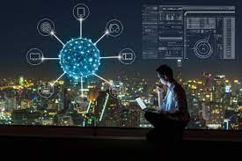
Lecture 6
Selfie Panic
In December 2013, Danish Prime Minister Helle Thorning-Schmidt took a selfie with UK Prime Minister David Cameron and US President Barack Obama during Nelson Mandela’s memorial service.
A news photo of her doing this sparked a series of intense reactions across media that became nicknamed ‘Selfiegate’. Miltner and Baym (2015) have analysed the debate and found that it included several different aspects of social norms: Who can take a selfie? When and where is it appropriate to take them?

Slide 23
Lecture 6
Selfie Panic
More generally, there has been a debate over the inappropriateness of selfies taken in some places and situations, such as at grave sites, the Anne Frank House, the Holocaust Memorial, at Chornobyl, in front of burning houses, hostage situations, together with homeless people, and so on. Have a look, for example, at selfiesatseriousplaces.tumblr.com or make a web search for ‘tasteless selfies’.

Slide 24
Lecture 6
Selfie Panic
Such selfies have been questioned since the often playful and humorous character of selfies fits badly with the seriousness of the settings, thereby giving the impression that the creator wants to diminish or ridicule them. Similarly, it has been questioned what the allure of the selfie might do to ‘serious’ politics. Some pundits have worried that selfies are ‘turning politicians into teenagers’, and that ‘the tyranny of selfies’ will transform the political climate for the worse.

Slide 25
Lecture 6
Selfie Panic
Such reactions have to do with selfies being a relatively new phenomenon around which no clear social norms have yet formed. A new genre like this might need new perspectives altogether to be fully understood. Still, it is natural that we initially react by falling back on norms that have been formed around other forms of photography.

Slide 26
Lecture 6
Selfie Panic
Media psychologist Pamela Rutledge writes that ‘the sheer volume and publicness of selfies defies any models we have’, so we tend to think that they ‘violate social rules of self-presentation and therefore something’s wrong’. She continues:
If the people in selfies aren’t famous or being paid to pose, then it must indicate a moral failing and they are labeled bragging, attention seeking, self-focused or narcissistic.

Slide 27
Lecture 6
Selfie Panic
Like Rutledge, social media researcher Anne Burns (2015) thinks that a ‘common sense’ understanding of selfies is that they are narcissistic.
The very word ‘selfie’, she writes, hints at a form of egotism. Furthermore, people tend to understand selfies in terms of their subjects being vain and overly preoccupied with their appearance.
McLuhan (1964: 41) anticipated this when writing about how people in the age of electronic media ‘become fascinated by any extension of themselves in any material other than themselves’.

Slide 28
Lecture 6
Selfie Panic
Part of why selfies have been seen as a social problem has to do with generational divides. Media technologies, platforms, and practices that are new to us often set in motion media panics. Therefore each generation of adults will question the media use of younger generations. Young people’s media use is different from the forms that were known before, and therefore it can generate worry.

Slide 29
Lecture 6
Selfie Panic
Much like popular print media in the 19th century, film in the early 20th century, rock music in the 1950s, and so on, selfies today are seen by some researchers and commentators as potentially dangerous to society. Media panics are polarising reactions that blow the possible consequences of the new technology out of proportion.

Slide 30
Lecture 6
Selfie Panic
Drawing on sociologist Stanley Cohen’s (1972) theory of so-called ‘moral panics’, media researcher Kirsten Drotner (1999) traces the history of media panics from the 18th century and up until the age of the internet. The panic reactions, Cohen writes, emerge when some phenomenon becomes ‘defined as a threat to societal values and interests’.
The nature of the phenomenon then tends to be ‘presented in a stylised and stereotypical fashion’, as ‘socially accredited experts pronounce their diagnoses and solutions’ (Cohen 1972: 9).

Slide 31
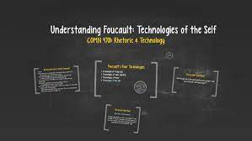
Lecture 6
Subversive Technologies of the Self
So, what is the purpose of selfies? Media and fashion researcher Lisa Ehlin (2015: 13) writes: If I post a selfie (a shared social media self-portrait) I desire to reach out, and enable contact. I watch myself anew in a form of endless self-fashioning. Images are personal, yet implicit.
But selfies do not only show what we look like, but also where we are, what we are doing, who we think might be watching, and who we want to be. Wendt (2014: 8) speculates that: ‘Perhaps, our preoccupation with Instagram is simple: it offers us infinite versions of ourselves, as though each picture promises a better version.

Slide 32
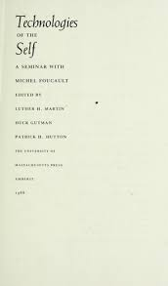
Lecture 6
Subversive Technologies of the Self
In taking and sharing selfies, versions of the images can be created through the different filters included in photo sharing apps, which enable experimenting with different styles that allow us to see ourselves in new or different ways.

Slide 33
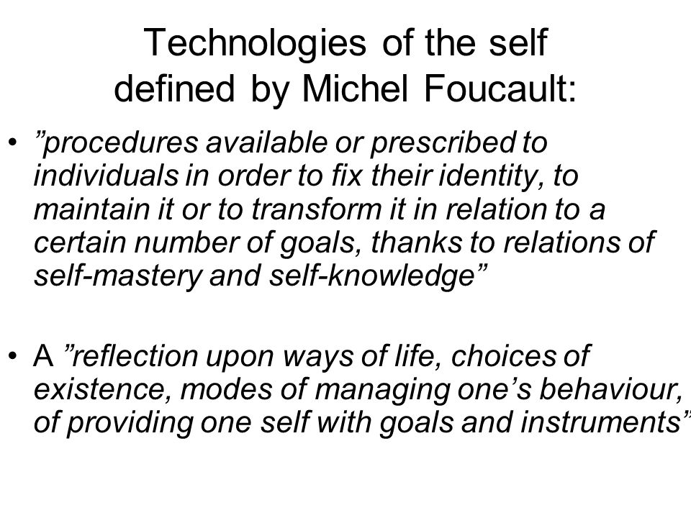
Lecture 6
Subversive Technologies of the Self
This can also be associated with the possibility of viewing ourselves from the outside, as digital culture researcher Jill Walker Rettberg (2014: 27) describes how the raw and revealing character of selfies, alongside the practices of running them through retro — and other — filters gives the image ‘a distance that makes them new to us’: We see ourselves and our surroundings as if we are outside of ourselves, through a retro filter or in the same poses and layouts as we see fashion models or homes in magazine spreads.

Slide 34
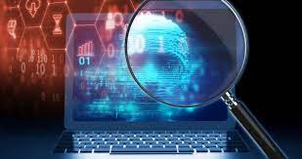
Lecture 6
Subversive Technologies of the Self
But the openness of the possibilities for being whomever we might want is limited. As with most other visual culture, selfies are definitely associated with the politics of gender. For example, one of the popular selfie poses is the mouth-pouting ‘duckface’, especially prominent among female subjects.
This gendered pejorative term refers to selfie takers who ‘suck in their cheeks to highlight their cheekbones, which tends to push the lips out in a manner that appears duck-like’ (Katz & Crocker 2015: 1866).

Slide 35
Lecture 6
Subversive Technologies of the Self
The way in which selfies are used and talked about can contribute to maintaining compliance with gendered social norms, and also govern under what circumstances men or women can participate in social and political settings online. As selfies are part of society and people’s construction of identities more generally, not only gender but also other social divisions have an effect as well. Sociologists Apryl Williams and Beatriz Aldana Marquez (2015) have found that many white men don’t take selfies as they are seen as ‘unmanly’.

Slide 36

Lecture 6
Subversive Technologies of the Self
Latino and black men, on the other hand, were more positive to taking and sharing selfies. Those research results point to selfies having a potential for self-empowerment, as well as for expressing alternatives to hegemony. More generally, selfies, while in part reproducing social stereotypes related to power, can also potentially be used to take control in various ways.
Philosopher Michel Foucault (1988: 18) wrote about something called technologies of the self, which permit individuals to effect by their own means or with the help of others a certain number of operations on their own bodies and souls, thoughts, conduct, and way of being, so as to transform themselves in order to attain a certain state of happiness, purity, wisdom, perfection, or immortality.

Slide 37
Lecture 6
Subversive Technologies of the Self
Selfies, or social media in general for that matter, can be seen as such a technology that we use for framing, filtering, presenting, and sharing ourselves. While selfies, on the one hand, are enforced by, and enforcing, social power and norms, they may also enable performances that resist such things (Losh 2015: 1649).

Slide 38
Lecture 6
Subversive Technologies of the Self
In other words, that selfies might be seen as superficial photos that express things such as problematic beauty ideals does not exclude the possibility of them being powerfully progressive.
Philosopher Judith Butler (1990), one of the originators of queer theory, has argued that identities are performances. Her concept of performativity suggests that nothing within our identities is fixed, so people maintain their gender identity, like any other aspect of identity, by repeatedly performing it in similar ways.

Slide 39
Lecture 6
Subversive Technologies of the Self
If people start doing things differently, society can gradually change. The problem is, however, as Butler argues, that the performances are not always conscious, and that some performances are repeated so often throughout culture and media that they appear ‘natural’ or ‘true’.
Still, this is just an illusion and the seemingly fixed identities — gendered, racialised, and other — can be subverted and reinvented through the accumulation of alternative performances.

Slide 40
Lecture 6
Thank You

