Slide 1

Lecture 7:
Reducing
Project Duration
PMG 605
Project Resources and Time Management
Dr. Eng.
Abdullah Jameel Halawany

Slide 2
Session Outline
Reducing Project Duration
Rationale for Reducing Project Duration
Options for Accelerating Project Completion
Project Cost–Duration Graph
Constructing a Project Cost–Duration Graph
Practical Considerations
When Resources Are Not Constrained
When Resources Are Constrained

Slide 3
Rationale for Reducing Project Duration

Slide 4
Imagine the Following Scenarios
After finalizing your project schedule, you realize the estimated completion date is two months beyond what your boss publicly promised an important customer.
Five months into the project, you realize that you are already three weeks behind the drop-dead date for the project.
Four months into a project top management changes its priorities and now tells you that money is not an issue. Complete the project ASAP!
7–4

Slide 5
Rationale for Reducing Project Duration
Time Is Money: Cost-Time Tradeoffs
Reducing the time of a critical activity usually incurs additional direct costs.
Cost-time solutions focus on reducing (crashing) activities on the critical path to shorten overall duration of the project.
7–5

Slide 6
Reasons For Imposed Project Duration Dates
Time-to-market pressures
Unforeseen delays
Incentive contracts (bonuses for early completion)
Imposed deadlines and contract commitments
Overhead and public goodwill costs
Pressure to move resources to other projects
7–6

Slide 7
Reasons For Imposed Project Duration Dates
Time-to-market pressures
Intense global competition and rapid technological advances have made speed a competitive advantage. To succeed, companies have to spot new opportunities, launch project teams, and bring new products or services to the marketplace in a flash. Perhaps in no industry does speed matter as much as in the electronics industry.
7–7

Slide 8
Reasons For Imposed Project Duration Dates
Unforeseen delays
adverse weather, design flaws, and equipment breakdown—cause substantial delays midway in the project. Getting back on schedule usually requires compressing the time on some of the remaining critical activities. The additional costs of getting back on schedule need to be compared with the consequences of being late. This is especially true when time is a top priority.
7–8

Slide 9
Reasons For Imposed Project Duration Dates
Incentive contracts (bonuses for early completion)
For example, a contractor finished a bridge across a lake 18 months early and received more than $6 million for the early completion. The availability of the bridge to the surrounding community 18 months early to reduce traffic gridlock made the incentive cost to the community seem small to users.
7–9

Slide 10
Reasons For Imposed Project Duration Dates
Imposed deadlines and contract commitments
For example, the president of a software company remarks in a speech that new advanced software will be available in one year. Such statements too often become imposed project duration dates—without any consideration of the problems or cost of meeting such a date.
The project duration time is set while the project is in its “concept” phase before or without any detailed scheduling of all the activities in the project.
7–10

Slide 11
Reasons For Imposed Project Duration Dates
Overhead and public goodwill costs
For example, it may cost $80,000 per day to simply house and feed a construction crew.
Pressure to move resources to other projects
Under these circumstances, the cost of compressing the project can be compared with the opportunity costs of not releasing key equipment or people.
7–11

Slide 12
Options for Accelerating Project Completion

Slide 13
Options for Accelerating Project Completion
Resources Not Constrained
  Adding resources
  Outsourcing project work
  Scheduling overtime
  Establishing a core project team
  Do it twice—fast and then correctly
Resources Constrained
  Improve the Efficiency of the Project Team
  Fast-tracking
  Critical-chain
  Reducing project scope
  Compromise quality
7–13

Slide 14
Options for Accelerating Project Completion
When Resources Not Constrained
Adding resources
The common method for shortening project time
There are limits as to how much speed can be gained by adding staff.
Doubling the size of the workforce will not necessarily reduce most completion time by half
Additional workers increase the communication requirements to coordinate their efforts
7–14

Slide 15
Options for Accelerating Project Completion
When Resources Not Constrained
Outsourcing project work
The subcontractor may have access to superior technology or expertise that will accelerate the completion of the activity
For example, contracting for a backhoe can accomplish in two hours what it can take a team of laborers two days to do
Subcontracting also frees up resources that can be assigned to a critical activity and will ideally result in a shorter project duration
7–15

Slide 16
Options for Accelerating Project Completion
When Resources Not Constrained
Scheduling overtime
The easiest way to add more labor to a project is not to add more people, but to schedule overtime
If a team works 50 hours a week instead of 40, it might accomplish 20 percent more
By scheduling overtime, you avoid the additional costs of coordination and communication encountered when new people are added
Overtime and working longer hours is the preferred choice for accelerating project completion, especially when the project team is salaried. The key is to use overtime judiciously. Remember a project is a marathon not a sprint! You do not want to run out of energy before the finish line.
7–16

Slide 17
Options for Accelerating Project Completion
When Resources Not Constrained
Establishing a core project team
one of the advantages of creating a dedicated core team to complete a project is speed
Assigning professionals full time to a project avoids the hidden cost of multitasking in which people are forced to juggle the demands of multiple projects
Professionals are allowed to devote their undivided attention to a specific project.
This singular focus creates a shared goal that can bind a diverse set of professionals into a highly cohesive team capable of accelerating project completion
7–17

Slide 18
Options for Accelerating Project Completion
When Resources Not Constrained
Do it twice—fast and then correctly
If you are in a hurry, try building a “quick and dirty” short-term solution, then go back and do it the right way
For example, software companies are notorious for releasing version 1.0 of products that are not finished and tested. Subsequent versions 1.1 . . . x correct bugs and add intended functionality to the product.
The additional costs of doing it twice are often more than compensated for by the benefits of satisfying the deadline
7–18

Slide 19
Options for Accelerating Project Completion
Resources Not Constrained
  Adding resources
  Outsourcing project work
  Scheduling overtime
  Establishing a core project team
  Do it twice—fast and then correctly
Resources Constrained
  Improve the Efficiency of the Project Team
  Fast-tracking
  Reducing project scope
  Compromise quality
  Critical-chain
7–19

Slide 20
Options for Accelerating Project Completion
When Resources Are Constrained
Improve the Efficiency of the Project Team
The project team may be able to improve productivity by implementing more efficient ways to do their work. This can be achieved by improving the planning and organization of the project or eliminating barriers to productivity such as excessive bureaucratic interference and red tape
7–20

Slide 21
Options for Accelerating Project Completion
When Resources Are Constrained
Fast-Tracking
Sometimes it is possible to rearrange the logic of the project network so that critical activities are done in parallel (concurrently) rather than sequentially
one of the most common methods for restructuring activities is to change a finish-to-start relationship to a start-to-start relationship.
For example, instead of waiting for the final design to be approved, manufacturing engineers can begin building the production line as soon as key specifications have been established
Changing activities from sequential to parallel is not without risk. Late design changes can produce wasted effort and rework.
Fast tracking requires close coordination
7–21

Slide 22
Options for Accelerating Project Completion
When Resources Are Constrained
Reducing Project Scope
For example, the new car will average only 25 mpg instead of 30, or the software product will have fewer features than originally planned
The key to reducing a project scope without reducing value is to reassess the true specifications of the project
It is important to talk to the customer and/or project sponsors and explain the situation
Calculating the savings of reduced project scope begins with the work breakdown structure
7–22

Slide 23
Options for Accelerating Project Completion
When Resources Are Constrained
Compromise Quality
Reducing quality is always an option, but it is rarely acceptable or used
If quality is sacrificed, it may be possible to reduce the time of an activity on the critical path
7–23

Slide 24
Options for Accelerating Project Completion
When Resources Are Constrained
Critical-Chain Project Management
CCPM creates an environment where people can quickly identify and monitor dependencies between tasks and resources. It also lets project managers handle uncertainty and unforeseen situations by:
  Bringing task duration estimates to an average
  Planning a schedule backward starting from the due date to make sure tasks are done when needed
  Protecting the project by putting buffers in the plan
  Controlling the plan and getting feedback by monitoring the buffers
Unlike the critical path method (CPM), this one doesn’t aim to find the absolute best schedule. Instead, it tries to find a good enough solution.
7–24

Slide 25
Options for Accelerating Project Completion
When Resources Are Constrained
Critical-Chain Project Management
CCPM uses the concept of buffers to make sure that resources are available when they’re required for the completion of a task. Four types of buffers are the following:
Project Buffers are inserted between the last task and the completion date and make sure the date doesn’t change
Feeding Buffer is set at the end of non-critical chains to prevent any delay from the critical chain
Resource Buffer is inserted at the beginning of the critical chain and ensures it has the essential resources
7–25

Slide 26
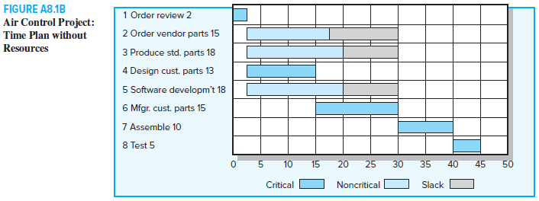
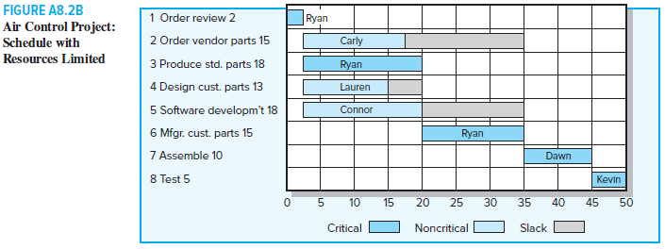
Critical-Chain Project Management
7–26

Slide 27
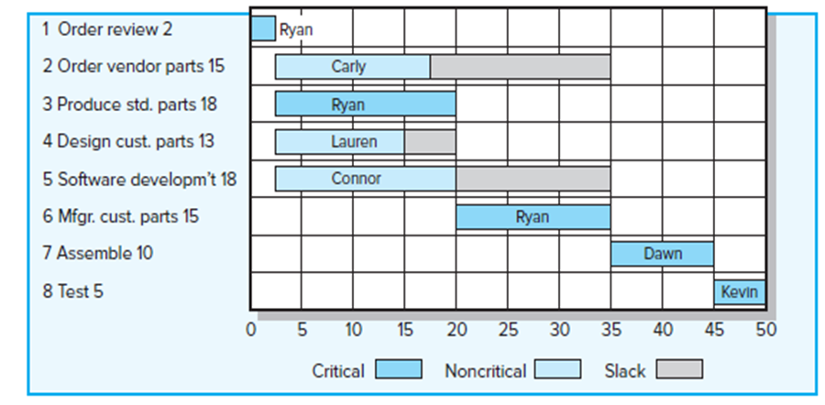
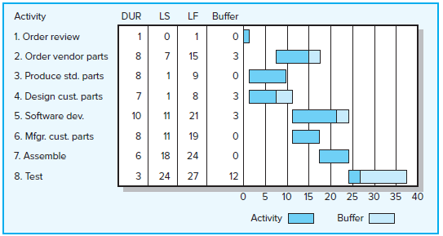
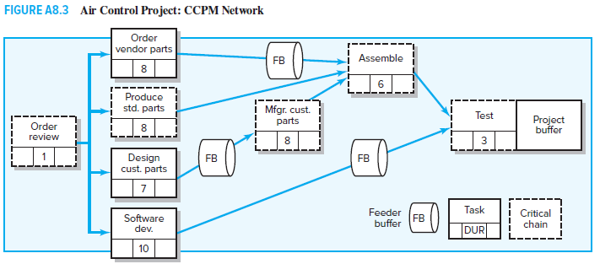
Critical-Chain Project Management
7–27

Slide 28
Options for Accelerating Project Completion
In practice
The methods most used to crash projects are scheduling overtime, outsourcing, and adding resources. Each of these maintains the essence of the original plan.
Options that depart from the original project plan include do it twice and fast-tracking. Rethinking of project scope, customer needs, and timing become major considerations for these techniques.
7–28

Slide 29
Project Cost–Duration Graph

Slide 30
Project Costs
Indirect Costs
Generally, represent overhead costs such as supervision, administration, consultants, and interest. Indirect costs cannot be associated with any work package or activity
That is, any reduction in time should result in a reduction of indirect costs. For example, if the daily costs of supervision, administration, and consultants are $2,000, any reduction in project duration would represent a savings of $2,000 per day
7–30

Slide 31
Project Costs
Direct Costs
Commonly represent labor, materials, equipment, and sometimes subcontractors
Direct costs are assigned directly to a work package and activity
Direct costs for an activity time represent normal costs, which typically mean low-cost, efficient methods for a normal time.
When project durations are imposed, direct costs may no longer represent low-cost, efficient methods.
Costs for the imposed duration date will be higher than for a project duration developed from ideal normal times for activities.
The sum of the costs of all the work packages or activities represents the total direct costs for the project.
7–31

Slide 32
Project Costs
Total costs,
Cost
Overhead, typically a function of duration
Direct costs, typically reducing with time
Project duration
The first plan is not necessarily the cheapest!
7–32

Slide 33
Constructing a Project Cost–Duration Graph

Slide 34
Constructing a Project Cost–Duration Graph
There are three major steps required to construct a project cost–duration graph:
Find total direct costs for selected project durations.
Find total indirect costs for selected project durations.
Sum direct and indirect costs for these selected durations.
The graph is then used to compare additional cost alternatives for benefits.
7–34

Slide 35
Determining the Activities to Shorten
The central concern is to decide which activities to shorten and how far to carry the shortening process.
Basically, managers need to look for critical activities that can be shortened with the smallest increase in cost per unit of time.
Shortening an activity is called crashing.
The direct cost for completing an activity in its crash time is called crash cost.
The crash point represents the maximum time an activity can be compressed.
7–35

Slide 36
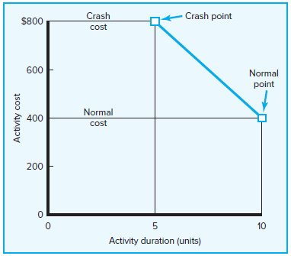
Activity Graph
The assumptions underlying the use of this graph are:
  The cost-time relationship is linear.
  Normal time assumes low-cost, efficient methods to complete the activity.
  Crash time represents a limit—the greatest time reduction possible under realistic conditions.
  Slope represents cost per unit of time.
  All accelerations must occur within the normal and crash times.
7–36

Slide 37
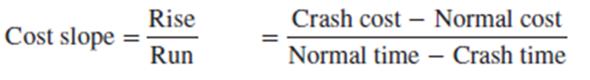
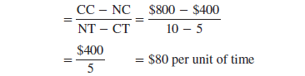
Activity Graph
Knowing the slope of activities allows managers to compare which critical activities to shorten
7–37

Slide 38
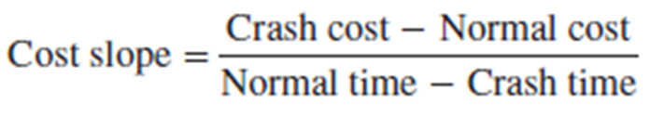
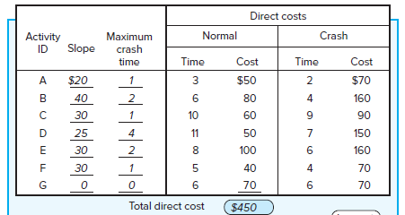
Example 1
7–38

Slide 39
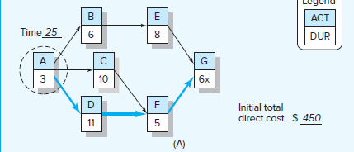
Example 1
Path | Duration
A-B-E-G | 3+6+8+6 = 23
A-C-F-G | 3+10+5+6 = 24
A-D-F-G | 3+11+5+6 = 25
7–39

Slide 40
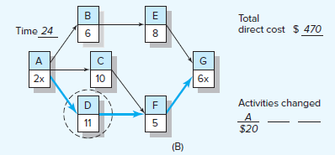
Example 1
Path | Duration
A-B-E-G | 2+6+8+6 = 22
A-C-F-G | 2+10+5+6 = 23
A-D-F-G | 2+11+5+6 = 24
7–40

Slide 41
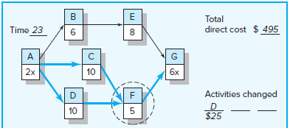
Example 1
Path | Duration
A-B-E-G | 2+6+8+6 = 22
A-C-F-G | 2+10+5+6 = 23
A-D-F-G | 2+10+5+6 = 23
7–41

Slide 42
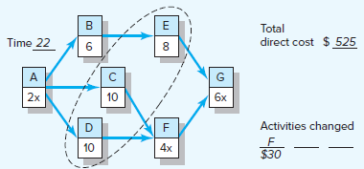
Example 1
Path | Duration
A-B-E-G | 2+6+8+6 = 22
A-C-F-G | 2+10+4+6 = 22
A-D-F-G | 2+10+4+6 = 22
7–42

Slide 43
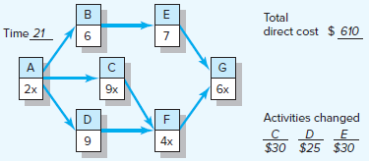
Example 1
Path | Duration
A-B-E-G | 2+6+7+6 = 21
A-C-F-G | 2+9+4+6 = 21
A-D-F-G | 2+9+4+6 = 21
7–43

Slide 44
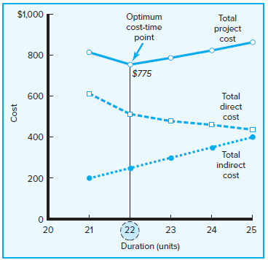
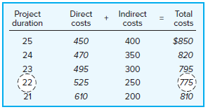
Example 1
Indirect Cost Saving = $50 / Duration unit
7–44

Slide 45
Practical Considerations

Slide 46
Practical Considerations
The inherent risks involved in crashing particular activities need to be considered.
There are rare situations in which activities cannot be crashed by single time units. Instead, crashing is “all or nothing.”
Resource availability, not cost, may dictate which activities are crashed
7–46

Slide 47
Crashing Example 2

Slide 48
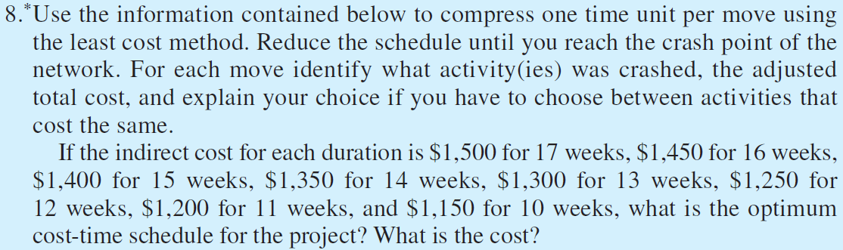
Example 2
7–48

Slide 49
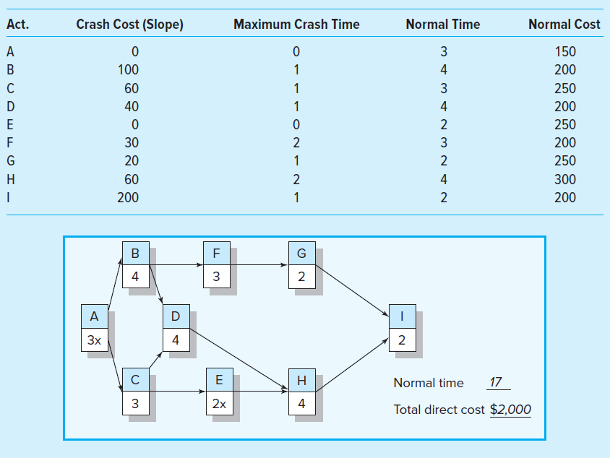
Example 2
7–49

Slide 50
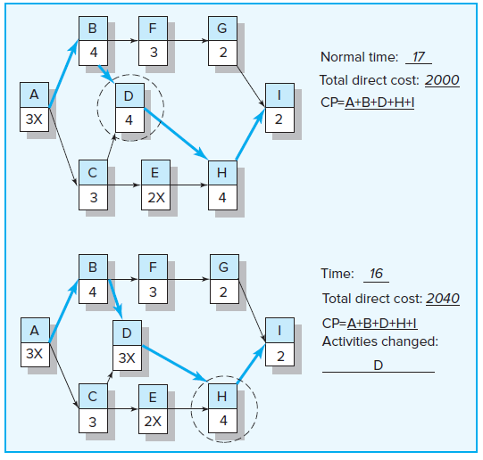
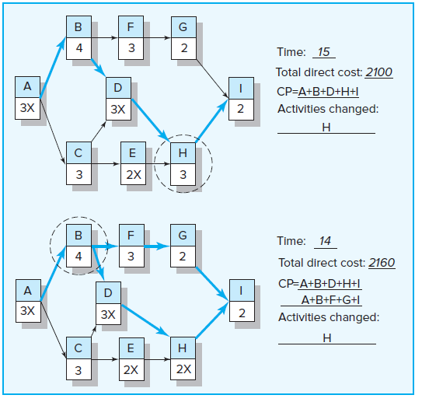
Example 2 Solution
7–50

Slide 51
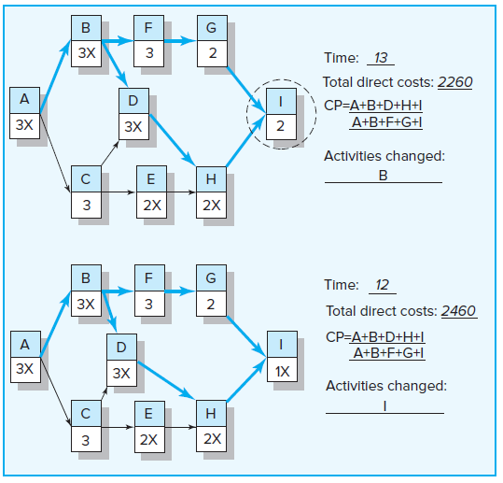
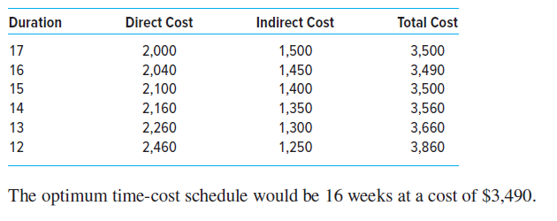
Example 2 Solution
7–51

Slide 52
Summary of Today Session

Slide 53
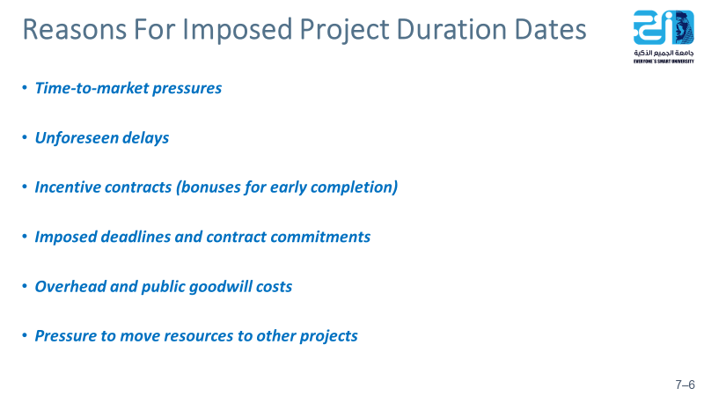
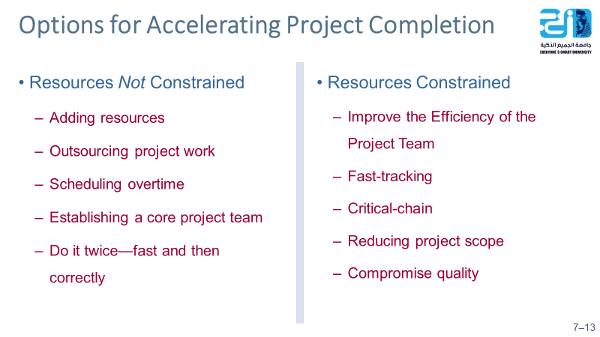
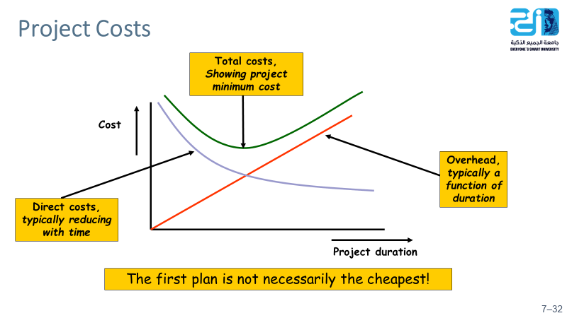
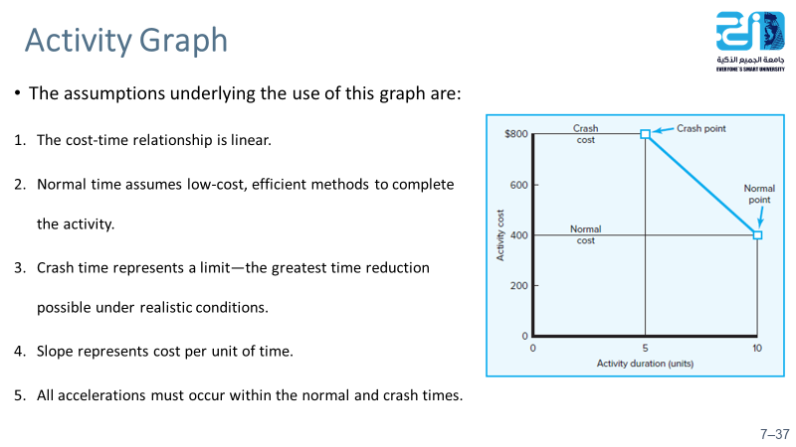
7–53

Slide 54
Resources
Project Management
The Managerial Process
Fifth Edition
By: Erik W. Larson
Oregon State University
Clifford F. Gray
Oregon State University
5–54

