Slide 1


Prepared by Dr. Mohamed Soliman
ENT 624
Entrepreneurial Strategy
Introductory Lecture

Slide 2



Introduction
Introductory Lecture
ENT 624
Entrepreneurial Strategy
Prepared by
Dr. Mohamed Soliman

Slide 3

Welcome to the Master’s in
The Entrepreneurship Program
Welcome to a new chapter in your journey through the Master’s in Entrepreneurship program. You’re here because you have the drive to create change, the courage to take risks, and the mindset to turn ideas into action. This program is more than coursework. It’s a launchpad to develop your leadership, understand markets, and build something real.
Remember:
Entrepreneurs don’t wait for opportunity—they create it.
Failure is not the end—it’s feedback.
The network you build now could shape your future.
Build something that matters.
We’re excited to see what you’ll create.

Slide 4

Biography of Lecturer
2020 to Present Senior Lecturer
Business Innovation Department, Prince of Songkla University, Thailand
2015 to 2019 Research Fellow /Teaching Assistant
School of Management, USM, Malaysia
2004 to 2014 Teaching Assistant / Lecturer
Faculty of Business, Economics and Information Systems. Misr University for Science and Technology (MUST), Egypt

Slide 5
Biography of Lecturer
PhD in Technology Management
School Of Management (SOM), Universiti Sains Malaysia (USM ), Malaysia
USM is No. 146 QS World University Ranking, 2025
The medium of study is English
Master of Business Administration
College of Postgraduate Studies, Arab Academy for Banking and Financial Science (AABFS), Egypt
The medium of study is English. Grade: Excellent (Honors)
Bachelor of Business Administration degree (Honors)
Faculty of Business and Economics, Misr University for Science and Technology (MUST), Egypt
The Medium of study is English. Grade: Excellent with Honors (CGPA 4.3)

Slide 6
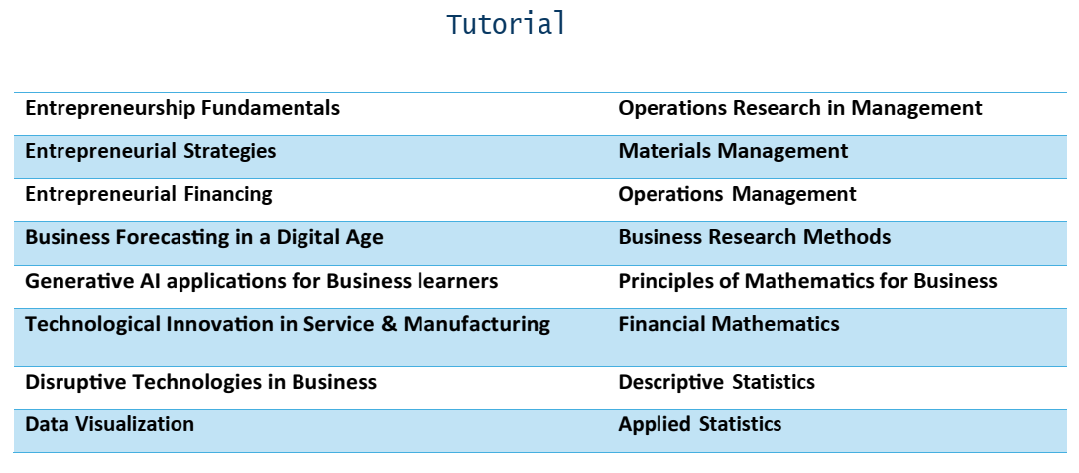
Biography of Lecturer

Slide 7
Awards
Delivering Excellence with Soul Award from MAJLIS PERSADA KENCANA, Universiti Sains Malaysia (USM).
Three-Minute Thesis (3MT) Competition, 34th Postgraduate Colloquium, School of Management, USM.
Poster Presentation Competition, 34th Postgraduate Colloquium, School of Management, USM.
Certificate of Graduation for Speechcraft, Bayan Baru Toastmasters Club, Penang, Malaysia.

Slide 8
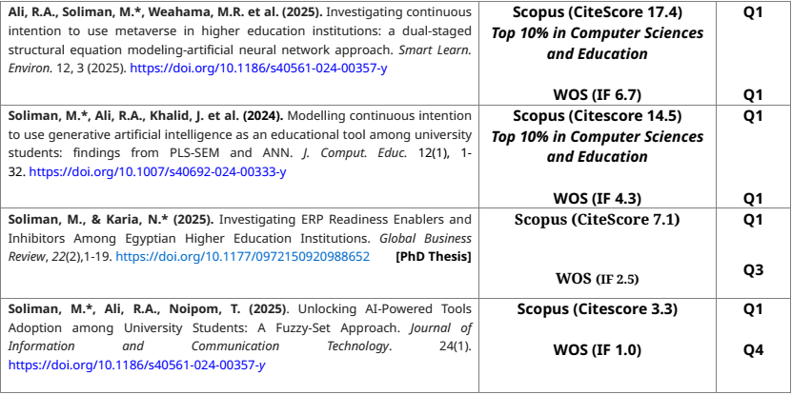
Biography of Lecturer
List of Publications

Slide 9
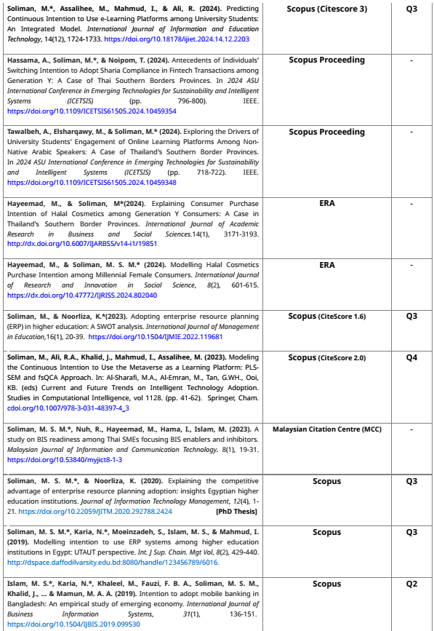
TITLE OF SLIDE

Slide 10
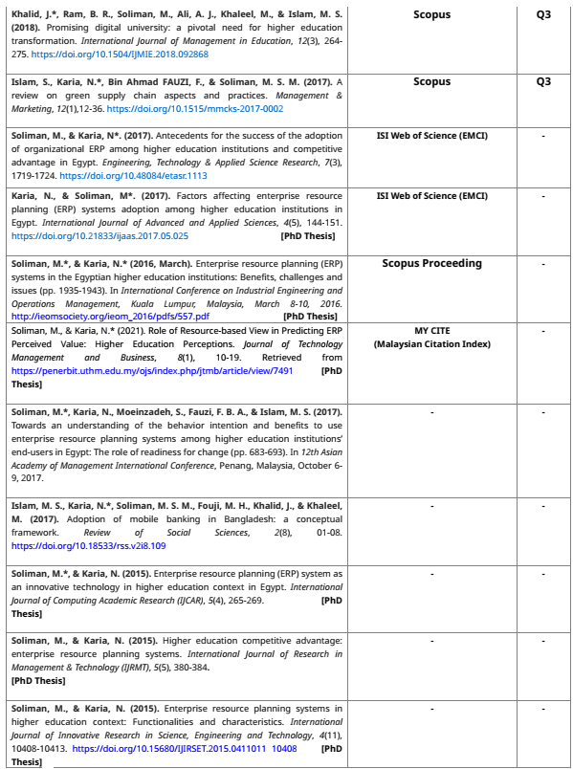
TITLE OF SLIDE

Slide 11
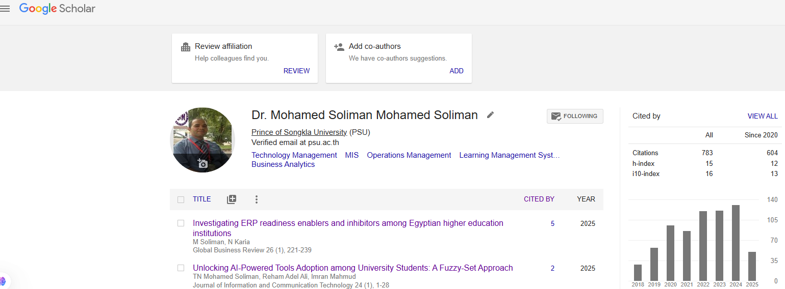
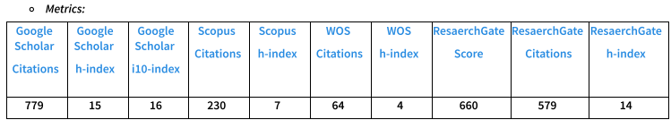
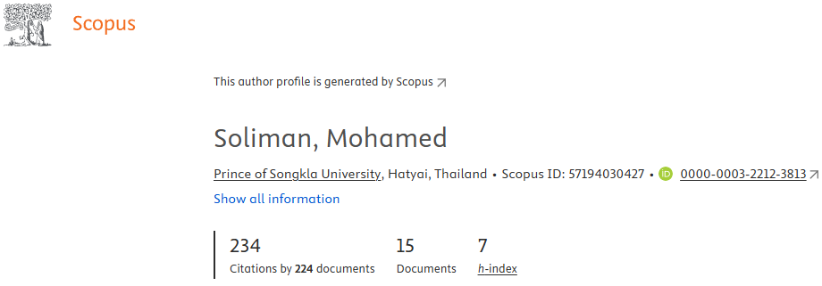
Biography of Lecturer

Slide 12
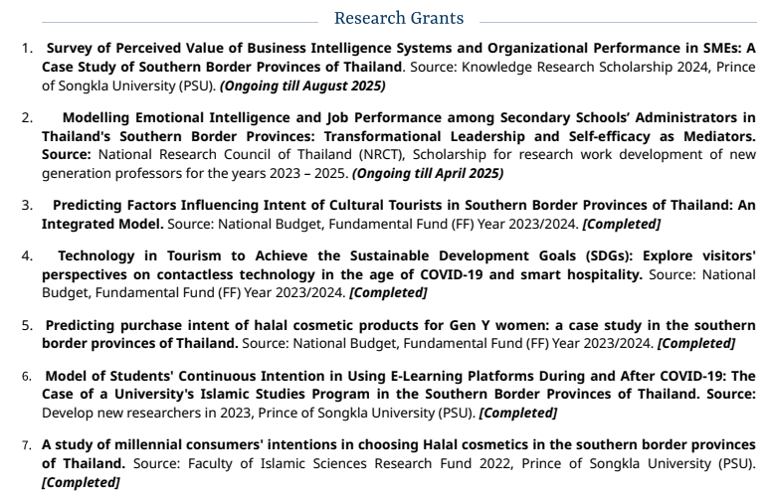
Biography of Lecturer

Slide 13
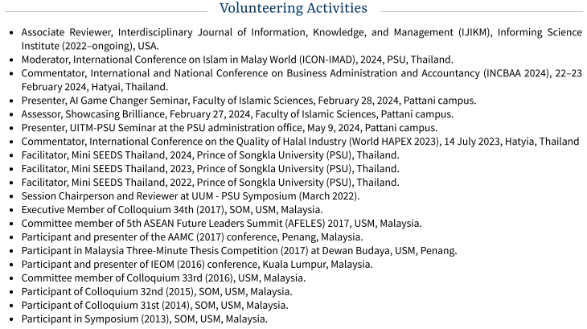
Biography of Lecturer

Slide 14

Midocean University is an investment of The Everyone’s Smart University Holding Group in the Kingdom of Saudi Arabia, with registration no. 1010664457. It’s accredited and licensed by the Ministry of Education in the United Republic of the Comoros with no. MENERSFIP/SG/110-22. In addition, it has the membership of the Association of Arab Universities. The university offers its services to the citizens and residents of Comoros in addition to offering them globally through its licensed operational branch under the name of Midocean University – Fujairah, UAE. This branch aims to support logistical services and services of infrastructure, technology, and development, as well as ensuring business continuity, and performing the financial work, including disbursement and collection, knowing that the degree-granting body for all study programs is Midocean University in the United Republic of the Comoros.

Slide 15
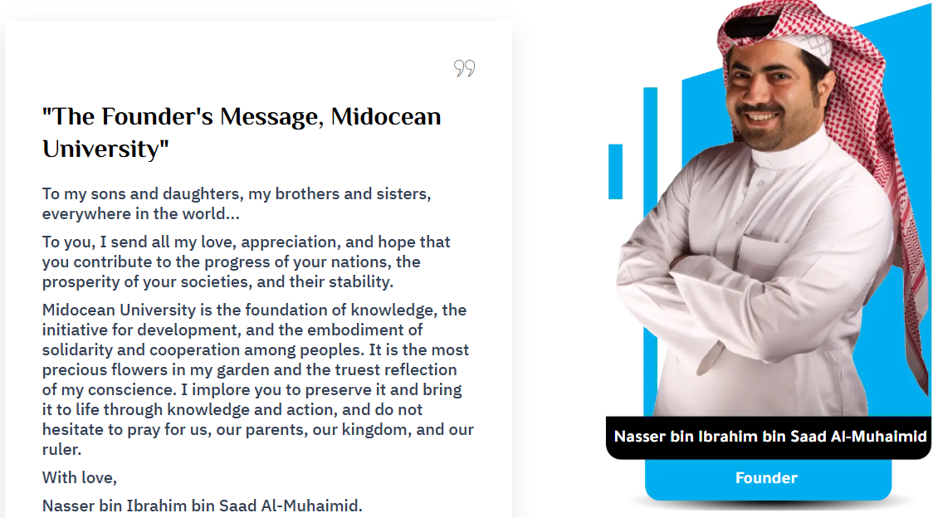

Slide 16
The college offers a bachelor’s degree in entrepreneurship and innovation and a master’s degree in entrepreneurship. 71 students have studied at the college since its opening.
The College of Entrepreneurship and Innovation at Midocean University was established in 2022. It aims to provide the knowledge and skills necessary to distinguish in the world of institutional and social entrepreneurship. The college offers a bachelor’s degree in entrepreneurship and innovation and a master’s degree in entrepreneurship.

Slide 17
The Master of Entrepreneurship is an outstanding, exciting program that leverages your skills to lead innovation, acquire negotiations, leadership skills, and apply design thinking to drive long-term career progression, improve business productivity, and global competitiveness.
This program is designed with a clear focus on the development of practical skills and opportunities for the application of knowledge to real-life organizational situations, aiming to generate value and drive sustainable economic, social, technological, and organizational development.
Processes and mindsets central to entrepreneurship and innovation that are created throughout this program are equally important to new and early-stage ventures, and within existing organizations.

Slide 18
ENT 624 Entrepreneurial Strategy
Credit Hours: 3 credit hours
This course emphasizes how entrepreneurial strategy focuses on creating structural change or responding to change that is induced externally.
It also covers Grabber-holder dynamics as an analytical framework for developing entrepreneurial strategy, which in turn increases success in creating and shaping the diffusion of new technology or product innovation dynamics.
It includes modeling, case studies, and a term project.
This course provides a strategy framework for growth entrepreneurship.
It is particularly focused on helping students create a sustainable competitive advantage and understand how to do so in the early uncertain stages of a startup.

Slide 19
Course Learning Outcomes (CLOs): On successful completion of the course, students will be able to:
CLO1: Analyze market opportunities and develop innovative business models to address unmet needs in diverse industries.
CLO2: Formulate competitive strategies that leverage unique value propositions and sustainable differentiation.
CLO3: Evaluate financial and operational risks associated with entrepreneurial ventures and propose mitigation strategies.
CLO4: Design scalable growth strategies for startups, including market entry and expansion plans.
CLO5: Apply strategic frameworks to real-world entrepreneurial challenges through case studies and simulations.
CLO6: Communicate entrepreneurial strategies effectively through case studies and written plans.

Slide 20
List of some relevant roles suitable for entrepreneurship and innovation:
  Founder
  Co-Founders
1. Innovation Project Manager
2. Entrepreneurship Consultant
3. Innovation Marketing Manager
4. Creative User Experience Designer
5. Social Innovation Researcher
6. Business Incubator Coordinator
7. Innovation Project Coordinator
8. Innovative Business Development

Slide 21


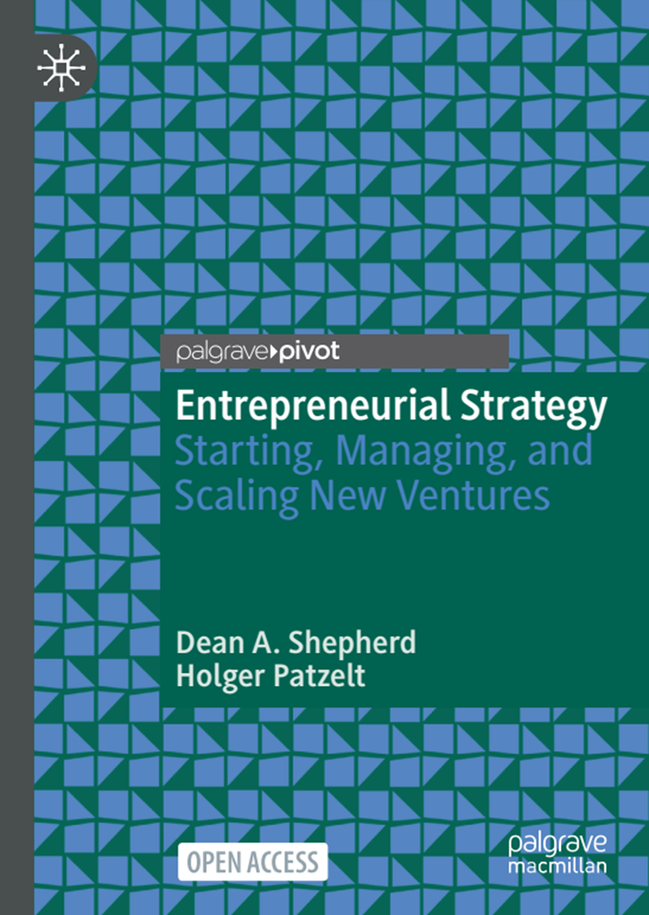


Slide 22
Study Plan (Lecture)
Week | Topics
0 | Introductory lecture
1 | Introduction to Entrepreneurial Strategies
2 | Identifying Market Opportunities
3 | Lean Startup Methodologies
4 | Business Model Design
5 | Market Entry Strategies
6 | Strategic Pivoting and Competitive Positioning
7 | Strategic Plan Outline
8 | Risk Management in Entrepreneurship
9 | Managing New Ventures
10 | Strategies for Growth and Scaling
11 | Revision
12 | Final Exam

Slide 23
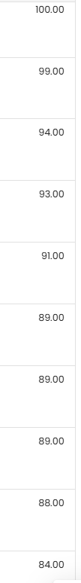
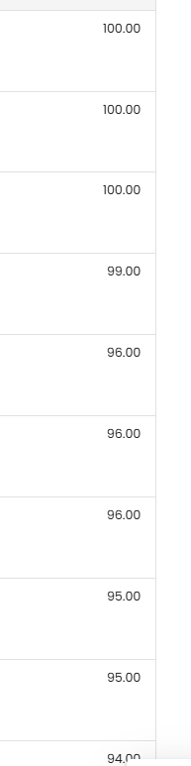
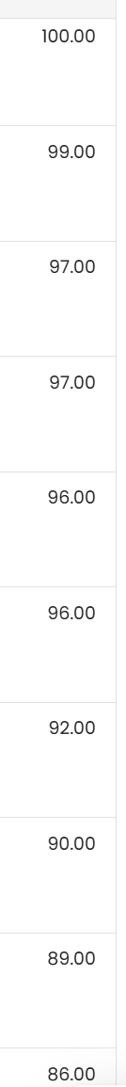
Assessment
items | Marks
10 x Quizzes (quiz = 8 marks) | 80
Final Exam | 20

Slide 24



Thank You

