Slide 1


Master of Financial Technology
Prepared by Dr. Omar Al-kasasbeh
FNT 615
Finance Concepts
Lecture 7

Slide 2



Finance Concepts
FNT 615
Finance Concepts
Prepared by
Dr. Omar Al-kasasbeh

Slide 3
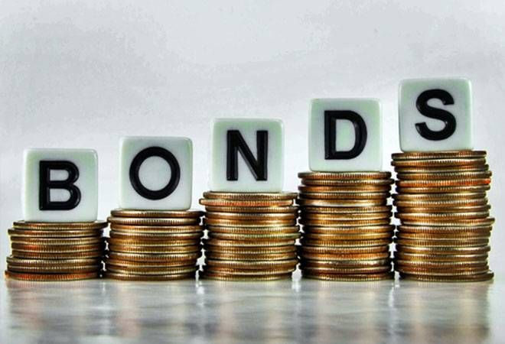
Lecture
7

Slide 4
Lecture
7
Bonds and Bond Valuation

Slide 5
Lecture
7
Table of contents
1. Characteristics of Bonds
2. Bond Valuation
3. Using the Yield Curve
4. Risks of Interest Rates and Default

Slide 6
Lecture
7
When an investor buys a bond, they are essentially lending money to the issuer, which could be a corporation, government, or local agency. In return, the issuer promises to repay the principal at maturity and make periodic interest (coupon) payments. These payments compensate for the time value of money, as investors give up funds now in exchange for future returns. Bonds are a fundamental investment tool, often used to diversify portfolios and add stability alongside stocks and mutual funds.

Slide 7
Lecture
7
Bonds as Investments
Investing in bonds means buying a stream of future cash flows that the issuer promises to pay. Bonds are often called fixed-income securities because their future payments are set when the bond is purchased.
Example: If you buy a $1,000 bond issued by Apple Inc. at 5% annual interest for 20 years, you will receive the fixed interest each year plus the return of your principal at the end of the period.

Slide 8
Lecture
Basic Terminology
7
To value a bond using the time value of money, we need to understand these basic bond terms:
Par value (Face value): The principal amount the issuer repays at maturity. For our example, the par value is $1,000.
Coupon rate: The annual interest rate used to calculate periodic interest payments. It usually stays the same throughout the bond’s life. In our example, the coupon rate is 5%.
Coupon payment: The regular interest payment, calculated by multiplying the par value by the coupon rate. For a bond paying annually, no adjustments are needed.

Slide 9
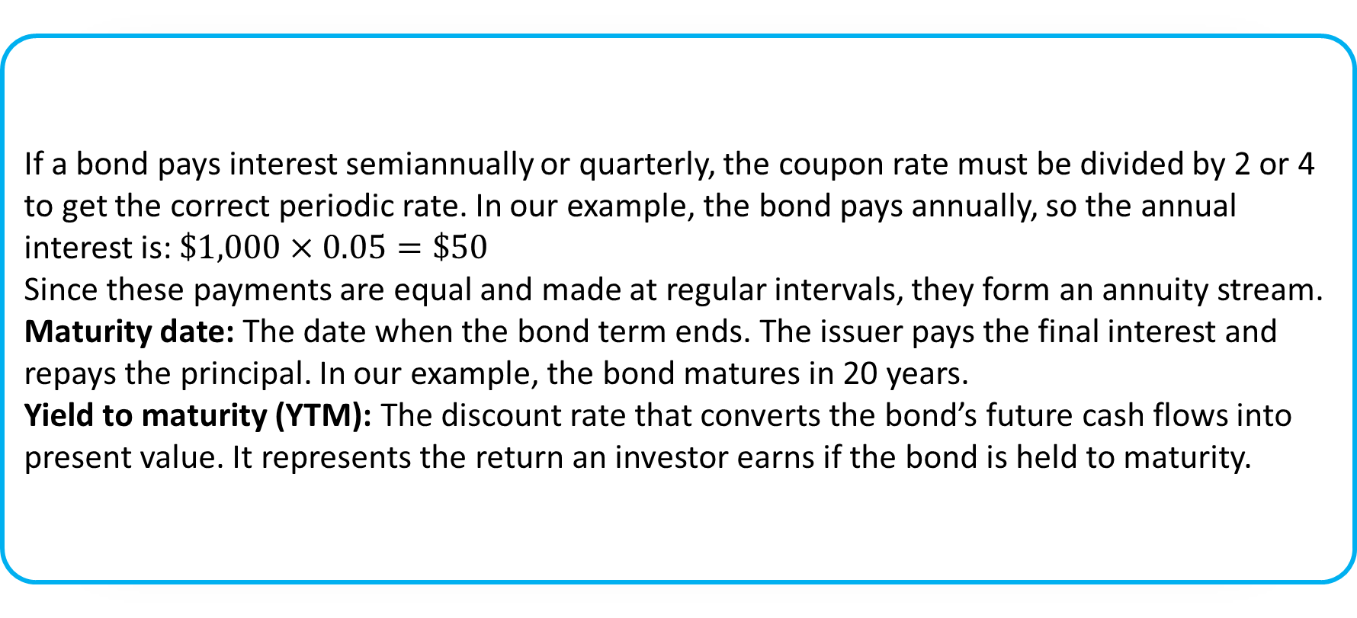
Lecture
7
If a bond pays interest semiannually or quarterly, the coupon rate must be divided by 2 or 4 to get the correct periodic rate. In our example, the bond pays annually, so the annual interest is: $\$1,000×0.05=\$50$
Since these payments are equal and made at regular intervals, they form an annuity stream.
Maturity date: The date when the bond term ends. The issuer pays the final interest and repays the principal. In our example, the bond matures in 20 years.
Yield to maturity (YTM): The discount rate that converts the bond’s future cash flows into present value. It represents the return an investor earns if the bond is held to maturity.

Slide 10
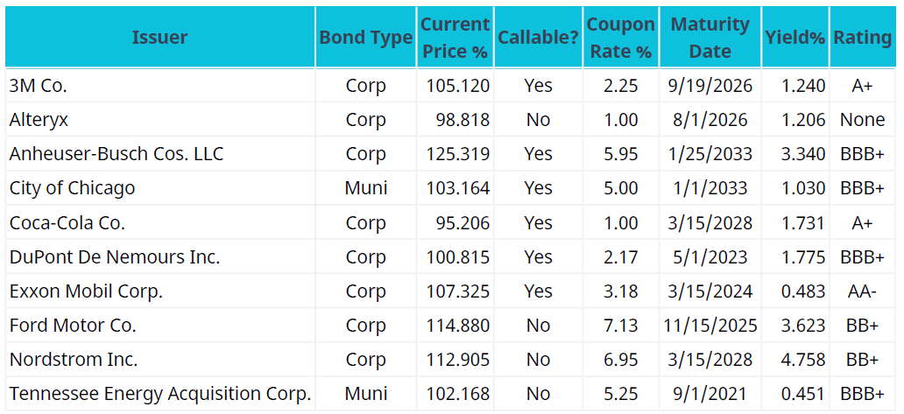
Lecture
7
Table1 displays a selected listing of bonds available for purchase or sale. First, let’s review the columns so you can learn how to read this table.

Slide 11
Lecture
7
Column 2 – Bond Type: Indicates whether the bond is corporate or municipal.
Column 3 – Current Price: The price someone is willing to pay today, quoted as a percent of par. Example: The Nordstrom bond sells at 112.905% of par, or $1,129.05 for a $1,000 par value bond ($1,000 × 1.12905).
Column 4 – Callable?: States if the bond can be called (redeemed early) before maturity.
Column 1 – Issuer: Shows the company, city, or state issuing the bond. Example: City of Chicago, Tennessee Energy, or corporate issuers.
Column 5 – Coupon Rate: The annual interest rate of the bond.
Column 6 – Maturity Date: The date the bond ends, when the issuer pays the final interest and repays principal.

Slide 12
Lecture
7
Column 7 – Yield: Shows the bond’s yield to maturity (YTM), the return you would earn if you buy the bond at the current price (Column 3) and hold it to maturity. YTM is used as the discount rate in bond pricing.
Column 8 – Rating: Indicates the bond’s credit quality, showing how likely the issuer is to make payments.
Types of Bonds:
Government Bonds: Safest bonds, backed by the U.S. government.
  Treasury bills (T-bills): Short-term, very safe, pay the least interest.
  Treasury notes: Medium-term, maturities of 1–10 years.
  Treasury bonds: Long-term, maturities of 10–30 years.
Safety affects return: the lower the risk, the lower the interest rate, and vice versa.

Slide 13
Lecture
7
Savings Bonds: Debt securities sold by the U.S. government to fund programs.
Investors loan money to the government and are guaranteed to receive the face value plus interest.
Virtually risk-free, but returns are relatively low compared to other bonds.
Municipal Bonds (“Munis”): Issued by cities, states, or local agencies. Slightly higher returns than Treasury bills but slightly riskier.
Corporate Bonds: Issued by companies and carry more risk than government bonds. Return depends on the company’s creditworthiness. High-risk, high-return corporate bonds are called junk bonds or non-investment grade.
Zero-Coupon Bonds: Corporate bonds that do not pay periodic interest. Sold at a deep discount and repay the full par value at maturity. The difference between purchase price and par value is the total return.
Convertible Bonds: Corporate bonds that can be converted into a set number of common stock shares. Conversion usually occurs at the bondholder’s discretion during the bond’s life.

Slide 14
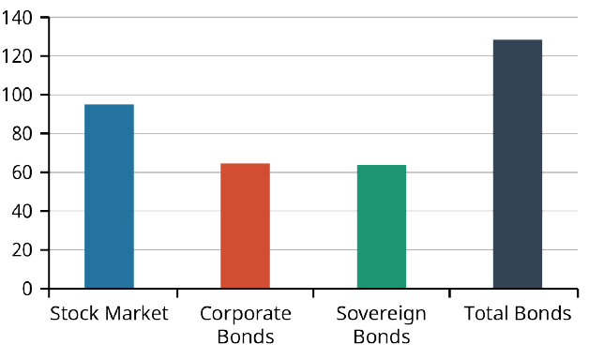
Lecture
7
The Global Bond Market versus the Global Stock Market Bonds have long been a trusted investment vehicle for many investors. Though the global fixed-income debt market remains considerably larger than the global stock market, this is not an entirely fair comparison. Bond markets include sovereign bonds, or bonds that are issues by governments, while stock markets do not. Some experts believe that a more relevant comparison is between the value of corporate bond markets only (excluding sovereign bonds) and total stock market value.
The chart in Figure 2 provides global market value information by category so that we may make our own conclusions about these markets.

Slide 15
Lecture
7
Although the total value of bond markets still exceeds that of stocks, stock markets have been growing in recent years because stocks have historically provided higher long-term returns than bonds, making them more attractive to investors despite their higher risk. A bond investment generates two types of cash inflows: the repayment of the par value at maturity and the periodic coupon payments, which are contractually fixed. To properly value a bond, the present value of each cash flow type must be calculated separately and then combined to determine the total bond value. Bond prices and interest rates have an inverse relationship, so when interest rates fall, bond prices rise, and when interest rates rise, the value of fixed-rate bonds declines, while floating-rate bonds adjust with market rates and are less sensitive to interest rate changes.

Slide 16
Lecture
7
A floating-rate note is like a regular bond but has a variable interest rate tied to benchmarks such as the U.S. Treasury rate, federal funds rate, LIBOR, or prime rate. Unlike fixed-rate bonds, floating-rate bonds adjust with market interest rates, so their value is less affected by rising rates. Bonds with very low coupon rates are called deep discount bonds, with zero-coupon bonds being the extreme case. The lower the coupon rate, the more sensitive the bond’s price is to interest rate changes.

Slide 17
Lecture
7
Pricing a Bond in Steps
Learning to price a bond is essential because it helps determine the value of an asset. We need to know what a bond is worth to a willing buyer and seller. Since a bond is a financial asset a company sells to raise money, both the issuer and the investor want to ensure they are selling or buying at a fair price. Pricing examples can be illustrated using the 3M Company corporate bond from the table above.

Slide 18
Lecture
7
The 3M Company issued 15-year corporate bonds on September 20, 2011, which pay annual coupons on September 19 and repay the face value of $1,000 on September 19, 2026. The bonds have an annual coupon rate of 2.25%, so each year they pay $22.50 in interest. The yield to maturity (YTM), which is used to discount future payments, is 1.24%. Since the coupon rate is higher than the YTM, the bond sells at a premium, meaning it earns more in interest than it loses when discounted for the time value of money. The bonds are rated A+ by Standard & Poor’s, indicating high credit quality, and are callable, giving 3M the option to redeem them before maturity. Bond pricing can be done using equations, a calculator, or a spreadsheet, starting with the equation method.

Slide 19
Lecture
7
The first step in pricing a bond is to identify the amounts and timing of its future cash flows. For coupon bonds, there are two types of cash flows: the periodic coupon payments, which act like an annuity, and the final lump-sum payment of the face value at maturity. In the 3M Co. example, the face value of $1,000 will be paid on September 19, 2026. The annual coupon payment is calculated by multiplying the coupon rate (2.25%) by the par value, resulting in $22.50 per year. This step involves laying out these cash flows clearly to prepare for discounting and valuation.

Slide 20
Lecture
7
Using the Yield Curve

Slide 21
Lecture
7
The term structure of interest rates refers to the expected yields of bonds across different maturities, showing how interest rates vary for different time periods. When these yields are plotted against their respective maturities, the resulting line is called a yield curve, with yields on the y-axis and maturities on the x-axis. To construct a yield curve, the yields of government bonds for each remaining time to maturity are calculated and plotted for example, bonds with one year to maturity are plotted at one year on the x-axis, bonds with two years to maturity at two years, and so on, until enough points create a meaningful graph. The yield curve for government bonds is also known as the risk-free yield curve because these bonds are considered safe, with very low likelihood of default.

Slide 22
Lecture
7
A normal yield curve slopes upward, meaning yields increase as the term to maturity grows. This happens because longer-term bonds carry greater risk, so investors demand higher returns. Corporate bonds typically offer higher yields than government bonds because they are riskier, as governments are unlikely to default on their obligations. Corporate bonds, on the other hand, carry some risk of default, which varies depending on the issuer, bond type, and maturity. The topic of bond default and default risk will be discussed next.

Slide 23
Lecture
7
The shape of a yield curve is defined by two main elements: its level and its slope. The level reflects the yields shown on the y-axis, while the slope shows the difference between short-term and long-term yields. This difference arises mainly from investors’ expectations about the direction of interest rates and the uncertainty of the federal funds rate (or cash rate in other countries) over time. For example, the yield on a three-year bond reflects both investor expectations for how bank rates may change over the next three years and the uncertainty surrounding those rates during that period.

Slide 24
Lecture
7
A positive or normal yield curve reflects investors’ demand for higher returns to compensate for the increased risk of longer-term fixed-income investments. As bond terms increase, so does interest rate risk, which is why longer-term bonds usually offer higher coupon rates. A steep positive yield curve can also signal that investors expect higher inflation in the future, leading to higher interest rates and yields over shorter periods. Normal yield curves are typically seen during periods of economic expansion, when growth and inflation are rising, and investors anticipate that central banks will raise short-term rates in response to inflation.

Slide 25
Lecture
7
A flat yield curve occurs when there is little difference between short-term and long-term yields. It is usually temporary and often appears when the curve is transitioning between a normal and an inverted shape. Flat curves can also result from low interest rates or unconventional monetary policies. The yield curve is important because analysts, brokers, and market technicians closely study its movements, as it serves as a key economic indicator and reflects the expectations, attitudes, and actions of both individual and institutional investors, influencing investment markets and the broader economy.

Slide 26
Lecture
7
Risks of Interest Rates and Default

Slide 27
Lecture
Bond Risks
7
Bonds, as fixed-income investments, carry several risks that can reduce their market value. The most well-known are interest rate risk and default risk, but other risks are also important. Credit risk occurs when investors doubt the issuer’s ability to make payments, prompting them to demand higher yields; government bonds generally have low credit risk due to their stability. Liquidity risk arises if a bond is hard to sell, with higher yields compensating for this lack of marketability, though government bonds are usually highly liquid except in severe economic crises. Duration risk measures a bond’s sensitivity to interest rate changes, expressed numerically, with higher duration indicating greater price fluctuations in response to a 1% change in rates.

Slide 28
Lecture
7
Bonds also carry call risk and reinvestment risk. Call risk arises when a bond issuer redeems the bond before maturity, often to refinance at lower interest rates, which can be disadvantageous to investors. This can lead to reinvestment risk, where investors must reinvest the proceeds from a called bond at lower, less favorable rates, potentially resulting in financial loss. Term risk occurs because lending money at fixed interest rates exposes investors to the possibility of rising rates, which would reduce the relative return compared to shorter-term investments; this risk is often measured by the term premium. Despite these additional risks, the most common concerns for bond investors remain interest rate risk and default risk.

Slide 29
Lecture
7
Interest rate risk refers to the risk that bond values will decline when interest rates rise. This is a key concern for investors in fixed-income securities and generally increases the longer a bond is held. Default risk arises from the possibility that a bond issuer may be late on payments or unable to pay at all. U.S. Treasury securities are considered free of default risk because they are government-backed, while most corporate bonds carry some risk of default, which varies by issuer. To help investors assess this risk, organizations regularly publish bond ratings, which indicate the credit quality of different bond issues.

Slide 30
Lecture
7
Bond Ratings and Rating Providers
Bond ratings help investors understand the risk of default when purchasing bonds. Rating agencies evaluate bonds and other fixed-income investments by analyzing available information and assigning a grade based on credit quality. The three most well-known rating providers are Fitch Ratings, Moody’s Investors Service, and Standard & Poor’s (S&P) Global Ratings. The highest-quality bonds are rated AAA (S&P/Fitch) or Aaa (Moody’s), followed by AA/Aa, and so on. Bonds rated BBB (S&P/Fitch) or Baa (Moody’s) and above are considered investment grade, meaning they are strong and stable, and are commonly held by banks and pension funds. Bonds rated below this threshold are called high-yield or junk bonds, reflecting higher risk but potentially higher returns.

Slide 31
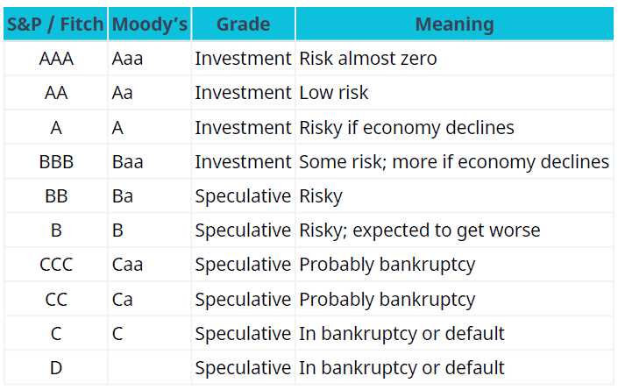
Lecture
7
Junk bonds have had mixed success as a way for companies to raise capital. In the early 1990s, the market collapsed partly due to political pressures and illegal insider trading by investment banks, leading to the bankruptcy of Drexel Burnham Lambert. The market briefly recovered later in the 1990s but shrank again in 2001, with 11% of U.S. junk bonds defaulting. Bond ratings are essentially judgments of a company’s ability to meet its debt obligations and growth prospects; there is no fixed formula for determining them. Analysts often assess ratings using financial ratios such as the company’s debt ratio, earnings-to-interest ratio, and return on assets.

Slide 32
Lecture
7
Bond returns come from two sources: interest income and capital gains. When investors buy bonds, they are lending money to the issuer, and the coupon rate set based on prevailing interest rates, the bond’s maturity, and the issuer’s credit rating determines the periodic interest payments. For example, a $1,000 bond with a 5% annual coupon and 20-year maturity pays $50 each year, totaling $1,000 in interest over the life of the bond. The attractiveness of this return depends on interest and inflation rates during the investment period: if rates are low, the fixed coupon payments are more valuable; if rates or inflation are high, the real return may be lower.

Slide 33
Lecture
7
Many bonds are sold before maturity in the secondary market, which can result in capital gains or losses depending on whether the bond is sold above or below its face value. For instance, if an investor holds a bond yielding 7% and new bonds in the market yield 10%, the original bond’s price would likely fall to remain competitive. Conversely, if market rates decline, the bond could be sold at a higher price, generating a capital gain.
A common investment strategy is bond laddering, which involves spreading investments across bonds with staggered maturities to balance risk, maintain regular coupon payments, and provide portfolio diversification. For example, an investor might buy ten bonds with maturities ranging from one to ten years, ensuring a steady stream of income while reducing interest rate and reinvestment risk.

Slide 34
Lecture
7
In a bond ladder, when the shortest-term bond matures, the investor reinvests in a new long-term bond to maintain the ladder. This strategy balances stability and return: short-term bonds provide lower risk and more stability, while long-term bonds offer higher returns but carry greater risk, such as from rising interest rates. By combining bonds of different maturities, investors can achieve better returns than investing only in short-term bonds while reducing overall risk compared to investing solely in long-term bonds. This combination of risk management and steady income explains why bond laddering is popular among both novice and experienced investors.
Additionally, when investors purchase bonds directly or through mutual funds they are lending money to the issuer, who promises to repay the principal (par value) at the bond’s maturity date.

Slide 35
Lecture
7
Bond issuers promise to pay investors periodic coupon payments as compensation for using their money, with the coupon rate usually fixed at issuance. Bond values have an inverse relationship with interest rates: when rates rise, bond prices fall, and when rates fall, bond prices increase. Interest rate movements can significantly affect a bond’s value and expose investors to various risks. Bond values are influenced by multiple factors, including prevailing interest rates, maturity periods, taxability of interest, issuer credit quality, and the likelihood of early bond calls. Investors should always recognize that interest rates fluctuate, which can impact bond values and yields either favorably or unfavorably.

Slide 36
Lecture
Limitations of Duration as a Risk Measure
7
Duration is widely used to measure a bond’s sensitivity to interest rate changes, but it has important limitations.
First, duration assumes a linear relationship between bond prices and interest rates, which is not accurate in reality.
Second, it assumes parallel shifts in the yield curve, while in real markets the yield curve often shifts in a non-parallel way.
Third, duration does not fully capture the effect of convexity, which reflects the curvature in the price-yield relationship.
Key Insight: Relying only on duration can lead to misestimation of risk, especially in volatile interest rate environments.

Slide 37
Lecture
7
Convexity and Advanced Bond Risk Measurement
Convexity measures the curvature in the relationship between bond prices and interest rates, improving upon duration.
While duration provides a linear estimate, convexity captures the non-linear behavior of bond prices.
Bonds with higher convexity are less sensitive to large interest rate changes and are generally more desirable.
Including convexity in analysis provides a more accurate estimate of bond price changes, especially in volatile markets.
Key Insight: Duration and convexity together provide a more complete measure of interest rate risk.

Slide 38
Lecture
7
Active vs Passive Bond Portfolio Management
Active bond management involves continuously adjusting the portfolio to outperform the market by predicting interest rate movements and credit changes.
Passive bond management focuses on matching a benchmark index and minimizing trading, aiming for stable and predictable returns.
Active strategies rely on market timing, security selection, and yield curve positioning.
Passive strategies often use techniques such as bond indexing or immunization to reduce risk.
Key Insight: Active management seeks higher returns but involves higher risk and costs, while passive management emphasizes stability and lower costs.

Slide 39
Lecture
7
Summary

Slide 40
Lecture
7
1. Characteristics of Bonds: Bonds are a fundamental investment involving a straightforward agreement between issuer and investor. They come in three main types—government bonds, corporate bonds, and convertible bonds which differ by issuer, maturity, interest rate, and risk.
2. Bond Valuation: To determine a bond’s worth to buyers and sellers, we can use an equation, calculator, or spreadsheet. The key steps are: identify the amount and timing of future cash flows, determine the discount rate, calculate the present value of the lump-sum principal and the annuity of coupon payments, and then combine these present values to find the total bond value.
3. Using the Yield Curve: The yield curve is created by plotting interest rate yields against their maturities. It visually represents the term structure of interest rates, with yields on the y-axis and maturities on the x-axis, helping investors understand how rates vary over different time periods.

Slide 41
Lecture
7
4 Risks of Interest Rates and Default
Because bonds are fixed-income investments, they are subject to a number of risks that could have negative effects on their market value. The most common and best-known risks are interest rate risk and default risk, but there are some others risks that should be understood, such as credit risk, liquidity risk, duration risk, call risk, investment risk, and term risk. To assist potential bond investors in understanding some of these risks, bond ratings have been developed and are regularly published by a number of organizations to express their assessment of the risk quality of various bond issues.

Slide 42
Lecture
Key Terms
7
bond call a feature of certain bonds or other fixed-income instruments that allows the issuer to repurchase and retire these instruments before maturity
bond price the present, discounted value of the future cash stream generated by a bond; the sum of the present values of all likely coupon payments and the present value of the par value at maturity
bond ratings grades assigned to bonds by rating services that indicate their overall credit quality
Business Cycle Dating Committee a subdivision of the National Bureau of Economic Research (NBER), the US government agency that maintains a chronology of US business cycles

Slide 43
Lecture
Key Terms
7
call risk the risk that a bond issuer will redeem a callable bond prior to maturity
capital gains the increase in a capital asset’s value that is realized when the asset is sold
cash rate the interest rate that a central bank, such as the Reserve Bank of Australia or the US Federal
Reserve System, will charge commercial banks for loans; also known as the bank rate or the base interest
rate
convertible bonds fixed-income corporate debt securities that yield interest payments but can be converted
into a predetermined number of common stock or equity shares

Slide 44
Lecture
Key Terms
7
term risk the risk of potentially earning lower returns on longer-term bond holdings compared to those potentially available when making several shorter-term investments over the same period of time
US Treasury bills (T-bills) short-term US government debt obligations backed by the Treasury Department with a maturity of one year or less
US Treasury note rate the interest rate that the US government pays to borrow money for different lengths of time; notes are issued in terms of two, three, five, seven, and 10 years
yield curve a line that plots yields (interest rates) of bonds having equal credit quality but differing maturity dates; gives an idea of future interest rate changes and economic activity
yield to maturity (YTM) the total return anticipated on a bond if the investment is held until maturity
zero-coupon bonds bonds that are issued at a deep discount from face value and offer no interest or coupon payments

Slide 45

Lecture
References
7
Julie Dahlquist, and Rainford Knight. (2022). Principles of finance. OpenStax.

Slide 46



Thank You

