Slide 1

Writing in Organizations
Prepared by Dr. Adam Yagoub
Lecture 8
MGM 202
Writing Effective Short Reports

Slide 2
Lecture 1
Lecture 8
Key Learning Points
Lecture Outline
Lecture 1: Getting Started: Writing and Your Career.
Lecture 2: The Writing Process and Collaboration at Work.
Lecture 3: Writing Routine Business Correspondence.
Lecture 4: Writing Letters: Some Basics for Communicating with Audiences Worldwide.
Lecture 5: How to Get a Job: Searches, Dossiers, Portfolios, Résumés, Letters, and Interviews.
Lecture 6: Designing Successful Documents, Visuals, and Websites.
Lecture 7: Writing Instructions and Procedures.
Lecture 8: Writing Effective Short Reports.
Lecture 9: Writing Proposals.
Lecture 10: Writing Careful Long Reports.

Slide 3
Lecture 1
Lecture 8
Key Learning Points
Lecture Outline
1- Why Short Reports Are Important
2- Types of Short Reports
3- Seven Guidelines for Writing Short Reports
4- Periodic Reports
5- Sales Reports
6- Progress Reports
7- Travel/Trip Reports
8- Incident Reports
9- Protecting Yourself Legally

Slide 4
Lecture 8
Writing Effective Short Reports
1- Why Short Reports Are Important:
A short report can be defined as an organized presentation of relevant data on any topic—money, travel, time, technology, personnel, service equipment, weather, the environment—that a company or agency tracks in its day-to-day operations. Short reports are practical and to the point. They show that work is being done, and they also show your boss that you are alert, professional, and reliable. Short reports are written to co-workers, employers, vendors, and clients. When they are intended for individuals within your organization, short reports are most often sent as memos or as e-mails. But, for clients, usually you will send your reports out as letters.

Slide 5
Lecture 8
Writing Effective Short Reports
Businesses cannot function without short written reports. Reports tell whether
■ work is being completed
■ schedules are being met
■ costs have been contained
■ sales projections are being met
■ unexpected problems have been solved
You may write an occasional report in response to a specific question, or you may be required to write a daily or weekly report about routine activities.

Slide 6
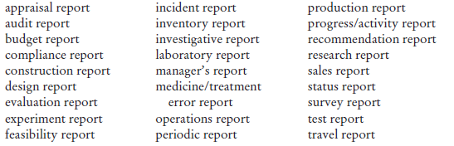
Lecture 8
Writing Effective Short Reports
2- Types of Short Reports:
To give you a sense of some of the topics you may be required to write about, here is a list of various types of short reports common in the business world.

Slide 7
Lecture 8
Writing Effective Short Reports
This chapter concentrates on five of the most common types of reports you are likely to encounter in your professional work.
1. periodic reports
2. sales reports
3. progress reports
4. travel reports
5. incident reports

Slide 8
Lecture 8
Writing Effective Short Reports
Although there are many kinds of short reports, they all are written for readers who need factual information so that they can get a job accomplished. Never think of the reports you write as a series of casual notes jotted down for your convenience.

Slide 9
Lecture 8
Writing Effective Short Reports
3- Seven Guidelines for Writing Short Reports:
the following seven guidelines will help you write any short report successfully.
1. Anticipate How an Audience Will Use Your Report
Knowing who will read your report and why is crucial to your success as a writer. A co-worker or someone else in your field may be familiar with technical information. But managers, who will constitute the largest audience for your report, may not always understand or be interested in such technical information. Instead they will want bottom- line details about costs and schedules, for example.

Slide 10
Lecture 8
Writing Effective Short Reports
2. Do the Necessary Research
An effective short report needs the same careful research that goes into other on the job writing. Your research may be as simple as instant messaging, e-mailing, or leaving a voice mail for a colleague or checking a piece of equipment. Or you may have to test or inspect a product or service or assess the relative merits of a group of competing products or services.

Slide 11
Lecture 8
Writing Effective Short Reports
3. Be Objective and Ethical
Your readers will expect you to report the facts objectively and impartially— locations, costs, sales, weather conditions, eyewitness accounts, observations, statistics, test measurements, and descriptions. Your reports should be truthful, accurate, and complete.

Slide 12
Lecture 8
Writing Effective Short Reports
Here are some guidelines to follow:
■ Avoid guesswork.
■ Do not substitute impressions or unsupported personal opinions for careful research.
■ Using biased, skewed, or incomplete data is unethical.
■ Make sure your report is relevant, accurate, and reliable.

Slide 13
Lecture 8
Writing Effective Short Reports
4. Organize Carefully
Organizing a short report effectively means that you include the right amount of information in the most appropriate places for your audience. Make your report easy to read and to follow. Many times a simple chronological or sequential organization will be acceptable for your readers. Your headings will show readers how you organized your report. Readers will expect your report to contain information on such topics as the purpose, findings, conclusions, and, in many reports, recommendations.

Slide 14
Lecture 8
Writing Effective Short Reports
5. Use Reader-Centered Headings, Bullets, Numbering, and Visuals
Help readers locate and focus on key information in your report quickly by using headings and subheadings that clearly demonstrate how you have organized and subdivided your report. See, for example, the headings in Figures 8.2. You can also use bulleted and numbered lists where relevant, as in Figure 8.2, to break up chunks of information into easy-to-grasp pieces.

Slide 15
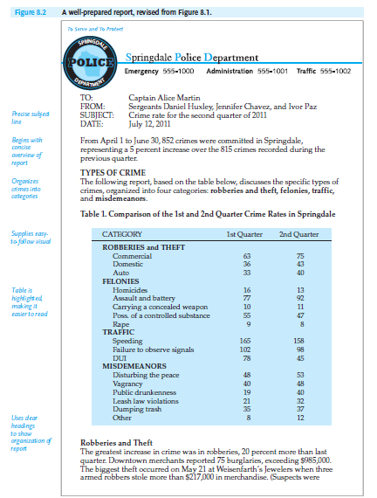
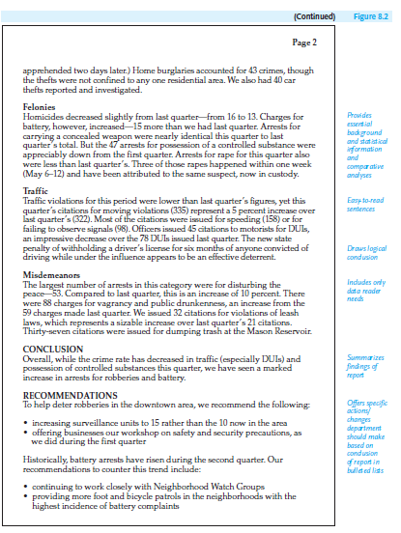
Lecture 8
Writing Effective Short Reports

Slide 16
Lecture 8
Writing Effective Short Reports
6. Write Clearly and Concisely
Writing clearly and concisely is essential in all business reports. Ask your boss or co-workers who have done short reports for your company about appropriate style. Also look at previous, similar reports to get a sense of your company or house style.
Here are a few guidelines to help you write clearly and concisely.
■ Use an informative title/subject line that gets to the point right away.

Slide 17
Lecture 8
Writing Effective Short Reports
■ Write in plain English.
■ For global readers, make sure you use international English.
■ Adopt a professional yet personal tone.
■ Keep your report as concise as possible while still giving readers the essential information they need.
■ Begin with the most important information.
■ Supply sufficient and relevant documentation.

Slide 18
Lecture 8
Writing Effective Short Reports
7. Choose the Most Appropriate Format
Depending on your audience, you can send your short report as an e-mail, a memo, or a letter. For routine reports to your boss or others inside your company, you will likely use a memo format. Note that with a memo format your readers will not expect you to include an inside address or formal salutation and complimentary close.

Slide 19
Lecture 8
Writing Effective Short Reports
4- Periodic Reports:
Periodic reports, as their name signifies, provide readers with information at regularly scheduled intervals—daily, weekly, bimonthly (twice a month), monthly, quarterly. They help a company or agency keep track of the quantity and quality of the services it provides and the amount and types of work done by employees. Information in periodic reports helps managers make schedules; order materials; hire, train, or assign personnel; budget funds; and, generally speaking, determine corporate needs.

Slide 20
Lecture 8
Writing Effective Short Reports
5- Sales Reports:
Sales reports provide businesses with a necessary and ongoing record of accounts, online and mail purchases, losses, and profits over a specified period of time. They help businesses assess past performance and plan for the future. In doing that, they fulfill two functions: financial and managerial. As a financial record, sales reports list costs per unit, discounts or special reductions, and subtotals and totals. Like a spreadsheet, sales reports show gains and losses. They may also provide statistics for comparing two quarters’ sales.

Slide 21
Lecture 8
Writing Effective Short Reports
6- Progress Reports:
A progress report informs readers about the status of an ongoing project. It lets them know how much and what type of work has been done by a particular date, by whom, how well, and how close the entire job is to being completed. A progress report emphasizes whether you are
■ specifying what work has been done
■ keeping your schedule

Slide 22
Lecture 8
Writing Effective Short Reports
■ staying within your budget
■ using the proper technology/equipment
■ making the right assignments
■ identifying an unexpected problem
■ providing adjustments in schedules, personnel, and so on
■ indicating what work remains to be done
■ completing the job efficiently, correctly, and according to codes

Slide 23
Lecture 8
Writing Effective Short Reports
- Audience for Progress Reports
A progress report is intended for people who generally are not working alongside you but who need a record of your activities to coordinate them with other individuals’ efforts and to learn about problems or changes in plans. For example, because supervisors may not be in the field or branch office or at a construction site, they will rely on your progress report for crucial information. Customers, such as a contractor’s clients, expect reports on how carefully their money is being spent. That way they can adjust schedules or alter specifications if there is a risk of going over budget.

Slide 24
Lecture 8
Writing Effective Short Reports
- Parts of A Progress Report
Progress reports should contain information on (1) the work you have done, (2) the work you are currently doing, and (3) the work you will do.
How to Begin a Progress Report
In a brief introduction, cover the following:
■ indicate why you are writing the report
■ provide any necessary project titles or codes and specific dates
■ help readers recall the job you are doing for them

Slide 25
Lecture 8
Writing Effective Short Reports
- How to Write the Body of a Progress Report
The body of the report should provide significant details about costs, materials, personnel, and times for the major stages of the project.
■ Emphasize completed tasks, not false starts.
■ Omit routine or well-known details (“I had to use the library when I wanted to read the back issues of Safety News that were not archived on the Internet”).
■ Describe in the body of your report any snags you encountered that may affect the work in progress.

Slide 26
Lecture 8
Writing Effective Short Reports
- How to End a Progress Report
The conclusion should give a timetable for the completion of duties or submission of the next progress report. Give the date by which you expect work to be completed. Be realistic; do not promise to have a job done in less time than you know it will take. Readers will not expect miracles, only informed estimates. Even so, any conclusion must be tentative.

Slide 27
Lecture 8
Writing Effective Short Reports
7- Travel/Trip Reports:
Reporting on the trips you take is an important professional responsibility in the world of work. In documenting what you did and saw, travel reports keep readers informed about your efforts and how they affect ongoing or future business. Moreover, such reports help you to better understand your job and to develop your networking skills. Travel reports also should be written after you attend a conference, convention, or sales meeting or call on customers.

Slide 28
Lecture 8
Writing Effective Short Reports
- Common Types of Travel/Trip Reports
Travel reports can cover a wide range of activities and are called by different names to characterize those activities. Most likely, you will encounter the following three types of travel reports.
1. Site inspection reports.
2. Field trip reports.
3. Home health or social work visits.

Slide 29
Lecture 8
Writing Effective Short Reports
- How to Gather Information for a Trip/Travel Report
Regardless of the kind of trip report you have to write, your assignment will be easier and your report better organized if you follow these suggestions.
1. Before you leave on the field trip, site inspection.
2. When you return from your trip.

Slide 30
Lecture 8
Writing Effective Short Reports
8- Incident Reports:
The short reports discussed thus far in this chapter have dealt with routine work. They have described events that were anticipated, planned, or supervised. But every business or agency runs into unexpected trouble that delays routine work. More often than not, these circumstances need to be documented in an incident report. Employers and, on some occasions, government inspectors, law enforcement, insurance agents, and attorneys must be informed about those events that interfere with or threaten normal, safe operations.

Slide 31
Lecture 8
Writing Effective Short Reports
- When to Submit an Incident Report
An incident report is required when there is, for example
■ an accident—fire, automobile, physical injury
■ a law enforcement offense
■ an environmental danger, including a computer virus
■ a machine breakdown
■ a delivery delay
■ a cost overrun
■ a production slowdown

Slide 32
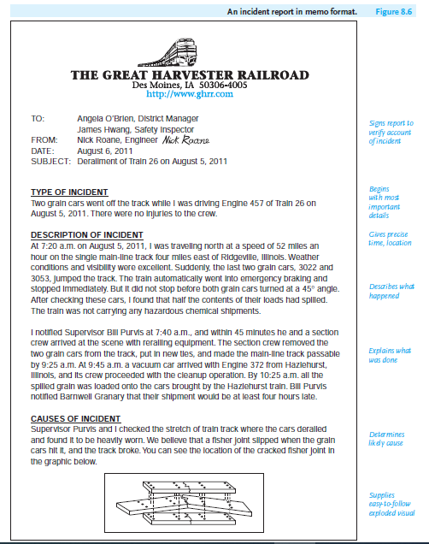
Lecture 8
Writing Effective Short Reports
- Parts of an Incident Report
Include the following information in your incident report. Because it can contain legally sensitive information, for which the reader needs a hard copy and paper trail, an incident report should not be sent as an e-mail. Note how Figure 8.6 includes detailed and accurate information on these parts.

Slide 33
Lecture 8
Writing Effective Short Reports
1. Type of incident.
2. Identification details.
3. Time and location of the incident.
4. Description of what happened.
5. What was done after the incident.
6. What caused the incident.
7. Recommendations.

Slide 34
Lecture 8
Writing Effective Short Reports
9- Protecting Yourself Legally:
An incident report can be used as legal evidence; it will then become part of a permanent legal record that can be used by law enforcement and attorneys in court to establish negligence and liability on your and your company’s part, including determining a worker’s compensation rights. It can also be used by an employer to assess employee responsibility. An incident report frequently concerns the two topics over which powerful legal battles are waged—health and property.

Slide 35
Lecture 8
Writing Effective Short Reports
You have to be very careful about collecting and recording details. Make sure your report is not biased, sketchy, or incomplete. To avoid these errors, you may have to interview employees or bystanders; travel to the incident site; check compliance manuals, code books, or other guides; consult safety experts; or research records and archives.

Slide 36
Lecture 8
Writing Effective Short Reports
To ensure that what you write is legally proper, follow these guidelines.
1. Submit your report promptly and sign or initial it.
2. Be accurate, objective, and complete.
3. Give facts, not opinions.
4. Do not exceed your professional responsibilities.

Slide 37

Lecture 8
Writing Effective Short Reports
References:
Successful Writing at Work, Concise Third Edition,
By: Philip C. Kolin
University of Southern Mississippi
Chapter 8

