Slide 1

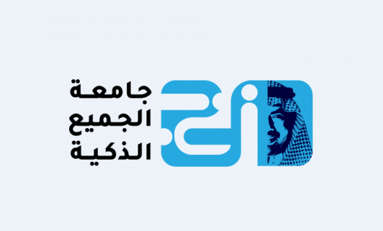
Ethical Hacking Essentials (EHE)
Master of Science in Cybersecurity
Dr. Kamal Alieyan
Everyone Smart University
Faculty of IT – 2022/2023

Slide 2

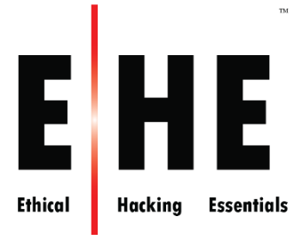
Module 01
Information Security Fundamentals

Slide 3
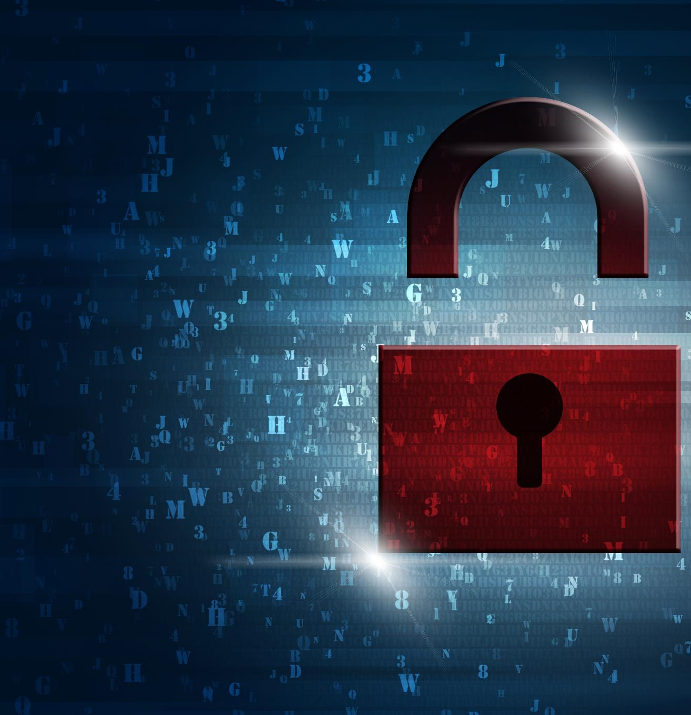
Module Objectives
Creative idea
1
Understanding the Need for Security
Understanding the Elements of Information Security
2
Understanding the Security, Functionality, and Usability Triangle
3
Understanding Motives, Goals, and Objectives of Information Security Attacks
4
5
Overview of Classification of Attacks
6
Overview of Information Security Attack Vectors
Overview of Various Information Security Laws and Regulations
7

Slide 4
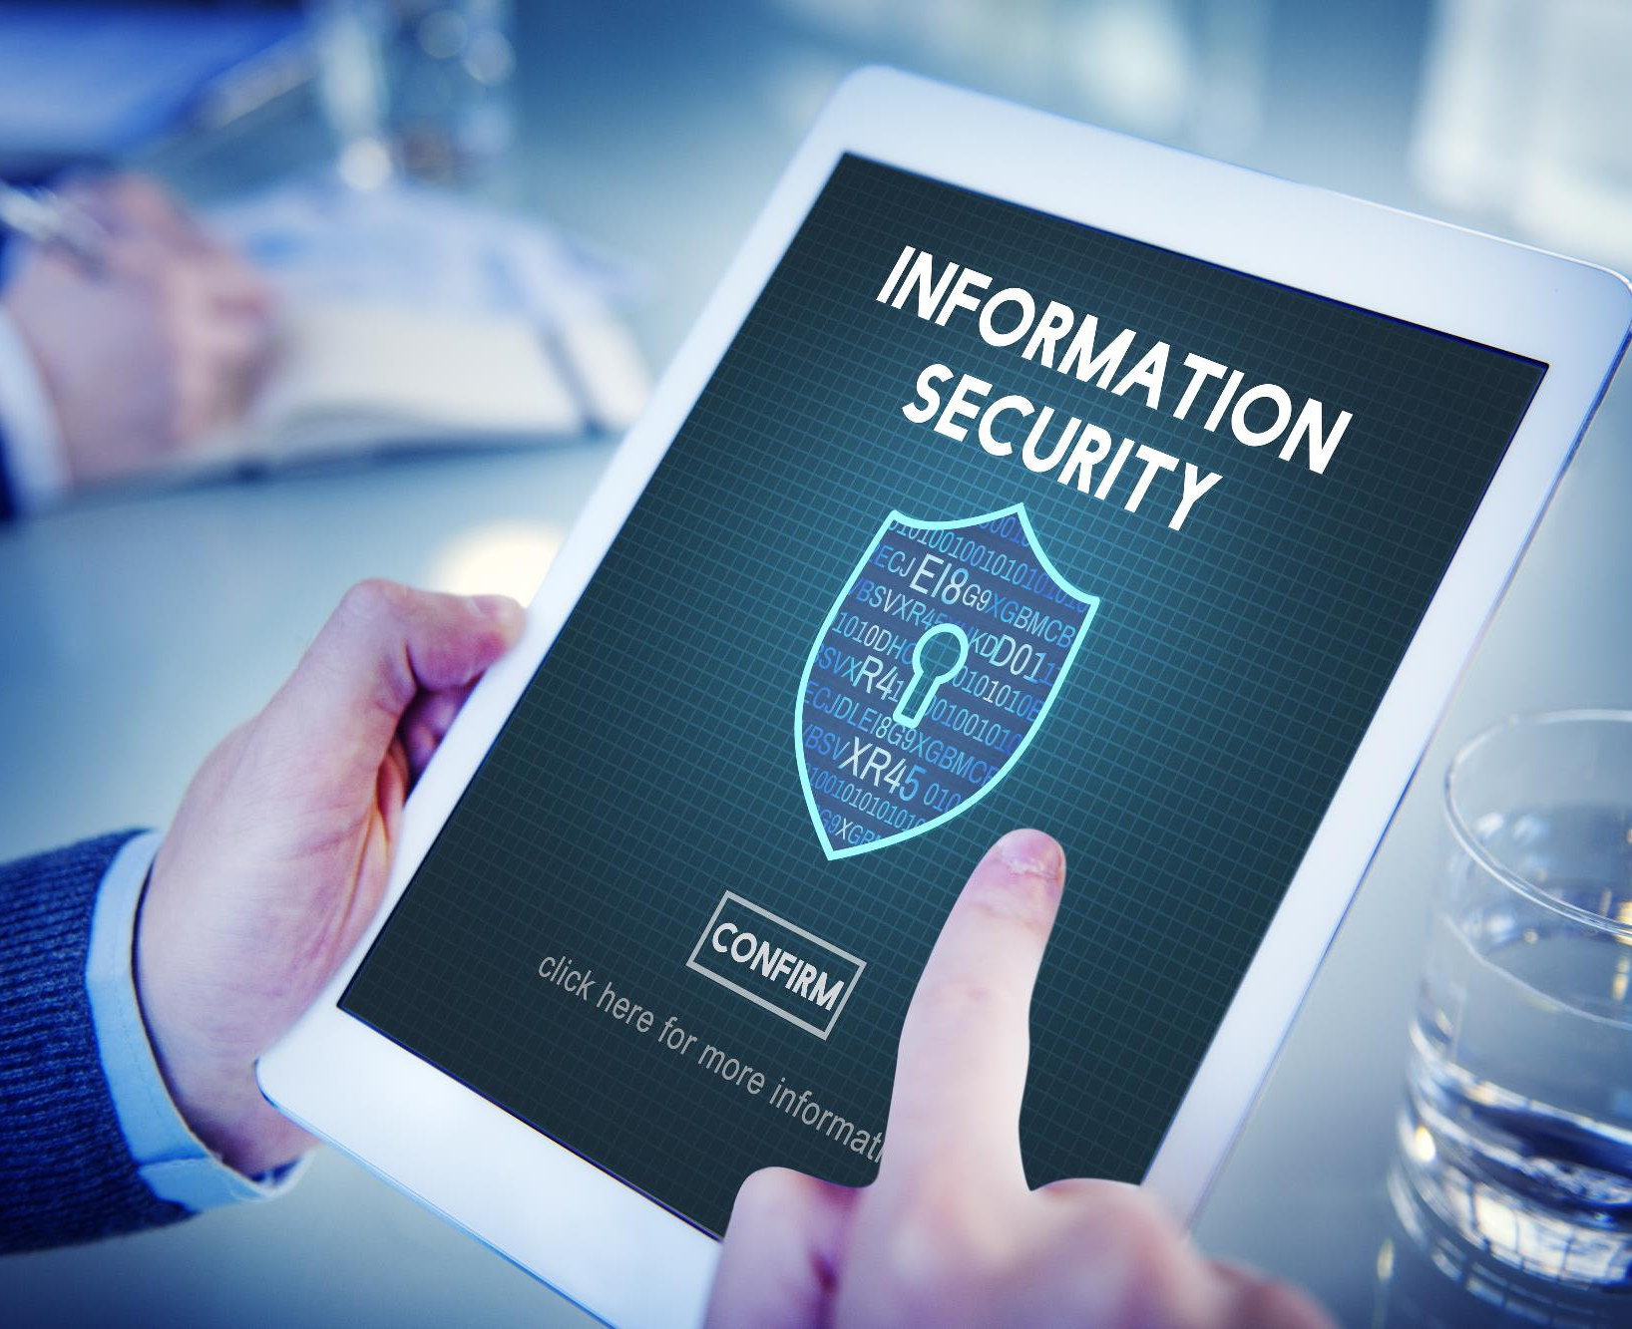



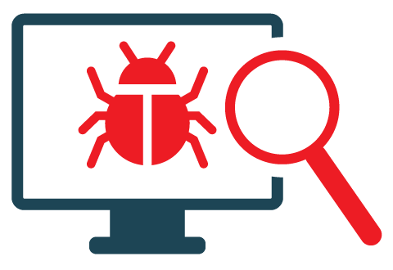
Module Flow
Discuss Information Security Fundamentals
Discuss Various Information Security Laws and Regulations

Slide 5

What is Information Security?
Information security is a state of well-being of information and infrastructure in which the possibility of theft, tampering, and disruption of information and services is low or tolerable

Slide 6
Need for Security
Evolution of technology, focused on ease of use
01
Rely on the use of computers for accessing, providing, or just storing information
02
Increased network environment and network-based applications
03
Direct impact of security breach on the corporate asset base and goodwill
04
Increasing complexity of computer infrastructure administration and management
05

Slide 7

Elements of Information Security
Confidentiality
Integrity
Availability
Assurance that the information is accessible only to those authorized to have access
The trustworthiness of data or resources in terms of preventing improper or unauthorized changes
Assurance that the systems responsible for delivering, storing, and processing information are accessible when required by the authorized users
Authenticity
Non-Repudiation
Refers to the characteristic of a communication, document, or any data that ensures the quality of being genuine
A guarantee that the sender of a message cannot later deny having sent the message and that the recipient cannot deny having received the message

Slide 8
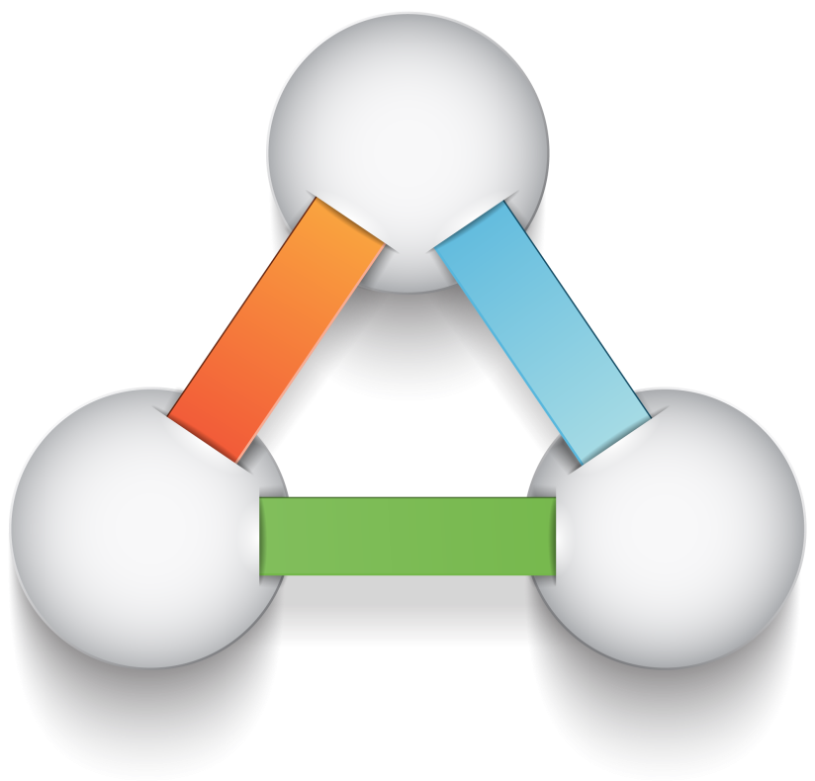




The Security, Functionality, and Usability Triangle
Level of security in any system can be defined by the strength of three components:
Moving the ball towards security means less functionality and usability
Functionality
(Features)
Security
(Restrictions)
Usability
(GUI)

Slide 9
Security Challenges
Compliance to government laws and regulations
Lack of qualified and skilled cybersecurity professionals
Difficulty in centralizing security in a distributed computing environment
Fragmented and complex privacy and data protection regulations
Compliance issues due to the implementation of Bring Your Own Device (BYOD) policies in companies
Relocation of sensitive data from legacy data centers to the cloud without proper configuration

Slide 10
Motives, Goals, and Objectives of Information Security Attacks
Attacks = Motive (Goal) + Method + Vulnerability
A motive originates out of the notion that the target system stores or processes something valuable, and this leads to the threat of an attack on the system
Attackers try various tools and attack techniques to exploit vulnerabilities in a computer system or its security policy and controls in order to fulfil their motives
Motives behind information security attacks
Disrupting business continuity
Stealing information and manipulating data
Creating fear and chaos by disrupting critical infrastructures
Causing financial loss to the target
Damaging the reputation of the target

Slide 11
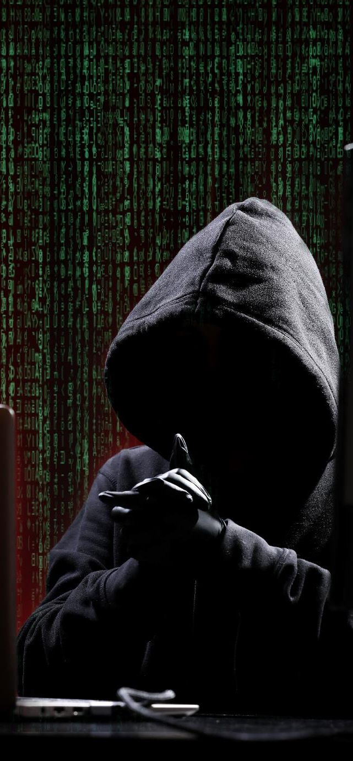
Classification of Attacks
Passive Attacks
Do not tamper with the data and involve intercepting and monitoring network traffic and data flow on the target network
Examples include sniffing and eavesdropping
Active Attacks
Tamper with the data in transit or disrupt the communication or services between the systems to bypass or break into secured systems
Examples include DoS, Man-in-the-Middle, session hijacking, and SQL injection
Close-in Attacks
Are performed when the attacker is in close physical proximity with the target system or network in order to gather, modify, or disrupt access to information
Examples include social engineering such as eavesdropping, shoulder surfing, and dumpster diving

Slide 12
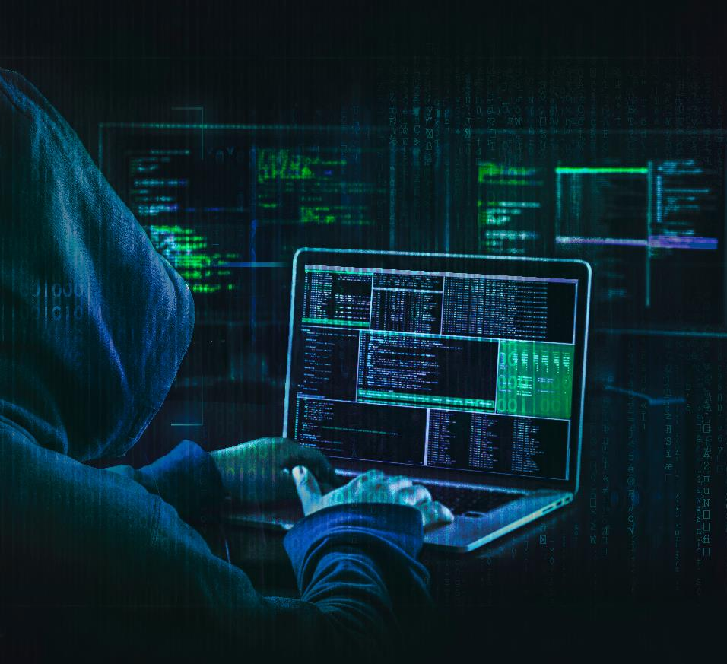
Classification of Attacks (Cont’d)
Insider Attacks
Distribution Attacks
Involve using privileged access to violate rules or intentionally cause a threat to the organization’s information or information systems
Examples include theft of physical devices and planting keyloggers, backdoors, and malware
Occur when attackers tamper with hardware or software prior to installation
Attackers tamper with the hardware or software at its source or in transit

Slide 13

Information Security Attack Vectors
Cloud Computing Threats
Advanced Persistent Threats (APT)
Viruses and Worms
Ransomware
Mobile Threats
Cloud computing is an on-demand delivery of IT capabilities where sensitive data of organizations, and their clients is stored. Flaw in one client’s application cloud allow attackers to access other client’s data
An attack that is focused on stealing information from the victim machine without the user being aware of it
The most prevalent networking threat that are capable of infecting a network within seconds
Restricts access to the computer system’s files and folders and demands an online ransom payment to the malware creator(s) in order to remove the restrictions
Focus of attackers has shifted to mobile devices due to increased adoption of mobile devices for business and personal purposes and comparatively lesser security controls

Slide 14

Information Security Attack Vectors (Cont’d)
Web Application Threats
Botnet
Insider Attack
Phishing
IoT Threats
A huge network of the compromised systems used by an intruder to perform various network attacks
An attack performed on a corporate network or on a single computer by an entrusted person (insider) who has authorized access to the network
The practice of sending an illegitimate email falsely claiming to be from a legitimate site in an attempt to acquire a user’s personal or account information
Attackers target web applications to steal credentials, set up phishing site, or acquire private information to threaten the performance of the website and hamper its security
IoT devices include many software applications that are used to access the device remotely
Flaws in the IoT devices allows attackers access into the device remotely and perform various attacks

Slide 15
Module Flow
Discuss Information Security Fundamentals
Discuss Various Information Security Laws and Regulations

Slide 16
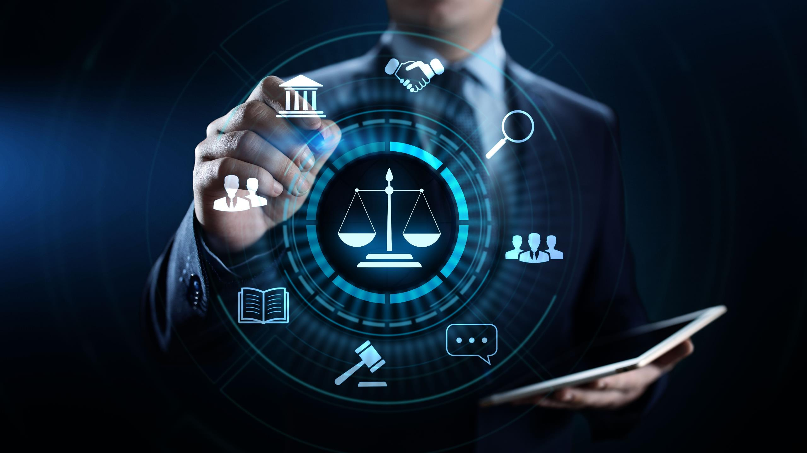
Payment Card Industry Data Security Standard (PCI DSS)
A proprietary information security standard for organizations that handle cardholder information for major debit, credit, prepaid, e-purse, ATM, and POS cards
PCI DSS applies to all entities involved in payment card processing — including merchants, processors, acquirers, issuers, and service providers, as well as all other entities that store, process, or transmit cardholder data
PCI Data Security Standard — High Level Overview
Build and Maintain a Secure Network
Implement Strong Access Control Measures
Protect Cardholder Data
Regularly Monitor and Test Networks
Maintain a Vulnerability Management Program
Maintain an Information Security Policy
https://www.pcisecuritystandards.org
Failure to meet the PCI DSS requirements may result in fines or the termination of payment card processing privileges

Slide 17
ISO/IEC 27001:2013
Specifies the requirements for establishing, implementing, maintaining, and continually improving an information security management system within the context of the organization
It is intended to be suitable for several different types of use, including:
  Use within organizations to formulate security requirements and objectives
  Identification and clarification of existing information security management processes
  Use within organizations to ensure that security risks are cost-effectively managed
  Use by organization management to determine the status of information security management activities
  Use within organizations to ensure compliance with laws and regulations
  Implementation of business-enabling information security
  Definition of new information security management processes
  Use by organizations to provide relevant information about information security to customers
https://www.iso.org

Slide 18

Health Insurance Portability and Accountability Act (HIPAA)
HIPAA's Administrative Simplification Statute and Rules
Electronic Transaction and Code Set Standards
Requires every provider who does business electronically to use the same health care transactions, code sets, and identifiers
Privacy Rule
Provides federal protections for the personal health information held by covered entities and gives patients an array of rights with respect to that information
Specifies a series of administrative, physical, and technical safeguards for covered entities to use to ensure the confidentiality, integrity, and availability of electronically protected health information
Security Rule
National Identifier Requirements
Requires that health care providers, health plans, and employers have standard national numbers that identify them attached to standard transactions
Enforcement Rule
Provides the standards for enforcing all the Administration Simplification Rules
https://www.hhs.gov

Slide 19

Sarbanes Oxley Act (SOX)
    Enacted in 2002, the Sarbanes-Oxley Act is designed to protect investors and the public by increasing the accuracy and reliability of corporate disclosures
    The key requirements and provisions of SOX are organized into 11 titles:
Title I
Title II
Title III
Public Company Accounting Oversight Board (PCAOB) provides independent oversight of public accounting firms providing audit services (“auditors”)
Auditor Independence establishes the standards for external auditor independence, intended to limit conflicts of interest and address new auditor approval requirements, audit partner rotation, and auditor reporting requirements
Corporate Responsibility mandates that senior executives take individual responsibility for the accuracy and completeness of corporate financial reports
https://www.sec.gov

Slide 20
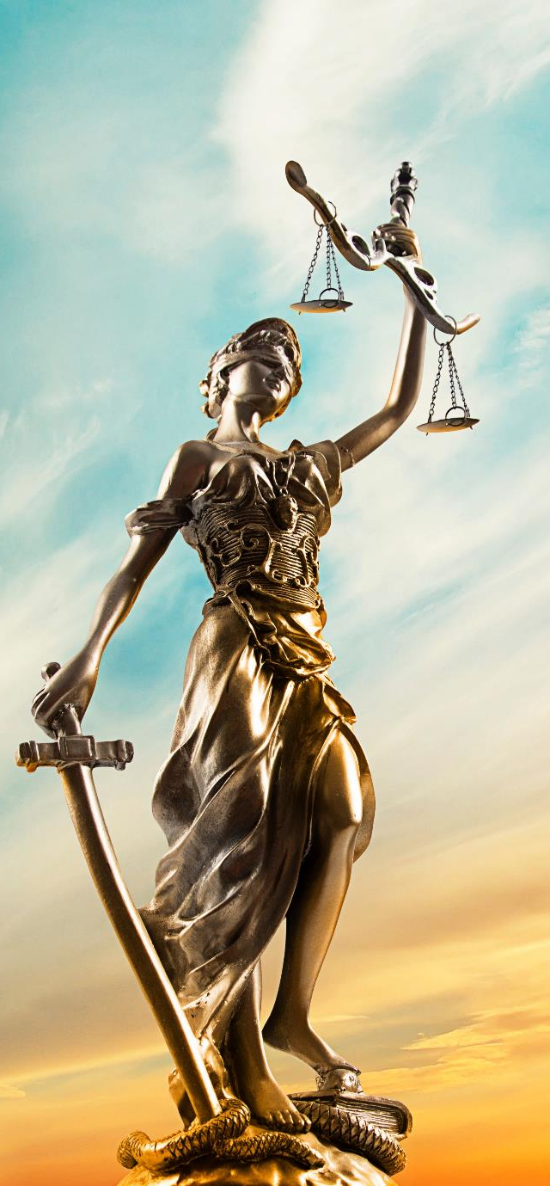
Sarbanes Oxley Act (SOX) (Cont’d)
Title IV
Enhanced Financial Disclosures describe enhanced reporting requirements for financial transactions, including off-balance-sheet transactions, pro-forma figures, and the stock transactions of corporate officers
Title V
Analyst Conflicts of Interest consist of measures designed to help restore investor confidence in the reporting of securities analysts
Title VI
Commission Resources and Authority defines practices to restore investor confidence in securities analysts
Title VII
Studies and Reports includes the effects of the consolidation of public accounting firms, the role of credit rating agencies in the operation of securities markets, securities violations and enforcement actions, and whether investment banks assisted Enron, Global Crossing, or others to manipulate earnings and obfuscate true financial conditions

Slide 21
Sarbanes Oxley Act (SOX) (Cont’d)
Title VIII
Corporate and Criminal Fraud Accountability describes specific criminal penalties for fraud by the manipulation, destruction, or alteration of financial records, or other interference with investigations while providing certain protections for whistle-blowers
100%
Title X
White Collar Crime Penalty Enhancement increases the criminal penalties associated with white-collar crimes and conspiracies. It recommends stronger sentencing guidelines and specifically adds the failure to certify corporate financial reports as a criminal offense
Title IX
Corporate Tax Returns states that the Chief Executive Officer should sign the company tax return
Title XI
Corporate Fraud Accountability identifies corporate fraud and record tampering as criminal offenses and assigns them specific penalties. It also revises sentencing guidelines and strengthens their penalties. This enables the SEC to temporarily freeze large or unusual payments

Slide 22

The Digital Millennium Copyright Act (DMCA)
The DMCA is a United States copyright law that implements two 1996 treaties of the World Intellectual Property Organization (WIPO)
It defines the legal prohibitions against the circumvention of technological protection measures employed by copyright owners to protect their works, and against the removal or alteration of copyright management information
https://www.copyright.gov

Slide 23
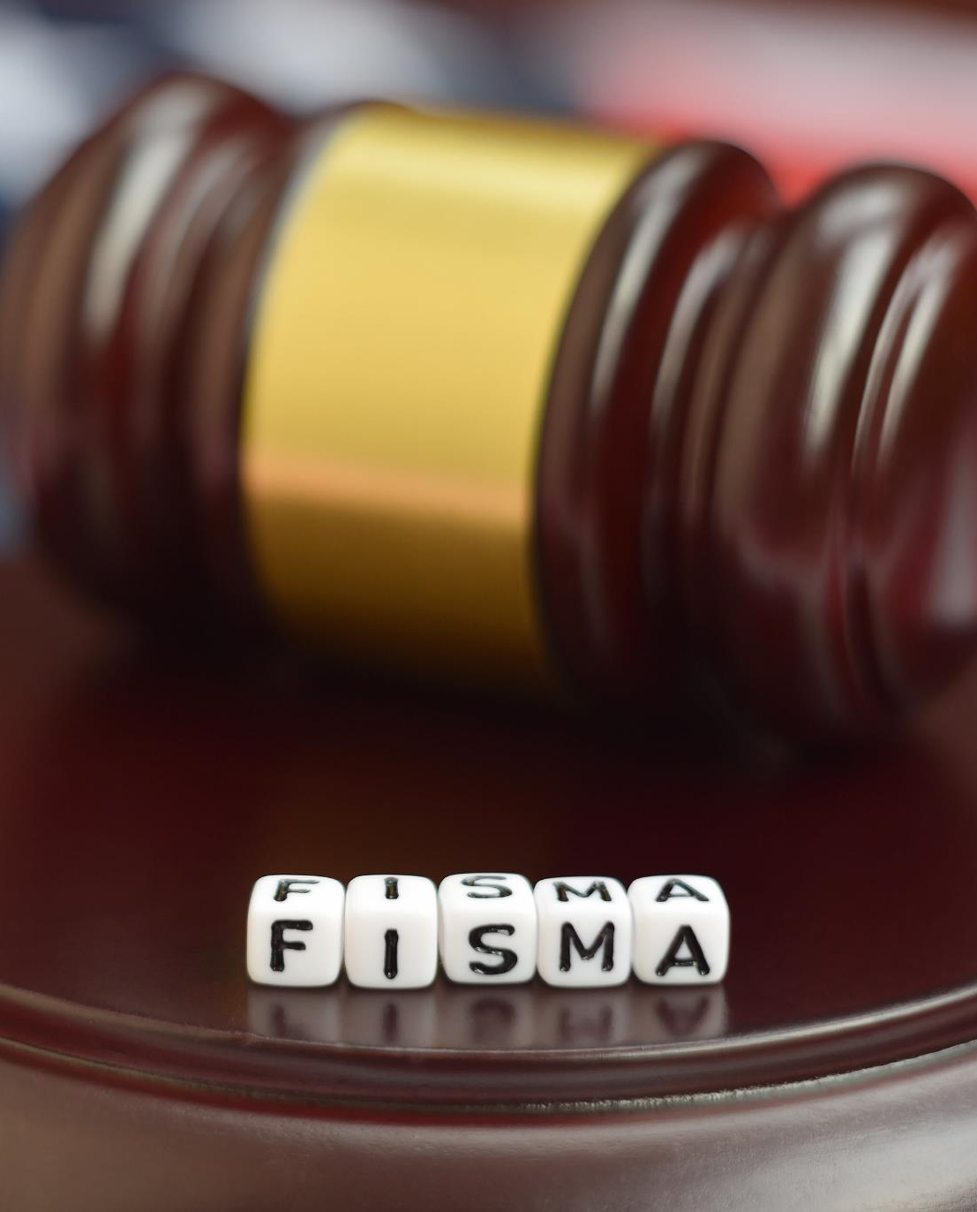
The Federal Information Security Management Act (FISMA)
Anna Stewart
The FISMA provides a comprehensive framework for ensuring the effectiveness of information security controls over information resources that support Federal operations and assets
It includes
Standards for categorizing information and information systems by mission impact
Standards for minimum security requirements for information and information systems
Guidance for selecting appropriate security controls for information systems
Guidance for assessing security controls in information systems and determining security control effectiveness
Guidance for security authorization of information systems
https://csrc.nist.gov

Slide 24
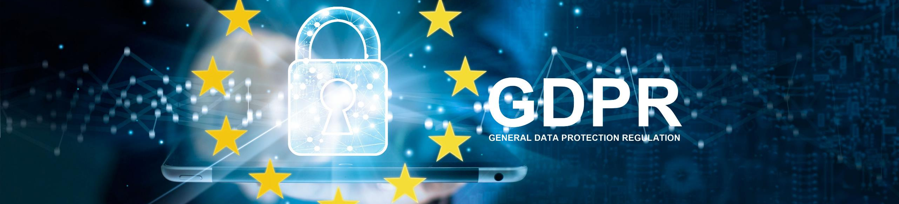
GDPR regulation was put into effect on May 25, 2018 and one of the most stringent privacy and security laws globally
The GDPR will levy harsh fines against those who violate its privacy and security standards, with penalties reaching tens of millions of euros
General Data Protection Regulation (GDPR)
GDPR Data Protection Principles
Lawfulness, fairness, and transparency
Purpose limitation
Data minimization
Accuracy
Storage limitation
Integrity and confidentiality
Accountability
https://gdpr.eu

Slide 25


Data Protection Act 2018 (DPA)
The DPA is an act to make provision for the regulation of the processing of information relating to individuals; to make provision in connection with the Information Commissioner’s functions under specific regulations relating to information; to make provision for a direct marketing code of practice, and connected purposes
The DPA protects individuals concerning the processing of personal data, in particular by:
Requiring personal data to be processed lawfully and fairly, based on the data subject’s consent or another specified basis,
Conferring rights on the data subject to obtain information about the processing of personal data and to require inaccurate personal data to be rectified, and
Conferring functions on the Commissioner, giving the holder of that office responsibility to monitor and enforce their provisions
https://www.legislation.gov.uk

Slide 26
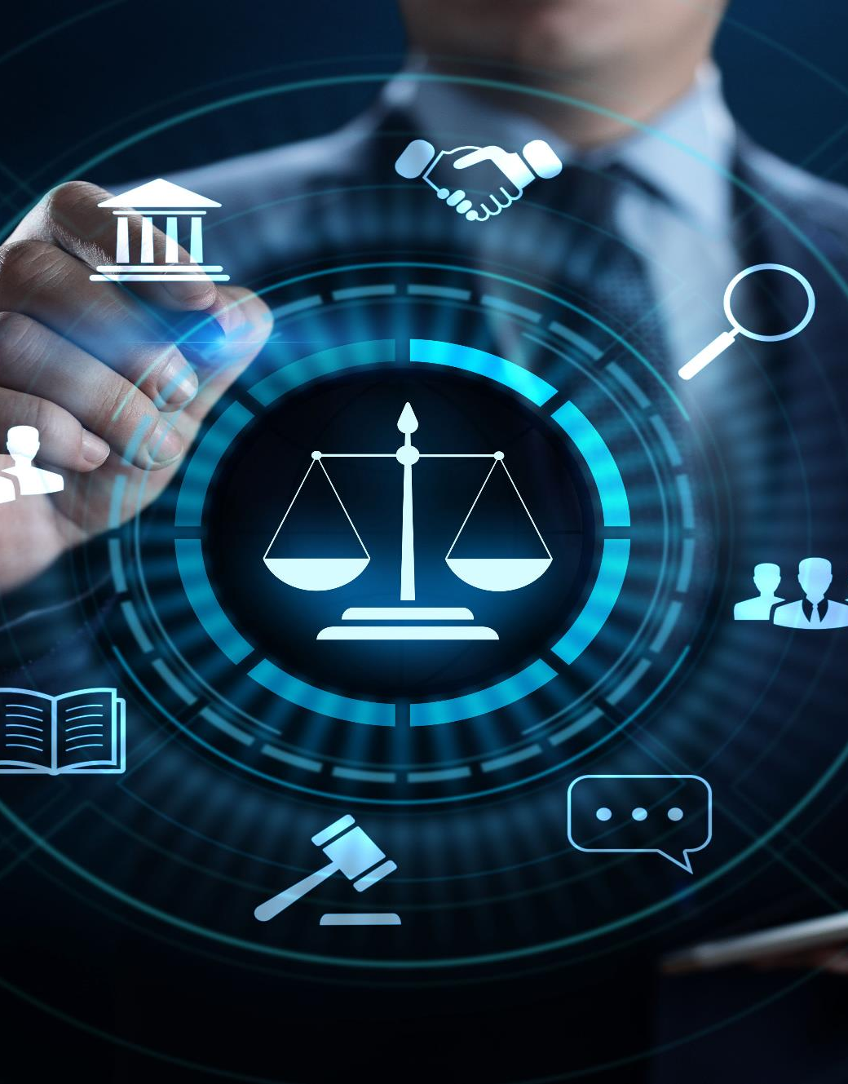
Cyber Law in Different Countries
Country Name | Laws/Acts | Website
United States | Section 107 of the Copyright Law mentions the doctrine of “fair use” | https://www.copyright.gov
 | Online Copyright Infringement Liability Limitation Act
 | The Lanham (Trademark) Act (15 USC §§ 1051 - 1127) | https://www.uspto.gov
 | The Electronic Communications Privacy Act | https://fas.org
 | Foreign Intelligence Surveillance Act | https://fas.org
 | Protect America Act of 2007 | https://www.justice.gov
 | Privacy Act of 1974 | https://www.justice.gov
 | National Information Infrastructure Protection Act of 1996 | https://www.nrotc.navy.mil
 | Computer Security Act of 1987 | https://csrc.nist.gov
 | Freedom of Information Act (FOIA) | https://www.foia.gov
 | Computer Fraud and Abuse Act | https://energy.gov
 | Federal Identity Theft and Assumption Deterrence Act | https://www.ftc.gov

Slide 27
Cyber Law in Different Countries (Cont’d)
Country Name | Laws/Acts | Website
Australia | The Trade Marks Act 1995 | https://www.legislation.gov.au
 | The Patents Act 1990
 | The Copyright Act 1968
 | Cybercrime Act 2001
United Kingdom | The Copyright, Etc. and Trademarks (Offenses And Enforcement) Act 2002 | https://www.legislation.gov.uk
 | Trademarks Act 1994 (TMA)
 | Computer Misuse Act 1990
 | The Network and Information Systems Regulations 2018
 | Communications Act 2003
 | The Privacy and Electronic Communications (EC Directive) Regulations 2003
 | Investigatory Powers Act 2016
 | Regulation of Investigatory Powers Act 2000
China | Copyright Law of the People’s Republic of China (Amendments on October 27, 2001) | http://www.npc.gov.cn
 | Trademark Law of the People's Republic of China (Amendments on October 27, 2001)
India | The Patents (Amendment) Act, 1999, Trade Marks Act, 1999, The Copyright Act, 1957 | http://www.ipindia.nic.in
 | Information Technology Act | https://www.meity.gov.in
Germany | Section 202a. Data Espionage, Section 303a. Alteration of Data, Section 303b. Computer Sabotage | https://www.cybercrimelaw.net

Slide 28
Cyber Law in Different Countries (Cont’d)
Country Name | Laws/Acts | Website
Italy | Penal Code Article 615 ter | https://www.cybercrimelaw.net
Japan | The Trademark Law (Law No. 127 of 1957), Copyright Management Business Law (4.2.2.3 of 2000) | https://www.iip.or.jp
Canada | Copyright Act (R.S.C., 1985, c. C-42), Trademark Law, Canadian Criminal Code Section 342.1 | https://laws-lois.justice.gc.ca
Singapore | Computer Misuse Act | https://sso.agc.gov.sg
South Africa | Trademarks Act 194 of 1993 | http://www.cipc.co.za
 | Copyright Act of 1978 | https://www.nlsa.ac.za
South Korea | Copyright Law Act No. 3916 | https://www.copyright.or.kr
 | Industrial Design Protection Act | https://www.kipo.go.kr
Belgium | Copyright Law, 30/06/1994 | https://www.wipo.int
 | Computer Hacking | https://www.cybercrimelaw.net
Brazil | Unauthorized modification or alteration of the information system | https://www.domstol.no
Hong Kong | Article 139 of the Basic Law | https://www.basiclaw.gov.hk

Slide 29
Module Summary
This module has discussed the need for security, elements of information security, the security, functionality, and usability triangle, and security challenges
It has covered motives, goals, and objectives of information security attacks in detail
It also discussed classification of attacks and information security attack vectors
Finally, this module ended with a detailed discussion of various information security laws and regulations
The next module will give you introduction on ethical hacking fundamental concepts such as cyber kill chain methodology, hacking concepts, hacker classes, and various phases of hacking cycle

