Slide 1



Project Monitoring
Lecture 9
PMG 333
Managing Project
Team
Prepared by
Dr. Mohammed Mustafa

Slide 2

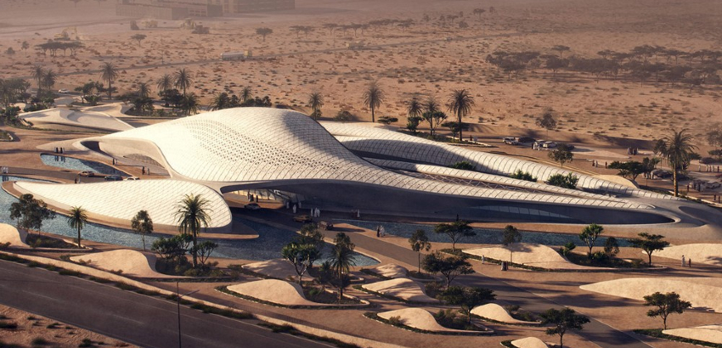
Learning objectives
The Five-Stage Team Development Model
Situational Factors Affecting Team Development
Building High-Performance Project Teams
Managing Virtual Project Teams
Project Team Pitfalls

Slide 3
Lecture
Outlines
09
Identify key characteristics of a high-performance project team.
Distinguish the different stages of team development.
Understand the impact situational factors have on project team development.
Identify strategies for developing a high- performance project team.
Distinguish functional conflict from dysfunctional conflict and describe strategies for encouraging functional conflict and discouraging dysfunctional conflict.
Understand the challenges of managing virtual project teams.
Recognize the different pitfalls that can occur in a project team
www.midocean.ae

Slide 4
9.1 The Five-Stage Team Development Model
Just as infants develop in certain ways during their first months of life, many experts argue that groups develop in a predictable manner.
One of the most popular models identifies five stages (see Figure .1) through which groups develop into effective teams (Tuchman, 1965; Tuchman and Jensen, 1977):
www.midocean.ae

Slide 5
9.1 The Five-Stage Team Development Model – Cont.
1. Forming: During this initial stage the members get acquainted with each other and understand the scope of the project.
They begin to establish ground rules by trying to find out what behaviors are acceptable with respect to both the project (what role they will play, what performance expectations are) and interpersonal relations (who’s really in charge).
This stage is completed once members begin to think of themselves as part of a group.
www.midocean.ae

Slide 6
9.1 The Five-Stage Team Development Model – Cont.
2. Storming: As the name suggests, this stage is marked by a high degree of internal conflict.
Members accept that they are part of a project group but resist the constraints that the project and group put on their individuality.
There is conflict over who will control the group and how decisions will be made.
As these conflicts are resolved, the project manager’s leadership becomes accepted, and the group moves to the next stage.
www.midocean.ae

Slide 7
9.1 The Five-Stage Team Development Model – Cont.
3. Norming: The third stage is one in which close relationships develop and the group demonstrates cohesiveness.
Feelings of camaraderie and shared responsibility for the project are heightened.
The norming phase is complete when the group structure solidifies and the group establishes a common set of expectations about how members should work together.
4. Performing: The team operating structure at this point is fully functional and accepted.
Group energy has moved from getting to know each other and how the group will work together to accomplishing the project goals.
www.midocean.ae

Slide 8
9.1 The Five-Stage Team Development Model – Cont.
5. Adjourning: For conventional work groups, performing is the last stage of their development. However, for project teams, there is a completion phase.
During this stage, the team prepares for its own disbandment. High performance is no longer a top priority.
Instead attention is devoted to wrapping up the project. Responses of members vary in this stage.
Some members are upbeat, basking in the project team’s accomplishments.
Others may be depressed over loss of camaraderie and friendships gained during the project’s life.
www.midocean.ae

Slide 9
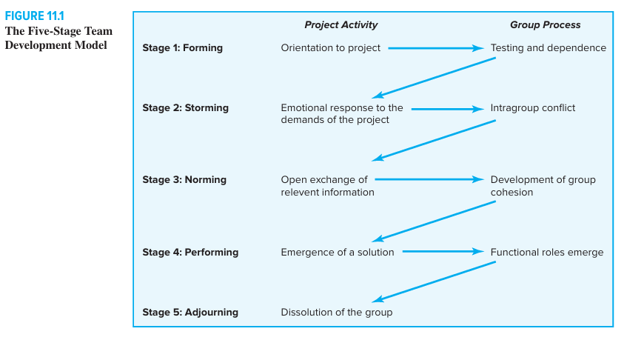

Slide 10

9.1 The Five-Stage Team Development Model – Cont.
This model has several implications for those working on project teams.
The first is that the model provides a framework for the group to understand its own development.
Project managers have found it useful to share the model with their teams.
It helps members accept the tensions of the storming phase, and it directs their focus to moving toward the more productive phases.
Another implication is that it stresses the importance of the norming phase, which contributes significantly to the level of productivity experienced during the performing phase.
Project managers, as we shall see, have to take an active role in shaping group norms that will contribute to ultimate project success.
www.midocean.ae

Slide 11
9.2 Situational Factors Affecting Team Development
Experience and research indicate that high-performance project teams are much more likely to develop under the following conditions:
There are 10 or fewer members per team.
Members volunteer to serve on the project team.
Members serve on the project from beginning to end.
Members are assigned to the project full time.
Members are part of an organization culture that fosters cooperation and trust.
Members report solely to the project manager.
www.midocean.ae

Slide 12
9.2 Situational Factors Affecting Team Development – Cont.
All relevant functional areas are represented on the team.
The project involves a compelling objective.
Members are located within conversational distance of each other.
It is important for project managers and team members to recognize the situational constraints they are operating under and do the best they can.
It would be naive to believe that every project team has the same potential to evolve into a high-performance team. Under less-than-ideal conditions, it may be a struggle just to meet project objectives.
Ingenuity, discipline, and sensitivity to team dynamics are essential to maximizing the performance of a project team.
www.midocean.ae

Slide 13
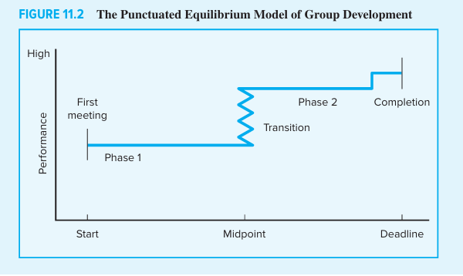

Slide 14
9.3 Building High-Performance Project Teams
Project managers play a key role in developing high-performance project teams.
They recruit members, conduct meetings, establish a team identity, create a common sense of purpose or a shared vision, manage a reward system that encourages teamwork, orchestrate decision making, resolve conflicts that emerge within the team, and rejuvenate the team when energy wanes.
www.midocean.ae

Slide 15
9.3 Building High-Performance Project Teams – Cont.
Project managers take advantage of situational factors that naturally contribute to team development while improvising around those factors that inhibit team development.
In doing so they exhibit a highly interactive management style that exemplifies teamwork and, as discussed in the previous chapter, manage the interface between the team and the rest of the organization.
www.midocean.ae

Slide 16
9.3 Building High-Performance Project Teams – Cont.
Recruiting Project Members: The process of selecting and recruiting project members will vary across organizations.
Two important factors affecting recruitment are the importance of the project and the management structure being used to complete the project.
Often for high- priority projects that are critical to the future of the organization, the project manager will be given virtual carte blanche to select whomever he or she deems necessary.
For less significant projects, personnel will simply be assigned to the project.
www.midocean.ae

Slide 17
9.3 Building High-Performance Project Teams – Cont.
In many matrix structures, the functional manager controls who is assigned to the project; the project manager will have to work with the functional manager to obtain necessary personnel.
Even in a project team where members are selected and assigned full time to the project, the project manager has to be sensitive to the needs of others.
There is no better way to create enemies within an organization than to be perceived as unnecessarily robbing other departments of essential personnel.
www.midocean.ae

Slide 18
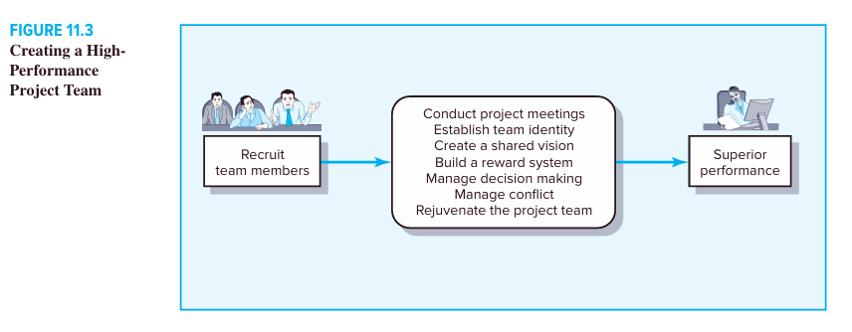

Slide 19
9.3 Building High-Performance Project Teams – Cont.
When selecting and recruiting team members, project managers naturally look for individuals with the necessary experience and knowledge/technical skills critical for project completion.
At the same time, there are less obvious considerations that need to be factored into the recruitment process:
Problem-solving ability. If the project is complex and fuzzy, then a manager wants people who are good at working under uncertainty and have strong problem- identification and problem-solving skills.
These same people are likely to be bored and less productive working on straightforward projects that go by the book.
www.midocean.ae

Slide 20
9.3 Building High-Performance Project Teams – Cont.
Availability. Sometimes the people who are most available are not the ones wanted for the team.
Conversely, if members recruited are already overcommitted, they may not be able to offer much.
Technological expertise. Managers should be wary of people who know too much about a specific technology.
They may be technology buffs who like to study but have a hard time settling down and doing the work.
Credibility. The credibility of the project is enhanced by the reputation of the people involved in the project.
Recruiting a sufficient number of “winners” lends confidence to the project.
www.midocean.ae

Slide 21
9.3 Building High-Performance Project Teams – Cont.
Political connections. Managers are wise to recruit individuals who already have a good working relationship with key stakeholders.
This is particularly true for projects operating in a matrix environment in which a significant portion of the work will be under the domain of a specific functional department and not the core project team.
Ambition, initiative, and energy. These qualities can make up for a lot of shortcomings in other areas and should not be underestimated.
www.midocean.ae

Slide 22
9.3 Building High-Performance Project Teams – Cont.
Familiarity. Research suggests repeat collaboration stifles creativity and innovation.
On challenging, breakthrough projects it is wise to interject the team with experts who have little previous working experience with others. (Skilton and Dooley, 2010)
www.midocean.ae

Slide 23
9.3 Building High-Performance Project Teams – Cont.
Conducting Project Meetings
The First Project Team Meeting: Research on team development confirms what we have heard from project managers:
The first project kick-off meeting is critical to the early functioning of the project team.
According to one veteran project manager: The first team meeting sets the tone for how the team will work together.
If it is disorganized, or becomes bogged down with little sense of closure, then this can often become a self- fulfilling prophecy for subsequent group work.
www.midocean.ae

Slide 24
9.3 Building High-Performance Project Teams – Cont.
On the other hand, if it is crisply run, focusing on real issues and concerns in an honest and straightforward manner, members come away excited about being part of the project team.
www.midocean.ae

Slide 25
9.3 Building High-Performance Project Teams – Cont.
Creating a Shared Vision: Unlike project scope statements, which include specific cost, completion dates, and performance requirements, a project vision involves the less tangible aspects of project performance.
It refers to an image a project team holds in common about how the project will look upon completion, how they will work together, and/or how customers will accept the project.
At its simplest level, a shared vision is the answer to the question, “What do we want to create?” Not everyone will have the same vision, but the images should be similar.
Visions come in a variety of shapes and forms; they can be captured in a slogan or a symbol or can be written as a formal vision statement.
www.midocean.ae

Slide 26
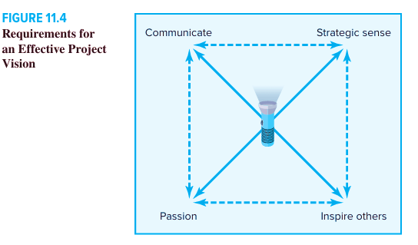

Slide 27
9.3 Building High-Performance Project Teams – Cont.
Managing Project Reward Systems. Project managers are responsible for managing the reward system that encourages team performance and extra effort.
One advantage they have is that often project work is inherently satisfying, whether it is manifested in an inspiring vision or simple sense of accomplishment.
Projects provide participants with a change in scenery, a chance to learn new skills, and an opportunity to break out of their departmental cocoon.
Another inherent reward is what was referred to in Tracy Kidder, The Soul of a New Machine, as “pinball”—project success typically gives team members an option to play another exciting game.
www.midocean.ae

Slide 28
9.3 Building High-Performance Project Teams – Cont.
Still, many projects are underappreciated, boring, interfere with other more significant priorities, and are considered an extra burden.
In some of these cases, the biggest reward is finishing the project so that team members can go back to what they really enjoy doing and what will yield the biggest personal payoffs.
Unfortunately, when this attitude is the primary incentive, project quality is likely to suffer.
In these circumstances, external rewards play a more important role in motivating team performance.
www.midocean.ae

Slide 29
9.3 Building High-Performance Project Teams – Cont.
Examples of this kind of rewards include:
Letters of commendation. While project managers may not have responsibility for their team members’ performance appraisals, they can write letters commending their project performance.
These letters can be sent to the workers’ supervisors to be placed in their personnel files.
Public recognition for outstanding work. Superlative workers should be publicly recognized for their efforts.
Some project managers begin each status review meeting with a brief mention of project workers who have exceeded their project goals.
www.midocean.ae

Slide 30
9.3 Building High-Performance Project Teams – Cont.
Examples of this kind of rewards include:
Letters of commendation. While project managers may not have responsibility for their team members’ performance appraisals, they can write letters commending their project performance.
These letters can be sent to the workers’ supervisors to be placed in their personnel files.
Public recognition for outstanding work. Superlative workers should be publicly recognized for their efforts.
Some project managers begin each status review meeting with a brief mention of project workers who have exceeded their project goals.
www.midocean.ae

Slide 31
9.3 Building High-Performance Project Teams – Cont.
Job assignments. Good project managers recognize that, while they may not have much budgetary authority, they do have substantial control over who does what, with whom, when, and where.
Good work should be rewarded with desirable job assignments.
Managers should be aware of member preferences and, when appropriate, accommodate them.
Flexibility. Being willing to make exceptions to rules, if done judiciously, can be a powerful reward.
Allowing members to work at home when a child is sick or excusing a minor indiscretion can engender long-lasting loyalty
www.midocean.ae

Slide 32
9.3 Building High-Performance Project Teams – Cont.
Orchestrating the Decision-Making Process: Most decisions on a project do not require a formal meeting to discuss alternatives and determine solutions.
Instead decisions are made in real time as part of the daily interactions between project managers, stakeholders, and team members.
For example, as a result of a routine “how’s it going?” question, a project manager discovers that a mechanical engineer is stuck trying to meet the performance criteria for a prototype he is responsible for building.
www.midocean.ae

Slide 33
9.3 Building High-Performance Project Teams – Cont.
Managing Conflict within the Project:
Distinguish functional conflict from dysfunctional conflict and describe strategies for encouraging functional conflict and discouraging dysfunctional conflict.
www.midocean.ae

Slide 34
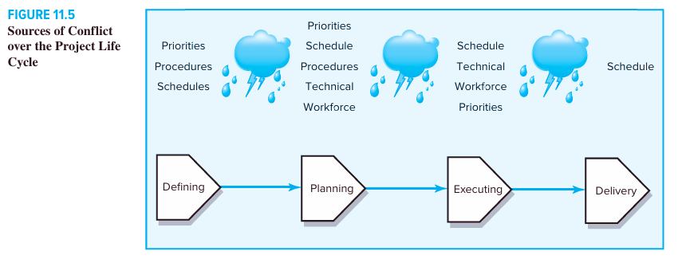

Slide 35
9.4 Managing Virtual Project Teams
Building a high-performance project team among a mixture of part-time and full-time members is a challenging task.
Consider how much more challenging it is to build a team when members cannot engage in face-to-face interactions.
Such would be the case for a virtual project team in which the team members are geographically situated so that they may seldom, if ever, meet face-to-face as a team.
www.midocean.ae

Slide 36
9.4 Managing Virtual Project Teams
For example, Hewlett-Packard’s integrated circuit business headquarters and a portion of the R&D facilities are located in Palo Alto, California; the two wafer fabrication operations are located in Corvallis, Oregon, and Fort Collins, Colorado; and the packaging assembly process is primarily in Singapore and Korea.
It is not uncommon for professionals at each of these locations to be involved in the same project.
www.midocean.ae

Slide 37
9.4 Managing Virtual Project Teams
When team members are spread across different time zones and continents, the opportunity for direct communication is severely limited.
Electronic communication such as the Internet, e-mail, and teleconferencing takes on much more importance in virtual projects because this is the primary means of communication.
www.midocean.ae

Slide 38
9.4 Managing Virtual Project Teams
Below are some additional tips for alleviating communication problems and enhancing the performance of virtual teams:
1. Don’t let team members vanish. Virtual teams often experience problems getting in touch with each other.
Use Internet scheduling software to store members’ calendars.
2. Establish a code of conduct to avoid delays. Team members need to agree not only on what, when, and how information will be shared but also on how and when they will respond to it.
Develop a priority system to distinguish messages that require immediate response from those with longer time frames.
www.midocean.ae

Slide 39
9.4 Managing Virtual Project Teams
3. Establish clear norms and protocols for surfacing assumptions and conflicts.
Because most communication is nonvisual, project managers cannot watch body language and facial expressions to develop a sense of what is going on.
They need to probe deeper when communicating to force members to explain their viewpoints, actions, and concerns more clearly; they must double-check comprehension.
www.midocean.ae

Slide 40
9.4 Managing Virtual Project Teams
4. Use electronic video technology to verify work. Instead of relying on others’ judgment, have members “show” work that has been done via Internet video.
This can avoid costly misunderstanding and provide useful feedback.
5. Share the pain. Do not require everyone to conform to your time zone and preferences.
Rotate meeting times so that all team members have a turn working according to their clock.
www.midocean.ae

Slide 41
9.5 Project Team Pitfalls
High-performance project teams can produce dramatic results.
However, like any good thing, there is a dark side to project teams that managers need to be aware of.
In this section we examine in more detail some of the pathologies that high-performance project teams can succumb to and highlight what project managers can do to reduce the likelihood of these problems occurring.
www.midocean.ae

Slide 42
9.5 Project Team Pitfalls
Groupthink Janis (1982) first identified groupthink as a factor that influenced the misguided 1961 Bay of Pigs invasion of Cuba.
His term refers to the tendency of members in highly cohesive groups to lose their critical evaluative capabilities.
This malady appears when pressures for conformity are combined with an illusion of invincibility to suspend critical discussion of decisions.
As a result decisions are made quickly with little consideration of alternatives; often the practice leads to fiascoes that, after the fact, appear totally improbable.
Some of the symptoms of groupthink include the following:
www.midocean.ae

Slide 43
9.5 Project Team Pitfalls
Illusion of invulnerability. The team feels invincible. It is marked by a high degree of esprit de corps, an implicit faith in its own wisdom, and an inordinate optimism that allows group members to feel complacent about the quality of their decisions.
Whitewash of critical thinking. The group members discuss only a few solutions, ignoring alternatives; they fail to examine the adverse consequences that could follow their preferred course of action; and they too quickly dismiss any alternatives that, on the surface, appear to be unsatisfactory.
www.midocean.ae

Slide 44
9.5 Project Team Pitfalls
Negative stereotypes of outsiders. “Good guy/bad guy” stereotypes emerge in which the group considers any outsiders who oppose their decisions as the bad guys, who are perceived as incompetent and malicious and whose points are unworthy of serious consideration.
Direct pressure. When a team member does speak out or question the direction in which the team is headed, direct pressure is applied to the dissenter. He or she is reminded that speed is important and that the aim is agreement, not argument.
www.midocean.ae

Slide 45



Thank You

