Slide 1
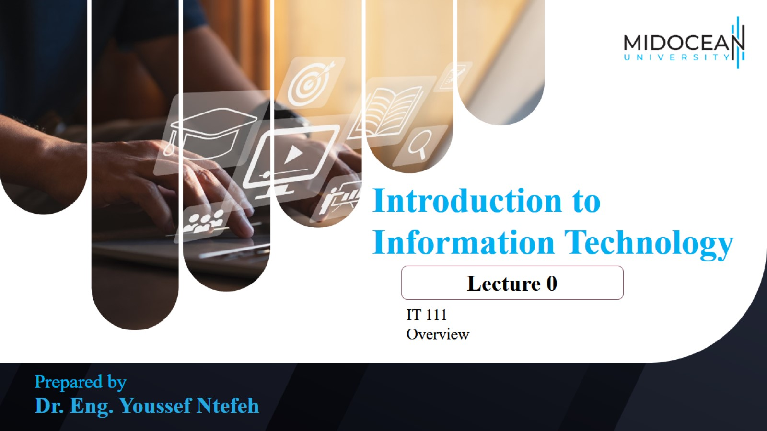

Slide 2
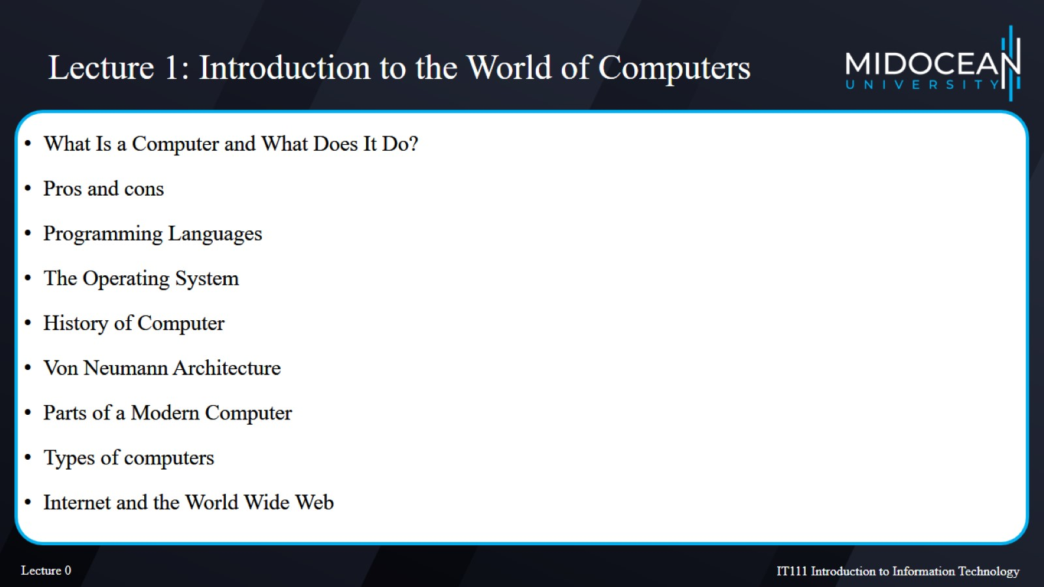
Lecture 1: Introduction to the World of Computers

Slide 3
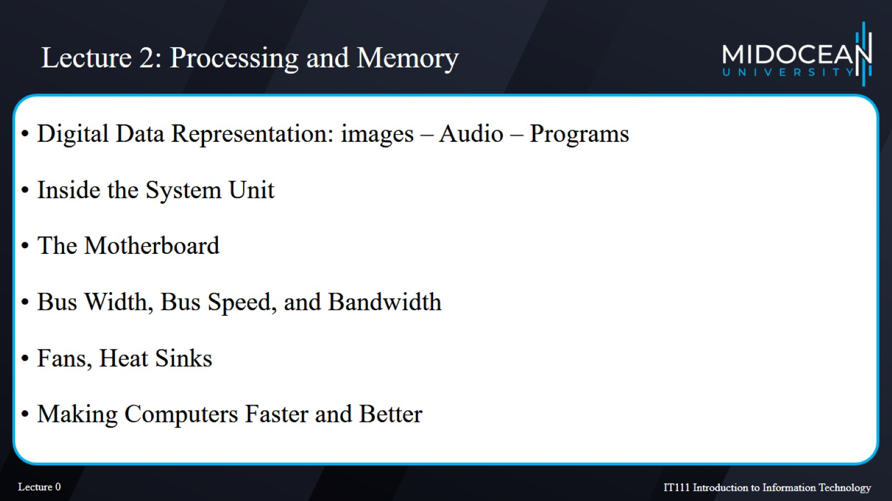
Lecture 2: Processing and Memory

Slide 4
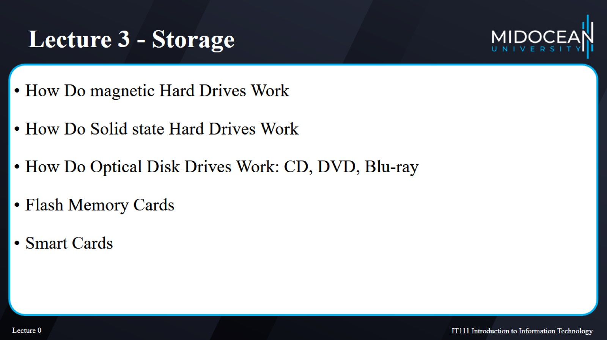
Lecture 3 - Storage

Slide 5
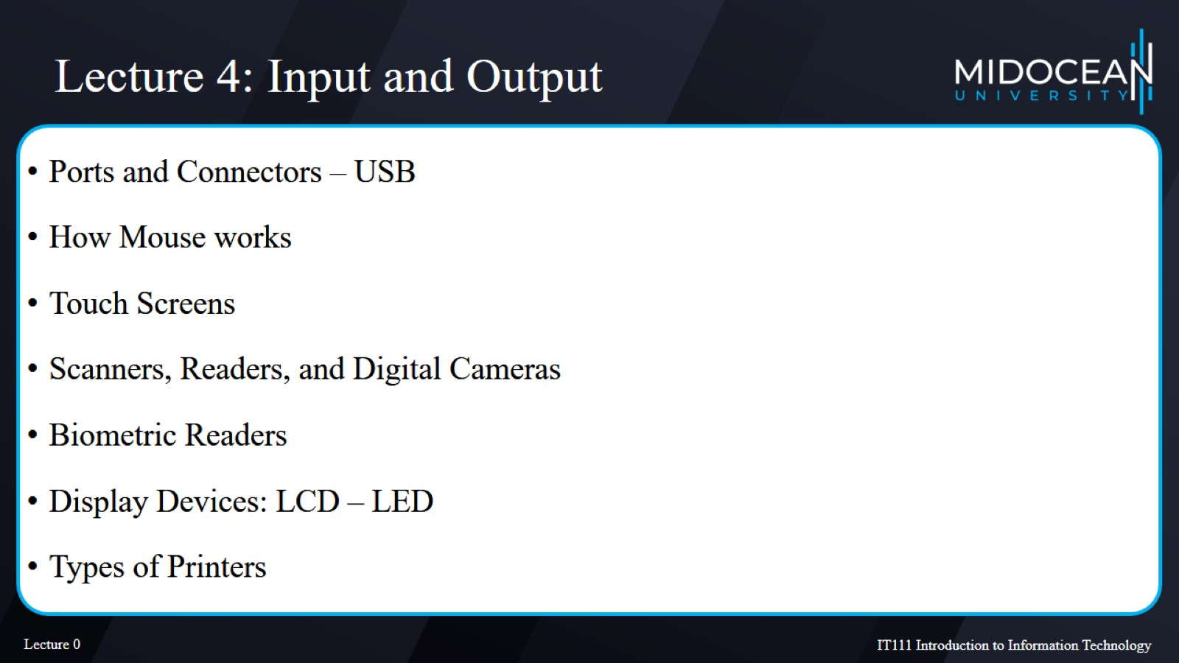
Lecture 4: Input and Output

Slide 6
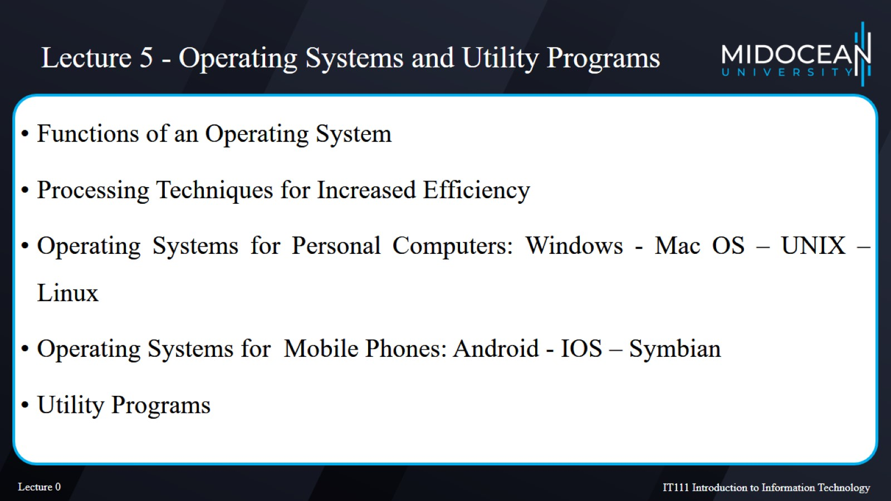
Lecture 5 - Operating Systems and Utility Programs

Slide 7
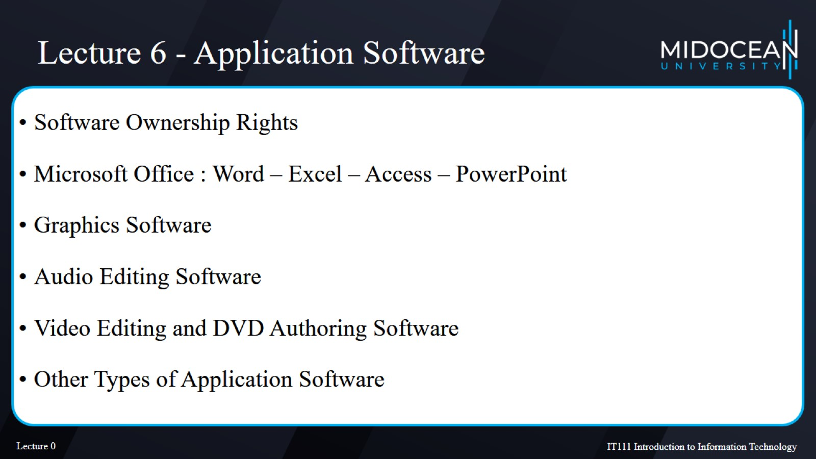
Lecture 6 - Application Software

Slide 8
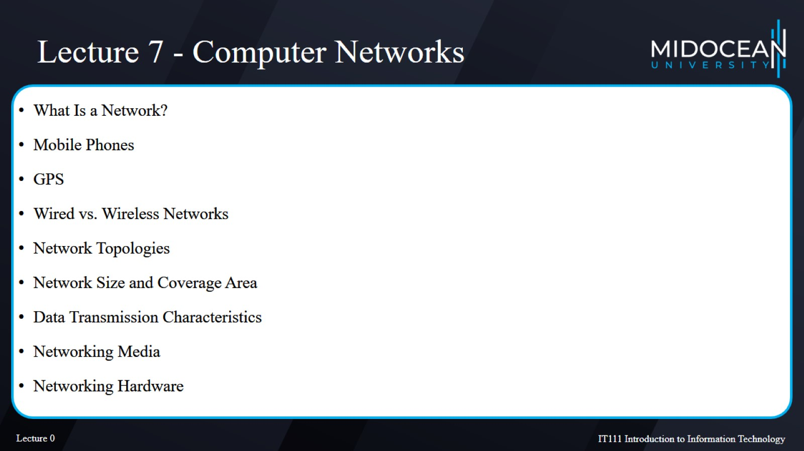
Lecture 7 - Computer Networks

Slide 9
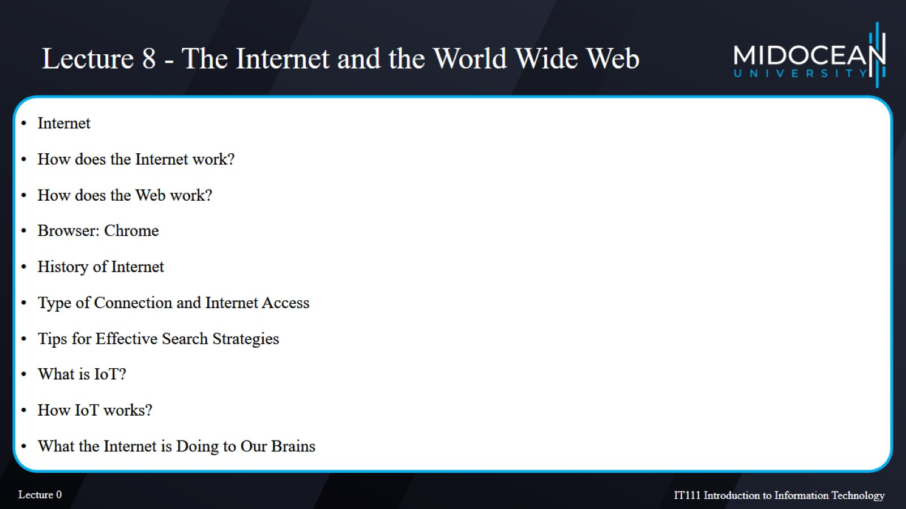
Lecture 8 - The Internet and the World Wide Web

Slide 10
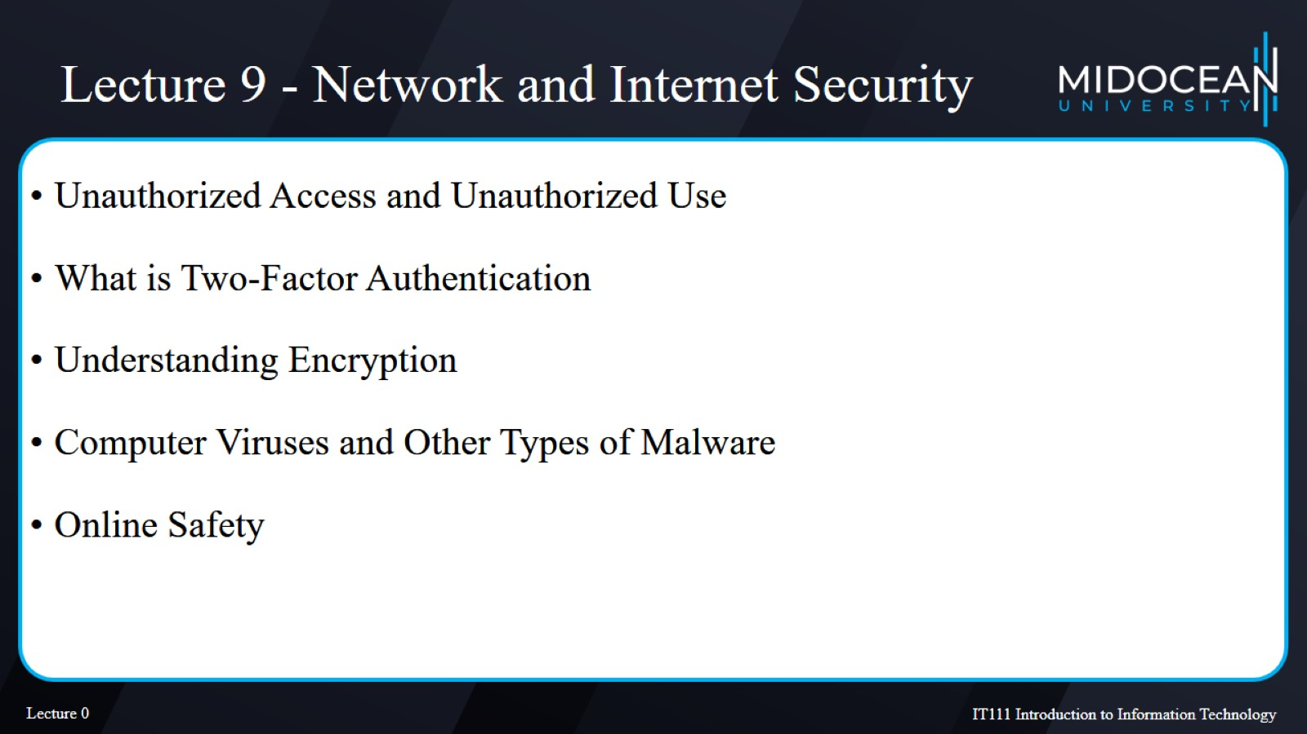
Lecture 9 - Network and Internet Security

Slide 11
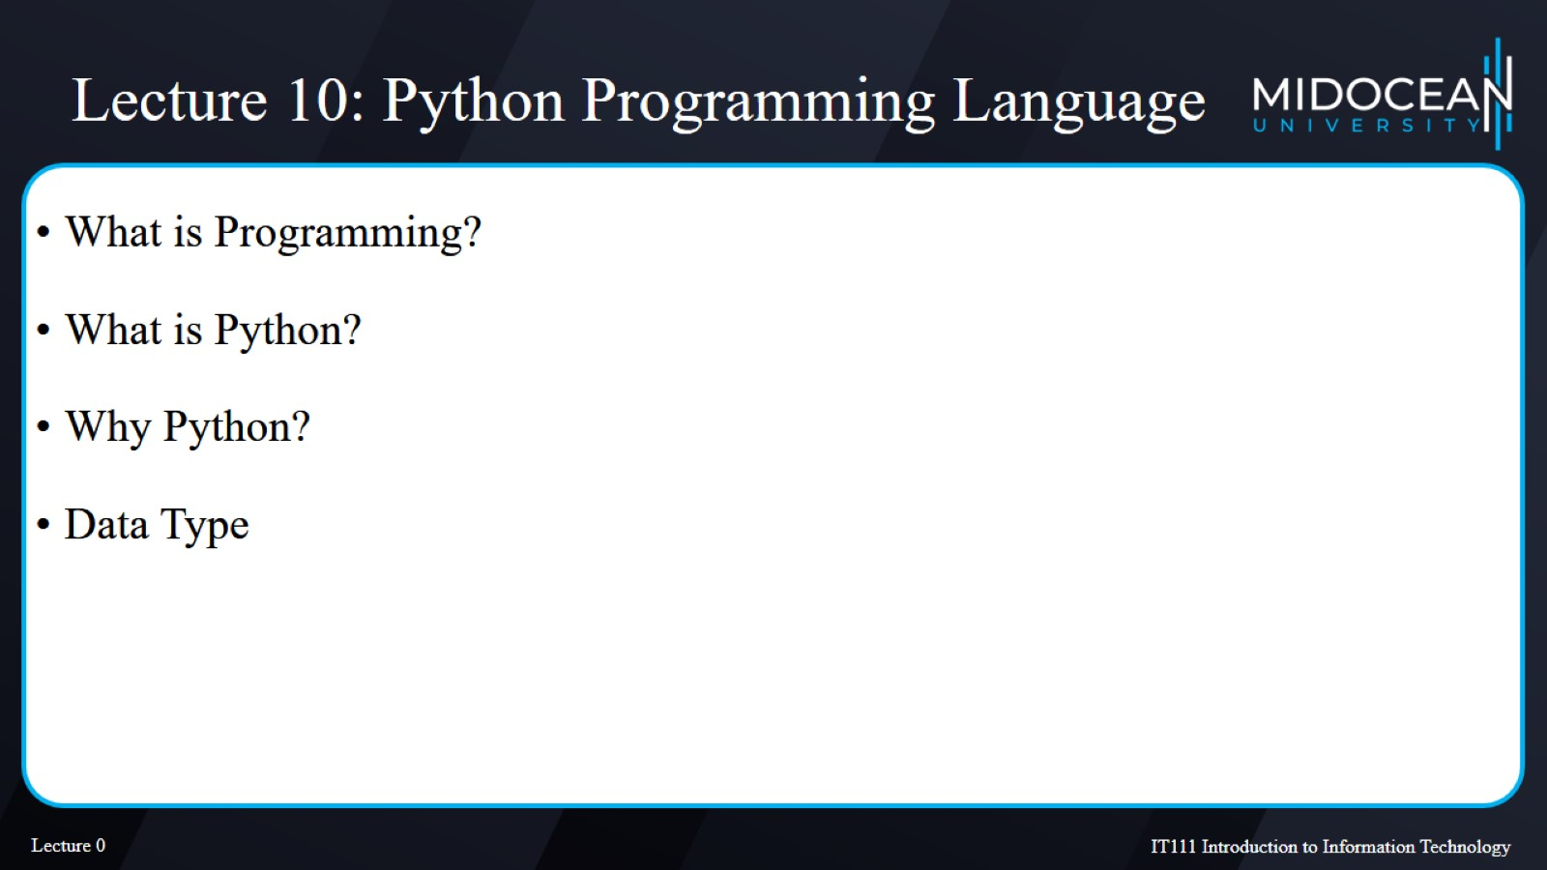
Lecture 10: Python Programming Language​

Slide 12


Slide 13
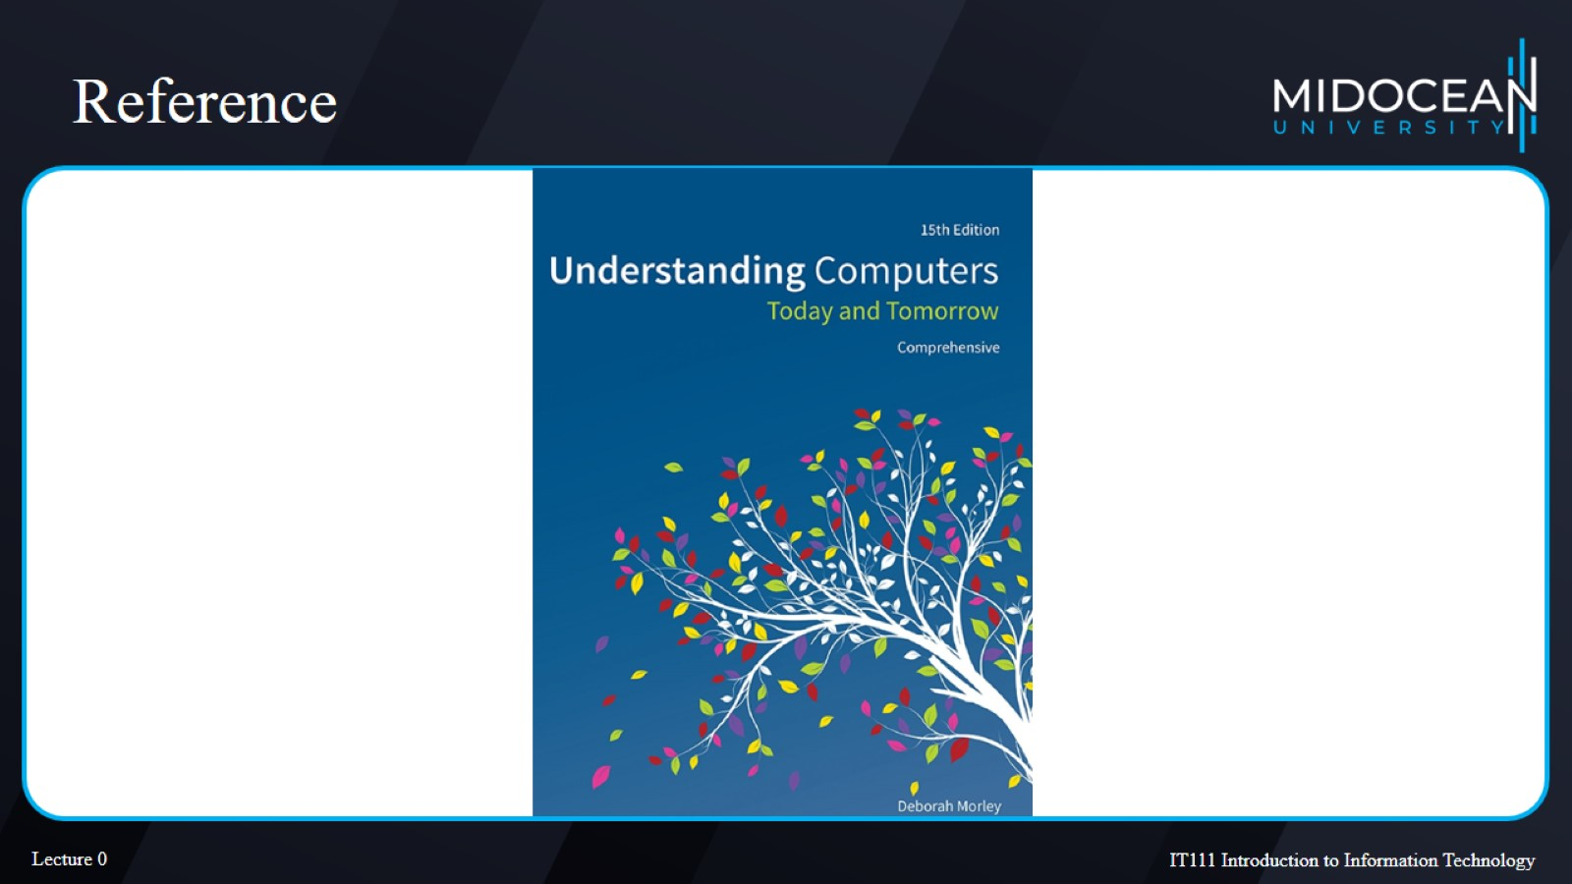
Reference

