Slide 1



PROJECT MONITORING
PMG333
Lecture 03
COST& TIME MONITORING 1
Prepared by
Dr. Bassel alhassan

Slide 2
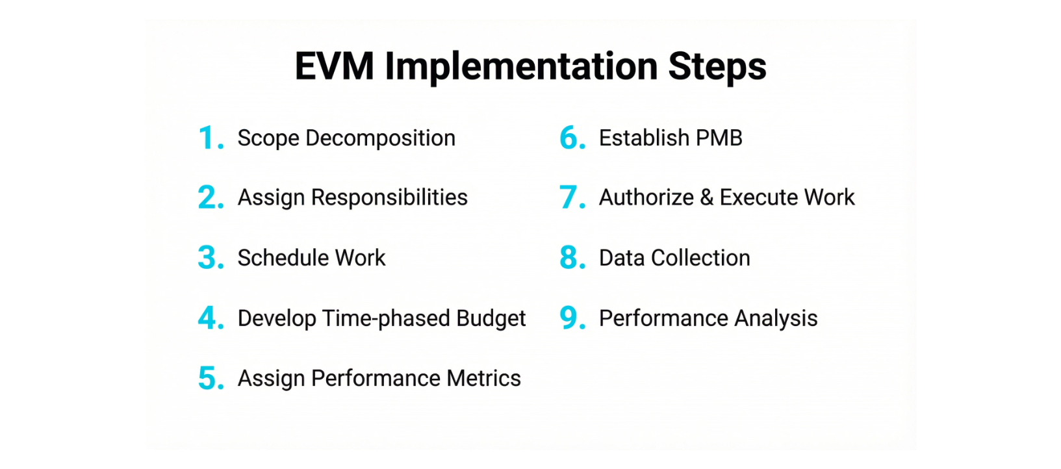
Lecture
03
Lecture Contents
1 - 2

Slide 3

Lecture
03
1 - 3

Slide 4
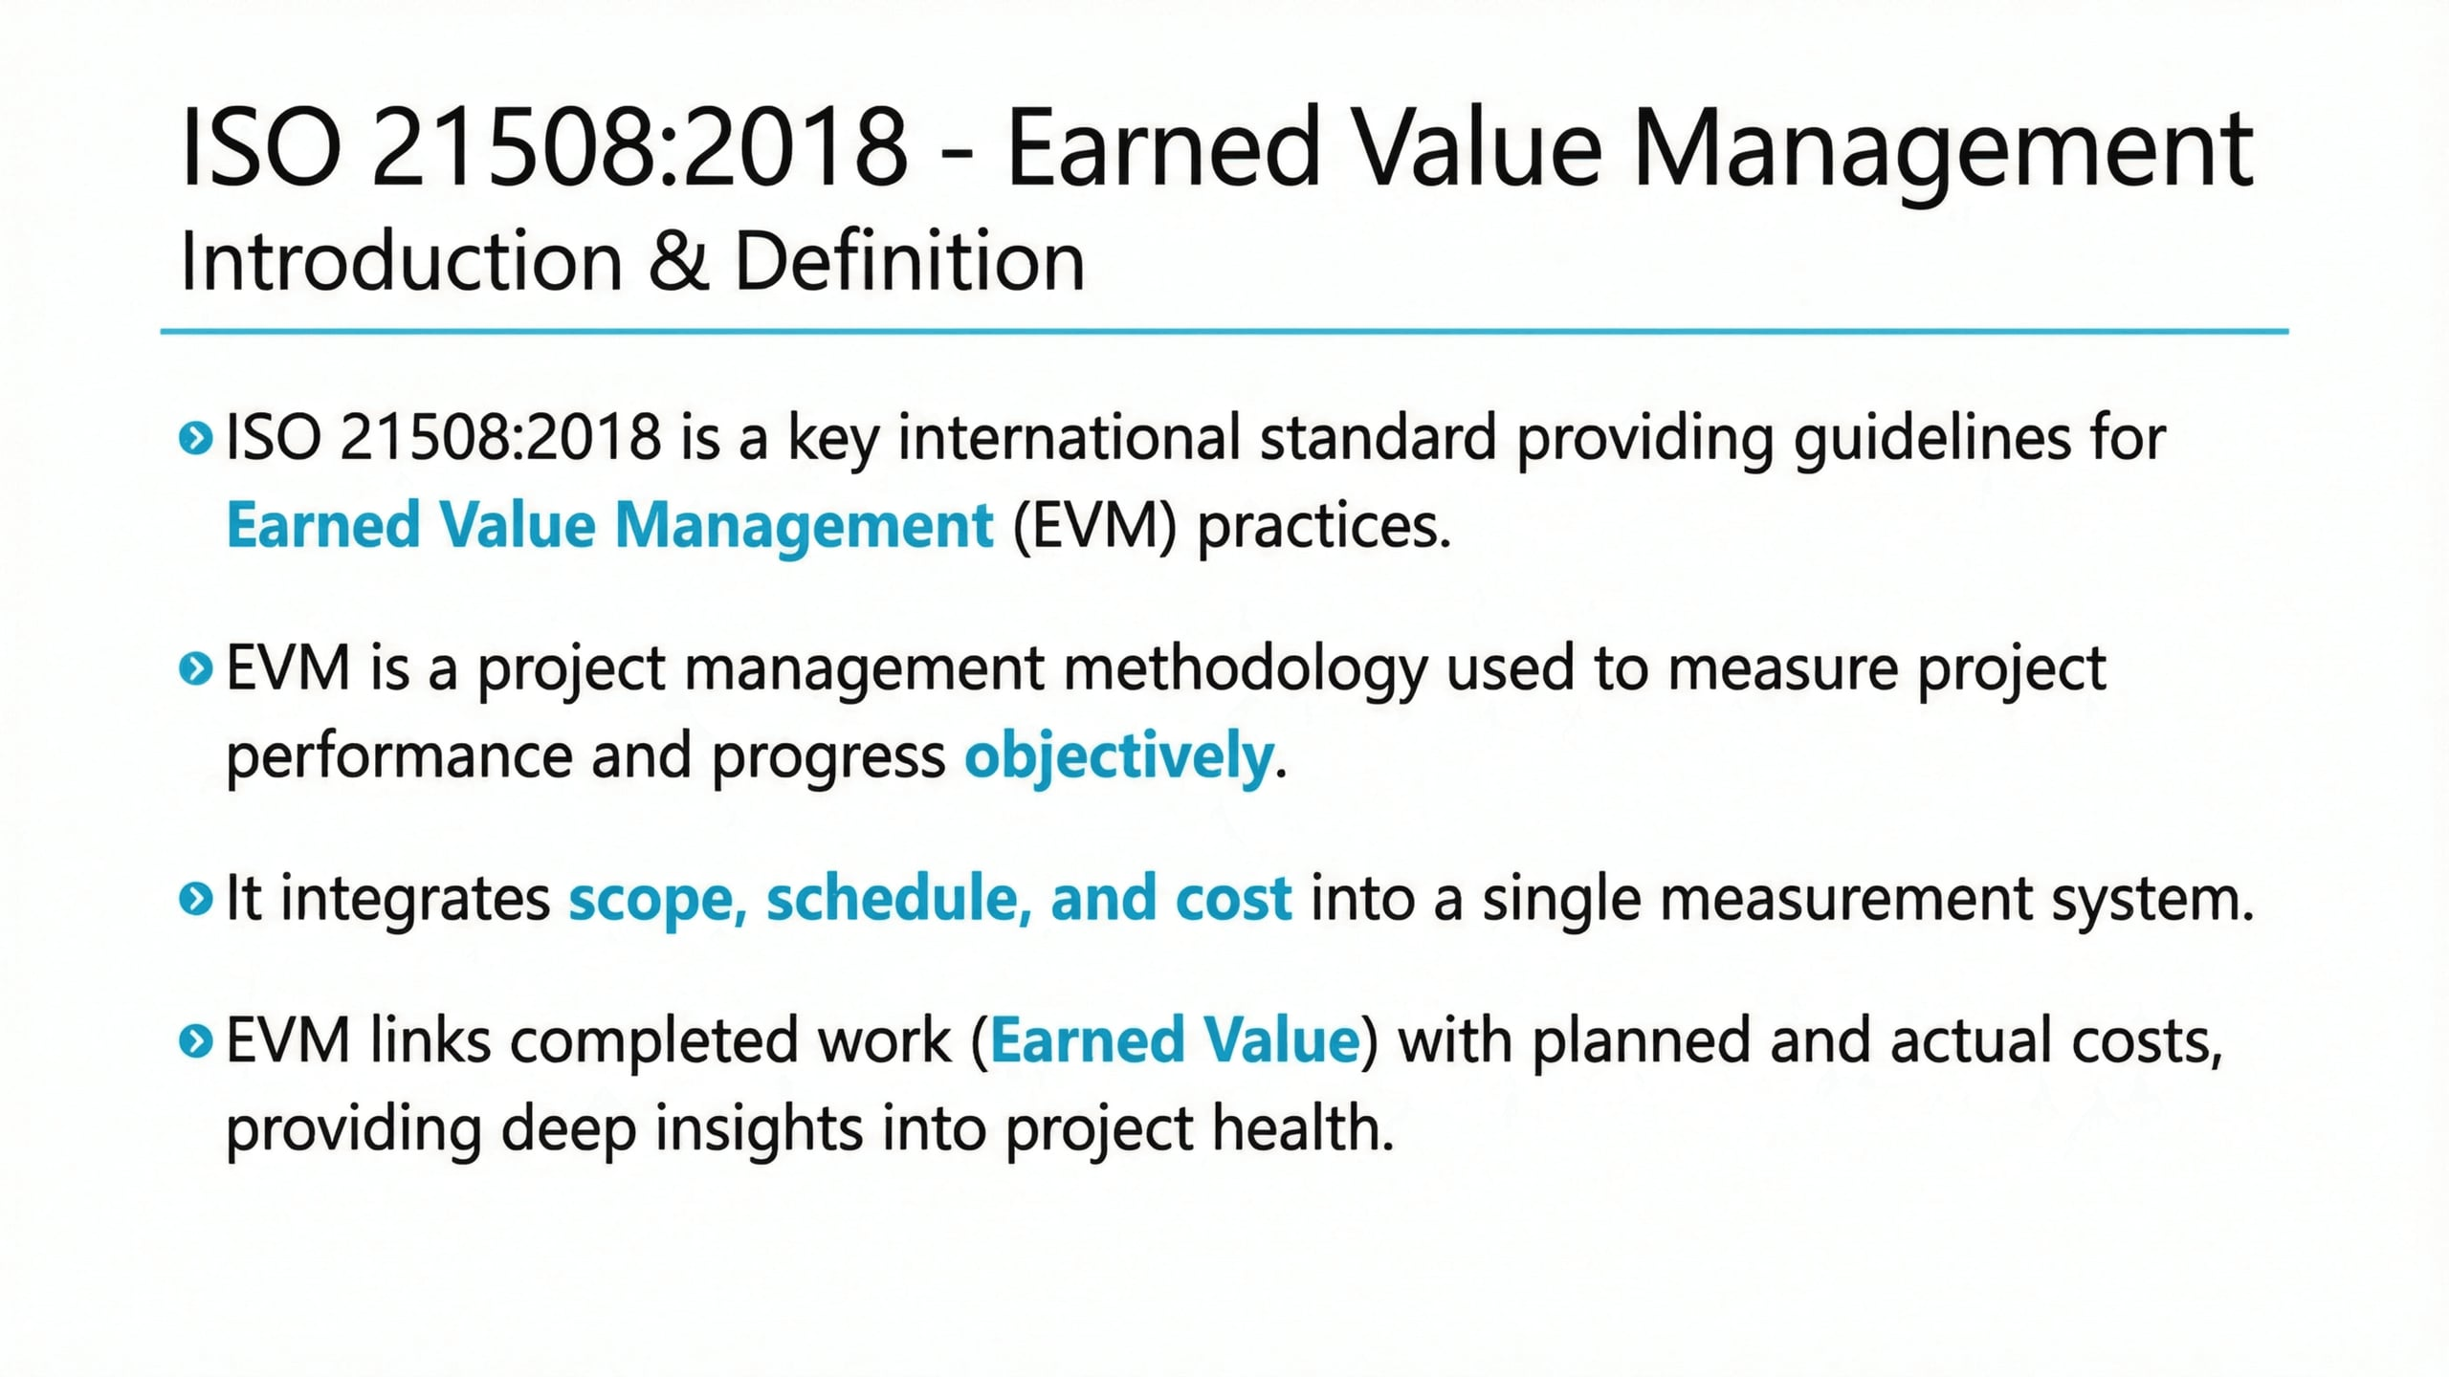
Lecture
03
ISO 21508:2018
1 - 4

Slide 5
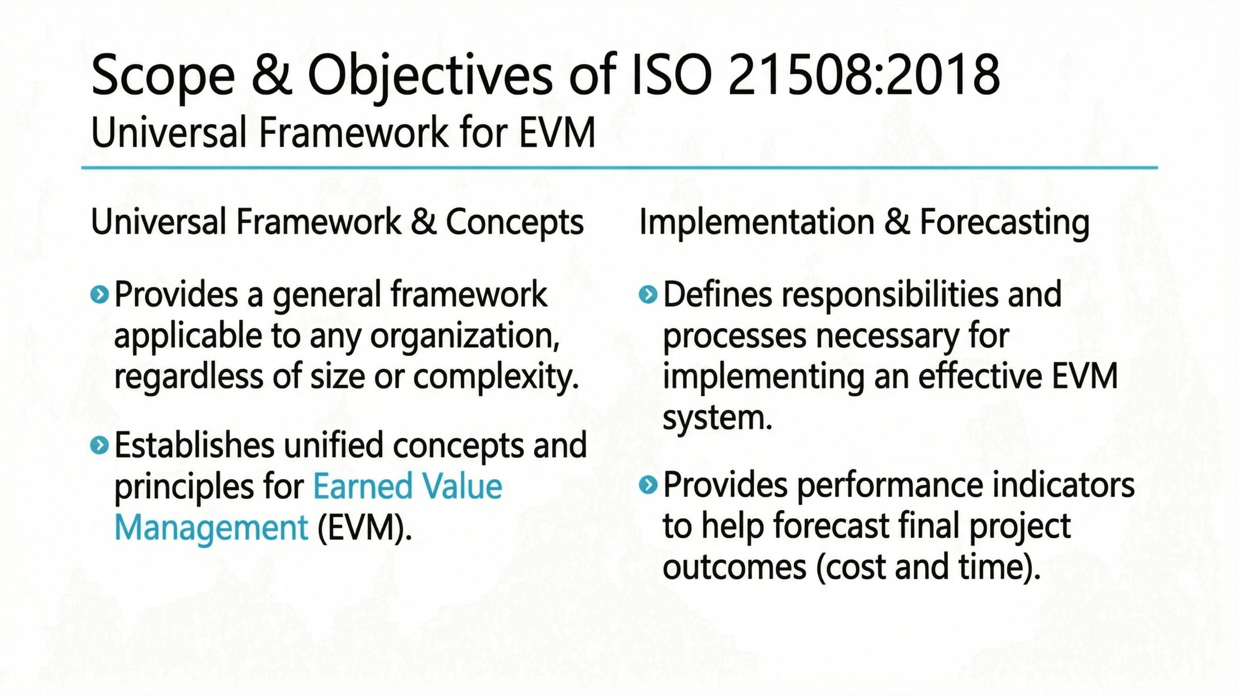
Lecture
03
Scope & Objective of ISO 21508:2018
1 - 5

Slide 6
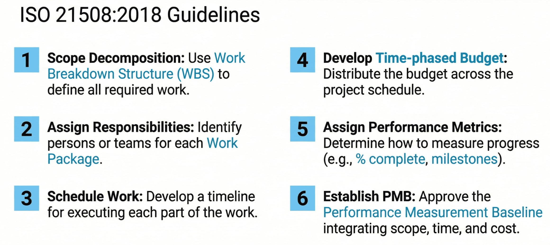
Lecture
03
EVM Implementation Steps
1 - 6

Slide 7
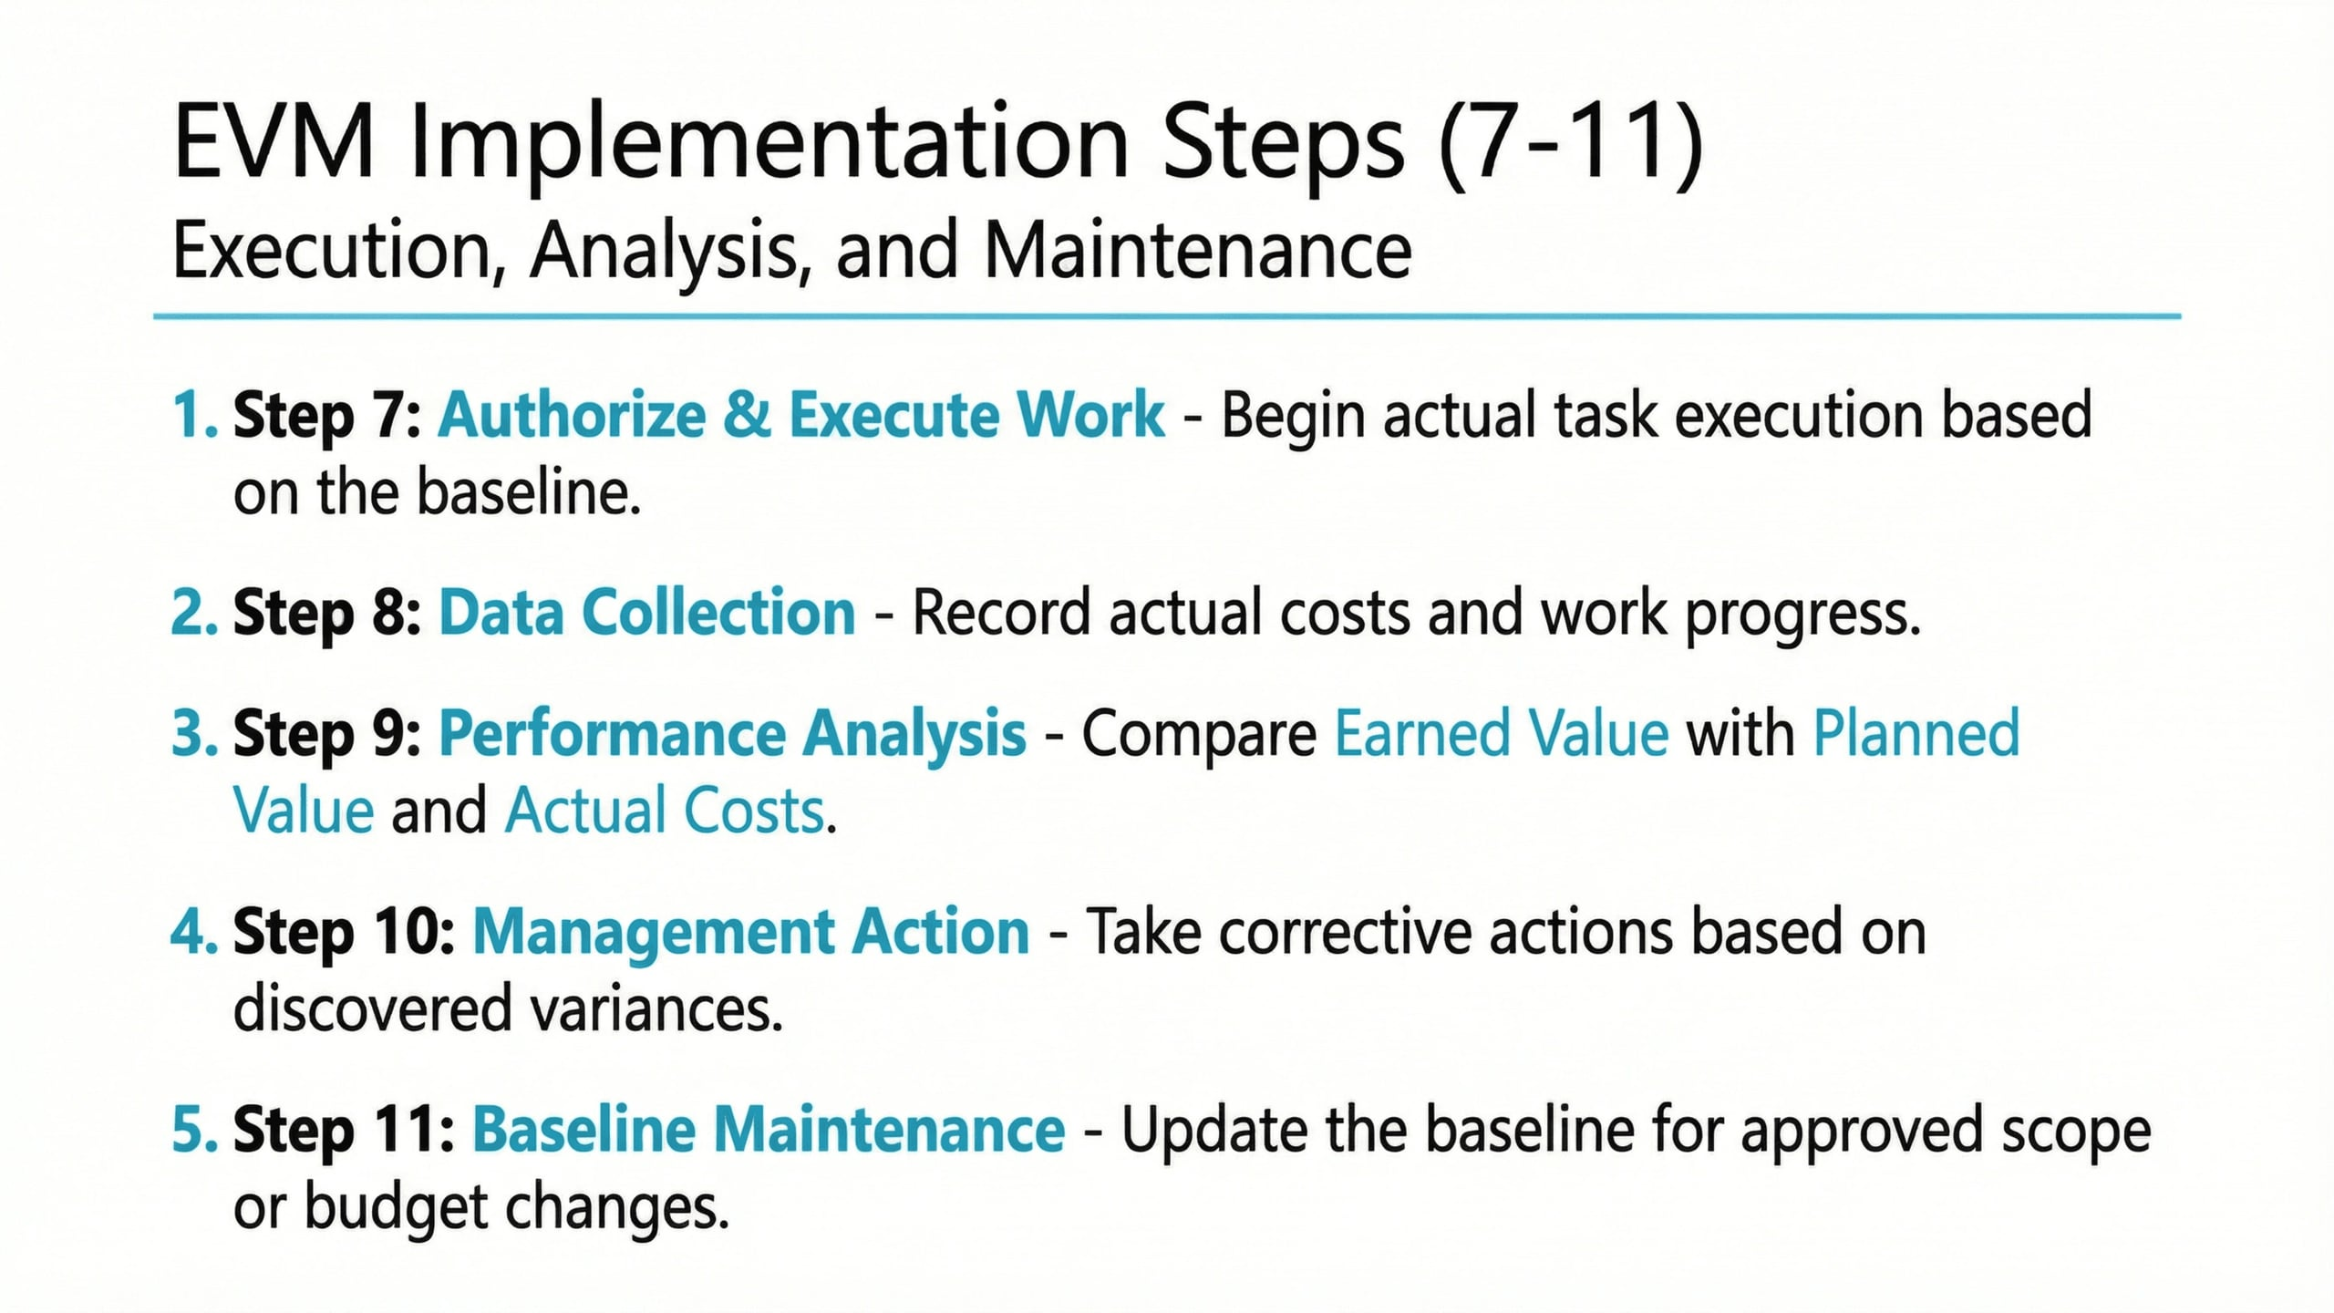
Lecture
03
EVM Implementation Steps
1 - 7

Slide 8
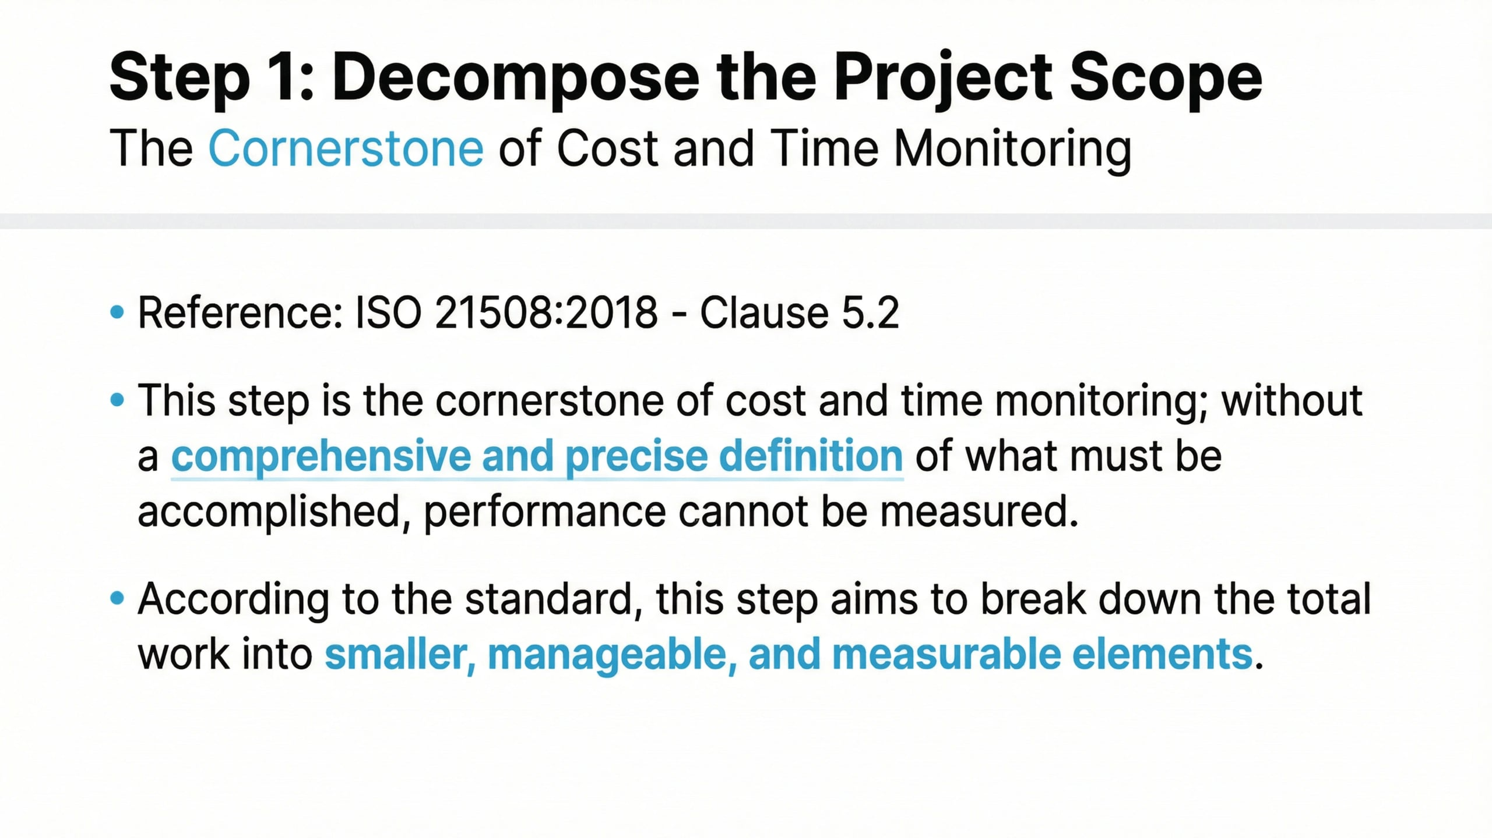
Lecture
03
Step 1: Decompose the Project Scope
1 - 8

Slide 9
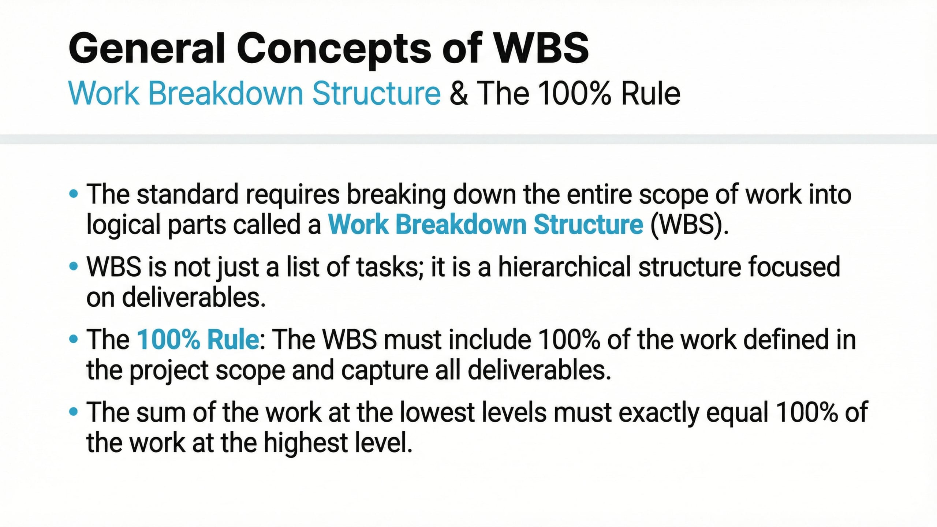
Lecture
03
General Concepts of WBS
1 - 9

Slide 10
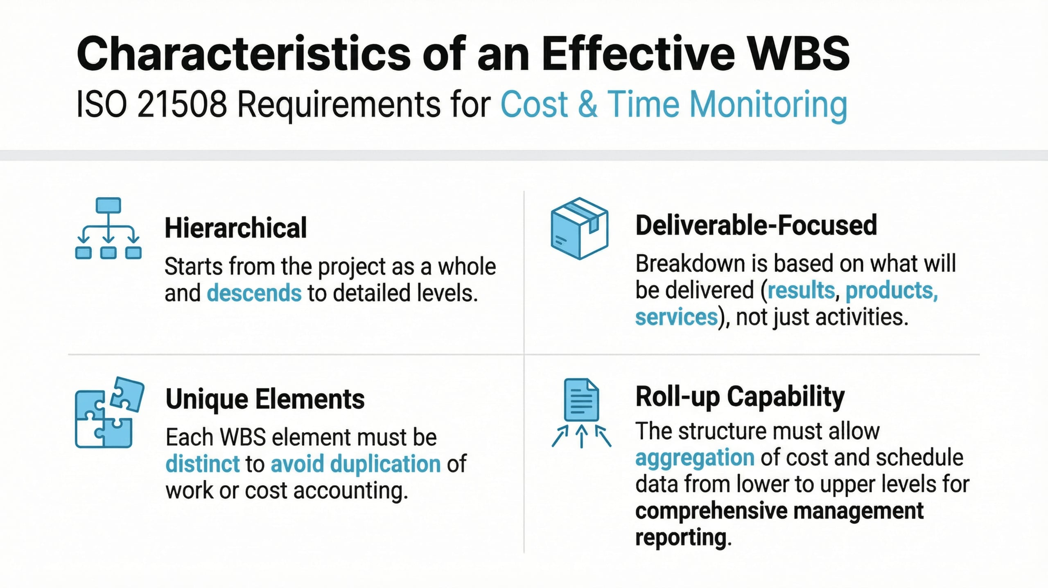
Lecture
03
Characteristics of an Effective WBS
1 - 10

Slide 11
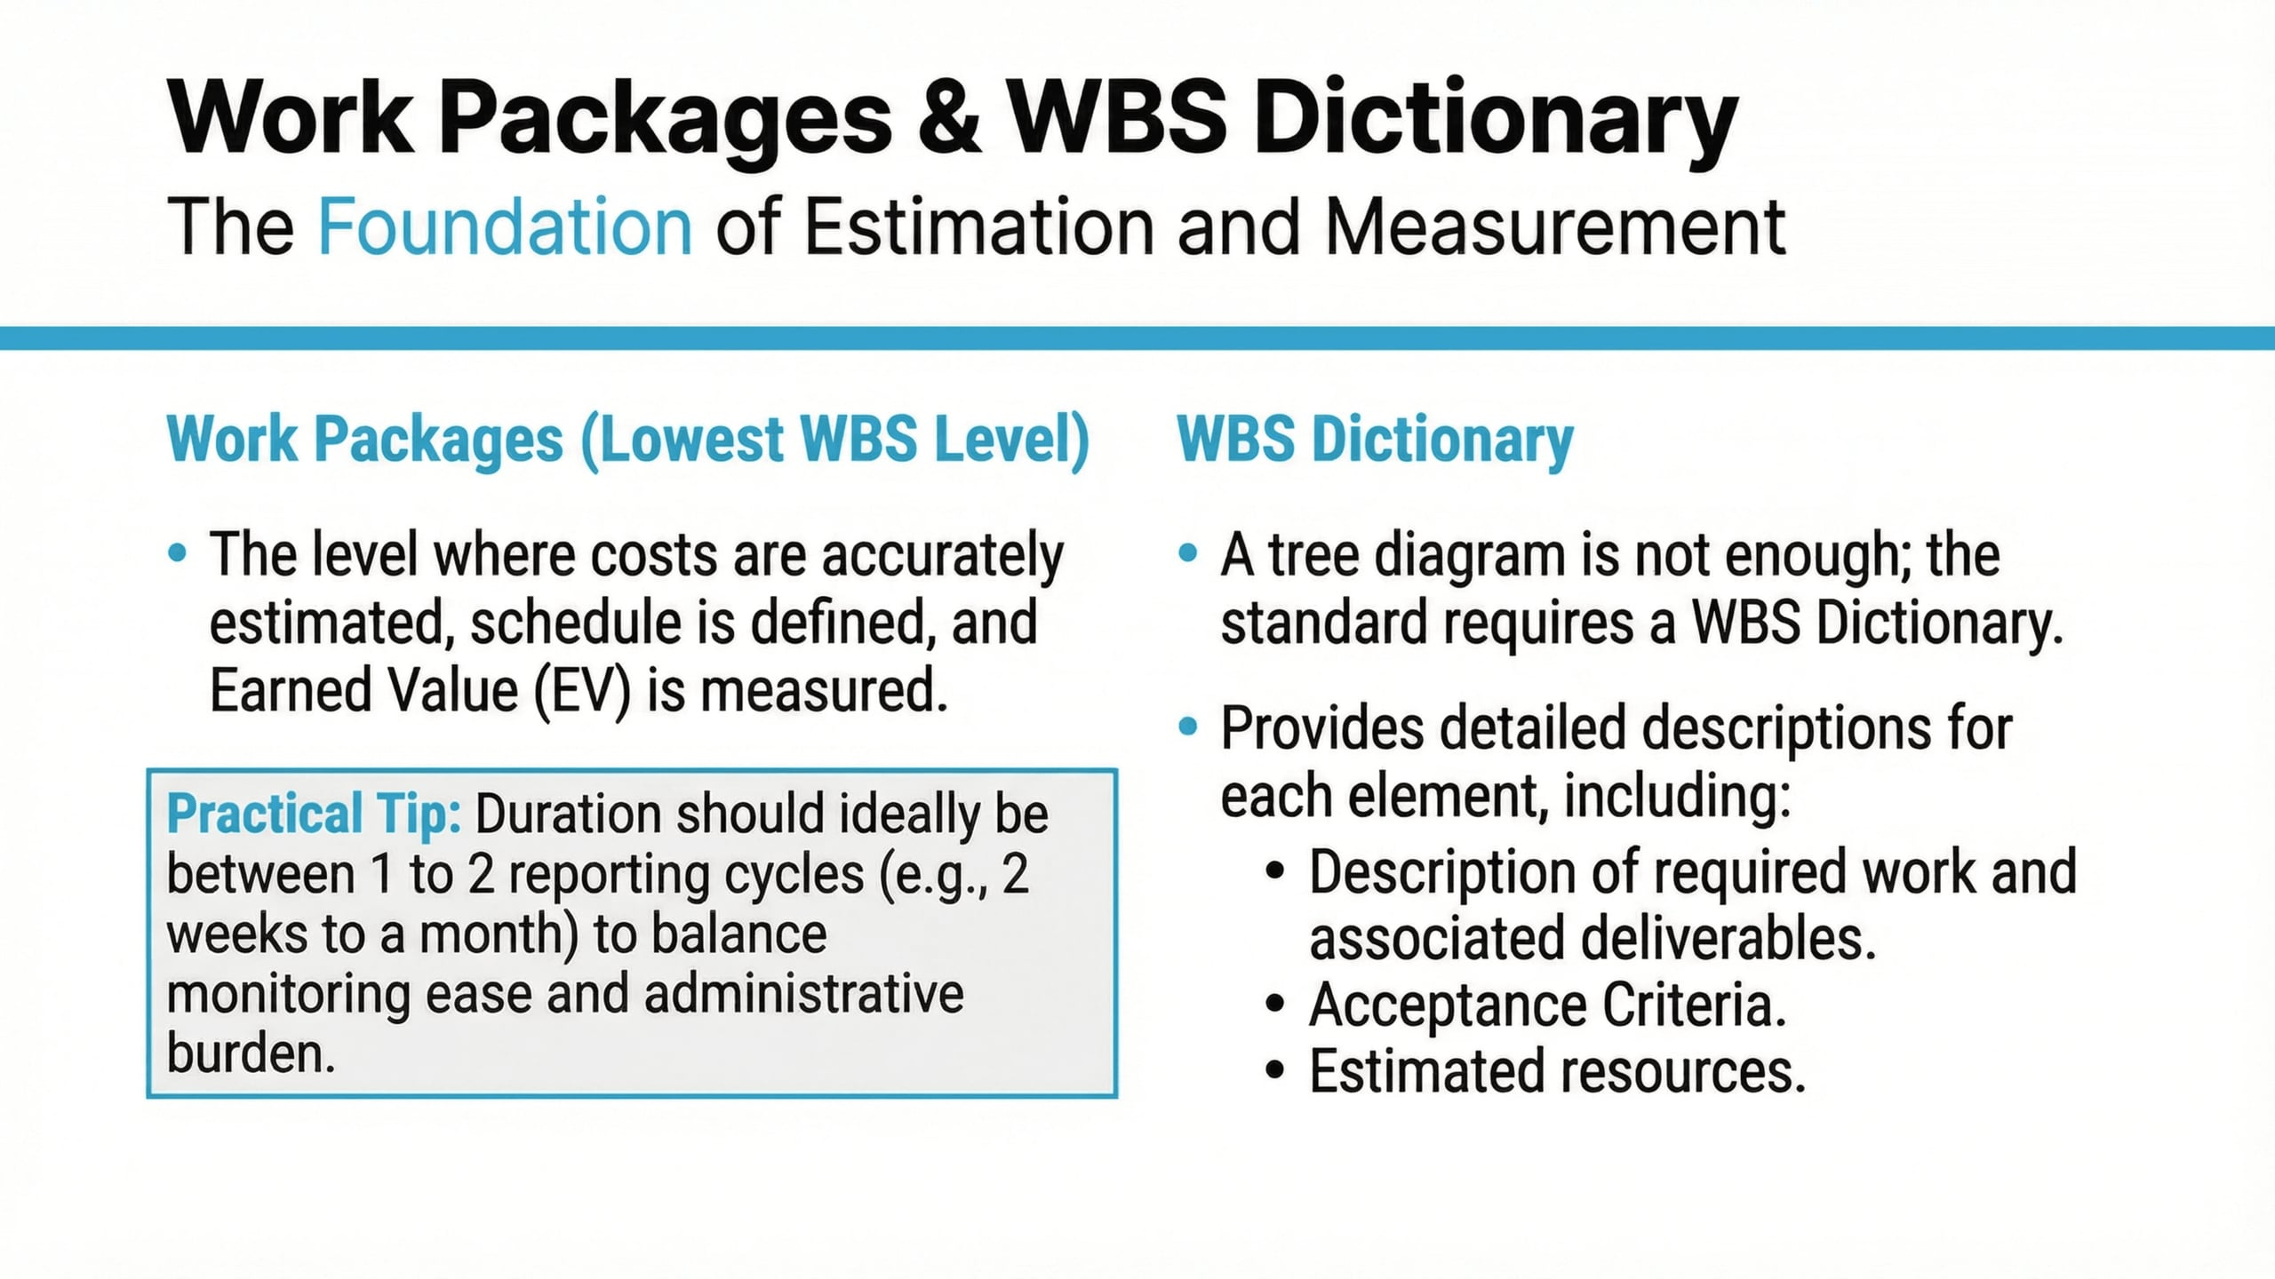
Lecture
03
Work Packages & WBS Dictionary
1 - 11

Slide 12
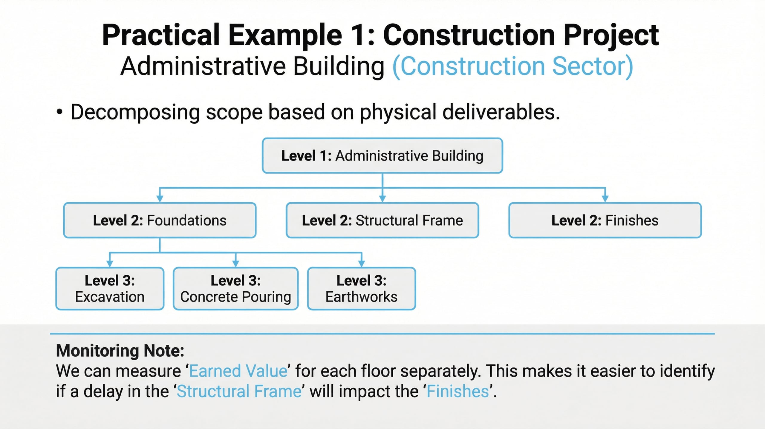
Lecture
03
Practical Example 1
1 - 12

Slide 13
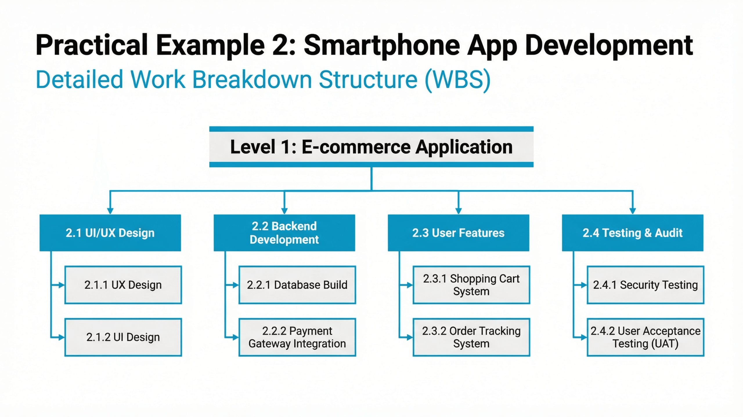
Lecture
03
Practical Example 2: Smartphone App Development
1 - 13

Slide 14
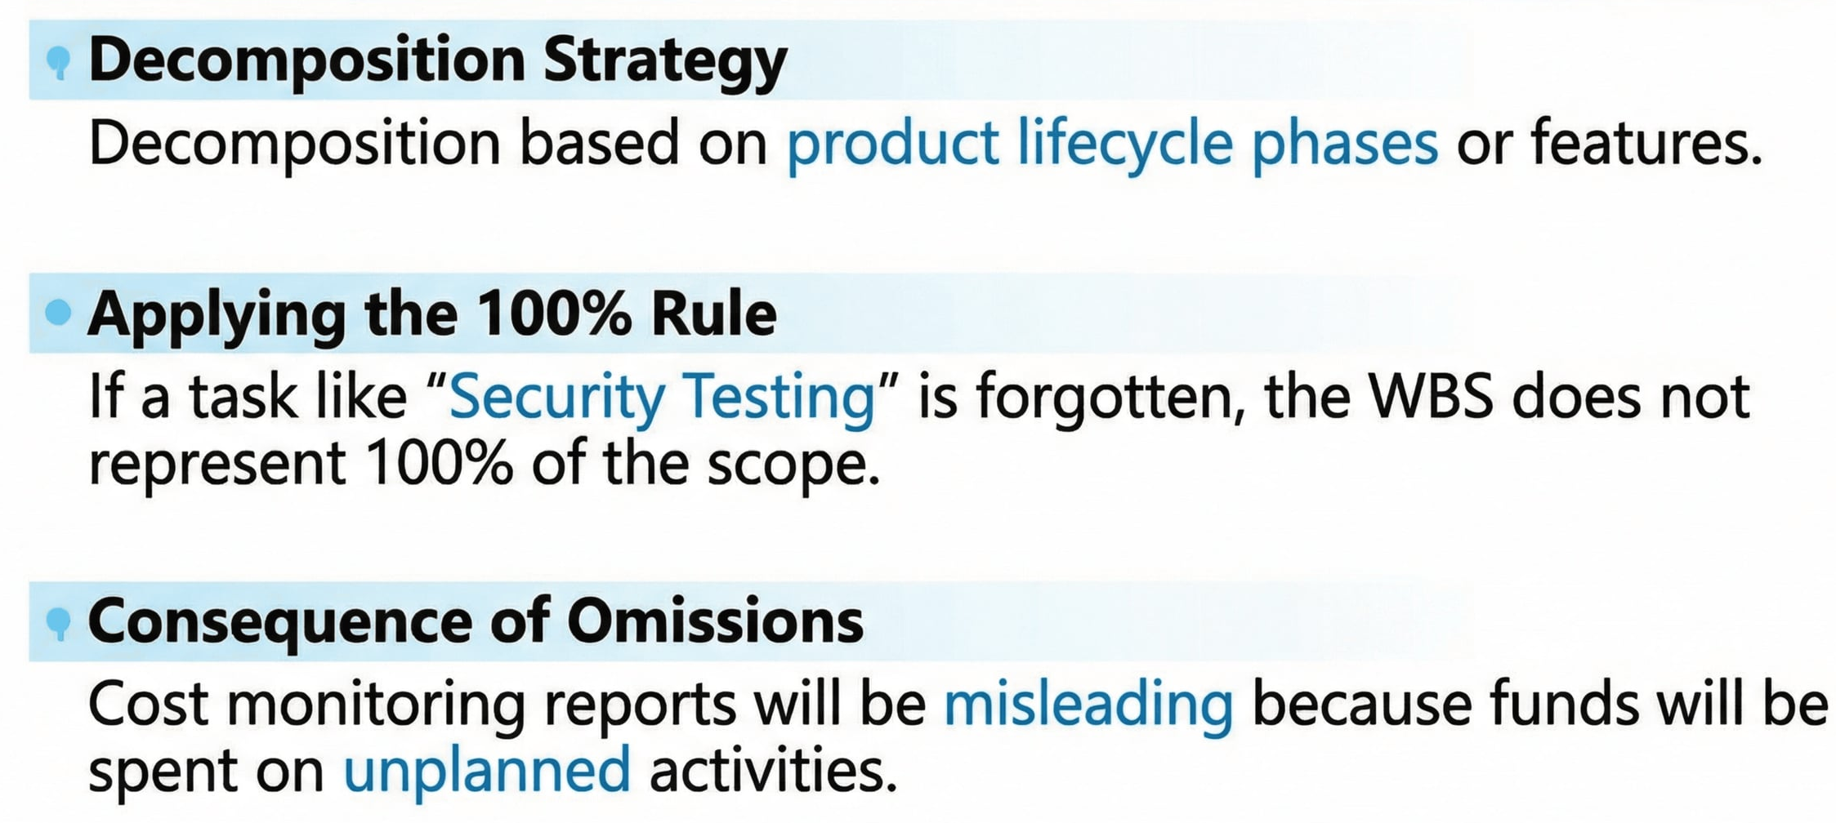
Lecture
03
Takeaways
1 - 14

Slide 15
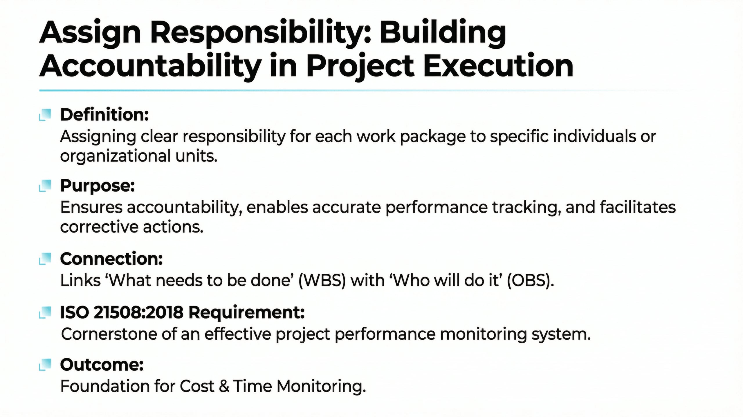
Lecture
03
Step2: Assign Responsibility
1 - 15

Slide 16
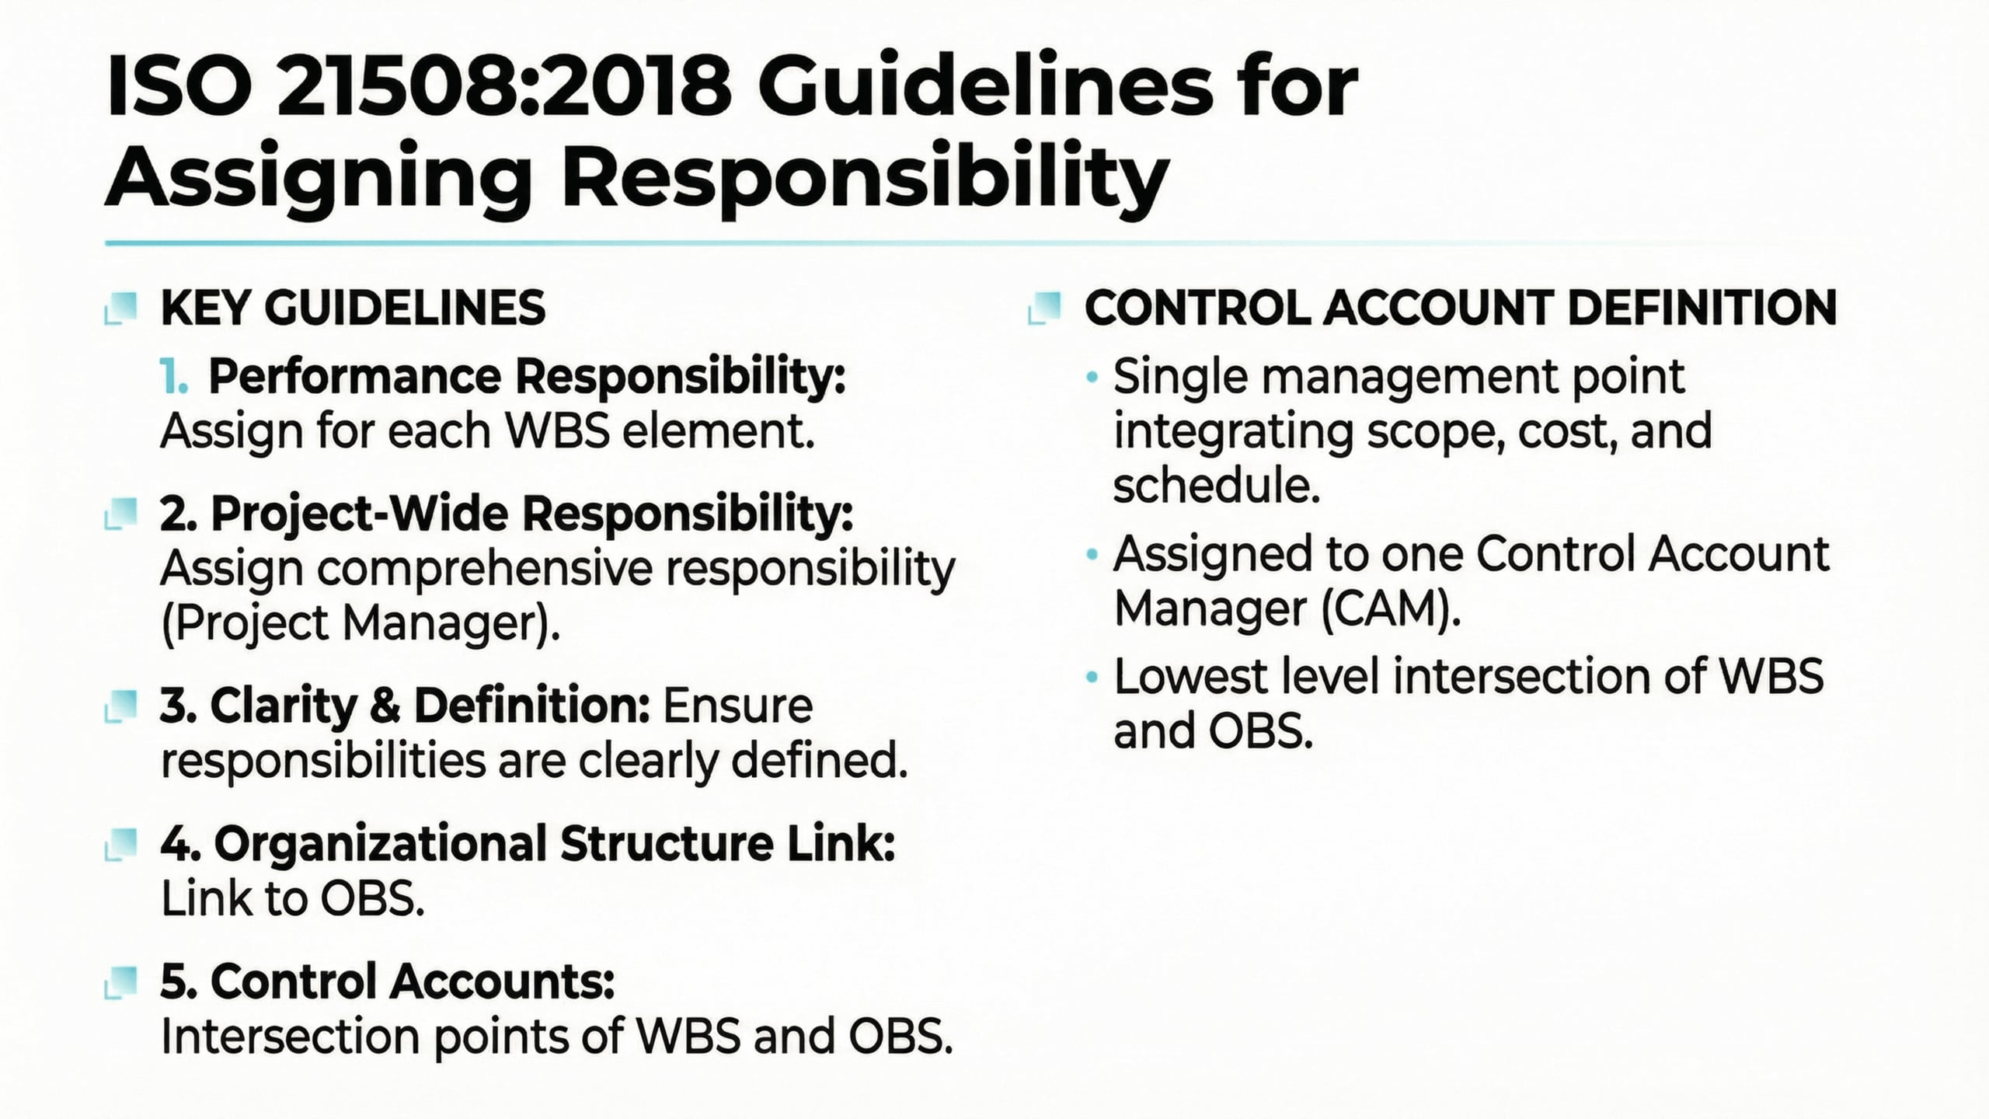
Lecture
03
Guidelines for Assigning Responsibility
1 - 16

Slide 17
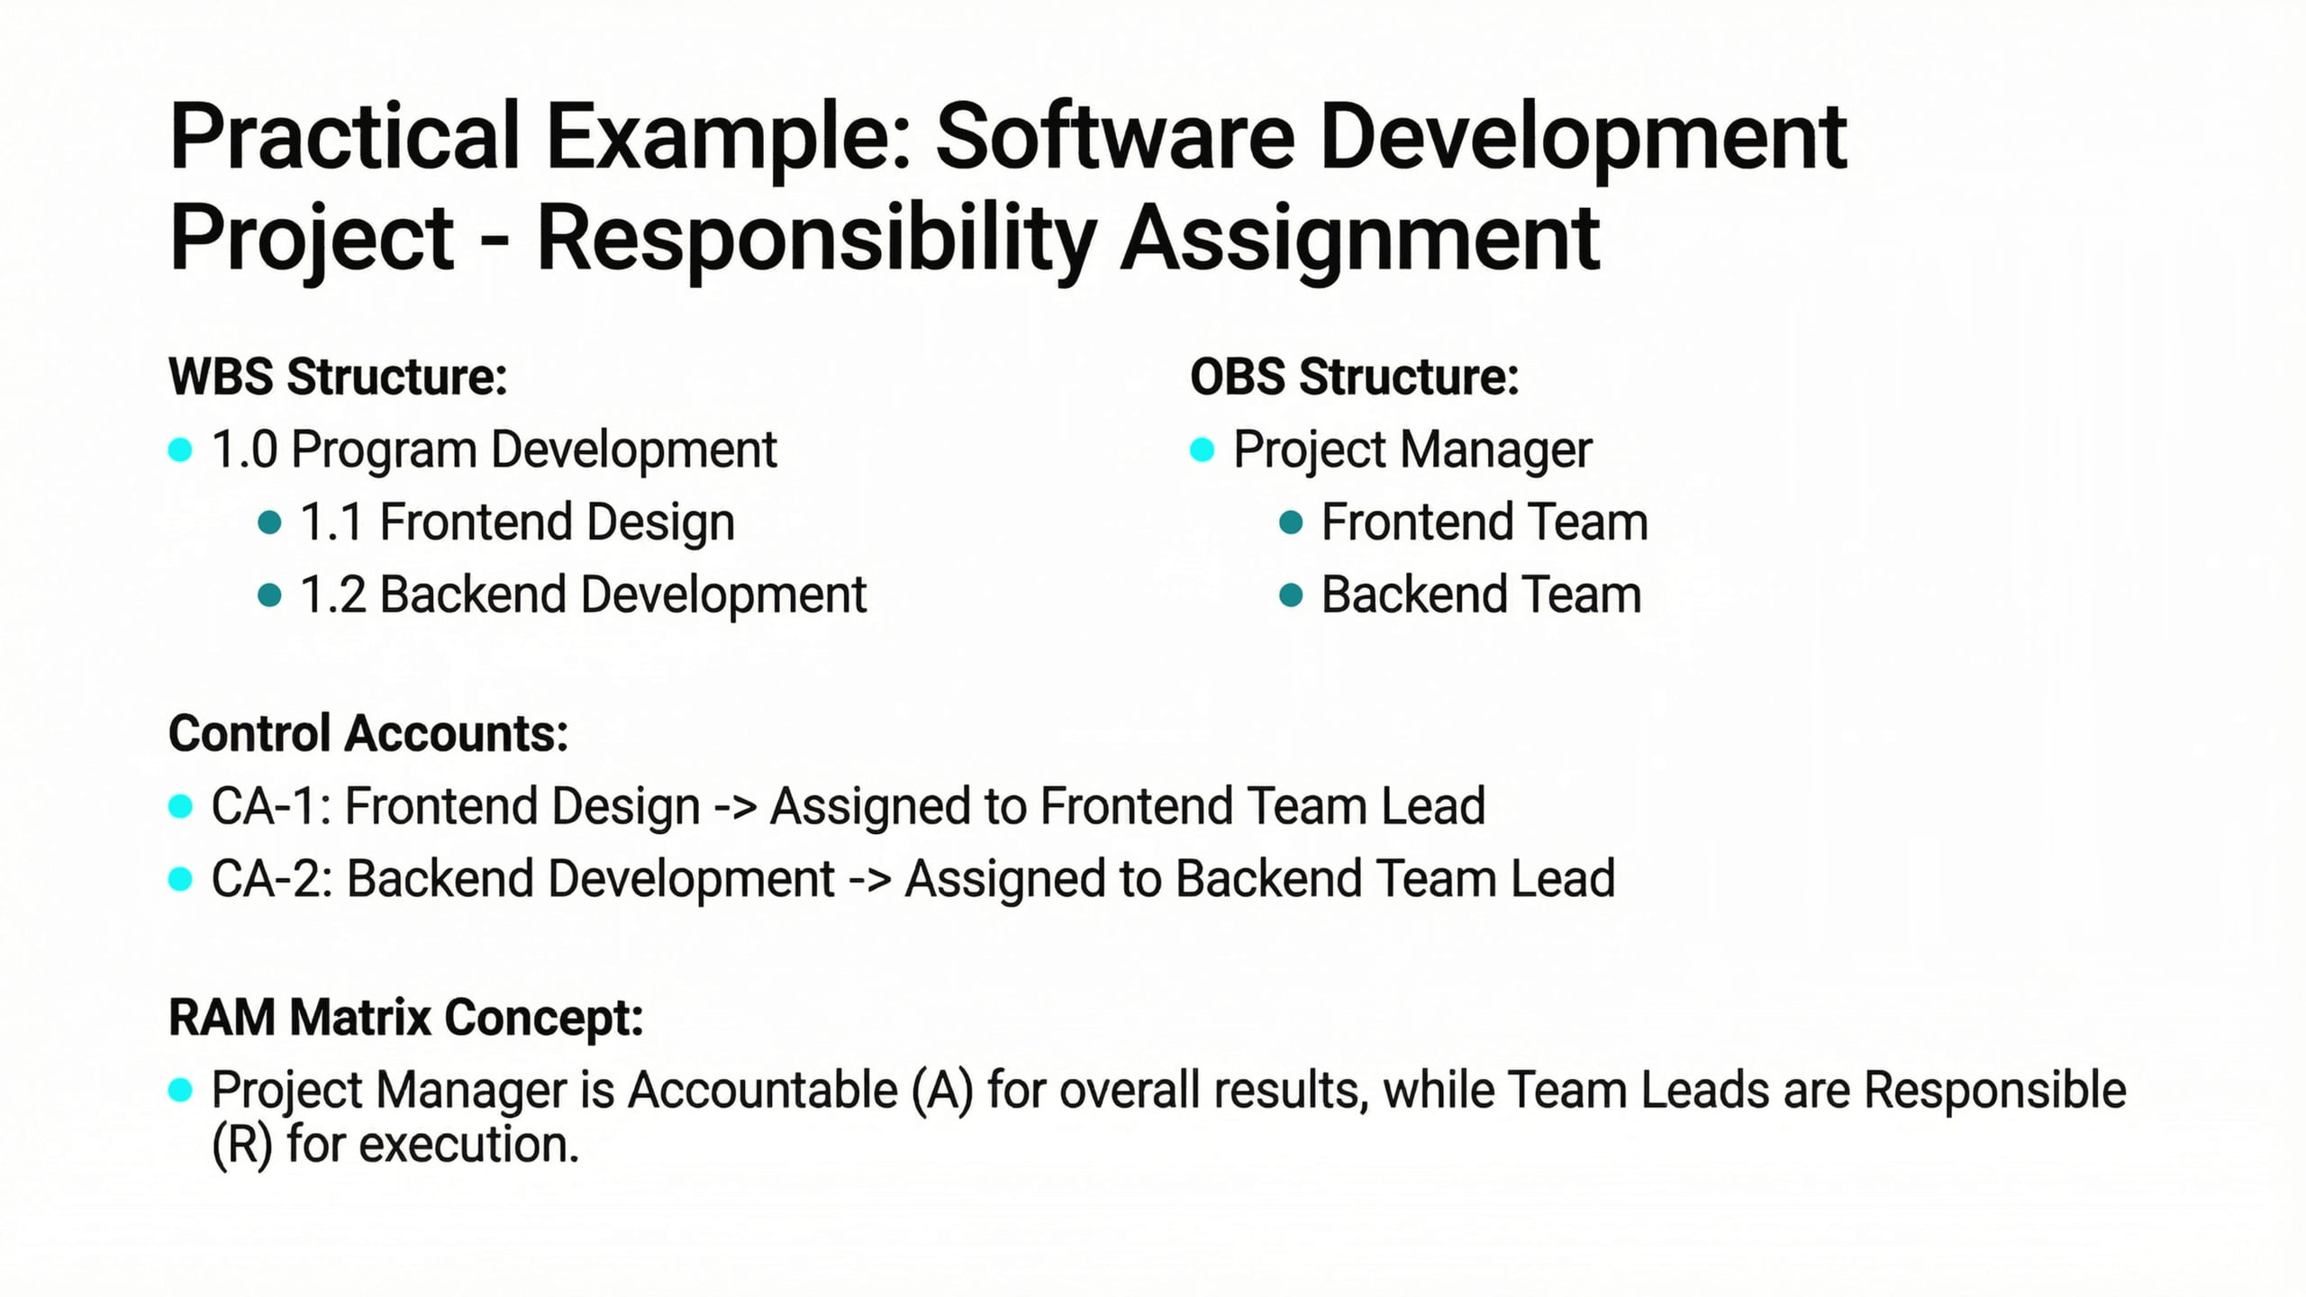
Lecture
03
Practical Example: Software Development
1 - 17

Slide 18
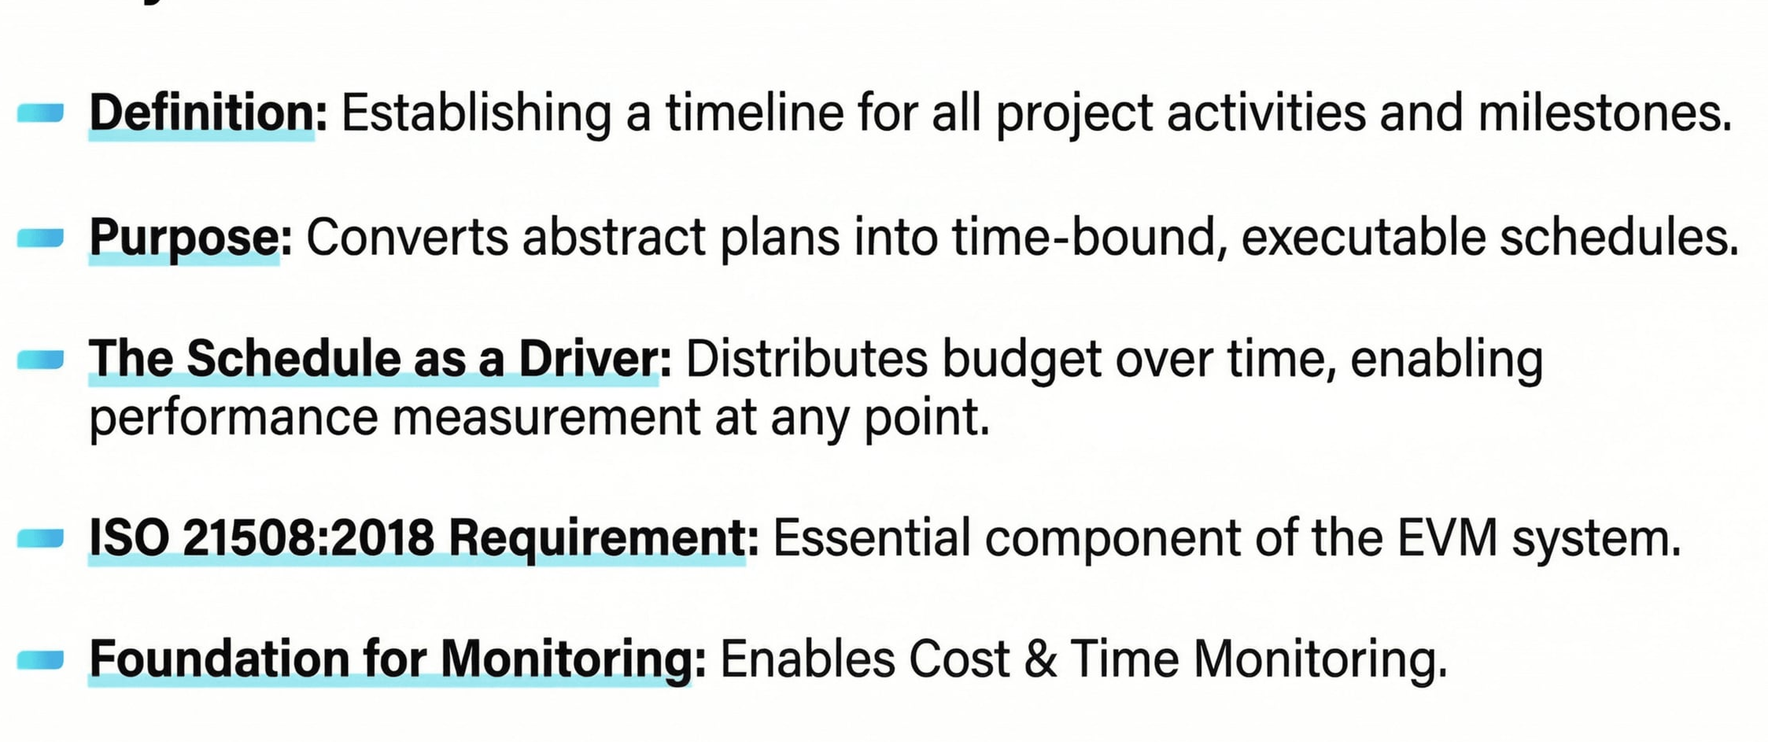
Lecture
03
Step 3: Schedule Work
1 - 18

Slide 19
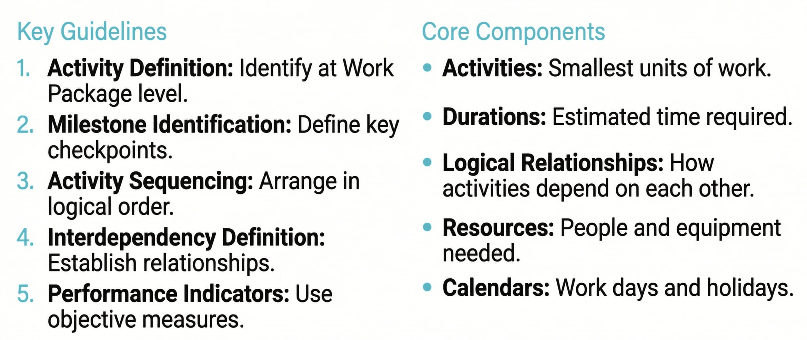
Lecture
03
Guidelines for Developing Project Schedules
1 - 19

Slide 20
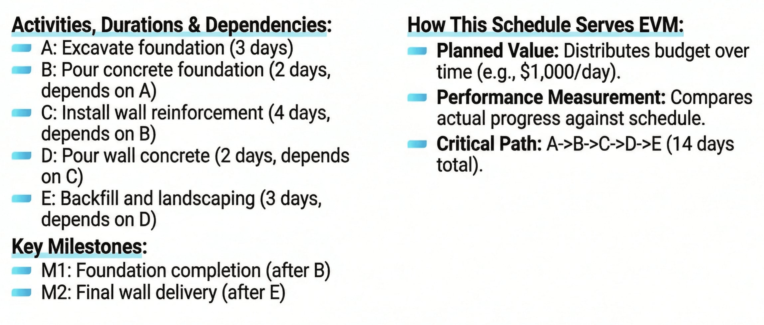
Lecture
03
Practical Example: Retaining Wall Construction
1 - 20

Slide 21
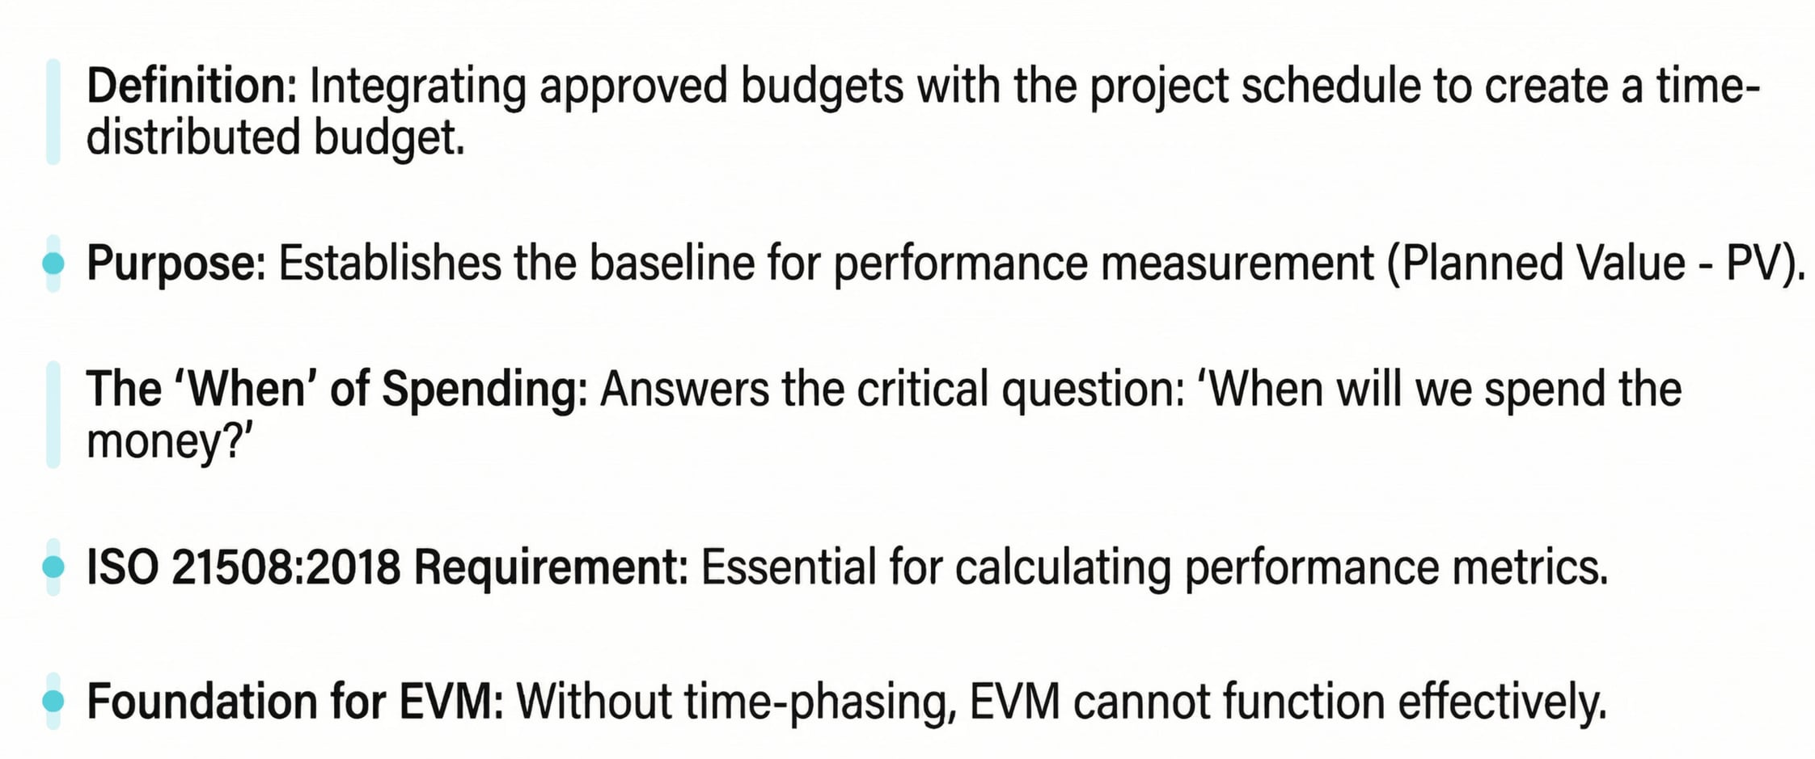
Lecture
Step 4: Develop Time- Phased Budget
03
1 - 21

Slide 22
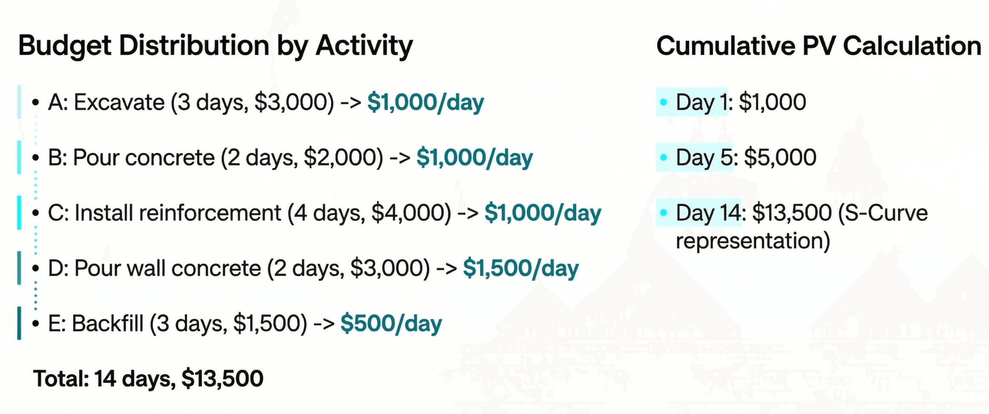
Lecture
03
Practical Example: Time- Phased Budget for Retaining Wall
1 - 22

Slide 23
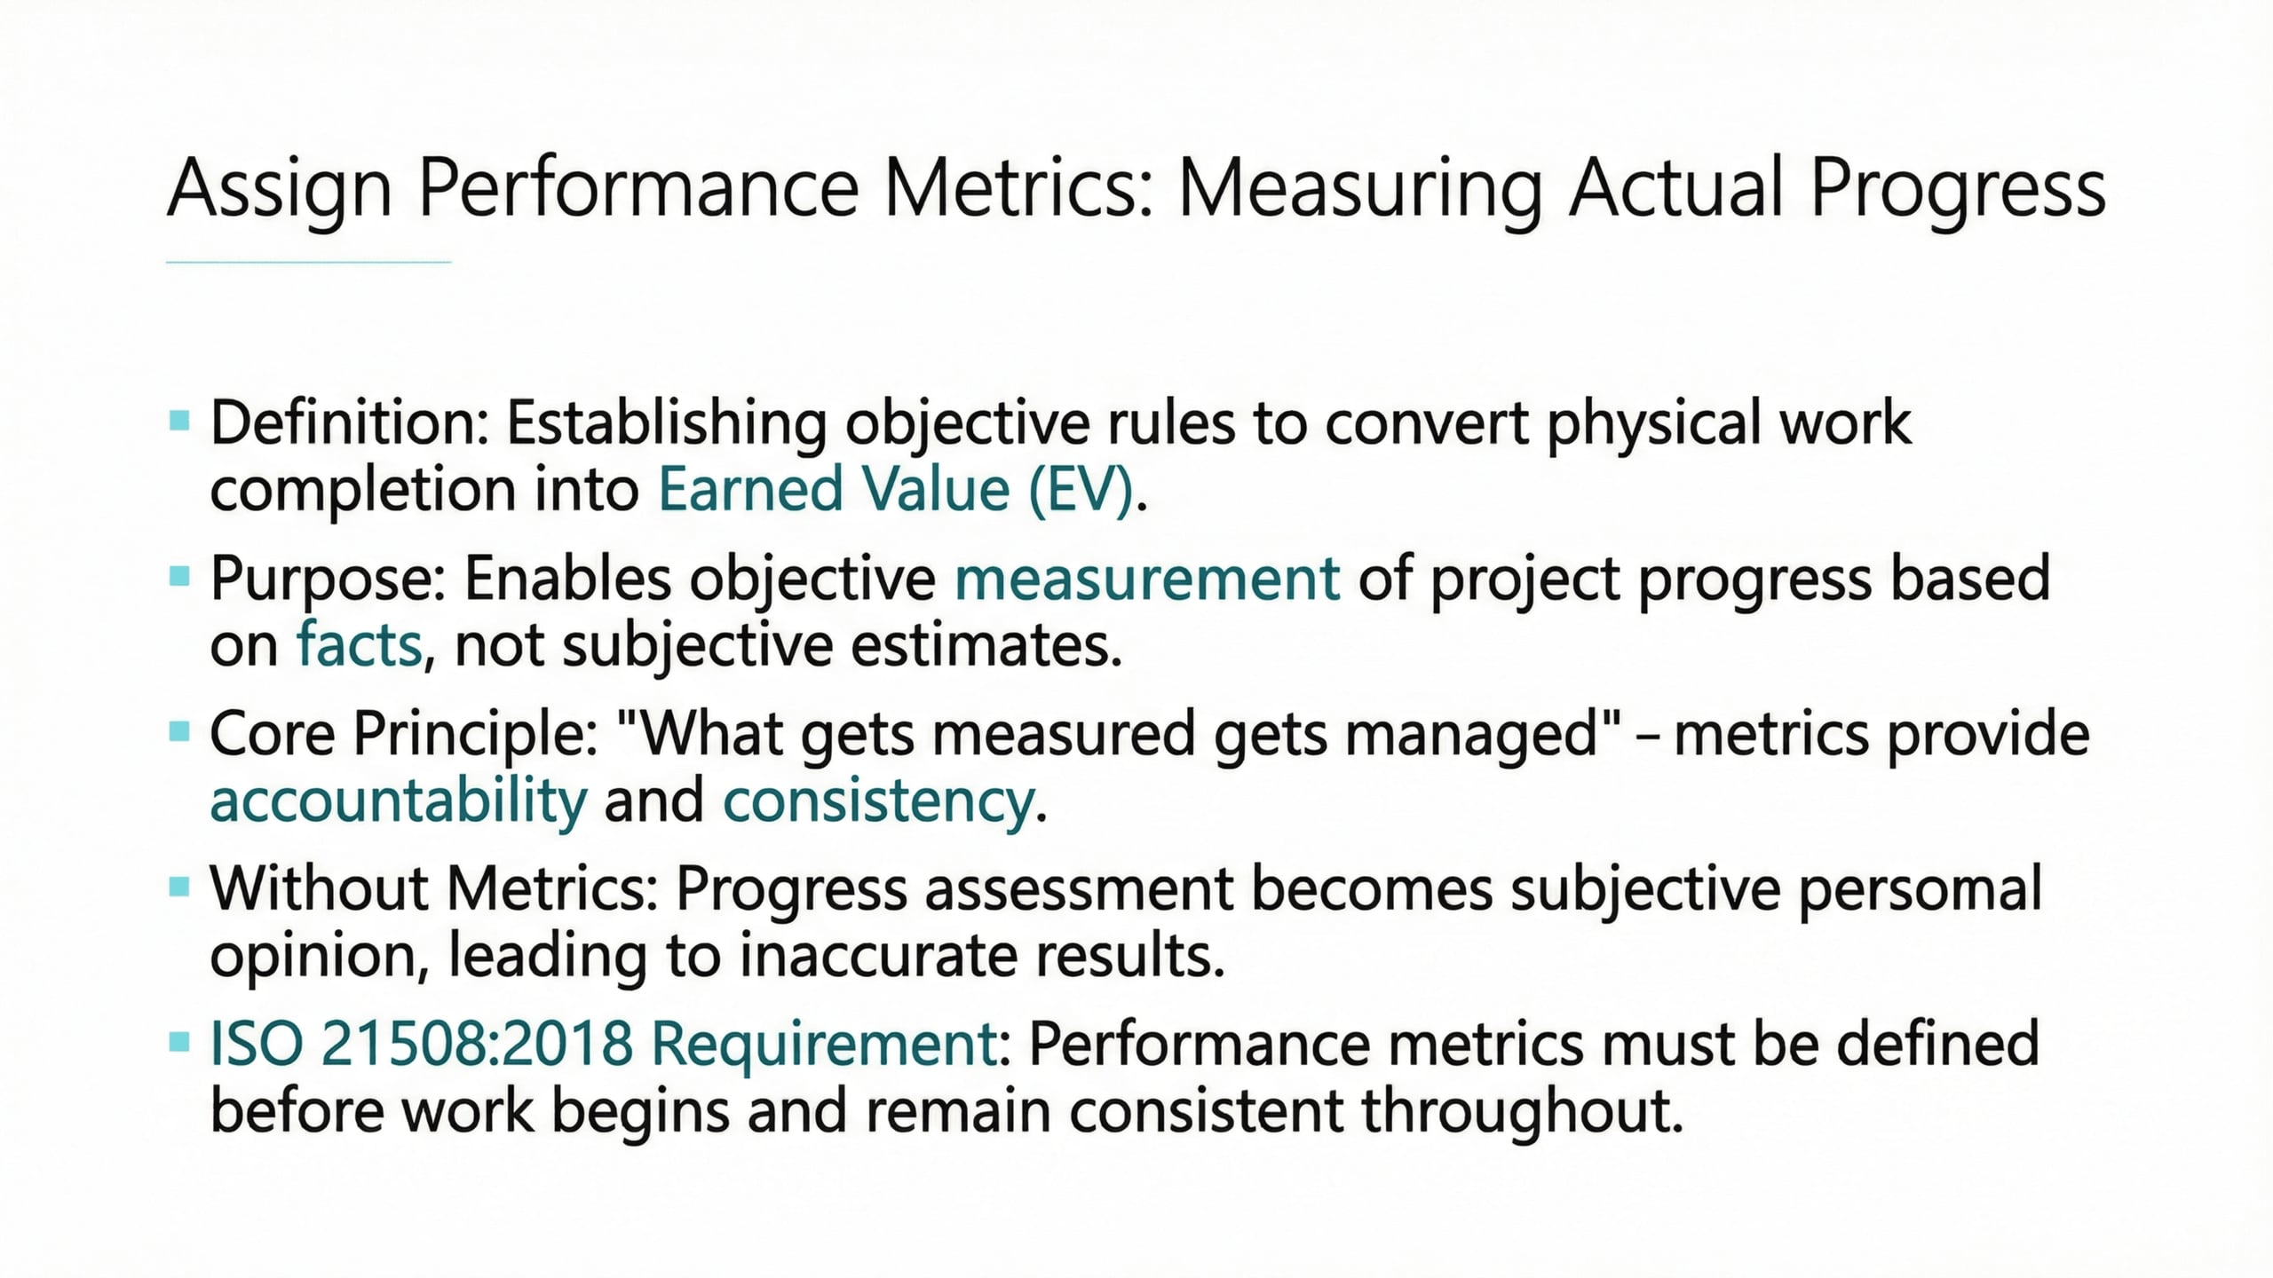
Lecture
03
Step 5: Assign Performance Metrics
1 - 23

Slide 24
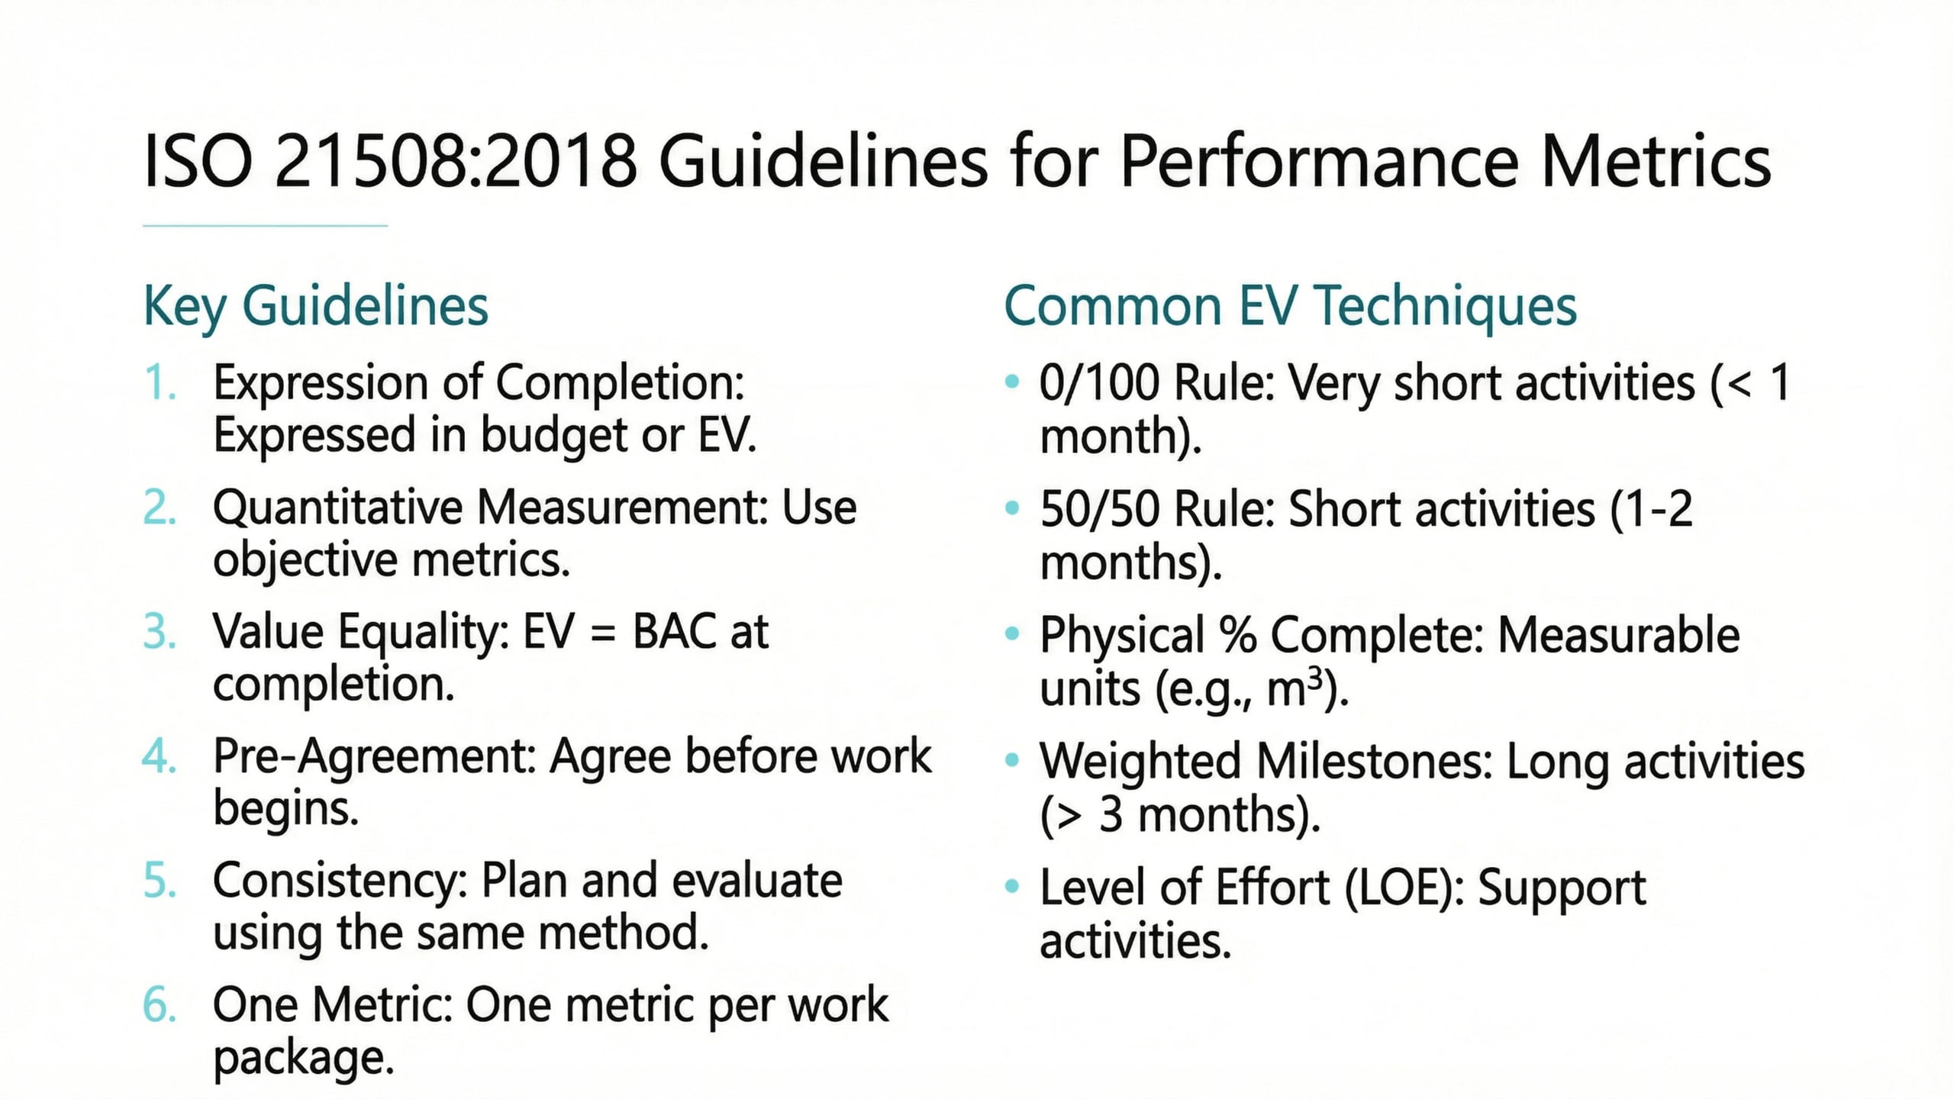
Lecture
03
Guidelines for Performance Metrics
1 - 24

Slide 25
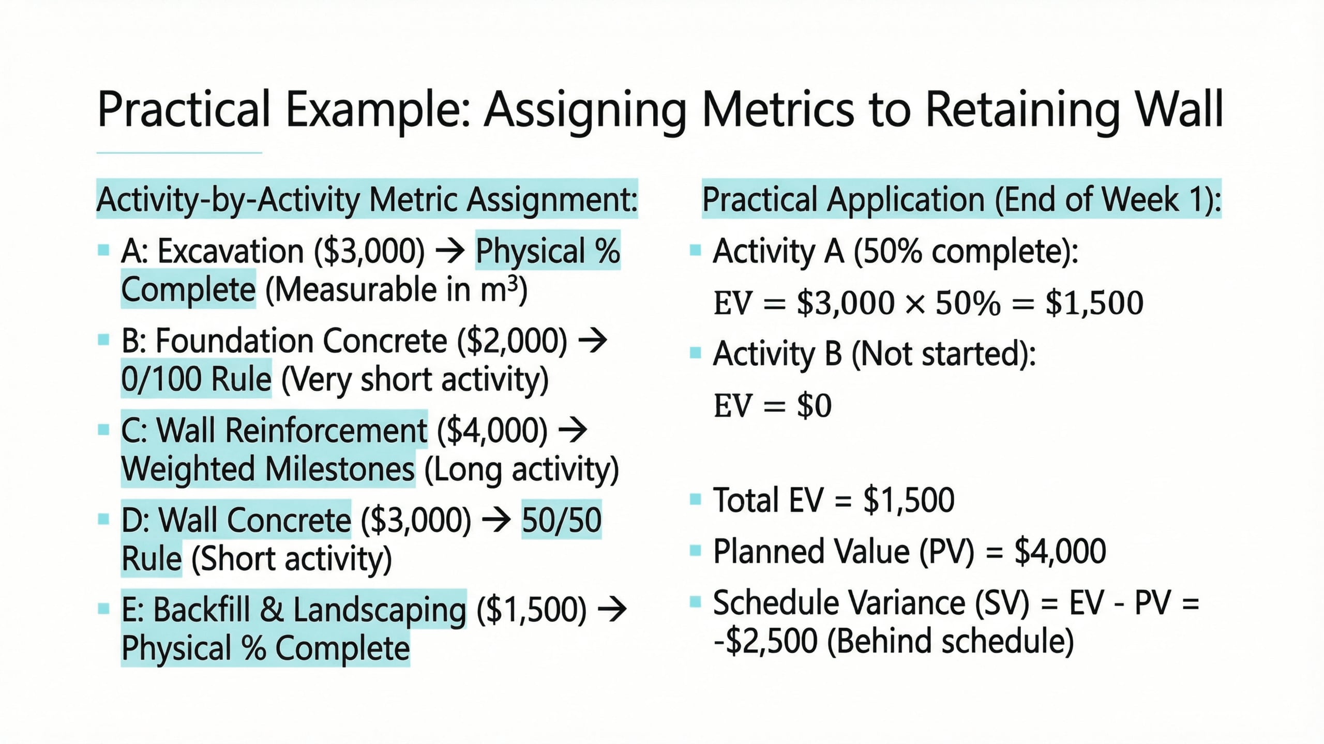
Lecture
03
Practical Example: Assigning Metrics to Retaining Wall
1 - 25

Slide 26
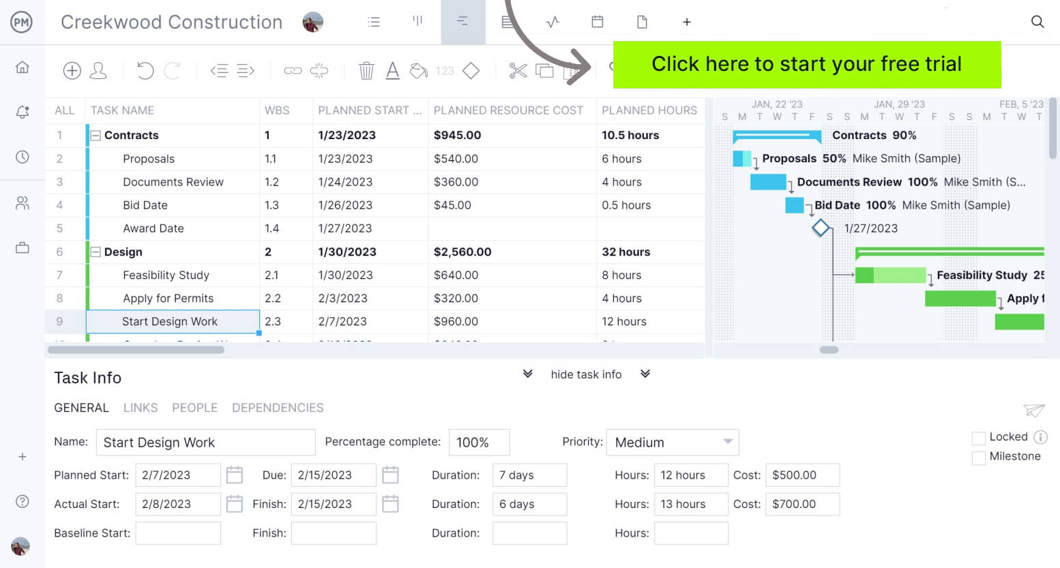
Lecture
03
Step 6: Establish PMB (Performance Management Baselines )
1 - 26

Slide 27
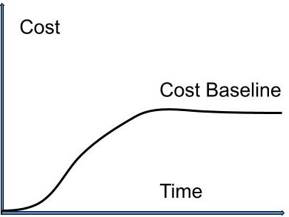
Lecture
03
Step 6: Establish PMB (Performance Management Baselines )
1 - 27

Slide 28
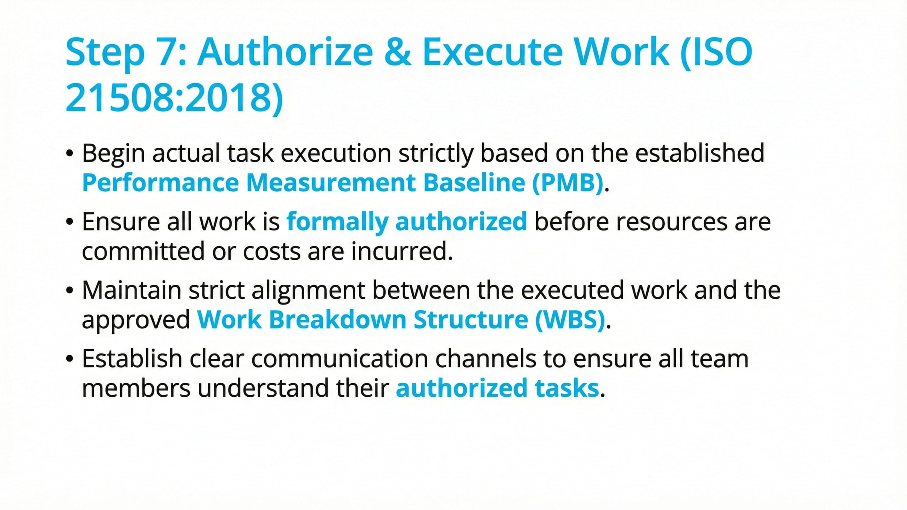
Lecture
03
Step 7: Authorize & Execute Work (ISO 21508:2018)
1 - 28

Slide 29
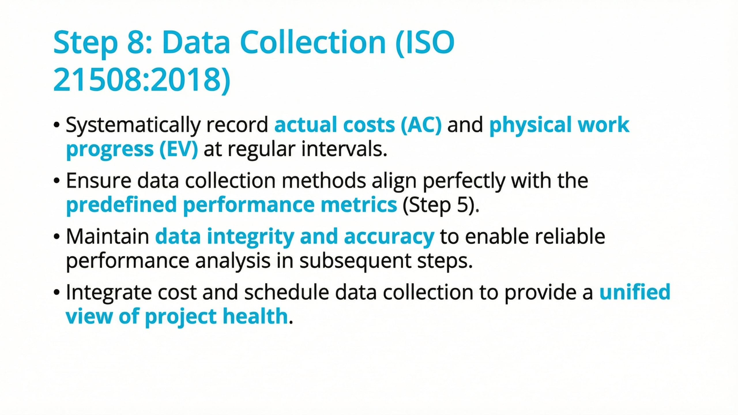
Lecture
03
Step 8: Data Collection (ISO 21508:2018)
1 - 29

Slide 30
Lecture
03
Step 9: Performance Analysis (EVM)
1 - 30

Slide 31

Lecture
03
Review of Previous Session
فا
The requirement is to deliver ten tables in ten days at a cost of one thousand per table
As a result, one table is delivered daily at a unit cost of one thousand
1 - 31

Slide 32
Lecture
03
Review of Previous Session
By day four, the planned completion is four tables at a cost of 4,000
However, upon reviewing the actual progress on day four, three tables had been completed at a cost of 5,000
1 - 32

Slide 33
Lecture
03
Review of Previous Session
Budget Cost of Work Schedule (BCWS)= 4000
Actual Cost of Work Performed (ACWP)= 5000
Budget Cost of Work Performed (BCWP)=3000
1 - 33

Slide 34
Lecture
03
Review of Previous Session
behind schedule
Lecture
Schedule Variance (SV)
= BCWP-BCWS
= 3000-4000=-1000<0
Cost Variance (CV)
= BCWP-ACWP
= 3000- 5000= -2000<0
over budget
1 - 34

Slide 35
Lecture
03
Review of Previous Session
Schedule performance Index (SPI)
= BCWP / BCWS
= 3000/4000=0.75<1
behind schedule
Cost performance Index (CPI)
= BCWP / ACWP
= 3000/5000=0.6<1
over budget
1 - 35

Slide 36
Lecture
03
Review of Previous Session
Estimated Final Time (EFT)
EFT = TAC / SPI
EFT= 10/0.75= 13.33= 14
1 - 36

Slide 37
Lecture
03
Review of Previous Session
Estimated Cost At Completion (EAC)
EAC = BAC / CPI
        EAC = 10000 / 0.6=16667(Estimated at complete )
  EAC = ACWP+ Original Remaining Budget
1 - 37

Slide 38
Lecture
03
Review of Previous Session
Estimated To Complete (ETC)
ETC = EAC – ACWP(estimated to complete )
ETC= 16667-5000=11667
Variance At Completion (VAC)
VAC = BAC – EAC
VAC= 10000-16667=-6667
Variance At Completion= Budget Cost At Completion - Estimated Cost At Completion
1 - 38

Slide 39
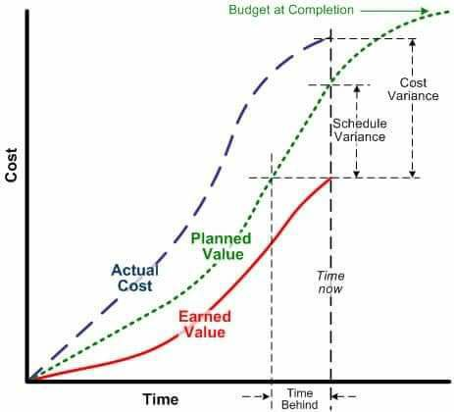
Lecture
03
EVM Graph
In the adjacent graph, we observe that the curve representing the Earned Value (in red) lies below the curve representing the Planned Value. Consequently, the Schedule Variance (SV) value will be negative, indicating that the project is behind schedule."
"Similarly, we observe that the curve representing the Earned Value (in red) lies below the curve representing the Actual Cost. Consequently, the Cost Variance (CV) value will be negative, which means the project is over budget based on the current performance
1 - 39

Slide 40
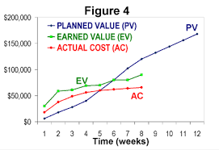
Lecture
03
EVM Graph
In the adjacent chart, we observe that until week six, the curve representing the Earned Value was higher than the curve representing the Planned Value. Therefore, the schedule variance was positive, and the project was ahead of schedule. However, starting from the sixth week, the Earned Value curve fell below the Planned Value. Consequently, schedule performance declined, the schedule variance became negative, and a delay relative to the planned value will occur."
"Throughout the entire duration of the project, the curve representing the Earned Value remained higher than the curve representing the Actual Cost. Therefore, the cost performance is excellent, and the project will be completed under the contractual budget
1 - 40

Slide 41


Thank You

