Slide 1



Industrial IoT Gateways
Lecture 3
IoT Security
Prepared by
Dr. Abdelrhman Ahmed

Slide 2
Chapter
Foreword
03
Amidst global competition, the net profit of industrial manufacturing continues to decline, while traditional business models are forced to transform. Emerging from this is a wide unknown market space – industrial interconnection. With opportunity for growth and profit, industrial interconnect scenarios involve harsher environments, require more diversified interfaces to adapt, face more network security challenges, and are more difficult to maintain than in enterprises or the family home.
To keep up, Huawei has designed and launched a series of high-end, mid-range, and low-end IoT gateways. These feature-rich gateways stand out for their unmatched edge computing, IoT platform support, and extensive adaption to industrial interconnection scenarios.

Slide 3
Chapter
Objectives
03
Upon completion of this course, you will be able to:
- Understand basic concepts and features of industrial IoT gateways.
- Master key technologies of industrial IoT gateways.
- Understand Huawei industrial IoT gateway products and features.
- Understand application scenarios of Huawei industrial IoT gateways.

Slide 4
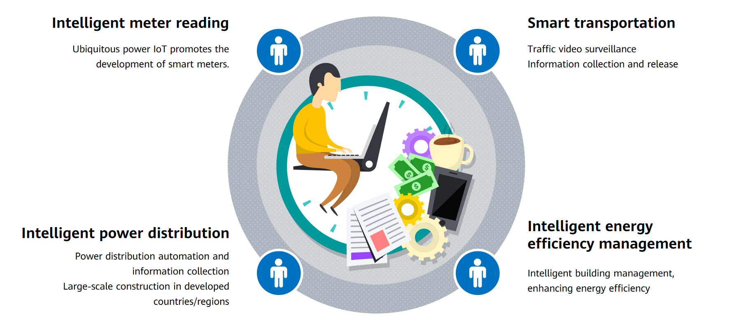
Chapter
Extensive Application of IoT in Industrial Scenarios
03
At the end of this course, you will have knowledge of:
Common IoT wired communication technologies.
The technical standards, features, and differences between various short-range wireless communications technologies.
The characteristics and developing trends of cellular mobile communication technologies.
The characteristics of Low Power Wide Area (LPWA) communications technologies and distinguish between their different types.

Slide 5
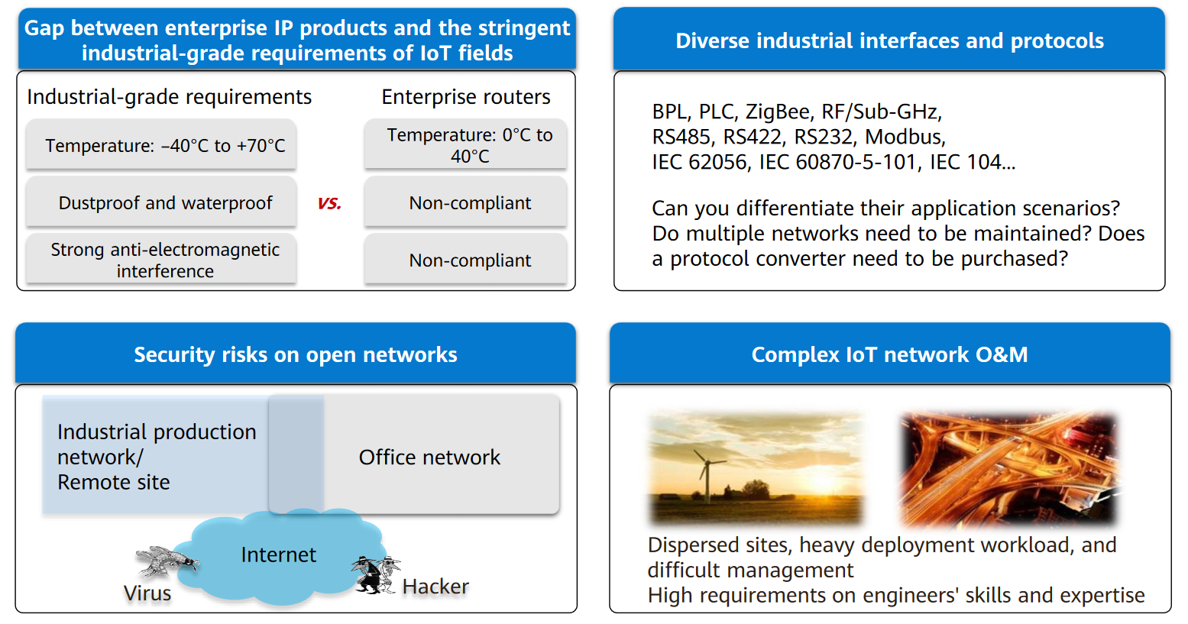
Chapter
03
Challenges Faced by IoT in the Industry Field

Slide 6
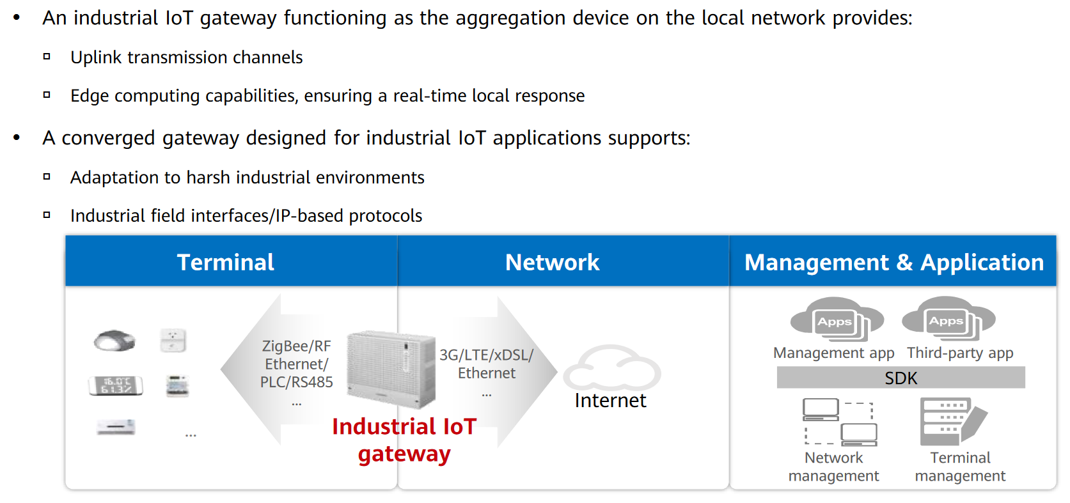
Chapter
Why Industrial IoT Gateways
03

Slide 7
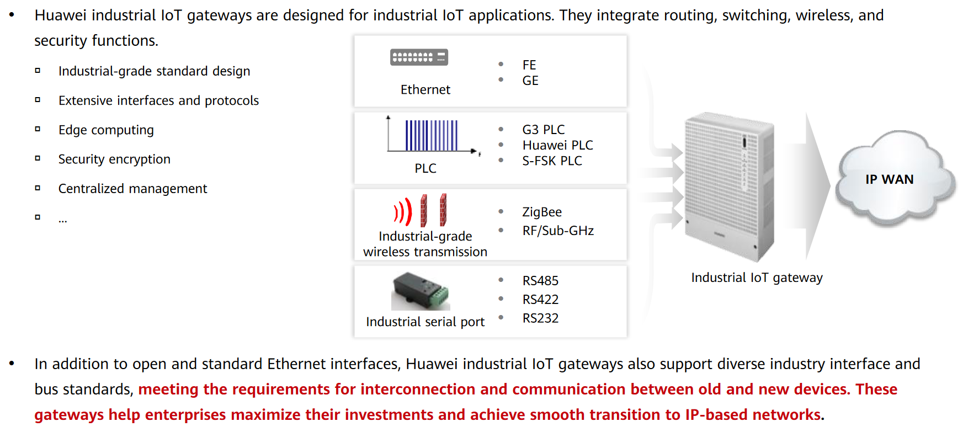
Chapter
03
Positioning of Industrial IoT Gateways

Slide 8
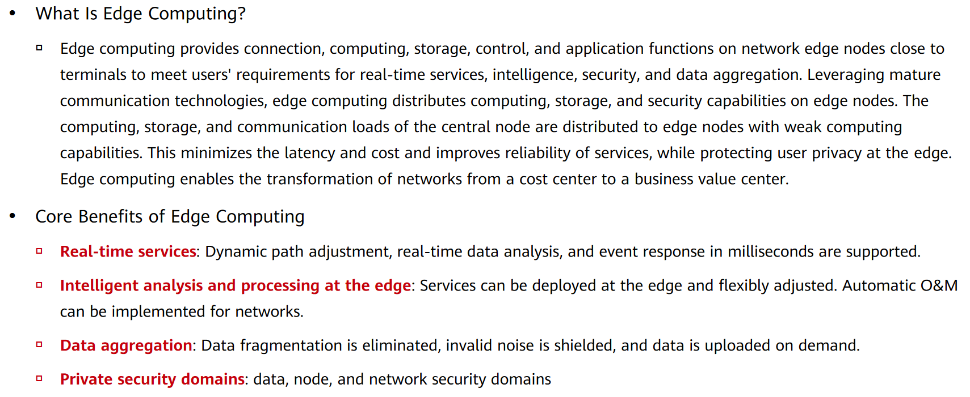
Chapter
Edge Computing (1/2)
03

Slide 9
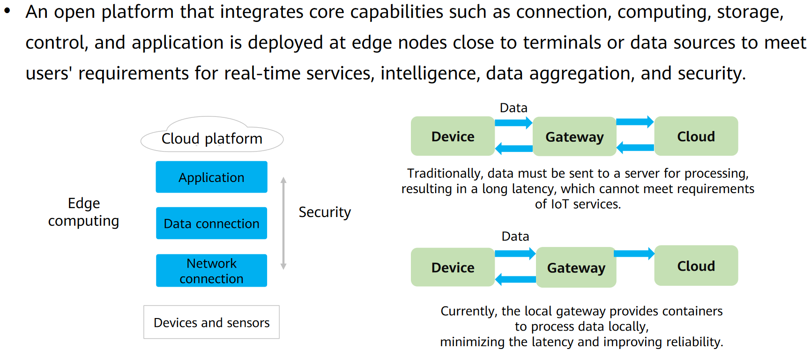
Chapter
Edge Computing (2/2)
03

Slide 10
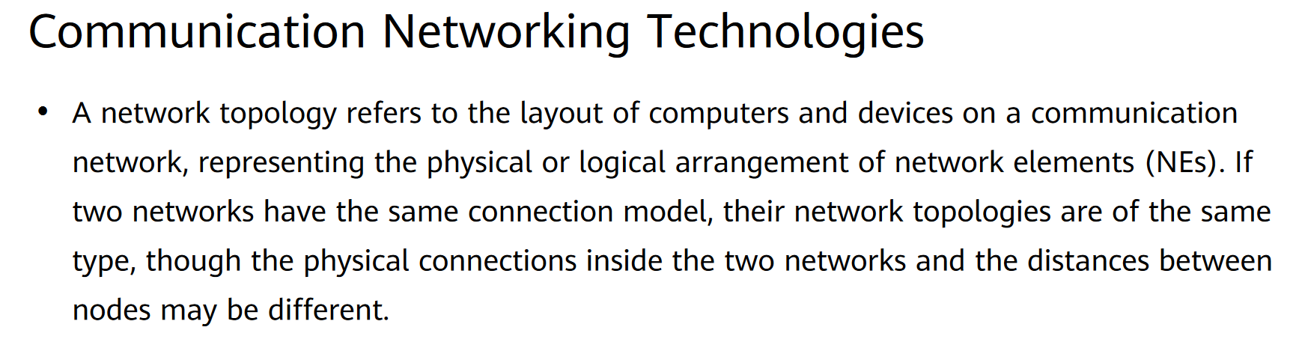
Chapter
Mesh Networking Technology
03

Slide 11
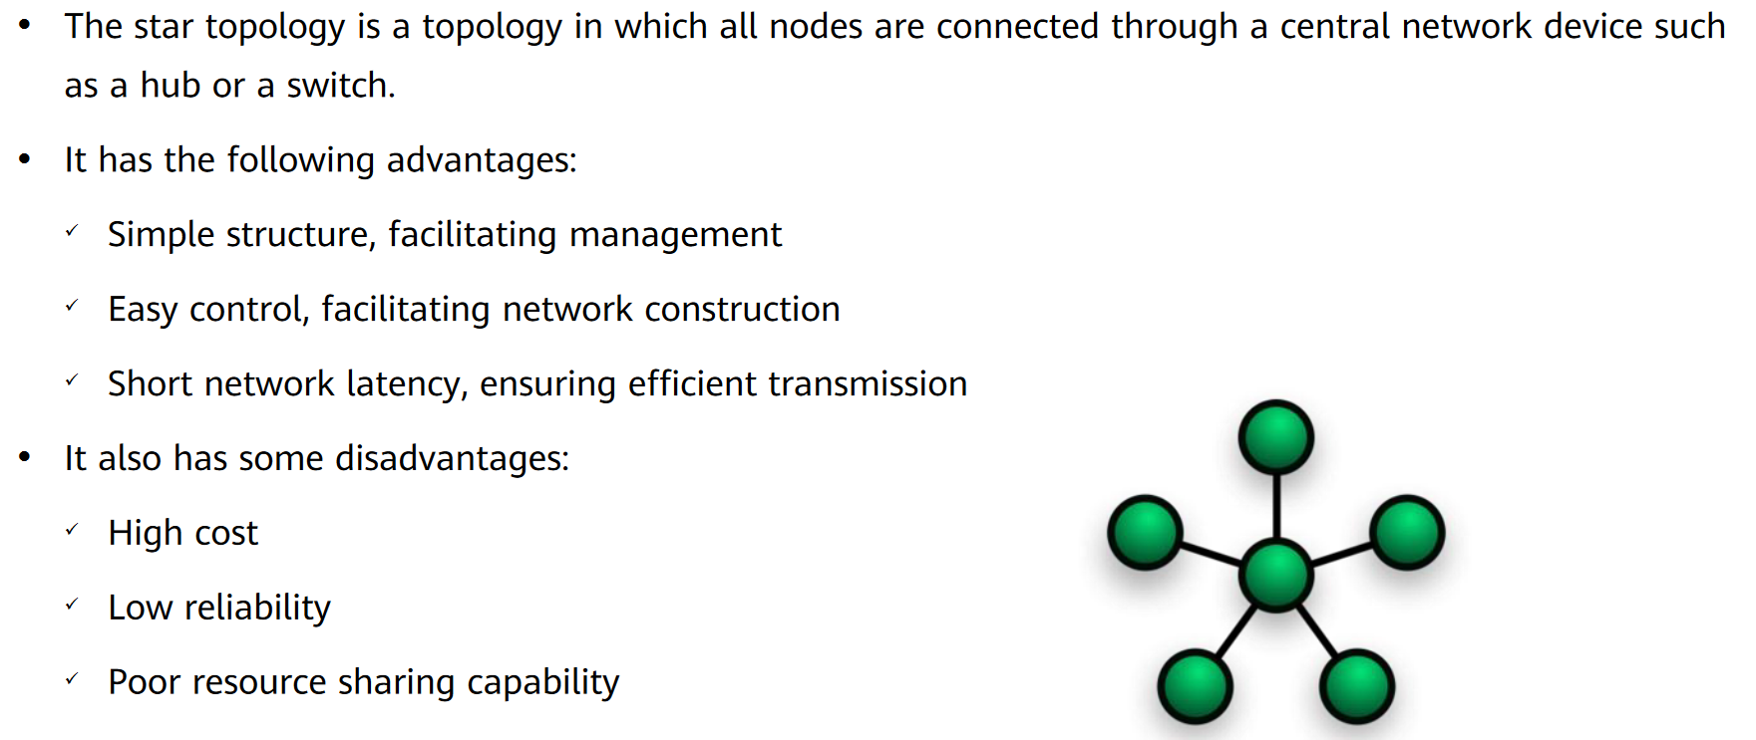
Chapter
Star Topology
03

Slide 12
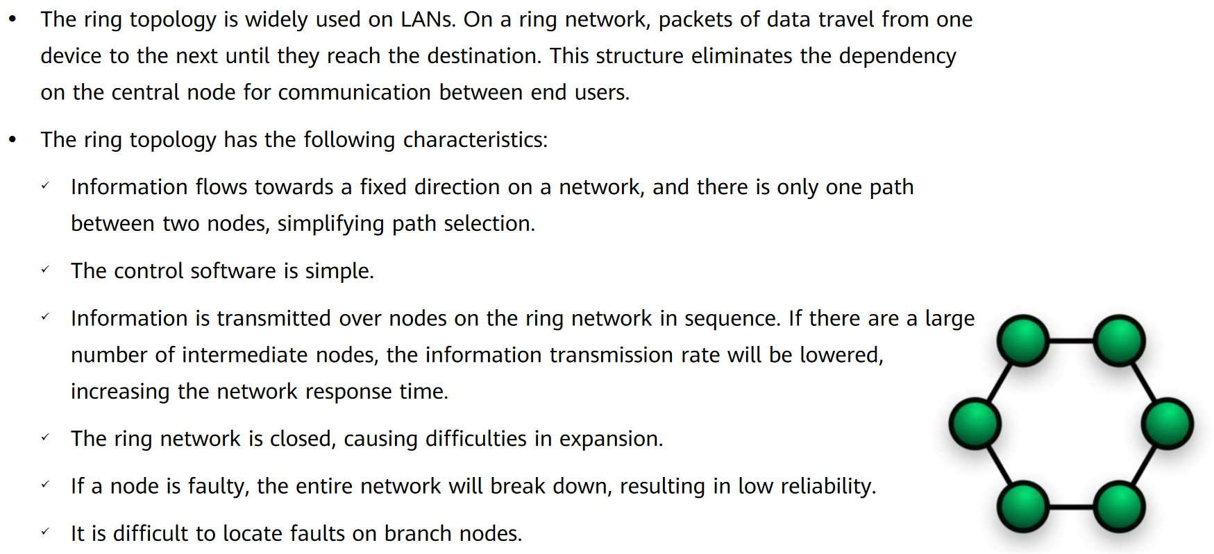
Chapter
Ring Topology
03

Slide 13
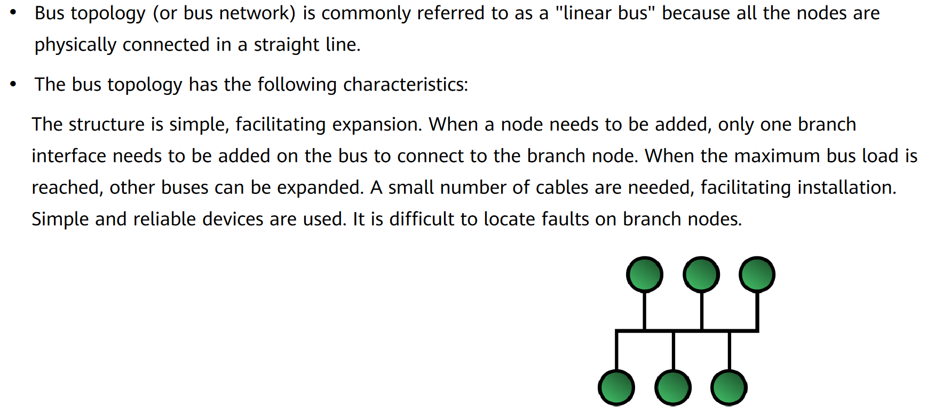
Chapter
03
Bus Topology

Slide 14
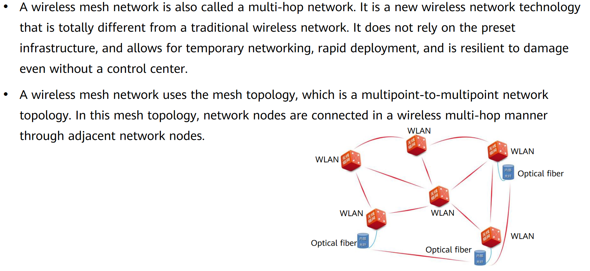
Chapter
Mesh Topology
03

Slide 15
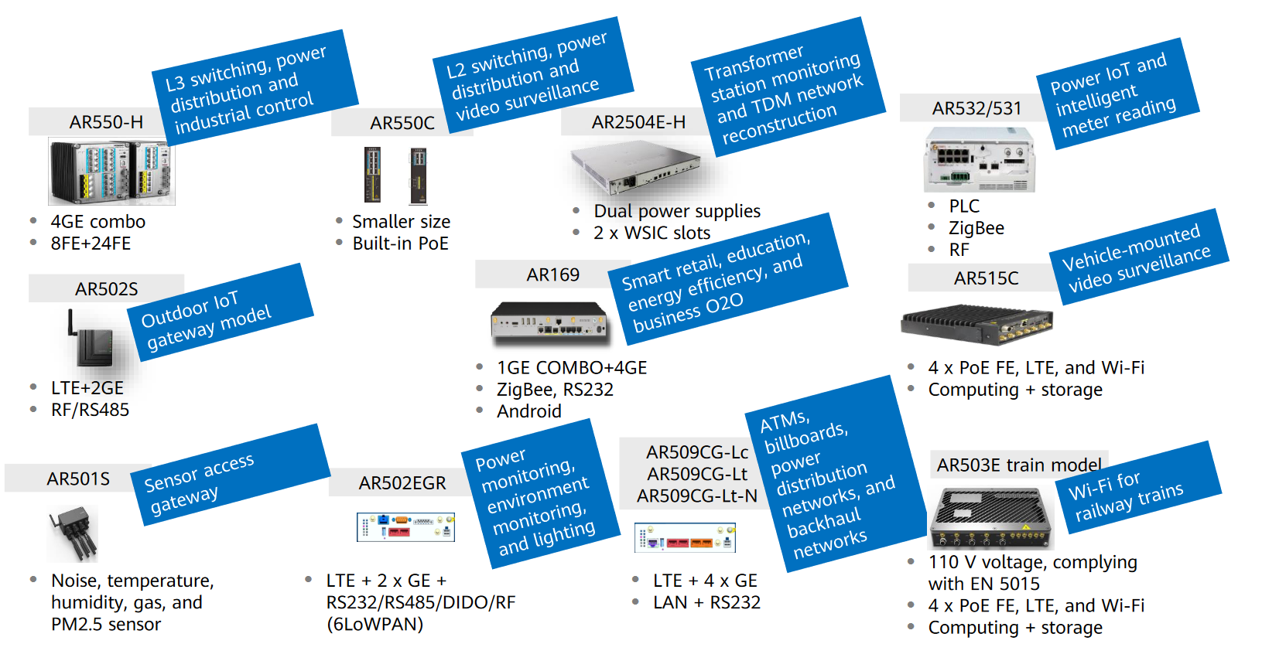
Chapter
Huawei Industrial IoT Gateway Portfolio
03

Slide 16
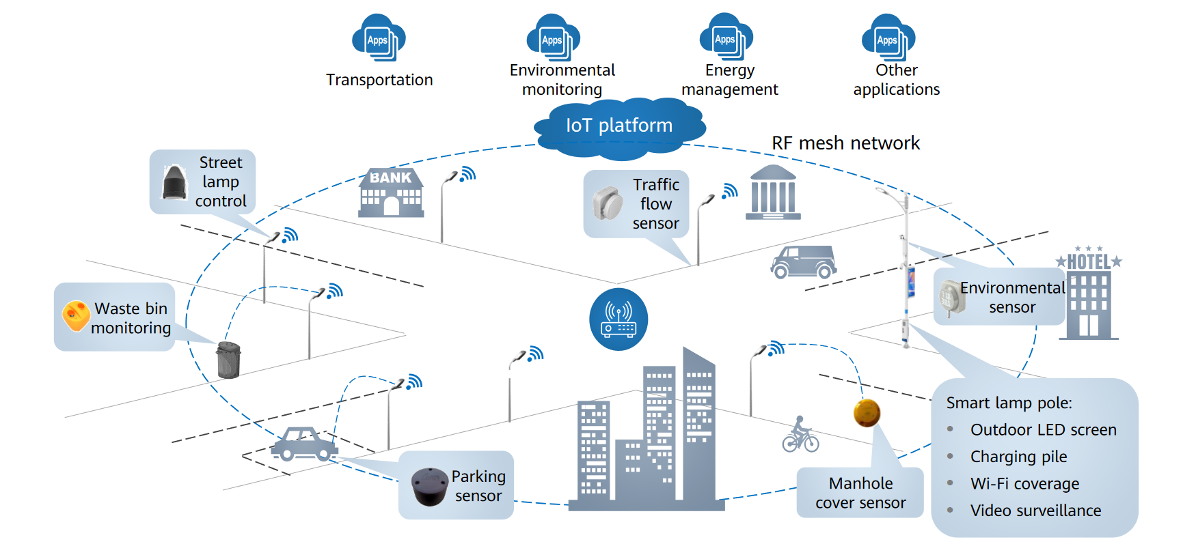
Chapter
From Street Lamp IoT to Campus IoT
03

Slide 17



Thank You

