Slide 1



Project Time Management
Prepared by Dr. Amira Elfekky
PMG 212
Lecture 2

Slide 2

Agenda
Project Control
Introduction to Project Control
Performance Measurement
Purpose of a Performance Measurement Baseline
Components of the Performance Baseline
Components and Assembly of the Performance Baseline
Scope
Contract Terms and Conditions (CTC)
Project Execution Plan (PEP)
Schedule
Work Breakdown Structure
Work Breakdown Structure Benefits
Organizational Breakdown Structure
WBS/OBS Diagram
Ownership
The Concept of Rolling Wave Planning

Slide 3
Agenda
Project Control
Introduction to Project Control
Performance Measurement
Purpose of a Performance Measurement Baseline
Components of the Performance Baseline
Components and Assembly of the Performance Baseline
Scope
Contract Terms and Conditions (CTC)
Project Execution Plan (PEP)
Schedule
Work Breakdown Structure
Work Breakdown Structure Benefits
Organizational Breakdown Structure
WBS/OBS Diagram
Ownership
The Concept of Rolling Wave Planning

Slide 4
Chapter
Introduction to Project Control
2
Understanding project control as a management discipline
Focus on time, cost, and performance monitoring
Essential across industries: IT, manufacturing, R&D, services
Benefits of proactive control: avoid delays, overruns, risks
Example: Apple tracks cost and schedule in product launch programs

Slide 5

Chapter
Project Management vs Project Control
2
  Project management: overall planning and execution
  Project control: monitoring and steering performance
  Focus on measurable variables: time and cost
  Supports decision-making and corrective actions
  Example: Microsoft integrates project control into software rollout

Slide 6
Chapter
Why Project Control Matters
2
  Technical success ≠ overall success
  Cost overruns reduce profitability
  Schedule delays affect stakeholder satisfaction
  Early control prevents cascading problems
  Example: Boeing faced delays in 787 Dreamliner, highlighting cost and schedule control needs

Slide 7
Chapter
Definition of Project Control
2
  Integration of cost, schedule, and performance data
  Continuous monitoring against baseline plan
  Identification of deviations and corrective action
  Enables informed decision-making
  Example: Siemens monitors large-scale energy projects using real-time dashboards

Slide 8
Chapter
Key Variables in Project Control
2
  Time as a performance constraint
  Cost as a financial constraint
  Interdependence of time and cost
  Performance must be measured against plan
  Example: Amazon monitors delivery and logistics projects with tight schedules

Slide 9
Agenda
Project Control
Introduction to Project Control
Performance Measurement
Purpose of a Performance Measurement Baseline
Components of the Performance Baseline
Components and Assembly of the Performance Baseline
Scope
Contract Terms and Conditions (CTC)
Project Execution Plan (PEP)
Schedule
Work Breakdown Structure
Work Breakdown Structure Benefits
Organizational Breakdown Structure
WBS/OBS Diagram
Ownership
The Concept of Rolling Wave Planning

Slide 10
Chapter
Performance Measurement
02
Accurate performance measurement ensures true project progress.
Provides early warning signs for at-risk projects.
Foundation for Earned Value Analysis (EVA).
Involves selecting the right progress calculation method.
Six recognized methods are commonly used in construction projects.

Slide 11
Chapter
Performance Measurement
02
Methods of Measuring Progress
Units Completed
Incremental Milestone
Start/Finish
Cost Ratio
Experience/Opinion
Weighted or Equivalent Units

Slide 12
Chapter
Performance Measurement
02
Method 1 – Units Completed
Suitable for repetitive, easily measurable tasks.
Each unit takes approximately the same effort/time.
Progress = (Completed Units ÷ Total Units) × 100%.
Example: 100 fixtures installed out of 200 → 50% complete.
Objective, simple, and widely applicable.

Slide 13
Chapter
Performance Measurement
02
Method 2 – Incremental Milestone
Used for sequential subtasks within one major task.
Each subtask = a mini milestone with a defined % weight.
% complete based on labor hours per subtask.
Example: Foundation wall operations (layout, rebar, pour, strip, etc.).
Requires pre-agreed weightings between stakeholders.

Slide 14
Chapter
Performance Measurement
02
Method 3 – Start/Finish
Used for short-duration tasks with no intermediate milestones.
Earned value given at start and finish only.
Common rules:
  50/50 Rule → 50% at start, 50% at finish.
  20/80 Rule → 20% at start, 80% at finish.
  0/100 Rule → No value until completion.
Suitable for tests, inspections, or short-duration tasks.

Slide 15
Chapter
Performance Measurement
02
Method 4 – Cost Ratio
Best for long-term, continuous tasks (e.g., project management, QA).
Progress tied to overall project completion %.
Example: If project = 42% complete → Earned 42% of overhead & fee.
Based on dollar allocation, not physical work.

Slide 16
Chapter
Performance Measurement
02
Method 5 – Experience/Opinion
Most subjective method.
Based on expert judgment or estimation.
Used only for minor or hard-to-measure tasks.
Risk: can cause disputes between owner and contractor.
Should be avoided when possible.

Slide 17
Chapter
Performance Measurement
02
Method 6 – Weighted or Equivalent Units
For complex, multi-unit tasks with dissimilar measurements.
Each subtask assigned a weight (labor hours or cost).
Converted into a common equivalent unit (e.g., tons of steel).
Enables accurate progress calculation across subtasks.
Example: Structural steel erection progress measured in tons.

Slide 18
Agenda
Introduction to Project Control
Performance Measurement
Purpose of a Performance Measurement Baseline
Components of the Performance Baseline
Components and Assembly of the Performance Baseline
Scope
Contract Terms and Conditions (CTC)
Project Execution Plan (PEP)
Schedule
Work Breakdown Structure
Work Breakdown Structure Benefits
Organizational Breakdown Structure
WBS/OBS Diagram
Ownership
The Concept of Rolling Wave Planning

Slide 19
Chapter
Purpose of a Performance Measurement Baseline
02
Roadmap for project execution
Integration of project components
Basis for change management
Project communication
Basis for project status and metrics

Slide 20
Agenda
Introduction to Project Control
Performance Measurement
Purpose of a Performance Measurement Baseline
Components of the Performance Baseline
Components and Assembly of the Performance Baseline
Scope
Contract Terms and Conditions (CTC)
Project Execution Plan (PEP)
Schedule
Work Breakdown Structure
Work Breakdown Structure Benefits
Organizational Breakdown Structure
WBS/OBS Diagram
Ownership
The Concept of Rolling Wave Planning

Slide 21
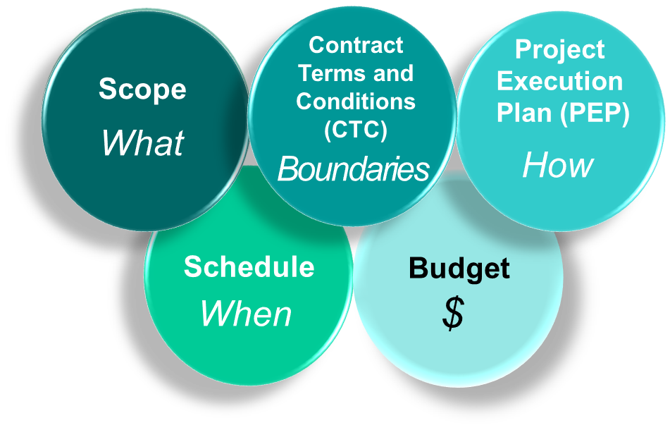
Components of the Performance
Baseline
Chapter
02
All five components interact and must be combined in baselining.
Project team members must be made aware of the components within their area of responsibility.

Slide 22
Agenda
Introduction to Project Control
Performance Measurement
Purpose of a Performance Measurement Baseline
Components of the Performance Baseline
Components and Assembly of the Performance Baseline
Scope
Contract Terms and Conditions (CTC)
Project Execution Plan (PEP)
Schedule
Work Breakdown Structure
Work Breakdown Structure Benefits
Organizational Breakdown Structure
WBS/OBS Diagram
Ownership
The Concept of Rolling Wave Planning

Slide 23
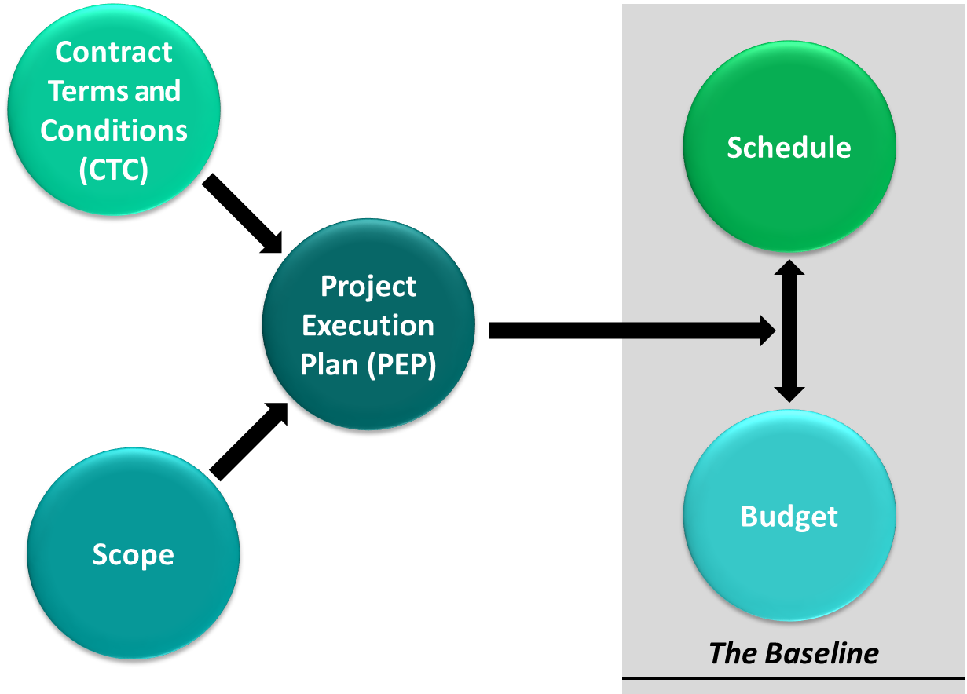
Components and Assembly of the Performance Baseline
Chapter
02

Slide 24
Agenda
Introduction to Project Control
Performance Measurement
Purpose of a Performance Measurement Baseline
Components of the Performance Baseline
Components and Assembly of the Performance Baseline
Scope
Contract Terms and Conditions (CTC)
Project Execution Plan (PEP)
Schedule
Work Breakdown Structure
Work Breakdown Structure Benefits
Organizational Breakdown Structure
WBS/OBS Diagram
Ownership
The Concept of Rolling Wave Planning

Slide 25

Chapter
02
Scope
Defines the work the contractor or supplier is required to complete
  Statement of Work
  Scope determines the cost and schedule
  Creation of Work breakdown structure

Slide 26
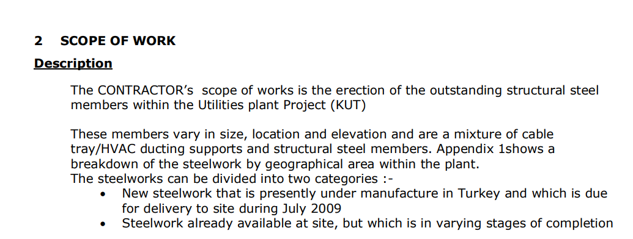
Chapter
Scope – Case study -1
02

Slide 27
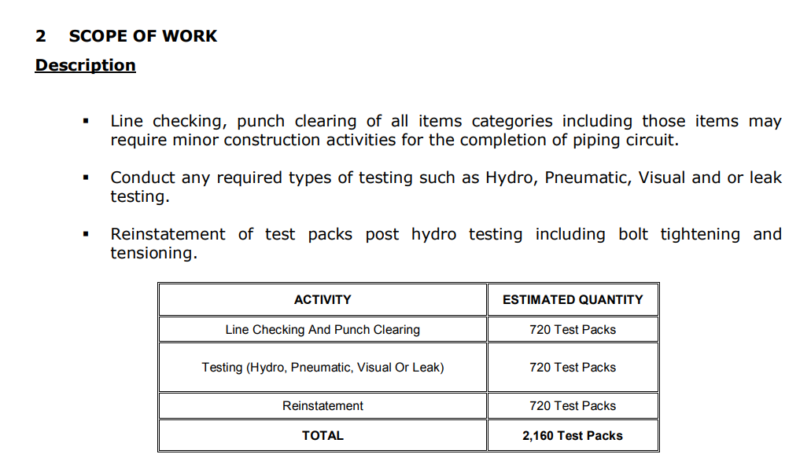
Chapter
02
Scope – Case study - 2

Slide 28
Agenda
Introduction to Project Control
Performance Measurement
Purpose of a Performance Measurement Baseline
Components of the Performance Baseline
Components and Assembly of the Performance Baseline
Scope
Contract Terms and Conditions (CTC)
Project Execution Plan (PEP)
Schedule
Work Breakdown Structure
Work Breakdown Structure Benefits
Organizational Breakdown Structure
WBS/OBS Diagram
Ownership
The Concept of Rolling Wave Planning

Slide 29
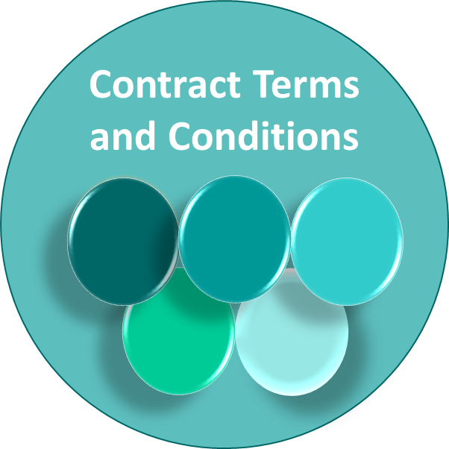
Chapter
Contract Terms and Conditions (CTC)
02
Contract terms and conditions address:
  Rights and obligations
  Contract form and function
  Risk allocation
  Contract management process, including dispute resolution

Slide 30
Contract Terms and Conditions (CTC)
Chapter
02
Contract terms and conditions address:
  Payment terms
  Quality requirements
  Acceptance and testing requirements
  Reporting requirements

Slide 31
Agenda
Introduction to Project Control
Performance Measurement
Purpose of a Performance Measurement Baseline
Components of the Performance Baseline
Components and Assembly of the Performance Baseline
Scope
Contract Terms and Conditions (CTC)
Project Execution Plan (PEP)
Schedule
Work Breakdown Structure
Work Breakdown Structure Benefits
Organizational Breakdown Structure
WBS/OBS Diagram
Ownership
The Concept of Rolling Wave Planning

Slide 32
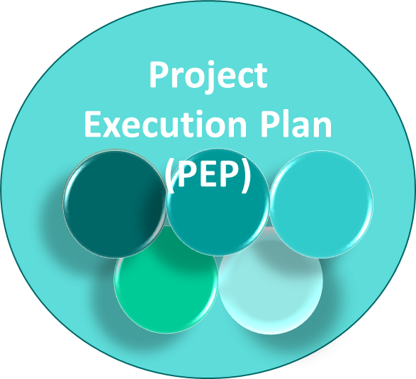
Project Execution Plan (PEP)
Chapter
02
Defines the execution approach
  Identifies how engineering will be carried out
  Identifies how equipment and materials will be acquired
  Identifies how construction will be completed

Slide 33
Chapter
Project Execution Plan (PEP)
02
Defines the execution approach
  Identifies what all functions (E, P, C, PC, Contracts, Startup, and others) will do in delivering the project and how they will do it
  Describes how handoffs, interfaces, and integration between functions will work

Slide 34
Agenda
Introduction to Project Control
Performance Measurement
Purpose of a Performance Measurement Baseline
Components of the Performance Baseline
Components and Assembly of the Performance Baseline
Scope
Contract Terms and Conditions (CTC)
Project Execution Plan (PEP)
Schedule
Work Breakdown Structure
Work Breakdown Structure Benefits
Organizational Breakdown Structure
WBS/OBS Diagram
Ownership
The Concept of Rolling Wave Planning

Slide 35
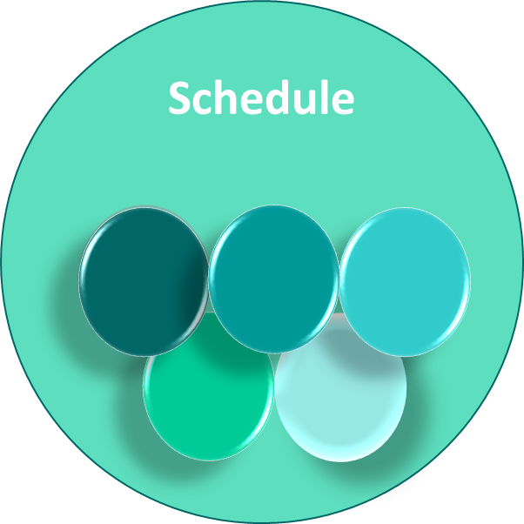
Schedule
Chapter
02
Management Schedule (Level I) includes:
  Major milestones
  Long lead items
Control Schedule (Level III)
  Part of the contract
  The CS is a package containing:
    Major milestones
    Engineering Work Packages (EWP)
    Procurement and Long lead items

Slide 36
Chapter
Schedule
02
Control Schedule (Level III)
  The CS is a package containing:
    Construction Work Packages
    Critical path activities
    Resources loaded schedule
    Progress curves
    Bulk commodity curves (concrete, structural steel, piping, wire & cable, etc.)

Slide 37
Chapter
Schedule
02
Always provide the Basis of Schedule (assumptions, exclusions, allowances, etc.).
Level II Summary Schedules and Level IV Medium Term Schedules are used when needed.

Slide 38
Agenda
Introduction to Project Control
Performance Measurement
Purpose of a Performance Measurement Baseline
Components of the Performance Baseline
Components and Assembly of the Performance Baseline
Scope
Contract Terms and Conditions (CTC)
Project Execution Plan (PEP)
Schedule
Work Breakdown Structure
Work Breakdown Structure Benefits
Organizational Breakdown Structure
WBS/OBS Diagram
Ownership
The Concept of Rolling Wave Planning

Slide 39

Chapter
Work Breakdown Structure
02
The Work Breakdown Structure (WBS) is a hierarchical code structure representing the entire work scope of a project. The WBS:
  Integrates project data from Engineering, Procurement, Construction, and Startup.

Slide 40
Chapter
Work Breakdown Structure
02
  Is used to separate project scope into manageable subsections, facilitate communication, and identify integration points for project plans.
  Provides a systematic approach to ensure key scope and activities are not omitted.

Slide 41
Agenda
Introduction to Project Control
Performance Measurement
Purpose of a Performance Measurement Baseline
Components of the Performance Baseline
Components and Assembly of the Performance Baseline
Scope
Contract Terms and Conditions (CTC)
Project Execution Plan (PEP)
Schedule
Work Breakdown Structure
Work Breakdown Structure Benefits
Organizational Breakdown Structure
WBS/OBS Diagram
Ownership
The Concept of Rolling Wave Planning

Slide 42
Chapter
Work Breakdown Structure Benefits
02
Facilitates systematic planning
Removes project complexity by allocating scope
Provides a framework for:
    Defining specific tasks
    Linking activities and resources
    Facilitating communication
    Allowing integration of project plans

Slide 43
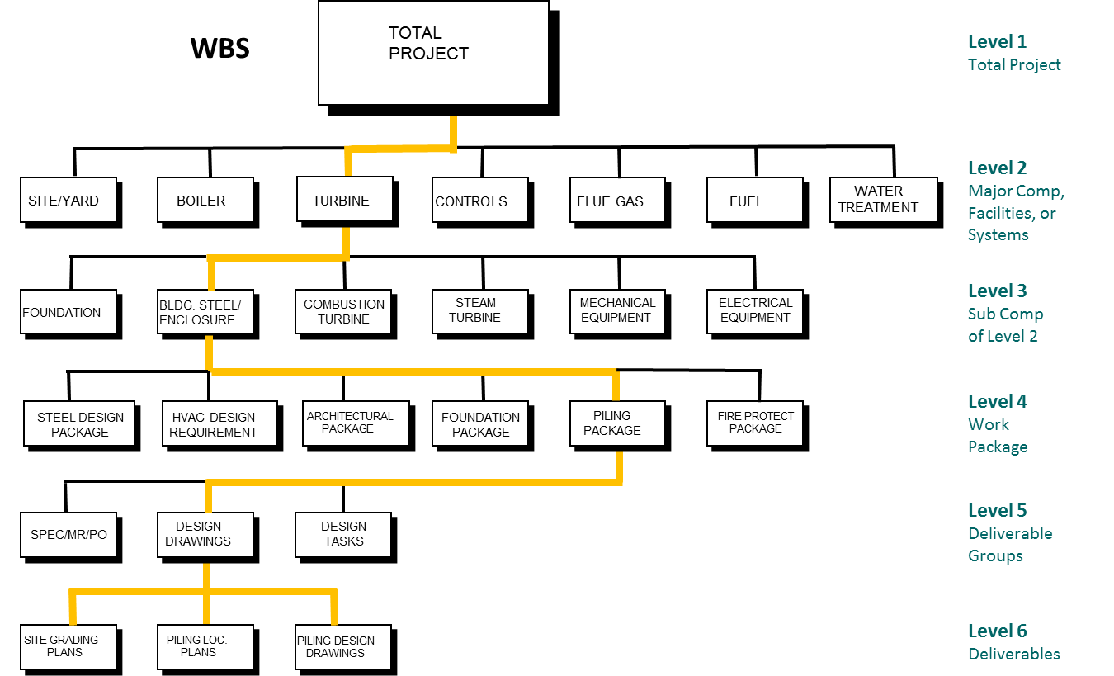
Chapter
Work Breakdown Structure Example
02

Slide 44
Agenda
Introduction to Project Control
Performance Measurement
Purpose of a Performance Measurement Baseline
Components of the Performance Baseline
Components and Assembly of the Performance Baseline
Scope
Contract Terms and Conditions (CTC)
Project Execution Plan (PEP)
Schedule
Work Breakdown Structure
Work Breakdown Structure Benefits
Organizational Breakdown Structure
WBS/OBS Diagram
Ownership
The Concept of Rolling Wave Planning

Slide 45

Chapter
Organizational Breakdown Structure
02
Takes the WBS and merges with the organization and individuals assigned to the project
Benefits:
      Enables clear assignment of scope to
      team members
      Facilitates ownership and accountability
      Assures all project elements are accounted for

Slide 46
Agenda
Introduction to Project Control
Performance Measurement
Purpose of a Performance Measurement Baseline
Components of the Performance Baseline
Components and Assembly of the Performance Baseline
Scope
Contract Terms and Conditions (CTC)
Project Execution Plan (PEP)
Schedule
Work Breakdown Structure
Work Breakdown Structure Benefits
Organizational Breakdown Structure
WBS/OBS Diagram
Ownership
The Concept of Rolling Wave Planning

Slide 47
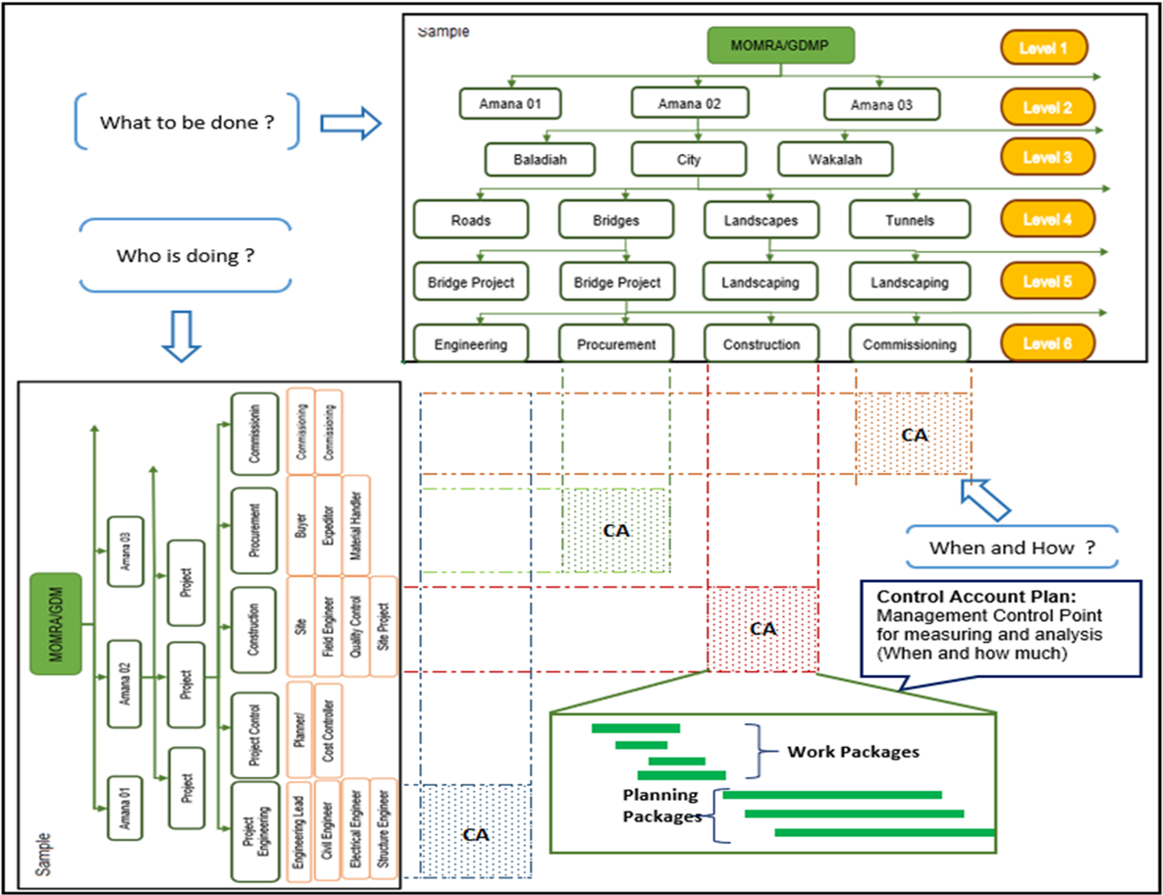
Chapter
WBS/OBS Diagram
02

Slide 48
Agenda
Introduction to Project Control
Performance Measurement
Purpose of a Performance Measurement Baseline
Components of the Performance Baseline
Components and Assembly of the Performance Baseline
Scope
Contract Terms and Conditions (CTC)
Project Execution Plan (PEP)
Schedule
Work Breakdown Structure
Work Breakdown Structure Benefits
Organizational Breakdown Structure
WBS/OBS Diagram
Ownership
The Concept of Rolling Wave Planning

Slide 49
Chapter
Ownership
02
Project organized by teams
100% of scope, budget,
schedule allocated
PEP
PEP
Contractor perform
Partners/ subs/ suppliers
Team A
Hold teams accountable (performance)
Manage change
Risk and contingency management
Project Execution Plan adjustments
Schedule
Team B
Scope
The Baseline
Team C
Budget
Team D

Slide 50
Alignment and Ownership of the Baseline Benefits
Chapter
02
Ensure teams know and accept their scope, schedule, and budgets.
Drive ownership.
Ensure that stretch goals and targets are defined and accepted by the teams.
Establish an environment of accountability.

Slide 51
Agenda
Introduction to Project Control
Performance Measurement
Purpose of a Performance Measurement Baseline
Components of the Performance Baseline
Components and Assembly of the Performance Baseline
Scope
Contract Terms and Conditions (CTC)
Project Execution Plan (PEP)
Schedule
Work Breakdown Structure
Work Breakdown Structure Benefits
Organizational Breakdown Structure
WBS/OBS Diagram
Ownership
The Concept of Rolling Wave Planning

Slide 52
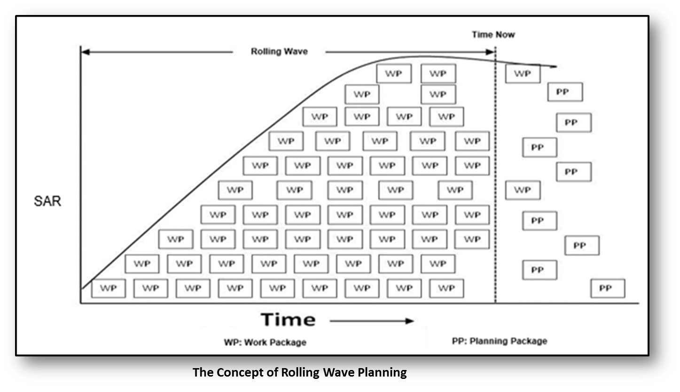
The Concept of Rolling Wave Planning

Slide 53
Chapter
The Concept of Rolling Wave Planning
02
Rolling wave planning is a project management technique that involves progressive elaboration to add detail to the Work Breakdown Structure (WBS) on an ongoing basis.
At the beginning of the project, near term deliverables are decomposed into individual components (work packages) and defined at the greatest level of detail.

Slide 54
Chapter
The Concept of Rolling Wave Planning
02
Deliverables and schedule activities that will take place several reporting periods in the future are more broadly defined. For example, Phases 1-2 might be broken down fully in the WBS.
Phases 3-6 might be outlined only to the level of subprojects.

Slide 55


Thank You

