Slide 1


Slide 2
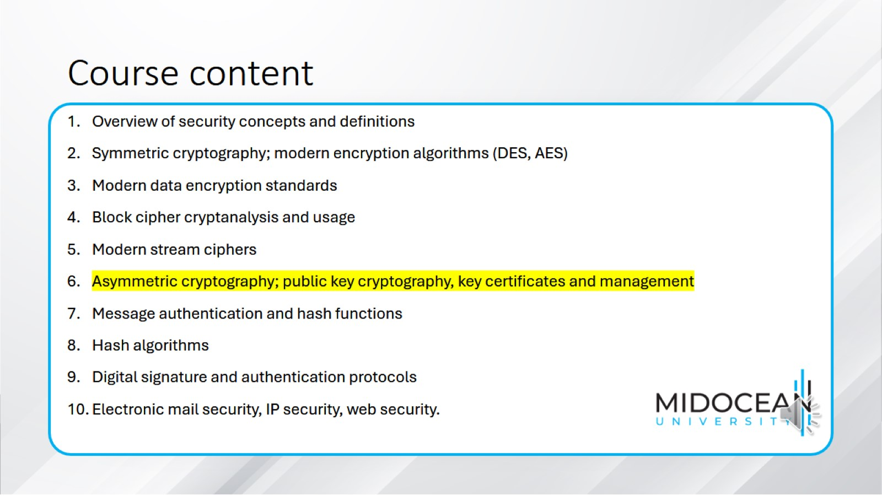
Course content

Slide 3
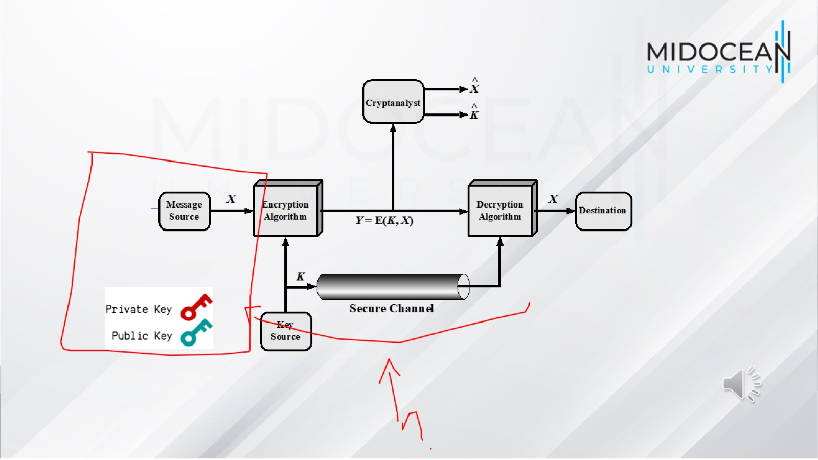

Slide 4
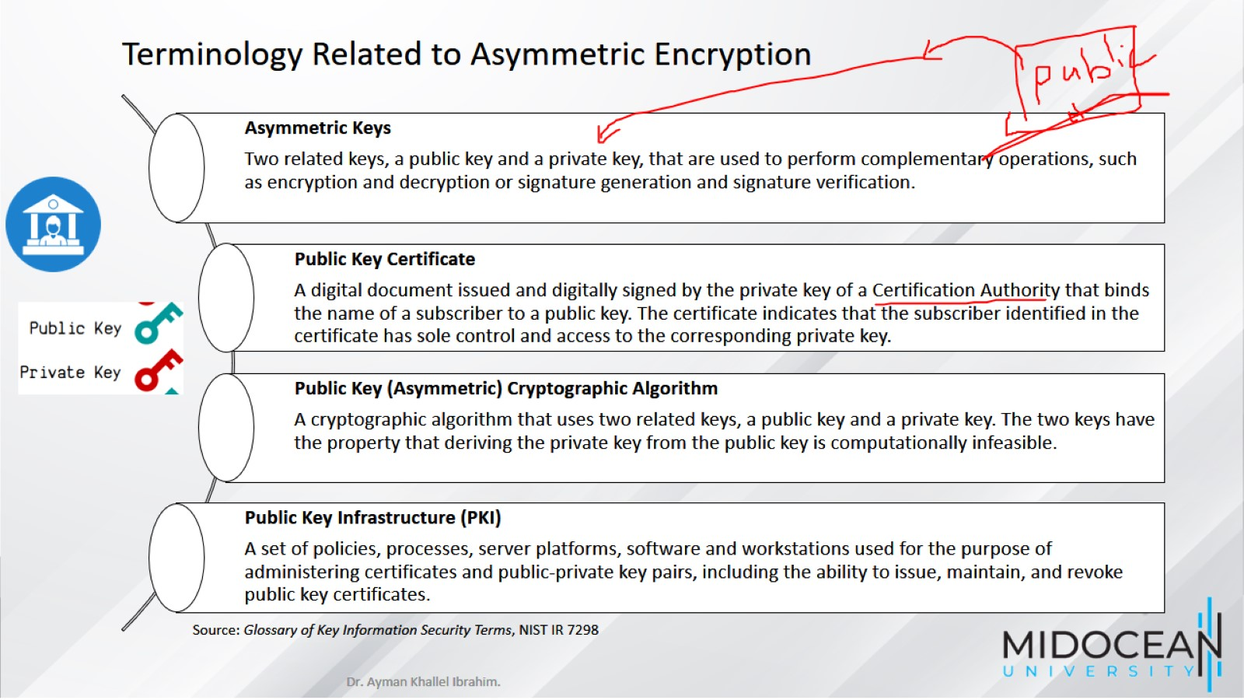

Slide 5
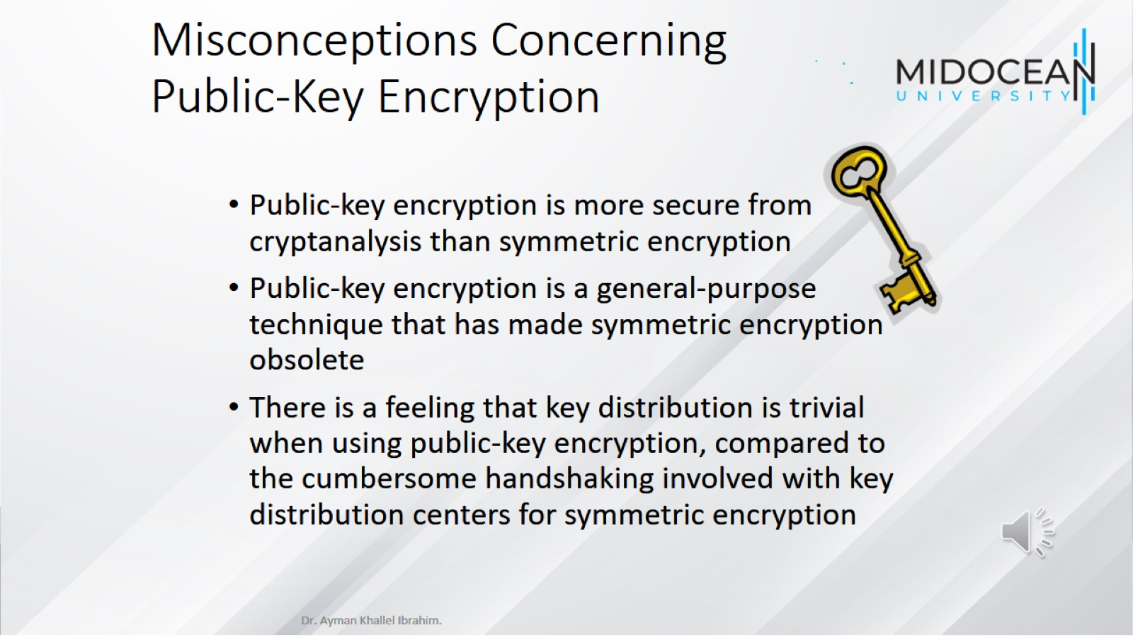
Misconceptions Concerning
Public-Key Encryption

Slide 6
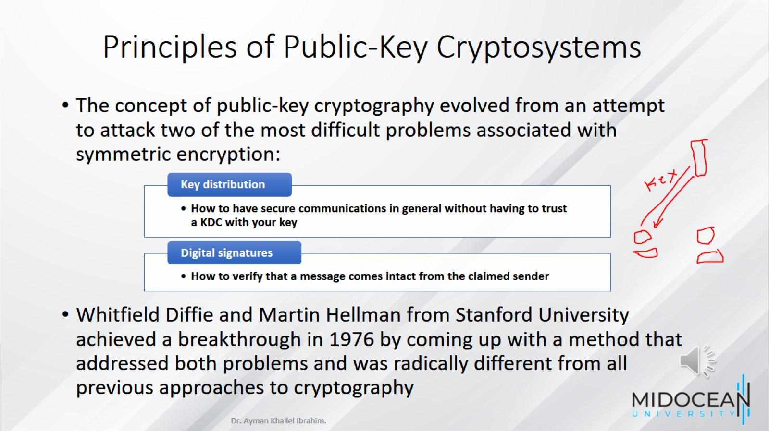
Principles of Public-Key Cryptosystems

Slide 7
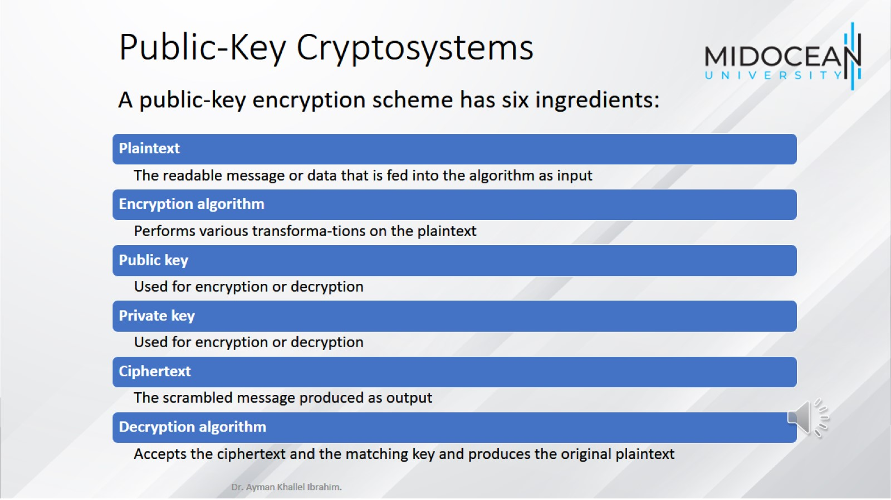
Public-Key Cryptosystems

Slide 8
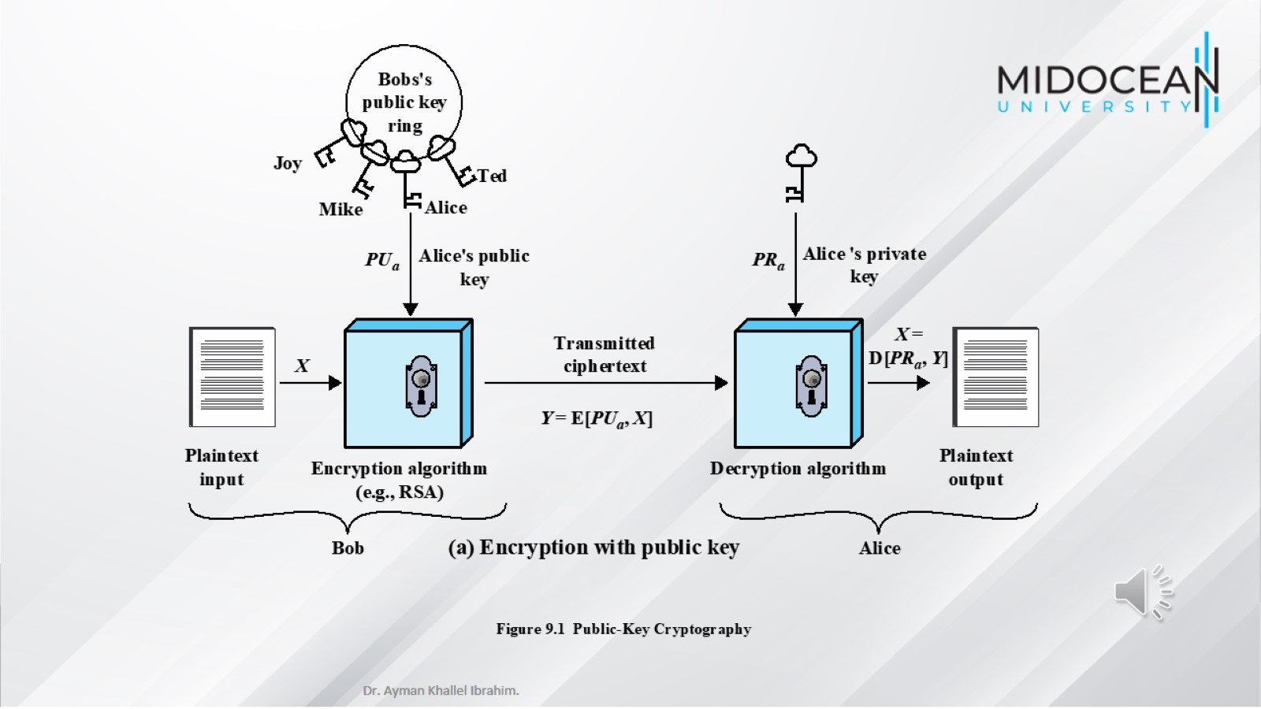

Slide 9
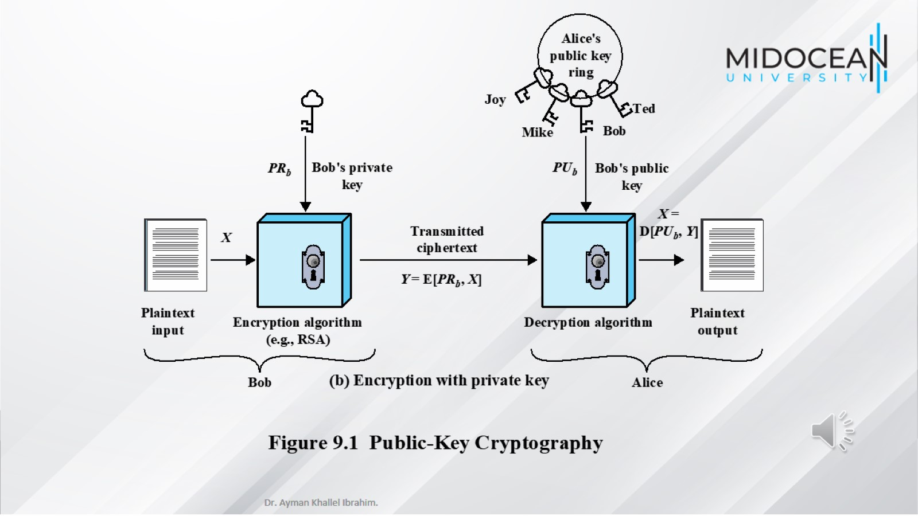

Slide 10
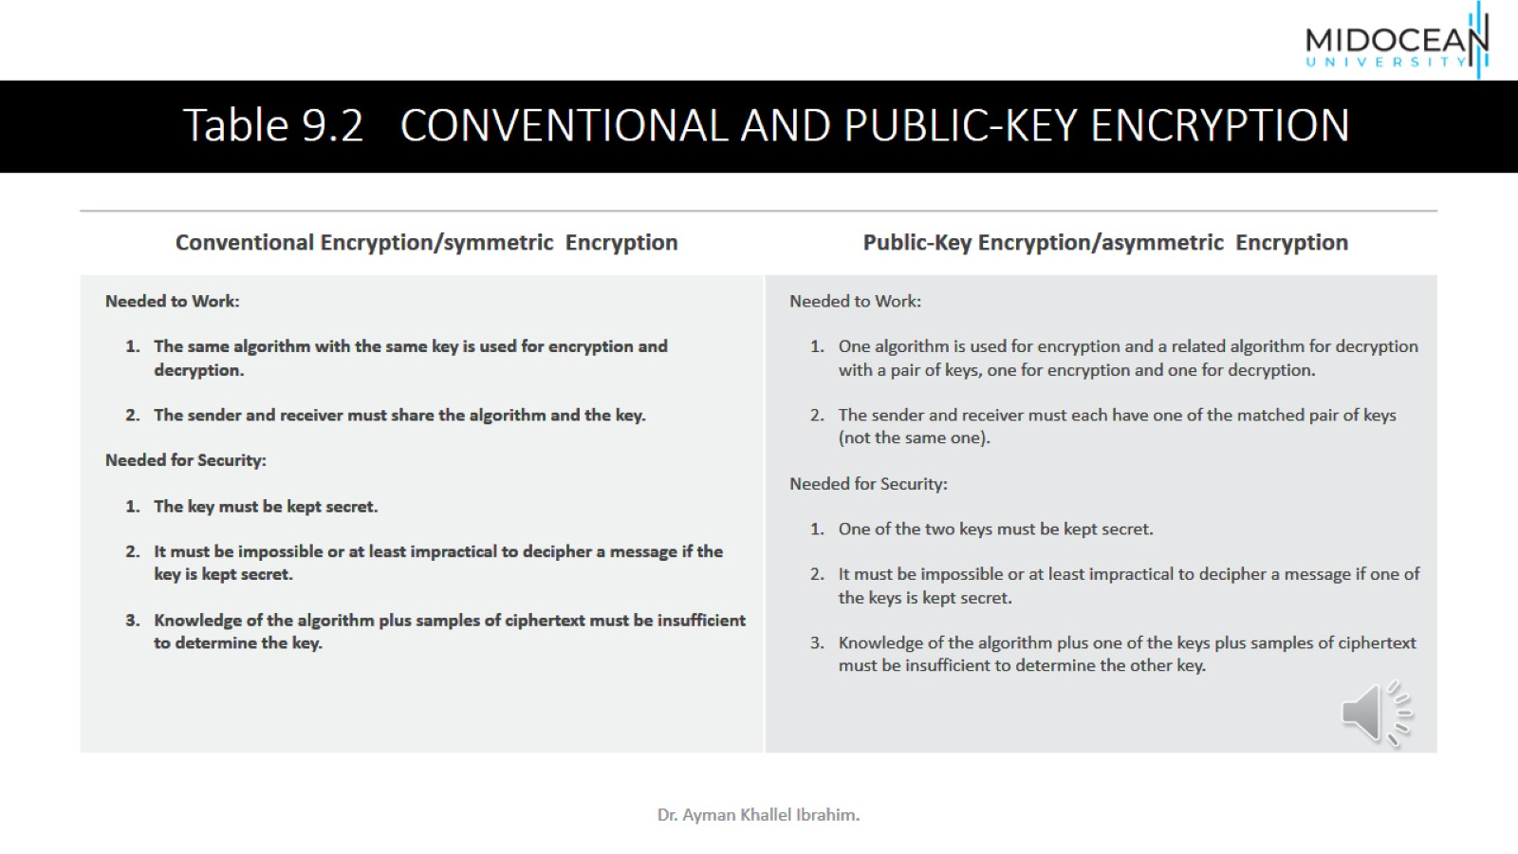

Slide 11
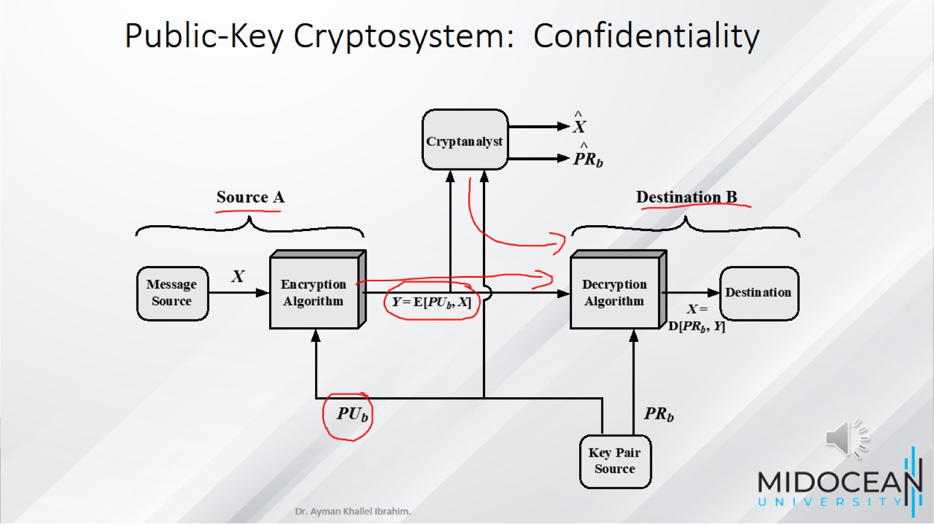
Public-Key Cryptosystem: Confidentiality

Slide 12
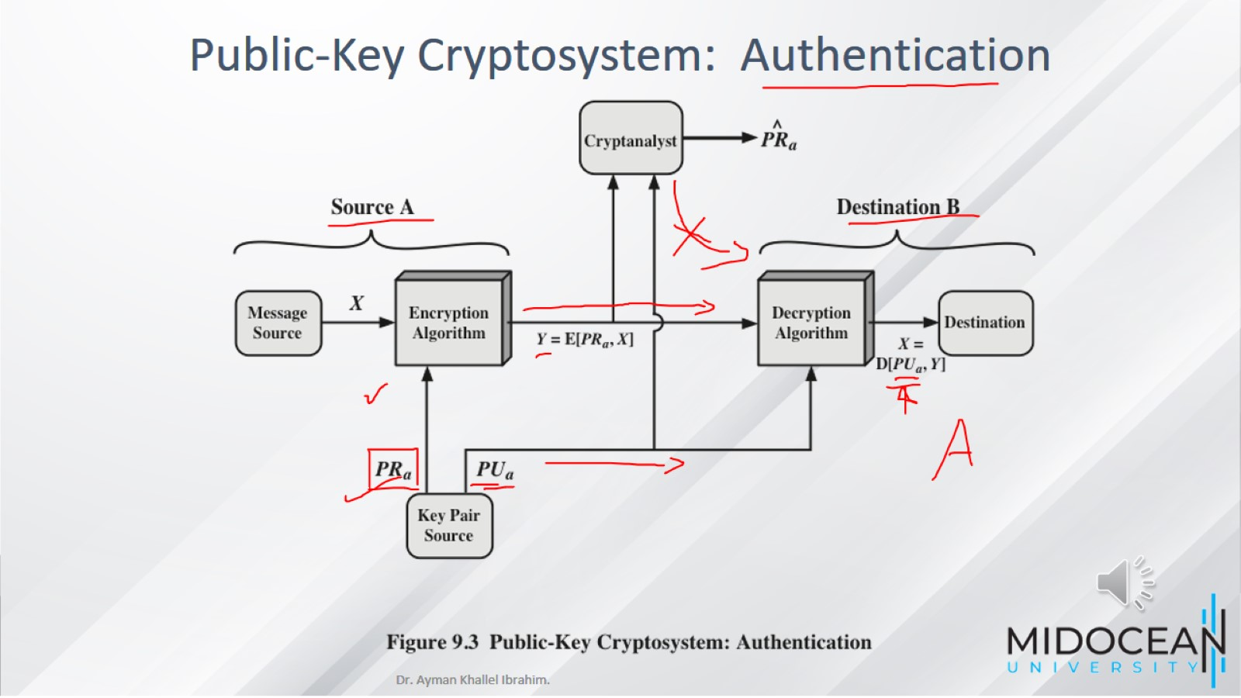

Slide 13
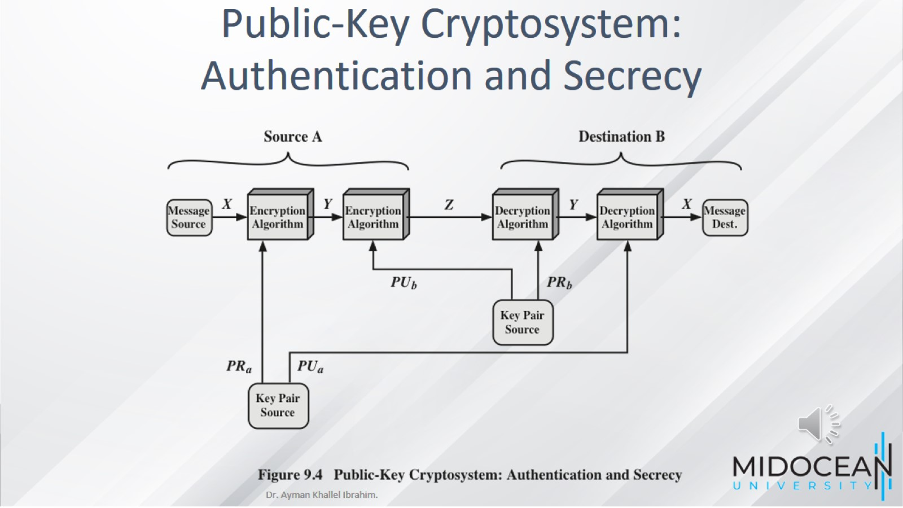

Slide 14
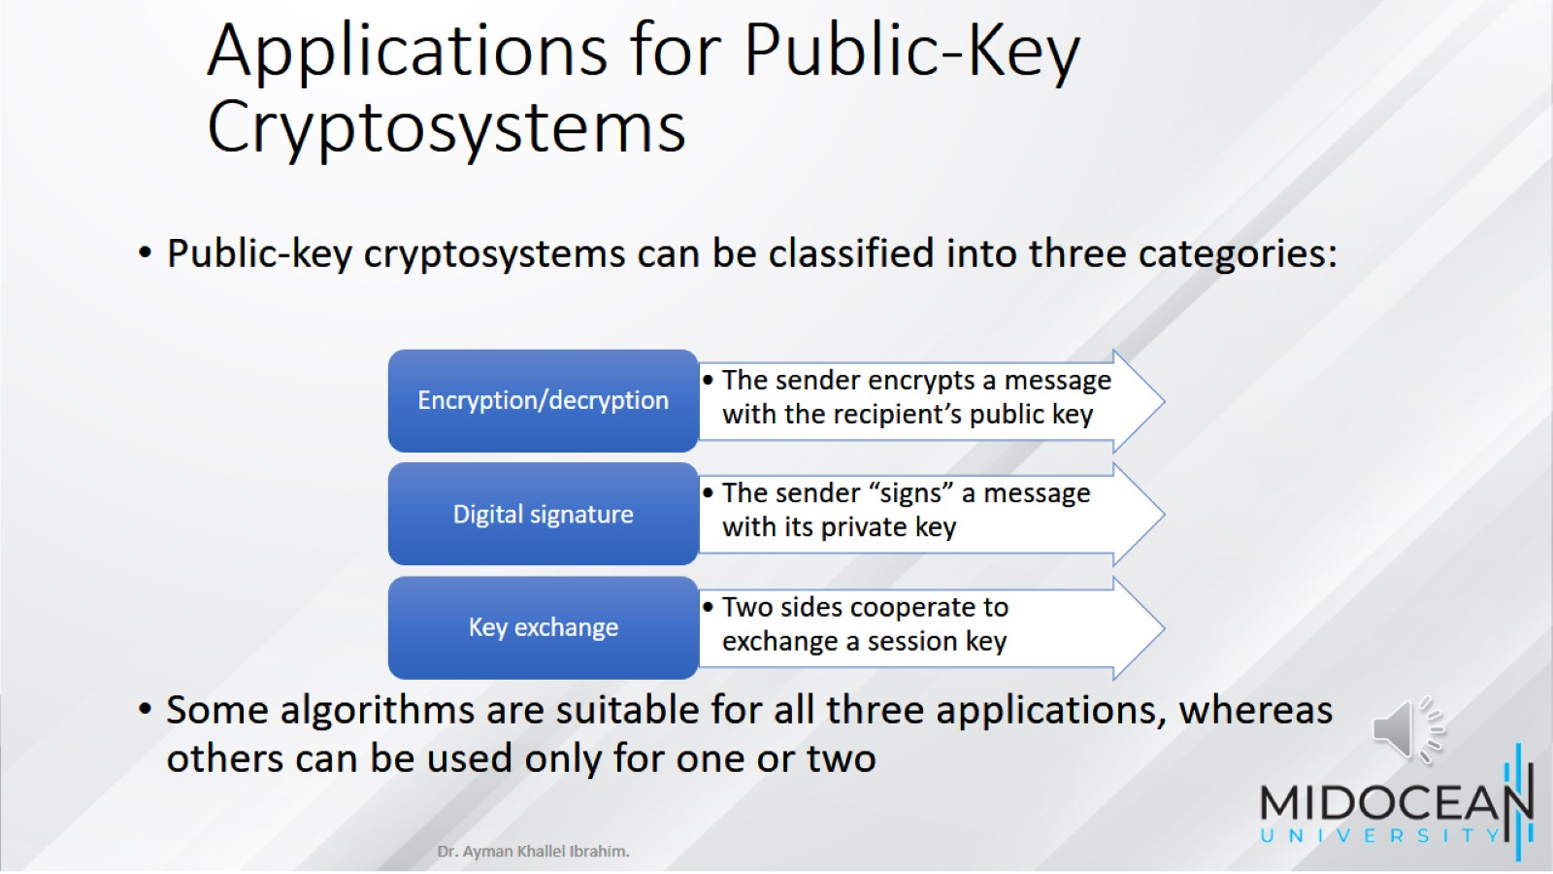
Applications for Public-Key Cryptosystems

Slide 15
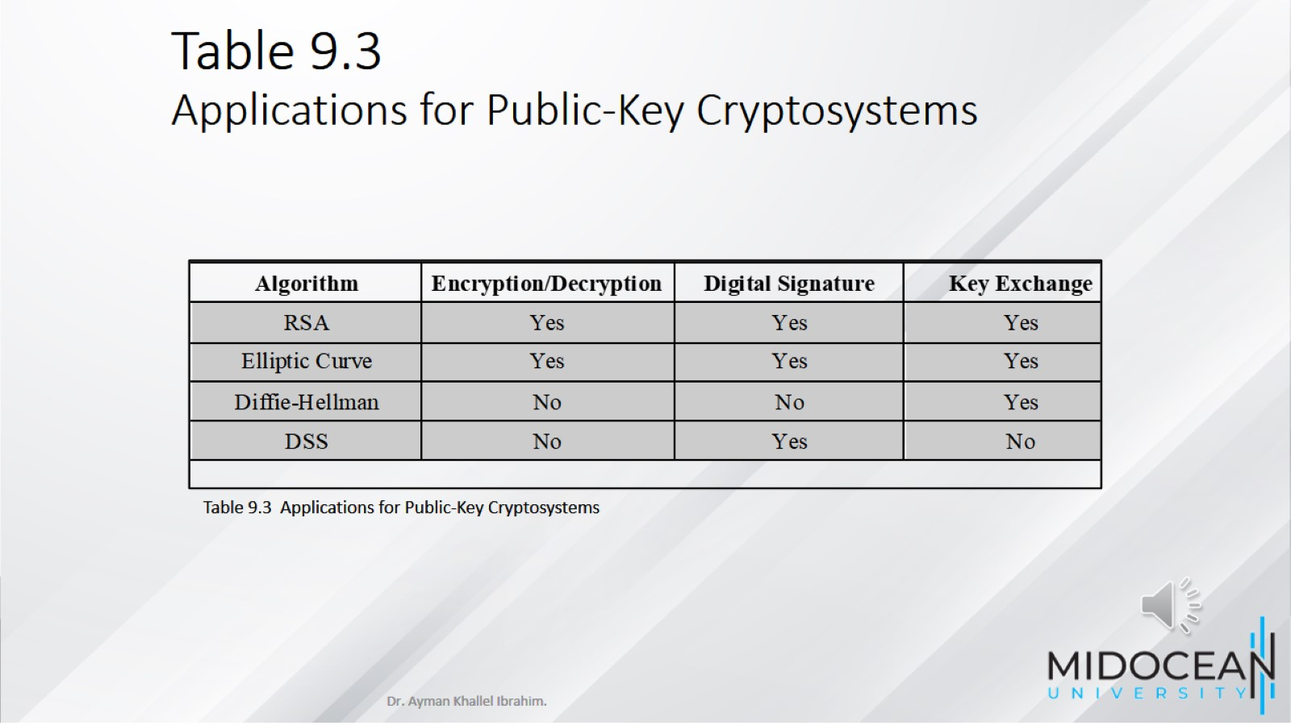
Table 9.3
Applications for Public-Key Cryptosystems

Slide 16
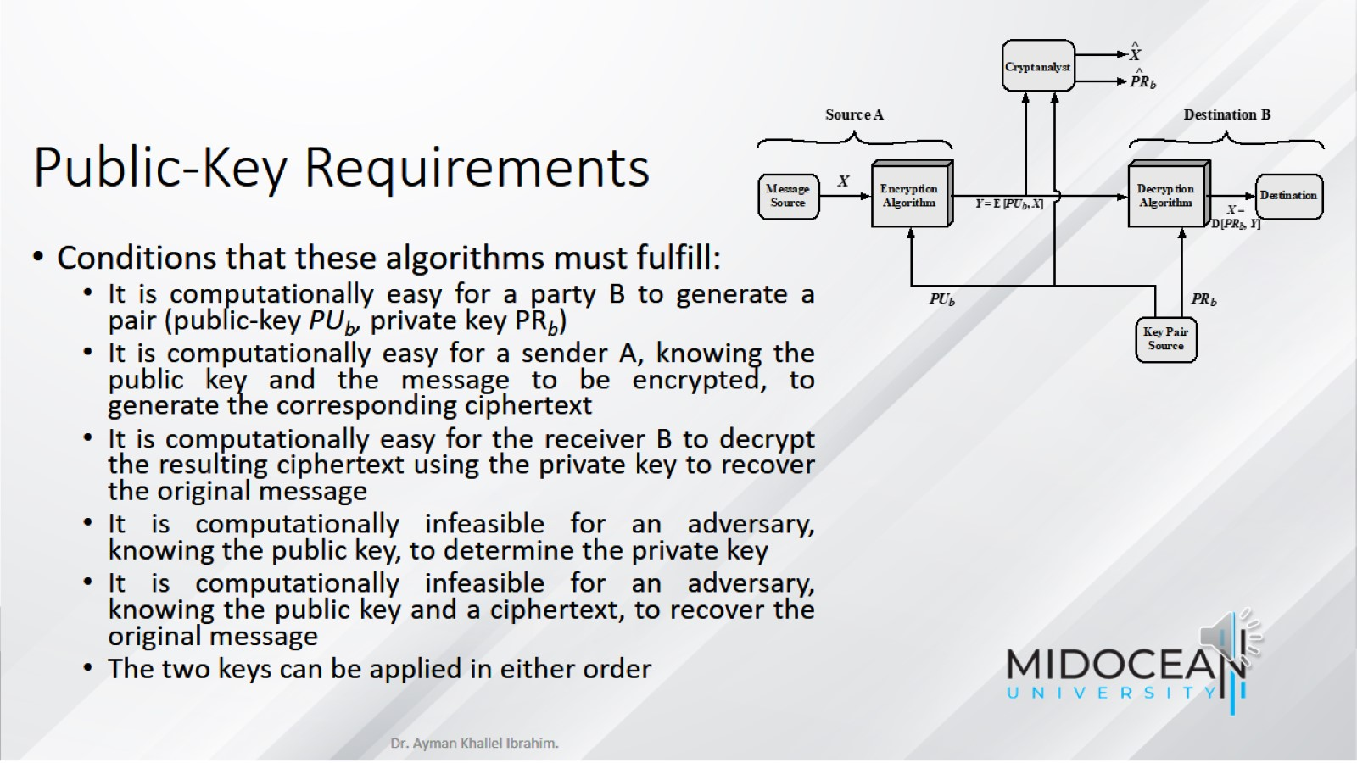
Public-Key Requirements

Slide 17
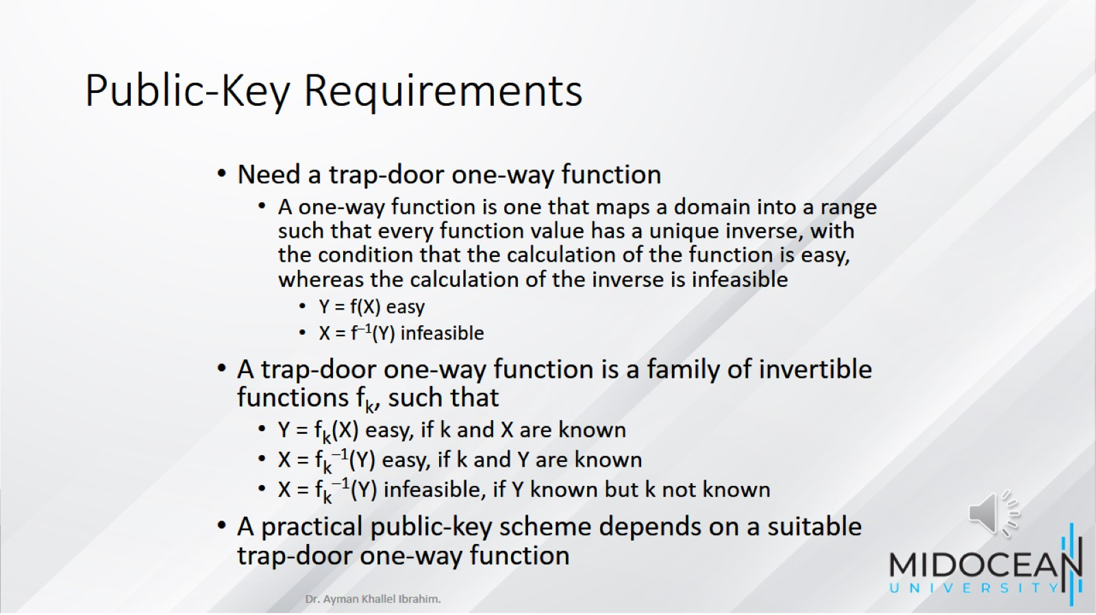
Public-Key Requirements

Slide 18
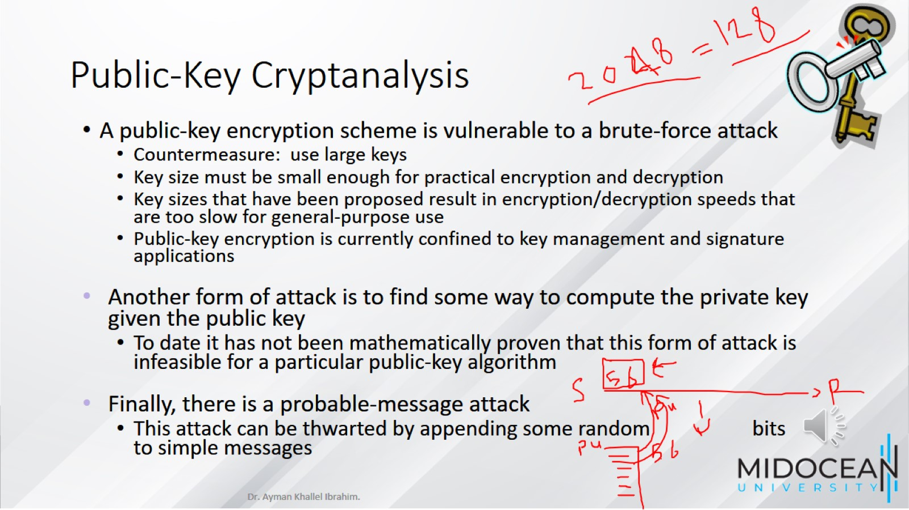
Public-Key Cryptanalysis

Slide 19
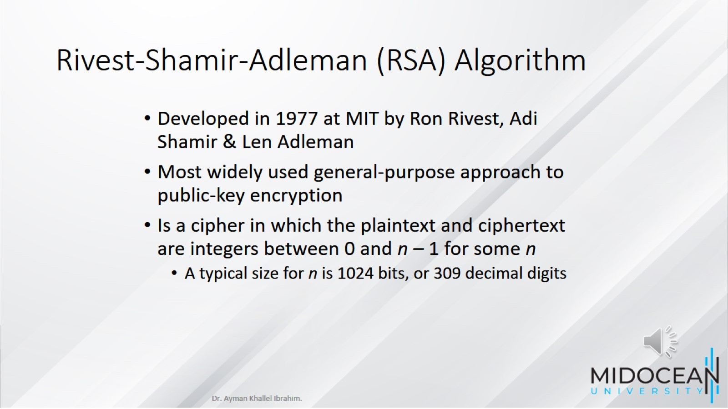
Rivest-Shamir-Adleman (RSA) Algorithm

Slide 20
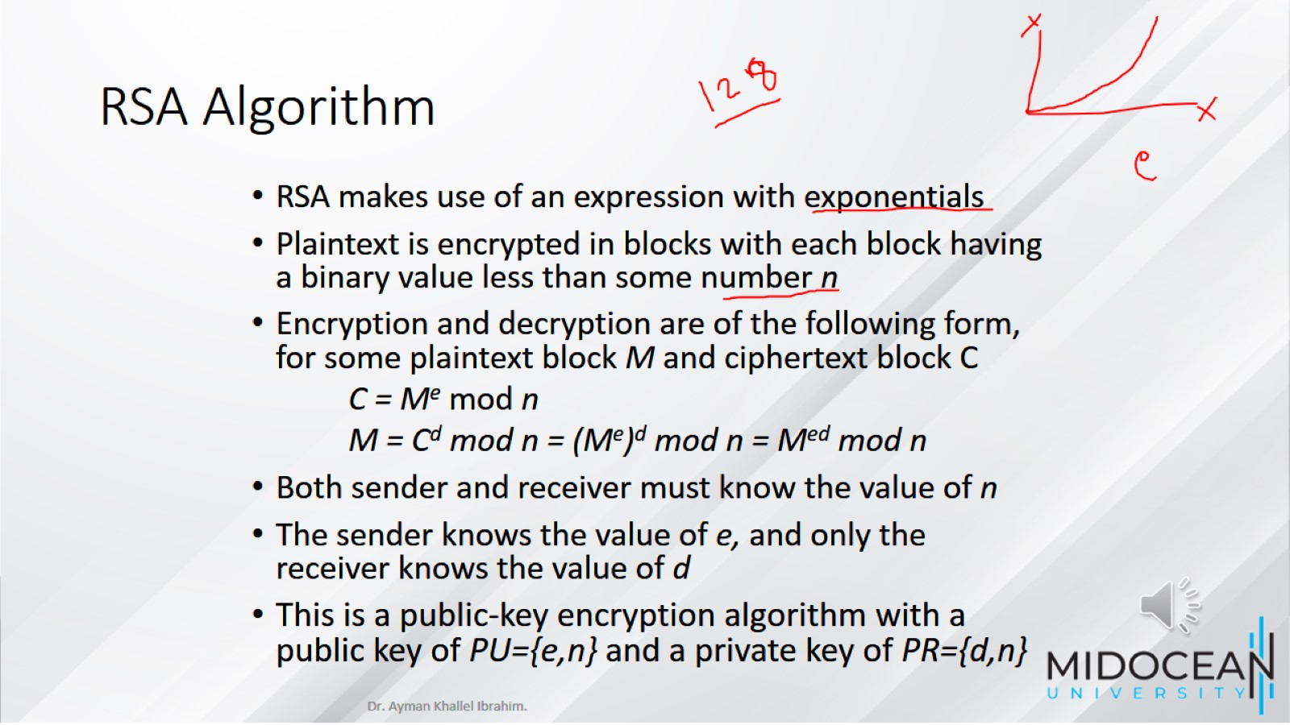
RSA Algorithm

Slide 21
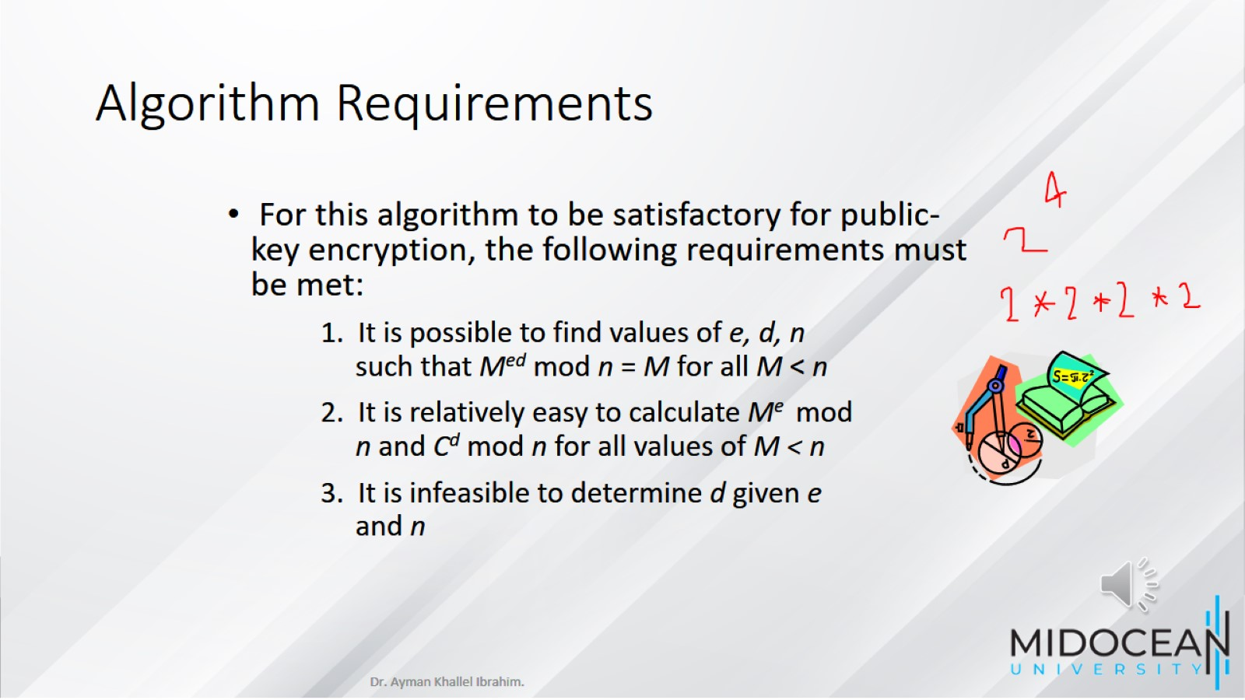
Algorithm Requirements

Slide 22
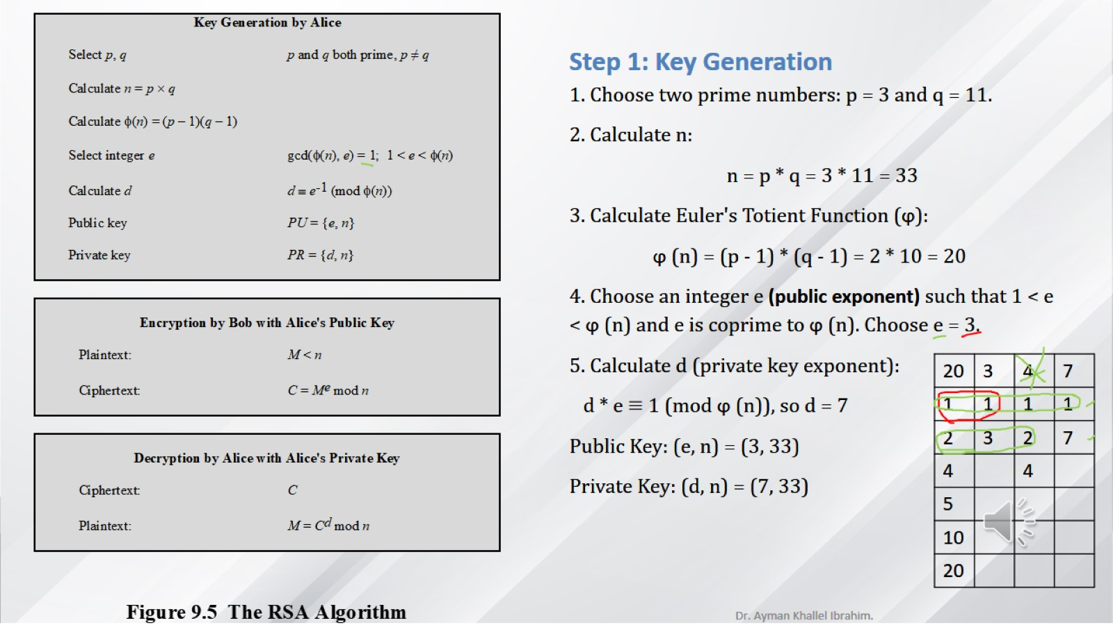

Slide 23
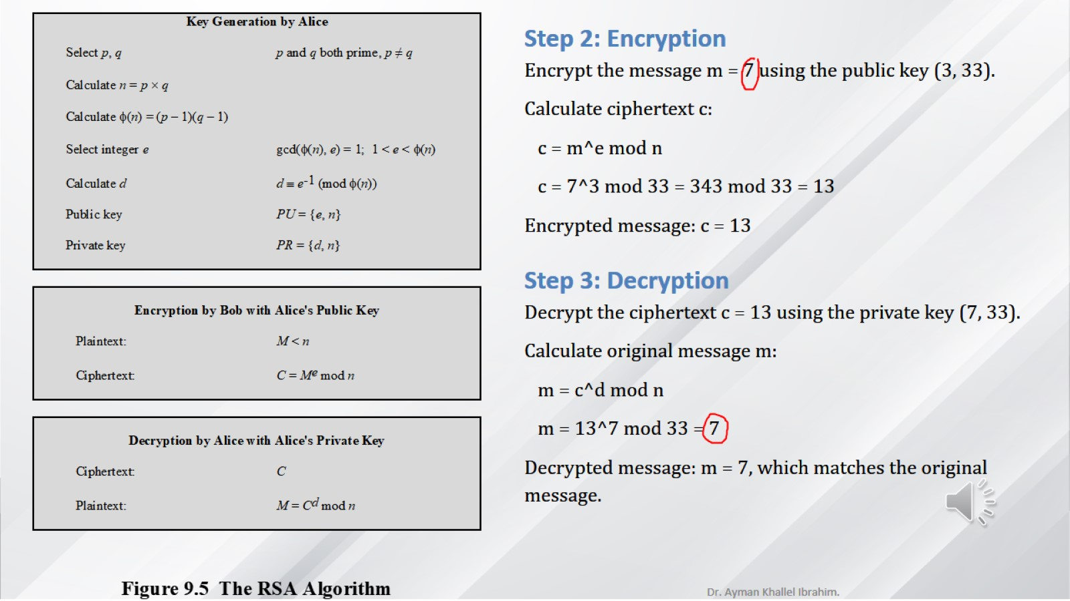

Slide 24
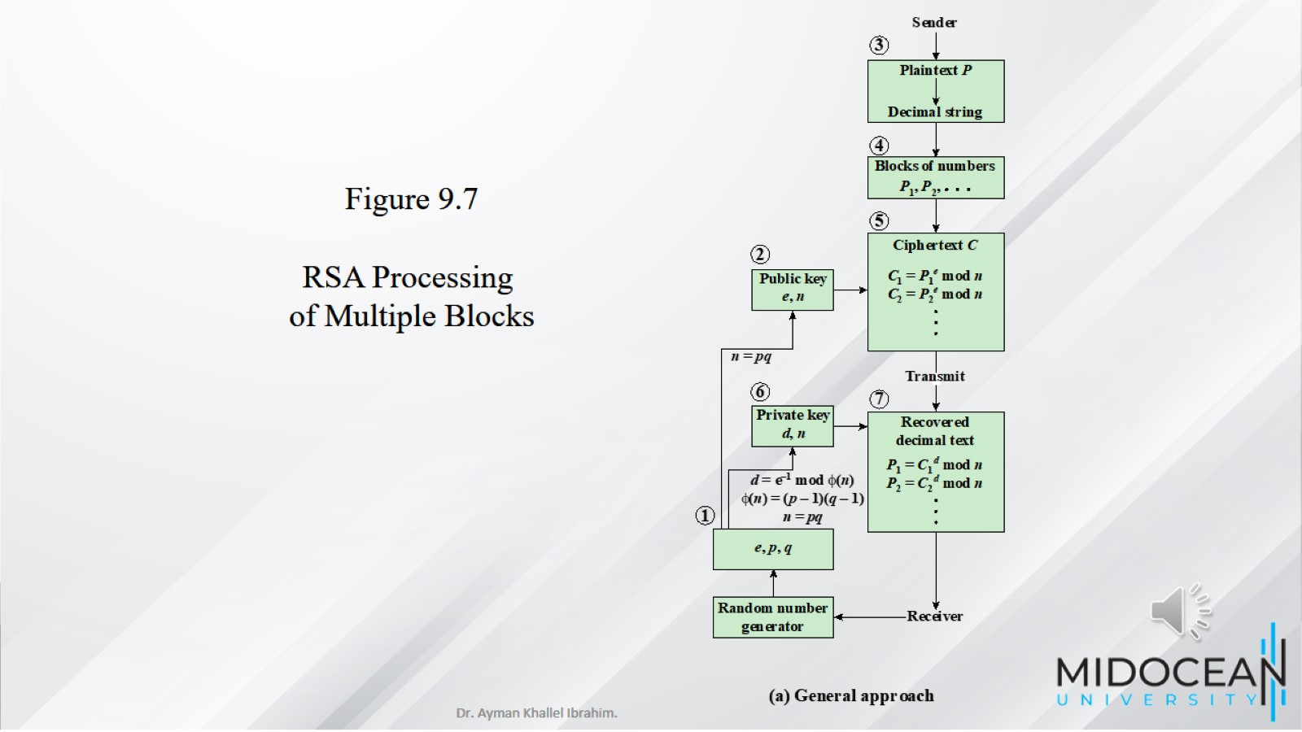

Slide 25
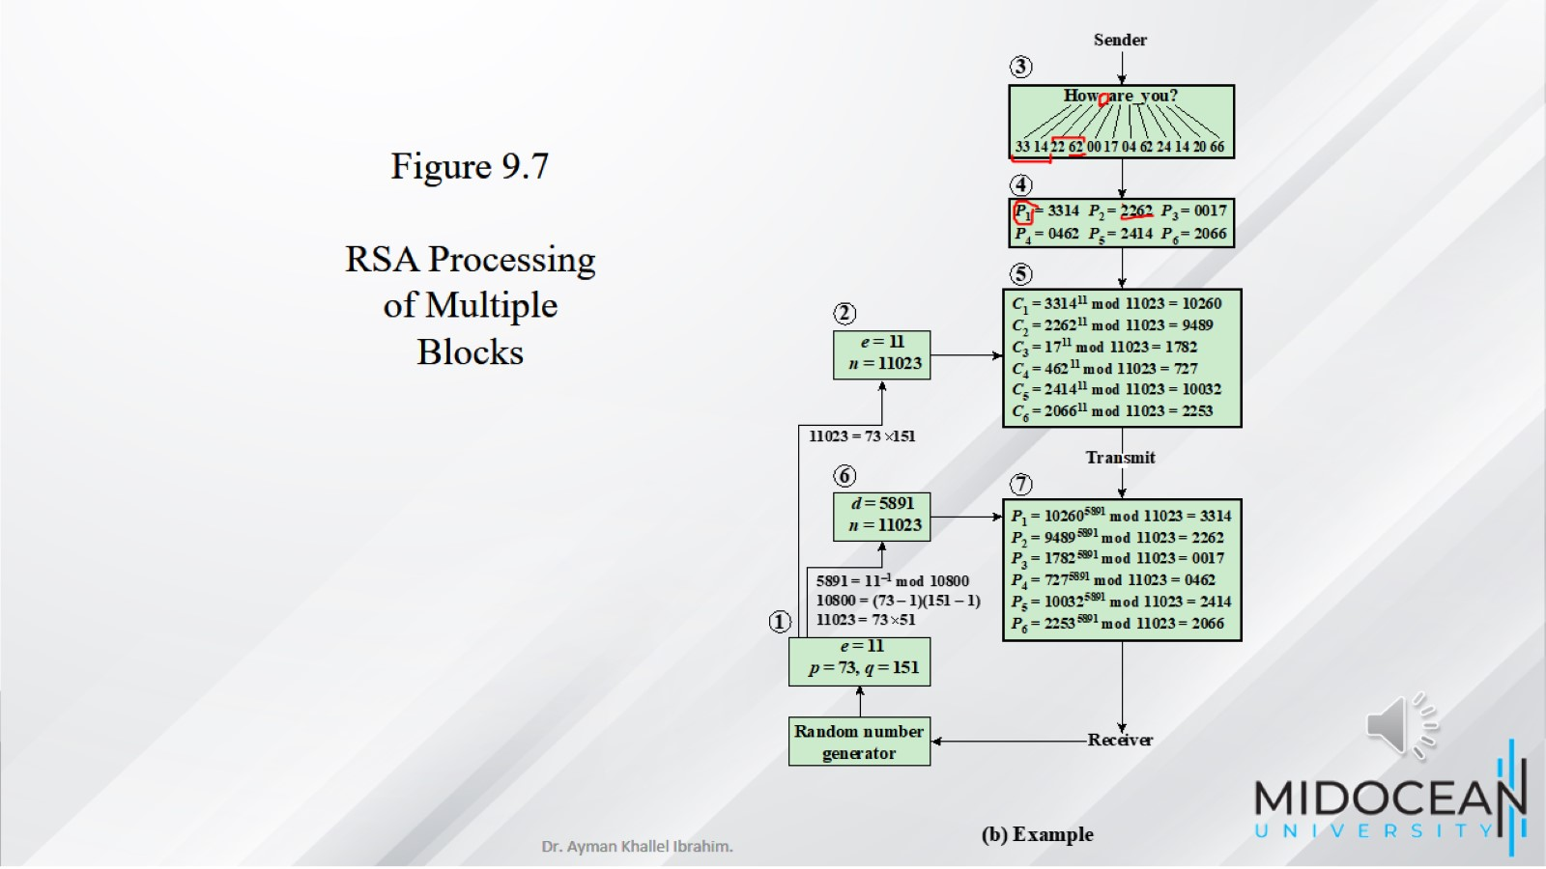

Slide 26
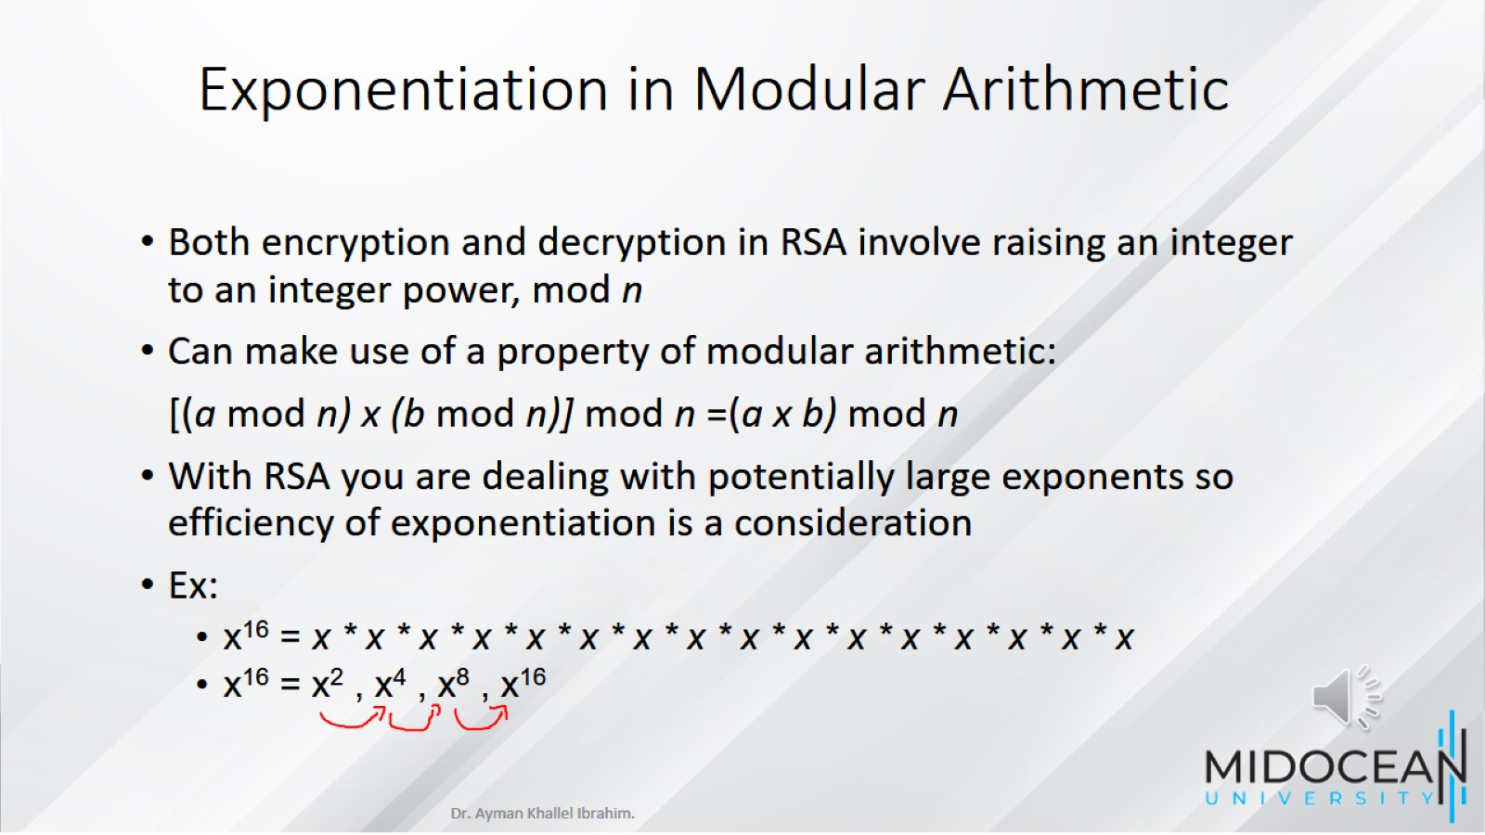
Exponentiation in Modular Arithmetic

Slide 27
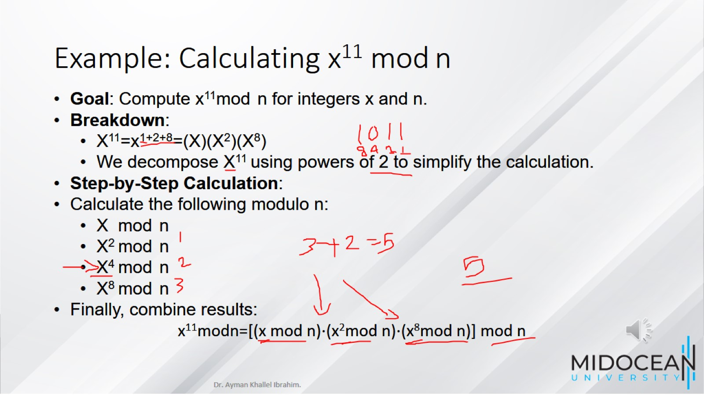
Example: Calculating x¹¹ mod n

Slide 28
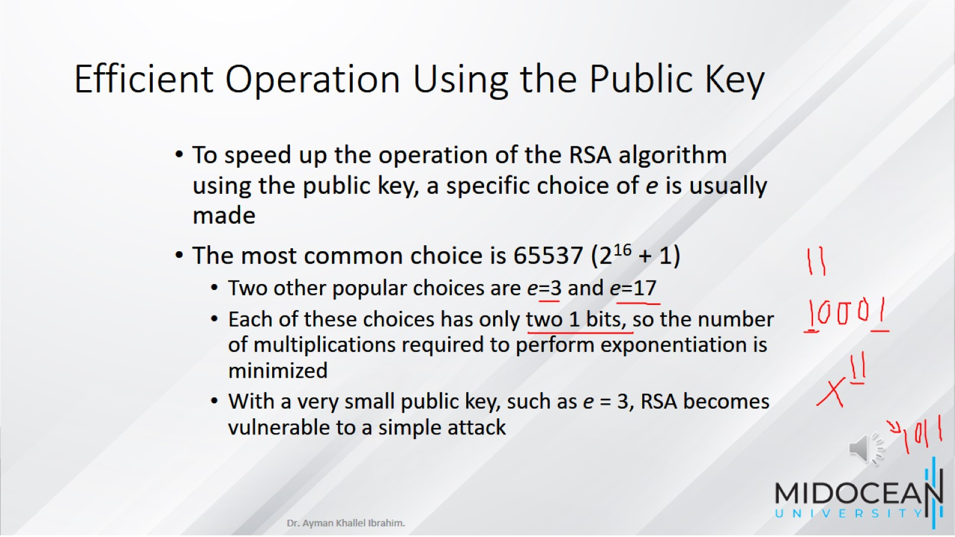
Efficient Operation Using the Public Key

Slide 29
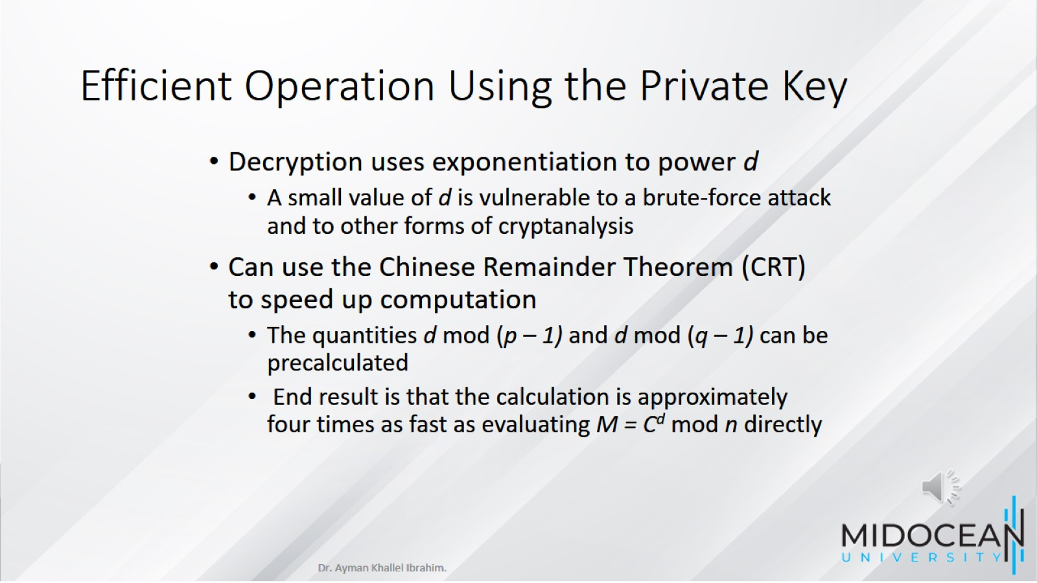
Efficient Operation Using the Private Key

Slide 30
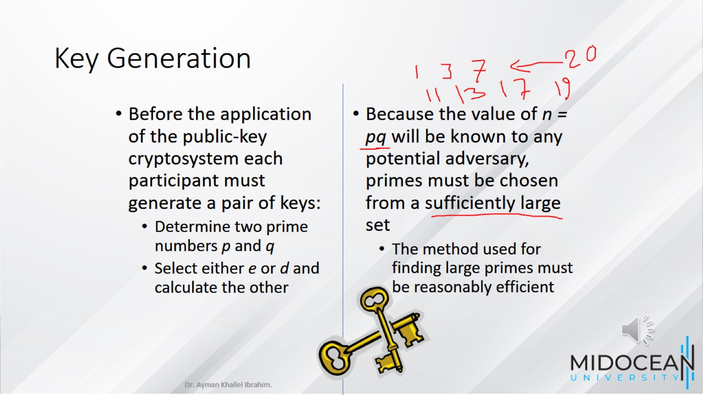
Key Generation

Slide 31
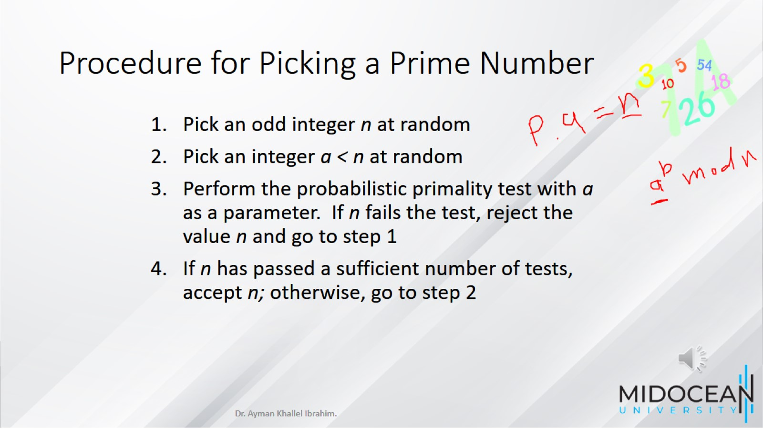
Procedure for Picking a Prime Number

Slide 32
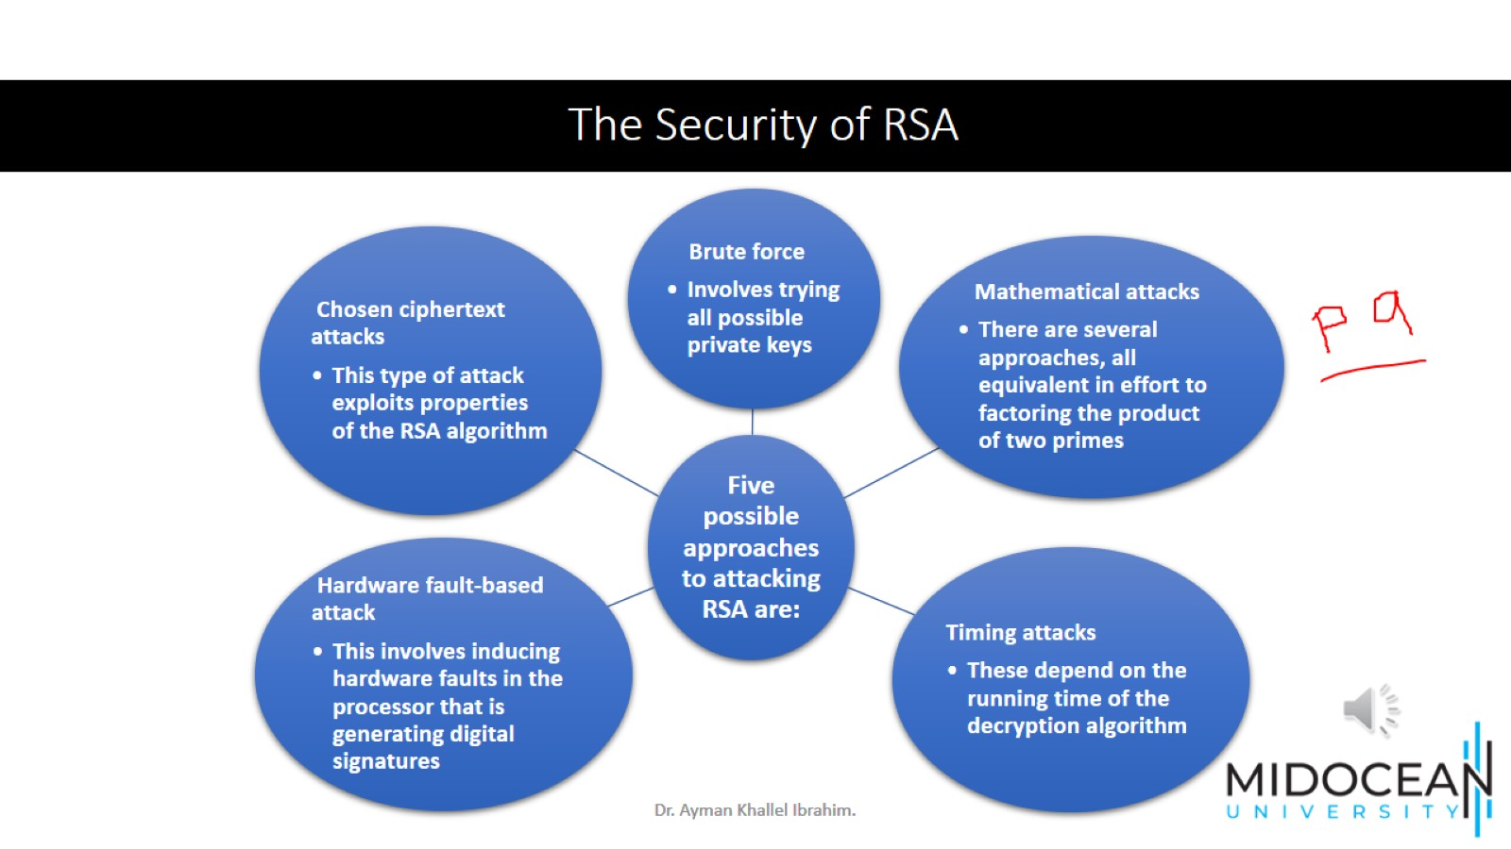
The Security of RSA

Slide 33
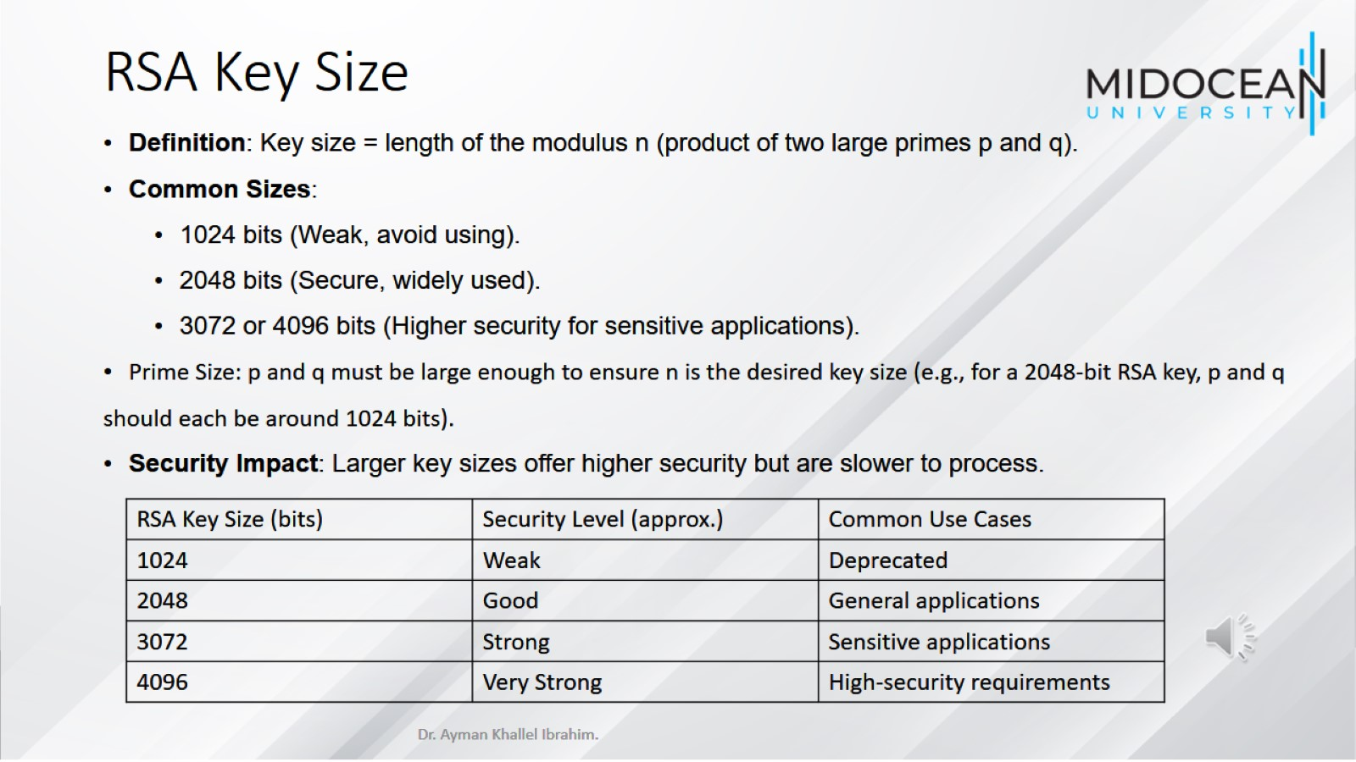
RSA Key Size

Slide 34
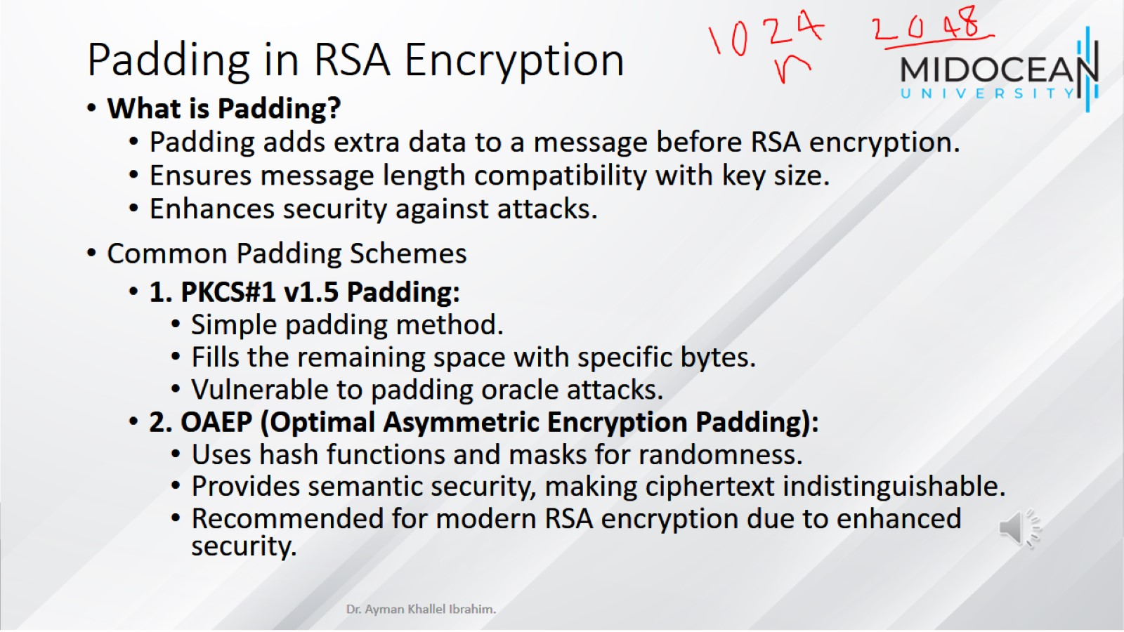
Padding in RSA Encryption

Slide 35
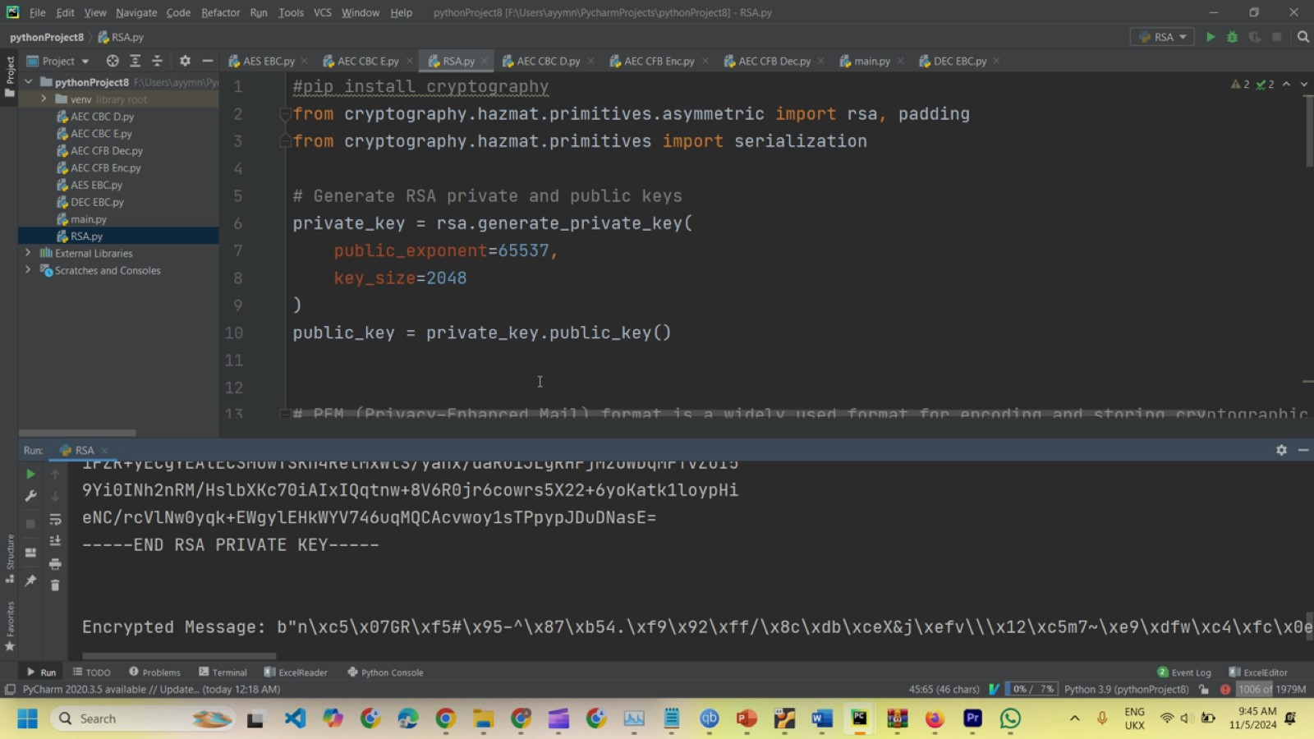

Slide 36
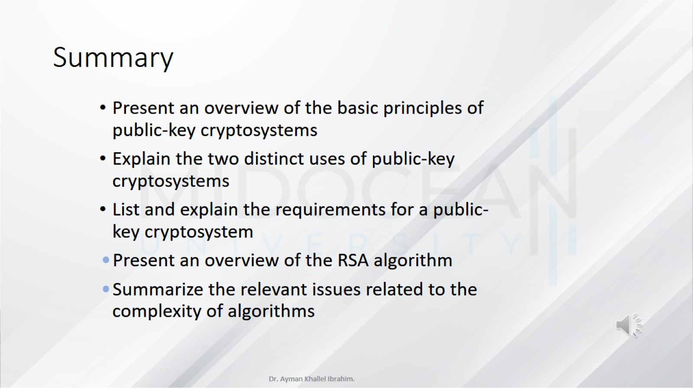
Summary

Slide 37


