Slide 1

Prepared by
Dr. Hamada I. AbdulWakel
Lecture 3
CYB615
Network Programming

Slide 2
Module2: Network Programming using
Python – Part II

Slide 3


Lecture 3
Agenda
Application Program Interface (API).
BeautifulSoup | Web Scraping.
Socket Programming in Python.

Slide 4
Lecture 3
Google Maps API (Geocoding)
Geocoding is the process of converting addresses (like "1600 Amphitheatre Parkway, Mountain View, CA") into geographic coordinates (like latitude 37.423021 and longitude -122.083739), which you can use to place markers on a map or position the map.
Reverse geocoding is the process of converting geographic coordinates into a human-readable address.
Google map API simulation
  Use this URL.

Slide 5
Lecture 3
Google Maps API (Geocoding)
Cont'd
import urllib.error, urllib.parse, urllib.request
import json
import ssl
api_key = False
if api_key is False:
api_key = 42
serviceurl = 'http://py4e-data.dr-chuck.net/json?'
else:
serviceurl='https://maps.googleapis.com/maps/api/geocode/json?'

Slide 6
Lecture 3
Google Maps API (Geocoding)
Cont'd
while True:
address = input("Enter location: ")
if len(address) < 1:
break
parms = dict()
parms['address'] = address
if api_key is not False: parms['key'] = api_key
url = serviceurl + urllib.parse.urlencode(parms)
print('Retrieving', url)

Slide 7
Lecture 3
Google Maps API (Geocoding)
Cont'd
while True:
...
urllib_handler = urllib.request.urlopen(url, context=ctx)
data = urllib_handler.read().decode()
print('Retrieved', len(data), 'characters')
try:
js = json.loads(data)
except:
js = None

Slide 8
Lecture 3
Google Maps API (Geocoding)
Cont'd
while True:
...
if 'status' not in js or js['status'] != 'OK':
print('Fail to retrieve data'); print(data); continue
print(json.dumps(js, indent=4))
lat = js['results'][0]['geometry']['location']['lat']
lng = js['results'][0]['geometry']['location']['lng']
location = js['results'][0]['formatted_address']
print('lat', lat, 'lng', lng); print(location)

Slide 9
Lecture 3
Web Scraping
When a program pretends to be a web browser and retrieves web pages, extracts information, and then looks at more pages.
This is what the search engine do.

Slide 10
Lecture 3
Why We Need Web Scraping?
Monitor a site for new information.
Make a database for a search engine.
Get your data from a system that has no export feature.
Pull social data.

Slide 11
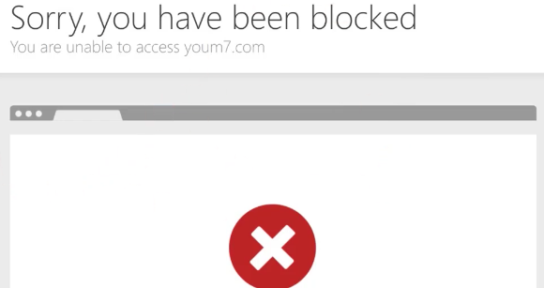
Lecture 3
Be Careful
There is some controversy about web scraping.
Do not republishing copyrighted material.
Do not violate terms of service.

Slide 12
Lecture 3
Beautiful Soup Module
Beautiful Soup is a Python library for pulling data out of HTML and XML files.
One of the important pieces of HTML document are tags, which may contain other tags/strings (tag’s children). Beautiful Soup provides different ways to navigate and iterate over’s tag’s children.
BeautifulSoup is the object created when we try to scrape a web resource. So, it is the complete document which we are trying to scrape.

Slide 13
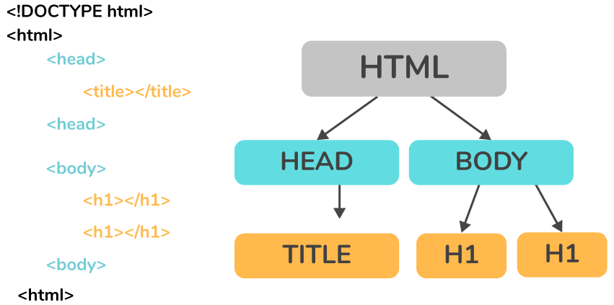
Lecture 3
Beautiful Soup Module
Cont'd

Slide 14
Lecture 3
Getting Basic – Making a Soup
Installation:
PyPi
Beautiful Soup supports different HTML parser such as:
  Html.parser: included in Python’s standard library
  Ixml pip install lxml
  Html5lib pip install html5lib

Slide 15
Lecture 3
Steps for Web Scraping
Inspect your data source: to understand the web site structure to extract the information that’s relevant for you.
Mac: Cmd+Alt+I
Windows/Linux: Ctrl+Shift+I
Scrape HTML content from a page: to get the site’s HTML code into your Python script so that you can interact with it.
Parse HTML code with BeautifulSoup: to make it more accessible and pick out the data you want.

Slide 16
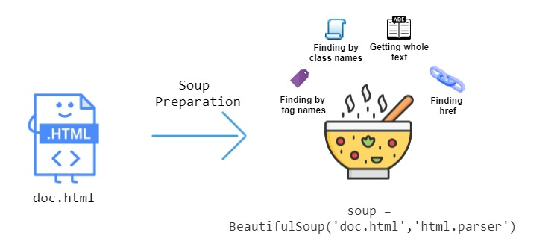
Lecture 3
Steps for Web Scraping
Cont'd

Slide 17
Lecture 3
Steps for Web Scraping
Cont'd
Parse HTML code with BeautifulSoup:
  Find element by ID:
  soup.find(id="idName")
  Find elements by HTML class name:
  soup.find_all("div", {"class":"cssClassName"})
  Extract text from HTML element:
  print(element.text)
  Find elements by class name and text content:
  soup.find_all("h2", string="Python")

Slide 18
Lecture 3
Web Scraping Example
import urllib.request
from bs4 import BeautifulSoup
url = 'http://www.dr-chuck.com/page1.htm'
html = urllib.request.urlopen(url).read()
soup = BeautifulSoup(html, 'html.parser')
tags = soup('a') #parsing anchor tags
for tag in tags:
print(tag.get('href'))

Slide 19
Lecture 3
Searching Job Example Using Wuzzuf
from itertools import zip_longest
import requests
from bs4 import BeautifulSoup
import csv
result = requests.get('https://wuzzuf.net/search/jobs/?q=python&a=hpb')
source = result.content
soup = BeautifulSoup(source, 'html.parser')
job_titles = soup.find_all("h2", {"class":"css-m604qf"})

Slide 20
Lecture 3
Searching Job Example Using Wuzzuf
Cont'd
company_names = soup.find_all("a", {"class":"css-17s97q8"})
locations = soup.find_all("span", {"class":"css-5wys0k"})
skills = soup.find_all("div", {"class":"css-y4udm8"})
print(len(job_titles))
jobs = []; comapnies = []; locs = []; skill = []
for i in range(len(job_titles)):
jobs.append(job_titles[i].text)
comapnies.append(company_names[i].text)
locs.append(locations[i].text)
skill.append(skills[i].text)

Slide 21
Lecture 3
Searching Job Example Using Wuzzuf
Cont'd
fileLists = [jobs, comapnies, locs, skill]
exported = zip_longest(*fileLists)
with open("/path/to/create/jobsResults.csv", "w") as f:
wr = csv.writer(f)
wr.writerow(["job title", "company name", "location", "skills"])
wr.writerows(exported)

Slide 22
Lecture 3
What are Sockets?
Sockets are the endpoints of a bidirectional communications channel.
Sockets may communicate within a process, between processes on the same machine, or between processes on different continents.
Sockets are a combinations of an IP address and a port.

Slide 23
Lecture 3
What are Sockets?
Cont'd
Protocol | Port Number | Python library | Function
HTTP | 80 | urllib | Web pages
FTP | 20 | ftplib | File transfer
SMTP | 25 | smtplib | Sending email
POP3 | 110 | poplib | Fetching email
Gopher | 70 | gopherlib | Document transfer

Slide 24
Lecture 3
The Socket Module
To create a socket, you must use the socket.socket() function available in socket module, which has the general syntax:
s = socket.socket (socket_family, socket_type, protocol=0)
The description of the parameters:
socket_family: This is either AF_UNIX or AF_INET
socket_type: This is either SOCK_STREAM or SOCK_DGRAM.
protocol: This is usually left out, defaulting to 0.

Slide 25
Lecture 3
The Socket Module
Cont'd
Method | Description
socket.socket() | Used to create sockets one for the server and another for the client.
socket.accept() | Used to accept a connection
socket.bind() | Used to bind to the address that is specified as a parameter.
socket.close() | Used to mark the socket as closed.
socket.connect() | Used to connect to a remote address that is specified as a parameter.
socket.listen() | Used to enable the server to accept a connection.

Slide 26
THANK YOU

