Slide 1



ORG 123
Organizational
Behavior
Lecture 8
Prepared by
Dr. Walid K. El Leithy
www.midocean.ae

Slide 2
Leadership qualities
This chapter discusses ten qualities that make a leader and influence the leadership process
  Vision
  Ability
  Enthusiasm
  Stability
  Concern for Others
  Self-Confidence
  Persistence
  Vitality
  Charisma
  Integrity

Slide 3
Vision
A leader requires a strong sense of purpose
  Recognizes what must be done and does it
  Inspires others
  Causes him/her to accept the leadership duties
  Evokes power
Questions to ask:
  Do I have a plan?
  What is the vision for this department or organization?

Slide 4
Ability
Leaders must know the job
  Employees do not respect, and lose faith in,
  leaders who:
    Fail to understand the job
    Rely on others when making decisions, giving guidance, or solving problems
Leaders must also:
  Keep job knowledge current
  Have an ability to understand information, formulate strategies, and make decisions

Slide 5
Ability
Questions to ask:
  How competent am I?
  Am I current in my field?
  Do I set an example?
  Do I keep job knowledge current?
  Are my perceptions accurate?
  Is my memory good?
  Are my judgments sound?

Slide 6
Enthusiasm
An important trait of a leader:
  Causes others to become interested and willing to accept the leader’s accomplishments
  Leaders can generate enthusiasm in followers
Questions to ask:
  Do I care about what I am doing, personally and deeply?
  Do I show enthusiasm to my employees?
  Does my enthusiasm ignite others to take action?

Slide 7
Stability
Leaders must understand their world and how it relates to others
Leaders should not:
  Bring personal problems to work
  Be emotionally unstable
Questions to ask:
  Do I possess objectivity?
  Do I convey stability to the employees?
  Do personal problems interfere with my judgment?

Slide 8
Concern for Others
The heart of caring leadership
  Leaders must:
    Never look down on others or treat people as machines
    Be concerned about others’ welfare
  Caring leaders never tear down, downgrade, or diminish others
  Leaders should possess humility and selflessness
    When the interests of others are put first,
    loyalty is built

Slide 9
Concern for Others
Questions to ask:
  Do I care about my employees as people?
  Do I ever demean ( cause people to feel less respected) people?
  Do I lift up my employees?
  Do my employees know
  that I value them?

Slide 10
Self Confidence
Gives the leader inner strength to overcome tasks
  People question a leader lacking self-confidence
  Successful leaders stay calm and confident
  Grace under pressure inspires others
Questions to ask:
  What is my self-confidence level?
  Do I show confidence in my actions?
  Have I done the homework and preparation to build self-confidence?

Slide 11
Persistence
Drive and determination are:
  Important for business success
  Important on the battlefield
Questions to ask:
  Do I have self-drive and the
  unflagging persistence to overcome adversity ( difficult situations)?

Slide 12
Vitality
Leaders need strength and stamina
  Effective leaders are electric, vigorous, active, and full of life, regardless of age or disability
To achieve goals, leaders need stamina, energy, health, and vigor
Questions to ask:
  Am I fit for the tasks of leadership?
  Do I have energy?
  Am I doing everything I can to keep strong?

Slide 13
Charisma
A quality that generates others’ interest and creates followers
  Charismatic leaders show optimism, a sense of adventure, and commitment
  Results in admiration, enthusiasm, and loyalty of followers
Questions to ask:
  Do I possess a positive outlook and commitment that promotes follower loyalty?

Slide 14
Integrity
The most important quality of leadership
  Honesty, strength of character, and courage
Leads to trust
  Trust leads to respect, loyalty, and action
Questions to ask:
  Do my people trust me?
  Do they know that I seek the truth and am true to my word?
  Do they see that I possess strength of character?

Slide 15
The Study of Followership
  The study of followership is integral to a better understanding of leadership, as the success and failure of groups, organizations, and teams is not only dependent on how well a leader can lead, but also on how well the followers can follow. Specifically, followers play an active role in organization, group, and team successes and failures.

Slide 16
Characteristics of Good Effective Followers
Self-Management: This refers to the ability to think critically, to be in control of one’s actions, and work independently. It is important that followers manage themselves well as leaders are able to delegate tasks to these individuals.

Slide 17
Characteristics of Good Effective Followers
Commitment: This refers to an individual being committed to the goal, vision, or cause of a group, team, or organization. This is an important quality of followers as it help keep one’s (and other member’s) morale and energy levels high.

Slide 18
Characteristics of Good Effective Followers
Competence: It is essential that individuals possess the skills and aptitudes necessary to complete the goal or task or the group, team, or organization. Individuals high on this quality often hold skills higher than their average co-worker (or team member). Further, these individuals continue their pursuit of knowledge by upgrading their skills through classes and seminars.

Slide 19
Characteristics of Good Effective Followers
Courage: Effective followers hold true to their beliefs and maintain and uphold ethical standards, even in the face of dishonest or corrupt superiors (leaders). These individuals are loyal and honest.

Slide 20
Fellowship Type ( Followers or Non- Followers
Kelley identified two underlying behavioral dimensions that help identify the difference between followers and non-followers. The first behavioral dimension is whether or not the individual is an independent, critical thinker. The second dimension is whether or not the individual is active or passive. From these dimensions, Kelley has identified five followership patterns, or types of followers:

Slide 21
Fellowship Type ( Followers or Non- Followers
The Sheep: These individuals are passive and require external motivation from the leader. These individuals lack commitment and require constant supervision from the leader.

Slide 22
Fellowship Type ( Followers or Non- Followers)
The Yes-People: These individuals are committed to the leader and the goal (or task) of the organization (or group/team). These conformist individuals do not question the decisions or actions of the leader. Further, yes-people will defend adamantly their leader when faced with opposition from others.

Slide 23
Fellowship Type ( Followers or Non- Followers)
The Pragmatics: These individuals will not stand behind controversial or unique ideas until the majority of the group has expressed their support. These individuals often remain in the background of the group.

Slide 24
Fellowship Type ( Followers or Non- Followers)
The Alienated: These individuals are negative and often attempt to bring the group down by constantly questioning the decisions and actions of the leader. These individuals often view themselves as the rightful leader of the organization and are critical of the leader and fellow group members.

Slide 25
Fellowship Type ( Followers or Non- Followers)
The Star Followers: These exemplary individuals are positive, active, and independent thinkers. Star followers will not blindly accept the decisions or actions of a leader until they have evaluated them completely. Furthermore, these types of followers can succeed without the presence of a leader.

Slide 26
Characteristics of Followers
Leadership requires adjustment to followers’ ideas and expectations
  Past leaders:
    Ruled with authority
    Forced employees to obey
    Fired or punished employees
  Defenses developed by employees:
    Organized unions
    Created legislation

Slide 27
Characteristics of Followers
Effective leaders avoid the power tactics of
the past
  Threatening employees is counterproductive
Leaders today:
  Motivate employees
  Function as facilitators
  Believe that trust and respect should be earned

Slide 28
The Importance of Trust
Stuart Levine and Michael Crom
  Wrote about building trust in the workplace
  Principles of trust for effective leadership:
    Deal openly with everyone
    Consider all points of view
    Keep promises
    Give responsibility
    Listen to understand
    Care about people

Slide 29
Factors Affecting Leadership Process
Situational factors influence the leadership process:
  1- Size of the organization
  2- Social and psychological climate
  3- Patterns of employment
  4- Type, place, and purpose of work performed
  5- Organizational Life Cycle
  6- Culture of the organization
  7- Leader-follower compatibility

Slide 30
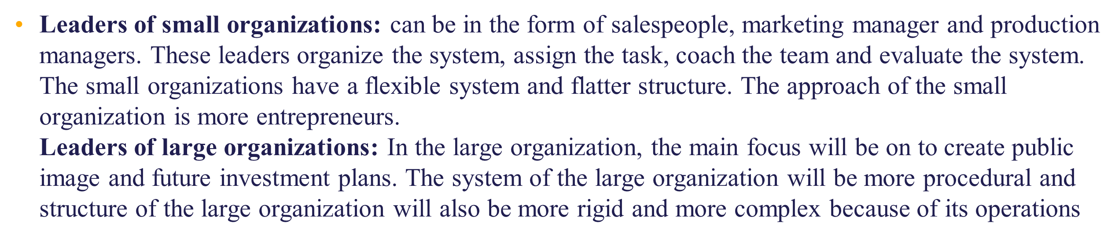
Size of the Organization

Slide 31
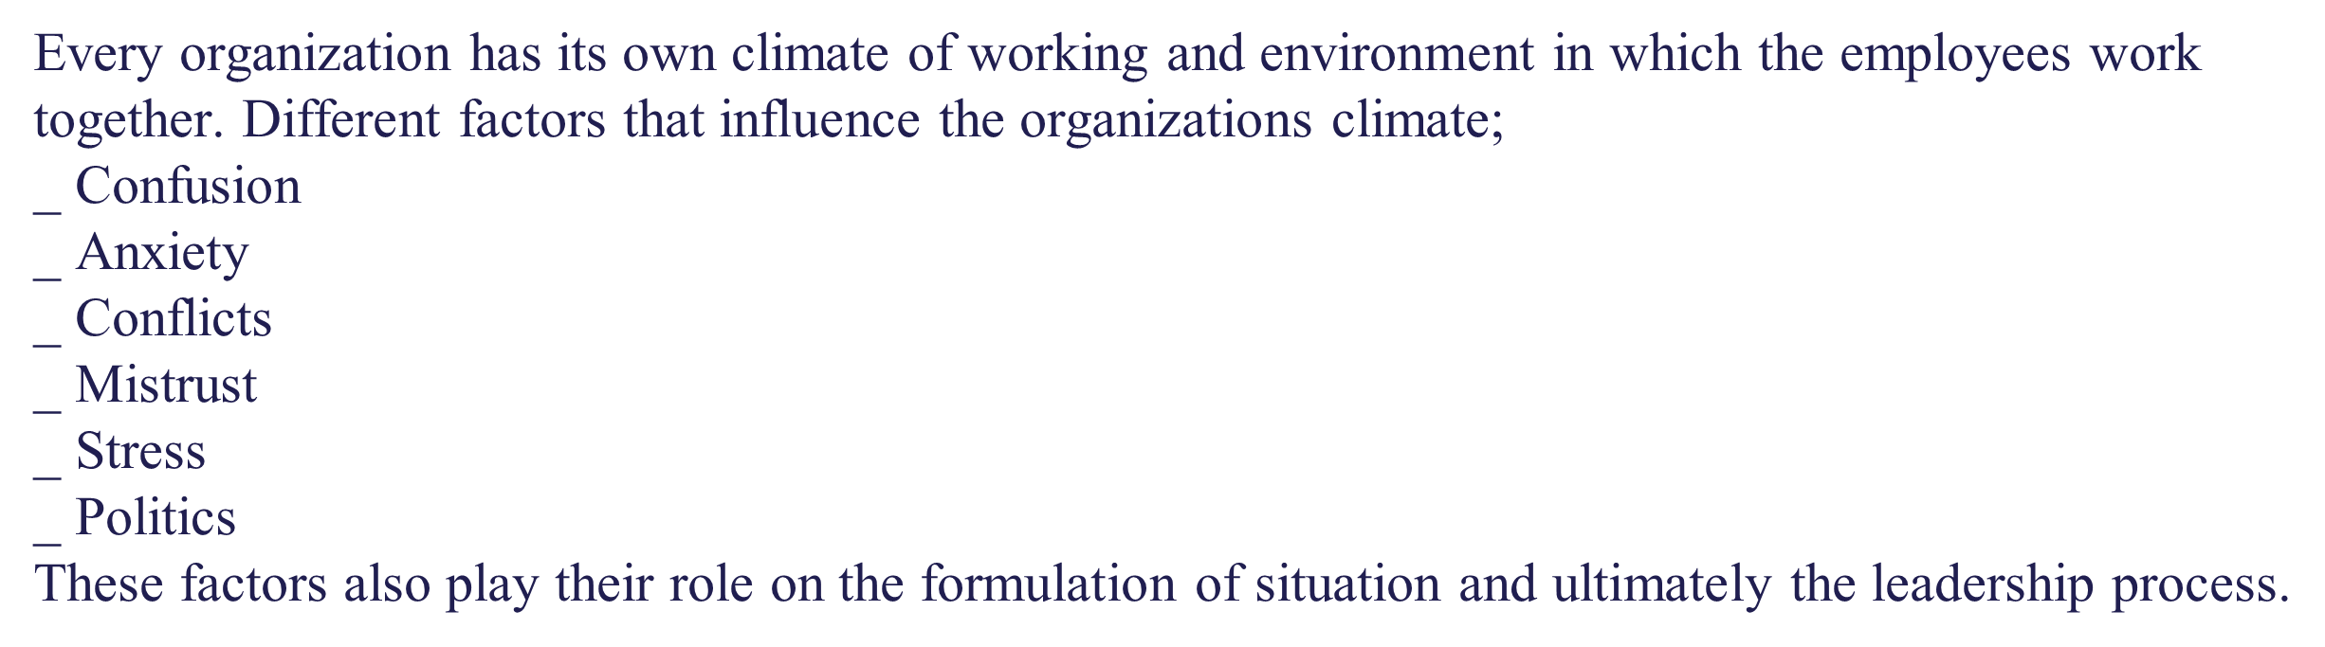
Social and Psychological Climate

Slide 32
Patterns of Employment
  In today’s organization the pattern of the employees also varies from organization to organization. We
  can now see the permanent or temporary and Short-term or Long-term employees. So it also effects the
  situation of the organization. Today’s people need more job security and organizations are facing more challenges in shape of changing the external environment. So it is another challenge for leadership to create a congenial working environment for satisfaction of
  employees.

Slide 33
Type, Place and Purpose of Work
The type of work is an important factor
The Work duties should be clear–cut. The routine or
monotonous work could create hostile working environment. Many researcher claims that in today’s
organization work duties loosely defined which always cause de-motivation and stress.
Context of place and purpose is also a factor
  Where is the setting?
  What is the challenge?

Slide 34
Organizational Life Cycle Stage
Every organization has its own life cycle. Which always start from its birth and end with its decline. To
save from decline, most of the organization introduces new products and new paths etc.

Slide 35
Culture of the Organization
The system of shared values and beliefs held by organizational members or the system of the shared
values norms and behavior that held by the top management is called organizational culture. All
organizations have their own cultures.
Culture has an effect on behaviors during Communication, Cooperation, Commitment, Decision Making, Implementation, and Leadership style etc.

Slide 36
Leaders- Follower Compatibility
For running an organization successfully there is need of leader-followers interaction. There should be
Leader-follower compatibility for working together in the organization. Proper communication and
confidence on each other is very essential for trust and performance.
This factor affects directly or indirectly the situation and ultimately the leadership process.

Slide 37
Leadership Effectiveness Today
Leadership is:
  More art than science
  More skill than knowledge
  Difficult
Effective leaders must be:
  Director and motivator
  Implementer and innovator
  Mentor and team builder
  Expert and moral force
  Organizer and developer of people

Slide 38
The Vision
Management author Peter Drucker once said,
“The best way to predict the future is to create it”
The leader wants to make a difference and strives to create a thing that never was before
  This thing, this difference, constitutes a vision
The most important function of a leader:
  To develop a clear picture of the future.

Slide 39
The Vision
Leaders must have intensity and stamina
  CEO of Johnson & Johnson,
  James Burke, spent 40% of
  his time communicating and
  reinforcing his vision
Leaders:
  Have energy and vitality
  Can transmit this energy to others
  Have deep passion

Slide 40
Why Create a Vision
Peter Drucker explains the importance of a vision:
  It makes the organization’s purpose crystal clear
  It provides a single-minded focus point
  A focused, shared vision holds an organization together and enables it to produce
  Without purpose and values, organizations lose credibility
  Without credibility, an organization loses its ability to attract the people it needs to perform

Slide 41
Vision as an ideal
Elements that give life and strength to vision
  Evokes pictures in the mind
  Suggests future orientation
  Implies a standard of
  excellence
  Has the quality of uniqueness
  Is an image of what could and should be

Slide 42
Vision as an ideal
Leaders must ask three questions to test his/her vision:
  Is this the right direction?
  Are these the right goals?
  Is this the right time?
The vision must be shared and supported

Slide 43
Forum Leadership Qualities
  The vision and strategy must be:
    Leader-initiated
    Shared and supported by followers
    Comprehensive and detailed
    Worth doing
  Vision must be uplifting and inspiring for others

Slide 44
Visioning Content Principles
Element 1
  A good vision should provide direction for the organization
Element 2
  A good vision should involve strategic planning; they give definition to the vision and focus people and resources on objectives
Element 3
  A good vision should refer to projects and activities that implement strategy

Slide 45
Requirements for an Affective Vision
  A vision must be comprehensive and detailed, so that every member of the organization can understand his or her part in the whole
  Roles and responsibilities must be understood
  Everyone must know what is expected and the rewards that will accrue when the vision is achieved
  A major determinant of vision fulfillment is personal rewards vs. personal efforts

Slide 46
Requirements for an Affective Vision
A vision must be uplifting and inspiring
The vision must be meaningful
and important to the members
The members of an organization
must try to achieve the
organization’s fullest potential

