Slide 2
The output from the BPP
1- the root cause(s) of the BPP
2- listing of the approved options
3-the predefined work packages and baseline as time box
4- the methodology of solving the BPP issue
5- the priority of the approved BPP
6- the holistic technical implementing approach for solving the BPP official options

Slide 3




Welcome on board of the professional quality track
What is the most fit solution of the BPP official options ?
Is this fit solution adding a business value ?
Q3 :is the selected method (project ) fit to this solution or not ?

Slide 4



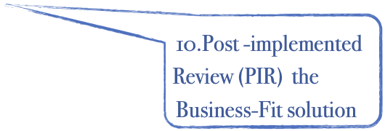


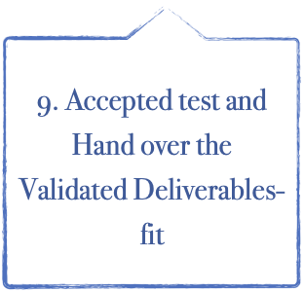




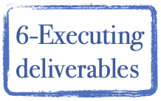
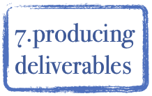



2 nd sector :Project technicality
Deliverables -Fit producing Processes
source: designed and developed by Dr.Mahmoud Ibrahim @2021

Slide 5
The target of this stage ….
Selecting the right recommended ,valid , value added solution which is called (PTS)successfully with full dimensions :
1- Covering the official BPP effectively
2- Satisfying the customers
3- Sustain the business success

Slide 6

Lecture outline
1st section contents :
The relationship between the HPMQS and the PLC
The input of the preparation stage
2nd section contents :
The preparation stage process
3rd section contents :
The output of the preparation stage

Slide 7
Section one
The preparation stage

Slide 8

What is Preparation stage ?
It is a Transformation stage from the BPP official options with a certain approach to the value-added PFS based on applying the HPMQS which is starting planning “deliverable fit technicality”(DFT) during conducting a very critical selective process through initiating a Business case(BC) for having the preferred recommend a solution.

Slide 9
The preparation benefits
The intent inhaling HPMQS more that just PQPlan is to learn and improved and to optimize project performance and efficiency, that will:
Allow the project team to well know the why’s,
Facilitate SMART decision,
Improve some aspect of the product or project performance,
Help avoid an issue, and
Prevent performance failure .
achieve the project objectives and performance targets.
facilitate the project team's ability to generate business value

Slide 10
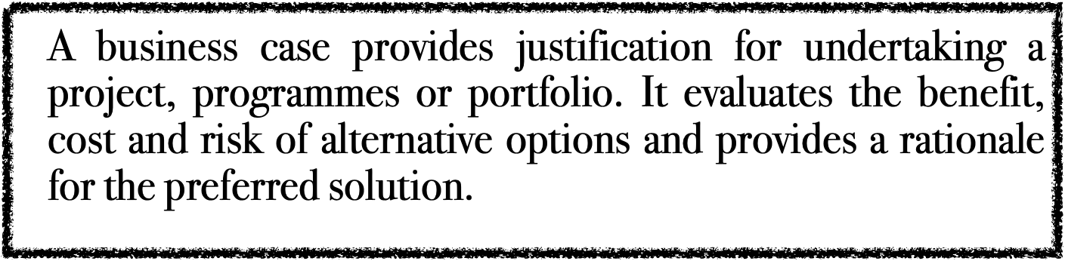
What is BC
It is strategic level of making a detailed assessment of the alternative solutions to this business problem and then defining a plan for the implementation of the agreed solution brings together the benefits, disadvantages, costs, and risks of the current situation and future vision so that executive management can decide if the project should go ahead

Slide 11

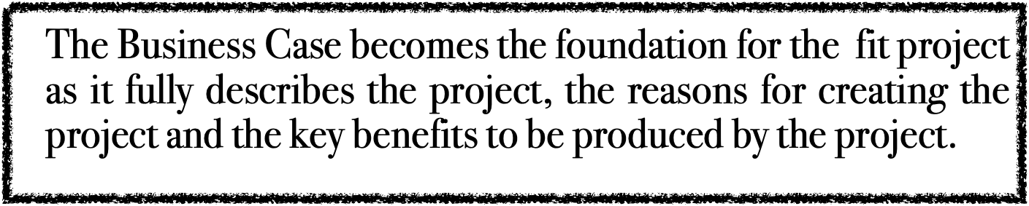
BC Benefit #1:On the level of the BPP
We need to ensure that the target options is succeeded in covering BPP

Slide 12

BC Benefit #2:On the success level of PLC
Creating a detailed Business Case is a critical step in the Project Lifecycle, as it provides the assessment basics to ensure that the project is on success track.
For instance, it is used in a:
1- Phase Review to ensure that current project costs and benefits are in line with original projections
2-Official closing the project to ensure that the project has achieved all the criteria required to close the project
3-after the project closed: to measure the extent to which the project has achieved its stated objectives

Slide 13
Section two
The Transformation process for preparation the PFS

Slide 14









Transformation from BPP official options to PFS
BPP
Approved options
BC
Options Listing
Assessing
Ranking
Validation
Preparation
Alternative solution
Designed and developed by Dr.Mahmoud Ibrahim 2023

Slide 15
1- Assessing the alternative potential solutions

Slide 16

Now that you have a detailed understanding of the business problem or opportunity, it is time to identify a preferred solution.
For every business option identified, there will likely be a range of alternative solutions available for implementation.

Slide 17



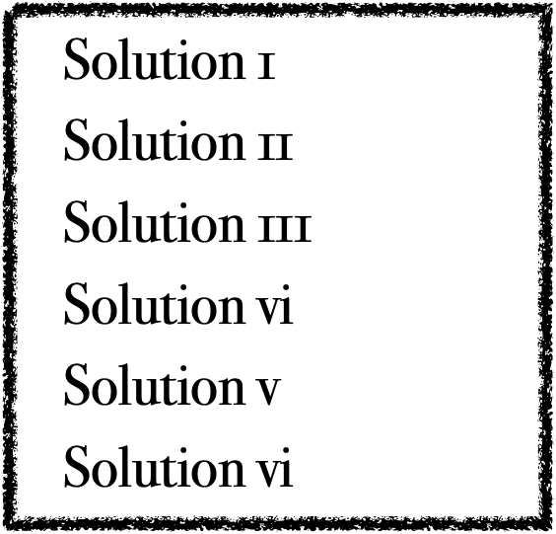
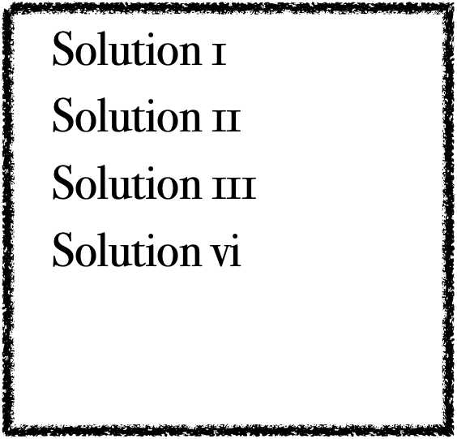
Options assessment
Solution 1
Solution 11
Solution 111
Designed and developed by Dr.Mahmoud Ibrahim 2023

Slide 18


The option assessment process
“Assessment criteria”
Take the time to identify at least three solid alternative solutions. State each alternative solution by describing :
Quantify the Benefits
Forecast the Costs
Assess the Feasibility
Identify any Risks
Document the Issues
List any Assumptions

Slide 19

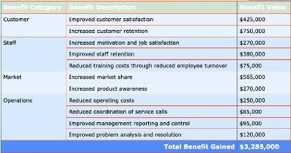
The following tangible benefits will be realized by the 1st solution for an example
List the financial and non-financial business benefits to be gained from implementing each alternative solution, by completing the following table:

Slide 20
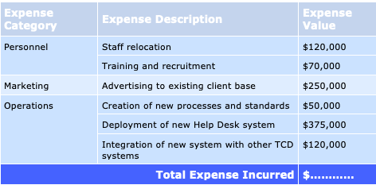
2-Forecast the Costs
Describe the tangible and intangible costs involved in implementing the solution. In addition to the actual cost of the project, you may also wish to quantify the cost of any impact to the business resulting from the delivery of the project (e.g. operational downtime).

Slide 21

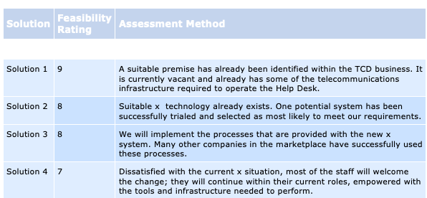
3-Assess the Feasibility
Rate the overall feasibility of each solution by determining whether it is likely to resolve the problem or realize the opportunity. You may need to undertake a formal Feasibility Study to determine the overall feasibility result. Use the following table to rank the level of feasibility for each solution identified:

Slide 22
4-Identify any Risks
1-Risk Description:Describe the risks associated with each alternative solution. Examples of risks may include: an inability to recruit skilled staff, a lack of project sponsorship, and the extent of change within the current business.
2-Then for each risk, list the mitigating actions required to reduce the likelihood of that risk occurring and the impact on the project should it eventuate. Use the following table to describe and rate each risk.
3-Risk Impact Rate the impact on the project if the risk were to eventuate, as Low, Medium or High.
4- Risk Mitigating Actions :
A-List the actions needed to mitigate the risk, such as outsourcing elements of the project to an external supplier or making additional funding available upfront, should it be required.
B-Communicate with the client base explaining the benefits of the new system and the fact that some records will not be carried across.

Slide 23
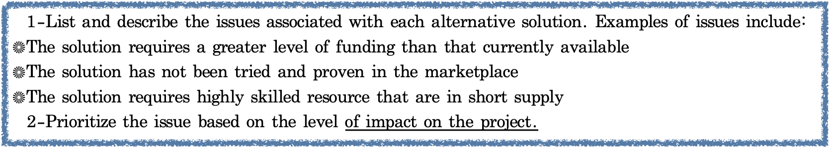

5-Document the Issues
Identify any key issues while describing each alternative solution and prioritize the issues based on their effect on the project.
An Issue is defined as any event that currently adversely affects the ability of the solution to produce the required deliverables. For each alternative solution,

Slide 24

6-List any Assumptions
Also list any assumptions made while describing each alternative solution. For example, it may be assumed that:
"There will be no legal , business strategy or policy changes during the project
The prices of raw materials will not increase during the course of the project
Additional resource will be available from the business as required"

Slide 25
2-Rank the assessed solutions and having recommend a preferred solution.

Slide 26
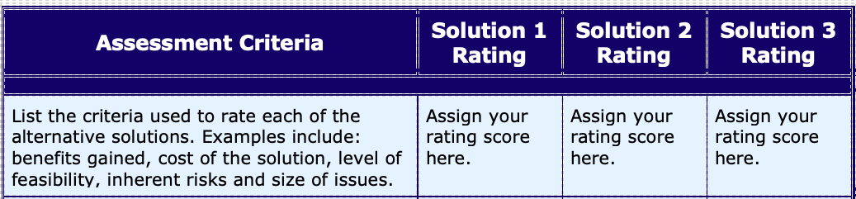
2-1-Rate the assessed Solutions
List the assessment criteria required to rate your alternative solutions and calculate a total score that are more important in making the final decision

Slide 27
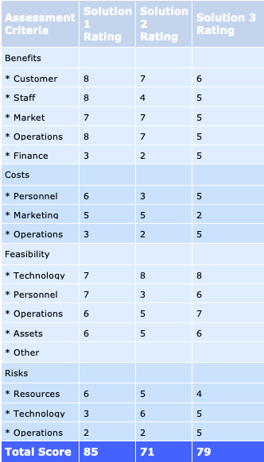

Slide 28
2-Having the preferred Solution
1-The solution with the highest score in the table above becomes your preferred solution for implementation.
2-Identify your preferred solution in your Business Case document, and state the primary reasons why this solution was chosen over the other alternatives available.

Slide 29
3- Updating the Supporting Documentation
The following documentation is attached to substantiate the findings and assumptions made in this stage .
Business strategies and plans
Market research findings and company growth projections
Root Cause Analysis and requirements documentation
Detailed results, logs and reports from feasibility assessment
Risk assessment reports and other relevant information

Slide 30
3-Validation the preferred solution by
Having (PFS)

Slide 31
1-HPMQS Validation/value added
The PFS is recommended but not selected until the HPMQS confirm its validation as follows :
1- Align :with the company scope and then the BPP
2- consistency : validation of the predefine work package that mentioned during BPP and breaking down at doing BC
3-Integration :verifying the conformance with the strategic BPP scope which is comply with the strategic scope based of the success
4-Transparency :Confirming informed the interested Stakeholders

Slide 32
4-the PFS official approval process

Slide 33
the official approval
1-A management approval process for the Business Cases to determine which ones have the highest value and are best aligned. These will be approved.
2-Once the Business Case has been documented, it is presented to a Project committee for approval.
3-The Project committee oversees the project at a strategic level: they authorize the project to proceed, allocates funding from their budget, and ensures that project objectives are achieved by participating in Phase Reviews.

Slide 34
The benefit of having the official approval
Confirming the top managerial support all over the three sectors (deliverable fit technicality -project fit technicality -product fit technicality ) of the HPMQS which will lead to maximizing not only the project success but also sustain the business success and exceeding the customer quality expectations

Slide 35

Section three

Slide 36
1-Validated PTS
1-Valid recommended solution , it is called potential product fit solution (PFS )
2- PFS success criteria , it will use used within the PLC and PMP as we mentioned above.

Slide 37
2- confirming the efficiency of the selected methodology
The project management is the most fit methodology for having the valid PFS and fulfill the BPP.

Slide 38
3- designing the DFT
Be Describe the PFS Implementation holistic Approach
for PLC and PMP as follows :

Slide 39
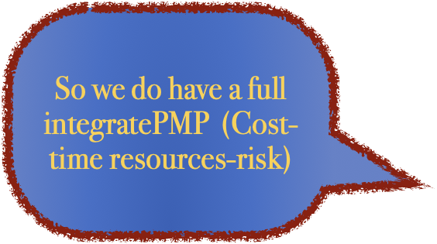
a . With Validated (PMP original baselines )
Clear working package which will affect the dependencies between the activities later during the project planning stage
As the required time, cost ,quality ,risks ,assumptions and so on.

Slide 40
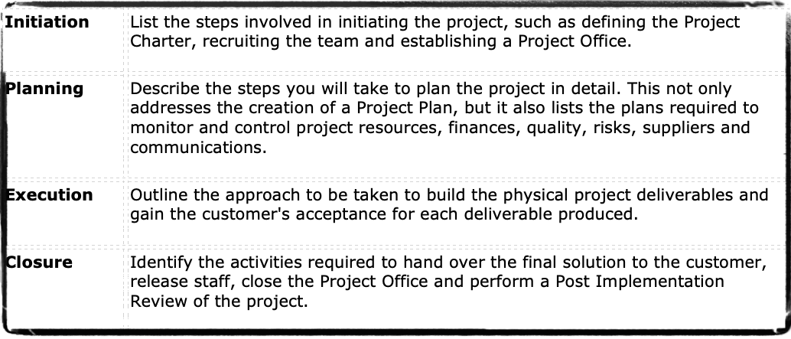
b.With Validated (PLC original baselines )
Providing the Project Sponsors with confidence that the implementation of the solution has been well planned . You can do this by describing in detail how the project will be initiated, planned, executed and closed effectively.

Slide 41

Thanks for paying attention
Full roadmap for managing the project success

Slide 42
Glossary
PFS | Product fit solution
BC | Business case
FS | Feasibility study
DFS | Deliverable fit solution
DFT | Deliverable-fit technicality
PT | Project technicality
PFT | Product fit technicality
PLC | Project life cycle
PMP | Project management plans
PFSQP | Product fit solution quality plan

Slide 43




Thank You

