Slide 1


Ch.9- Training &
Development
Prepared by Dr. Sahar Ahmed
Week Seven
Lecture 6

Slide 2

Learning Outcome
1
Understand how training and development activities can contribute to an organization’s strategic objectives
Describe how to conduct a needs assessment as part of a training program
Explain the different modes of delivery of training and how to maximize transfer of training
4
Understanding various levels of evaluation of training and the benefits and limitations of each
Describe the role of organizational development in promoting change with an organization
Understand the critical link between training, performance management, and compensation

Slide 3
Introduction
Organizations that view employees as assets invest heavily in training and development.
Training focuses on immediate skill acquisition, while development prepares employees for future challenges.
The term "learning" is preferred to emphasize a broader and ongoing process.
Effective learning requires reinforcement through the organization's reward system.

Slide 4
Strategic Importance for Training and Development
Rapid technological advancements make skills obsolete quickly. Training ensures employees use the latest technologies.
Restructured jobs with broader responsibilities require employees to develop teamwork, communication, and problem-solving skills.
Mergers and acquisitions necessitate integrating employees from different cultures, requiring cultural sensitivity training.
Increased employee mobility necessitates onboarding and integrating new hires more effectively.
Globalization demands managers to possess intercultural skills.

Slide 5
Sofitel Rebranding Through Employee Training
Challenge:
Sofitel, a luxury hotel chain, faced increased competition in the high-end market.
They needed to differentiate themselves and offer a unique guest experience.
Solution:
Rebranding Program: Sofitel embarked on a program to position itself as an exclusive brand with a focus on guest experience.
Employee Training as a Key Strategy: An extensive, two-year training program was launched across all 40 countries and 25,000 employees.
Target Audience: All employees, from new hires to executives.
Training Format: On-site training at individual hotels delivered by a corporate training team.
Training Focus: Creating a sense of luxury for guests, and empowering employees to personalize guest experiences.

Slide 6
Sofitel Rebranding Through Employee Training
Rewards:
  Gift certificates
  Celebrations
  Accreditation
  Increased responsibilities
Ongoing Training: Monthly training for employees who completed the initial program.
Results:
Improved Guest Satisfaction: Training contributed significantly to guest satisfaction.
Employee Retention: The program also helped retain employees.

Slide 7
Standard Training Needs
New hires need orientation and socialization programs to understand the organization's culture, policies, and operations.
Organizations promoting from within require ongoing training to keep employees updated on industry trends and technologies.
New hires from outside the organization need to be socialized into the company's norms and network with colleagues.

Slide 8
New-hire Training & orientation
New-hire orientation can be overwhelming if not designed strategically.
Ideally, it should connect individual jobs to the organization's success and overall strategy.
Programs should allow for questions, interaction, and network building amongst new hires and colleagues.
Rotational programs expose new hires to different areas of the organization.
This helps them find a good fit between their skills and interests and the company's needs.
While expensive initially, rotations benefit the company in the long run.

Slide 9
Benefits of Rotation Program
Rotational programs expose new hires to different areas of the organization. This helps them find a good fit between their skills and interests and the company's needs.
While expensive initially, rotations benefit the company in the long run.
Benefits for Employers:
Increased flexibility in assigning work tasks.
Employees understand how their role contributes to the whole.
Reduced risk of knowledge being concentrated in a single person.
Benefits for Employees:
Increased job satisfaction and retention through opportunity exploration

Slide 10
MicroStrategy Boot Camp Orientation Program
MicroStrategy, a data mining leader based in Virginia, has a unique approach to onboarding new employees. Their program, known as "boot camp," goes beyond typical orientation and aims to immerse new hires in the company's culture from the very first day.
Key Points:
Mandatory for All: This intensive program is a written requirement in every employment contract, ensuring all employees across 18 states and 35 countries experience MicroStrategy's culture.
Founder's Vision: Driven by the company's founder, Michael Saylor, boot camp is designed to expose and commit each employee to the core values and beliefs of MicroStrategy.

Slide 11
MicroStrategy Boot Camp Orientation Program
Tailored Programs: Three variations exist – a general three-day boot camp, a two-week sales boot camp, and a five-week technical boot camp – each catering to different employee groups and focusing on relevant skills.
Testing and Reinforcement: All boot camps utilize examinations and assessments to solidify learning, with the technical program featuring continuous testing.
Positive Feedback: Despite the intensity, employee feedback has been overwhelmingly positive. The only reported complaint is that the program feels too short, indicating a strong desire for deeper cultural immersion

Slide 12
Benefits & Challenges of Training Program
For Employees: Increased skills and marketability, making them more marketable and adaptable to changing job landscapes. lead to better job opportunities.
For Employers:
Organizations benefit from a more skilled and flexible workforce that can take on varied responsibilities.
Leads to Improved financial performance.

Slide 13
Benefits & Challenges of Training Program
Key Challenges
Training improves employee performance and value, but also makes them more attractive to competitors.
This is especially true for technical employees who see training as a way to find a new job.

Slide 14
Key factors to consider
Decision Makers should view training and development as Long term Investment
Centralized vs. Decentralized Training:
Centralized training offers cost-efficiency and consistency across the organization.
Decentralized training caters better to specific needs of different business units.
Integration with HR Strategy:
Effective training aligns with staffing strategies, allowing for targeted development and minimizing remedial needs for new hires.

Slide 15
Planning and Strategizing Training:
Developing successful training programs requires careful planning and strategizing. This involves four main steps:
Needs Assessment: Identify the need for training and analyze its fit within the organization's context.
Set Objectives and Measures: Define what the training aims to achieve and how success will be measured.
Deliver the Training: Implement the training program according to the plan.
Evaluate: Assess the effectiveness of the training program after delivery.

Slide 16
Needs Assessment - Three Levels:
Organizational Level: Analyze the training's impact on the organization's culture, strategy, and daily operations. Consider costs and benefits, including "opportunity costs" (what else could be done with the resources?).
Task Level: Identify the skills and knowledge needed for specific job duties. Explore where learning should happen (on or off the job), how to minimize mistakes, and if similar training needs exist for other jobs.
Individual Level: Analyze trainees' existing skills and learning styles. Consider personality, interpersonal skills, and any special needs that could affect training design and delivery.

Slide 17
Objectives, Design, and Delivery in Training Programs
Setting Objectives:
Training objectives should be specific, measurable, and directly address identified training needs.
Objectives should define desired employee behaviors and expected results from those behaviors.
Vague objectives hinder successful evaluation and program improvement.
Performance data from the organization's performance management system can be a valuable source for setting objectives.

Slide 18
Overcoming Challenges in Training Design
Interference: Prior learning, habits, or established work practices can hinder new learning.
  Trainers should anticipate potential interference and develop strategies to overcome it.
Transfer: The ability to apply new skills and knowledge on the job is crucial.
  Training design and delivery should maximize transfer by simulating real-world work conditions whenever possible.

Slide 19
Enhancing Transfer Through Delivery
Supportive organizational environment: CEO and senior leader participation signals the importance of training.
Simulating real-world work conditions:
  On-the-job training (when feasible) allows immediate application of skills.
  Off-the-job training with simulations (case studies, role plays) can replicate work settings.

Slide 20
Online Computer-Based Instruction (OCBI)
Benefits:
Self-paced learning: Individuals can learn at their own speed and comfort level.
Adaptable: Can be customized to different employee needs.
Easy delivery: Accessible from any workstation or home computer.
Cost-effective: Efficient for geographically dispersed organizations.
Convenience: Training can be undertaken anytime, without scheduling.

Slide 21
Online Computer-Based Instruction (OCBI)
Drawbacks:
Self-motivation: Learners need to be self-motivated and take initiative.
High development cost: Creating interactive online materials can be expensive.
Outdated content: Content may need frequent updates and revisions.
Limited interaction: Lack of interaction and two-way communication can hinder learning for some

Slide 22
Qualcomm: A Leader in Customized, Strategic Computer-Based Training
Qualcomm, a San Diego-based giant in wireless communication technology, stands out for its innovative approach to employee training.
Here's what makes their program unique:
Extensive Online Course Library: They offer over 250 custom-designed courses online, catering to both technical and professional development needs.
Flexibility for Learners: Courses are designed to accommodate various learning styles and schedules. Options include 24/7 online access and traditional classroom settings (for those who prefer it).
Strategic Focus: Training is meticulously aligned with Qualcomm's culture and business goals.
Needs Assessment: Learning specialists actively identify training needs by attending staff meetings, interacting with senior management, and conducting group assessments within business units.

Slide 23
Qualcomm: A Leader in Customized, Strategic Computer-Based Training
Customized Content: Courses are developed with unique content tailored to the specific needs of each business unit and Qualcomm as a whole.
Integration with Competency Management: "MySource," an intranet tool, allows employees to track their skills, accomplishments, and career goals. They can then choose relevant learning modules from the online library to facilitate skill development and career advancement.
Benefits of Qualcomm's Approach:
Cost Savings: Moving to computer-based training has significantly reduced costs associated with traditional, centralized training programs.
Employee Empowerment: The program effectively unlocks employee potential by providing targeted training, supporting skill development, and facilitating career planning through competency management.

Slide 24
Training Evaluation
Training evaluation is essential to assess the program's effectiveness and determine if it should continue, be modified, or be eliminated.
Four Levels of Training Evaluation (Hierarchy):
Reaction: Measures trainee satisfaction with the training (trainer, content, facilities) - usually through questionnaires.
  Low satisfaction might indicate lack of value or interest.
  High satisfaction doesn't guarantee effectiveness.
Learning: Measures knowledge or skill acquisition through tests, demonstrations, or simulations.
  No learning suggests the training was ineffective.
  Learning is a prerequisite for behavior change.

Slide 25
Training Evaluation
Four Levels of Training Evaluation (Hierarchy):
3. Behavior: Measures on-the-job application of new skills or knowledge.
  Behavior change indicates successful transfer of training.
  Evaluated through performance appraisals by supervisors.
  No change in behavior suggests no improvement in performance.
4. Results: Measures the overall impact of training on organizational outcomes (productivity, efficiency, customer service, etc.).
Evaluated through reports, sales figures, surveys, etc.
Results may take time to appear due to ongoing training or skill development needs.

Slide 26
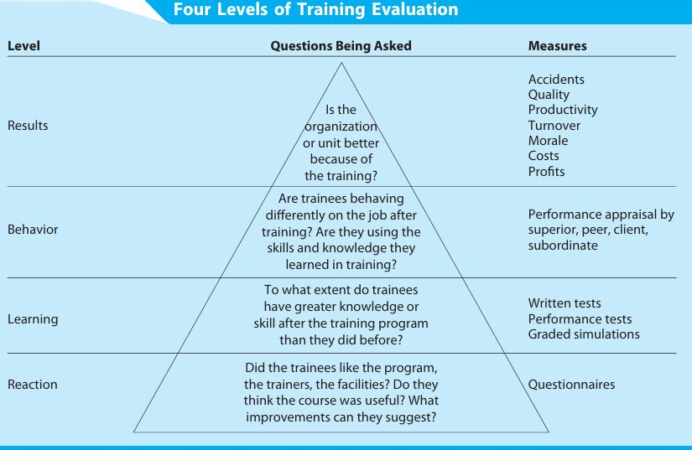
Training Evaluation

Slide 27
Choosing the Right Level
While results are often most relevant, focusing solely on short-term outcomes might lead to abandoning valuable training programs.
Some training, like leadership development, might be better assessed by measuring learning rather than results.
Recommendation:
Consider all four levels (partially or fully) when deciding how to evaluate training, based on your organization's strategy.

Slide 28
Organizational Development (OD)
Focus:
OD focuses on improving an organization's overall effectiveness through planned interventions.
It contrasts with training and development, which targets individual skills for improved productivity.
Scope:
OD takes a macro or organization-wide perspective, looking at processes, culture, and overall performance.
It considers the organization as an open system influenced by external factors and internal interconnectedness.

Slide 29
Organizational Development (OD)
Interventions:
OD interventions address various needs, including culture change, mergers, learning, knowledge management, and process improvement.
They consider both performance and human aspects, promoting values like respect, inclusion, and collaboration.

Slide 30
Key Considerations
Interpersonal relationships: Effective OD requires developing strong interpersonal relationships, especially within leadership teams.
Leadership development: Strong leadership programs are linked to improved financial performance. Models like NASA's can guide leadership development efforts.
Team dynamics: As discussed in Chapter 6, teams have distinct learning and training needs that OD initiatives must address.

Slide 31
Integrating Training with Performance and Compensation
Training Reinforcement:
  Training alone doesn't guarantee success.
  Organizations need to ensure learned skills are applied and rewarded.
Separate HR Functions:
  Some large companies have separate departments for training, performance evaluation, and compensation.
Integration is Key:
  When these functions are not integrated, it's harder to reinforce desired outcomes from training.

Slide 32
Integrating Training with Performance and Compensation
Performance Measurement: Performance evaluations should reflect the skills learned in training, especially critical skills.
Compensation and Training: Compensation should be adjusted to reflect successful application of learned skills.
Training Integration: Training linked to performance and compensation systems is more likely to succeed.
Strategic Training: Training needs to be designed within the organization's larger strategy and receive commitment for success.

Slide 33
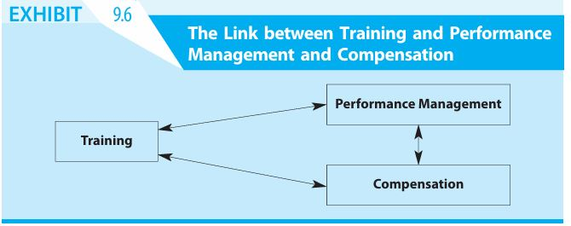

Slide 34
Hilton's "I Lead" Program: Empowering Managers for Guest Experience Excellence
Hilton, a global hospitality leader, implemented the "I Lead" program, a strategic training initiative focused on empowering managers to drive guest satisfaction and employee engagement. Here's how it mirrors Anheuser-Busch's WIL program:
Target Audience: I Lead" targets a broad spectrum within the organization, in this case, all hotel managers across various departments and locations.
Program Features:
Blended Learning: "I Lead" incorporates a mix of online modules, in-person workshops, and on-the-job coaching, catering to diverse learning styles and offering practical application.
Performance Management Integration: Manager performance reviews track progress on "I Lead" objectives, ensuring consistent implementation.

Slide 35
Hilton's "I Lead" Program: Empowering Managers for Guest Experience Excellence
Development Process:
Needs Assessment: Hilton identified a gap in leadership skills focused on guest experience and employee motivation.
Competency-Based Training: The program was designed based on core leadership competencies essential for hotel operations, including communication, coaching, and conflict resolution.
Outcomes:
Improved Guest Satisfaction: Following the program rollout, Hilton witnessed a significant increase in guest satisfaction scores.
Empowered Employees: Managers equipped with effective leadership skills are better able to motivate and support their teams, leading to higher employee engagement.

Slide 36
Conclusion
Onboarding Programs: Immerse new hires in company culture and equip them with essential skills from day one (e.g., MicroStrategy Boot Camp).
Customized Training: Develop training content tailored to the specific needs of different departments and employee roles (e.g., Qualcomm).
Blended Learning: Offer a mix of online modules, in-person workshops, and on-the-job training to cater to diverse learning styles (e.g., Hilton's "I Lead" program).
Strategic Focus: Align training programs with the organization's goals and business objectives (e.g., all case studies discussed).

Slide 37
Conclusion
Needs Assessment: Identify skill gaps and training needs through data analysis and employee interaction
Technology Integration: Utilize online learning platforms and other technological tools to deliver, manage, and track training programs Performance Management Integration: Connect training programs with performance evaluation and development planning to ensure skill development translates to better job performance
Employee Empowerment: Focus on providing training that equips employees with the skills and knowledge they need to grow in their careers

Slide 38
Conclusion
Benefits of Effective Training and Development
Increased Employee Engagement: Employees who feel invested in through training are more likely to be engaged and motivated.
Improved Productivity: Well-trained employees possess the skills needed to perform their jobs effectively and efficiently.
Reduced Turnover: Investing in employee development demonstrates a company's commitment to its workforce, leading to higher employee retention.
Enhanced Company Culture: A focus on learning and development fosters a culture of continuous improvement and innovation.
Competitive Advantage: A skilled and adaptable workforce positions a company for success in a competitive marketplace.

Slide 39
Week
01
References
Main Reference
Mello A .Jeffrey (2011). Strategic Management of Human Resources (3rd ed.) South-Western Cengage Learning.
Additional Resources for extra reading.
Boselie, Paul (2014). Strategic Human Resource Management: A Balanced Approach .McGraw Hill Companies.
Millmor, Mike, Philip Lewis, and others (2007), Strategic Human Resource Management Contemporary issues. Ft Prentice Hall.

Slide 40



Thank You

