Slide 1



Introduction to Economics
Lecture 10
MGM112
International Trade
Prepared by
Lec. Dina ElWakkad
www.midocean.ae

Slide 2

International Trade
Chapter
10
v
After studying this chapter, you will be able to
What is the relationship between international trade and the nation’s standard of living
Which country produces which good(s)?
Analyze Tariffs, and Non-Tariff Distortions to Trade
www.midocean.ae

Slide 3
The relationship between international trade and the nation’s standard of living
Chapter
10
1) The relationship between international trade and the nation’s standard of living
www.midocean.ae

Slide 4
The relationship between international trade and the nation’s standard of living
Chapter
10
v
Some countries rely on international trade to obtain many products that it does not produce and some minerals of which it has no reserves.
So, Interdependence in the world economy is reflected in the flow of goods, services, labor, and capital across national boundaries, which lead to increase the nation’s standard of living.
www.midocean.ae

Slide 5
Classical International Trade Theories
Chapter
10
2) Classical International Trade Theories
www.midocean.ae

Slide 6
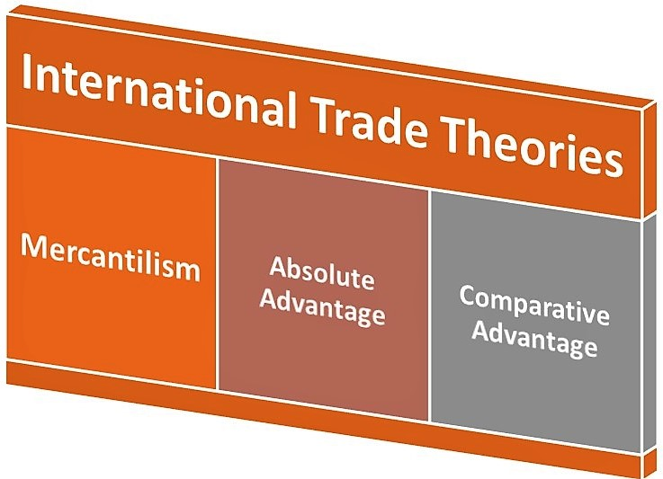
Classical International Trade Theories
Chapter
10
www.midocean.ae

Slide 7
Classical International Trade Theories
Chapter
10
v
1) Mercantilism.
The doctrine of Mercantilism Believed that a country’s wealth was based on how much gold and silver was held, Because gold and silver circulated as money
A country could increase its wealth by: Exporting more goods than it imported. (EX>IM) because:
    Exports created inflows of gold and silver
    Imports created outflows of gold and silver.
    So, when a country’s exports exceedewealth increasedd its imports (EX>IM), its stock of gold and silver rose, and the country’s.
www.midocean.ae

Slide 8
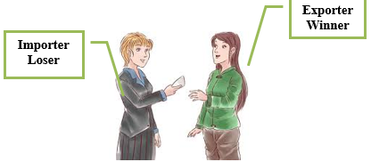
Classical International Trade Theories
Chapter
10
v
1) Mercantilism.
A Favorable Trade Balance:
  The Mercantilists advocated regulating international trade in a way that would promote large exports and small imports to increase wealth by using restrictions as Tariffs and Quotas
They assumed Trade is:
    Zero-Sum-Game
    Win-Lose- Game
www.midocean.ae

Slide 9
Classical International Trade Theories
Chapter
10
v
2) Absolute Advantage (Adam Smith)
It is the ability of the country to produce goods using:
  Fewer resources
  Lower cost (Cheaper)
www.midocean.ae

Slide 10
Classical International Trade Theories
Chapter
10
v
2) Absolute Advantage (Adam Smith)
Main Assumptions:
two-nation
two-commodity
two-factor world
no trade restrictions
  Adam Smith and other classical economists advocated policy of laissez-faire, or minimal government interference with economic activity.
perfect mobility of factors within the nations but no international mobility
perfect competition in all commodity and factor markets
no transportation costs
www.midocean.ae

Slide 11
Classical International Trade Theories
Chapter
10
v
2) Absolute Advantage (Adam Smith)
Table 1 : One Labor per day produces
 | Machines | Cloth
U. S | 5 | 10
India | 2 | 15
Machines: | Cloth
In U.S: 1 labor produces 5M In India: 1 labor produces 2M | In U.S: 1 labor produces 10C In India: 1 labor produces 15C
www.midocean.ae

Slide 12
Classical International Trade Theories
Chapter
10
v
2) Absolute Advantage (Adam Smith)
U.S has
  an absolute advantage in machine production (M)
  an absolute disadvantage in cloth production (C)
India has
  an absolute advantage in cloth production (C)
  an absolute disadvantage in machine production (M)
 | Machines | Cloth
U. S | 5 | 10
India | 2 | 15
www.midocean.ae

Slide 13
Classical International Trade Theories
Chapter
10
v
2) Absolute Advantage (Adam Smith)
So, Trade occurs between U.S and India according to absolute advantage as:
  US specializes in producing machines
    Exports (M) to India
    Imports (C) from India
  India specializes in producing cloth
    Exports(C) to U.S
    Imports (M) from U.S
www.midocean.ae

Slide 14
Classical International Trade Theories
Chapter
10
v
2) Absolute Advantage (Adam Smith)
Both nations can gain from specialization, as
  Gains from Trade as World output increase by 3 machines, and 5 yards of cloth
 | Machines | Cloth
U. S | + 5 | -10
India | - 2 | + 15
Change in world output | +3 | +5
www.midocean.ae

Slide 15

Classical International Trade Theories
Chapter
10
v
2) Comparative Advantage (David Ricardo)
If one country has an absolute advantage in the production of both products, and the other country has absolute disadvantage in the production of both products.
According to Adam smith, No Trade occurs between two countries and No Gains.
But According to David Ricardo a country could have an absolute disadvantage in the production of a product relative to another country and still has a comparative advantage in the production of the product, so Trade occurs
www.midocean.ae

Slide 16
Classical International Trade Theories
Chapter
10
v
2) Comparative Advantage (David Ricardo)
 | Machines | Cloth
U. S | 5 | 15
India | 1 | 5
According to an absolute advantage (Adam smith)
  U.S has an absolute advantage in both goods (M) and (C)
  India has an absolute disadvantage in both goods (M) and (C)
  So, there is No Trade occurs between U.S and India and No Gains.
  But According to comparative advantage theory and David Ricardo, trade will occur. How?
www.midocean.ae

Slide 17
Classical International Trade Theories
Chapter
10
v
2) Comparative Advantage (David Ricardo)
It is the ability of the country to produce goods at :
  Lower opportunity cost which is:
    amount of one good that a country must forego to produce each additional unit of another good
لما انتج سلعة واحدة _ هضحي باد ايه من السلعة الاخري ؟؟؟
www.midocean.ae

Slide 18
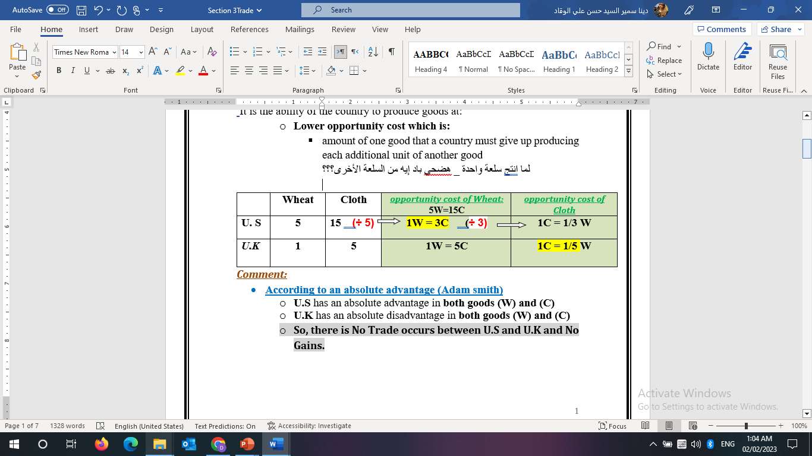
Classical International Trade Theories
Chapter
10
v
2) Comparative Advantage (David Ricardo)
According to a comparative advantage (David Ricardo):
  U.S has
    A comparative advantage in wheat production (W)
  U.K has
A comparative advantage in cloth production (C)
www.midocean.ae

Slide 19
Classical International Trade Theories
Chapter
10
v
2) Comparative Advantage (David Ricardo)
  So, Trade occurs between U.S and U.K according to A comparative advantage as:
    US specializes in producing wheat
      Exports (W) to U.K
      Imports (C) from U.K
    U.K specializes in producing cloth
      Exports(C) to U.S
      Imports (W) from U.S
Although U.K has an absolute disadvantage in both goods, U.K has a comparative advantage in cloth production
www.midocean.ae

Slide 20
Think
Chapter
10
v
The Mercantilists believed:
that international trade was a zero-sum game.
that international trade was an n-sum game.
that maximizing a country’s imports would improve its welfare.
that exports were detrimental to a country’s economy.
The Mercantilists did not support:
Free trade
Increase exports
Increase accumulation of precious metals (gold and silver)’
All of the above
www.midocean.ae

Slide 21
Think
Chapter
10
v
The Mercantilists advocated that each country should try to create balanced trade by having exports equal to imports.
False
The Mercantilists believed that international trade was a zero-sum game.
True
The Mercantilists believed that imports were “bad” because they led to an outflow of gold and silver from the country.
True
www.midocean.ae

Slide 22
Think
Chapter
10
v
Specialization and trade by countries based on absolute advantage results in:
A faster depletion of the world’s resources.
Products produced at higher cost.
The world using its resources more efficiently causing an increase in world output, and welfare.
The world using its resources more efficiently causing a decrease in world output.
Absolute advantage is a trading principle that states that:
differences in resource endowments determine comparative advantage.
differences in incomes determine comparative advantage.
absolute cost differences determine the basis for trade.
relative cost differences determine the basis for trade.
www.midocean.ae

Slide 23
Think
Chapter
10
v
When country A uses fewer resources to produce a product than another country, then:
country A has a comparative advantage in the production of the product.
country A has an absolute advantage in the production of the product.
country A has a comparative disadvantage in the production of the product.
country A has an absolute disadvantage in the production of the product.
Smith’s theory of absolute advantage is based on:
the labor theory of value. (Labor are productive so they use lower resources)
opportunity costs.
absolute theory of value.
capital theory of value.
www.midocean.ae

Slide 24
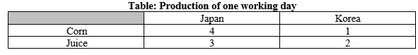
Think
Chapter
10
v
According to the table, Which of the following statements is correct?
(A) Japan got absolute advantage in both corn and juice
(B) Korea got absolute advantage in both corn and juice
(C) Both Korea and Japan got disadvantage in the two goods
(D) Neither Korea nor Japan has absolute advantage in any good
Specialization and trade increase the world’s output of goods and services. True
www.midocean.ae

Slide 25
Think
Chapter
10
v
Opportunity cost is:
the dollar cost of producing the goods.
the dollar price paid for final goods and services.
the dollar price associated with using one good in place of another.
the alternative that must be given up in order to get something else.
According to the theory of comparative advantage, which of the following is not a reason why countries trade?
A) Costs are higher in one country than in another.
B) Prices are lower in one country than in another.
C) Exports give a country a political advantage over other countries that export less
D) The productivity of labor differs across countries and industries.
www.midocean.ae

Slide 26
Think
Chapter
10
v
A country’s ability to produce a specific good with fewer resources than another country determines whether it has a comparative advantage in producing the good. False
If a country has an absolute advantage in the production of all products, then it makes no sense for it to trade with other countries. False
Comparative advantage is based on the opportunity costs of producing particular goods. True
www.midocean.ae

Slide 27
Classical International Trade Theories
Chapter
10
3) Trade Barriers
www.midocean.ae

Slide 28
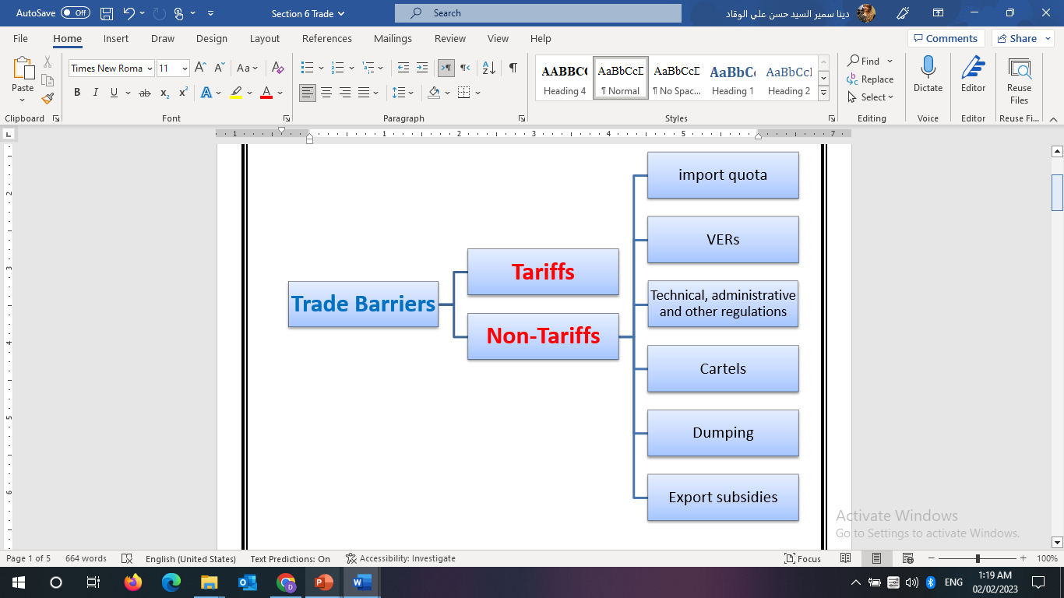
Classical International Trade Theories
Chapter
10
www.midocean.ae

Slide 29
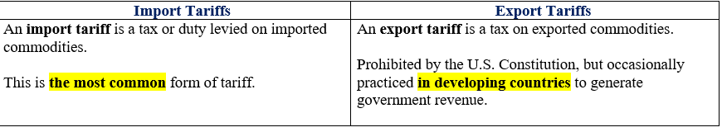
Trade Barriers
Chapter
10
v
1) Tariffs
Definition:
is a tax levied on the traded commodity as it crosses a national boundary
There are two types of tariffs
www.midocean.ae

Slide 30
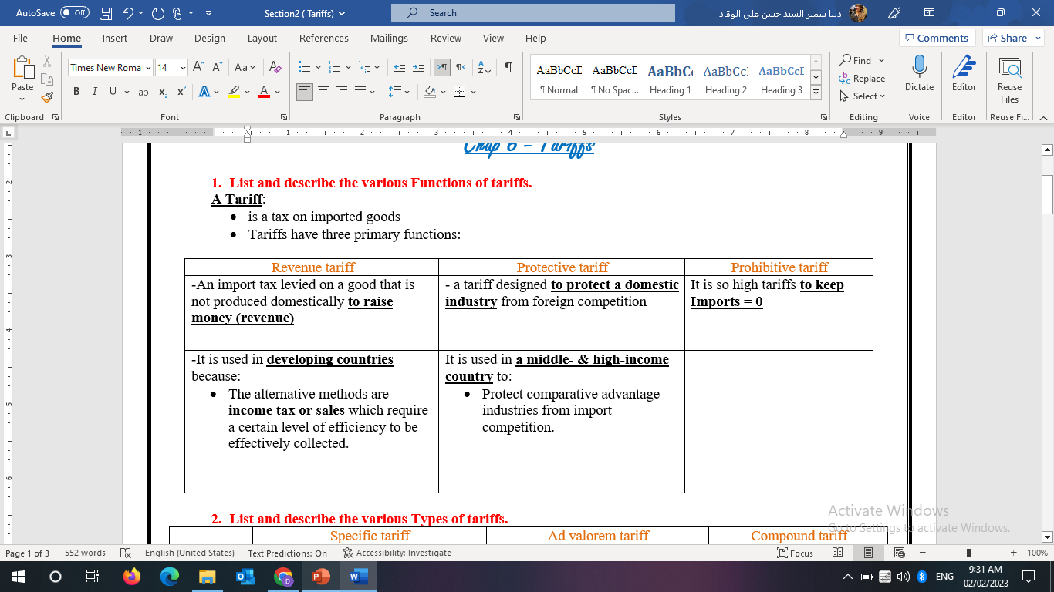
Trade Barriers
Chapter
10
v
1) Tariffs
Functions of tariffs:
www.midocean.ae

Slide 31
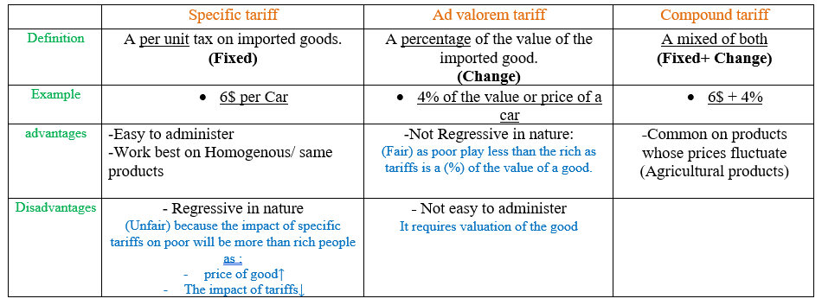
Trade Barriers
Chapter
10
v
1) Tariffs
Types of tariffs:
www.midocean.ae

Slide 32
Trade Barriers
Chapter
10
v
2) Non-Tariff Distortions to Trade
1- Import Quota:
A direct quantitative restriction on the amount of a commodity allowed to be imported, imposed by importing countries
are used to protect:
domestic industry
domestic agriculture,
and/or for balance of payments reasons.
www.midocean.ae

Slide 33
Trade Barriers
Chapter
10
v
2) Non-Tariff Distortions to Trade
2- Voluntary Export Restraints (VERs):
It is a voluntary quota imposed by exporting countries to reduce its exports voluntarily, under threat of higher trade restrictions
VERs allow industrial nations to appear to support the principle of free trade.
Less effective in limiting imports than import quotas because exporters tend to fill the quota with higher quality, higher priced goods over time.
www.midocean.ae

Slide 34
Trade Barriers
Chapter
10
v
2) Non-Tariff Distortions to Trade
3- Technical, Administrative, Other Regulations:
Domestic country’s national standards for
  Health regulations
  safety regulations
  Labeling requirements
that the country uses to raising the costs of imported products to protect domestic industries.
www.midocean.ae

Slide 35
Trade Barriers
Chapter
10
v
2) Non-Tariff Distortions to Trade
4- International Cartels:
Organization of suppliers from different nations that agrees to restrict output and exports of a commodity with the aim of maximizing or increasing total profits.
For example, OPEC (the Organization of Petroleum Exporting Countries) quadrupled the price of crude oil between 1973 and 1974 by restricting production and exports.
www.midocean.ae

Slide 36
Trade Barriers
Chapter
10
v
2) Non-Tariff Distortions to Trade
5- Dumping:
Dumping is the export of a commodity at below cost, or the sale of a commodity at a lower price abroad than domestically.
www.midocean.ae

Slide 37
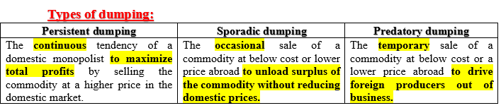
Trade Barriers
Chapter
10
v
2) Non-Tariff Distortions to Trade
5- Dumping:
www.midocean.ae

Slide 38
Trade Barriers
Chapter
10
v
2) Non-Tariff Distortions to Trade
6- Export Subsidies:
the Payments and incentives offered to export producers,
or subsidized loans to foreign buyers
intended to raise the nation’s exports.
Export subsidies are illegal by international agreement
www.midocean.ae

Slide 39
Think
Chapter
10
v
The purpose of a protective tariff is:
a.to protect domestic consumers from harmful products.
b.to protect the international laws of commerce.
c.to protect the foreign country from anti-trust actions.
d.to protect domestic producers from foreign competition.
Specific tariffs are collected:
a. only on industrial products.
b. only on pharmaceutical products.
c. only on products that arrive by train.
d. as a fixed amount of money per unit traded.
www.midocean.ae

Slide 40
Think
Chapter
10
v
A tariff of 20% on imported goods is called:
a. a specific tariff.
b. a percentage tariffs.
c. an ad valorem tariff.
d. a compound tariffs.
A tariff of ($250/import + 15% of the C.I.F. value/import) is known as a(n) _____ tariff.
a. nonspecific
ad valorem
compound
specific
www.midocean.ae

Slide 41
Think
Chapter
10
v
Limitations on the number of specific products that may be imported from certain countries during a given time
quotas
free trade
specialization
factor endowments
Dumping by a firm can be defined as:
a firm selling a product at a price below its cost of production in a foreign market.
a firm selling a product in a foreign market at a price lower than the price charged in its home market.
the discharge of waste products into the environment.
both a and b
www.midocean.ae

Slide 42
Think
Chapter
10
v
Which of the following is not a type of dumping?
A sporadic dumping
predatory dumping
complex dumping
persistent dumping
Which of the following does not cause lasting?
sporadic dumping
persistent dumping
predatory dumping
all of the above
www.midocean.ae

Slide 43
Think
Chapter
10
v
Like tariffs, quotas result in:
a. additional government revenue.
b. an increase in consumer surplus.
c. a higher imported price.
d. more imports.
If Canada imposes a tariff on bananas and if none are grown in Canada, this tariff has
A. only revenue effects
B. only protective effects
C. both protective and revenue effects
D. neither protective nor revenue effects.
www.midocean.ae

Slide 44
Think
Chapter
10
v
The purpose of a protective tariff is:
A) to protect domestic consumers from harmful products.
B) to protect domestic producers from foreign competition.
C) to protect the international laws of commerce.
D) to protect the foreign country from anti-trust actions.
www.midocean.ae

Slide 45
Think
Chapter
10
v
Which country has an absolute advantage in the production of corn?
a. Japan b. Korea
Korea must specialize in the production of --------
a. Corn b. Juice
www.midocean.ae

Slide 46
Think
Chapter
10
v
True or False
Predatory dumping is a foreign firm pricing its product in such a manner to drive domestic firms out of business. True
A quota restricts the imports of a product to a certain quantitative level. True
VER is a direct quantitative restriction on the amount of a commodity allowed to be imported, imposed by importing countries False (Quota)
www.midocean.ae

Slide 47
Summary outlines
Chapter
10
v
The relationship between international trade and the nation’s standard of living
Classical International Trade Theories
  Mercantilism
  Absolute Advantage (Adam Smith)
  Comparative Advantage (David Ricardo)
Trade Barriers
  Tariffs
  Non-Tariff Distortions to Trade
www.midocean.ae

Slide 48


Thank You

