Slide 1



Influence and Negotiation Skills
The communication’s key tactics for effective negotiation
Prepared by:
Dr. Bothaina Mahmoud Fouad
College of
Entrepreneurship and Innovation
Code ENT623
Week 5

Slide 2

Lec. 4 Overview
The main points:
Understand the importance of communication during the negotiation process.
Understand the dynamics of working/ communicating with others
Case studies

Slide 3


Communication in negotiation
means by which negotiators can achieve objectives, build relationships, and resolve disputes.

Slide 4
Reasons of using communication skills in negotiation?
Negotiators communicate to clarify their preferences, viewpoints and perspectives, to exchange information and to persuade the other party of their ideas and convictions.
For these reasons, the ability to communicate has been considered as a critical skill in a negotiator

Slide 5

Most negotiators know that communication is the most important tool you can have for successful negotiations
Because
Relation between effective communication and
effective negotiation

Slide 6
Negotiation is primarily a complex process of verbal and non verbal interaction
Communication is an essential tool in order to exchange messages between negotiators
Communication is only partly responsible for the negotiation outcomes
Relation between effective communication and
effective negotiation

Slide 7
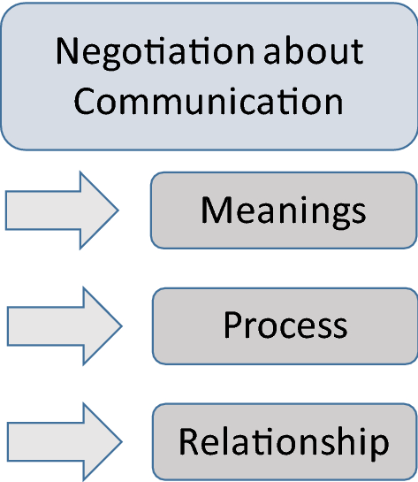
Meta negotiation communication
If a negotiator does not communicate, the relationship with the negotiation partner will break down.
https://link.springer.com/article/10.1007/s10100-020-00730-5

Slide 8

What is communicated during the negotiation
Offers, counteroffers and motives
Information about alternatives
Information about outcomes
Social accounts
    Explanations of mitigating circumstances
    Explanations of exonerating circumstances
    Refarming explanations
David Saunders and others, Essentials of Negotiations

Slide 9
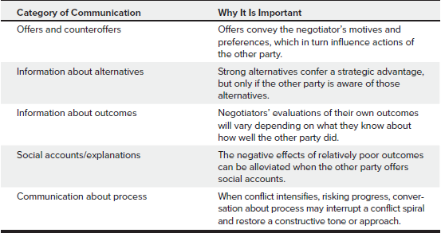
What is communicated during the negotiation
David Saunders and others, Essentials of Negotiations

Slide 10
Communicator as a Negotiator
Clear Presentation
Presentation according to the listener needs’
Credibility has to be established
Evidence to support one’s argument
Emotions expressed must be genuine

Slide 11
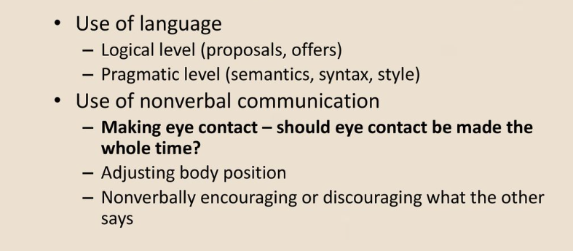
How people communicate in negotiation

Slide 12
Role of Non-Verbal Communication in Negotiation and Conflict Resolution
Mirror the other person
Look at the body language of the other person and try to adopt their same tone and behavior. This is the ‘mirroring’ technique; try to imitate others so as to favor a situation of trust
There are many non-verbal means of communication that may spoil or succeed negotiation processes, so we can focus on this 5 Tricks to enhance the success of negotiations:
Mirror the other person ” mirroring technique “: Look at the body language of the other person and try to adopt their same tone and behavior. to gain a situation of trust.
Nodding and keep eye contact: is essential to reduce tension and build relationships, even if you are in the middle of a disagreement or harsh criticism. “The eyes are the windows to the soul” when you avoid eye contact, you are showing unease and lack of confidence, which translates into a burden for any negotiator.
Pay attention to your hands: Your hands should show confidence and calmness.
Relax your body: Even in intense negotiations, it is important to keep a relaxed body position to help you relieve tension. Add to that a soft and non-aggressive tone of voice to build trust and favor effectiveness in negotiations.
Don’t forget to smile: It is highly likely that we will try to build long-term relationships in a negotiation. emphasis is placed on these types of relationships, to be built on friendly and sincere foundations. Smiling and showing a natural and transparent attitude is essential for the agreement to succeed.
https://www.game-learn.com/en/resources/blog/5-non-verbal-communication-tricks-be-successful-in-negotiations/#:~:text=Nodding%20and%20keeping%20eye%20contact,is%20the%20most%20damaging%20one.

Slide 13
Digital Communication in Negotiation
For the past few years, almost all negotiations have been occurring virtually. But even before Covid-19, an increasing number of dealmakers were connecting through digital tools. Video technologies, low-cost teleconferencing, and email have all become efficient ways for teams to prepare together and to negotiate with counterparts.
https://accentonbusiness.net/top-six-communication-skills-negotiation/

Slide 14
Digital Communication in Negotiation
Advantages | Disadvantages
time constraints | Limitations with seeing a negotiator’s emotions: There are non-verbal clues that come along with the physical mode of negotiation, such as facial gestures, hand movement, sitting positions, among many others. Virtual communication hardly gives access to all those features.
removes pressure from the negotiator. and allowed him to freely explore ideas, adjust strategy, and provide a more considered approach to their next input to the negotiation. | Technical challenges: there could still be technical challenges such as poor audio recording or limited bandwidth.
Sometimes, negotiating through email or text can also encourage a more sophisticated level of thinking and lead to more objective and rational solutions. | Misinterpretation of text: the other person at the end of the negotiation table might easily read another meaning.
https://accentonbusiness.net/top-six-communication-skills-negotiation/

Slide 15
Top Six Communication Skills for Negotiation
Know your purpose for the conversation. On what are you willing to negotiate? What are your critical points and your non-negotiables?
Ex. When you need your audience to be an advocate for you, appeal to his/her specific personality types, respect her needs, answer her expectations, and remember to be specific about the purpose of your meeting.
https://accentonbusiness.net/top-six-communication-skills-negotiation/

Slide 16
Know your audience. People generally fall into four categories of business personality: the driver, the amiable, the analytic, or the expressive.
Driver types
are straight and to the point, very focused on business and not interested in your personal life.
Amiable types
care strongly about relationships and they go into business with people they like. They want to get to know you and want you to make them feel comfortable with the business opportunity. It usually takes them awhile to make decisions because you have to talk them through each of the steps – they like to take everyone’s opinion into consideration before making a decision.
Analytic types
need a spreadsheet. They like to see the numbers and will know if it works for their company or not based solely on the spreadsheet. They are usually a bit more reserved and do not like to have large amount of conversation.
Expressive types
are similar to drivers, but have a stronger focus on relationships. They will make the best decision for their company in a timely manner, but want to get to know you, too
They want to see profit and success and will need for you to explicitly state how your partnership will help them be successful.

Slide 17
Top Six Communication Skills for Negotiation
2. Focus on how you deliver your messages. What body language should you be using with your audience? What facial expressions? Do you look and sound likeable, believable, and interesting in your presentation?
Ex. Your smile is our biggest sign that you believe what you’re saying. Use inflection to make meaningful words stick.
https://accentonbusiness.net/top-six-communication-skills-negotiation/

Slide 18
Top Six Communication Skills for Negotiation
3. Mirror your audience’s speed of speech and tone. If he/she is serious, you should be serious. If he/she is talking fast, then you should talk fast. This “mirroring and watching” makes negotiations stronger, shows your respect for him or her, and keeps you at equal business stature.
https://accentonbusiness.net/top-six-communication-skills-negotiation/

Slide 19
Top Six Communication Skills for Negotiation
4. Listen to their “REALLY” emotions: really happy, really excited, or really mad. What words are they using and what senses do they appeal to? Visual, auditory, or kinesthetic? Stay on that same “sensory mode” during that topic. This improves your bonding and rapport while showing respect.
In using this technique, you relate to them and their point of view, what they are seeing, feeling, and hearing. You listen better, and can address the problem in a constructive way that lets them know that you understand why they are feeling that way and that their feelings are valid.
https://accentonbusiness.net/top-six-communication-skills-negotiation/

Slide 20
Top Six Communication Skills for Negotiation
5. Practice saying your content out loud before the meeting. This should include your purpose statement, your opening, and your closing. Saying it out loud may prompt you to polish and clarify your first key message.
https://accentonbusiness.net/top-six-communication-skills-negotiation/

Slide 21
Top Six Communication Skills for Negotiation
6.Create suspense in relaying the details and why they are important. Suspense in public speaking goes deeper into the emotion centers of our brains. It creates impact and is powerful.
https://accentonbusiness.net/top-six-communication-skills-negotiation/

Slide 22
Barriers of communication in negotiation
Language barriers: When parties speak different languages or dialects, it can be difficult to communicate effectively and accurately. This can lead to misunderstandings and misinterpretations of what is being said.
Cultural barriers: Cultural differences can affect communication in negotiation, as different cultures may have different communication styles, norms, and expectations. For example, some cultures may value direct communication, while others may use indirect communication.
Emotional barriers: Strong emotions such as anger, frustration, and anxiety can make it difficult to communicate effectively in negotiation. Parties may become defensive, dismissive, or unresponsive, which can lead to breakdowns in communication.

Slide 23
Barriers of communication in negotiation, Con’t
4.Information barriers: Parties may have different levels of information or access to information, which can create an imbalance of power and lead to misunderstandings or mistrust.
5.Perception barriers: Parties may have different perceptions of the situation, the other party, or the negotiation process. These different perceptions can lead to misunderstandings and misinterpretations of what is being said.
6.Technology barriers: In today's digital age, parties may communicate through technology such as email and video conferencing, which can create barriers to effective communication. Technical difficulties and miscommunications can occur, which can hinder the negotiation process.

Slide 24
Ex: Barriers of communication in negotiation
Before taking my new job, I had 10 years of successful experience negotiating with suppliers all over the United States.
The company I just joined sources materials and components from almost everywhere but the United States.
What advice can you give me on negotiating with foreign suppliers?

Slide 25
Ex: Barriers of communication in negotiation
When negotiating with foreign suppliers, you’ll confront a variety of obstacles, such as:
unfamiliar laws,
ideologies, and governments, that are usually absent from negotiations with U.S. suppliers.
the cultural differences between the two sides ( in case of International negotiations).

Slide 26
Ex: Barriers of communication in negotiation
Culture consists of the socially transmitted behavior patterns, attitudes, norms, and values of a given community, whether a nation, an ethnic group, or even an organization.
Understanding a foreign counterpart’s culture is a lot like peeling an onion, as you interpret behavior to reveal attitudes, which reflect norms, which are founded on values.

Slide 27
To overcome these barriers
parties can improve their communication and achieve more successful negotiation outcomes through taking a lot of steps, such as:
actively listening,
asking clarifying questions, and
using clear and concise language.
Parties can also work to understand and respect cultural differences,
manage their emotions, and share information openly and transparently. By addressing these barriers,

Slide 28
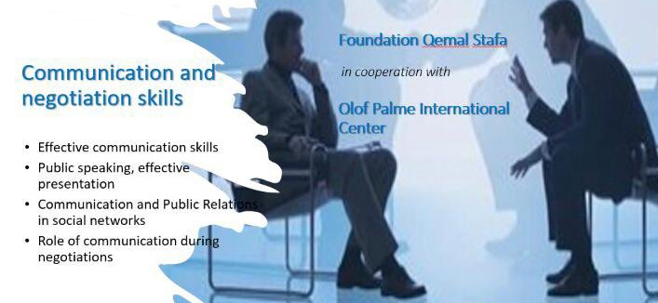
A Checklist for effective communication during the negotiation
Put yourself in the recipient’s shoes, and ask yourself what are their needs, interests and motivations?
Be positive
Plan all communication
Make sure that you have your message clear in your own mind before trying passing it to others
Phrase it in language the receiver understands
Keep to the point, don’t ramble
Be yourself , be natural , be relaxed

Slide 29
 | Yes / No
In negotiations, do people often take advantage of you?
Do you struggle to have difficult conversations?
Do you win negotiations but struggle to maintain business relationships?
Do you win negotiations but struggle to maintain business relationships?
Do you avoid talking about price until the end?
Do you avoid talking about difficult issues until the end?
Negotiation skills checklist

Slide 30
 | Yes/ No
Do you know how to respond when, early in the negotiation, the other party says let’s skip the haggling, just give me your best price?
Do you know how to cope with there being another decision maker who is not present?
Do you know how to deal with delaying tactics?
Do you know the difference between positions and interests in a negotiation?
Can you handle an aggressive negotiator?
Do you know how to avoid “buyer s remorse” (when the buyer cancels the sale some time after you’ve agreed it)?
Negotiation skills checklist, Con’t

Slide 31
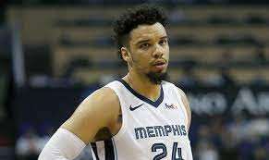
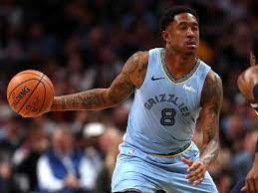
Case Study
Dillon and Marshon Brooks
Insert Your Amazing Statement Here
A wonderful serenity has taken possession of my entire soul, like these sweet

Slide 32
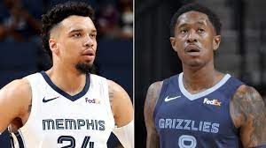
Memphis has two players with the last name Brooks – Dillon Brooks, a twenty-two-year-old small forward with a lot of skill and potential; and MarShon Brooks, a twenty-nine-year-old shooting guard who was out of the NBA playing in China last season. Somehow, Washington and Phoenix thought that Dillon Brooks was part of the trade deal; Memphis, however, was offering MarShon Brooks. Seemingly, no one confirmed which Brooks it was until the deal was about to be finalized
https://www.mwi.org/the-importance-of-communication-in-negotiation/

Slide 33
When the teams discovered that they were talking about two very different Brooks, the trade talks broke down and temporarily ended. The impact rippled throughout the league (and on Twitter). Some players were already informed about the trade, and many of the details were being talked about widely in the press. The breakdown of the trade happened in such a public and embarrassing way over the course of just thirty minutes that it seemed almost unbelievable.

Slide 34
Ariza ultimately was traded to Washington, but the resulting public embarrassment and locker room tension could have been avoided with improved preparation, reflection, and communication.

Slide 35
As negotiation trainers and consultants, we see the following as three important lessons to take away from this case study
01
Preparation
each team should have been aware that there were multiple Brooks playing for Memphis had they prepared more effectively. It can be easy to jump right into a negotiation without spending time preparing, especially in a fast-paced, high-stakes industry like professional sports. As we’ve stated before, however, preparation is an essential part of the negotiation process. The time and effort spent on this step will pay off in dividends during the negotiation itself.

Slide 36
As negotiation trainers and consultants, we see the following as three important lessons to take away from this case study
02
Question your assumptions
It’s interesting that each team assumed that the Brooks in play was the one who benefited them the most. Phoenix would have preferred the young up-and-comer Dillon, while Memphis would have preferred dealing a deep reserve player like MarShon. It’s easy to laugh at a situation like this and think that we would never make such a mistake. However, we all rely on assumptions. When we act upon assumptions without questioning them first, we create situations ripe for misunderstanding. If you find yourself talking to someone and feel like you are talking past one another, ask yourself: is there a conclusion or assumption I’m making that might be different from the other side?

Slide 37
As negotiation trainers and consultants, we see the following as three important lessons to take away from this case study
03
Confirm your understanding – early and often
Luckily, each team ultimately recognized their error and were able to make a trade work. Miscommunication happens – you cannot prepare for everything, and you cannot expect to be perfect. However, we can increase the likelihood that we catch miscommunications earlier in the negotiation process by confirming our understanding of what our counterpart is saying. Utilizing active listening techniques, we summarize what our negotiation counterpart is saying. If we have misunderstood them – or if we are talking about two different things, as in the case of the Ariza trade – we can clarify it up front and keep it from possibly derailing the negotiation in the future

Slide 38
This messy trade negotiation delivers one final lesson:
when you make a mistake during a negotiation, you can use it as a chance to improve moving forward. Reviewing your negotiations is as important as preparing for them because it allows you to learn and grow, and you can utilize those lessons in your next negotiation to continue improving your skills and negotiated outcomes

Slide 39
Conclusion
Understanding Communication in Negotiation.
Verbal and Non-Verbal Communication in Negotiation.
Digital Communication in Negotiation
Overcoming Communication Barriers in Negotiation

Slide 40


Thank You

