Slide 1











PROJECT FEASIBILITY STUDY
PMG201
Prepared by
Dr. Manal Elsayed
Lecture No. 6

Slide 2








Prepared by
Dr. Manal Elsayed
Planning the Project

Slide 3

The Contents of a Project Plan—The “Project Charter”.
The Planning Process—Overview.
The Planning Process—Nuts and Bolts.
More on the Work Breakdown Structure and Other Aids .
Multidisciplinary Teams—Balancing Pleasure and Pain.

Slide 4

Introduction
If problems arise during the life of a project, our first hunch لولأا انسدحwould be that the project was not properly planned. Most of the time our hunch would be correct. حيحص نوكيس اذهو Inadequate planning is more the case than the exception.

Slide 5

Project Planning
Basic objective:
To create a plan to of the project.
meet the commitments
Create a path that, if followed, will lead to a
successful project.
Planning involves
Defining the
LC life cycle
process to be
followed, estimates, detailed schedule, plan for quality, etc.
Main output
A project management plan, and project schedule.

Slide 6

Key Planning Tasks
Define suitable processes for executing the project.
Estimate effort.
Define project milestones and
create a schedule.
Define
quality objectives
and a
quality plan
.
Identify risks and make plans to mitigate them.
Define measurement plan, project- tracking procedures, training plan, team organization, etc.

Slide 7
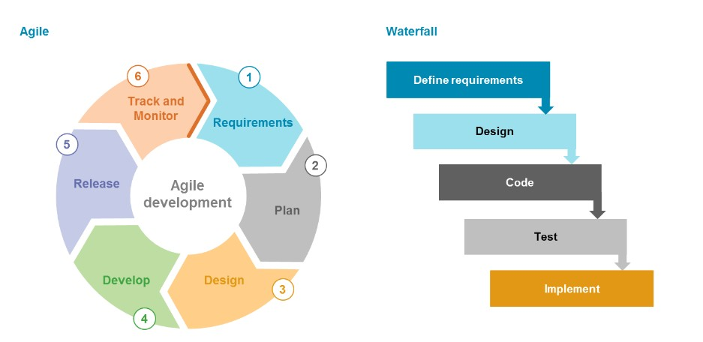
Life Cycle Process
Various LC models - waterfall, iterative, prototyping; diff models ةيلوأ جذامن ، يراركت ، للاش
قرفلا جذامن ؛suit different projects
•
During planning can select the
model that is best for the
project
.
This gives the overall process which has to be fine-tuned to
suit the
project needs
Usually done by process tailoring - changing the process to suit the project
Tailoring finally results in adding, deleting, modifying some process steps

Slide 8
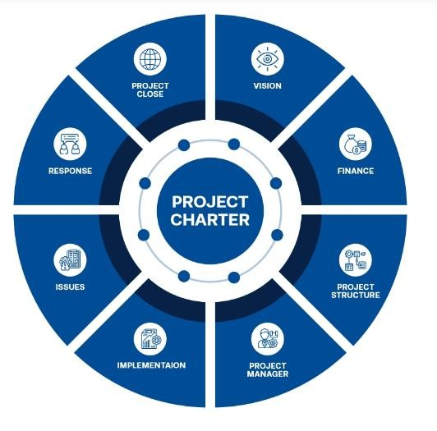
1. The Contents of a Project Plan The Project Charter
It is a document that serves to
formally
announce the selection
and approval of the project
, as
well as grant the
project manager
the authority to meet project
objectives
using organizational
resources. It also includes the main goals of the project, and the
designation of roles and
responsibilities.

Slide 9
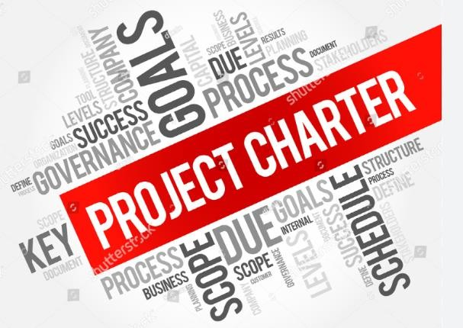
The Project Charter عورشملا قاثيم
The purpose of the project charter is to provide support for the project managers involved, as well as helping the stakeholders to understand what the given project is hoping to accomplish. It defines the project's success, offers deadlines, provides information on identified risks, and outlines the budget. The project charter serves as the basis for the project planning, and it maps out each step of the way so that any changes can be implemented easily and smoothly.

Slide 10

The
project plan
fall into one of the following nine categories:
Overview.
Objectives.
General approach.
Contractual aspects.
Schedules.
Resource requirements .
Personnel.
Risk management.
Evaluation methods.

Slide 11

1- Overview
This section contains
a brief description
of the project
and its deliverables
This
section should include the
Business
Case for the project.
•
The Business Case includes the
strategic reasons
for the project, its
expected profitability and competitive
effects as well as the
desired scope
and
any other technical results. The main goal of the Business Case is to communicate to project team members (and others) the reasons why the organization is undertaking the project.
.

Slide 12

2. Objectives.
This is a
more detailed description
of the project ’ s scope, its deliverables and outcomes. Another approach to describing a
project ’ s objectives
is the project
mission statement. While somewhat similar to the Business Case, the focus of the mission statement is to communicate to project team members (and others) what will be done to achieve the project ’ s overall objectives. To foster team understanding of the project as a whole.

Slide 13

3 .General approach.
In this section, the
technological and
managerial approaches
to the work
are described. Also noted are plans that go beyond the organization ’ s standard management practices. For example, some firms do not allow the use of consultants or subcontractors without special approval.

Slide 14

4. Contractual aspects
This section contains a complete
description of
all agreements made
with the client or any third party.
This list would include
all reporting
requirements; the technical
specifications of all deliverables
;
agreements on delivery dates.
If relevant, it may contain
agreements
to comply with legal, environmental,
and other constraints on the project
work and outputs.

Slide 15

5. Schedules
An outline of all schedules
and milestones.
Each task
in the project is listed in a
project WBS. Listed with
each task is the time
required to perform it
.
The project schedule is constructed from these data and is included in this section.

Slide 16

6. Resource requirements
Estimates of project expenses,
both
capital and operating, are
included here. The costs associated
with each task are shown, and
overhead and fixed charges are
listed
. In addition,
cost monitoring
and cost control procedures are
described here.
The details of
materiel acquisition are also detailed in this section.

Slide 17

7. Personnel.
This section covers the
details of
the project work
force. It notes any special skill requirements, necessary training. Combined with the schedule, it notes the time - phasing of all personnel requirements.

Slide 18

8. Risk management
Planners should list
the major
and minor disasters that may
strike projects.
The argument is
made that crises cannot be predicted.
The only uncertainty, however, is which of the crises will occur
and when.
In any case, dealing
with crises does not require a
which - and - when prediction
.
Contingency plans to deal with such potential crises should be a standard part of the project plan.

Slide 19

9. Evaluation methods.
Descriptions of all project evaluation procedures and quality standards are found in this section. Also included are procedures to ensure compliance with all corporate requirements for monitoring, collecting, and storing data on project performance.

Slide 20

2. The Planning Process—Overview
A great deal has been written about planning. Some of the literature focuses on the strategic aspect of planning —
choosing and planning projects that
contribute to the organization ’ s goals.
Another body of writing is directed at
the techniques of how to plan rather
than what to plan
.
As far as we can determine,
the way
that planning techniques vary in these
different cases has more to do with
nomenclature than substance. ةقيرطلا
تلااحلا هذه يف طيطختلا تاينقت اهب فلتخت يتلا
.رهوجلا نم رثكأ تايمستلاب ةقلاع اهل ةفلتخملا

Slide 21

The following planning process that has been divided into EIGHT distinct steps.
1.
Develop and evaluate the concept
of the
project.
Describe what it is you wish to
develop, including its basic performance
characteristics,
and decide if getting such a
deliverable is worthwhile.
2. Carefully identify the
actual capabilities that
the project ’ s deliverable must have to be
successful.
3.
Create a system (
product or service), which is
to say, build a prototype deliverable ميلست يلولأا جذومنلا.
4. Test the prototype to see if it does, in fact,
have the desired capabilities. If necessary,
cycle back to step
3 to modify the prototype
and retest it. Continue until the deliverable meets the preset requirements.

Slide 22
Integrate the deliverable into the system for which it was designed.
Validate the deliverable — which answers the question, “does it still work properly? ”
If the deliverable has been validated, let
the client test it.
Can the client operate the
system? If not, instruct the client
.
8. If the client can operate (and accepts) the
deliverable,
make sure that the client
understands all standard operating and
maintenance requirements
. Then shake the
client ’ s hand, present the client with a written copy of maintenance and operating instructions, give the client the bill, and leave.
، ليغشتلاو ةنايصلا تاميلعت نم ةبوتكم ةخسن ليمعلل مدق رداغو ، ةروتافلا ليمعلا طعأو

Slide 23

3. The Planning Process—Nuts and Bolts
This section deals with the
problem of
determining and
listing the various tasks that must
be accomplished in order to
complete a project
. The
important matters of generating a project budget and developing a
precise project schedule
are left
to coming chapters,
though
much of the raw material
for doing those important things
will come from the planning process described here.

Slide 24
The Planning Process—Nuts and Bolts cont. …
The project launch meeting sets the project scope, demonstrates managerial commitment to the project, and initiates the project plan.
The result is a
WBS that lists all the
tasks required to carry out the plan
together with task resource
requirements
, durations, predecessors,
and identification of the people responsible for each task.

Slide 25
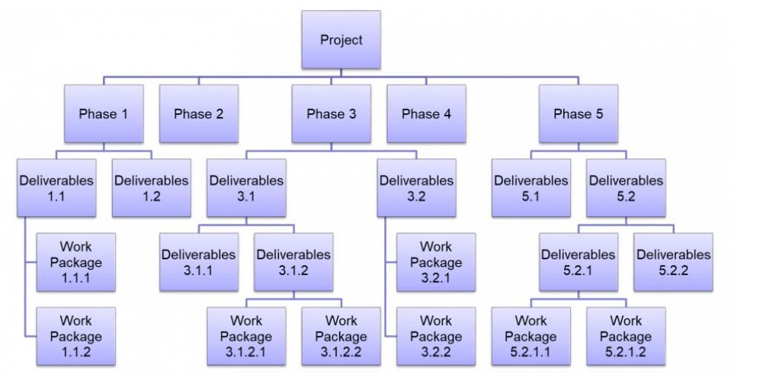
4. More on the
Work Breakdown Structure
and Other Aids
The process of building a WBS is
meaningful.
The PM and
individual team members may
differ on the technical approach
to working on the task
, the type
and quantity of resources needed, or the duration for each subtask.
If so, negotiation is apt to
accompany the planning process.
As usual,
participatory
management
and
negotiation
often lead to
improved project
performance and better ways of
meeting the project ’ s goals.

Slide 26
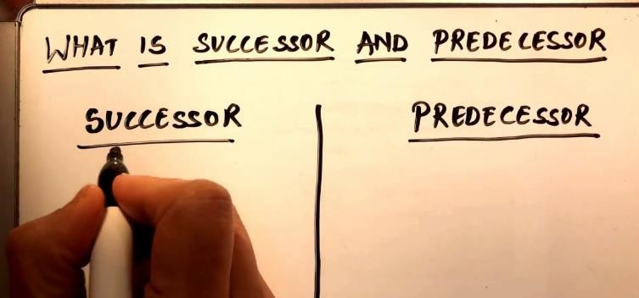
More on the Work Breakdown Structure and Other Aids cont.
1. All project activities will be identified and arranged in successively finer detail, that is, by levels.
2. For each activity,
the type and quantity of
each required resource
(including personnel)
are identified.
For each activity, predecessors قبس ام لك
and task duration are estimated.
All project milestones ملاعملا are identified and located on the project schedule following their predecessor activities.
For each activity, the individual or group
assigned to perform
the work is identified.

Slide 27

More on the Work Breakdown Structure and Other Aids cont.
6. If project milestones, task durations, and predecessors are combined, the
result is
the project master schedule.
7. The master schedule allows the PM to
compare actual and planned task
durations and resource usage at any level
of activity.
The need for such comparisons provide the information about project performance should be monitored. This gives the PM the ability to control the
project and if the
take corrective action
project is not proceeding according to plan.

Slide 28
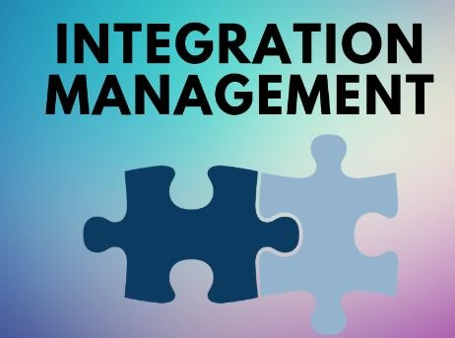
5. Multidisciplinary Teams,
Balancing Pleasure and Pain
Integration Management
Integration management is an organized approach
that
ensures all processes within a project are synchronized
and executed efficiently
, and resources remain on track to
achieve the project goals. It helps project managers to balance stakeholder expectations and customer needs while optimizing tasks and resources, steering the project toward
success.
what can be
achieved through integration management:
Processes and tasks can be organized and listed out.
Team members can be allocated responsibilities.
Shared resources and their overlapping schedules are managed.
Work efficiency within teams is enhanced.

Slide 29
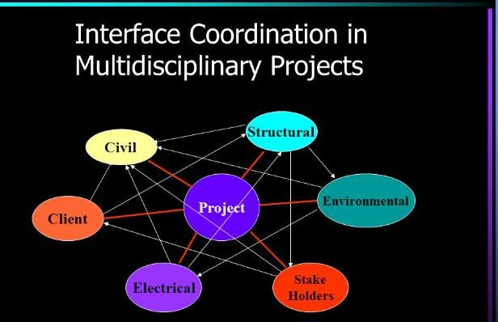
Interface Coordination , Interface Management
One of the PM ’ s more difficult
problems
is coordinating the work
of different functional groups
interacting as team members.
•
The team members
come from
different functional areas
and often
are not used to dealing with one another directly.
For the most part, they have
no
established dependencies on each
other and being co - members of a
team is not sufficient
to cause them
to associate — unless the team has
a mission that makes
it important
for the members to develop
relationships.

Slide 30
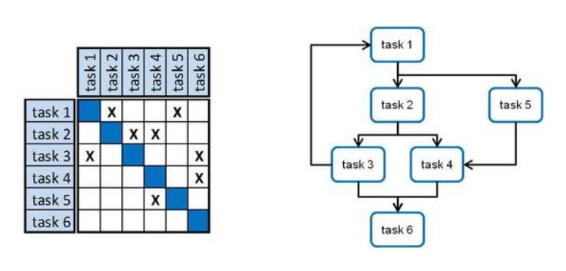
The Design Structure Matrix
The Design Structure Matrix (DSM)
is a for
general method
representing and analyzing system models in a variety of application areas. A DSM is a square
matrix that shows relationships between elements in a system. DSM has two main advantages:
It provides a simple and concise way to represent a complex system.
It is amenable to
powerful analyses, such as
clustering and sequencing. ةلباق
.لسلستلاو عيمجتلا لثم ،ةيوقلا تلايلحتلل

Slide 31

Comments on Empowerment and Work Teams
Some of the more important advantages of empowerment are:
Teams generate high - quality
solutions to appropriate problems.
Micromanagement is avoided.
The team is given accountability for some part of the project deliverable.
Synergistic solutions are frequent.
The PM has a tool for timely team
evaluation and feedback.

Slide 32


