Slide 1


Mathematics
Prepared by Dr. Israa Lewaa
Lecture 6
MAT 122
Determinants

Slide 2

Lecture
06
Lecture Outline
Definition of the determinants
Determinant for 2*2 matrix
Determinant for 3*3 matrix – First Way
Determinant for 3*3 matrix – Second Way
Lecture 6 Dr. Israa Lewaa Mathematics 2

Slide 3
Lecture
06
Definition of the determinants
Definition
The determinant of a 2 × 2 matrix A is denoted |A| and is given by
Observe that the determinant of a 2 × 2 matrix is given by the different of the products of the two diagonals of the matrix.
The notation det(A) is also used for the determinant of A.
Lecture 6 Dr. Israa Lewaa Mathematics 2

Slide 4
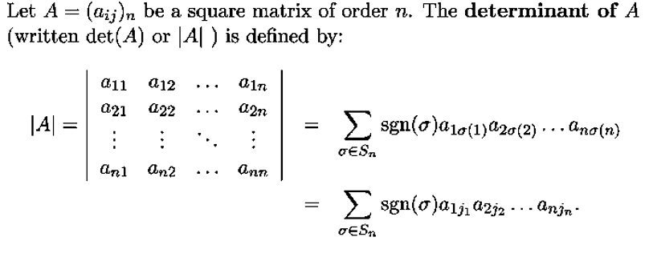
Lecture
06
Determinant
Lecture 6 Dr. Israa Lewaa Mathematics 2

Slide 5
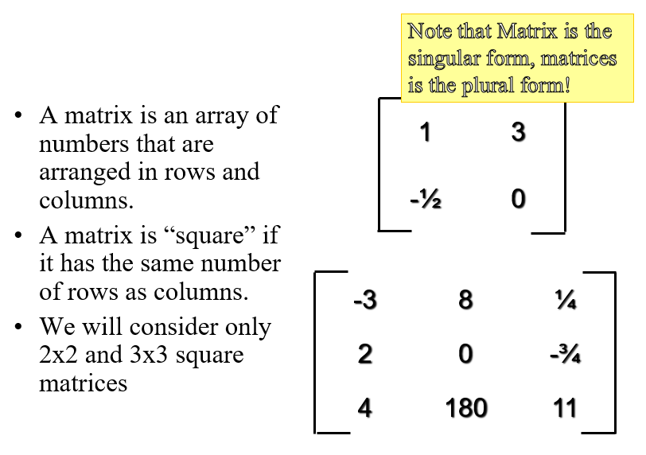
Lecture
06
Matrices
Lecture 6 Dr. Israa Lewaa Mathematics 2

Slide 6
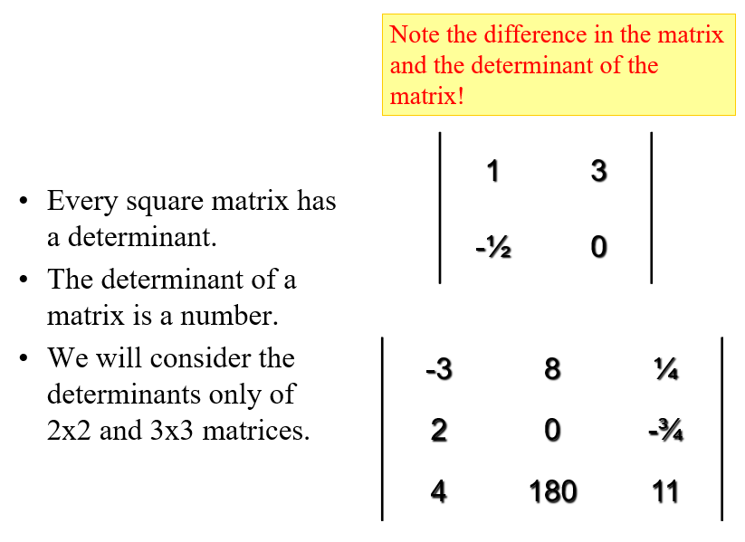
Lecture
06
Determinant
Lecture 6 Dr. Israa Lewaa Mathematics 2

Slide 7
Lecture
06
Determinants of 2*2 Matrix
Determinants of 2*2 Matrix
Lecture 6 Dr. Israa Lewaa Mathematics 2

Slide 8
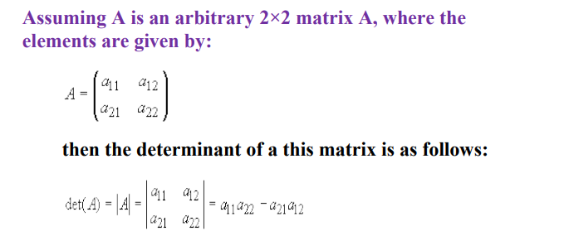
Lecture
06
Determinants of 2*2 Matrix
Lecture 6 Dr. Israa Lewaa Mathematics 2

Slide 9
Lecture
06
Determinants of 2*2 Matrix
Lecture 6 Dr. Israa Lewaa Mathematics 2

Slide 10
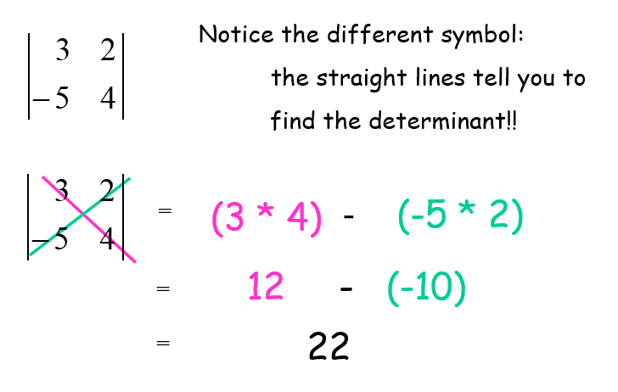
Lecture
06
Determinants of 2*2 Matrix
Lecture 6 Dr. Israa Lewaa Mathematics 2

Slide 11
Lecture
06
Determinants of 3*3 Matrix – First Way
Determinants of 3*3 Matrix – First Way
Lecture 6 Dr. Israa Lewaa Mathematics 2

Slide 12
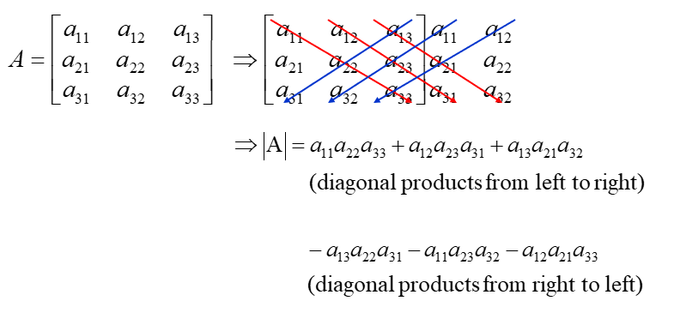
Lecture
06
Determinants of 3*3 Matrix – First Way
Lecture 6 Dr. Israa Lewaa Mathematics 2

Slide 13
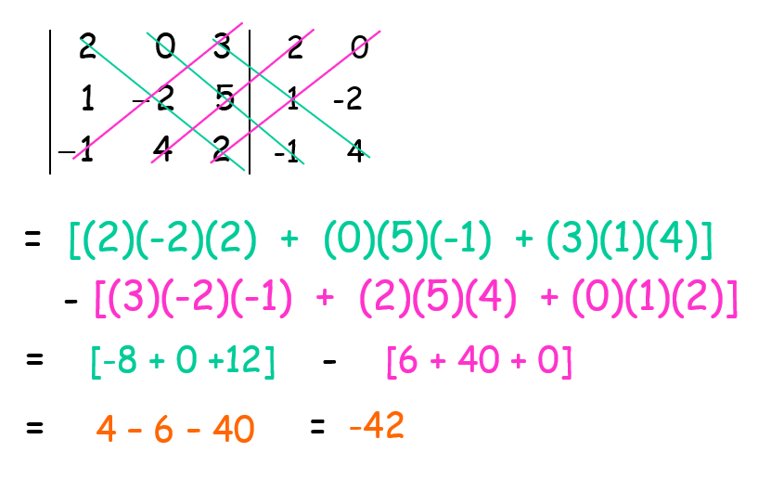
Lecture
06
Determinants of 3*3 Matrix – First way
Lecture 6 Dr. Israa Lewaa Mathematics 2

Slide 14
Lecture
06
Determinants of 3*3 Matrix – Second Way
Determinants of 3*3 Matrix – Second Way
Lecture 6 Dr. Israa Lewaa Mathematics 2

Slide 15
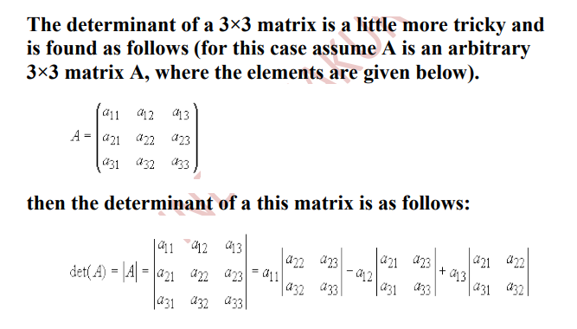
Lecture
06
Determinants of 3*3 Matrix – Second Way
Lecture 6 Dr. Israa Lewaa Mathematics 2

Slide 16
Lecture
06
Determinants of 3*3 Matrix – Second Way
Lecture 6 Dr. Israa Lewaa Mathematics 2

Slide 17
Lecture
06
Determinants of 3*3 Matrix – Second Way
Lecture 6 Dr. Israa Lewaa Mathematics 2

Slide 18
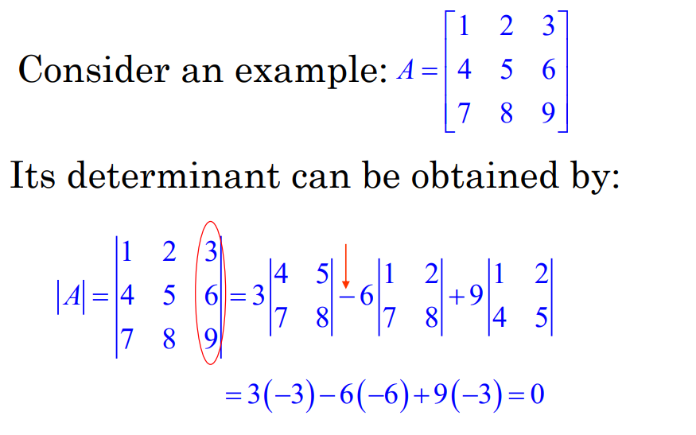
Lecture
06
Determinants of 3*3 Matrix – Second way
Lecture 6 Dr. Israa Lewaa Mathematics 2

Slide 19
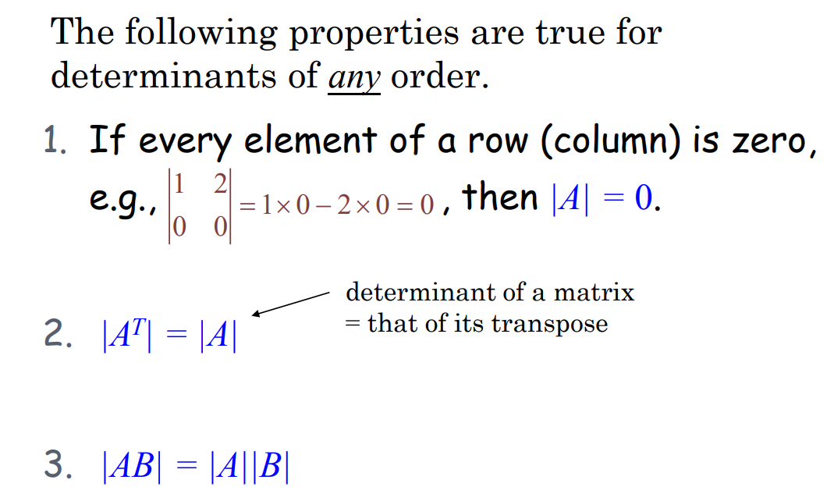
Lecture
06
Properties of Determinants
Lecture 6 Dr. Israa Lewaa Mathematics 2

Slide 20
Lecture
06
Let’s Practice
Let’s Practice
Lecture 6 Dr. Israa Lewaa Mathematics 2

Slide 21

Lecture
06
Example 1
Find the determinants for the following matrix
Lecture 6 Dr. Israa Lewaa Mathematics 2

Slide 22
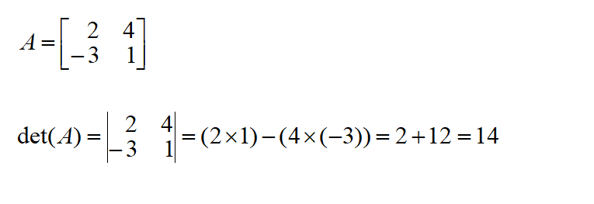
Lecture
06
Solution
Lecture 6 Dr. Israa Lewaa Mathematics 2

Slide 23
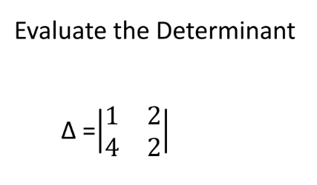
Lecture
06
Example
Lecture 6 Dr. Israa Lewaa Mathematics 2

Slide 24
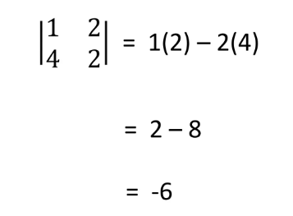
Lecture
06
Solution
Lecture 6 Dr. Israa Lewaa Mathematics 2

Slide 25
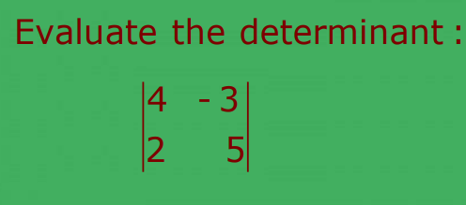
Lecture
06
Example
Lecture 6 Dr. Israa Lewaa Mathematics 2

Slide 26
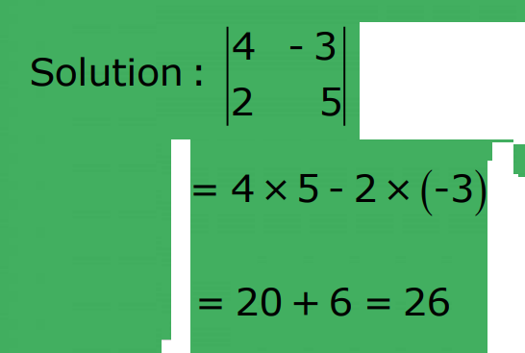
Lecture
06
Example
Lecture 6 Dr. Israa Lewaa Mathematics 2

Slide 27
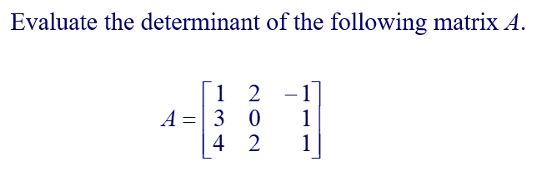
Lecture
06
Example
Lecture 6 Dr. Israa Lewaa Mathematics 2

Slide 28
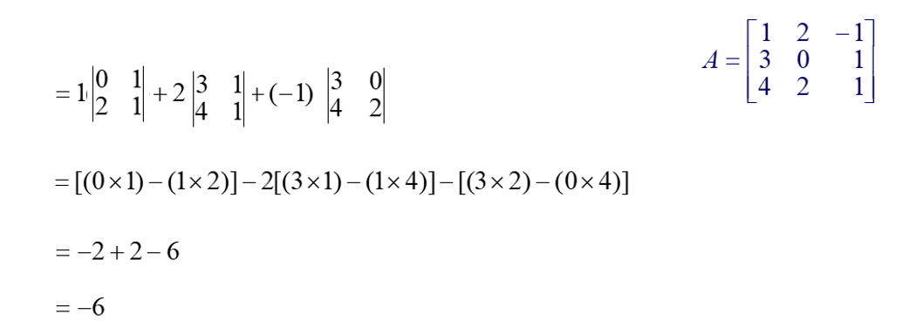
Lecture
06
Extra Practice -- Example
Lecture 6 Dr. Israa Lewaa Mathematics 2

Slide 29
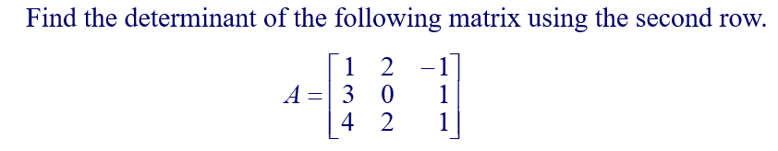
Lecture
06
Extra Practice -- Example
Lecture 6 Dr. Israa Lewaa Mathematics 2

Slide 30
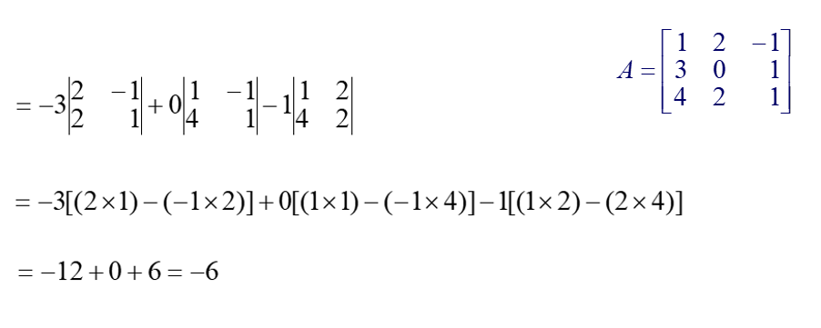
Lecture
06
Example
Lecture 6 Dr. Israa Lewaa Mathematics 2

Slide 31
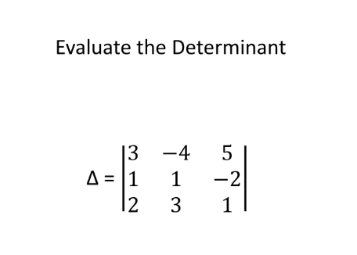
Lecture
06
Example
Lecture 6 Dr. Israa Lewaa Mathematics 2

Slide 32
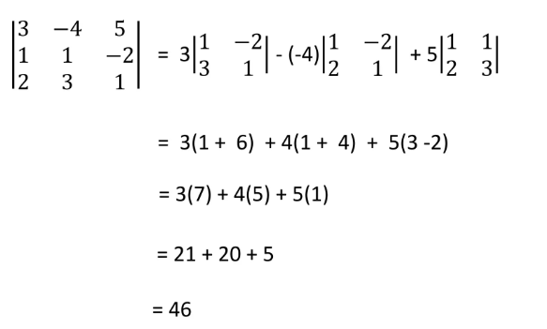
Lecture
06
Example
Lecture 6 Dr. Israa Lewaa Mathematics 2

Slide 33
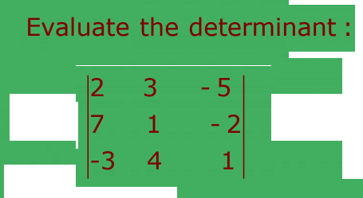
Lecture
06
Example
Lecture 6 Dr. Israa Lewaa Mathematics 2

Slide 34
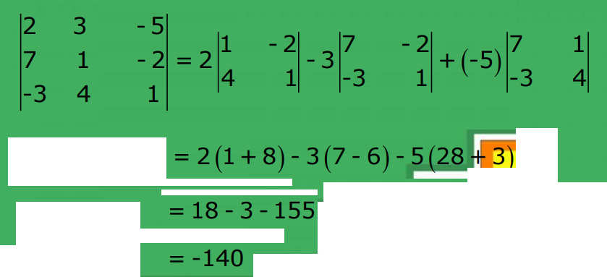
Lecture
06
Solution
Lecture 6 Dr. Israa Lewaa Mathematics 2

Slide 35
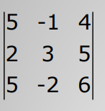
Lecture
06
Example
Evaluate the following determinant
Lecture 6 Dr. Israa Lewaa Mathematics 2

Slide 36
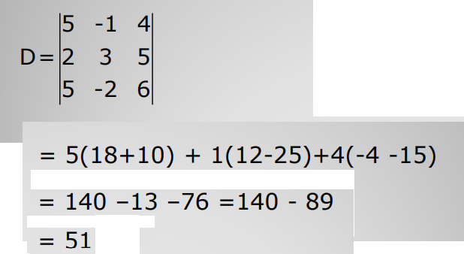
Lecture
06
Solution
Lecture 6 Dr. Israa Lewaa Mathematics 2

Slide 37
Lecture
06
Lecture Summary
Definition of the determinants
Determinant for 2*2 matrix
Determinant for 3*3 matrix – First Way
Determinant for 3*3 matrix – Second Way
Lecture 6 Dr. Israa Lewaa Mathematics 2

