Slide 1




Social Media and Crises
Lecture 4
DGM 730
Crisis Communication & crises management
(Approaches & Theories)
Prepared by
Dr. Doaa Rady

Slide 2

Lecture
Lecture outline
Crisis Communication & crises management:
(Approaches & Theories)
04
Crisis Communication and Crisis Management: Definitions
    Public Relations (PR)
    Crisis Communication
    Reputation
    Crisis management
Social Media in Crisis Communication: opportunities and challenges
PR Models:
    press agentry/publicity,
    public information,
    two-way asymmetrical,
    and two-way symmetrical
Crisis Communication Theories
    Image Restoration Theory
    Situational Crisis Communication Theory
    The Social-Mediated Crisis Communication (SMCC) model
    The influencer impact on Social Media Crisis

Slide 3


تنويه عن الندوة
رابط التسجيل
https://sis.midocean.ae/public-forms/create?public_hash=84e901db44e9891f0289ef5d62becb5551d919a4

Slide 4

H&M PR Crisis
Case Study

Slide 5
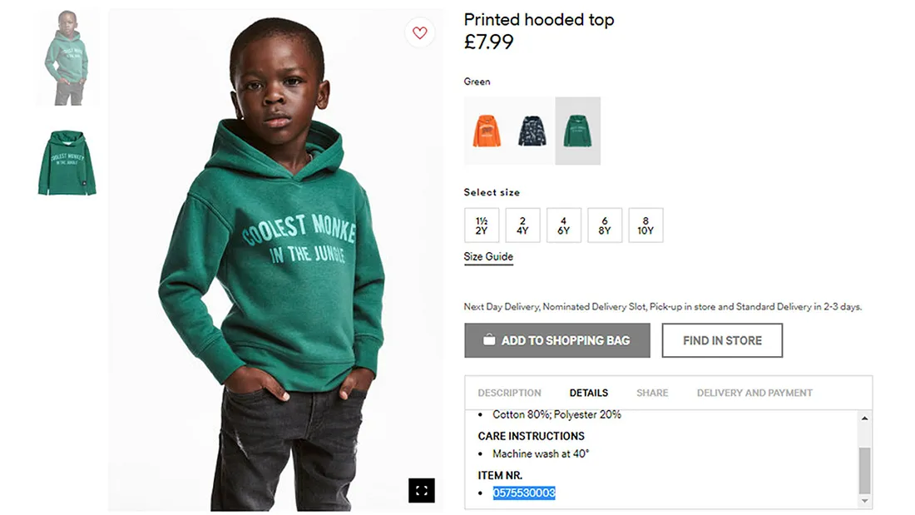
Lecture
04
Case Study
https://medium.com/@villa.naomi/h-m-pr-crisis-a-case-study-2ca2085255fe

Slide 6
Lecture
04
Case Study
H&M’s PR crisis was caused by a racist children's sweatshirt. The sweatshirt was modeled by an African American boy with the imprinted words “Coolest Monkey in the Jungle. عليه عبارة "أروع قرد في الغابة"” To the millions that saw the image it was a “shocking admission that white companies still saw Black consumers as a degrading and ugly stereotype” (Wang, 2019). "اعترافًا صادمًا بأن الشركات البيضاء لا تزال تنظر إلى المستهلكين السود على أنهم صورة نمطية مهينة وقبيحة"
Multiple factors contributed to fueling of the crisis. In the photo the child had a somber look on his faceكان للطفل نظرة حزينة على وجهه, hands in his pocketsويداه في جيوبه, and a stiff stance almost as if he were aware of the humiliationووقفة متصلبة كما لو كان على علم بالإهانة.

Slide 7
Lecture
04
Case Study
The child’s mother also made comments about the issue that also inadvertently fueled the crisis. These comments were met with vicious backlash, even being called a “traitor to her own community.”
كما أدلت والدة الطفل بتعليقات حول القضية التي أدت أيضًا إلى تأجيج الأزمة عن غير قصد. وقد قوبلت هذه التعليقات برد فعل عنيف، حتى أنها وصفت بأنها "خائنة لمجتمعها".
H&M Response
H&M reacted by removing the sweatshirt from stores, apologized on all of their social media accounts, and apologized through statements to the media.

Slide 8

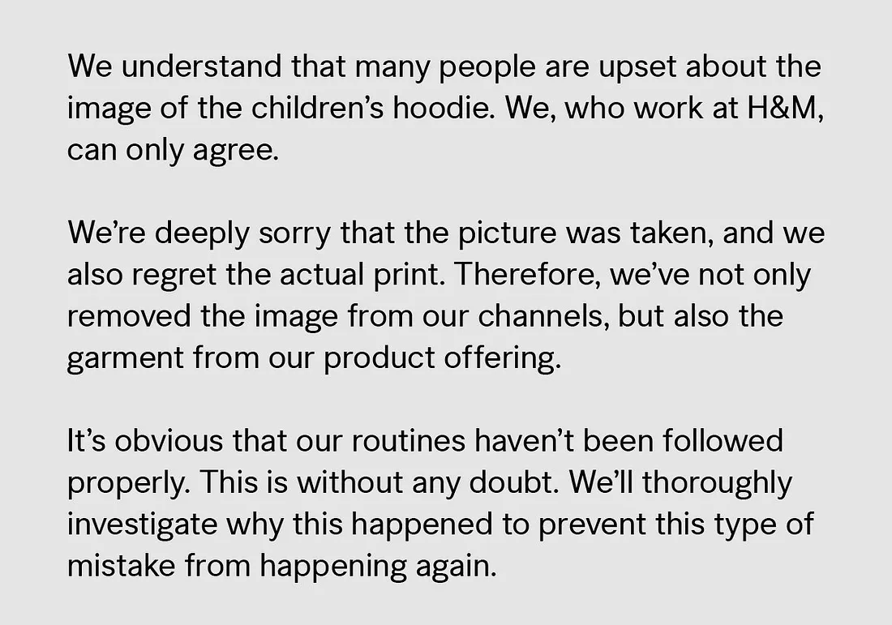
Lecture
04
Case Study
They also promoted Annie Wu, a Taiwanese immigrant, to a new position as the global head of diversity and inclusivity based in Stockholm.
This was their statement:
"نحن نفهم أن الكثير من الناس مستاؤون من الصورة. نحن، الذين نعمل في H&M، لا يسعنا إلا أن نتفق مع ذلك.نأسف بشدة لالتقاط الصورة، ونأسف أيضًا للطباعة الفعلية. لذلك، لم نقم بإزالة الصورة من قنواتنا فحسب، بل قمنا أيضًا بإزالة الملابس من عروض منتجاتنا.من الواضح أن إجراءاتنا الروتينية لم يتم اتباعها بشكل صحيح. وهذا بلا أدنى شك. سنحقق بدقة في سبب حدوث ذلك لمنع حدوث هذا النوع من الأخطاء مرة أخرى.

Slide 9
Lecture
04
Case Study
Even with efforts to fix the issue the fallout was severe. Petitions were made for global boycotts of H&M, demonstrations were held around the world, stores were vandalized by protestors, The Weeknd vowed to never work with the retailer again and other celebrities like LeBron James, Diddy, and G-Eazy condemned the brand.
Although H&M made efforts to manage the crisis not only was it not enough but the biggest issue was that garment of clothing should not of ever been created.
وحتى مع الجهود المبذولة لإصلاح المشكلة، كانت التداعيات شديدة. تم تقديم التماسات للمقاطعة العالمية لـ H&M، ونظمت مظاهرات في جميع أنحاء العالم، وتم تخريب المتاجر من قبل المتظاهرين، وتعهد The Weeknd بعدم العمل أبدًا مع بائع التجزئة مرة أخرى، وأدان مشاهير آخرون مثل LeBron James وDiddy وG-Eazy العلامة التجارية.على الرغم من أن شركة H&M بذلت جهودًا لإدارة الأزمة، إلا أن ذلك لم يكن كافيًا فحسب، بل كانت المشكلة الأكبر هي أنه لا ينبغي تصنيع الملابس على الإطلاق.

Slide 10
Lecture
04
Case Study
There are many things that could have been done differently and many lessons that could be learned.
The first lesson is about diversity within the company. For something so blatantly racist to have been created shows the lack of diversity and attention to the importance of diversity within the company. To work to resolve this H&M has “decided that by 2025, 100% of their employees will feel that they have the same opportunity as the person sitting next to them,” that number will also be tracked by internal employee engagement surveys. H&M has also pledged that “by 2025, 100% of its employees can see visible diversity in those holding leadership positions, wherever they are” (Wang, 2019).
الدرس الأول يدور حول التنوع داخل الشركة. إن إنشاء شيء عنصري بشكل صارخ يدل على عدم وجود التنوع والاهتمام بأهمية التنوع داخل الشركة. للعمل على حل هذه المشكلة، "قررت شركة H&M أنه بحلول عام 2025، سيشعر 100٪ من موظفيها أن لديهم نفس الفرصة التي يتمتع بها الشخص الذي يجلس بجانبهم"، وسيتم تتبع هذا الرقم أيضًا من خلال استطلاعات مشاركة الموظفين الداخلية. وتعهدت H&M أيضًا بأنه "بحلول عام 2025، سيتمكن 100% من موظفيها من رؤية تنوع واضح في أولئك الذين يشغلون مناصب قيادية، أينما كانوا" (Wang, 2019).

Slide 11
Lecture
04
Case Study
There are many things that could have been done differently and many lessons that could be learned.
The second lesson is about the system in which H&M uses for new clothing items. Although they had a seven step system there was still large room for error. To reduce this room for error “ there are now opportunities to flag garments at every stage of the process and make notes about particular sensitivities ranging from where it should (and shouldn’t) be sold to how it should be styled to who should be wearing it on the site” (Wang, 2019).
الدرس الثاني يدور حول النظام الذي تستخدمه شركة H&M في الملابس الجديدة. على الرغم من أنه كان لديهم نظام من سبع خطوات، إلا أنه لا يزال هناك مجال كبير للخطأ. وللحد من هذه المساحة للخطأ "توجد الآن فرص لوضع علامة على الملابس في كل مرحلة من مراحل العملية وتدوين ملاحظات حول حساسيات معينة تتراوح بين المكان الذي ينبغي (أو لا ينبغي) بيعه فيه إلى كيفية تصميمه ومن يجب أن يرتديه". على الموقع" (وانغ، 2019).

Slide 12
Lecture
04
Case Study
There are many things that could have been done differently and many lessons that could be learned.
They also have made a system where “any flagged items are now discussed in meetings that bring together various departments. There are email groups where anyone can submit a concern and weigh in on items. They’ve also increased the amount of people who do the final-round of quality checks, not only to prevent visual fatigue but also to establish objective distance between the checker and image” (Wang, 2019).
لقد أنشأوا أيضًا نظامًا حيث تتم الآن مناقشة أي عناصر تم وضع علامة عليها في الاجتماعات التي تجمع الأقسام المختلفة. هناك مجموعات بريد إلكتروني حيث يمكن لأي شخص تقديم مخاوفه والتعليق على العناصر. لقد قاموا أيضًا بزيادة عدد الأشخاص الذين يقومون بالجولة النهائية من فحوصات الجودة، ليس فقط لمنع الإرهاق البصري ولكن أيضًا لإنشاء مسافة موضوعية بين المدقق والصورة "(وانغ، 2019).

Slide 13

Crisis Communication and Crisis Management
Definitions

Slide 14
Lecture
04
Public Relations (PR)
Public relations (PR) has been the backbone of corporate relationships in society so that both parties may benefit in some way, whether it involves community relations, media relations, issues management or crisis communication.
PR is “the management function that establishes and maintains mutually beneficial relationships between an organization and the publics on whom its success or failure depends”

Slide 15
Lecture
04
Crisis Communication
Definition of Crisis Communication
Crisis communication research mainly deals with the interrelationships between crisis situations, communication strategies and crisis perceptions.
Crisis communication, when done successfully, can help mitigate negative media coverage and manage perceptions both during and after the crisis.
Crisis communication has been broadly defined as “the collection, processing, and dissemination of information required to address a crisis situation”.
Also, crisis communication defined as “the ongoing process of creating shared meaning among and between groups, communities, individuals and agencies, within the ecological context of a crisis, for the purpose of preparing for and reducing, limiting and responding to threats and harm”

Slide 16
Lecture
04
Crisis Management
Reputation is “a perceptual representation of a company’s past actions and future prospects آفاق that describe the firm’s appeal جاذبية الشركة to all of its key constituents”.
Crises are harmful to organizations and their stakeholders who might have conflicting interests and needs.
Crisis management is the organizational actions and communication that are expected to lower the likelihood of a crisis, minimize the harm from a crisis, and re-establish orders after a crisis.

Slide 17
Lecture
04
Crisis Management
As a result, organizational research regarding crisis management usually addresses one or more of the event’s three areas/stages: (a) pre-crisis preparedness, (b) proposal for handling midst crisis situations, and (c) post-crisis strategies to restore the corporate image.
Although reputation-attribution إسناد السمعة is a more straightforward psychological process, crisis communication strategies are more complicated but can influence cognitions and help lessen a crisis’s negative impacts on an organization and its stakeholders

Slide 18

Social Media in Crisis Communication
Opportunities and Challenges

Slide 19
Lecture
04
Social Media in Crisis Communication
Social media provides both opportunities and challenges for crisis communication. With more than three billion people around the globe using social media.
By using social media effectively, crisis managers can ensure their communication is received by their intended audience at the time it needs to be received.
Para can mean “like” something. A paracrisis is like a crisis. It can “look like” a crisis and does require action from the organization.

Slide 20
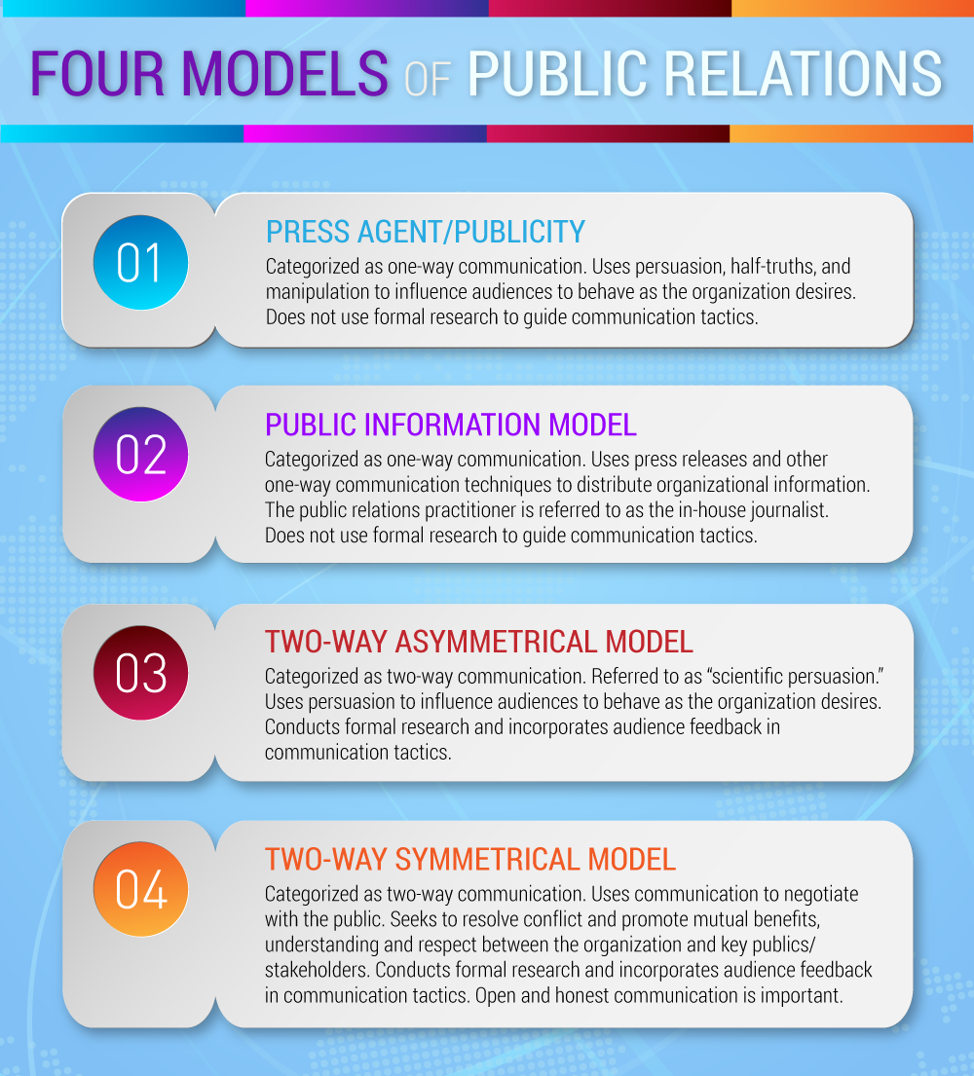
PR Models

Slide 21
Lecture
04
PR Models
Models developed to explain the behavior of PR practitioners in 1970s. Asymmetrical communication is unbalanced in that the organization tries to change the public and symmetrical communication is balanced in that there are adjustments by the organization and its stakeholders.
There are four models of public relations which includes press agentry/publicity, public information, two-way asymmetrical, and two-way symmetrical.
1) The press agentry/publicity model وكالة الصحف/ الدعاية is characterized as a one-way asymmetrical model of communication, traveling from the organization to the public primarily through the mass media, used as a way of persuading and manipulating a desired audience to act as the organization wishes. (Pure Propaganda)

Slide 22
Lecture
04
PR Models
2)The public information model المعلومات العامة, developed as a reaction to attacks on large corporations and government agencies by journalists. Leaders of these organizations realized they needed more than the propaganda of press agents to counter the attacks in the media. The public information model is also a one-way asymmetrical model of communication, traveling from the organization to the audience, with mass media as its primary channel.
3) The two-way asymmetrical model نموذج الاتجاهين غير المتناسق/غير المتماثل some public relations practitioners began to base their work on the behavioral and social sciences, and, as a result, to give more credence to examining audience behavior: PR practitioners both sought information from and gave information to the public. Here, the key is to persuade publics to accept an organization’s point of view. Unlike the first two models, feedback was generated through scientific research to advance and secure the interests and needs of the organization ahead of its publics.

Slide 23
Lecture
04
PR Models
4)The two-way symmetrical model نموذج الاتجاهين المتناسق/ المتماثل is to use communication to create and maintain a mutual understanding and respect between an organization and its publics. The two-way symmetrical model of public relations focuses on a balanced dialogue, where the organization listens to the concerns of the public to encourage an open and honest, mutually beneficial relationship.
This model is based on a free exchange of information that is used to alter attitudes in both the organization and its public rather than the public changing to suit the organization. Given that communication is a balance between senders and receivers, both the public and the organization can, in theory, be persuaded to shift their thinking and/or practice.

Slide 24
PR Models
Live
https://konahpr.wixsite.com/konah/post/%D8%AC%D9%8A%D9%85%D8%B3-%D8%AC%D8%B1%D9%88%D9%86%D8%AC

Slide 25

Crisis Communication Theories

Slide 26
Lecture
04
Image Restoration Theory
William Benoit (1995; 1997) developed a theory of image restoration نظرية استعادة الصورة to understand how corporations recover from crises. The process of image repair is most often framed as apologia اعتذار , or a genre of public apologetic discourse.
Image restoration theory is based on the assumption that image and reputation have both symbolic and economic value, that threats to an organization’s image can occur (sometimes frequently), and that communication can help repair the damage.
An attack on one’s image has two components: 1) an offensive act فعل مسئ and 2) an accusationالاتهام of responsibility for the act. If there is no offensive act or no accusations of responsibility for the act, there is no reputational threat.

Slide 27
Lecture
04
Image Restoration Theory
Benoit’s theory is founded on two key assumptions:
  communication is a goal-directed activity; and
  2) maintaining a positive reputation is one of the central goals of communication.
In his theory of image restoration, Benoit organizes strategies into five distinct categories:
            Denial إنكار,
            Evading التهرب responsibility,
            reducing offensiveness,
            corrective action, and
            Mortification الإماتة. tries to restore an image by asking forgiveness.
These strategies are grounded in a belief that communication (words and actions) affects how stakeholders perceive the organization in crisis.

Slide 28
Lecture
SCCT: Situational Crisis Communication Theory
النظرية الموقفية لاتصال الأزمات
04
Coombs (2014) summarized 10 SCCT communication strategies under four crisis response strategy clusters as shown in the Table.
Organizations usually adopt different types of SCCT communication strategies, depending on their belongingness to the victim, accidental, or preventable clusters.
For example, organizations may choose the strategies in the 1) denial posture to avoid any connections with a crisis. They may also use the strategies in the 2) diminishment تناقص cluster to lower a crisis’s negative effects. 3) Rebuilding posture allows organizations to re-establish relationships with the stakeholder through apologies or compensations. Strategies in the 4) bolstering تعزيز posture enable organizations to build a positive relationship with the stakeholders.

Slide 29
Lecture
SCCT: Situational Crisis Communication Theory
النظرية الموقفية لاتصال الأزمات
04
التكامل

Slide 30
Lecture
04
Social-mediated crisis management (SMCM)
ﻧﻣوذج إدارة اﺗﺻﺎﻻت اﻷزﻣﺔ ﻋﺑر وﺳﺎﺋل اﻟﺗواﺻل اﻻﺟﺗﻣﺎﻋﻲ
Social media has the potential to one day contribute to agenda building for public relations practitioners so they must learn to adopt it into their practices.

Slide 31
Lecture
04
Social-mediated crisis management (SMCM)
ﻧﻣوذج إدارة اﺗﺻﺎﻻت اﻷزﻣﺔ ﻋﺑر وﺳﺎﺋل اﻟﺗواﺻل اﻻﺟﺗﻣﺎﻋﻲ
The Social-Mediated Crisis Communication (SMCC) model is also known as the “social-mediated dialogue” between organizations and publics during crises.
This model is considered to be the first theoretical model to focus on relationships between online and offline audiences, organizations, social media platforms, and traditional media, before, during and after the crises.
In Social-Mediated Crisis Communication model, both the direct and indirect exchange of information on social media, as well as between traditional media and social media are significant .

Slide 32
Lecture
04
Social-mediated crisis management (SMCM)
ﻧﻣوذج إدارة اﺗﺻﺎﻻت اﻷزﻣﺔ ﻋﺑر وﺳﺎﺋل اﻟﺗواﺻل اﻻﺟﺗﻣﺎﻋﻲ
This model is quite useful for communication in emergency situations for defining the at-risk population and how to reach these people in an effective way and timely manner.
Today’s world is deeply connected via social media networks and the information circulated through social media platforms during emergencies has the potential to engage with multiple types of public audiences according to SMCC model.
It is to be noted that, social media platforms can facilitate organizations to monitor crisis issues, cultivate critical relationships, and create transparency.
On the other hand, misinformation is being circulated on social media managers and crisis managers may lose control of correct flow of messages under some circumstances.

Slide 33

The influencer impact on
Social Media Crisis

Slide 34
Lecture
04
How influencers can help you manage a social media PR crisis
Outlining a dialogic public relations theory, Kent and Taylor (2002) presented that public relations could enhance dialogue by creating channels for dialogic communication to occur.
They specifically identified online communication as an ideal opportunity for promoting dialogue.
They recommended that organizations have an opportunity to establish dialogic relationships with stakeholders through strategically designed websites.

Slide 35
Lecture
04
How influencers can help you manage a social media PR crisis
So, let’s now go through the five ways you can use influencers to help in a PR crisis on social media.
1. Move conversations away from the crisis
Negative comments or news stories about your brand can dominate the headlines during a PR crisis. This tends to happen when you take too long to respond or don’t take accountability and address the issue in good time.
By generating positive commentary about your brand and engaging your target audience, influencers can help shift conversations.

Slide 36
Lecture
04
How influencers can help you manage a social media PR crisis
1. Move conversations away from the crisis
Influencers can help shift the attention and conversations. But that’s not to say you shouldn’t own up to your mistakes. Before recruiting influencers to change the conversation, address the issue and show your commitment to fixing it. Then, you can bring in influencers to add positive vibes.

Slide 37
Lecture
04
How influencers can help you manage a social media PR crisis
2. Improve the search results for your brand
Even with an excellent website, good landing pages and a user-friendly app, you still need a way to drive positive traffic to your most relevant web resources in times of crisis.
That’s because when you search for a particular term, Google will sometimes provide a “top stories” segment near the very top of their search results. If your brand has been on the news and is trending on social media for all the wrong reasons, those negative remarks are likely to appear here. You don’t want that.

Slide 38
Lecture
04
How influencers can help you manage a social media PR crisis
2. Improve the search results for your brand
A timely and well-executed influencer marketing strategy can improve positive mentions and remarks about your brand. This increases social momentum as the influencer’s audience engages with the positive content.

Slide 39
Lecture
04
How influencers can help you manage a social media PR crisis
2. Improve the search results for your brand
It’s hard to believe that in late 2021, Britain’s #1 breakfast cereal – Weetabix – was facing a significant PR crisis that made headlines. Workers at the food giant partly downed their tools across various factories, causing a shortage of Weetabix. As a result, significant negative sentiment erupted around the Weetabix brand.
Live

Slide 40
Lecture
04
How influencers can help you manage a social media PR crisis
2. Improve the search results for your brand
While the strike was resolved, Weetabix anticipated that negative conversations about the brand would still pervade online search items and mentions in the days and weeks that followed.
By partnering with content creators and micro-influencers from the food and lifestyle niches, Weetabix managed to ignite يشعل several viral moments on social platforms including Instagram and TikTok. In particular, the #WeetabixCheesecake viral challenge generated positive mentions for the brand.
Live

Slide 41
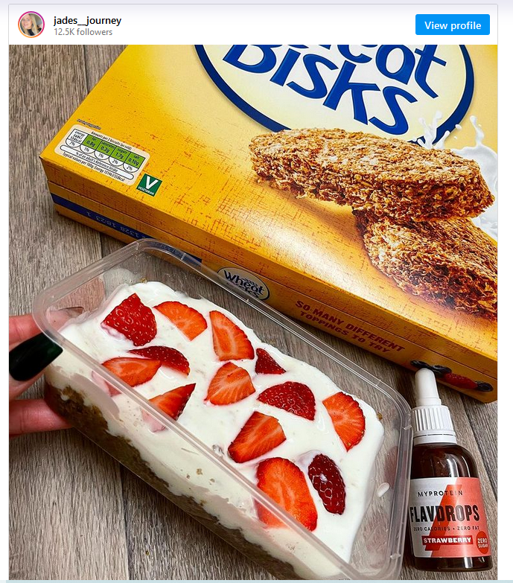
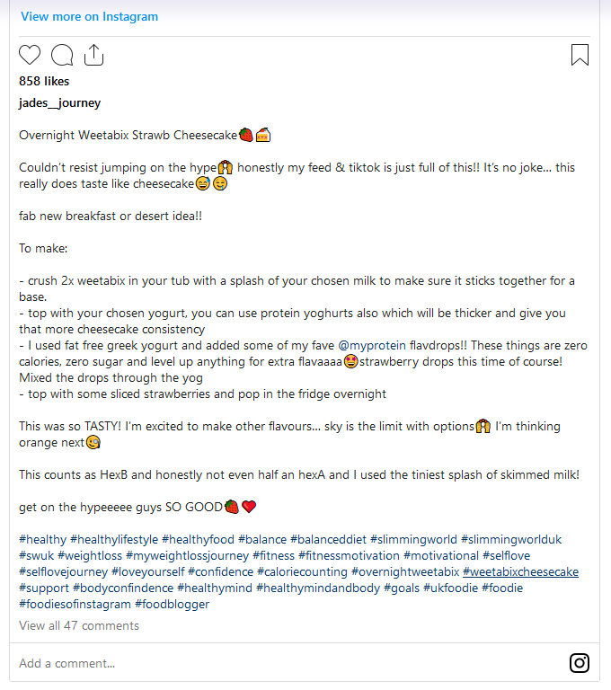
Lecture
04
How influencers can help you manage a social media PR crisis
Live

Slide 42
Lecture
04
How influencers can help you manage a social media PR crisis
3. Boost your engagement
Writing better content for your brand and telling your stories organically is a key advantage of combining PR with influencer marketing. This, in turn, improves your brand engagement rate.
An influencer campaign effectively connects you with specific audiences on social media platforms during a PR crisis. Influencers can increase your brand’s likes, shares, reposts, comments, DMs, link clicks, hashtag engagements – pretty much everything.

Slide 43
Lecture
04
How influencers can help you manage a social media PR crisis
3. Boost your engagement
High audience engagement rates generally mean that folks are interested in and interacting with your content. This is precisely what you want during a PR crisis; an engaged audience that's open to getting clarification on what's going on and provide feedback.

Slide 44
Lecture
04
How influencers can help you manage a social media PR crisis
3. Boost your engagement
Walkers Crisps is an example of a brand that aimed to connect better with audiences on social media after a minor PR crisis. The brand’s 2017 #WalkersWave ad campaign was intended in good humor, and it did amuse me quite a bit.
Live

Slide 45
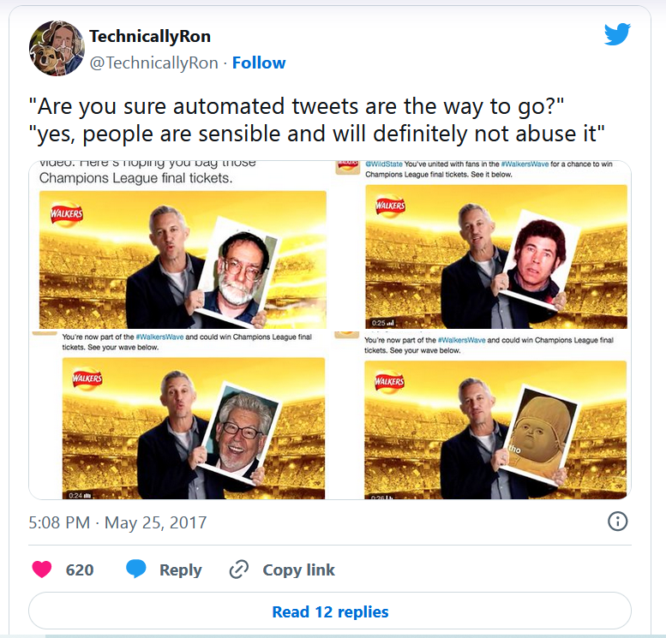
Lecture
04
How influencers can help you manage a social media PR crisis
3. Boost your engagement
However, the campaign, fronted by football legend Gary Lineker, backfired after it failed to consider how people on the internet might try and have fun with it, and it ended up showing the star holding portraits of questionable characters such as Joseph Stalin and Fred West doing the Mexican wave. All a tad embarrassing.
Live

Slide 46
Lecture
04
How influencers can help you manage a social media PR crisis
3. Boost your engagement
To quickly overcome the public relations backlash, Walkers’ strategy was to rejuvenate customer perceptions and engagements with the brand through influencer partnerships.
Walkers employed a multi-faceted approach. First, the brand, a darling of soccer fans in the UK, enlisted influencers from this circle. The most visible was influencer and journalist Reggie Yates, who fronted its #WalkersUnited and #SnapandShare campaigns across socials such as Snapchat.
Live
https://vimeo.com/213405274?embedded=true&source=video_title&owner=1356983

Slide 47
Lecture
04
How influencers can help you manage a social media PR crisis
3. Boost your engagement
The next strategy was for Walkers to enlist celebrity influencers, the Spice Girls, as the new face of the brand with the social media campaign #BestEverFan.
This campaign had a massive return on investment. A single live stream on Facebook generated an average engagement of 50%, with 36,000 comments, likes and shares, and hundreds of thousands of views.
Live

Slide 48
Lecture
04
How influencers can help you manage a social media PR crisis
4. Improve brand awareness
When a public relations crisis hits, naturally, more people will look up your brand. And some of these people might not know anything about you. It’s therefore possible that they’ll view your brand negatively due to the PR crisis you’re facing. Any misinformation or negative press coming from the crisis will affect their attitude towards your brand.
Influencers can help you counteract that. A good influencer marketing campaign will help shed some light on what your brand is all about. Besides showing the good work of your brand, influencers may also help people who have never heard about you discover what your company does.

Slide 49
Lecture
04
How influencers can help you manage a social media PR crisis
4. Improve brand awareness
Snapchat faced mounting criticism in 2018 when the company announced sweeping redesign changes. Among many things, they wanted to condense their Stories and Discover features on a single page. Snapchat users were less than impressed, with some describing the new design as cumbersome and hard to get used to.
Initially, Snapchat’s CEO Evan Spiegel was bullish about the design changes and assured users that “they were here to stay”. However, after increased backlash, competition from a revamped Instagram, and a single tweet from Kylie Jenner that sent Snapchat’s shares tumbling, Snapchat backtracked.
Live

Slide 50
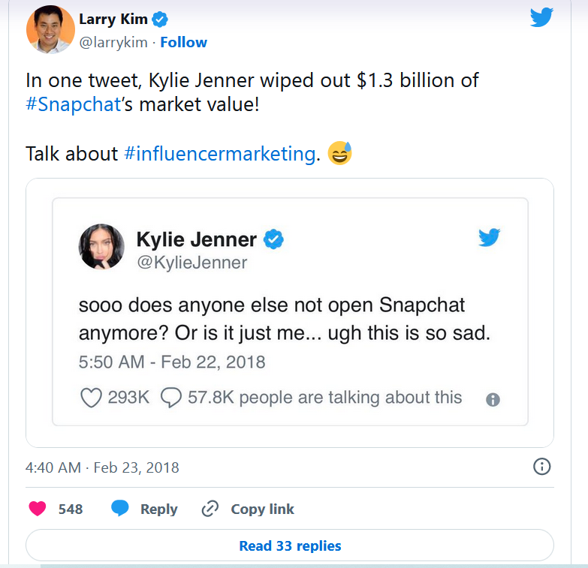
Lecture
04
How influencers can help you manage a social media PR crisis
4. Improve brand awareness
Besides resolving some of the UX issues on the app, Snapchat also conducted promos with some of the most famous influencers on the app. That included Cyrene Quiamco (CyreneQ), a digital artist, creative and influencer with over 200k followers. The influencers promoted the new design and increased awareness about the new product rollouts.
Live

Slide 51
Lecture
04
How influencers can help you manage a social media PR crisis
5. Build brand trust
Influencers will not make a bad product good. However, influencer relationships can help rebuild trust with people amid a bad PR outlay.
Influencers can help you rebuild trust and brand sentiment, generate positive search traffic and social signals, earn potential customers, and improve engagement. This is achieved through sharing positive content and directing conversations.

Slide 52
Lecture
04
How influencers can help you manage a social media PR crisis
5. Build brand trust
Chipotle has been in the news since 2015, when the first cases of E. coli outbreak were reported at the giant Mexican-themed food retailer. Negative sentiment about Chipotle rippled across the company’s customer base of health-conscious food lovers. Lawsuits and sales slumps dogged the company through a rough couple of years.
Live

Slide 53
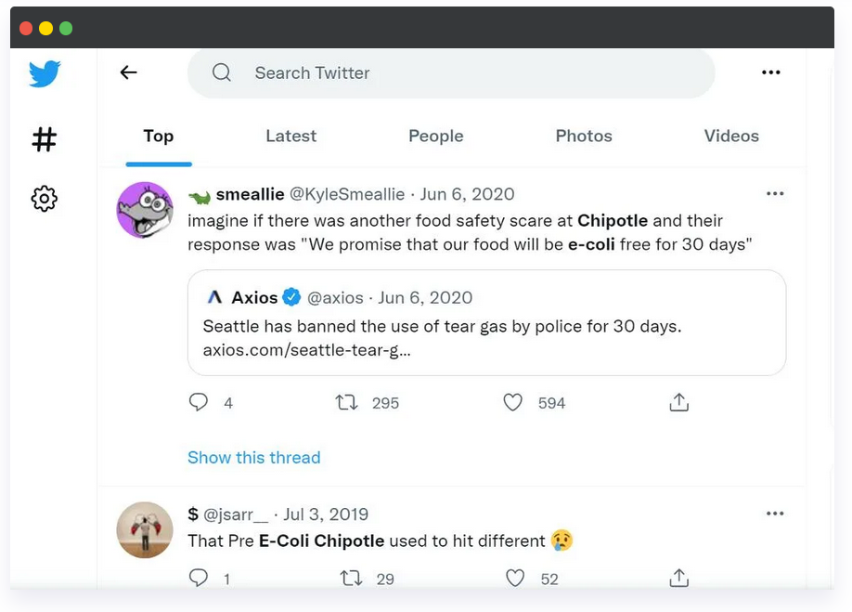
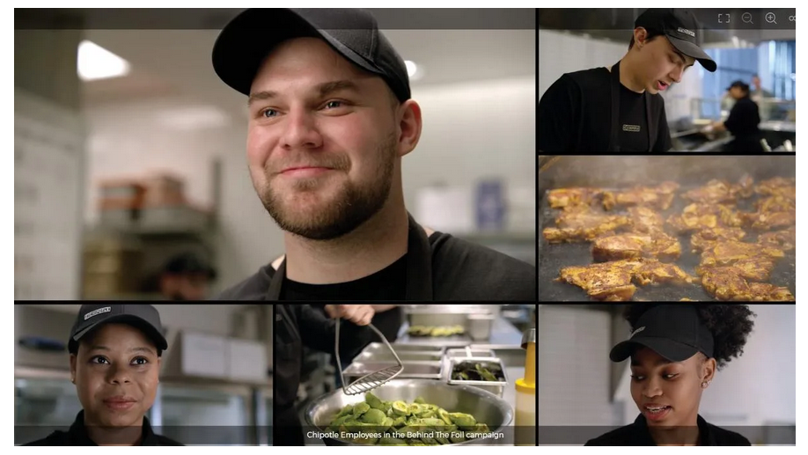
Lecture
04
How influencers can help you manage a social media PR crisis
5. Build brand trust
A $50million advertising campaign on TV and sites like YouTube did little to salvage Chipotle’s image. Free coupons and giveaways didn’t help either.
Live

Slide 54
Lecture
04
How influencers can help you manage a social media PR crisis
Live
5. Build brand trust
But then Chipotle released a video ad (the Behind the Foil campaign) that took cameras inside its elusive kitchens, showcasing its “safety first” approaches. Besides the video-ad campaign, Chipotle further engaged digital influencers in a move that saw the company target Gen-Z and millennials, who had fast become its main target segment.
Under the #chipotlecreator program, various influencers from Facebook and TikTok produced content for Chipotle that would resonate with the younger generations, aiming to rebuild lost trust and create relationships that would drive up market share and help shape the brand's future.
https://www.tiktok.com/@chipotle/video/7005949765573790981?embed_source=71223855%2C121331973%2C120811592%2C120810756%3Bnull%3Bembed_share&refer=embed&referer_url=www.prezly.com%2Facademy%2Fhow-influencers-can-help-you-manage-a-social-media-pr-crisis&referer_video_id=7005949765573790981

Slide 55
Lecture
04
How influencers can help you manage a social media PR crisis
Influencers of social media usage
Interactive digital media platforms are changing the marketing scene.
These platforms have empowered consumers to connect, share, and collaborate, creating spheres of influence that have deeply distorted the way marketers engage in influencing activities.

Slide 56
Lecture
04
How influencers can help you manage a social media PR crisis
Influencers of social media usage
Social network advertising offers an online marketing opportunity that narrowing the gap between sales and advertising activities, which are obtained from tracing consumer reactions.
Therefore, nearly every business is planning social media marketing activities.

Slide 57
Lecture
04
How influencers can help you manage a social media PR crisis
Social Media Usage Benefits:
Perform integrated marketing activities with much less effort and cost than before
Enhance brand’s reputation,
Improve value,
Improve relationship and brand equity,
digital advertising and promotion,

Slide 58
Lecture
04
How influencers can help you manage a social media PR crisis
Social Media Usage Benefits:
handle customer service issues,
mine innovation ideas
build and improve customer relations
cost reduction in terms of marketing,
enhance communication and customer service,
improve brand image.

Slide 59
Lecture
04
How influencers can help you manage a social media PR crisis
Influencer marketing presents one of the best ways to reach out to and engage with consumers in real time during a crisis. Influencers are trusted, and research has shown the power of influencers over vital purchase decisions.
But influencer marketing isn’t just about going viral on social platforms. It’s about building an authentic relationship with your customers, connecting with a target audience, and telling your brand story. The PR and influencer marketing approach has also become an important part of most brands’ crisis management planning, and it's proving to be quite effective.

Slide 60
Lecture
04
How influencers can help you manage a social media PR crisis
A good response to a crisis can show your brand’s commitment to looking after its community. It can turn a bad situation into good PR, helping you solidify your bond with your existing fans by showing your brand's true colors.
But for that to happen, you’ll need ​ to have a solid PR crisis management plan in place.
And as it happens, influencers can play a critical role in that plan.

Slide 61
Lecture
04
How influencers can help you manage a social media PR crisis
As PR crises are an almost inevitable part of business operations, staying one step ahead of the curve is crucial. Influencer strategies can turn the tide for your business or brand when facing a public relations crisis.
Social influencers are favorable due to their instant access and connection to audiences. The trust afforded to them and their ability to speak in a voice that resonates with both customers and brands make them extremely valuable comms assets.

Slide 62
Lecture
Conclusion:
Crisis Communication & crises management:
    (Approaches & Theories)
04
Crisis Communication and Crisis Management: Definitions
    Public Relations (PR)
    Definition of Crisis Communication
    Reputation
    Crisis management
Social Media in Crisis Communication: opportunities and challenges
PR Models:
    press agentry/publicity,
    public information,
    two-way asymmetrical,
    and two-way symmetrical
Crisis Communication Theories
    Image Restoration Theory
    Situational Crisis Communication Theory
    The Social-Mediated Crisis Communication (SMCC) model
The influencer impact on Social Media Crisis

Slide 63
Lecture
04
Recommended Reference
Norton, C. (2022, July). How influencers can help you manage a social media PR crisis: PR Academy. Prezly.com. https://www.prezly.com/academy/how-influencers-can-help-you-manage-a-social-media-pr-crisis
Wedlock, B. C. (2012, May). (dissertation). The diffusion of social media in public relations: Use of social media in crisis response strategies. ProQuest. Retrieved May 2023, from https://www.researchgate.net/publication/295547824_The_Diffusion_of_Social_Media_in_Public_Relations_Use_of_Social_Media_In_Crisis_Response_Strategies.
Barbe, D., & Pennington-Gray, L. (2020). Social Media and Crisis Communication in Tourism and Hospitality.
Kwok, L., Lee, J., & Han, S. H. (2021). Crisis communication on social media: What types of covid-19 messages get the attention? Cornell Hospitality Quarterly, 63(4), 528–543. https://doi.org/10.1177/19389655211028143
Ward, C. A. (2011, June). Social Media and Crisis Communication: Are organizations using social media in times of crisis? (dissertation). SOCIAL MEDIA AND CRISIS COMMUNICATION: ARE ORGANIZATIONS USING SOCIAL MEDIA IN TIMES OF CRISIS? Retrieved May 2023, from https://cardinalscholar.bsu.edu/bitstream/handle/123456789/195041/WardC_2011-3_BODY.pdf?sequence=1.
Burak, Begüm. (2021). RETHINKING THE SOCIAL-MEDIATED CRISIS COMMUNICATION MODEL: THE ROLE OF SOCIAL MEDIA DURING THE CORONAVIRUS PANDEMIC.

Slide 64


Thank You

