Slide 1


AWS Cloud Security Foundations
(AWS-CSF)
Lecture 9
Protecting Data in your Application
Prepared by
Dr. Ibrahim Gomaa

Slide 2

Lecture
Course Outline
9
Lecture 9: Protecting data in your application
Topics
Protect data at rest
Amazon S3 protection features
Protection through encryption
Protect data in transit
Best practices to protect data in Amazon S3
Additional data protection services
AWS Cloud Security Foundations– AWS-CSF
Lecture 9: Protecting data in your application
Dr. Ibrahim Gomaa

Slide 3
Lecture
Protecting data in your application
9
Protect data at rest
AWS Cloud Security Foundations– AWS-CSF
Lecture 9: Protecting data in your application
Dr. Ibrahim Gomaa

Slide 4
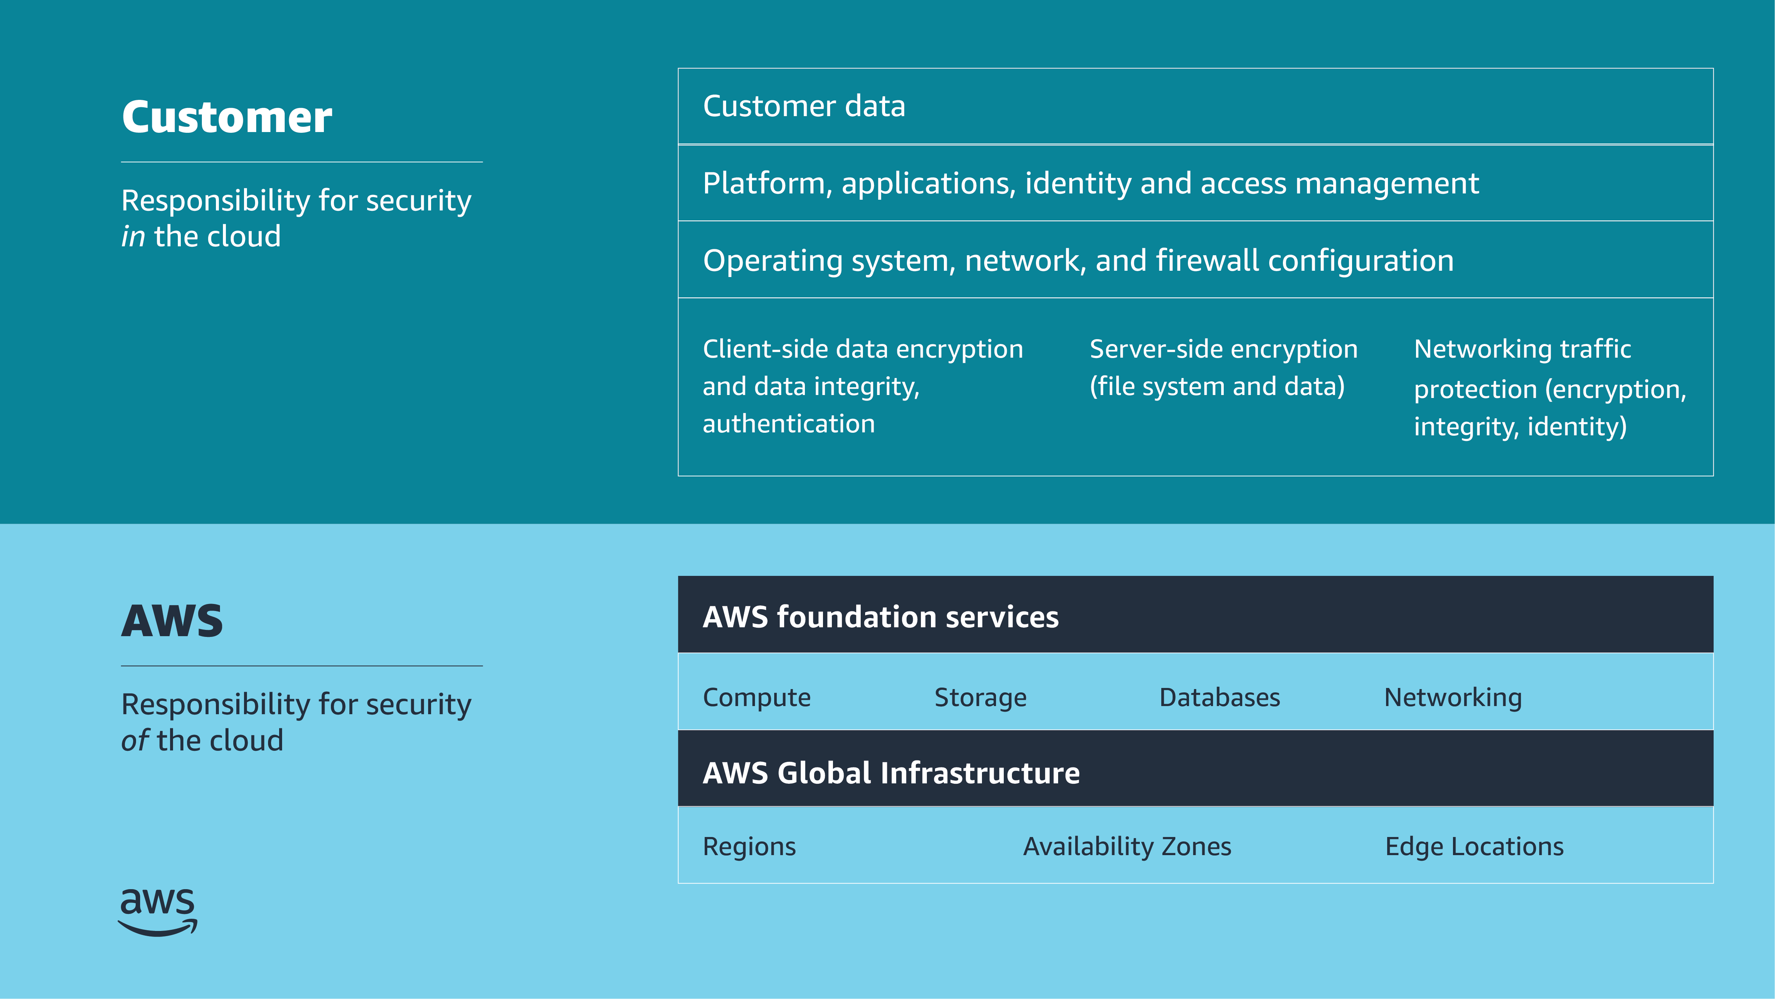
Lecture
9
Protect data at rest
Shared responsibility model
AWS Cloud Security Foundations– AWS-CSF
Lecture 9: Protecting data in your application
Dr. Ibrahim Gomaa

Slide 5

Lecture
9
Protect data at rest
Why protect data at rest?
Common scenarios
  Information disclosure
  Data integrity compromise
  Accidental or malicious deletion
  System, hardware, and software availability
Extra layer of protection if your system is compromised
AWS Cloud Security Foundations– AWS-CSF
Lecture 9: Protecting data in your application
Dr. Ibrahim Gomaa

Slide 6
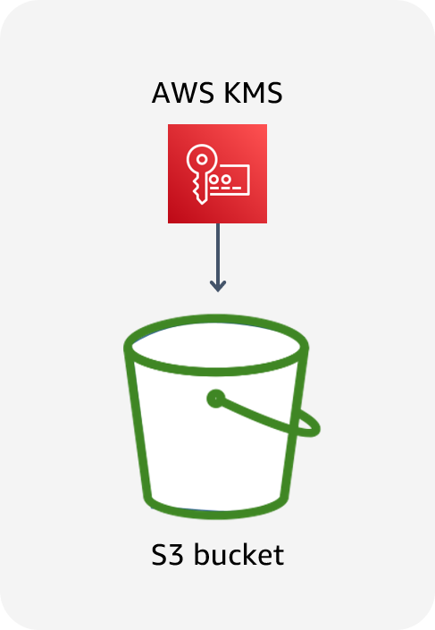
Lecture
9
Protect data at rest
Data at rest in Amazon S3
Data stored in Amazon S3 is private by default and requires AWS credentials for access.
  Use bucket policies for granular access to objects.
  Consider encrypting data at rest.
AWS Cloud Security Foundations– AWS-CSF
Lecture 9: Protecting data in your application
Dr. Ibrahim Gomaa

Slide 7
Lecture
9
Protect data at rest
Granting permissions
Resource based
(Attached to an AWS resource)
Identity based
(Attached to an IAM principal)
Resource | Get | Put | List
Bucket X | ALLOW | ALLOW | ALLOW
Bucket Y | N/A | N/A | ALLOW
Bucket X
User | Get | Put | List
Bob | ALLOW | DENY | ALLOW
Bucket Y
User | Get | Put | List
Bob | ALLOW | N/A | ALLOW
Can Bob GET, PUT, or LIST for bucket X?
Can Bob GET or LIST for bucket Y?
AWS Cloud Security Foundations– AWS-CSF
Lecture 9: Protecting data in your application
Dr. Ibrahim Gomaa

Slide 8
Lecture
Protecting data in your application
9
Amazon S3 protection features
AWS Cloud Security Foundations– AWS-CSF
Lecture 9: Protecting data in your application
Dr. Ibrahim Gomaa

Slide 9


Lecture
Amazon S3 protection features
9
Amazon S3 Block Public Access
Helps you manage public access to Amazon S3 resources
Has four settings:
  Block Public Acls: Block public access granted by new ACLs.
  Ignore Public Acls: Block public access granted by any ACLs.
  Block Public Policy: Block public access granted by new public bucket policies.
  Restrict Public Buckets: Block public and cross-account access by any public bucket policies.
Bucket with block public access settings
AWS Cloud Security Foundations– AWS-CSF
Lecture 9: Protecting data in your application
Dr. Ibrahim Gomaa

Slide 10
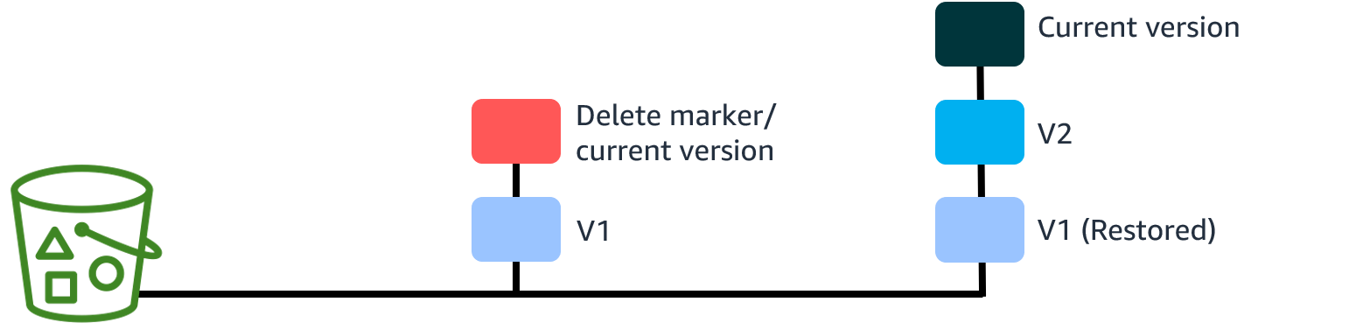
Lecture
Amazon S3 protection features
9
Amazon S3 Versioning
Creates a new version with every upload
Protects from unintended deletion
Provides retrieval of deleted objects
Can be used with lifecycle policies for cost savings
Can’t be turned off once enabled (only suspended)
Offers multi-factor authentication (MFA) delete for extra security
AWS Cloud Security Foundations– AWS-CSF
Lecture 9: Protecting data in your application
Dr. Ibrahim Gomaa

Slide 11
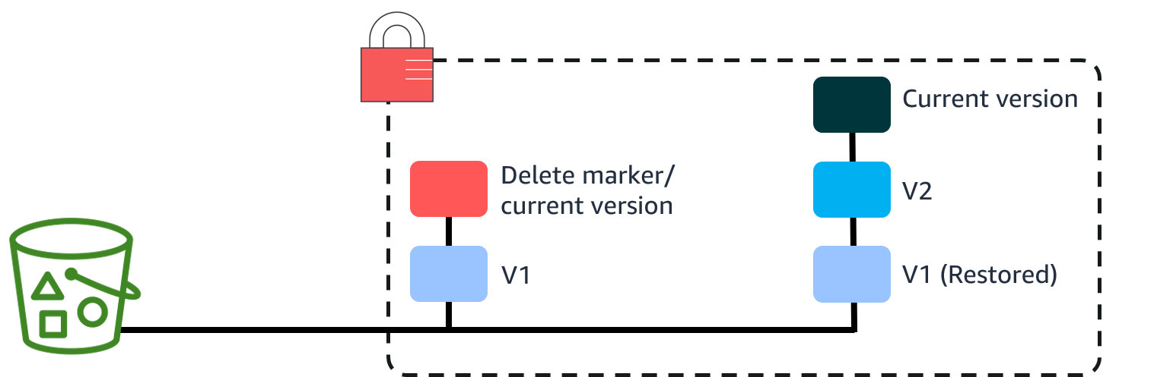
Lecture
Amazon S3 protection features
9
Amazon S3 Object Lock
Object Lock prevents an object version from being deleted or overwritten for a fixed amount of time or indefinitely
Stores objects by using the write-once-read-many (WORM) model
Works only in versioned buckets
Provides the ability to manage object retention (A retention period specifies a fixed period during which an object remains locked. During this period, your object is WORM-protected and can't be overwritten or deleted. A legal hold provides the same protection as a retention period but has no expiration date. Instead, remains in place until you explicitly remove it)
Provides two retention modes:
  Governance users can't overwrite or delete an object version or alter
  its lock settings unless they have special permissions
  Compliance a protected object version can't
  be overwritten or deleted by any user,
  including the root user in your AWS account.
AWS Cloud Security Foundations– AWS-CSF
Lecture 9: Protecting data in your application
Dr. Ibrahim Gomaa

Slide 12
Lecture
Protecting data in your application
9
Protection through encryption
AWS Cloud Security Foundations– AWS-CSF
Lecture 9: Protecting data in your application
Dr. Ibrahim Gomaa

Slide 13
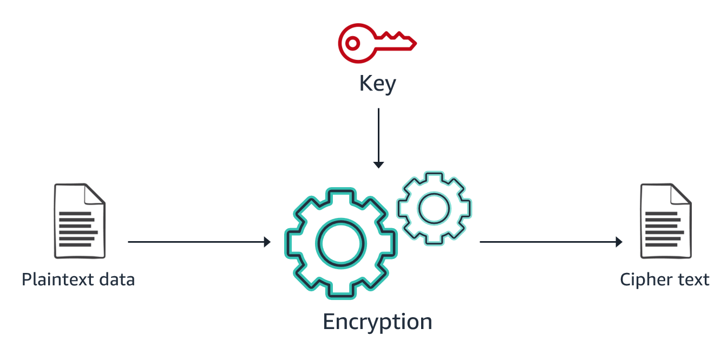
Lecture
Protection through encryption
9
Encryption: What, how, and why
AWS Cloud Security Foundations– AWS-CSF
Lecture 9: Protecting data in your application
Dr. Ibrahim Gomaa

Slide 14
Lecture
Protection through encryption
9
Comparing client-side and server-side encryption
Client-side encryption (CSE)
Server-side encryption (SSE)
Your application encrypts data before sending it to AWS.
Data is stored in its encrypted state.
The keys and algorithms are known only to you.
AWS encrypts data on your behalf after receiving it.
The process is transparent to the user.
AWS Cloud Security Foundations– AWS-CSF
Lecture 9: Protecting data in your application
Dr. Ibrahim Gomaa

Slide 15
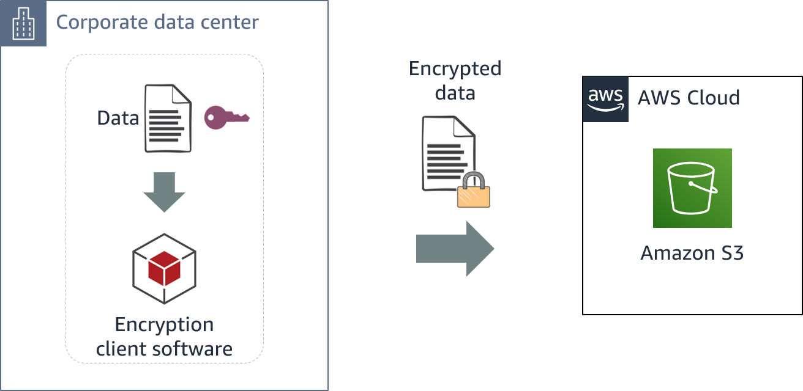
Lecture
Protection through encryption
9
Client-side encryption
AWS Cloud Security Foundations– AWS-CSF
Lecture 9: Protecting data in your application
Dr. Ibrahim Gomaa

Slide 16
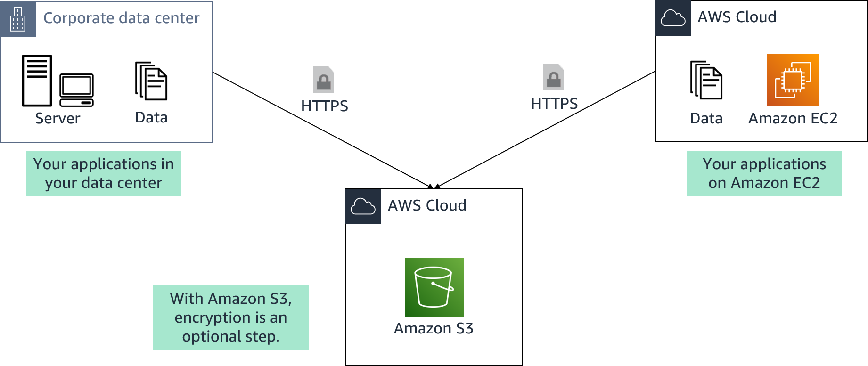
Lecture
Protection through encryption
9
AWS server-side encryption
AWS Cloud Security Foundations– AWS-CSF
Lecture 9: Protecting data in your application
Dr. Ibrahim Gomaa

Slide 17

Lecture
Protection through encryption
9
Types of Amazon S3 server-side encryption
SSE with customer-provided keys
SSE with Amazon S3 managed keys
SSE with AWS KMS keys
SSE-C
SSE-S3
SSE-KMS
You retain control of the keys.
Amazon S3 doesn't store the encryption keys that you provide.
AWS manages the keys.
The encrypted data and keys are stored in separate hosts.
AWS manages the keys.
An envelope key is used for added protection.
AWS Cloud Security Foundations– AWS-CSF
Lecture 9: Protecting data in your application
Dr. Ibrahim Gomaa

Slide 18
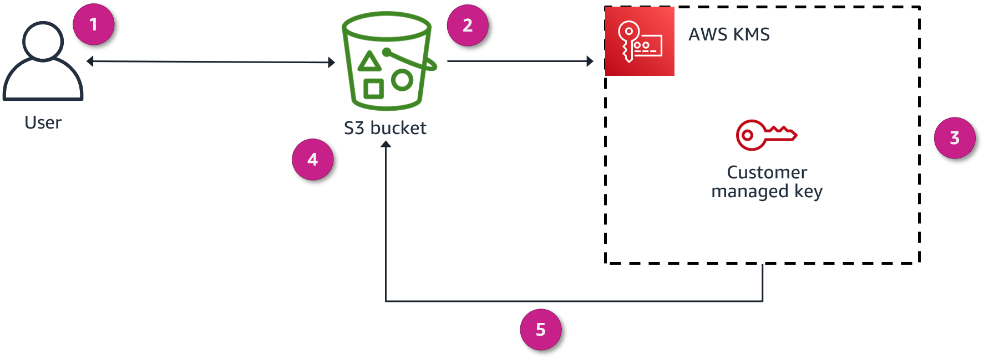
Lecture
Protection through encryption
9
Encryption overview
This diagram explains how encryption happens when uploading a file to Amazon S3:
You request to upload a file and store it as an encrypted object in an S3 bucket.
Amazon S3 requests a data key from AWS KMS to use to encrypt the file.
AWS KMS generates a plaintext data key and encrypts the data key by using the customer managed key.
AWS KMS sends both copies of the data key to Amazon S3.
Amazon S3 encrypts the object by using the plaintext data key, stores the object, and then deletes the plaintext data key. The encrypted key is kept in the object metadata.
AWS Cloud Security Foundations– AWS-CSF
Lecture 9: Protecting data in your application
Dr. Ibrahim Gomaa

Slide 19
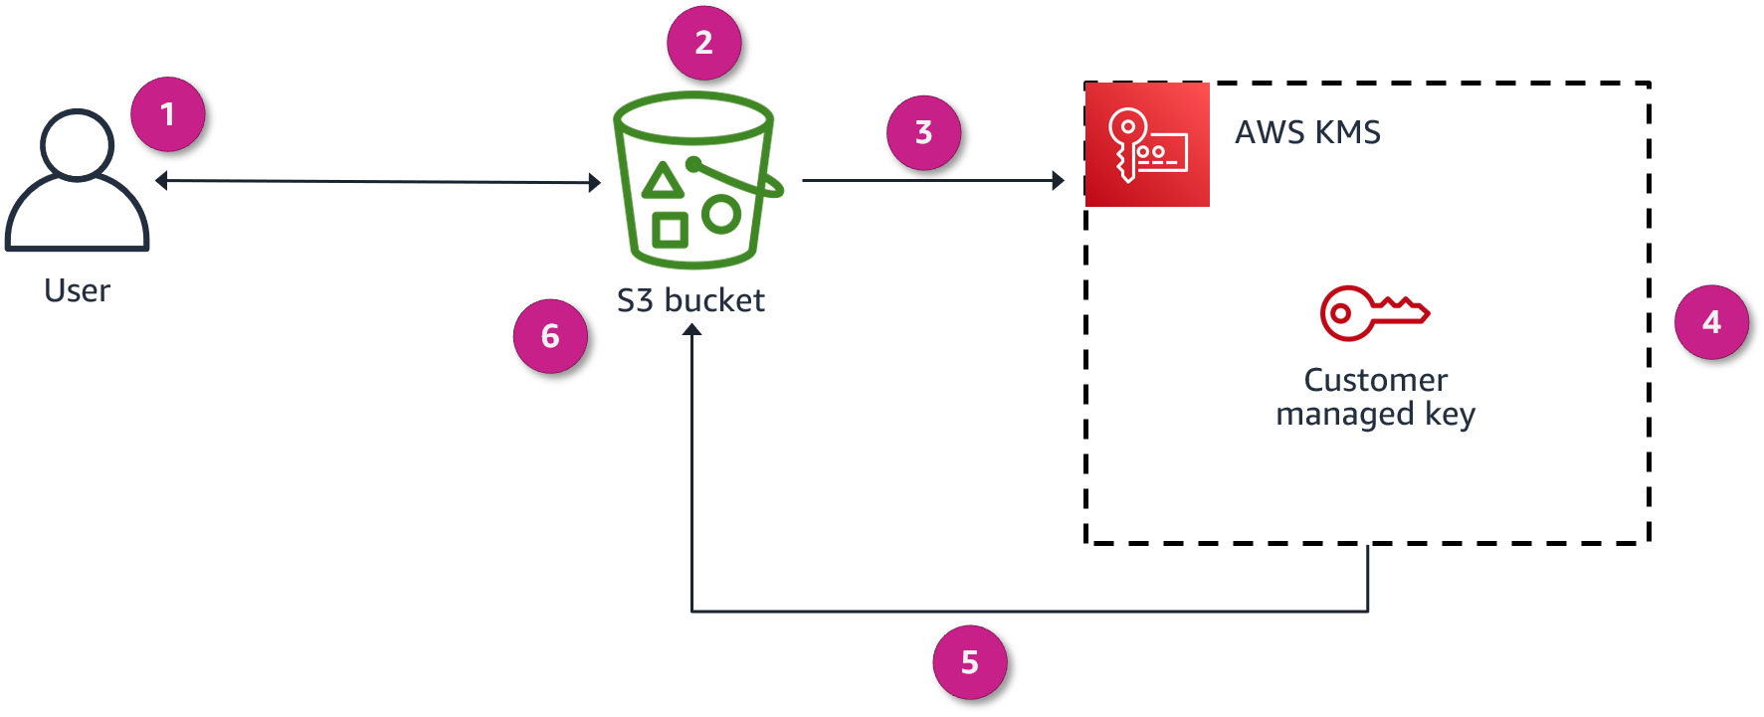
Lecture
Protection through encryption
9
Decryption overview
Now, this diagram explains what happens in the same scenario (SSE-KMS) when the user requests to open an encrypted object that is stored in Amazon S3:
You request to open the object.
Amazon S3 notices that the requested object is encrypted.
Amazon S3 sends the encrypted copy of the data key that the object is encrypted with to AWS KMS.
AWS KMS then decrypts the data key by using the customer managed key (which never leaves the AWS KMS service).
AWS KMS then sends the plaintext data
key back to Amazon S3.
6. Finally, Amazon S3 decrypts the ciphertext
of the data object, allows you to open the object,
and deletes the plaintext copy of the data key
AWS Cloud Security Foundations– AWS-CSF
Lecture 9: Protecting data in your application
Dr. Ibrahim Gomaa

Slide 20

Lecture
Protection through encryption
9
AWS Key Management Service (AWS KMS)
Provides the ability to create and manage cryptographic keys
Uses hardware security modules (HSMs) to protect your keys
Is integrated with other AWS services
Provides the ability to set usage policies to determine which users can use keys
AWS Key Management Service (AWS KMS)
AWS Cloud Security Foundations– AWS-CSF
Lecture 9: Protecting data in your application
Dr. Ibrahim Gomaa

Slide 21
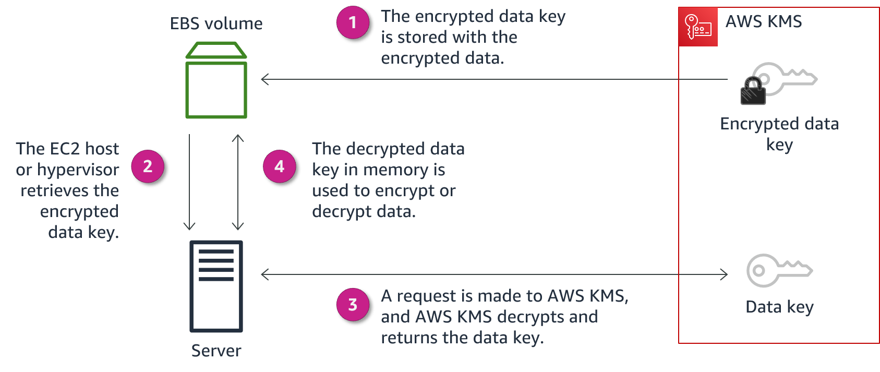
Lecture
Protection through encryption
9
AWS KMS example with Amazon EBS
AWS Cloud Security Foundations– AWS-CSF
Lecture 9: Protecting data in your application
Dr. Ibrahim Gomaa

Slide 22
Lecture
Protecting data in your application
9
Protect data in transit
AWS Cloud Security Foundations– AWS-CSF
Lecture 9: Protecting data in your application
Dr. Ibrahim Gomaa

Slide 23
Lecture
Protect data in transit
9
Why protect data in transit?
Your communications might go through the public internet.
What are the risks that data in transit is exposed to?
  Accidental information disclosures
  Data integrity compromises
  Identity compromises
    Man-in-the-middle (MITM) attacks
    Identity spoofing
AWS Cloud Security Foundations– AWS-CSF
Lecture 9: Protecting data in your application
Dr. Ibrahim Gomaa

Slide 24
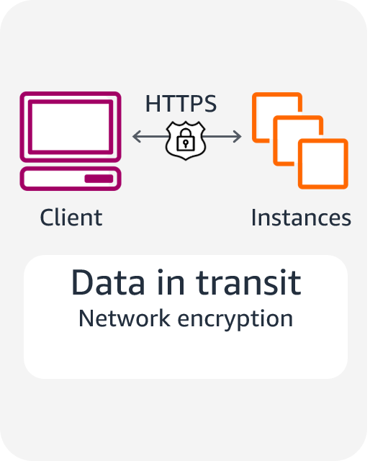
Lecture
Protect data in transit
9
Protecting data in transit
Use Secure Sockets Layer (SSL) endpoints over Transport Layer Security (TLS) (HTTPS).
Use encryption.
Use Amazon Virtual Private Cloud (Amazon VPC) endpoints to limit access to your bucket.
AWS Cloud Security Foundations– AWS-CSF
Lecture 9: Protecting data in your application
Dr. Ibrahim Gomaa

Slide 25
Lecture
Protect data in transit
9
Protecting remote connections to servers
Remote Desktop Protocol (RDP) is typically used for Windows servers.
  RDP establishes an underlying SSL/TLS connection.
  For better security, issue a trusted X.509 certificate.
  Don't use the default self-signed certificates.
Secure Shell (SSH) is typically used for Linux servers.
  SSH establishes a secure communication channel.
  Use tunneling to protect the application session in transit.
  Don't allow the root user to use an SSH terminal.
  Be sure that all users log in with an SSH key pair, and then deactivate password authentication.
AWS Cloud Security Foundations– AWS-CSF
Lecture 9: Protecting data in your application
Dr. Ibrahim Gomaa

Slide 26

Lecture
Protect data in transit
9
AWS Certificate Manager (ACM)
Provides a single interface to manage both public and private certificates
Makes it easy to deploy certificates
Protects and stores private certificates
Minimizes downtime and outages with automatic renewals
AWS Certificate Manager (ACM)
AWS Cloud Security Foundations– AWS-CSF
Lecture 9: Protecting data in your application
Dr. Ibrahim Gomaa

Slide 27
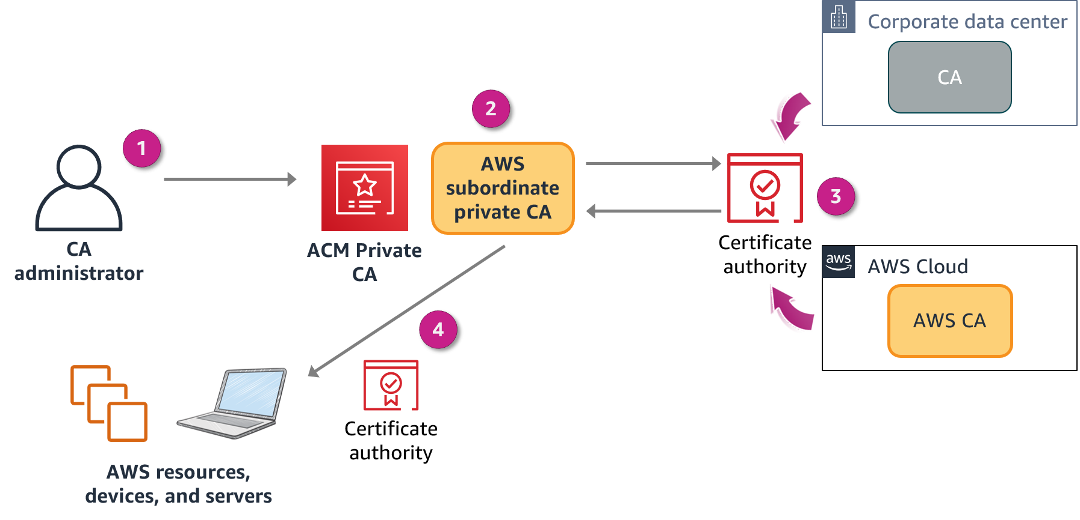
Lecture
Protect data in transit
9
AWS Certificate Manager Private Certificate Authority
By using AWS Certificate Manager Private Certificate Authority, you can create private certificate authority (CA) hierarchies, including root and subordinate CAs, without the investment and maintenance costs of operating an on-premises CA
The diagram shows ACM Private CA in action:
The CA administrator creates a subordinate CA to issue certificates.
The subordinate CA sends the certificate to be signed.
The on-premises CA or AWS CA signs the certificate.
ACM Private CA issues the signed certificate to resources.
AWS Cloud Security Foundations– AWS-CSF
Lecture 9: Protecting data in your application
Dr. Ibrahim Gomaa

Slide 28
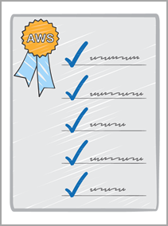


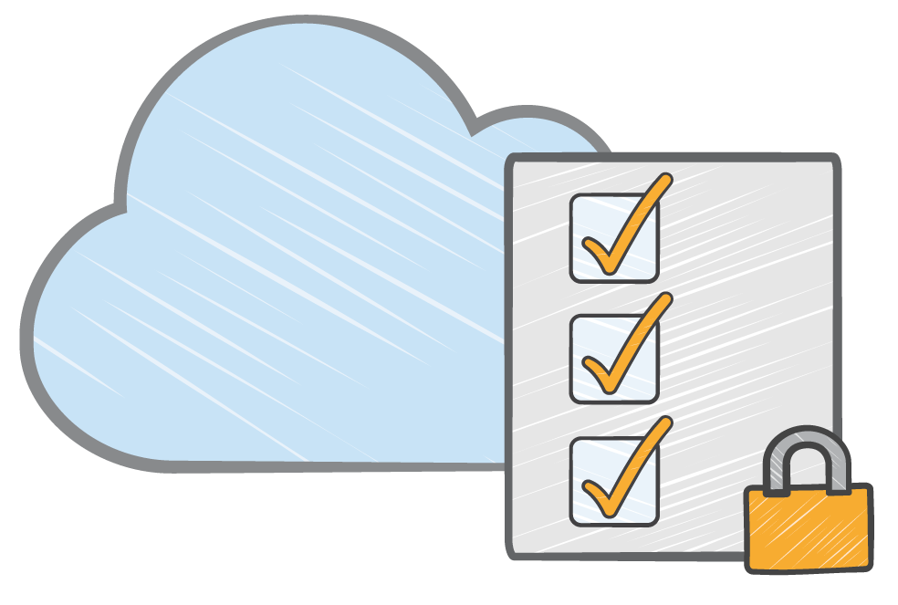

Lecture
Protect data in transit
9
ACM Private CA considerations
Hardware security modules (HSMs)
IAM policies for access control
Certificate revocation
list
Generated audit
reports
AWS Cloud Security Foundations– AWS-CSF
Lecture 9: Protecting data in your application
Dr. Ibrahim Gomaa

Slide 29
Lecture
Protecting data in your application
9
Best practices to protect data
in Amazon S3
AWS Cloud Security Foundations– AWS-CSF
Lecture 9: Protecting data in your application
Dr. Ibrahim Gomaa

Slide 30
Lecture
Best practices to protect data in Amazon S3
9
Presigned URLs
All objects in an S3 bucket are private by default. Only the object owner has permissions to access these objects. However, the object owner can optionally share objects with others by creating a presigned URL, using their own security credentials, to grant time-limited permissions to upload or download the objects
Generate an S3 Presigned URL, and use it to upload files (objects).
A presigned URL uses three parameters to limit user access:
  Bucket: Bucket that the object is in (or will be in)
  Key: Name of the object
  Expires: Amount of time that the URL is valid
AWS Cloud Security Foundations– AWS-CSF
Lecture 9: Protecting data in your application
Dr. Ibrahim Gomaa

Slide 31
Lecture
Best practices to protect data in Amazon S3
9
Security considerations and best practices (1 of 2)
Consider encryption of data at rest, and enforce encryption of data in transit.
Ensure that your S3 buckets use the correct policies and are not publicly accessible.
Use the principle of least privilege.
Enable MFA delete for buckets.
Enforce encryption for each PUT request.
Use presigned URLs for applications that refer to Amazon S3 objects.
AWS Cloud Security Foundations– AWS-CSF
Lecture 9: Protecting data in your application
Dr. Ibrahim Gomaa

Slide 32
Lecture
Best practices to protect data in Amazon S3
9
Security considerations and best practices (2 of 2)
To encrypt all objects, set default encryption on a bucket.
If using S3 Object Lock, use the appropriate retention mode.
Use S3 Block Public Access.
Upload data to Amazon S3 over SSH File Transfer Protocol (SFTP) through AWS Transfer for SFTP.
Enable S3 Versioning.
AWS Cloud Security Foundations– AWS-CSF
Lecture 9: Protecting data in your application
Dr. Ibrahim Gomaa

Slide 33
Lecture
Protecting data in your application
9
Additional data protection services
AWS Cloud Security Foundations– AWS-CSF
Lecture 9: Protecting data in your application
Dr. Ibrahim Gomaa

Slide 34

Lecture
Additional data protection services
9
AWS Secrets Manager
AWS Secrets Manager is a service that makes it easier for you to manage secrets. Secrets can be database credentials, passwords, third-party API keys, and even arbitrary text. You can store and control access to these secrets centrally by using the console, AWS CLI, or API and SDKs.
Is a secure and scalable method for managing access to secrets
Is a way to meet regulatory and compliance requirements
Rotates secrets safely without breaking applications
Audits and monitors the lifecycle of secrets
Helps you to avoid putting secrets in code or config files
AWS Secrets Manager
AWS Cloud Security Foundations– AWS-CSF
Lecture 9: Protecting data in your application
Dr. Ibrahim Gomaa

Slide 35
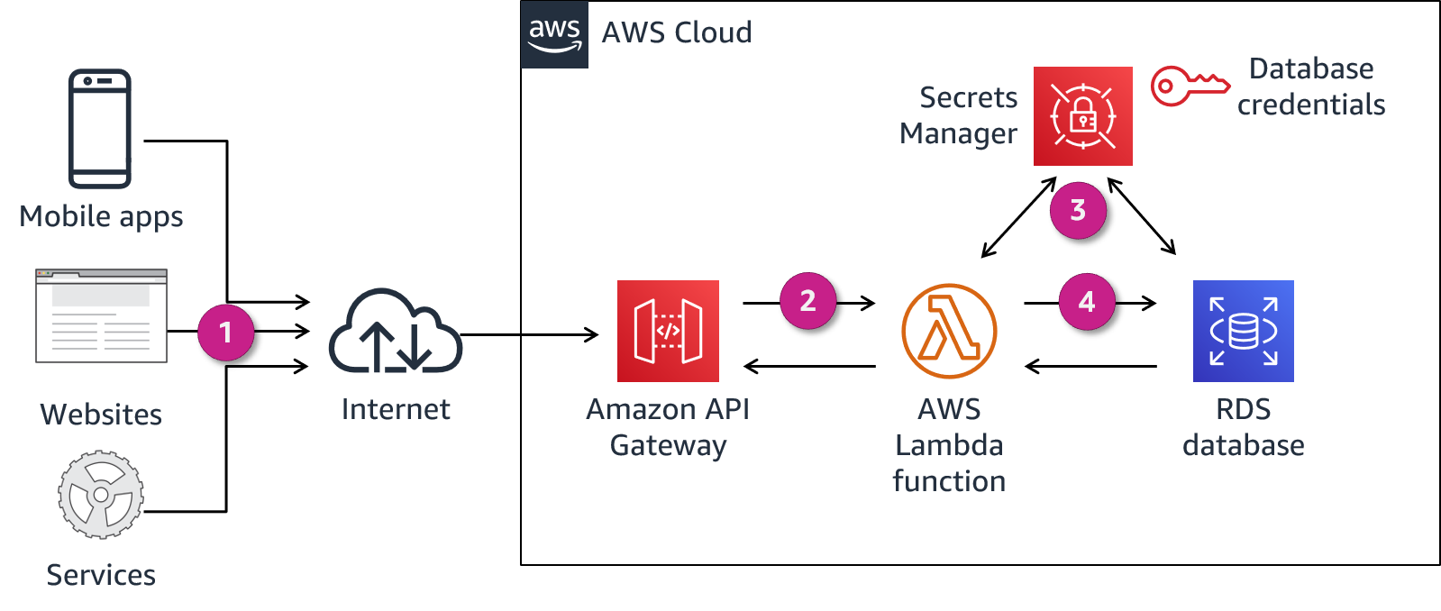
Lecture
Additional data protection services
9
Using Secrets Manager
The steps in this workflow are as follows:
Clients call the RESTful API hosted on Amazon API Gateway.
API Gateway runs the Lambda function.
The Lambda function retrieves the database secrets using the Secrets Manager API. Secrets Manager retrieves the secret, decrypts the protected secret text, and returns it to the function over a secured channel.
The Lambda function connects to the Amazon RDS database by using database secrets from Secrets Manager and returns the query results.
AWS Cloud Security Foundations– AWS-CSF
Lecture 9: Protecting data in your application
Dr. Ibrahim Gomaa

Slide 36
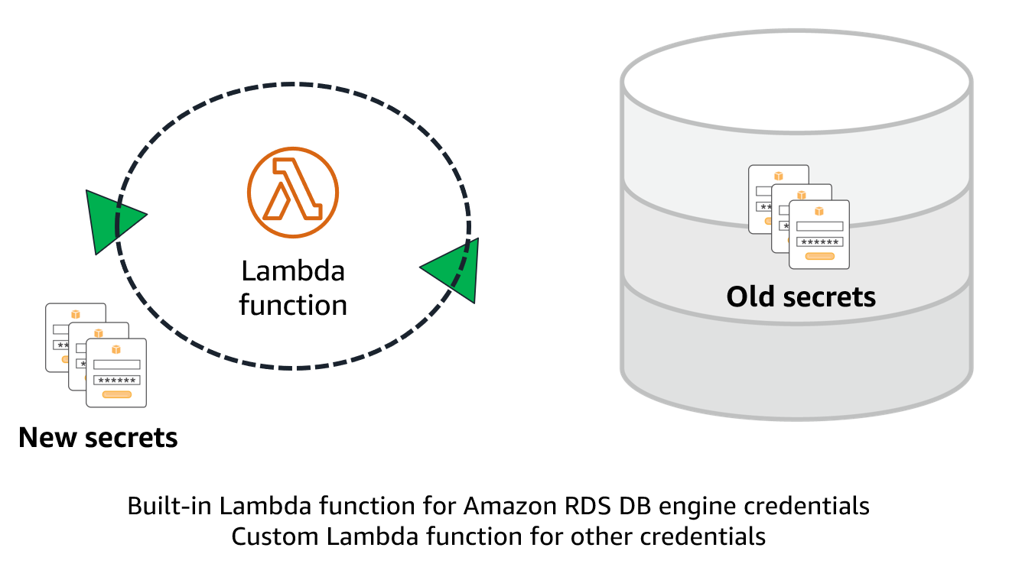
Lecture
Additional data protection services
9
Rotating secrets
The rotation function does the work of rotating the secret. The process to rotate a secret has four steps, which correspond to four steps in the Lambda rotation function. Secrets Manager uses staging labels to label secret versions during rotation:
The function contacts the DB for new credentials.
Secrets Manager stores the new credentials with the AWSPENDING label.
The new credentials are tested.
The new credentials are made the default with the AWSCURRENT label.
AWS Cloud Security Foundations– AWS-CSF
Lecture 9: Protecting data in your application
Dr. Ibrahim Gomaa

Slide 37

Lecture
Additional data protection services
9
Amazon Macie
Amazon Macie is a security service that uses machine learning to automatically discover, classify, and protect sensitive data in AWS
Recognizes sensitive data such as personally identifiable information (PII), financial information, encryption keys, and credentials
Allows for custom-defined data types
Protects data stored in Amazon S3 by monitoring resource policies and ACLs
Provides full API coverage for management
Integrates with AWS Organizations
Amazon Macie
AWS Cloud Security Foundations– AWS-CSF
Lecture 9: Protecting data in your application
Dr. Ibrahim Gomaa

Slide 38
Lecture
Additional data protection services
9
Classify data and monitor its access permissions
Macie scans and evaluates bucket objects for policy violations and sensitive data.
Macie generates findings in real-time for the following:
  Buckets that are public
  Buckets that are not encrypted
  Buckets that are shared or replicated with AWS accounts outside of a customer’s organization
AWS Cloud Security Foundations– AWS-CSF
Lecture 9: Protecting data in your application
Dr. Ibrahim Gomaa

Slide 39
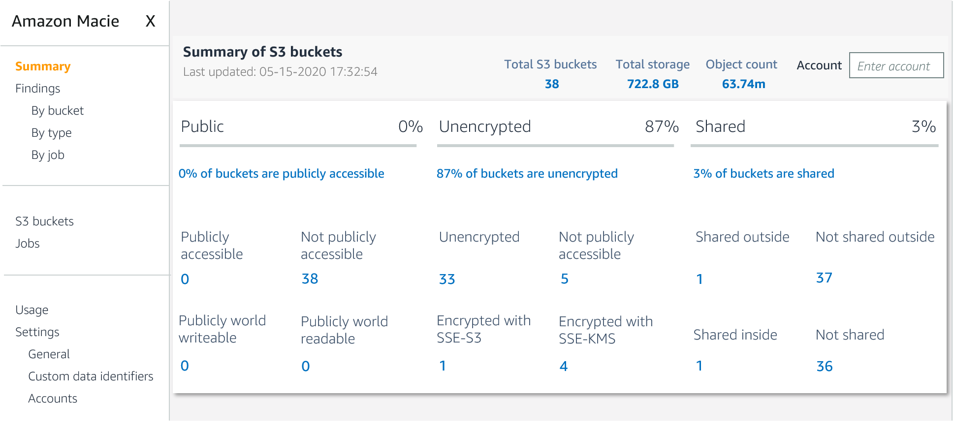
Lecture
Additional data protection services
9
Macie summary
AWS Cloud Security Foundations– AWS-CSF
Lecture 9: Protecting data in your application
Dr. Ibrahim Gomaa

Slide 40
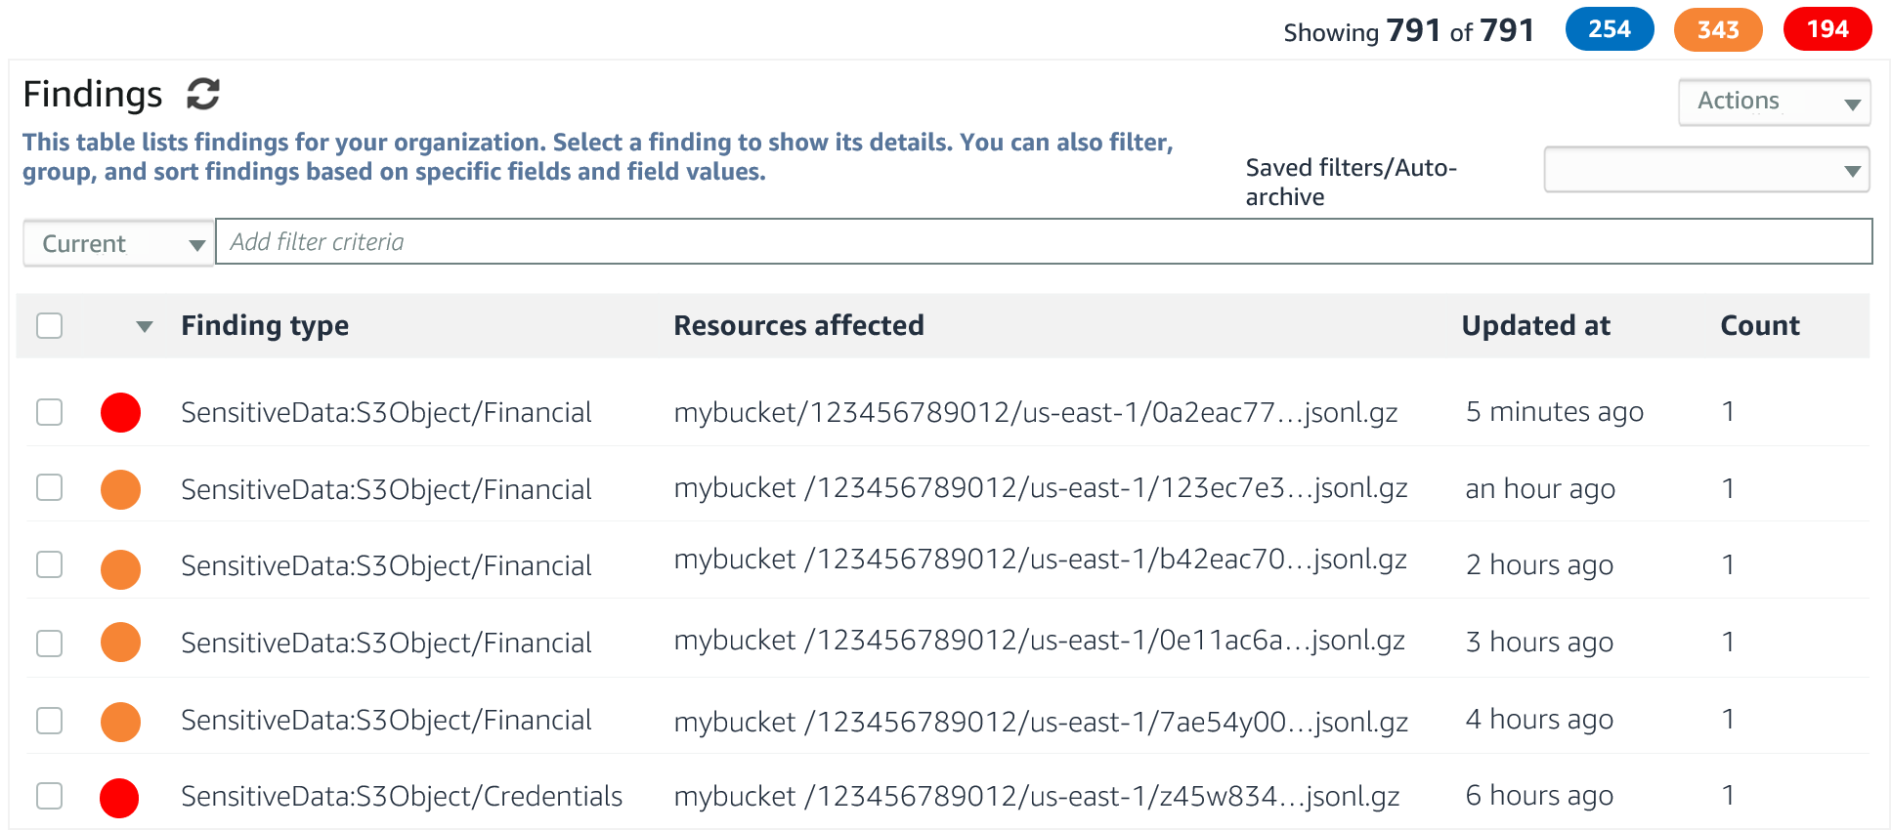
Lecture
Additional data protection services
9
Macie findings
AWS Cloud Security Foundations– AWS-CSF
Lecture 9: Protecting data in your application
Dr. Ibrahim Gomaa

Slide 41
Lecture
Protecting data in your application
9
Thanks
AWS Cloud Security Foundations– AWS-CSF
Lecture 9: Protecting data in your application
Dr. Ibrahim Gomaa

