Slide 1
Lecture 6: (execution stage )
Monitoring and controlling the Deliverable-fit technicality
Performing HPMQA (DFT - Quality conformance )

Slide 2
The story of the execution phase
-The stage of being succussed or failed from the 3d of the HPQMS
 -Create superior competitive advantage.
-Branding Experience .
Causes -defect
Variables- Attributes
errors - Defects

Slide 3
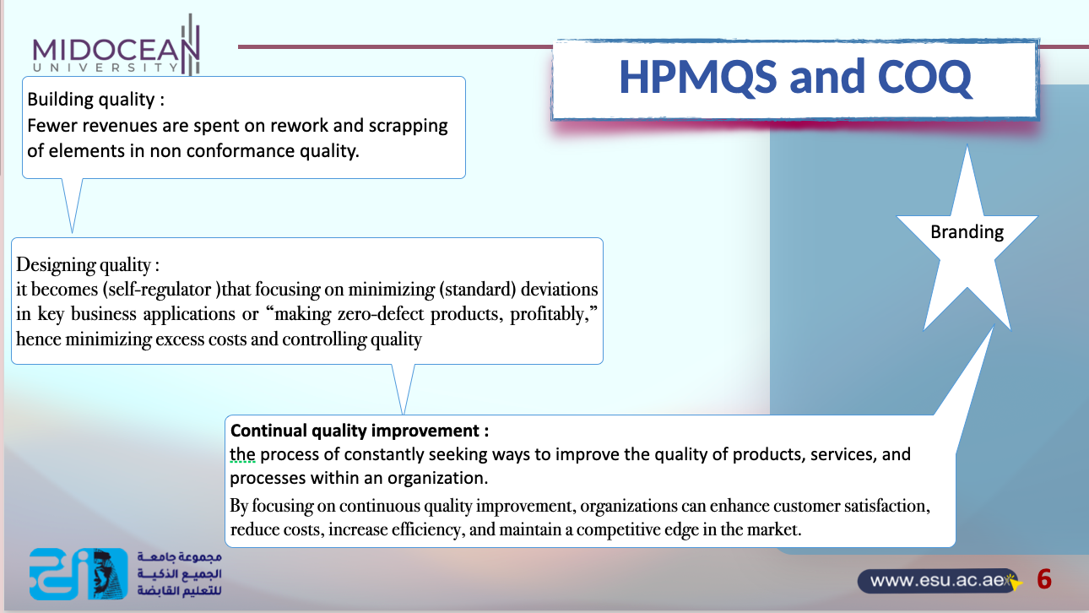

Slide 4
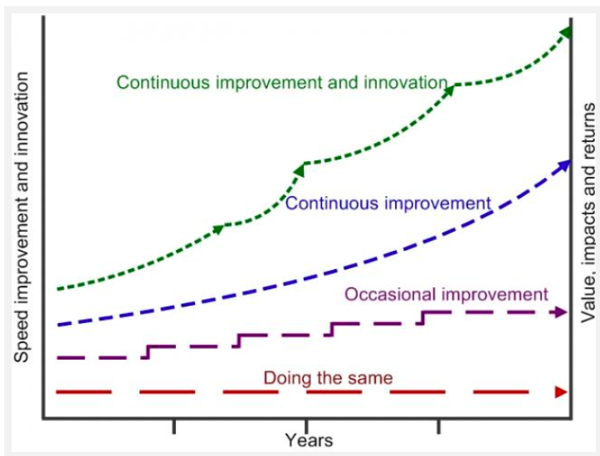
The relationship between theHPMQA and HPMQCI

Slide 5
The impact of the HPMQS on the PLC
PLC | Its quality function | HPMQS | Its quality function
X | X | BPP Stage | Holistic project quality planning
X | X | PFS-QP
Initiation Stage | X | Project -Fit success criteria
Planning Stage | Project quality planning | Developing PDQP | Holistic quality plan
Execution stage | Performing Quality plan | Executing the deliverable quality plan | HPMQA/HPMQC
Monitoring and controlling the execution phase | PQA verification 1 | HPMQA/HPMQC | HPMQA(verification 1)
 | X | HPMQC | HPMQC (validation2)
 | X | HPMQC and project manager | Project assessment (validation 3)
 | X | HPMQA - project manager and the customers | Customer acceptance (validation 4) -Project scope validation
Closure | PQC validation 1 | Unofficial project closure | Project manager with PDQP leader
 | X | Official project closure | Project manager with sponsor (agreed on PFS)
X | X | BFS (Post - implementations ) | HPMQCI Validation 5- having BVA

Slide 6




Lecture outline
1st section content:
The impact of the HPMQA on the DFT and PjT
2nd section contents :
HPMQA short term and long term decisions based on the cost of poor quality
3rd section contents :
HPMQA process with the basic quality tools

Slide 7
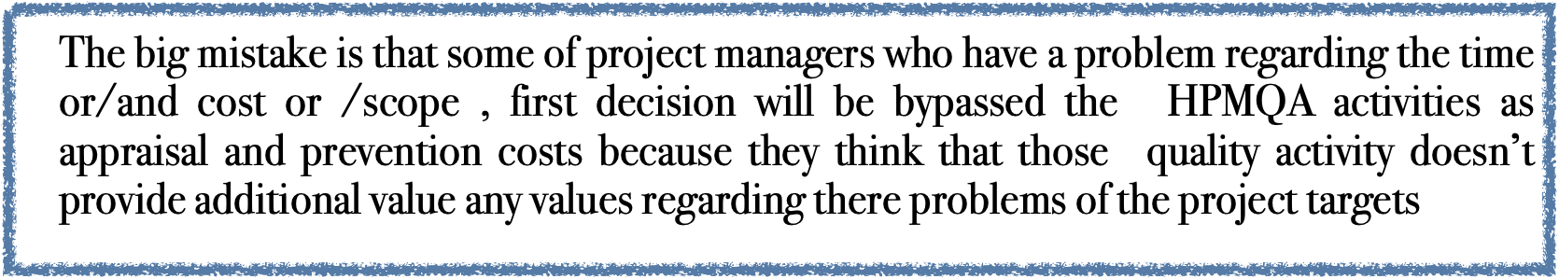

Slide 8
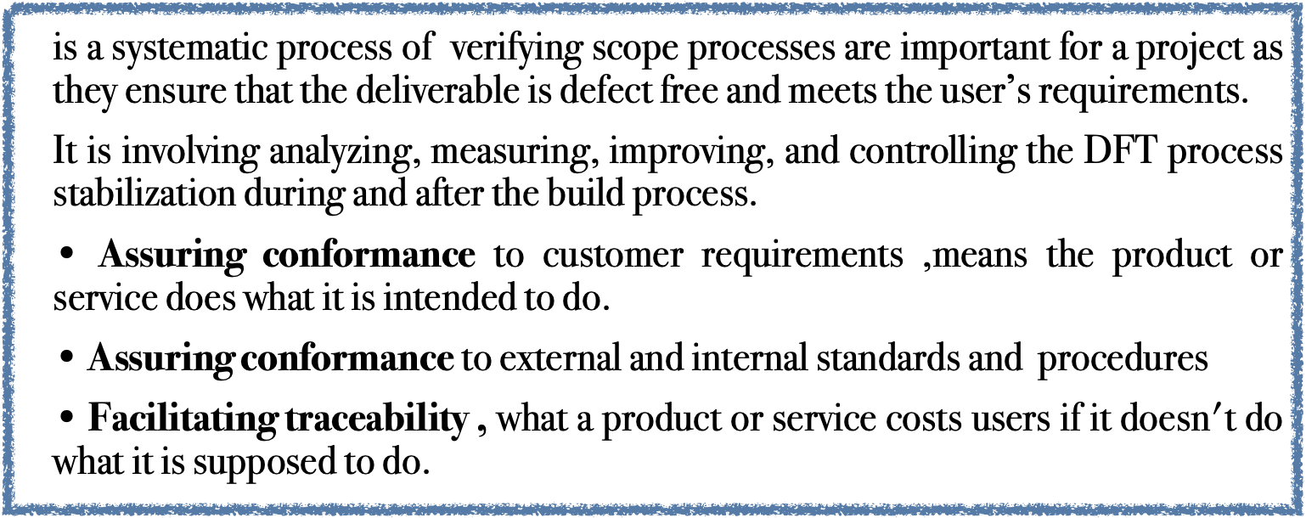


Slide 9
The impact of the HPMQA on theDFT and PjT
HPMQA -DFT is verifying scope processes are important for a project as they ensure that the deliverable is defect free and meets the user’s requirements.
HPMQA-PjT should also verify that the project quality processes are actually being followed. For instance, if the team had a formal process for managing issues and scope changes, an audit would review
-Review of the Issues Logs, Scope Change Logs, schedule activities, Status Reports, etc.
-And the information from preparation, planning, sponsor, process owner, and subject matter experts to identify root causes of problems and ensuring compliance with PFS quality.

Slide 10
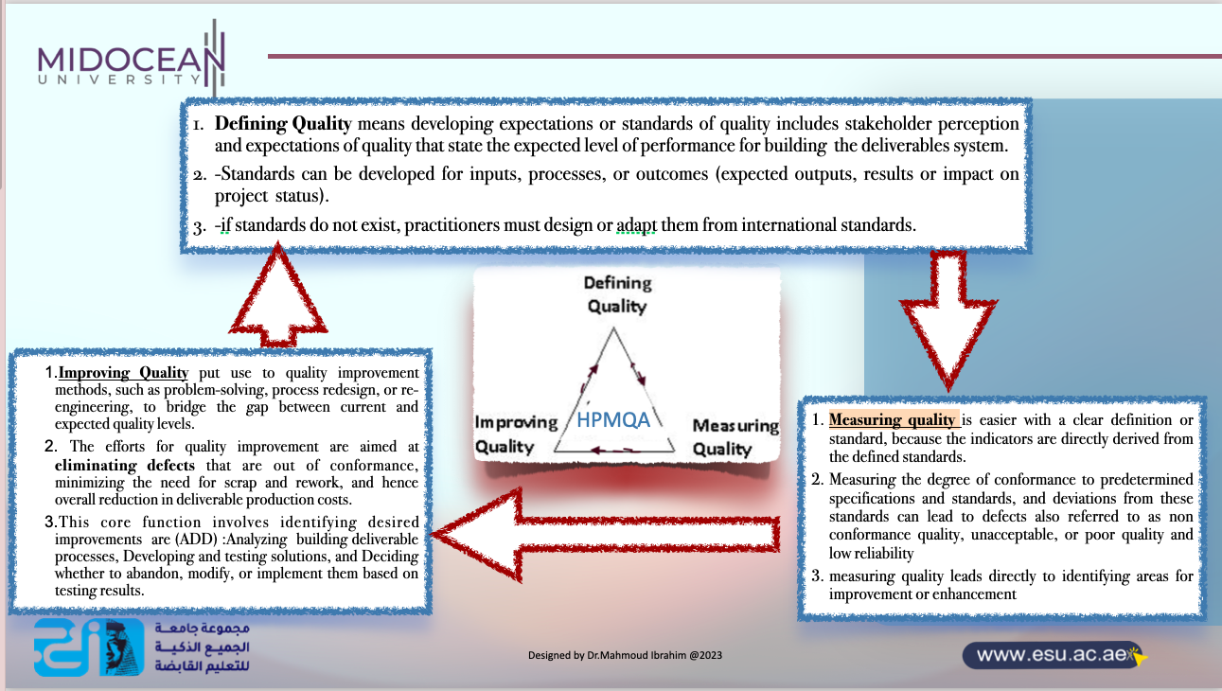
The target
Done-DFT

Slide 11
The HPMQA and Cost Of Quality (COQ)

Slide 12
What are the principles of HPMQA?
quality management principles— which are not customer focus, not leadership, engagement of people, not process approach, not evidence-based decision and so on
The updated HPMQS quality principles

Slide 13

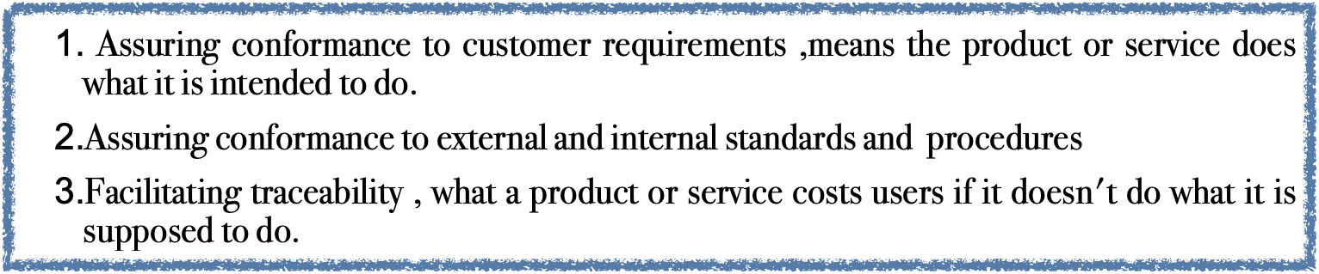
Why does HPMQA need to manage the COQ?
It is the total of the costs incurred by:
1. Investing in the prevention of nonconformance to requirements.
2. Appraising an element for conformance to requirements.
3. Failing to meet requirements.
13

Slide 14
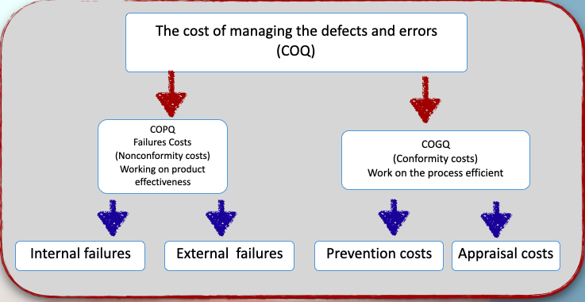
Quality cost is a HPMQA success factor
Lecture 7
These are costs resulting from elements not conforming to requirements or customer/user needs. Failure costs are divided into internal and external failure categories.

Slide 15

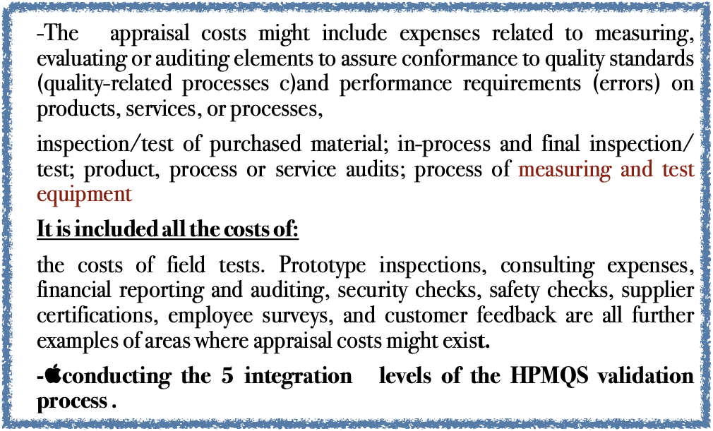
prevention costs
“Design quality approach”
(prevent poor quality )
-The costs of prevention are the expenses that are related to any activity meant to stop an error or defect from occurring .
-Quality review and evaluation processes also create prevention the costs of all activities specifically designed to prevent poor quality in element.
-These costs can be divided into two categories: identify areas where errors can be removed or where quality-related processes can be improved
It is included all the costs of:
-whether those reviews are related to suppliers, products, processes, or people. Customer surveys, the creation of technical manuals, work to create and manage requirements and specifications, and the management of job descriptions can all lead to prevention costs
-.HPMQS (BPP stage- Preparation stage -Selective the fit project )
15

Slide 16
1-The relationship between them
Costs that are considered in the definition of prevention costs are those that must be incurred if the current cost of failure and appraisal is to be reduced.
These represent an investment in the “Continuous Improvement” initiative and, if effective, should result in a significant reduction of the overall costs. Obviously, these costs are likely to be small otherwise the failures would not occur and relevant appraisal cost would not be necessary.

Slide 17
2-The relationship between the apprising cost and Project risk management plan
Costs that are considered in the definition of appraisal costs are those that are related directly to the likelihood of occurrence of error or failure.
There are those costs that must be incurred regardless of the likelihood of occurrence of the regarding the identified risk event, why????????
because the consequences of such an event are severe and potentially deliverable threatening.
Such is the case for many of the controls and procedures at power stations. This form costs are not to be considered in this definition of appraisal costs. Because they will always be incurred regardless of the likelihood of occurrence of a threatening risk event.

Slide 18
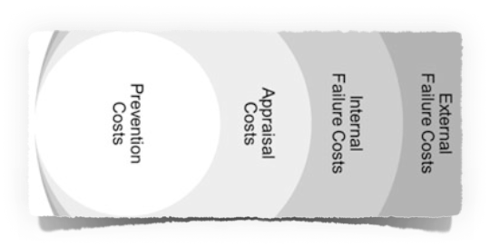
3-The relationship between the COQ and the Customers satisfaction
the Cost of Quality increases as the element moves toward the customers

Slide 19
HPMQA check list for selecting the right cost of quality
Questions help teams identify areas where errors can be removed or where quality-related processes can be improved. If you think an activity related to a process might be an unnecessary form of prevention or appraisal, ask:
Does the activity itself add any value to the output?
Does the activity substantially reduce the time it takes for the process to produce an output?
Does the activity substantially increase the cost of the process?
If the activity is designed to prevent defects within the process, can the activity be made more
efficient?
If the activity is designed to prevent defects, can the activity be made less expensive?
If an activity is designed to capture quality data about the process for reporting purposes, are
those reports necessary?
If quality reports are necessary– either because of obligatory requirements -internal deliverables as compliance indicator or because the reports provide value in another process – can the reports be automated to reduce associated expense?

Slide 20
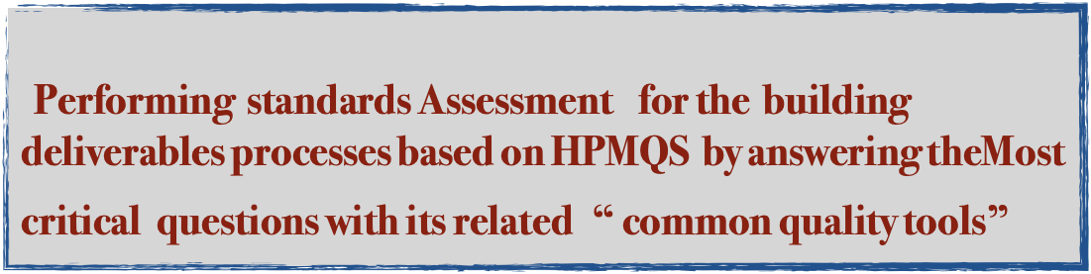
The HPMQA basic measuring/analysing process

Slide 21
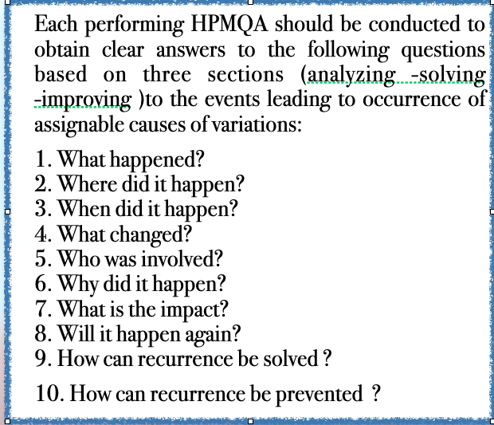
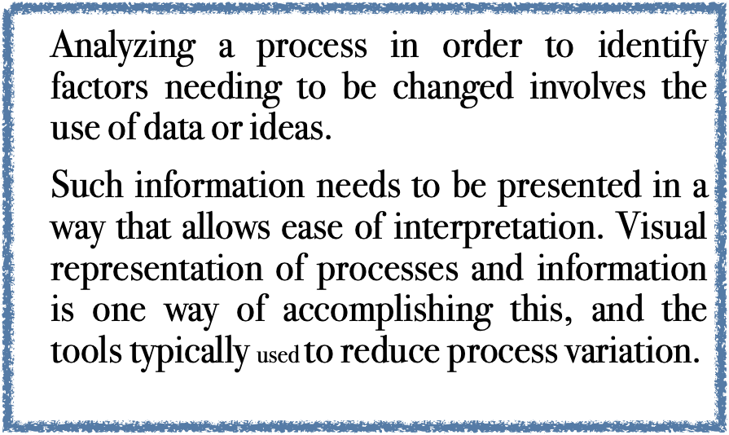

Slide 22
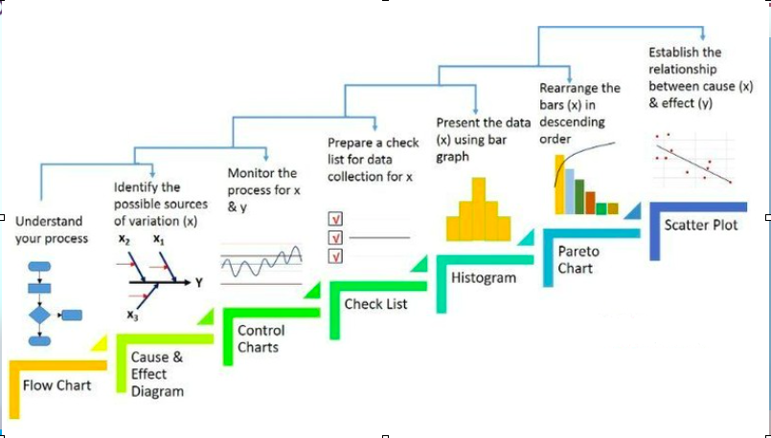
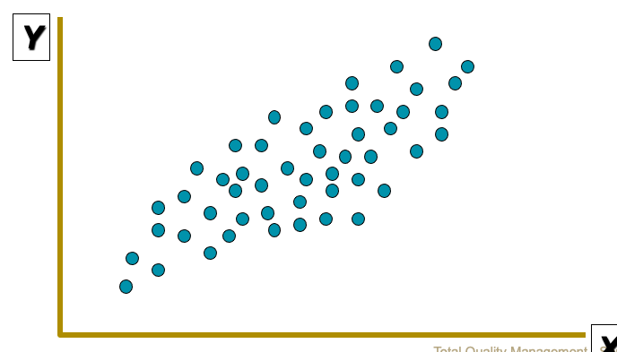
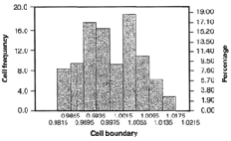
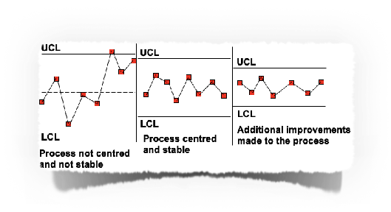

Slide 23
1. What happened?
Clarifying what actually happened is an essential requirement of identifying assignable causes.
The purpose of this first Reviewing question is too clearly and specifically identify and describe a problem detected on to focus a root cause analysis and corrective action efforts as follows :
A problem is
(1) a deviation from a requirement or expectation; ; and/or
(2) when “actual” observation is different from “should” observation; ; and/or
(3) an undesirable event, situation, or performance trend;
Once a potential assignable cause has been identified, HPMA team must quantify its effects on the “process to be improved” outcomes in order to target the improvement efforts correctly and thereby avoid wasted resources.

Slide 24
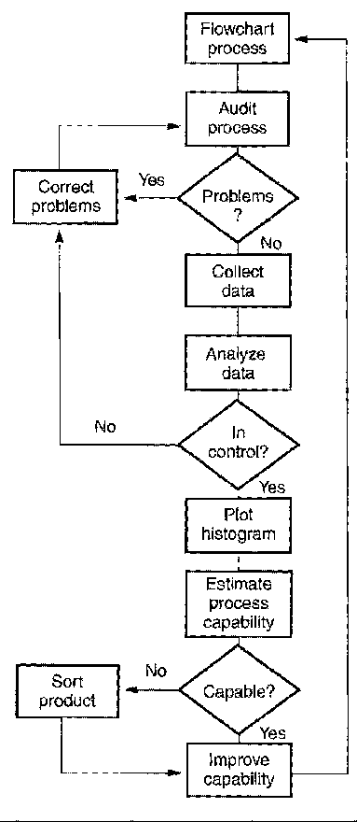
Flowchart
A flowchart is a map of the sequence of steps and decision points in a process.
-Flowcharting a process is a good starting point for a team, as it helps the group gain a common understanding of the process flow.
-Each team member typically has a perspective based on his/her own role, but may not have a full understanding of the entire process.
A flowchart may be used to:
Document the as-is condition of a process
Reflect changes that are to be made to a process
Design an entirely new process

Slide 25
2. Where did it happen?
-A clear description of the exact location of the event leading to occurrence of assignable causes helps isolate and resolve the problem.
-In addition to the location, the team members conducting gathering info.and should determine if the event leading to occurrence of assignable causes also occurred in locations similar to the one where the current process is executed.
Simply we need to know is the assignable causes uniques or systemic and widespread

Slide 26
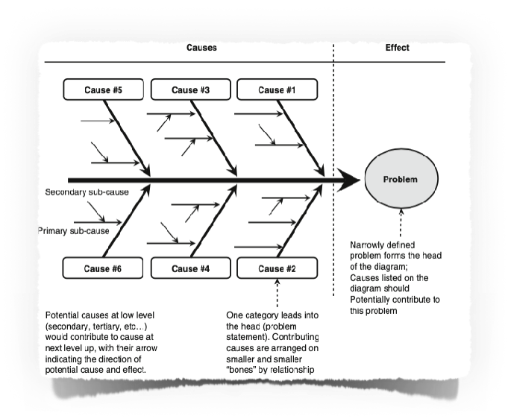
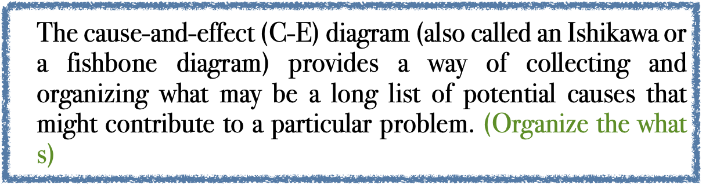
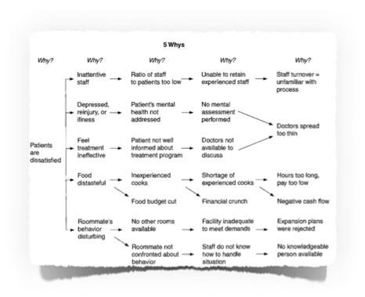
-Cause-and-Effect Diagram
  (Process analysis)
In a C-E diagram, the problem (the effect) is stated in a box at the right side of the chart, and likely causes are listed under major categories that can lead to the effect. (Where)The four M's (manpower, machinery, methods, and materials) are categories of problem sources typically used for manufacturing problems, although other headings such as environment and measurements are sometimes added.
The items for the diagram may be created through a brainstorming session or by a review of the relevant process flowchart to explore what can go wrong at each step.
Once the C-E diagram is completed, the potential causes should be organized and ordered so that internal and external relationships are clear.

Slide 27
3. When did it happen?
Isolating the specific time that an event occurred greatly improves the project team’s ability to determine its source.
When the actual time frame of an event leading to occurrence of an assignable cause is known, it is much easier to quantify the process, operations, and other variables that may have contributed to the event.
This type of investigation, in most cases, will isolate the timing to events such as the following:
1. Production of a specific product.
2. Work schedule of a specific operating team.
3. Changes in human resources and intervention.
4. Changes in methods and procedures used in every step of the process. 5. Changes in management systems and methodologies.
6. Changes in ambient environment.

Slide 28
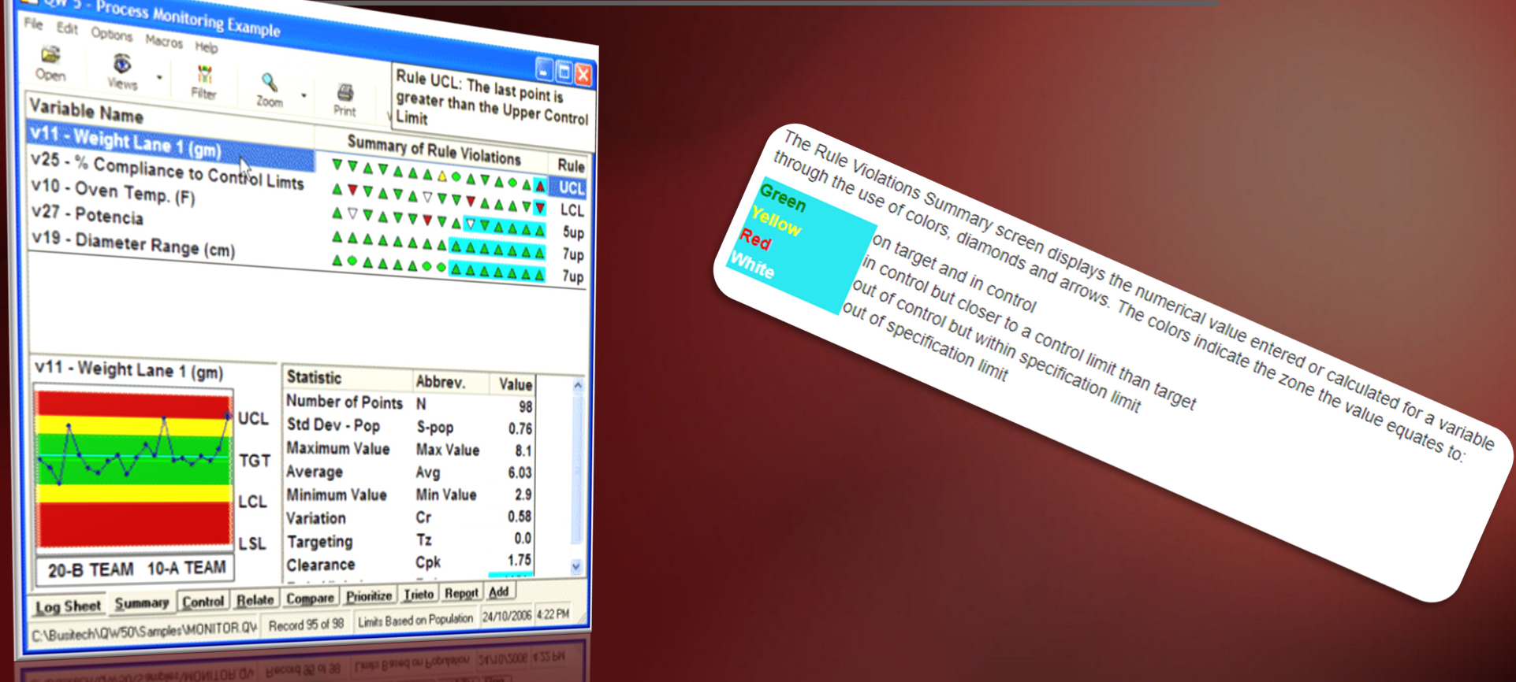
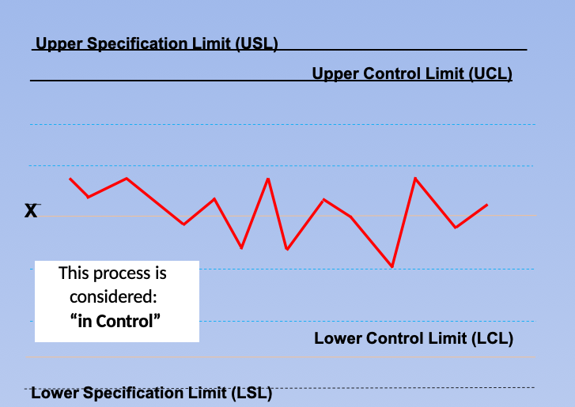
-Control Charts
Control charts are a refinement of the original run chart, which does not include control limits. A control chart serves two vital purposes as a data-gathering tool:
(1) it shows when a process is being influenced by special causes, creating an out- of-control condition, and
(2) it indicates how a process behaves over time.
Control charts should be examined for nonrandom patterns of data points; such an analysis of patterns can indicate what source of variation is most likely creating the condition (for example, which of the causes in the C-E diagram is most likely influencing the process). Patterns could reflect wildly fluctuating values, sudden process jumps or shifts, a gradual trend, or increased variation. Each of the causes in the C-E diagram is likely to create only a particular type of pattern, making the control chart a valuable diagnostic tool. The pattern might also reveal improvement in a process, indicated by decreased variation. Investigating this change to find the cause may provide deeper learning.

Slide 29
4-. Who was involved?
The HPMQA team should identify all personnel involved, directly or indirectly, in the event leading to occurrence of assignable causes. Events leading to occurrence of assignable causes often result from human actions or inadequate skills to execute the process. However, the HPMQA team must remember that the purpose of these gathered info. is to identify and quantify assignable causes that are displayed on the process behavior charts, not to place blame.
This approach helps reduce fear of punishment for those directly involved in the occurrence of assignable causes of variations. In addition, it reduces prejudice or preconceived opinions about individuals within the enterprise business.

Slide 30
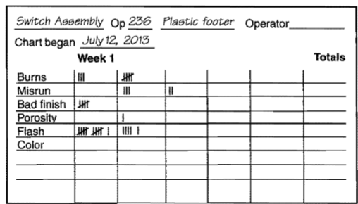
-The check sheet
The check sheet (sometimes called a tally sheet) is used for gathering information to analyze. As with most of the tools, it facilitates the use of facts, rather than just opinions, in talking about and solving problems. Check sheets are used to gather data on frequency of occurrence .
=Data from several check sheets can be organized into a Pareto chart for final analysis.
(This type of check sheet is sometimes called a measles chart or a defect data check sheet.)

Slide 31
5. What changed?
Occurrence of assignable causes and major deviations from acceptable performance levels in process outcomes do not just happen.
In every case, specific variables, singly or in combination, caused the event leading to occurrence of assignable causes to occur. Therefore, it is essential that any changes in the system that occurred in conjunction with the event be defined.
No matter what the event is (i.e., equipment failure, environmental release, accident, etc.), the project team must quantify all the variables associated with the event leading to occurrence of assignable causes.

Slide 32
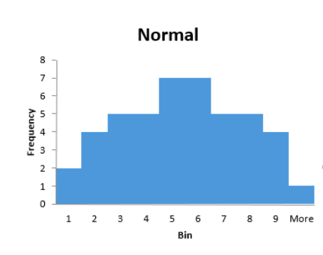
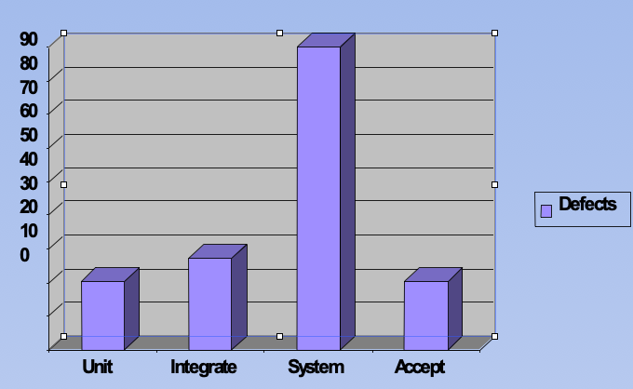
Histograms
Control charts display process performance over time, while histograms display frequency distribution, detecting non-bell-shaped curves and relating process spread to specifications.
In the first, the data elements are concentrated toward the center. The histogram approximates what is called the bell curve, or normal curve. This shape is likely to indicate that the data used to create the histogram is normal data,

Slide 33
6. Why did it happen?
To identify and quantify an assignable cause, the project team must conduct a thorough analysis of the symptoms or perceptions. Symptoms are tangible evidence of a problem, not the cause.
1-A clear cause can be assigned based on these symptoms, but identifying and treating the real cause is crucial for preventing recurrence.
2- The project team should generate a list of factors contributing to assignable causes, including both real and assumed ones. Clear note of all assumptions and proven causes, and a sequence-of-events analysis helps separate fact from fiction during the analysis process.

Slide 34
7. What is the impact?
The project team should quantify the impact of the event leading to occurrence of assignable causes before embarking on a full cause-and-effect relationship analysis or a full root cause and failure analysis. Again, not all events, even some that are repetitive, warrant a full analysis.
This part of the identification and quantification process should be as factual as possible. Even though all the details are unavailable at this point, the project team should attempt to assess the real or potential impact of the event.
Identified assignable causes must be quantified so that further improvements focus on the deep assignable causes, and not on the original symptoms of “process to be improved” underperformance.

Slide 35
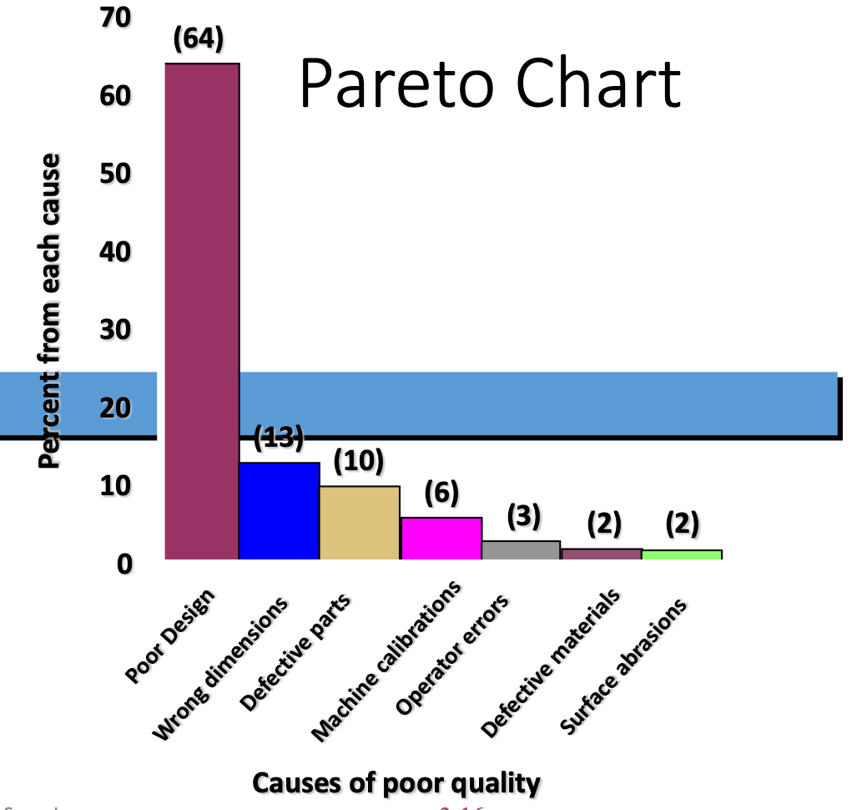
Pareto Chart(ranked histogram )
Pareto chart that indicates how much each work center contributes to quality costs. Pareto analysis could also be used by a supervisor within each of the higher-cost work centers to pinpoint the particular machines that are the primary sources of trouble
Pareto Principle, or 80/20 rule, which says that 20 percent of the causes lead to 80 percent of the results. Because of this, a Pareto chart is a good starting point for root cause brainstorming – teams can start with the few inputs or attributes accounting for the bulk of the Pareto chart. Just as you can “drill down” using the fishbone diagram, asking deeper and deeper “Why?” questions, you can drill down using a Pareto chart.

Slide 36
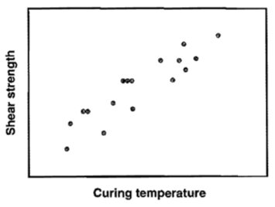
Scatter Diagram
A scatter diagram shows whether or not there is a correlation between two variables. Correlation does not necessarily mean a direct cause-and-effect relationship, however. If it appears that values for one of the variables can be predicted based on the value of another variable, then there is correlation.
While correlation does not prove causality, the lack of correlation may indicate that no cause-and-effect relationship exists.

Slide 37
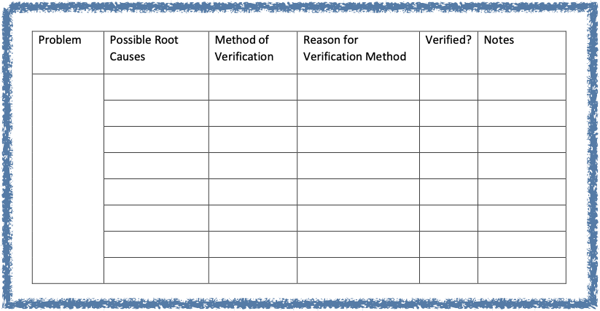
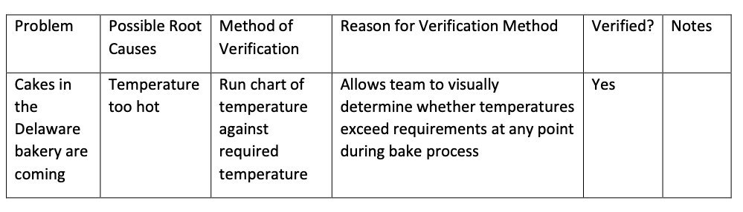
II-Documentation verified root cause by using root cause verification matrix
II-Documentation regarding root cause verification is usually completed on a matrix that includes the problem, possible root causes, the verification method, why the verification method was chosen, results of the verification.

Slide 38
III-On-Going Risk Notification
The HPMQA shall immediately verbally report to the Project Manager the discovery of problems, new risks, or previously known risks that have increased in risk probability or potential impact, which pose a risk of failure or danger to the success of the project.
2- and then shall develop and submit a written On-Going Risk Notification Report within two business days for an example
3-The on-going risk notification will follow the same requirements as defined for the initial risk assessment with an emphasis on managing risks that occur and change during the executing and implementation process.
On-going risk assessment will be conducted while conducting the quality assurance and quality control tasks.

Slide 39
8. Will it happen again?
In case of nonrecurring assignable causes
If a first investigation finds assignable causes nonrecurring, the questing process may be discontinued. However, a thorough review of historical records is necessary to determine if the event is truly nonrecurring.
All reported events should be recorded and maintained for future reference. A full investigation should be conducted on events with a history of periodic recurrence or a high probability of recurrence,

Slide 40
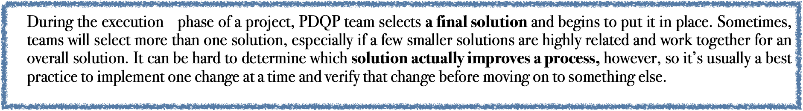
9. In case of recurring assignable causes
How can recurrence be solved ?
Although this is the next logical question to ask, it generally cannot be answered until the entire root cause analysis of assignable causes is completed.
1- list of possible actions that should be developed.
2-each should be evaluated as to its potential for success, cost and timing to implement, and other important criteria
3-A Simple processes such as ranking or multi-voting, or more scientific analysis using a matrix, are likely to be used in the selection process.
4—Then the Select and implement a solution.

Slide 41
10. In case of recurring assignable causes
How can recurrence be prevented ?
1-Follow up to evaluate the effect As with any good corrective action process, however, it is necessary that the process be monitored after the solution has been implemented.
Tools for assessing whether the issue has been resolved include control charts and Pareto diagrams. There may have been no effect, a partial effect, or a complete resolution of the problem, depending on how well the solution was applied,
whether it was appropriate for the root cause, or if the real root cause wasn't discovered. If there was no impact, it is necessary to review the actions taken in the earlier stages of the problem-solving model to determine whether an error may have been made.
2-Standardize the process. Even if the problem has been resolved, there is one final step that needs to occur. The solution needs to be built into the process so that it will continue to work once focused attention on the problem is gone. A review to see what was learned from the project is also sometimes useful.

Slide 42

Earlier detection when errors do occur, which keeps hidden costs down.
Employees are able to support and manage higher quality. Poor performance on a continuous basis does need to be addressed, but employees should not default to a negative feeling when they hear the word quality.
In-process quality assurance is actually more effective than post-process or over-process prevention and appraisal methods.
creates a positive impact on project process quality , deliverable production, and customer and employee satisfaction.
Stable process
Minimizing the cost of poor quality

Slide 43


