Slide 1


Project Management Technologies
PMG 312
Prepared by Dr. Majid Saad
Lecture 3

Slide 2



Project Management Technologies
PMG 312
Lecture 3
Prepared by
Dr. Prepared by Dr. Majid Saad

Slide 3
AGENDA
Project ranking matrix
The weighted project ranking matrix
Quality management
Sponsor and supplier agreements
Microsoft Project 2010
Summary

Slide 4

CH2
Project ranking matrix
What occurs when an organization has a number of requested new projects but you have limited time, resources, and/or money to develop the new systems?

Slide 5
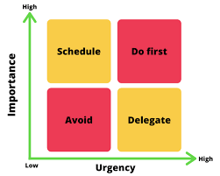
Project ranking matrix
CH2
The best thing to do is to rank the different requested projects against each other in the area of importance or adding extra value to the overall organization and only work on the high-ranking projects.

Slide 6
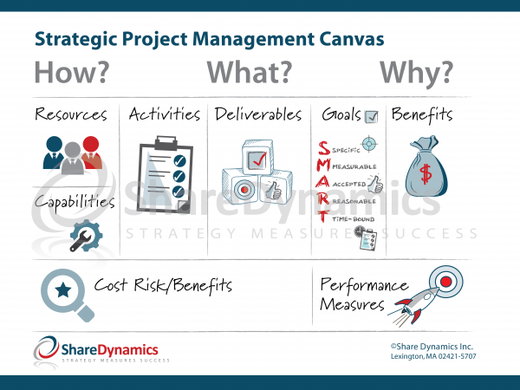
CH2
Project ranking matrix
Keep in mind that about 40% of large-scale projects that IT organizations are working on are no longer relevant to the overall business of the organization.

Slide 7
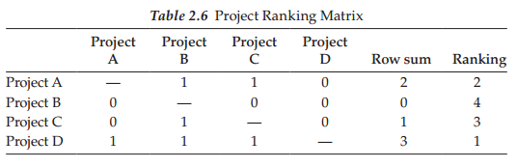
CH2
Project ranking matrix
The characteristics of a project ranking matrix:
The key column is the first column, which lists all the requested projects.
The first column of projects is ranked in importance against the other projects starting in the second column.
If a project in column 1 is more important than another project in a sequential column, then enter a 1. Otherwise, enter a 0.
When done, sum up the rows, and then rank the projects by importance with the highest row sum getting the number 1 ranking and so on.

Slide 8
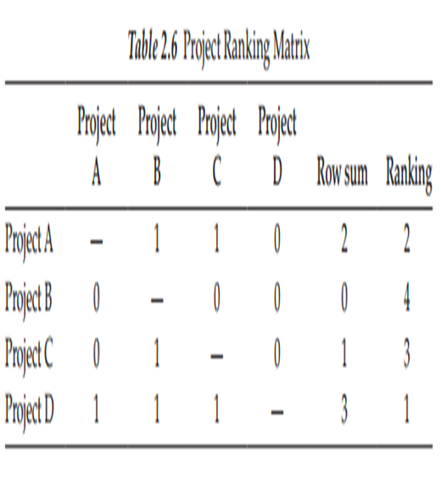
CH2
Project ranking matrix
As shown in Table : an organization might only work on Project D and Project A.
Project C and Project B could be permanently dropped or be reviewed again at some other time in the future.
Companies need to set up a process (e.g., using portfolio management software) to help them prioritize their projects, optimize resource allocation and staffing, and track project progress and to make sure they were successful in meeting their strategic business goals.

Slide 9
The weighted project ranking matrix
CH2
When seeking executive approval for a new project, most departments and business managers build a case around objectives, benefits, and return on investment.
Rarely, though, do they evaluate the project requirements and goals against recently approved or current projects.
New project requests should, in fact, have a strong relationship with projects in the queue or in progress, as well as with the organization’s strategic plan

Slide 10
The weighted project ranking matrix
CH2
When comparing the new request with funded projects in progress, you may discover that because of resource constraints, work cannot begin until another project wraps up.
Likewise, you may discover you do not have the staff for a new project, which could delay its start and/or completion.

Slide 11
The weighted project ranking matrix
CH2
Instructions:
You can use Table 2.7 for ranking your currently requested projects.
Add on the funded projects currently under way in your organization and complete the criteria scoring exercise.
You may decide to modify the criteria and their weights to best fit your goals.
The criteria scores and weighted total scores you come up with should be reusable for future projects, but expect some of the project rankings to change

Slide 12
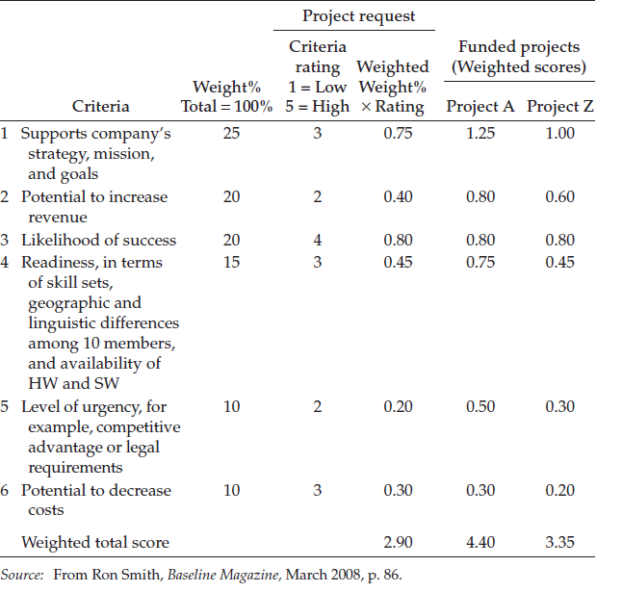
The weighted project ranking matrix
CH2

Slide 13
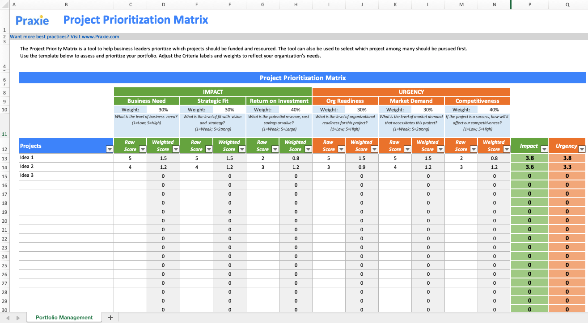
The weighted project ranking matrix
CH2

Slide 14
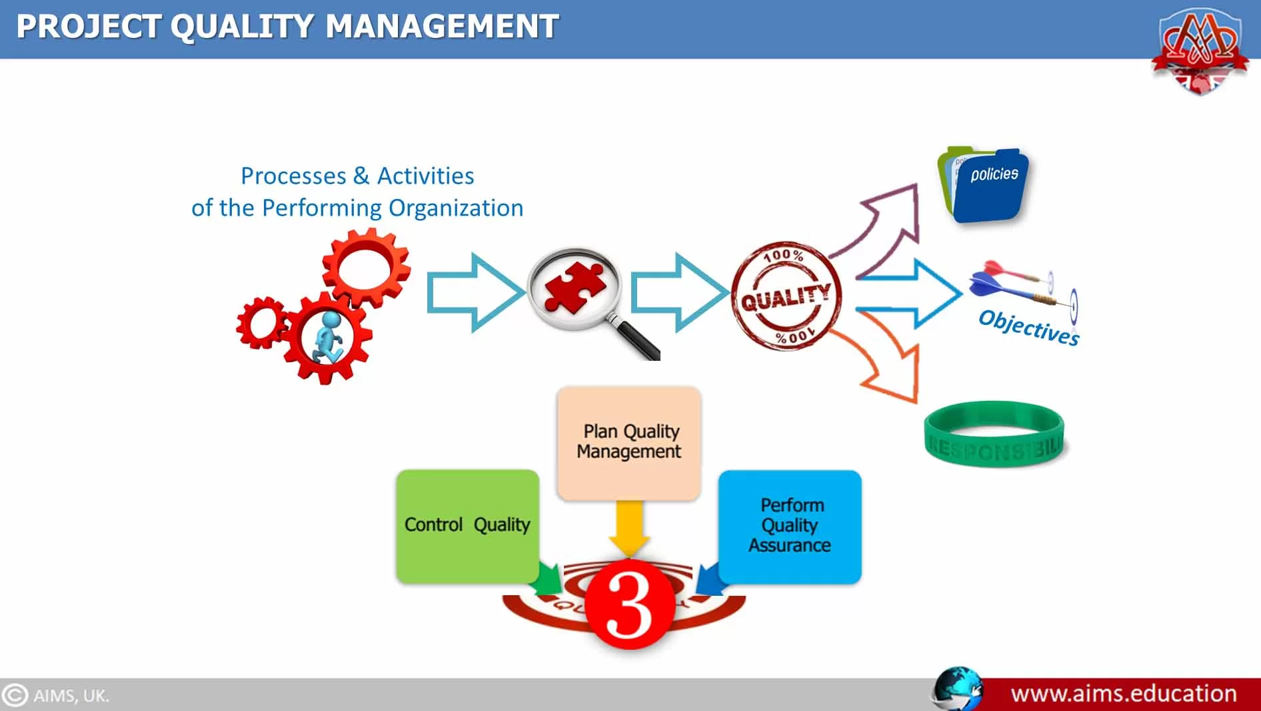
Quality management
CH2
The importance of quality management in project management cannot be overstated.
Effective project quality management ensures that your team consistently delivers quality products and services.
Your customers will take notice and continue to rely on you for transparent, efficient, and quality work.

Slide 15
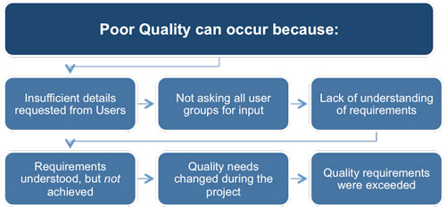
Quality management
CH2

Slide 16
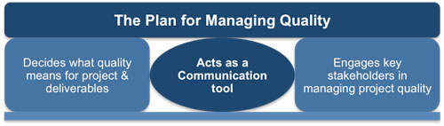
Quality management
CH2
http://www.free-management-ebooks.com/dldebk/dlpm-quality.htm

Slide 17
What is project quality management?
CH2
Project quality management is the process of continually measuring the quality of all activities and taking corrective action until the team achieves the desired quality.
Quality management processes help to:
Control the cost of a project
Establish standards to aim for
Determine steps to achieve standards
Effective quality management of a project also lowers the risk of product failure or unsatisfied clients.

Slide 18
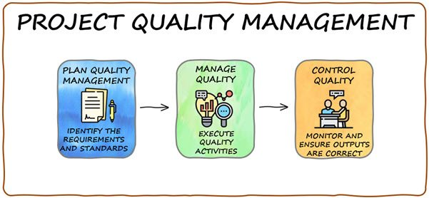
Project quality management plan
CH2
Measuring quality may seem like something you can’t do until after the project is complete.
However, project quality management should be planned from the beginning and monitored throughout with these three quality management processes:
Quality planning
Quality assurance
Quality control

Slide 19
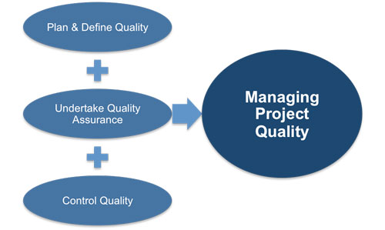
Project quality management plan
CH2
http://www.free-management-ebooks.com/dldebk/dlpm-quality.htm

Slide 20

Quality planning
CH2
A good quality management plan starts with a clear definition of the goal of the project.
First, be clear on what the product or deliverable is supposed to accomplish. Then, ask yourself:
What does it look like?
What is it supposed to do?
How do you measure customer satisfaction?
How do you determine whether the project was successful?

Slide 21
Quality planning
CH2
Answering these questions and others will help you identify and define quality requirements, allowing you to discuss the approach and plans needed to achieve those goals.
This includes:
Assessing the risks to success
Setting high standards
Documenting everything

Slide 22
Quality assurance.
CH2
Quality assurance provides evidence to stakeholders that all quality-related activities are being done as defined and promised.
It ensures safeguards are in place to guarantee all expectations regarding quality outputs will be met.
Quality assurance is done to the products and services delivered by a project, as well as the processes and procedures used to manage the project.
The team can do this through systems such as a process checklist or a project audit.

Slide 23
Quality control in project management assurance.
CH2
Quality control involves operational techniques meant to ensure quality standards. This includes identifying, analyzing, and correcting problems.
While quality assurance occurs before a problem is identified, quality control is reactionary.
It occurs after a problem has been identified and suggests methods of improvement.
It measures specific project outputs and determines compliance with applicable standards.
It also identifies project risk factors, their mitigation, and ways to prevent and eliminate unsatisfactory performance.

Slide 24
CH2
Quality management
It is recommended to have independent reviews of a project to ensure the project is on the right course or what actions need to be implemented to get the project back on track.
Besides performing an “outside check-and-balance,” QM people will ensure that the project and related documentation are being developed according to an acceptable process.
Projects should have periodic mini reviews that rate its progress against certain defined metrics.

Slide 25

CH2
Quality management- Mini reviews
There are three types of reviews:—
Health
Compliance
Deliverable.

Slide 26
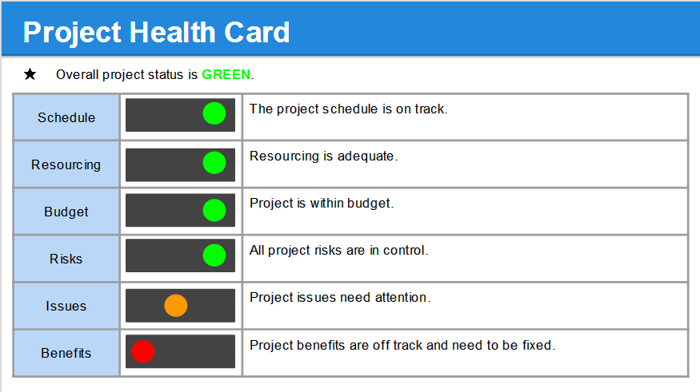
CH2
Quality management
https://shop.techno-pm.com/products/monthly-status-update-template

Slide 27
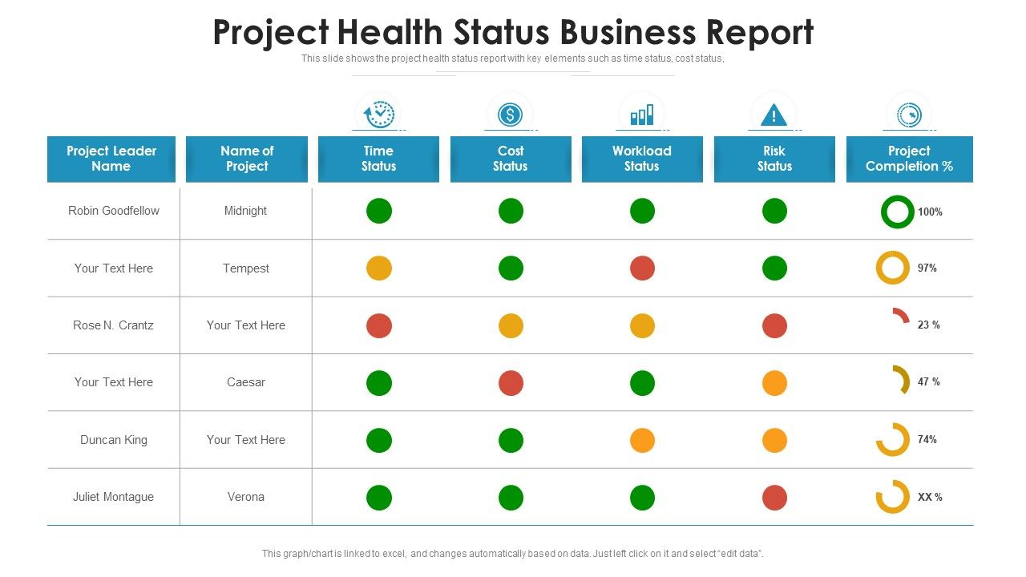
CH2
Quality management

Slide 28

CH2
Sponsor and supplier agreements
This section contains sponsor and supplier agreements, which specify the mutual commitments of the involved parties during the life of this project.
The agreements provide project team members with access to the baseline of each agreement and its amendments.
The statement of work (SOW) that was generated from the request for proposal (RFP) document should also be included.

Slide 29

CH2
Sponsor and supplier agreements
The Statement Of Work (SOW) includes:
Information such as the work to be performed by the vendor
When work is due, how the work will be measured for acceptance
The working relationship between the vendor and your organization.
Finally, the SOW becomes a major part of the eventual contract between your organization and the vendor

Slide 30
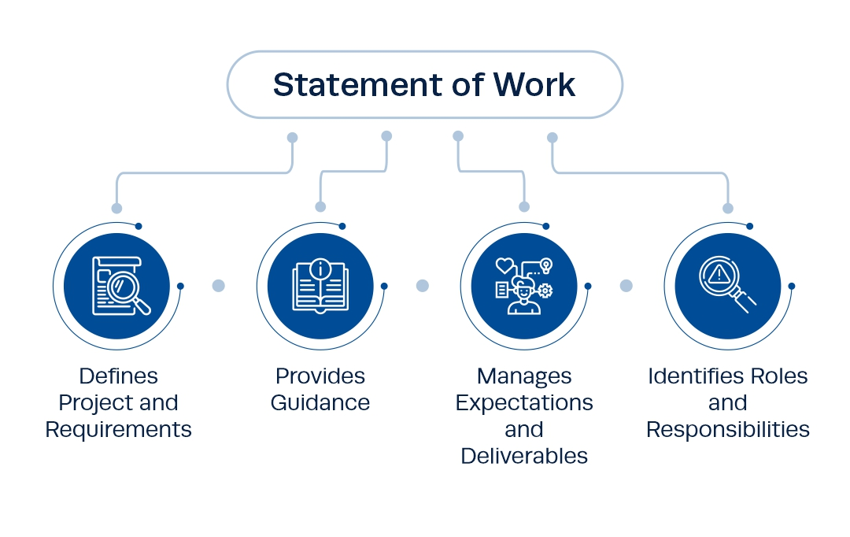

CH2
https://www.projectmanagement.ie/blog/statement-of-work/

Slide 31

CH2
Sponsor and supplier agreements
There are three basic contract types
Fixed price
Best estimate
Hourly services.

Slide 32
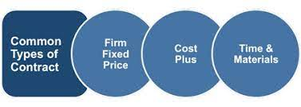
CH2
Sponsor and supplier agreements
A fixed price contract has a system solution, defined requirements, fixed schedule, and a high-risk factor because of the possibility of cost/schedule overruns.
A best estimate contract has specific amount of hours, defined skills, and minimum risk.
An hourly services contract or “body shop” has an undefined amount of hours, rate based on skill type, and no risk.
http://www.free-management-ebooks.com/faqpm/budget-08.htm

Slide 33

CH2
Sponsor and supplier agreements
The structure and content of agreements can vary markedly from project to project.
In particular, agreements with external sponsors and sub-contractors are usually very different from those with internal organizations.

Slide 34



CH2
Sponsor and supplier agreements
When the parties are from the same enterprise, the agreement is less formal but should exist to eliminate future misunderstandings.
Outsourcing a project can be a long and winding road, studded with sweet points and painful pitfalls.

Slide 35

CH2
Sponsor and supplier agreements
At any point, organizations can make irreparable errors, including inadequate due diligence up front, cost cutting at the expense of quality, and insufficient focus on knowledge transfer and training.
في أي وقت ، يمكن للمنظمات ارتكاب أخطاء لا يمكن إصلاحها ، بما في ذلك عدم كفاية العناية الواجبة مقدمًا ، وخفض التكاليف على حساب الجودة ، والتركيز غير الكافي على نقل المعرفة والتدريب.

Slide 36
CHThe Table shows 10 key questions to ask to improve an organization’s chances for outsourcing success.
Number | Ten Questions for Outsourcing Success
1 | Do we have a methodology for evaluating the business case for outsourcing? Identify your strategic reasons (improving business focus, gaining access to capabilities you do not have) and tactical reasons such as reducing operating costs and making capital funds available
2 | Have we identified the hidden costs? Hidden costs could include understanding the price of hardware, software, or the length of the project, losing key resources and scope creep
3 | Do we have other projects or events that will hinder the outsourcing project? Overlap might include duplicating efforts with other departments, unknown dependent activities, and working on tasks out of sequence
4 | Will our stakeholders and project sponsor be committed? If the stakeholders and/or sponsor are not committed, your project’s progress will be hindered and your chances of success will decrease
5 | What are our conditions of satisfaction (COS)? Define your COS: Ensure your expectations are met or exceeded and knowledge transfer will be completed successfully before your project starts. Make sure the outsourcer understands the expectations.

Slide 37
CH2
Number | Ten Questions for Outsourcing Success
6 | How will we manage our relationship with the outsourcer? At the start of the project, the outsourcer must develop a communication plan that has to be approved by you. The plan should include how stakeholders will be kept informed on a consistent and timely basis
7 | What are our responsibilities before the outsourcing project begins? A good outsourcer will have responsibilities—the facilities you are expected to provide, for example—outlined in the final agreement. Remember that the outsourcer’s performance depends on you following through on your responsibilities
8 | How do we meet our responsibilities once the outsourcing project begins? The degree of discipline your leadership exercises can determine project success. You must have discipline to meet schedule commitments, such as equipment and available people, to be successful
9 | Can we free up internal resources to work on the outsourcing project? Your resource considerations should include matching skills to what is needed, staffing ramp-up/roll-off, training time and learning curve, holidays, vacations, and part-time resources
10 | Have we selected an outsourcer that understands our business? You must spend the time and energy to select the best outsourcer. You will have to live with the decision during and after the project. Always get two or three bids and consult your legal representatives

Slide 38
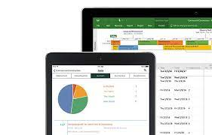
CH2
Microsoft Project 2010
Also, there are many different types of add-ins for Microsoft Project 2010 and Microsoft has a large growing library of project plan templates (e.g., for engineering, construction, new business, new product, and start-up business) that could be used for developing new project plans.

Slide 39
CH2
Microsoft Project 2010
Most companies that have a project management process or program using Microsoft Project 2010 as a planning and scheduling tool (MS has about a 90% market share), which is a key instrument that is referenced many times in this book.
The first time you access Microsoft Project 2010, the menu ribbon will be confusing because the user interface is not very intuitive!
In short, the user interface has many choices, many screens, and much functionality, which can be confusing at times (Biafore 2010). For example, there are multiple ways of adding a new task and resource.

Slide 40
CH2
Microsoft Project 2010
But overall, the new features and utilities added to Microsoft Project 2010 far outweigh its nonintuitive user interface.
Some of the new features include faster filtering, grouping and sorting, automatic word-wrapping of long task names, easier formatting, leveling overallocations, playing what-if games, and viewing scheduling issues to be fixed. The following are some time-saving features that you should consider setting up or using within the first tab—File:
At least 90% of the time you open Microsoft Project 2010, you want to open the last file worked on. You can automate the opening of your last file by choosing Options—Advanced and in the General section, check the box for “Open last file on startup.”

Slide 41
CH2
Microsoft Project 2010
The default for tasks is “Manually Scheduled” when most of the time you want it to be “Auto Scheduled.” You can change this default by choosing Options—Schedule and select “Auto Scheduled” from the pull-down menu under Scheduling Options.
Most of the time you probably save your project updates every 10 or 15 min but sometimes you get interrupted and forget to do this. You can protect yourself by choosing Option—Save and check the box for “Auto Save Every” by any time you want. 45 minutes would be a safe choice.

Slide 42
CH2
Microsoft Project 2010
Why start a project from scratch when Microsoft on-line has a large library of useful project plan templates you can use as a starting point?
This is truly one of the great treasures found within Microsoft Project 2010 and currently has more than 70 different types of project templates.
Some of these online plans include Project Management Institute Process, Engineering Project Plan, New Product Plan, and Proposal Development Plan. To select your online project template, choose New and under Office.com Templates choose Plans and proposals and then Business plans to see the growing library of useful templates

Slide 43
CH2
Microsoft Project 2010
To save valuable printing time and paper, which is important, you should get very familiar with Print—Page Setup tabs and the various options you can choose.
For example, in the Page tab you might want adjust the scaling to less than 100%, get familiar with the Margins, Header, Footer, and View tab options.
Finally, you might want to select None under the Legend tab to not print page legends at the bottom.
For very useful add-ins (Options—Add-Ins), besides Microsoft Visio and Excel see Table 2.10, which shows products with descriptions that you can use with Microsoft Project 2010 that can save you time and add value to your overall project

Slide 44

CH2
Challenges
The PM position can be very challenging because every project has its unique personality.
For example, if companies Path X and Path Y were developing an identical system using the same tools and had similar organizations, there would be differences in how they developed, implemented, and used the new system.
Also, it is possible that company Path X completed the project on time and within budget, whereas company Path Y went over schedule and eventually canceled the project.
In summary, good project management can make a difference

Slide 45



Thank You

