Slide 1



Basic Network Concepts
Lecture 2
HCIA-Security
Prepared by
Dr. Abdelrhman Ahmed

Slide 2
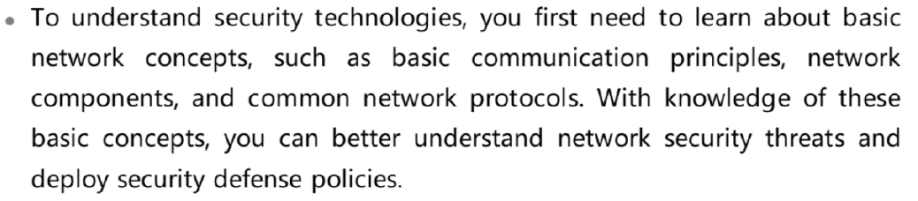
Chapter
02
Forward

Slide 3
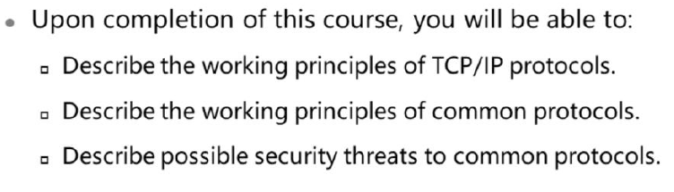
Chapter
Objectives
02

Slide 4
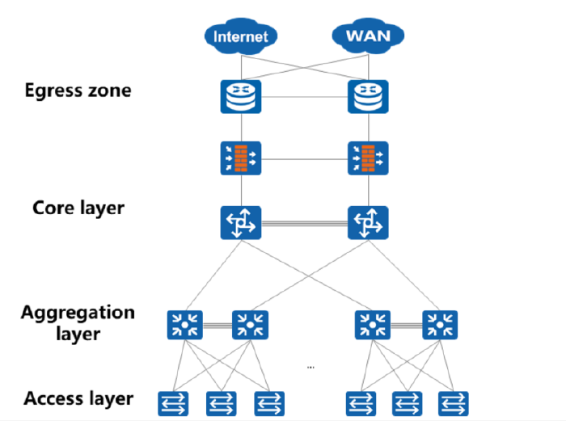
Chapter
Architecture of a Typical Campus Network
02

Slide 5
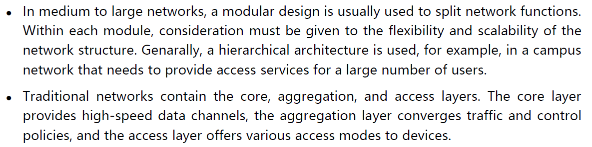
Chapter
Architecture of a Typical Campus Network
02

Slide 6

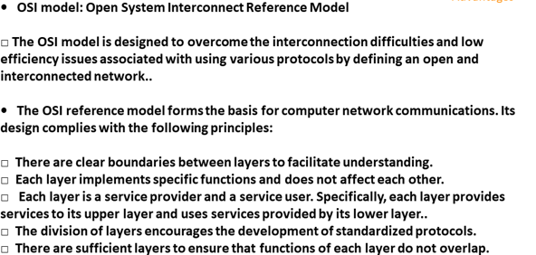
Chapter
OSI
02

Slide 7
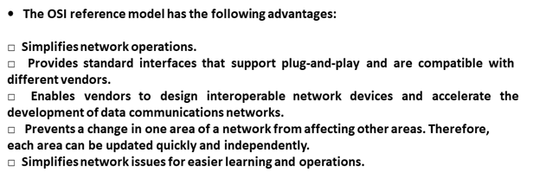
Chapter
02
OSI

Slide 8
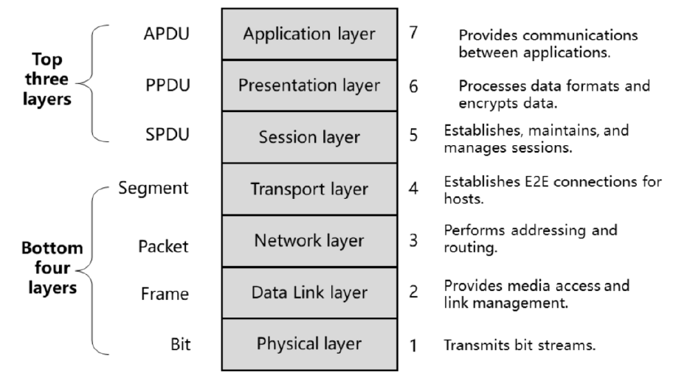
Chapter
02
OSI Model Architecture

Slide 9
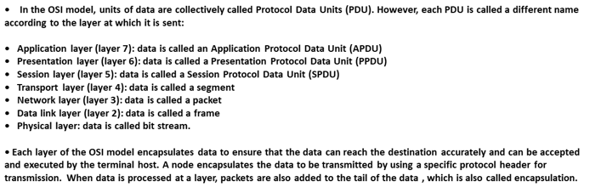
Chapter
OSI Model
02

Slide 10
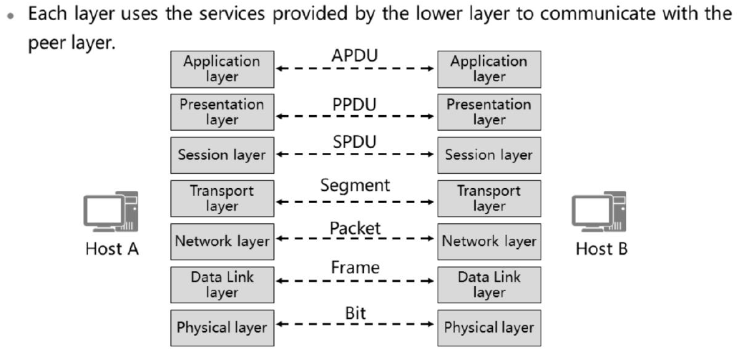
Chapter
Peer Layer Communications
02

Slide 11
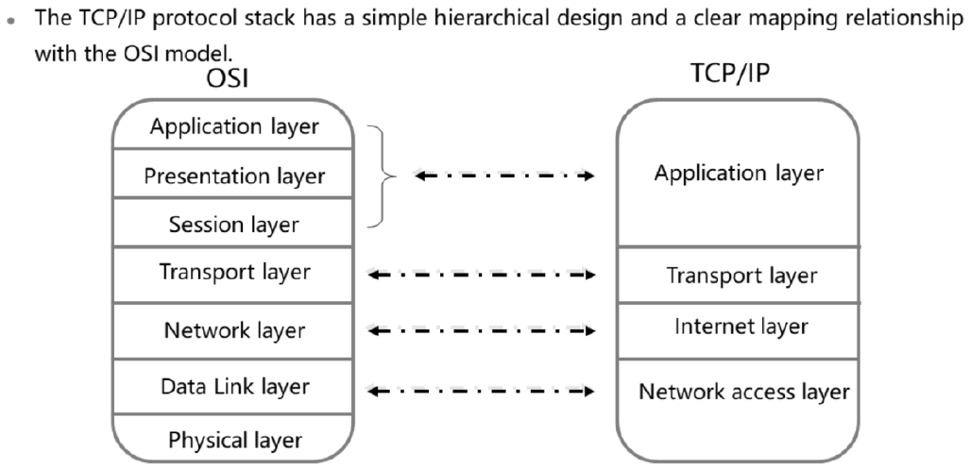
Chapter
Mapping Between TCP/IP & OSI
02

Slide 12
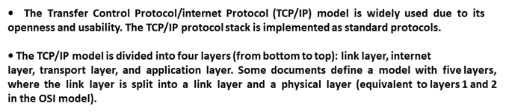
Chapter
02
Mapping Between TCP/IP & OSI

Slide 13
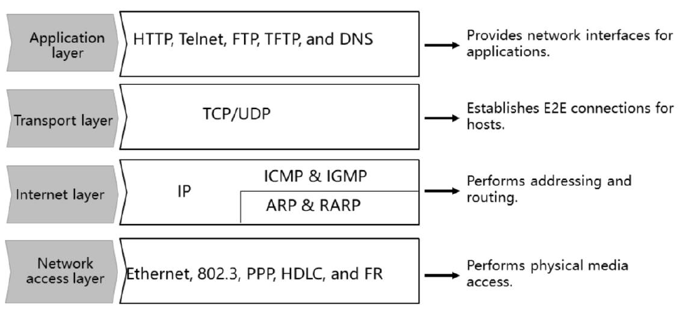
Chapter
02
Functions of Each Layer of the TCP/IP

Slide 14
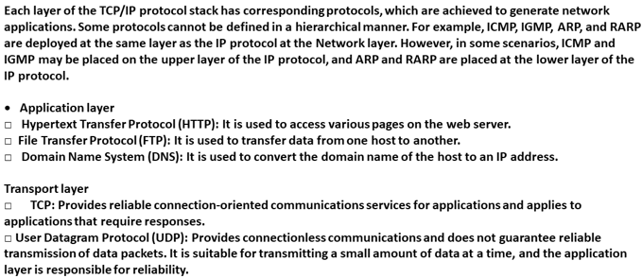
Chapter
02
Functions of Each Layer of the TCP/IP

Slide 15
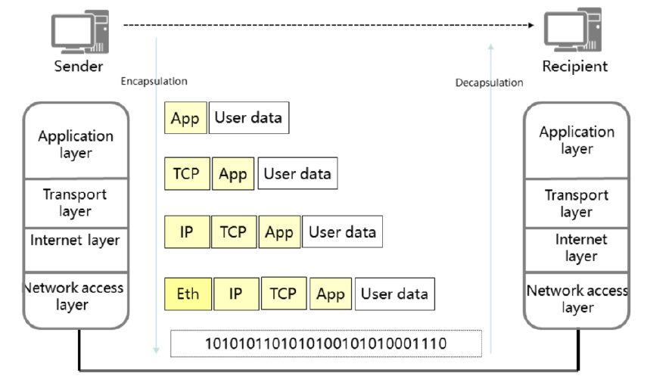
Chapter
02
Encapsulation & Decapsulation Processes of the TCP/IP

Slide 16
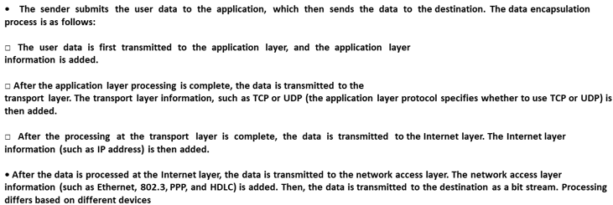
Chapter
02
Functions of Each Layer of the TCP/IP

Slide 17
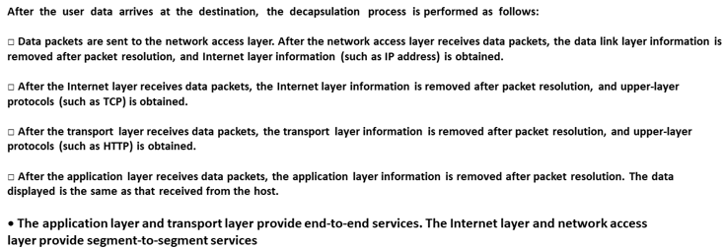
Chapter
02
Functions of Each Layer of the TCP/IP

Slide 18
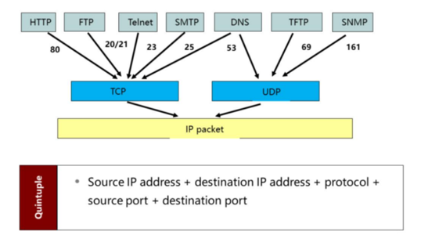
Chapter
02
Quituple

Slide 19
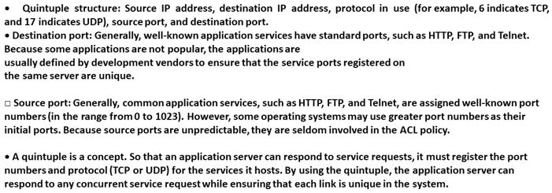
Chapter
02
Quintuple

Slide 20



Thank You

