Slide 1


Prepared by Dr. Weam Nasan Agha
REA625
Real Estate Valuation
Introduction Lecture

Slide 2



Real Estate Management
Introduction Lecture
REA625
Real Estate Valuation
Prepared by
Dr. Weam Nasan Agha

Slide 3

Contents
The Concept of Real Estate Valuation
Course Description
Course Objectives
Topics to be covered
Learning Outcomes
References

Slide 4
The Concept of Real Estate Valuation
Real Estate Valuation is defined as “a systematic process of determining the estimated value of a specific property at a given date, through the application of appropriate valuation methodologies, in accordance with the International Valuation Standards , taking into account the characteristics of the property, market conditions, and the purpose of the valuation”.
International Valuation Standards:
Royal Institution of Chartered Surveyors (RICS, Red Book 1974)
Royal Institution of Chartered Surveyors (RICS),1868
European Valuation Standards (EVS, Blue Book,1977)
TEGoVA (The European Group of Valuers’ Associations)
International Valuation Standards (IVS,1985)
International Valuation Standards Council (IVSC),1981

Slide 5
The Concept of Real Estate Valuation
Historical Period | Key Developments in the Concept of Real Estate Valuation
Ancient Civilisations (c. 3000–1000 BC) | The emergence of valuation in its primitive form through land measurement, registration, and tax assessment based on yield or revenue, as practiced in ancient Egypt and Mesopotamia, without a formal concept of monetary market value.
Hellenistic Period (2nd century BC) | Continued use of systematic land surveys and administrative assessment of land as a fiscal and revenue-control instrument, with more detailed documentation of land tenure and income.
Medieval Period (11th century AD) | Systematic recording of land values and obligations at the national level, as exemplified by the Domesday Book, marking early attempts to quantify land value in monetary terms.
17th Century | Expansion of valuation practices to include estimation of land value for purposes of sale, financing, and state asset management, beyond purely tax-based assessment.
19th Century | Development of economic theories underpinning land and property value, particularly rent, location, and land-use theories, alongside the emergence of large-scale, organized valuation exercises.
Early 20th Century | Formalization of real estate valuation within an analytical and academic framework, including the publication of early specialized texts on urban land values.
20th Century (1930s) | Establishment of real estate valuation as a distinct profession through the creation of professional institutions and the standardization of valuation methods.
Late 20th Century – Present | Adoption of international and professional valuation standards (IVS and RICS), consolidating real estate valuation as a globally recognized applied discipline based on market value and standardized methodologies.

Slide 6

Course Description
Real estate valuation is a critical component of the property industry, playing a central role in decision-making processes for investment, financing, taxation, development, and legal matters.
This course provides students with foundational knowledge and practical skills necessary to evaluate the market value of various types of real estate. By combining theoretical concepts with real-world applications, students will gain a comprehensive understanding of the valuation process and its implications in the dynamic real estate market.
Total Hours
3

Slide 7
Course Objectives
Understand the fundamental principles, methods, and practices of real estate valuation.
Apply standard valuation techniques to determine property values for residential, commercial, and industrial real estate.
Analyze the impact of market conditions, property characteristics, and legal considerations on property value.
Use valuation tools and approaches in professional contexts, including appraisal reports.
Gain awareness of ethical considerations and professional standards in valuation.

Slide 8
Topics to be covered
Introduction to Real Estate Valuation
Principles of Value and Market Dynamics
Valuation Approaches and Methods
Legal and Regulatory Framework
Valuation of Specific Property Types
Inspection and Data Collection
Valuation Report Writing and Ethics
Trends in Modern Valuation Practice

Slide 9
Learning Outcomes:
Explain the purpose and importance of real estate valuation in various economic and legal contexts.
Apply different valuation techniques to accurately assess real property value.
Analyze the impact of market conditions, location, and legal constraints on property values.
Conduct site inspections and collect relevant data for valuation.
Prepare professional valuation reports aligned with current industry standards.
Demonstrate ethical awareness and uphold integrity in valuation practices.

Slide 10
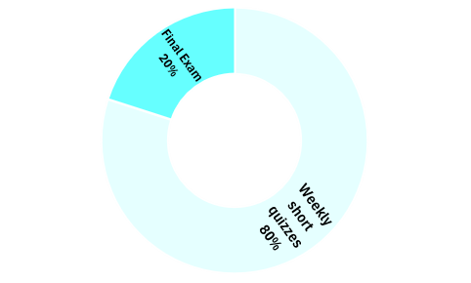
Final Exam 20%
Weekly short quizzes 80%
Total questions
8

Slide 11

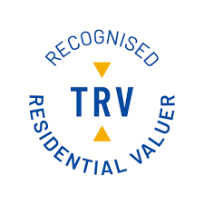

Credited Certificates for Real Estate Valuation

Slide 12
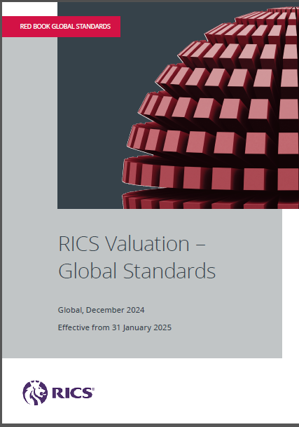
References
RICS (Royal Institution of Chartered Surveyors). (2024). RICS Valuation – Global Standards (Red Book). https://www.rics.org

Slide 13
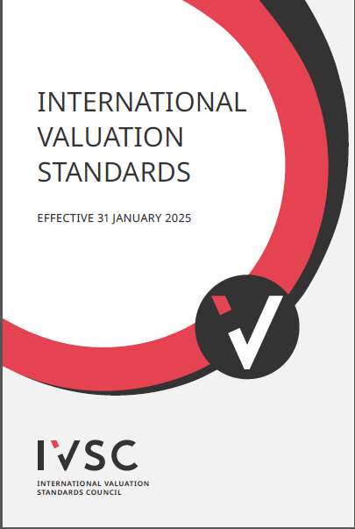
References
• International Valuation Standards Council (IVSC). (2024). International Valuation Standards 2024. https://www.ivsc.org

Slide 14
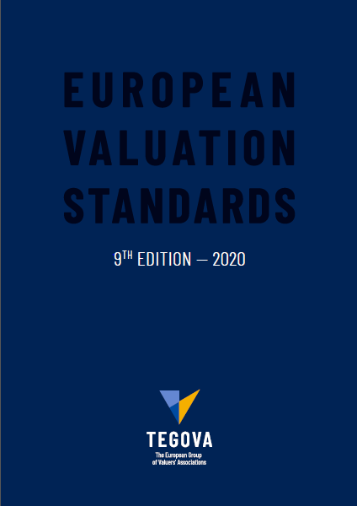
References
• European valuation standards.,2020, TEGOVA The European group of valuer's association.

Slide 15



Thank You

