Slide 1





Project Monitoring Course
Prepared & presented by:
Dr. Dhouha Melliti
2022-2023
Lecture 04: Monitoring:Methods
& Results

Slide 2





Lecture4
Session3: Monitoring:
Methods&Results(Part1)
“And what is the use of executing projects, since the project is in itself a sufficient enjoyment? " Charles Baudelaire
«

Slide 3



Lecture4
Session3: Monitoring:
Methods & Results(Part1)
Session outline
Programme theory
01
An overview of how to monitor
Theory of Change
What is the Theory of Change?
  When to use a Theory of change?
  How to develop a Theory of change?
02
03
Results Matrix
  The difference between the Theory of Change and a logical framework
  Results Monitoring Framework
Remote management, monitoring and third-party monitoring
Pulling it all together: Monitoring and evaluation plan
Monitoring and reporting on results
04

Slide 4

Lecture4
Session3: Monitoring:
Methods&Results(Part1)
An overview of how to monitor
A strong project design is the foundation for successful monitoring. The proposal development stage clearly articulates the desired results an intervention aims to achieve, how it achieves them and stipulates how progress towards these results will be measured

Slide 5

Lecture4
Session3: Monitoring:
Methods&Results(Part1)
Programme theory
The Programme theory is a key aspect of implementation design and explains how an intervention (project/programme, strategy and policy) is expected to contribute to a chain of results.
It is a representation of all the building blocks that are required to bring about a higher- level change or results.
It is usually formulated at the proposal development stage.
It can therefore be useful in providing a conceptual framework for monitoring, as well as for evaluation.

Slide 6

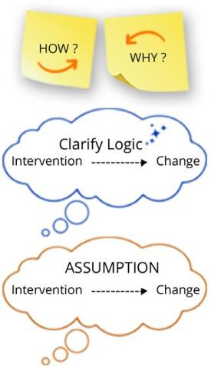
Lecture4
Session3: Monitoring:
Methods & Results(Part1)
    What is the Theory of Change?
Theory of Change
is a comprehensive description and explanation of how and why a desired change is expected to happen in a particular context.
Specifically, it focuses on mapping out what an intervention or change initiative does (its activities) and how these lead to achievement of the objective through results (outputs, outcomes, objectives).
In this way, a ToC articulates hypotheses about how change happens by explaining the connection between an intervention and its effect. It does so by surfacing the logic and rationale for an intervention and articulating the assumptions inherent in the approach (multiple pathways).

Slide 7

Lecture4
Session3: Monitoring:
Methods & Results(Part1)
    When to use a Theory of Change?
The use of a ToC is more and more common and developed for all types of interventions.
It can be applied to design, monitor, as well as evaluate different types of interventions and is best used to measure the complexity of transformation and change.
A ToC is a process-oriented approach that can be used to analyse the interrelations and/or interactions in complex

Slide 8

Lecture4
Session3: Monitoring:
Methods & Results(Part1)
            How to develop a Theory of Change?
Multiple pathways of change
Graphic depiction
Participatory approach

Slide 9

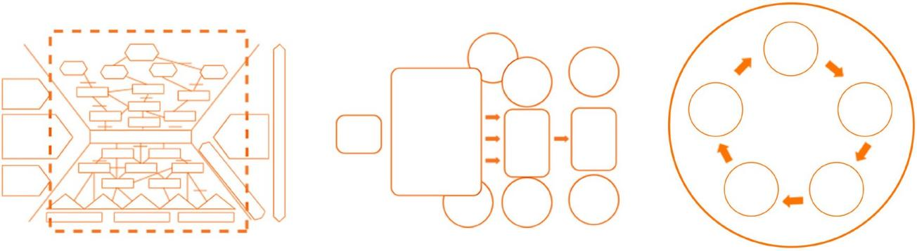
Lecture4
Session3: Monitoring:
Methods&Results(Part1)
The graphic depiction of a ToC
can help with mapping out multiple causal pathways to identify the most feasible one for a given intervention. Another advantage of graphically depicting a ToC is that it makes possible causal links more understandable and immediately visible.
It enables comparisons between different pathways and can help identify implicit assumptions.

Slide 10

Lecture4
Session3: Monitoring:
Methods & Results(Part1)
Participatory approach
The process of developing a ToC should be participatory and collaborative, and include key stakeholders, as well as the beneficiaries, or people that the Organization seeks to assist, and/or affected populations, who can offer their different perspectives to define what an expected change within a specific thematic field may look like.
Their participation can also help identify underlying assumptions that are inherent to explaining why a particular change is expected to occur.

Slide 11
Lecture4
Session3: Monitoring:
Methods & Results(Part1)
Multiple pathways of change
A ToC acknowledges that change is dynamic and complex and can show different possible pathways that might lead to change.
The process of developing a ToC helps discover these multiple pathways of change.
The process of developing a ToC can help identify whether, and at which stage or level, assumptions, logical jumps or missing key steps in the change process are taking place.

Slide 12
Lecture4
Session3: Monitoring:
Methods & Results(Part1)
With each result articulated at the outcome level, an if-then-because statement is articulated, and the assumptions surfaced at the objective-level ToC.
Developing a ToC is a good way to raise further questions such as the following:
      Why is a particular change expected to happen?
      What evidence is available to support that expected change will/has occur/red?
      What logical jumps are made?
      What assumptions are made?

Slide 13
Lecture4
Session3: Monitoring:
Methods & Results(Part1)
    How to develop a Theory of Change using the if-then-because formula?
  While ToCs can be illustrated in different ways, the logic of the chain of results, or causal pathway, can be tested using if-then-because statements. In other words, it helps reveal assumptions that are “tested” through actions/activities, while assumptions play a central role in developing the ToC.
  A common challenge when designing an intervention are logical leaps and gaps. There may be a disconnect between strong problem analysis and seemingly unrelated activities, with weak links and/or assumptions between objectives, outcomes, outputs and activities. Through surfacing underlying assumptions, the ToC may provide a bridge between analysis and programming.

Slide 14

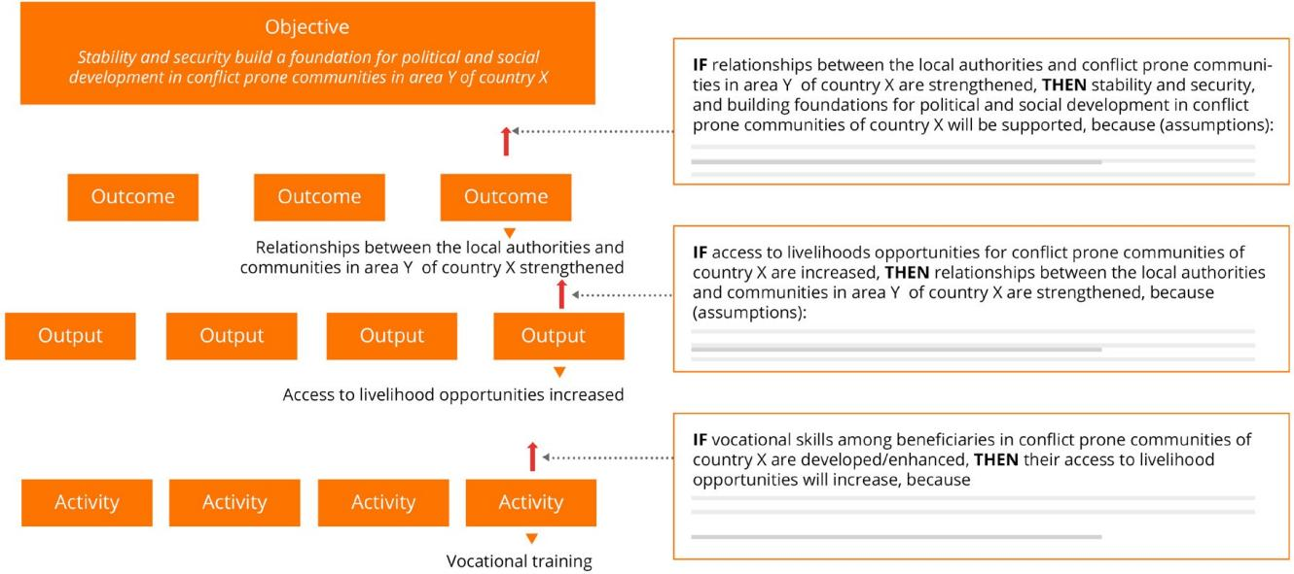
Lecture4
Session3: Monitoring:
Methods & Results(Part1)
The process of surfacing such underlying assumptions can help identify where logical jumps are made or helps identify missing key steps in the change process.

Slide 15

Lecture4
Session3: Monitoring:
Methods & Results(Part1)
Objective-level Theory of Change
If relationships between the local authorities and conflict-prone communities in area Y of country X are strengthened,
then stability and security, and building foundations for political and social development in conflict-prone communities of country X will be supported, because:
The relationship between the local authorities and conflict-prone communities is weak;
The lack of attention from the local authorities towards the needs of conflict-prone communities has affected the relationship between them;
The weakened relationship between the local authorities and the conflict-prone communities may be one of the causes for conflict;
The lack of attention from the local authorities to the needs of conflict-prone communities is one of the causes of instability and poor security, which impedes sociopolitical development in the area.

Slide 16

Lecture4
Session3: Monitoring:
Methods&Results(Part1)
Outcome-level Theory of Change
If access to livelihood opportunities for conflict-prone communities of country X is increased, then relationships between the local authorities and communities in area Y of country X are strengthened, because People consider the government responsive for meeting their needs; Targeted areas lack quality services from government; Target areas have historically been neglected; If people are grateful and appreciate the local, then they are more likely to perceive the authorities’ service delivery more positively, which may lead to improving their mutual relationship; Others.
🢂 Multiple pathways: With each result articulated at the output level, an if-then-because statement is articulated, and the assumptions surfaced at the outcome-level ToC.
Output-level Theory of Change
If vocational skills among beneficiaries in conflict-prone communities of country X are developed/enhanced, then their access to livelihood opportunities will increase, because Improved vocational skills may increase the chance for beneficiaries to find a job; Capacities are relevant to the opportunities in the target areas; Opportunities exist in the area; Local government and line departments continue to provide support; Local government and line departments take ownership of the activity and provide follow-up support to beneficiaries; Others.
🢂 Multiple pathways: With each result articulated at the activity level, an if-then-because statement is articulated, and the assumptions surfaced at the output-level ToC.

Slide 17
Lecture4
Session3: Monitoring:
Methods & Results(Part1)
    How to review a Theory of Change that applies the if-then-because formula
    When reviewing a ToC, one may want to focus on the links a ToC is trying to make. The following checklist consists of five simple questions that may help with the review process:
Are both the action (X) and the result (Y) clearly formulated?
Is the result realistic and achievable given the scale of action, resources and time frame?
Do the assumptions explain why the approach is suitable?
Are the relevant preconditions that are necessary for success included in the assumptions?
Does the ToC make sense if it is reversed?

Slide 18
Lecture4
Session3: Monitoring:
Methods & Results(Part1)
How to monitor an if-then-because Theory of Change?
Monitoring the IF statements: Include questions into the data collection tools that directly relate to the if statement.
Example of output-level ToC:
If access to livelihood opportunities for conflict-prone communities of country X are increased
        Was there an increase of knowledge and vocational skills? (Assess whether there was an increase in knowledge through the training pre/post-test; beneficiary feedback);
        Are beneficiaries using attained knowledge and vocational skills? If yes, how so; if no, why not (draft lesson learned)?
Monitoring the THEN statements: Include questions into your data collection tools that directly relate to the then statement.
Example of output-level ToC:
        Then their access to livelihood opportunities will increase
        Have livelihood opportunities for target beneficiaries increased?
        If yes, was it due to the intervention; if no, why not (draft a lesson learned)?

Slide 19
Lecture4
Session3: Monitoring:
Methods & Results(Part1)
Monitoring the BECAUSE statements: Include questions into your data collection tools that directly relate to the because statement.
Examples of output-level ToC:
        Because improved vocational skills may increase the chance for beneficiaries to find a job
        Were beneficiaries unemployed prior to training?
        Did they find a (better) job due to increased skills (beneficiary feedback)?
        Because capacities are relevant to the opportunities in the target areas
        Ask beneficiaries if this is accurate.
        Opportunities exist in the area

Slide 20
Lecture4
Session3: Monitoring:
Methods & Results(Part1)
  2. Results Matrix
  As previously mentioned, also belonging to programme theory is the logical framework, which helps identify an intervention’s operational design and is a foundation for M&E.
  It is an overview of an intervention’s intended approach to attain results, based on the situation and problem analysis undertaken during the conceptualization stage.
  Specifically, it uses a matrix to summarize the logical sequence in which an intervention aims to achieve desired results, the activities required to attain these results and the indicators and sources of verification that help measure progress towards achieving results.

Slide 21
Lecture4
Session3: Monitoring:
Methods & Results(Part1)
    The difference between the Theory of Change and a logical framework
Theory of Change | Logical framework
Based on the underlying network of processes driving change. Explanatory: Articulates and explains the “what”, “how” and “why” of the intended change process. “If we do X, then Y will change because…”. Unlimited pathways of change: Articulates assumptions and causal effects, and also drivers and all immediate states/steps in the critical pathway of change. Critical thinking, room for complexity and deep questioning. Shows all the different possible pathways that might lead to change, even those pathways that are not directly related to the intervention (a network). Articulates assumptions underlying the strategic thinking of a strategy, programme or project. | Generally based on the practical achievements that the project is expected to deliver. Descriptive: Largely shows what is thought will happen/will be achieved. Three result levels (outputs, outcomes, objective). Mostly looks at assumptions that have to hold for the next-level result to be realized. Linear representation of change simplifies reality. Describes how logically programme activities will lead to the immediate outputs, and how these will lead to the outcomes and goal (linear, vertical). Focuses on assumptions about external conditions.

Slide 22
Lecture4
Session3: Monitoring:
Methods & Results(Part1)
  After having set up achievable and well-defined results and having identified related assumptions, the next step in developing a Results Matrix is to select indicators to monitor progress towards achieving those results.
  Indicators consist of information that signals change.
  Indicators can be defined as “the quantitative or qualitative factors or variables to measure achievement or to reflect expected changes”.
  Indicators can either be qualitative, quantitative, binary or proxy indicators.
  Indicators help indicate change towards an intended result and demonstrate whether an intervention is on or off track.

Slide 23
Lecture4
Session3: Monitoring:
Methods & Results(Part1)
Levels of intervention control
Result level | Indicator description | Level of intervention control
Objective | Measures progress made in achieving the specific objective. Helps confirm changes to the following: – Political, economic and/or social conditions of beneficiaries. | Intervention can contribute to
Outcome | Measures progress made in achieving the specific outcome. Helps confirm intended change in the following: Institutional performance; Individual and/or group behaviour and attitudes; Immediate political, economic and/or social positions of beneficiaries. | Intervention can influence
Output | Measures progress made in achieving the specific output. Helps confirm the intended change in the following: Skills and/or abilities of beneficiaries; Availability of new products or services. | Intervention has direct control over

Slide 24
Lecture4
Session3: Monitoring:
Methods&Results(Part1)
Components of an indicator
What is to be measured | Unit of measurement | Target population | Direction of change
Qualitative | Quantitative
Used to measure things that are subjective in nature, such as experience, opinions, perception and the quality and mastery of a new skills. Can be expressed through changes in perception, experience, attitudes, awareness and others. Can also be numerical. Examples include the following: Improved public perception of parliamentary effectiveness; Percentage of households who state that they have changed their hygiene practices as a result of the training/ information received. | Used to measure things inherently objective and quantifiable, such as how many, how often, how much or how long. Can be expressed in absolute figure, percentage, rate or ratio. Examples include the following: The number of persons with access to each water point. Percentage of surveyed citizens who say that they have access to a court system to resolve disputes.

Slide 25
Lecture4
Session3: Monitoring:
Methods & Results(Part1)
It is also important to keep in mind the specific, measurable, achievable, relevant and time-bound (SMART)
criteria used to develop indicators:
Specific:
Does the indicator capture the essence of the
desired result?
Measurable
Are changes verifiable? Is the indicator a
reliable and clear measurement of the results?
Achievable:
Will the indicator require no more than a reasonable amount
of time, effort, and money
Relevant:
Is
the indicator plausibly associated with the
result?
Time-bound
Does the indicator reflect a time frame for
measurement?

Slide 26
Lecture4
Session3: Monitoring:
Methods & Results(Part1)
Achieving outcomes
It is important to think about how to achieve outcomes within the time frame of the intervention or with an understanding of how to measure their achievement after the intervention concludes already at the development stage of an intervention. There can be short- or medium-term outcomes, depending also on the nature and duration of the project.
How to formulate an outcome to ensure that indicators can be measured within the implementation period or with mechanisms in place for measurement shortly after its completion will greatly depend on the following:
          Type and complexity of intervention;
          Type of results the intervention aims to achieve;
          Duration of the intervention;
          Resources available for verification.

Slide 27
Lecture4
Session3: Monitoring:
Methods & Results(Part1)
Another useful approach to drafting indicators is to apply QQT targeting, which ensures that each indicator is measurable in terms of Quantity, Quality and Time (QQT).
An indicator can define the how many, how often, how much, how long or a mixture of it as illustrated in the example below:

Slide 28
Lecture4
Session3: Monitoring:
Methods & Results(Part1)
Step 1: Basic indicator | % of participants trained that report using the information gained
Step 2: Add quality (What kind of change) | % of border management officials of country X trained that report using the tools and knowledge provided in their work
Step 3: Add quantity (How much) | % of border management officials of country X trained that report using the tools and knowledge provided in their work on a regular basis
Step 4: Add time (By when) | % of border management officials of country X trained that report using the tools and knowledge provided in their work on a regular basis six months after the training

Slide 29
Lecture4
Session3: Monitoring:
Methods & Results(Part1)
When selecting a data source, the following should be considered:
Will there be access to the information?
Where will the information be attained from?
Can the data source provide quality data?
How will the information be attained given limited resources?
How costly and feasible is collecting the information?

Slide 30
Lecture4
Session3: Monitoring:
Methods & Results(Part1)
Key considerations in setting indicator baselines
Depending on the context and nature of an intervention, baseline data may not always be available during its development phase. In such cases, it may be appropriate to propose collecting baseline data (and subsequently the targets) once the intervention begins, in agreement with other key counterparts and donors.
In some cases, a baseline study or assessment may be required to identify the appropriate baseline data, if a budget is available for it, as it may have costly implications. For instance, in cases where changes to the general population are of interest, a census can be used as a baseline; however, this may not always be available, and it would be costly to conduct one related to the intervention

Slide 31
Lecture4
Session3: Monitoring:
Methods & Results(Part1)
  In other scenarios, it may not be possible to conduct a needed baseline study due to security restrictions or other reasons outside of control.
  In such cases, data collected during the first monitoring visit, when a specific indicator is measured for the first time, can be considered a baseline for that indicator.
  Particularly in multiphase programs, baseline data may be available through other previously implemented interventions.
  However, in all cases, it is critical to be consistent in the way data is presented within the intervention, at the development phase and throughout reporting, as well as to always have a solid understanding and justification for why baseline data is presented in a particular way.

Slide 32
Lecture4
Session3: Monitoring:
Methods & Results(Part1)
    Results Monitoring Framework
Once the Results Matrix is developed and finalized, it can be converted into a monitoring tool that can be used during the implementation of an intervention: the Results Monitoring Framework (RMF).
The RMF is developed at the start of the implementation, after a project has been funded and activated.
The RMF is the primary tool to monitor the results of any intervention.
  It enables all members of the implementing team, as well as stakeholders, to track the progress being made towards achieving intended results.

Slide 33
Lecture4
Session3: Monitoring:
Methods & Results(Part1)
Results Matrix and Results Monitoring Framework comparison
Results Matrix
Results | Indicators | Data source and collection method | Baseline | Target | Assumptions
Objective
Outcome
Output
Results Monitoring Framework
Results | Indicators | Data source and collection method | Data analysis | Frequency | Responsible person | Baseline | Target | Achieved | Progress
Objective
Outcome
Output

Slide 34
Lecture4
Session3: Monitoring:
Methods & Results(Part1)
Data analysis
        This column is to be filled with a description of how the data collected will be analysed.
        The main categories of analysis are qualitative and quantitative.
        Some qualitative and/or higher-level indicators may require a more specialized type of analysis or more resource- and time-intensive data collection than the immediate intervention team is able to provide.
        In such cases, a good practice is to incorporate this data analysis into scheduled evaluations, where expertise and resources external to the team can be recruited.

Slide 35
Lecture4
Session3: Monitoring:
Methods & Results(Part1)
Frequency
        Refers to how often data will be collected (such as weekly, monthly, annually, quarterly, one-off and end of intervention). Frequency should correspond to the activities and indicators.
        For example, if one training is to be held, and the indicator being measured is “percentage of trainees, by sex, who pass the post-training test”, then the measurement would be taken once (one-off) following the completion of the training and the test.
        If an ongoing activity is being monitored, for example “transport assistance to refugees during a protracted crisis”, then it would make sense to monitor the number of persons being transported on a regular basis (such as weekly or even daily).

Slide 36
Lecture4
Session3: Monitoring:
Methods & Results(Part1)
Responsible person
  This column indicates the name of the person from the intervention team who will be responsible for organizing data collection, data analysis and data storage.

Slide 37
Lecture4
Session3: Monitoring:
Methods & Results(Part1)
Achieved
        This column is to be filled with information, periodically or as it becomes available, which indicates the progress being made towards reaching the target.
        For example, if the target is to train 100 humanitarian workers on preventing human trafficking in emergencies, and 75 workers have been trained, enter 75 [out of a target of 100].
        When required, it is good practice to break down this column into several periods (such as by month, quarter or year) to enable the tracking of progress over time.
        Ideally, this should align with the intervention’s reporting periods to simplify both tracking and reporting.

Slide 38
Lecture4
Session3: Monitoring:
Methods&Results(Part1)
Progress
        This column is to be filled with information, periodically or as it becomes available, which analyses the extent of the progress towards reaching the target.
        If appropriate, this can be expressed as a percentage (such as if 75 out of 100 humanitarian workers have been trained, the progress towards the target is 75%).
        In some cases, a narrative description of progress towards the target may be more appropriate, particularly for qualitative indicators.

Slide 39
Lecture4
Session3: Monitoring:
Methods & Results(Part1)
    For example, if the target indicator is “presence of legislation that reflects international best practice”, the confirmation of the existence of the legislation only partially reflects international best practice, then a brief description of how it reflects best practices and what gaps still remain would be most appropriate.
    Note that the progress column should not be used for describing the activities carried out. It should only describe information related to the achievement of results, specifically related to the measurement of the specific indicator.

Slide 40

Lecture4

