Slide 2
Contents
Combinational circuits
Decoder
Encoder
Multiplexer

Slide 3
Decoder Definition
A decoder is a combinational circuit that converts binary information from n input lines to a maximum of 2^{n} unique output lines.
A decoder generally decodes a binary value into a non-binary one by setting exactly one of its n outputs to logic “1”.
When a decoder receives n inputs, it activates one and only one of its 2^{n} outputs based on that input with all other outputs deactivated.

Slide 4
Decoding
Known as n-to-m-line decoder, or simply n:m or nxm or n-to-m line decoder (m ≤ 2^{n}).
  It generate 2^{n} (or fewer) minterms for the n input variables
  When n = 2, 4 outputs can be decoded.
  When n = 3, 8 outputs can be decoded.
n-to-2^{n}
Decoder
0
1
2
n inputs
3
.
.
.
2^{n} outputs
2^{n}-1

Slide 5
Decoders
Decoders are important combinational circuits.
Among other things, they are useful in selecting a memory location according a binary value placed on the address lines of a memory bus.
Address decoders with n inputs can select any of 2^{n} locations.
0
1
2
3.
.
.
2^{n}
Decoder
n X 2^{n}
Memory
(101…1)
.
.
.

Slide 6
Decoders
1-to-2-Line Decoder
A
D
D
0
1
D
0
A
0
1
0
1
0
1
A
D
A
1
(a)
(b)

Slide 7
2-to-4-line Decoder
A
0
2-to-4-Line Decoder
Note that the 2-to-4-line
made up of 2 1-to-2-line decoders and 4 AND gates.
A
1
D
0
5
A
1
A
0
D
1
5
A
1
A
0
A
1
A
0
D
0
D
1
D
2
D
3
0
0
1
0
0
0
0
1
0
1
0
0
D
2
5
A
1
A
0
1
0
0
0
1
0
1
1
0
0
0
1
D
3
5
A
1
A
0
(a)
(b)

Slide 8
3-to-8-line Decoder
Truth table for a 3X8 decoder
Output |  |  |  |  |  |  |  | Input
D₇ | D₆ | D₅ | D₄ | D₃ | D₂ | D₁ | D₀ | z | y | x
0 | 0 | 0 | 0 | 0 | 0 | 0 | 1 | 0 | 0 | 0
0 | 0 | 0 | 0 | 0 | 0 | 1 | 0 | 1 | 0 | 0
0 | 0 | 0 | 0 | 0 | 1 | 0 | 0 | 0 | 1 | 0
0 | 0 | 0 | 0 | 1 | 0 | 0 | 0 | 1 | 1 | 0
0 | 0 | 0 | 1 | 0 | 0 | 0 | 0 | 0 | 0 | 1
0 | 0 | 1 | 0 | 0 | 0 | 0 | 0 | 1 | 0 | 1
0 | 1 | 0 | 0 | 0 | 0 | 0 | 0 | 0 | 1 | 1
1 | 0 | 0 | 0 | 0 | 0 | 0 | 0 | 1 | 1 | 1

Slide 9
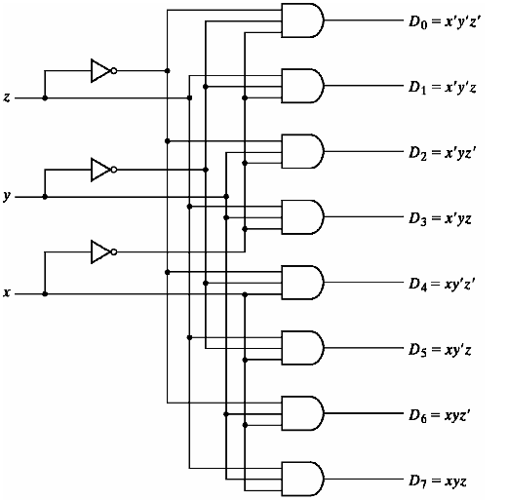
3-to-8-line Decoder

Slide 10
Decoder with Enable input
Decoders may include one or more enable inputs to control the circuit operation.
The decoder is enabled (or activated) if E=1
3-to-8
decoder
F₀
F₁
x
F₂
F₃
y
F₄
z
F₅
F₆
F₇
Enable input

Slide 11
3x8 decoder with enable (E)
F0 = x'y'z'
F1 = x'y'z
F2 = x'yz'
F3 = x'yz
F4 = xy'z'
F5 = xy'z
F₀
F6 = xyz'
3-to-8
decoder
F₁
x
F₂
F7 = xyz
F₃
Enabel (E)
y
F₄
z
F₅
x
y
z
F₆
F₇
Enable input

Slide 12
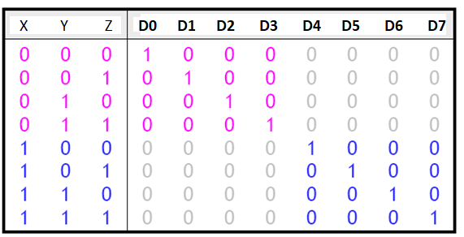
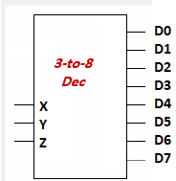
Decoder Expansion
Another way to design a decoder is to break it into smaller pieces.
Notice some patterns in the table below:
  When X = 0, outputs D0-D3 are generated as in a 2-to-4 decoder.
  When X = 1, outputs D4-D7 are generated as in a 2-to-4 decoder.

Slide 13
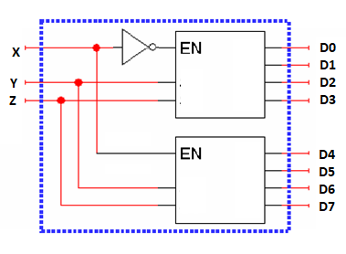
Decoder Expansion
Here’s a 3-to-8 decoder built from two smaller 2-to-4 decoders.
When X=0, the top 2-to-4 decoder is enabled and generates a 1 for one of outputs D0, D1, D2 or D3.
When X=1, the bottom 2-to-4 decoder is enabled instead, and a 1 will be output for either D4, D5, D6 or D7.
Notes:
In this case, we must use the enable to determine which decoders will used according to it value (0, 1)

Slide 14
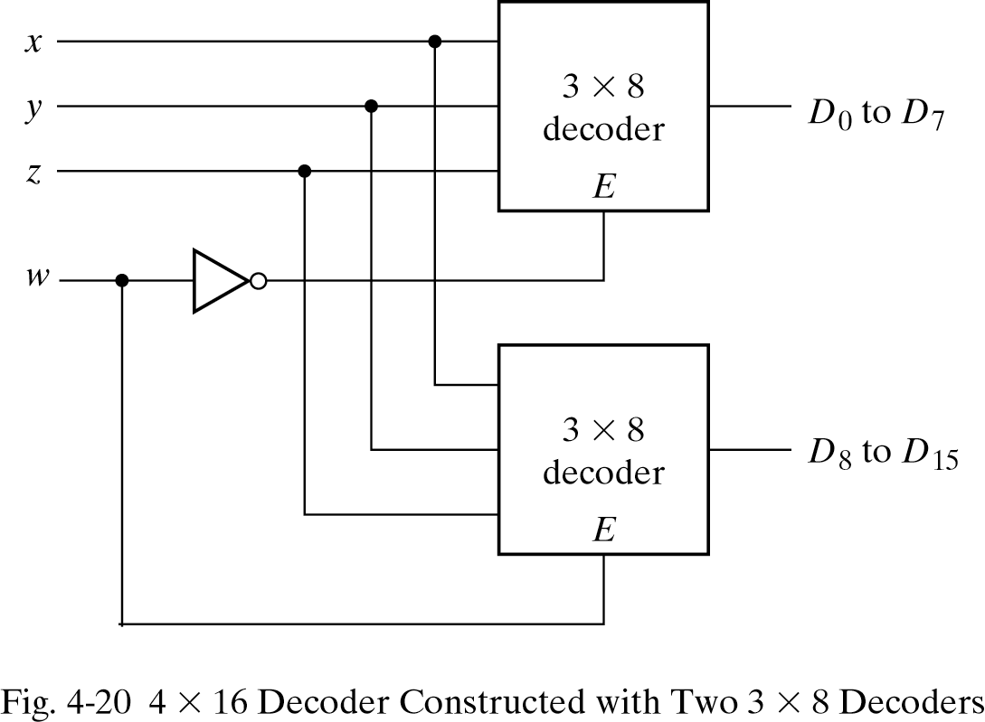
4-to-16-line Decoder

Slide 15
Combinational Logic Implementation
Since any Boolean function can be expressed in sum-of-minterms form, a decoder that generates the minterms of the function, together with an external OR gate that forms their logical sum, provides a hardware implementation of the function.
In this way, any combinational circuit with n inputs and m outputs can be implemented with an n-to-2n-line decoder and m OR gates.

Slide 16
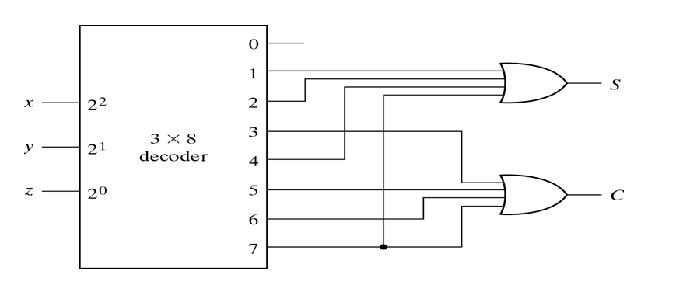
Combinational Logic Implementation
From truth table of full adder, we have functions
S(x, y, z) = Σ(1, 2, 4, 7) and C(x, y, z) = Σ(3, 5, 6, 7)

Slide 17
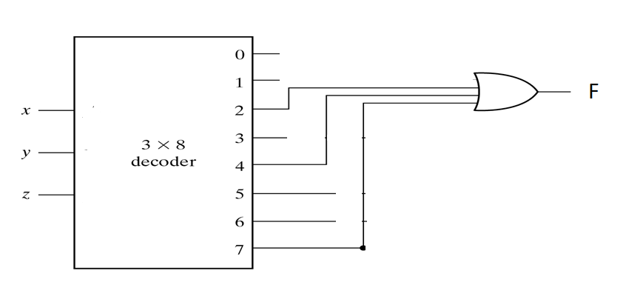
Exercise:
Implement the following function using 3 to 8 decoders and or gates
F = ∑ (2,4,7)
F(X,Y,Z) = X’.Y.Z’ + X.Y’.C’ + X.Y.Z

Slide 18
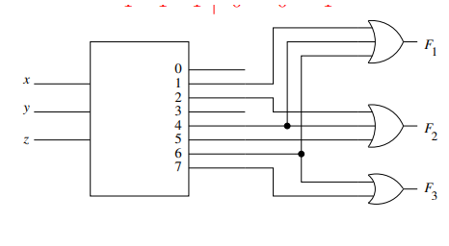
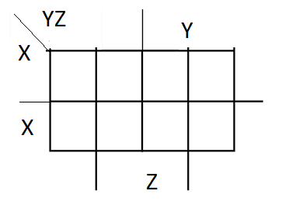
Exercise:
What is the functions implemented by the decoders in the following fig:
Solution:
F1 = x.‘y‘.z + x.z’
F1=∑ (1,4,6)
F2 = x.‘y.z’ + x.y’
F2=∑ (2,4,5)
F3 = x.y
= ∑ (6,7)

Slide 19
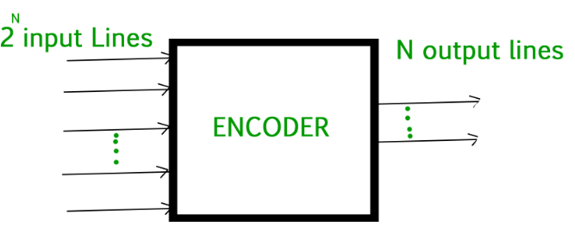
Encoding
Encoding is the opposite of decoding –
It has a maximum of 2^{n} input lines and n output lines;
Circuits that perform encoding are called encoders

Slide 20
Encoding
An encoder has 2^{n} (or fewer) input lines and n output lines which generate the binary code corresponding to the input values
Typically, an encoder converts a code containing exactly one bit that is 1 to a binary code corresponding to the position in which the 1 appears.

Slide 21
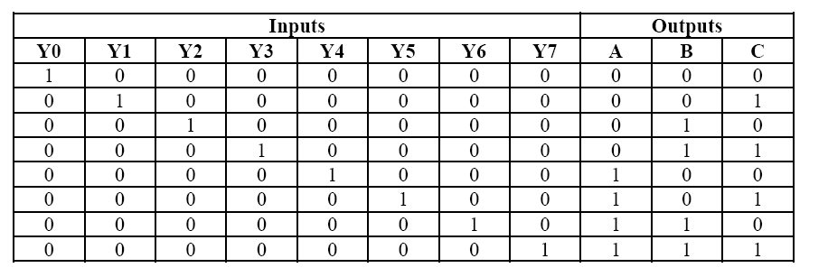
Encoders
Truth table for a 8X3 encoder

Slide 22
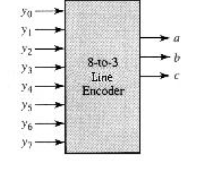
Encoders
Block diagram for a 8X3 encoder

Slide 23
Multiplexer
A multiplexer or data selector (abbreviated MUX) consists of a group of data inputs and a group of control inputs. The control inputs are used to select exactly one data input to be outputted.
N X 1
Mux
Data Input Lines
Y
…
Control; Inputs (Selector)

Slide 24
Multiplexer
A MUX with n control inputs can select from a maximum of 2^{n} data inputs.
  When n = 2, 4 data inputs can be selected.
  When n = 3, 8 data inputs can be selected.
An 8X1 (n = 3) MUX uses three control inputs to select exactly one of eight data inputs to be outputted.

Slide 25
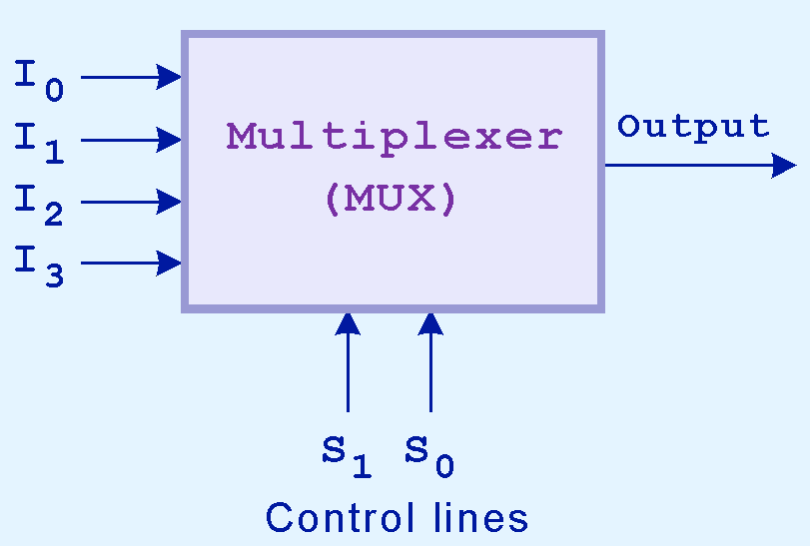
Block Diagram for Multiplexer
It selects a single output from several inputs.
The particular input chosen for output is determined by the value of the multiplexer’s control lines.
To be able to select among n inputs, log₂n control lines are needed.

Slide 26
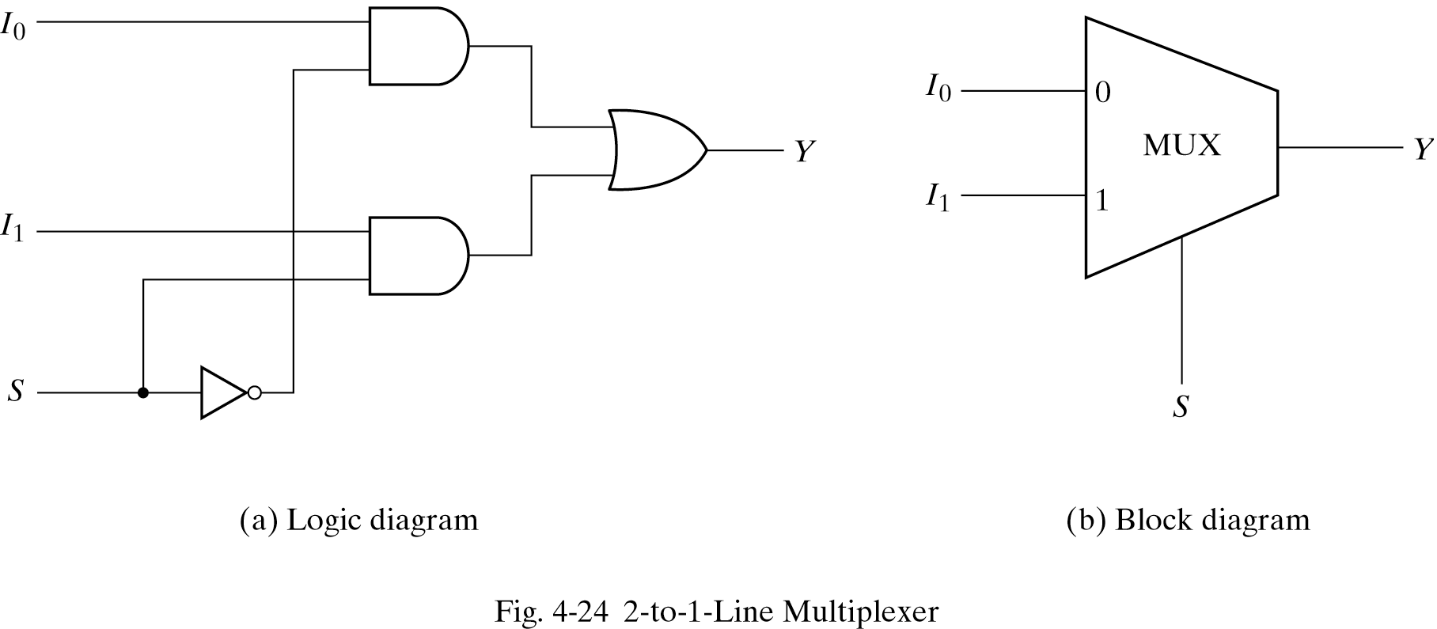
2-to-1-line Multiplexer

Slide 27
Multiplexer
I₀
MUX
I₀
I₁
MUX
I₁
I₂
Y=I₁
I₂
Y=I₀
I₃
I₃
0
1
0
0
I₀
MUX
I₀
I₁
MUX
I₁
I₂
Y=I₃
I₂
Y= I₂
I₃
I₃
1
1
1
0

Slide 28
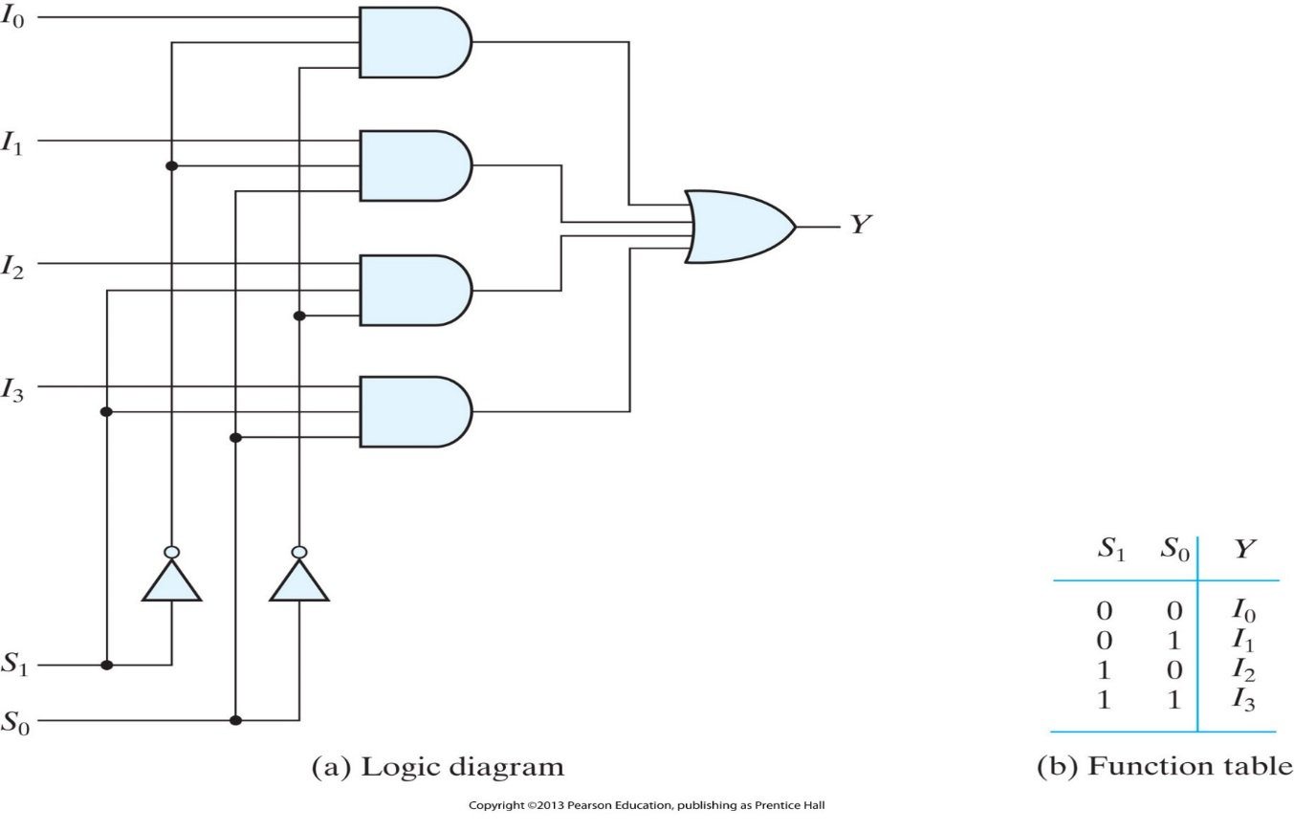
4-to-1-line Multiplexer
Design 4-to1 MUX:
  There are four data inputs → two selection inputs S₁,S₀.
  The input selected to be passed to the output depends on the minterm of the input.
 | S₁ | S₀ | Y
m₀ | 0 | 0 | I₀
m₁ | 0 | 1 | I₁
m₂ | 1 | 0 | I₂
m₃ | 1 | 1 | I₃
Y = S₁’S₀’ I₀ + S₁’S₀ I₁ + S₁ S₀’ I₂ + S₁ S₀ I₃
m₀
m₁
m₂
m₃
Notes:
Each of the four inputs, I0 through I3, is applied to one input of an AND gate. Selection lines S1 and S0 are decoded to select a particular AND gate.
The outputs of the AND gates are applied to a single OR gate that provides the one-line output.

Slide 29
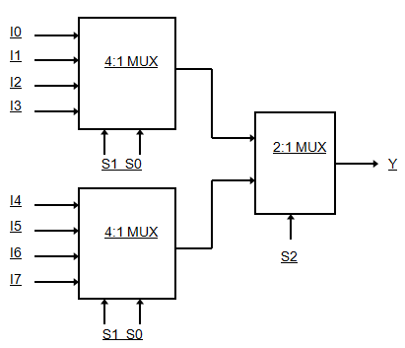
Multiplexer Expansion
Larger multiplexer can be constructed from smaller ones.
An 8-to-1 multiplexer can be constructed from smaller multiplexers like this (note placement of selector lines):
  4-to-1 has 4 data input, 2 selection input, and 1 output.
  2-to-1 has 2 data input, 1 selection input, and 1 output.

Slide 30
CC Implementation with MUX
Given a function of n-variables MUXex can be used to implement this function.
This can be accomplished in one of 2 ways:
  Using a Mux with n-select inputs
      n variables need to be connected to n select inputs.
      Minterms of a function are generated according to select inputs.
      Individual minterm can be selected by the data inputs → proper assignment of the data inputs (D i ∈ {0 , 1}).

Slide 31
CC Implementation with MUX
  Using a Mux with n-1 select inputs
      Find truth table.
      The first n-1 variables in table are connected to selection inputs of MUX.
      For each combination of selection variables, evaluate output as function of the remaining variable (d)
      This remaining variable (d) is then used for data inputs which can be 0,1,d,d’.

Slide 32
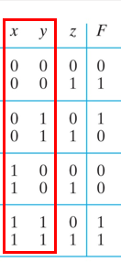
Example 1
Implement the function F(x,y,z) = ∑(1,2,6,7) using a multiplexer with (n-select inputs)
  The function has 3 variables → using 3-select inputs, we need a 8-to-1 MUX.
0
0
1
8-to-1
MUX
1
1
2
0
3
F
0
4
0
5
1
6
1
7
y
z
x

Slide 33
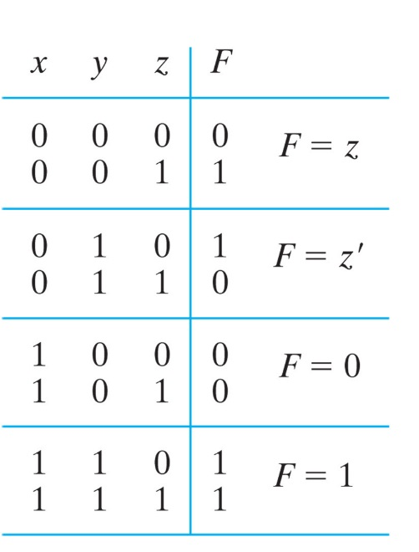
Example 2
Implement the function F(x,y,z) = ∑(1,2,6,7) using a multiplexer with (n-1 select inputs).
  The function has 3 variables → using 2-select inputs, (2^{n} ⁻ ¹ data inputs) we need a 4-to-1 MUX.
z
0
4-to-1
MUX
z’
1
F
0
2
1
3
x
y
Notes:
The first n - 1 variables of the function are connected to the selection inputs of the multiplexer. The remaining single variable of the function is used for the data inputs.
This function of three variables can be implemented with a four-to-one-line multiplexer as shown in Fig. 4.27. The two variables x and y are applied to the selection lines in that order;
The values for the data input lines are determined from the truth table of the function. When xy = 00, output F is equal to z because F = 0 when z = 0 and F = 1 when z = 1.
This requires that variable z be applied to data input 0.The operation of the multiplexer is such that when xy = 00, data input 0 has a path to the output, and that makes F equal to z.
In a similar fashion, we can determine the required input to data lines 1, 2, and 3 from the value of F when xy = 01, 10, and 11, respectively.
This particular example shows all four possibilities that can be obtained for the data inputs.
The general procedure for implementing any Boolean function of n variables with a multiplexer with n - 1 selection inputs and 2n - 1 data inputs follows from the previous example. To begin with, Boolean function is listed in a truth table.
Then first n - 1 variables in the table are applied to the selection inputs of the multiplexer. For each com- bination of the selection variables, we evaluate the output as a function of the last variable. This function can be 0, 1, the variable, or the complement of the variable. These values are then applied to the data inputs in the proper order.

Slide 34
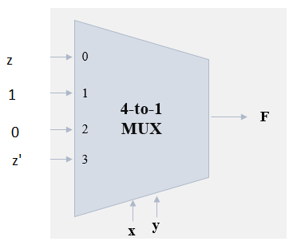
Exercise:
Deduce the function implemented by the following circuit?
Solution
F1=∑ (1,2,3,6)
x | y | z | F
0 | 0 | 0 | 0
0 | 0 | 1 | 1
0 | 1 | 0 | 1
0 | 1 | 1 | 1
1 | 0 | 0 | 0
1 | 0 | 1 | 0
1 | 1 | 0 | 1
1 | 1 | 1 | 0

Slide 35
End of lecture 7

