Slide 1

Risk Management
Prepared by Dr. Nael Zabel
Lecture 8
MGM 510
Risk Management

Slide 2

Lecture 8
Topics to Cover in Week 8
Risk Assessment
Importance of risk assessment
Approaches to Risk Assessment
Risk assessment techniques
nature of the risk matrix
Attitude to risk

Slide 3
Lecture 8
Risk Assessment
Risk recognition and risk rating together form the risk assessment component of the risk management process.
Risk assessment involves the recognition of risks and the rating of them to determine the significant risks facing the organization, project or strategy.

Slide 4
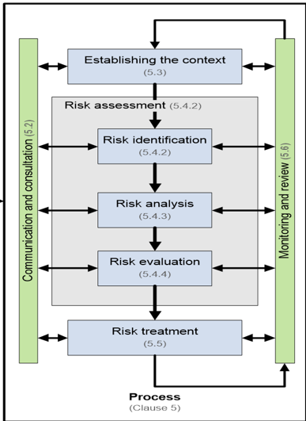
Lecture 8
Risk Assessment
It is defined in British Standard BS 31100 as the overall process of risk identification, risk analysis and risk evaluation.

Slide 5
Lecture 8
Risk Assessment
Because the risk management input into strategy focuses on improved decision making, risk assessment is the main risk management input into strategy formulation.
Risks may be attached to corporate objectives, stakeholder expectations, core processes and key dependencies.

Slide 6
Lecture 8
Risk Assessment
Whichever of these features is selected as the starting point, risk assessment can be undertaken.
The purpose of risk assessment is to identify the significant risks that could impact the selected feature.

Slide 7
Lecture 8
Importance of risk assessment
Although risk assessment is vitally important, it is only useful if the conclusions of the assessment are used to inform decisions and/or to identify the appropriate risk responses for the type of risk under consideration.
It should be considered as the starting point of the risk management process and it is certainly not an end in itself.

Slide 8
Lecture 8
Importance of risk assessment
An important feature of undertaking a risk assessment is to decide whether the identified risk is going to be evaluated at the inherent level or at the current (or residual) level.
Assessment of inherent risk is undertaken without taking account of the controls that are currently in place.

Slide 9
Lecture 8
Importance of risk assessment
This is the approach that has been recommended by internal auditors.
An internal auditor will point out that two risks at the same current or net value may have significantly different inherent or gross values.
It is important to know when this is the case.

Slide 10
Lecture 8
Importance of risk assessment
The benefit of undertaking assessment of inherent risk is that the difference between the current level and the inherent level can be identified.

Slide 11
Lecture 8
Importance of risk assessment
This will give an indication of the importance of the existing control measures and the information is used by internal auditors to help identify critical controls and set audit priorities.
Although this may be a useful approach, there can be considerable difficulties in identifying the value of the inherent level of risk.

Slide 12
Lecture 8
Approaches to Risk Assessment
There are several approaches that can be taken when planning how to undertake risk assessment.
One of the key decisions will be who to involve in the risk assessment exercise.
Sometimes risk assessments are undertaken by the board of directors as a top-down exercise.

Slide 13
Lecture 8
Approaches to Risk Assessment
Risk assessments can also be undertaken by involving individual members of staff and local departmental management.
This bottom-up approach is also valuable.

Slide 14
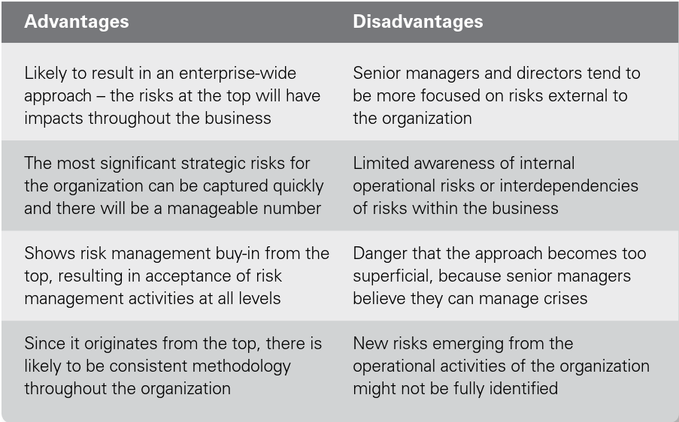
Lecture 8
Top-down risk assessment

Slide 15
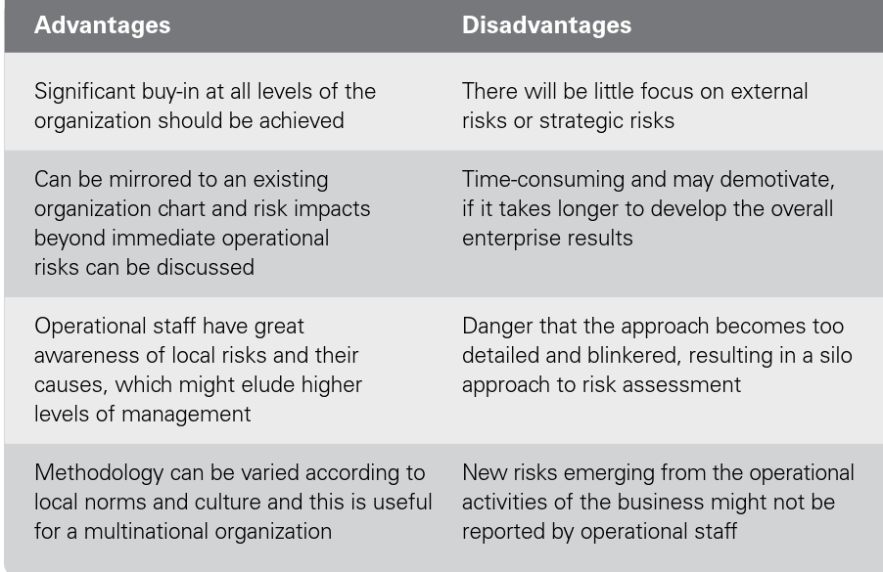
Lecture 8
Bottom-up risk assessment

Slide 16
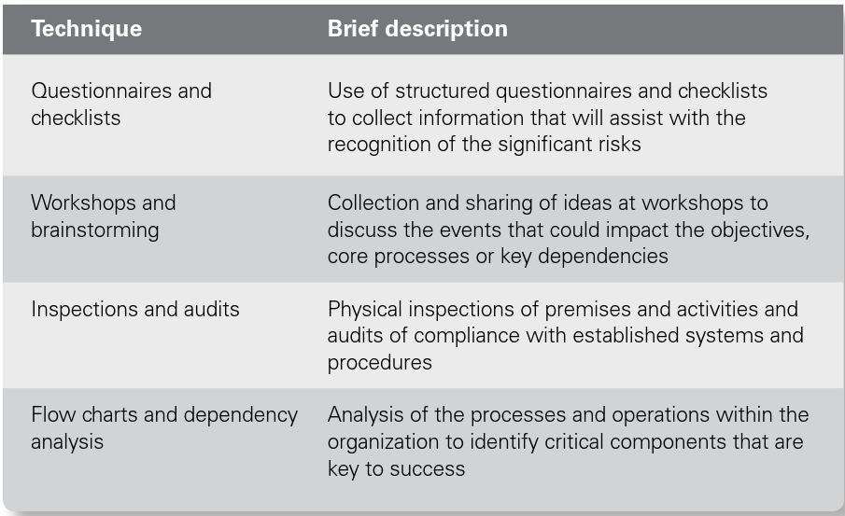
Lecture 8
Risk assessment techniques

Slide 17
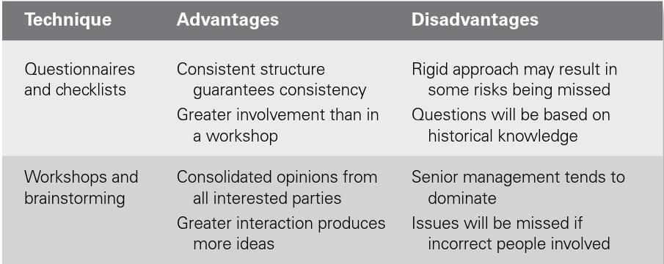
Lecture 8
Risk assessment techniques

Slide 18
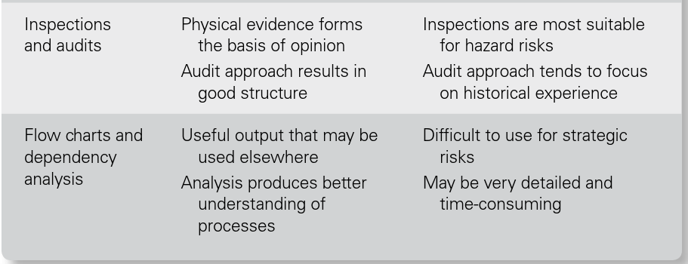
Lecture 8
Risk assessment techniques

Slide 19
Lecture 8
Risk assessment techniques
Risk workshops are probably the most common of the risk assessment techniques.
Brainstorming during workshops enables opinions regarding the significant risks faced by the organization to be shared.

Slide 20
Lecture 8
Risk assessment techniques
A common view and understanding of each risk is achieved.
However, the disadvantage can be that the more senior people in the room may dominate the conversation, and contradicting their opinions may be difficult and unwelcome.

Slide 21
Lecture 8
Risk assessment techniques
In order to have a structured discussion at a risk assessment workshop, several brainstorming structures are in common use.
These may be qualitative or quantitative, depending on the level of analysis of the risk that is required.

Slide 22
Lecture 8
Risk assessment techniques
The most common of the qualitative brainstorming structures are the SWOT and PESTLE analysis.
SWOT is an analysis of the strengths, weaknesses, opportunities and threats faced by the organization.

Slide 23
Lecture 8
Risk assessment techniques
The SWOT analysis has the benefit that it also considers the upside of risk by evaluating opportunities in the external environment.
One of the strengths of the SWOT analysis is that it can be linked to strategic decisions.
However, because it is not a structured risk classification system, there is a possibility that not all of the risks will be identified.

Slide 24
Lecture 8
Risk assessment techniques
The other common qualitative approach is the PESTLE analysis that considers the political, economic, social, technological, legal and ethical (or environmental) risks faced by the organization.
PESTLE is a well-established structure with proven results for undertaking brainstorming sessions during risk assessment workshops.

Slide 25
Lecture 8
Nature of the risk matrix
When a risk has been recognized as significant, the organization needs to rate it so that the priority significant risks can be identified.
Techniques for rating risks are well established, but there is also a need to decide what scope exists for further improving control.

Slide 26
Lecture 8
Nature of the risk matrix
Consideration of the scope for further cost-effective improvement is an additional consideration that assists the clear identification of the priority significant risks.
An organization will need to establish the measures of risk likelihood and risk impact that will be used throughout the organization.

Slide 27
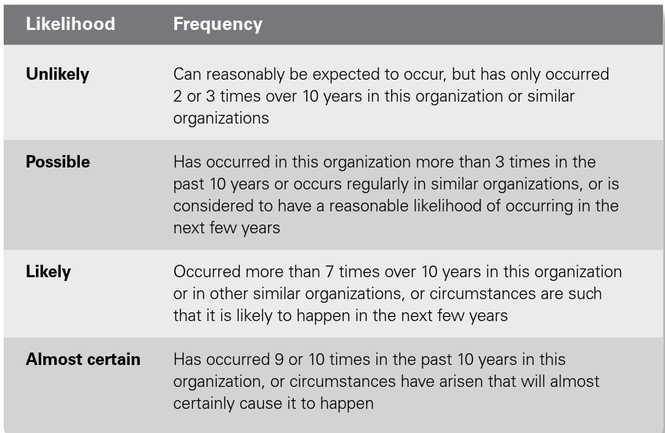
Lecture 8
Definitions of likelihood

Slide 28
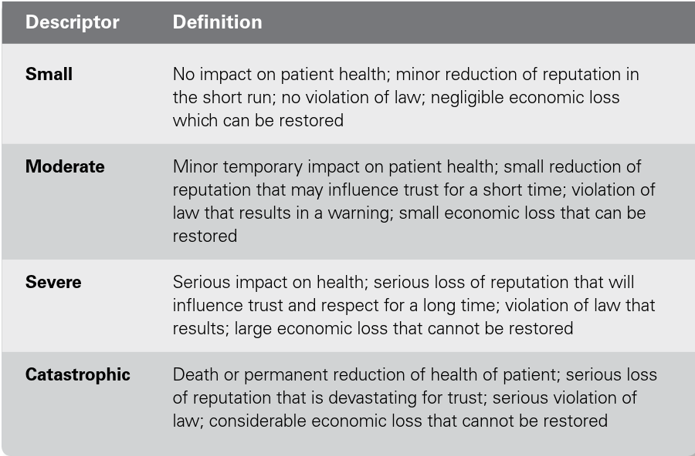
Lecture 8
Definitions of impact

Slide 29
Lecture 8
Attitude to risk
Figure 10.1 provides an empirical illustration of risk attitude using a standard risk matrix.
It represents the risk attitude of a risk-averse organization.
It is becoming more common for a risk attitude matrix to contain four sections.
These sections can be represented by the 4Cs of comfort, cautious, concerned and critical.

Slide 30
Lecture 8
Attitude to risk
Risk attitude represents the long-term approach of the organization to risk.
These descriptors can also be attached to the four sections on a risk appetite matrix to describe the approach to short-term risk taking.

Slide 31
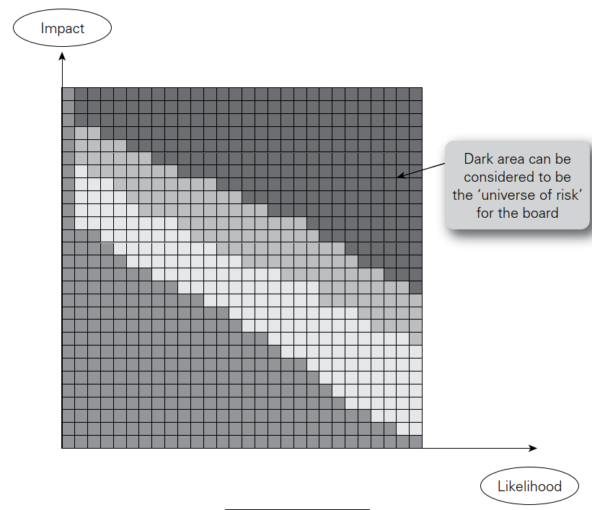
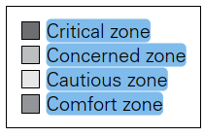
Lecture 8
Risk attitude matrix

Slide 32
Lecture 8
Thank You

