Slide 1


Organizational Change
and
Stress Management
Prepared by Dr. Mumen Thabet
Lecture 7

Slide 2
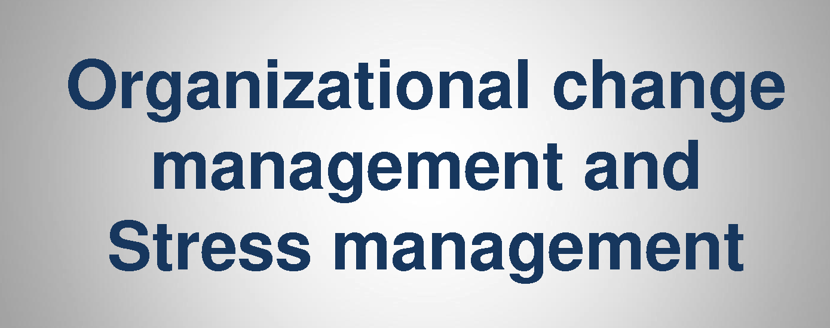
stress and resistance are not inevitable reactions to organizational change. Rather, what makes organizational change stressful or susceptible to resistance of employees is the way people are treated during implementation of the change.

Slide 3



Forces for
Change

Slide 4
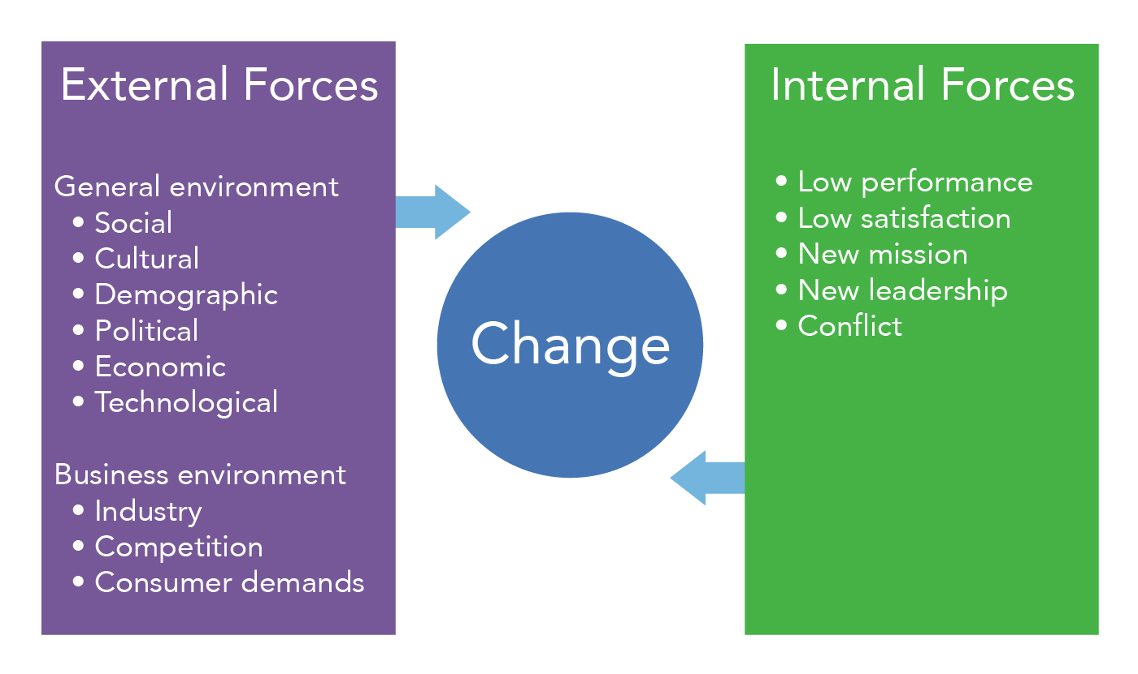
Forces for change
call for businesses and employees to be responsive to the needs around them and then require the organization to adapt to meet those needs. Successful organizations understand the need to adapt and change with the times.

Slide 5
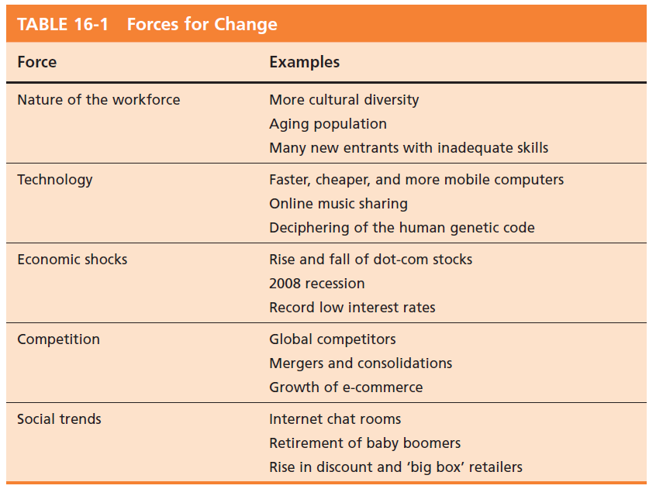
Forces for Change
© Pearson Education 2012

Slide 6
Planned Change
Change
  Making things different.
Planned change
  Activities that are proactive and purposeful: an intentional, goal-oriented activity.
  Goals of planned change:
    Improving the ability of the organization to adapt to changes in its environment.
    Changing employee behavior.
Change agents
  Persons who act as catalysts and assume the responsibility for managing change activities.

Slide 7
Resistance to Change
Resistance to change appears to be a natural and positive state.
Forms of resistance to change:
  Overt and immediate
    Voicing complaints, engaging in job actions.
  Implicit and deferred
    Loss of employee loyalty and motivation, increased errors or mistakes, increased absenteeism.
    Deferred resistance clouds the link between source and reaction.
© Pearson Education 2012

Slide 8
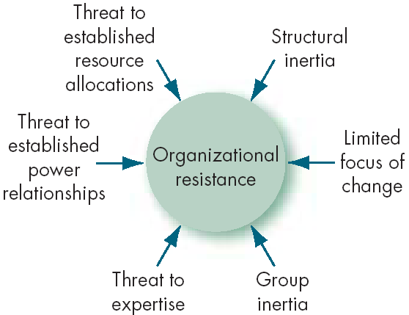
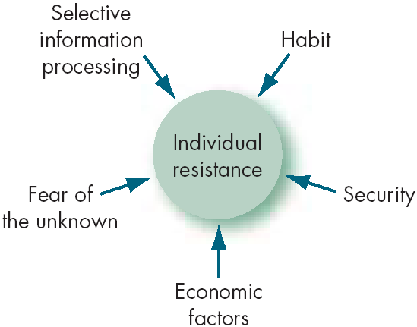
Sources of Resistance to Change
© Pearson Education 2012

Slide 9
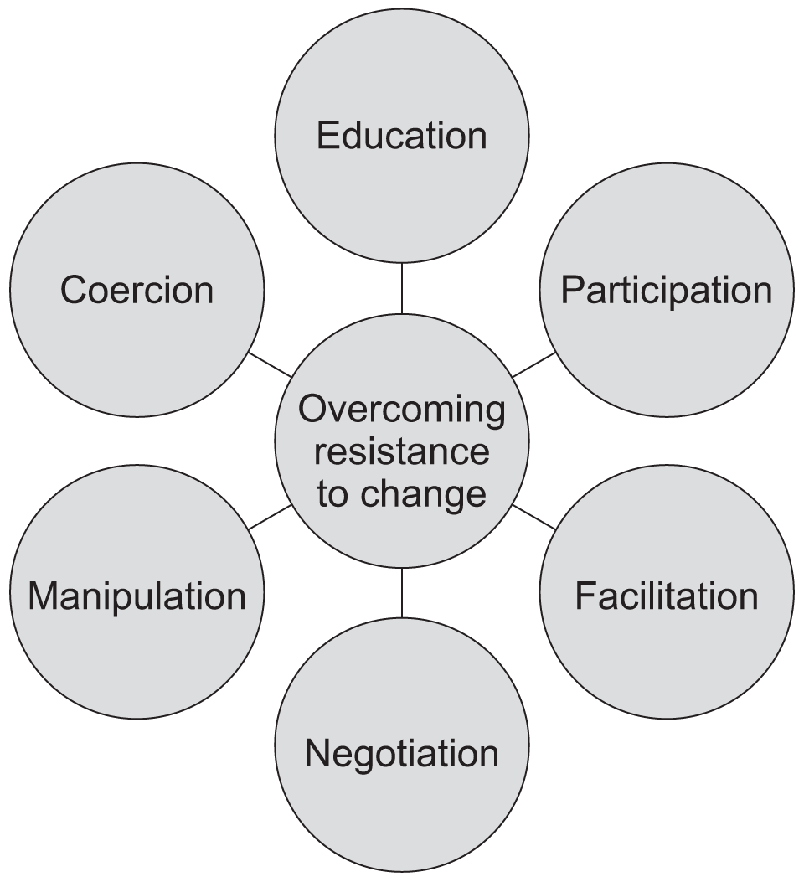
Tactics for Overcoming Resistance to Change

Slide 10
Tactics for Overcoming Resistance to Change
Education and communication
    Show those effected the logic behind the change.
Participation
    Participation in the decision process lessens resistance.
Building support and commitment
    Counseling, therapy, or new-skills training.
Implementing change fairly
    Be consistent and procedurally fair.

Slide 11
Tactics for Overcoming Resistance to Change (cont’d)
Manipulation and cooperation
    ‘Spinning’ the message to gain cooperation.
Selecting people who accept change
    Hire people who enjoy change in the first place.
Coercion
    Direct threats and force.

Slide 12
The Politics of Change
Motivation for change is likely to come from outside change agents, new employees, or managers outside the main power structure.
Internal change agents are most threatened by their loss of status in the organization.
Long-time power holders tend to implement incremental but not radical change.
The outcomes of power struggles in the organization will determine the speed and quality of change.

Slide 13
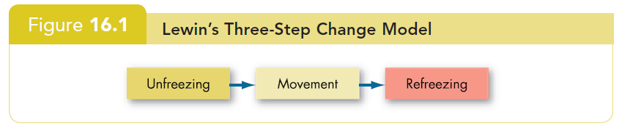
Lewin’s Three-Step Change Model
Unfreezing
  Change efforts to overcome the pressures of both individual resistance and group conformity.
Refreezing
  Stabilizing a change intervention by balancing driving and restraining forces.

Slide 14
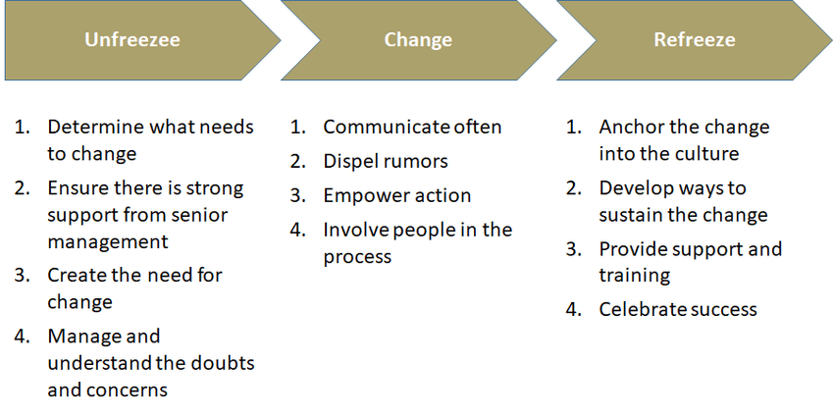
Lewin’s Three-Step Change Model

Slide 15
Lewin: Unfreezing the current situation
Driving forces
  Forces that direct behavior away from the status quo.
Restraining forces
  Forces that hinder movement from the existing equilibrium.

Slide 16
Lewin: freezing the current situation
freezing (sometimes refreezing) the new ways of being into place, to establish a new mindset. During this phase, people adapt to the changed reality. They start to find ways to take advantage of the opportunities it offers. Alternatively, they decide to opt out of the change and move on.

Slide 17
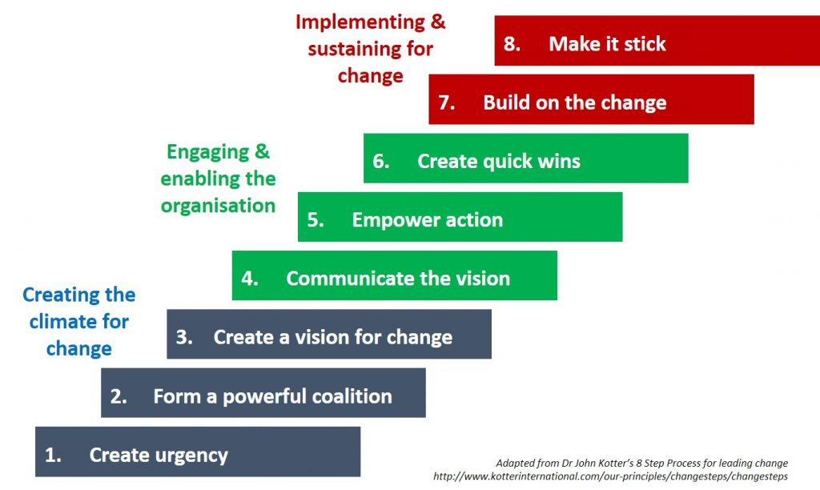
Kotter’s Eight-Step Plan

Slide 18
Action Research
  A change process based on systematic collection of data and then selection of a change action based on what the analyzed data indicates.
  Process steps:
    Diagnosis
    Analysis
    Feedback
    Action
    Evaluation
  Action research benefits:
    Problem-focused rather than solution-centered.
    Heavy employee involvement reduces resistance to change.

Slide 19
Organizational Development
Organizational development (OD)
    A collection of planned interventions, built on humanistic-democratic values, that seeks to improve organizational effectiveness and employee well-being.
OD values:
    Respect for people
    Trust and support
    Power equalization
    Confrontation
    Participation

Slide 20
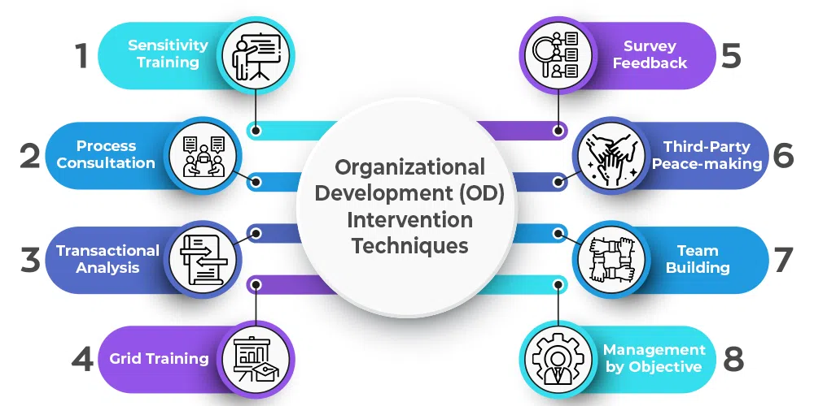

Slide 21
Six OD Techniques
Sensitivity training
  Training groups (T-groups) that seek to change behavior through unstructured group interaction.
  Provides increased awareness of others and self.
  Increases empathy with others, listening skills, openness, and tolerance for others.
Survey feedback approach
  The use of questionnaires to identify discrepancies among member perceptions; discussion follows and remedies are suggested.
© Pearson Education 2012

Slide 22
Six OD Techniques (Cont’d)
Process consultation (PC)
  A consultant gives a client insights into what is going on around the client, within the client, and between the client and other people; identifies processes that need improvement.
Team building
  High interaction among team members to increase trust and openness.

Slide 23
Six OD Techniques (Cont’d)
Intergroup development
  OD efforts to change the attitudes, stereotypes, and perceptions that groups have of each other.
Appreciative inquiry
  Seeks to identify the unique qualities and special strengths of an organization, which can then be built on to improve performance.
    Discovery: recalling the strengths of the organization.
    Dreaming: speculation on the future of the organization.
    Design: finding a common vision.
    Destiny: deciding how to fulfill the dream.

Slide 24
Creating a Culture for Change
1. Innovation
Stimulating a culture of innovation
  Innovation: a new idea applied to initiating or improving a product, process, or service.
  Sources of Innovation:
    Structural variables: organic structures
    Long-tenured management
    Slack resources
    Interunit communication
  Idea Champions: individuals who actively promote the innovation.

Slide 25
Creating a Culture for Change
2. Learning
Learning Organization
  An organization that has developed the continuous capacity to adapt and change.
  Learning Types
    Single-Loop: errors are corrected using past routines.
    Double-Loop: errors are corrected by modifying routines.
  Characteristics:
    Holds a shared vision
    Discards old ways of thinking
    Views organization as system of relationships
    Communicates openly
    Works together to achieve shared vision

Slide 26

Creating a Learning Organization
2. Learning (cont’d)
Overcomes traditional organization problems:
    Fragmentation
    Competition
    Reactiveness
How to manage learning
  Establish a strategy.
  Redesign the organization’s structure:
    Flatten structure and increase cross-functional activities.
  Reshape the organization’s culture:
    Reward risk-taking and intelligent mistakes.

Slide 27
Work Stress
Stress: a dynamic condition in which an individual is confronted with an opportunity, constraint, or demand related to what he or she desires and for which the outcome is perceived to be both uncertain and important.

Slide 28
Work Stress
Types of stress
  Challenge stressors
    Stress associated with workload, pressure to complete tasks, and time urgency.
  Hindrance stressors
    Stress that keeps you from reaching your goals, such as red tape.
    Cause greater harm than challenge stressors.

Slide 29
Demands–Resources Model of Stress
Demands
    Responsibilities, pressures, obligations, and uncertainties in the workplace.
Resources
    Things within an individual’s control that can be used to resolve demands.
Adequate resources help reduce the stressful nature of demands.

Slide 30
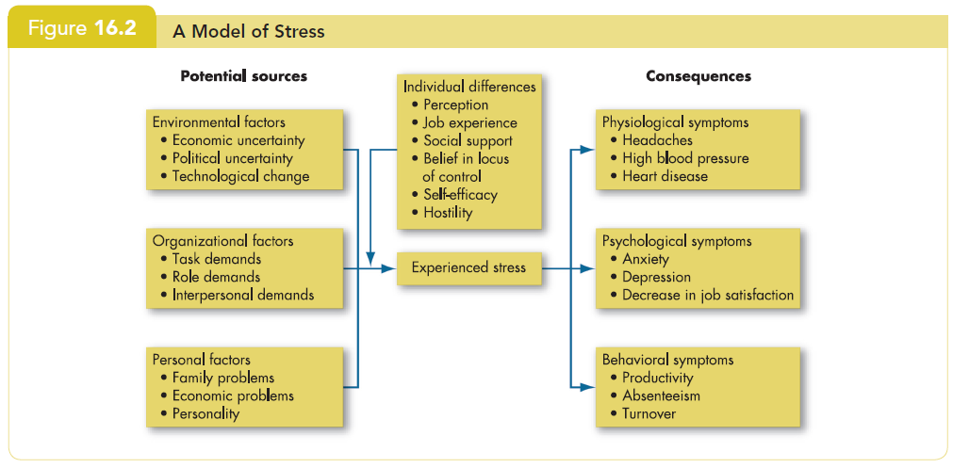
A Model of Stress
© Pearson Education 2012

Slide 31
Potential Sources of Stress
Environmental factors
  Economic uncertainties of the business cycle.
  Political uncertainties of political systems.
  Technological uncertainties of technical innovations.
Organizational factors
  Task demands related to the job.
  Role demands of functioning in an organization.
  Interpersonal demands created by other employees.
Personal factors
  Family and personal relationships
  Economic problems from exceeding earning capacity.
  Personality problems arising from basic disposition.

Slide 32
Individual Differences
  Some people thrive on stressful situations, others are overwhelmed.
  Four variables affect an individual’s response:
    Perception
    Job experience
    Social support
    Personality

Slide 33
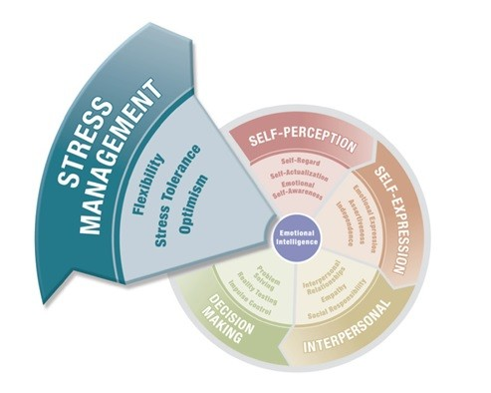

Slide 34
Emotional Intelligence (EI) and Stress
Emotional intelligence is:
  the ability to detect and to manage emotional cues and information.
  the ability to perceive, control, and evaluate emotions.
  the ability to succeed in coping with environmental demands and pressures.
Emotional Intelligence can equip individuals to cope with stress, by achieving a state of balance, calm energy, alertness and focus.

Slide 35
Consequences of Stress
High levels of stress can lead to the following symptoms
  Physiological
    Blood pressure, headaches, stroke.
  Psychological
    Dissatisfaction, tension, anxiety, irritability, boredom, and procrastination.
    Greatest when roles are unclear in the presence of conflicting demands.
  Behavioral
    Changes in job behaviors, increased smoking or drinking, different eating habits, rapid speech, fidgeting, and sleep disorders.

Slide 36

How do you handle stress in work?
Track your stressors. Keep a journal for a week or two to identify which situations create the most stress and how you respond to them. ...
Develop healthy responses. ...
Establish boundaries. ...
Take time to recharge. ...
Learn how to relax. ...
Talk to your supervisor. ...
Get some support.

Slide 37
Not All Stress Is Bad
Some levels of stress can increase productivity.
Too little or too much stress will reduce performance.
This model is not empirically supported.

Slide 38
Managing Stress
Individual approaches
  Implementing time management
  Increasing physical exercise
  Relaxation training
  Expanding social support network

Slide 39
Managing Stress (cont’d)
Organizational approaches
  Improved personnel selection and job placement
  Training
  Use of realistic goal setting
  Redesigning of jobs
  Increased employee involvement
  Improved organizational communication
  Offering employee sabbaticals
  Establishment of corporate wellness programs

Slide 40



Thank You

