Slide 1



Project Monitoring
Lecture 8
PMG 333
Being an Effective
Project Manager
Prepared by
Dr. Mohammed Mustafa

Slide 2

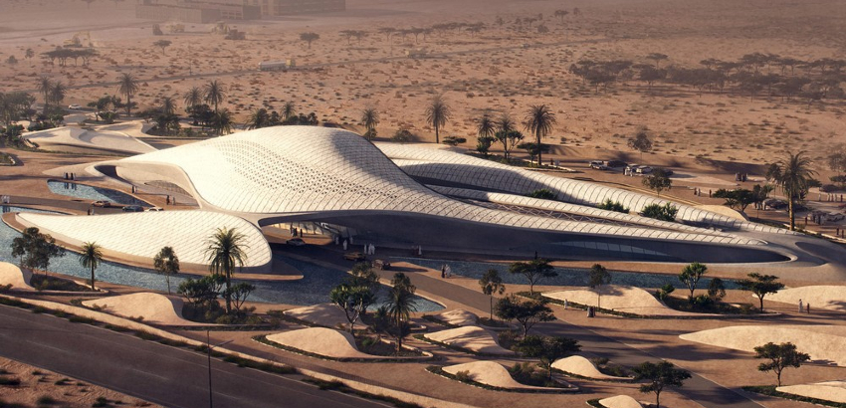
Learning objectives
Understand the difference between leading and managing a project.
Understand the need to manage project stakeholders.
Identify and apply different “influence currencies” to build positive relations with others.
Create a stakeholder map and develop strategies for managing project dependencies.
Understand the need for a highly interactive management style on projects.
More effectively manage project expectations.
Develop strategies for managing upward relations.
Understand the importance of building trust and acting in an ethical manner while working on a project.
Identify the qualities of an effective project manager

Slide 3
Lecture
Outlines
08
Managing versus Leading a Project
Managing Project Stakeholders
Influence as Exchange
Social Network Building
Ethics and Project Management
Building Trust: The Key to Exercising Influence
Qualities of an Effective Project Manager
www.midocean.ae

Slide 4
(1) Managing versus Leading a Project
The project manager would work with others to formulate a schedule, organize a project team, keep track of progress, and announce what needs to be done next, and then everyone would charge along.
Of course no one lives in a perfect world, and rarely does everything go according to plan.
Project participants get testy; they fail to get along with each other; other departments are unable to fulfill their commitments; technical glitches arise; work takes longer than expected.
www.midocean.ae

Slide 5
(1) Managing versus Leading a Project – Cont.
The project manager’s job is to get the project back on track.
A manager expedites certain activities; figures out ways to solve technical problems; serves as peacemaker when tensions rise; and makes appropriate trade-offs among time, cost, and scope of the project.
However, project managers often do more than put out fires and keep the project on track.
They also innovate and adapt to ever-changing circumstances.
They sometimes have to deviate from what was planned and introduce significant changes in the project scope and schedule to respond to unforeseen threats or opportunities.
www.midocean.ae

Slide 6
(1) Managing versus Leading a Project – Cont.
For example, customers’ needs may change, requiring significant design changes midway through the project.
Competitors may release new products that dictate crashing project deadlines.
Working relationships among project participants may break down, requiring a reformulation of the project team.
Ultimately, what was planned or expected in the beginning may be very different from what was accomplished by the end of the project.
www.midocean.ae

Slide 7
(1) Managing versus Leading a Project – Cont.
Project managers are responsible for integrating assigned resources to complete the project according to plan.
At the same time they need to initiate changes in plans and schedules as persistent problems make plans unworkable.
In other words, managers want to keep the project going while making necessary adjustments along the way.
According to Kotter (1990) these two different activities represent the distinction between management and leadership.
Management is about coping with complexity, while leadership is about coping with change.
www.midocean.ae

Slide 8
(2) Managing Project Stakeholders
First-time project managers are eager to implement their own ideas and manage their people to successfully complete their project.
What they soon find out is that project success depends on the cooperation of a wide range of individuals, many of whom do not directly report to them.
For example, during the course of a system integration project, a project manager was surprised by how much time she was spending negotiating and working with vendors, consultants, technical specialists, and other functional managers:
www.midocean.ae

Slide 9
(2) Managing Project Stakeholders – Cont.
Instead of working with my people to complete the project, I found myself being constantly pulled and tugged by demands of different groups of people who were not directly involved in the project but had a vested interest in the outcome.
Too often when new project managers do find time to work directly on the project, they adopt a hands-on approach to managing the project.
They choose this style not because they are power-hungry egomaniacs but because they are eager to achieve results.
www.midocean.ae

Slide 10
(2) Managing Project Stakeholders – Cont.
They become quickly frustrated by how slowly things operate, the number of people that have to be brought on board, and the difficulty of gaining cooperation.
Unfortunately, as this frustration builds, the natural temptation is to exert more pressure and get more heavily involved in the project.
These project managers quickly earn the reputation of “micro managing” and begin to lose sight of the real role they play on guiding a project.
www.midocean.ae

Slide 11
(2) Managing Project Stakeholders – Cont.
Some new managers never break out of this vicious cycle.
Others soon realize that authority does not equal influence and that being an effective project manager involves managing a much more complex and expansive set of interfaces than they had previously anticipated.
They encounter a web of relationships that requires a much broader spectrum of influence than they felt was necessary or even possible.
www.midocean.ae

Slide 12
(2) Managing Project Stakeholders – Cont.
Stakeholders are people and organizations that are actively involved in the project, or whose interests may be positively or negatively affected by the project (PMBOK, 2013).
The sheer breadth and complexity of stakeholder relationships distinguish project management from regular management.
To be effective, a project manager must understand how stakeholders can affect the project and develop methods for managing the dependency.
The nature of these dependencies is identified here:
www.midocean.ae

Slide 13
(2) Managing Project Stakeholders – Cont.
The project team manages and completes project work.
Most participants want to do a good job, but they are also concerned with their other obligations and how their involvement on the project will contribute to their personal goals and aspirations.
Project managers naturally compete with each other for resources and the support of top management. At the same time they often have to share resources and exchange information.
www.midocean.ae

Slide 14
(2) Managing Project Stakeholders – Cont.
Administrative support groups, such as human resources, information systems, purchasing agents, and maintenance, provide valuable support services.
At the same time they impose constraints and requirements on the project such as the documentation of expenditures and the timely and accurate delivery of information
www.midocean.ae

Slide 15
(2) Managing Project Stakeholders – Cont.
Functional managers, depending on how the project is organized, can play a minor or major role toward project success.
In matrix arrangements, they may be responsible for assigning project personnel, resolving technical dilemmas, and overseeing the completion of significant segments of the project work.
Even in dedicated project teams, the technical input from functional managers may be useful, and acceptance of completed project work may be critical to in-house projects.
Functional managers want to cooperate up to a point, but only up to a certain point. They are also concerned with preserving their status within the organization and minimizing the disruptions the project may have on their own operations.
www.midocean.ae

Slide 16

(2) Managing Project Stakeholders – Cont.
Top management approves funding of the project and establishes priorities within the organization. They define success and adjudicate rewards for accomplishments.
Significant adjustments in budget, scope, and schedule typically need their approval.
They have a natural vested interest in the success of the project, but at the same time have to be responsive to what is best for the entire organization.
Project sponsors champion the project and use their influence to gain approval of the project.
Their reputation is tied to the success of the project, and they need to be kept informed of any major developments. They defend the project when it comes under attack and are a key projectally.
www.midocean.ae

Slide 17
(2) Managing Project Stakeholders – Cont.
Contractors may do all the actual work, in some cases, with the project team merely coordinating their contributions.
In other cases, they are responsible for ancillary segments of the project scope.
Poor work and schedule slips can affect work of the core project team.
While contractors’ reputations rest with doing good work, they must balance their contributions with their own profit margins and their commitments to other clients.
www.midocean.ae

Slide 18
(2) Managing Project Stakeholders – Cont.
Government agencies place constraints on project work.
Permits need to be secured: Construction work has to be built to code. New drugs have to pass a rigorous battery of U.S.
Food and Drug Administration tests: Other products have to meet safety standards, for example, Occupational Safety and Health Administration standards.
www.midocean.ae

Slide 19
(2) Managing Project Stakeholders – Cont.
Other organizations, depending on the nature of the project, may directly or indirectly affect the project.
For example, suppliers provide necessary resources for completion of the project work.
Delays, shortages, and poor quality can bring a project to a standstill. Public interest groups may apply pressure on government agencies.
Customers often hire consultants and auditors to protect their interests on a project.
www.midocean.ae

Slide 20
(2) Managing Project Stakeholders – Cont.
Customers define the scope of the project, and ultimate project success rests in their satisfaction.
Project managers need to be responsive to changing customer needs and requirements and to meeting their expectations.
Customers are primarily concerned with getting a good deal and, as will be elaborated in related Chapter, this naturally breeds tension with the project team
www.midocean.ae

Slide 21
(3) Influence as Exchange
To successfully manage a project, a manager must adroitly build a cooperative network among divergent allies.
Networks are mutually beneficial alliances that are generally governed by the law of reciprocity (Kaplan, 1984; Grant, 2013).
The basic principle is that “one good deed deserves another, and likewise, one bad deed deserves another.”
The primary way to gain cooperation is to provide resources and services for others in exchange for future resources and services.
This is the age-old maxim: “Quid pro quo (something for something).” Or in today’s vernacular: “You scratch my back, I’ll scratch yours.”
www.midocean.ae

Slide 22
(3) Influence as Exchange – Cont.
Cohen and Bradford (1990) described the exchange view of influence as “currencies.”
If you want to do business in a given country, you have to be prepared to use the appropriate currency, and the exchange rates can change over time as conditions change.
In the same way, what is valued by a marketing manager may be different from what is valued by a veteran project engineer, and you are likely to need to use different influence currency to obtain the cooperation of each individual.
www.midocean.ae

Slide 23
(3) Influence as Exchange – Cont.
Although this analogy is a bit of an oversimplification, the key premise holds true that in the long run, “debit” and “credit” accounts must be balanced for cooperative relationships to work.
Table below presents the commonly traded organizational currencies identified by Cohen and Bradford; they are then discussed in more detail in the following sections.
www.midocean.ae

Slide 24
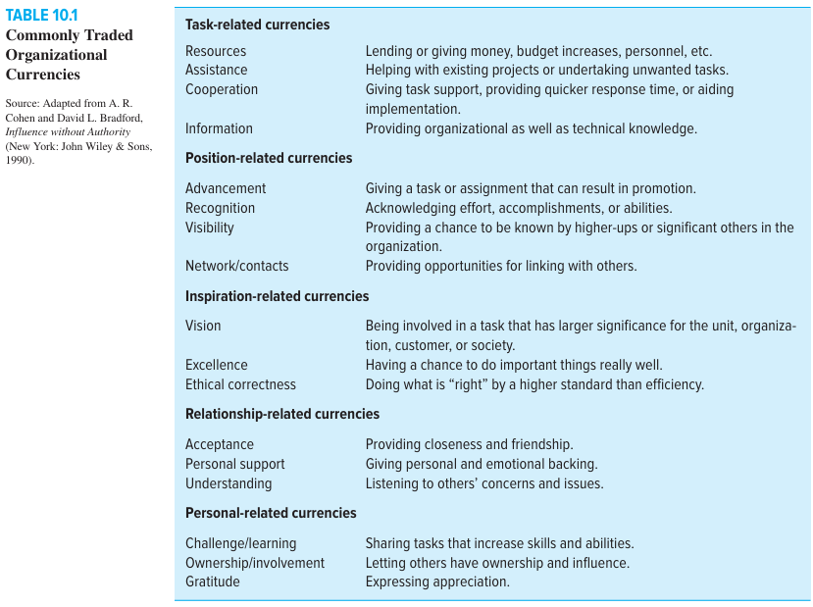

Slide 25
(4) Social Network Building
Mapping Stakeholder Dependencies:
The first step to social network building is identifying those stakeholders on whom the project depends for success.
The project manager and his or her key assistants need to ask the following questions:
  Whose cooperation will we need?
  Whose agreement or approval will we need?
  Whose opposition would keep us from accomplishing the project?
www.midocean.ae

Slide 26
(4) Social Network Building – Cont.
Many project managers find it helpful to draw a map of these dependencies.
For example, Figure below contains the dependencies identified by a project manager responsible for installing a new financial software system in her company.
It is always better to overestimate rather than underestimate dependencies.
All too often, otherwise talented and successful project managers have been derailed because they were blindsided by someone whose position or power they had not anticipated.
After identifying the stakeholders associated with your project, it is important to assess their significance.
www.midocean.ae

Slide 27
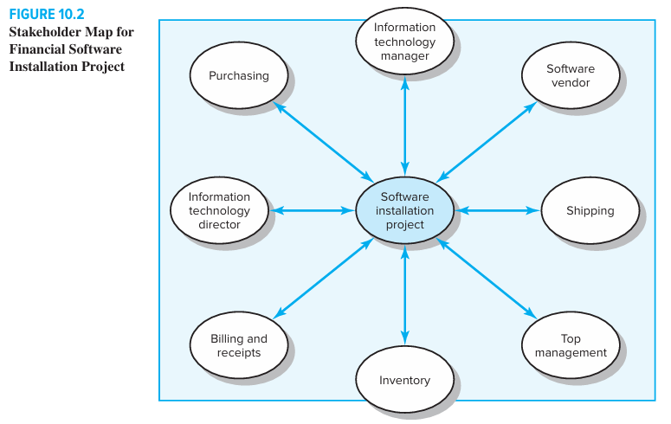

Slide 28
(5) Ethics and Project Management
In a survey of project managers, 81 percent reported that they encounter ethical issues in their work.
These dilemmas range from being pressured to alter status reports, backdate signatures, compromising safety standards to accelerate progress, and approving shoddy work.
The more recent work of Müller and colleagues suggests that the most common dilemma project managers face involves transparency issues related to project performance (Müller et al., 2013, 2014).
www.midocean.ae

Slide 29
(5) Ethics and Project Management – Cont.
For example, is it accept able to falsely assure customers that everything is on track when in reality you are doing so to prevent them from panicking and making matters even worse?
Project management is complicated work, and, as such, ethics invariably involve gray areas of judgment and interpretation.
For example, it is difficult to distinguish deliberate falsification of estimates from genuine mistakes or the willful exaggeration of project payoffs from genuine optimism.
It becomes problematic to determine whether unfulfilled promises were deliberate deception or an appropriate response to changing circumstances.
www.midocean.ae

Slide 30
(5) Ethics and Project Management – Cont.
To provide greater clarity to business ethics, many companies and professional groups publish a code of conduct.
Cynics see these documents as simply window dressing, while advocates argue that they are important, albeit limited, first steps.
In practice, personal ethics do not lie in formal statutes but at the intersection of one’s work, family, education, profession, religious beliefs, and daily interactions.
Most project managers report that they rely on their own private sense of right and wrong— what one project manager called his “internal compass.”
www.midocean.ae

Slide 31
(5) Ethics and Project Management – Cont.
One common rule of thumb for testing whether a response is ethical is to ask, “Imagine that whatever you did was going to be reported on the front page of your local newspaper.
How would you like that? Would you be comfortable?”
Unfortunately, scandals at Enron, WorldCom, and Arthur Andersen have demonstrated the willingness of highly trained professionals to abdicate personal responsibility for illegal actions and to obey the directives of superiors.
www.midocean.ae

Slide 32
(5) Ethics and Project Management – Cont.
Top management and the culture of an organization play a decisive role in shaping members’ beliefs of what is right and wrong.
Many organizations encourage ethical transgressions by creating a “win at all cost” mentality.
The pressures to succeed obscure consideration of whether the ends justify the means.
Other organizations place a premium on “fair play” and command a market position by virtue of being trustworthy and reliable.
www.midocean.ae

Slide 33
(6) Building Trust: The Key to Exercising Influence
Trust is an elusive concept. It is hard to nail down in precise terms why some project managers are trusted and others are not.
One popular way to understand trust is to see it as a function of character and competence.
Character focuses on personal motives (i.e., does he or she want to do the right thing?),
while competence focuses on skills necessary to realize motives (i.e., does he or she know the right things to do?).
www.midocean.ae

Slide 34
(6) Building Trust – Cont.
Stephen Covey resurrected the significance of character in the leadership literature in his best-selling Seven Habits of Highly Effective People.
Covey criticized popular management literature as focusing too much on shallow human relations skills and manipulative techniques, which he labeled the personality ethic.
He argues that at the core of highly effective people is a character ethic that is deeply rooted in personal values and principles such as dignity, service, fairness, the pursuit of truth, and respect.
www.midocean.ae

Slide 35
(7) Qualities of an Effective Project Manager
Project management is, at first glance, a misleading discipline in that there is an inherent logic to the process.
There is a natural progression from formulating a project scope statement, to creating a WBS, developing a network, adding resources, finalizing a plan, and reaching milestones.
However, when it comes to actually implementing and completing projects, this logic can quickly disappear.
Project managers often encounter a much messier world, filled with inconsistencies and paradoxes.
www.midocean.ae

Slide 36
(7) Qualities of an Effective Project Manager – Cont.
Effective project managers have to be able to deal with the contradictory nature of their work. Some of those contradictions are listed here:
Innovate and maintain stability:
Project managers have to put out fires, restore order, and get the project back on track.
At the same time they need to be innovative and develop new, better ways of doing things.
Innovations unravel stable routines and spark new disturbances that have to be dealt with.
www.midocean.ae

Slide 37
(7) Qualities of an Effective Project Manager – Cont.
See the big picture while getting your hands dirty:
Project managers have to see the big picture and how their project fits within the larger strategy of their firm.
There are also times when they must get deeply involved in project work and technology.
If they don’t worry about the details, who will?
www.midocean.ae

Slide 38
(7) Qualities of an Effective Project Manager – Cont.
Encourage individuals but stress the team: Project managers have to motivate, cajole, and entice individual performers while at the same time maintaining team work.
They have to be careful that they are considered fair and consistent in their treatment of team members while at the same time treating each member as a special individual.
Hands-off/Hands-on: Project managers have to intervene, resolve stalemates, solve technical problems, and insist on different approaches.
At the same time they have to recognize when it is appropriate to sit on the sidelines and let other people figure out what to do.
www.midocean.ae

Slide 39
(7) Qualities of an Effective Project Manager – Cont.
Flexible but firm:
Project managers have to be adaptable and responsive to events and outcomes that occur on the project.
At the same time they have to hold the line at times and tough it out when everyone else wants to give up.
www.midocean.ae

Slide 40
(7) Qualities of an Effective Project Manager – Cont.
Team versus organizational loyalties:
Project managers need to forge a unified project team whose members stimulate one another to extraordinary performance.
But at the same time they have to counter the excesses of cohesion and the team’s resistance to outside ideas.
They have to cultivate loyalties to both the team and the parent organization.
www.midocean.ae

Slide 41



Thank You

