Slide 1


Policy Decision (2/2)
الجزء الثاني من المحاضرة
Part 2 of the Lecture
Prepared by Dr. Sami Alzahrani
Risk & Decision Analysis - PMG 621
Lecture 4

Slide 2
Policy Decision (2/2)
الجزء الثاني من المحاضرة
Part 2
Lecture 4

Slide 3

Chapter
03
Attitude toward Risk
Risk attitude, or risk preference, is a fascinating aspect of decision analysis. Unaided intuition, for most people, leads us to make inconsistent tradeoffs between value and risk. That is, most people, unknowingly, make choices that are inconsistent with their long-term objectives. We do better in project evaluations, decisions, and negotiations by understanding the concept of risk preference. This is the purpose of risk policy.
www.midocean.ae

Slide 4
Chapter
03
The uninitiated typically exhibit excessive conservatism. For example, consider the manager of a large project who foregoes a chance to invest $1 million to gain a 50 percent chance at saving $10 million in project PV cost. That is, there are equal chances between a $1 million loss and a $9 million PVnet gain. This behavior may seem rational if the manager or project has a modest budget.
www.midocean.ae

Slide 5
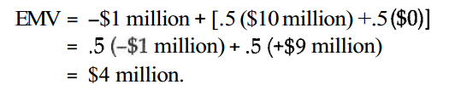
Chapter
03
"Risk $1 million with a 90 percent chance of failure?!" A more proper perspective, however, is to consider decision outcomes relative to the size of the entire organization's capital. For the example, the EMV for this decision is:
www.midocean.ae

Slide 6
Chapter
03
For our example, a risk-neutral decision maker would be indifferent be-tween having $4 million cash in hand or having this project opportunity. Risk-neutral means being objective about money; that is, the scale of the outcomes does not matter. This means being an EMV decision maker. The EMV decision criterion is widely used in decision analysis, either as a decision criterion by itself or as a reference to the "objective" value.
www.midocean.ae

Slide 7
Chapter
03
How much risk aversion is appropriate for a corporation? The ideal perspective, though perhaps impractical, is to compare the possible project out- comes to the collective net worth of the stockholders. For the second term, one approach is to assess a typical stockholder's net worth and multiply this times the number of stockholders. Very risky projects would have little effect on individual investors. For large, widely held companies, a nearly risk- neutral decision policy is perhaps best. Even for conservative individuals, most persons should be nearly risk-neutral for modest day decisions.
www.midocean.ae

Slide 8
Chapter
03
Upon realizing the implications of conservative selections, most people begin to make future decisions more objectively. An investment like the earlier example will reduce the project's cost by $4 million on average. This is clearly a good decision in a portfolio of many similarly sized decisions. When the project's value-or, better, the company's value-is large in comparison to the outcomes of a particular decision, the project manager generally will be better off using a neutral attitude toward risk when evaluating alternatives.
www.midocean.ae

Slide 9
Chapter
03
However, if one does want to have a conservative risk policy as a part of the decision policy, there is a straightforward way to do this. We determine a utility function, unique to the DM or orfeelsganization, that relates "value" (i.e., utility) to wealth. It defines how the DM about money. This function also portrays a DM'S risk policy. The utility function transformation provides a guide in how to make tradeoffs between objective value and risk.
www.midocean.ae

Slide 10
Chapter
03
In calculations, we translate outcome value (usually PV) into utility units. The usual methods apply for calculating expected (value) utility. Then, the expected utility decision rule is to choose the alternative with the highest expected utility (EU). The next chapter details this topic.
www.midocean.ae

Slide 11
Chapter
03
Decision Policy Summary
Consistent decisions in an organization require a clear decision policy. Setting the guideline is straightforward, yet most organizations fail to do this. The result is sub-optimal decision making across the organization. Some parts of the organization are rejecting opportunities that would be approved elsewhere.
www.midocean.ae

Slide 12
Chapter
03
Most companies use DCF analysis for project evaluations. Dollars or other currency units measure value. PV discounting reflects attitude about the time value of money. If desired, a utility function expresses a conservative risk policy. Many people may have never seen or heard of the technique. Instead, they subjectively make tradeoffs between risk and value. And, typically, people do this poorly. Fortunately, adjusting for risk aversion is not important for most decisions. If the outcomes are small in comparison to project value, then risk aversion should have little effect on decision making. For most purposes, EMV adequately measures value.
www.midocean.ae

Slide 13
Chapter
03
Example
Crane Size Decision
The problem-solving approach in this example is typical, and illustrates use of the EMV decision rule. In this example, the decision is what Sue Crane to order for a specific task. We will solve this using two different presentation and calculation methods: a payoff table and a decision tree.
www.midocean.ae

Slide 14
Chapter
03
The project manager is planning Activity 15, which requires use of a crane. Table 3.1 shows the crane-sue alternatives and possible outcomes, valued in activity Completion Days. A Medium Crane and a Large Crane are available by rental. The medium-sized crane is adequate in performing Activity 15. A large crane, however, would accomplish the activity faster.
www.midocean.ae

Slide 15

Chapter
03
Table: 3.1 Delay Days Given Activity 15 Are Critical
www.midocean.ae

Slide 16
Chapter
03
The decision pending is: Which Size Crane is the best alternative? If the project goes according to the baseline plan, Activity 15 is not on the metical path ("not critical") and does not delay the overall completion time. (Critical path is discussed in Chapter 9 and Chapter 14.) A conventional project analysis sees no benefit of greater crane capacity on the project completion time. In fact, the Large Crane is inferior because of its higher cost.
www.midocean.ae

Slide 17
Chapter
03
However, a stochastic (probabilistic) project model shows the potential for Activity 15 (A15) to be on the experienced critical path. Suppose that the probability that A15 will be critical is .30 (30 percent, the criticality index) with the Medium Crane. That is, there is a .70 chance that A15 will not be critical. Table 3.1 represents best judgments about completion days, regardless of whether A15 is critical.
www.midocean.ae

Slide 18
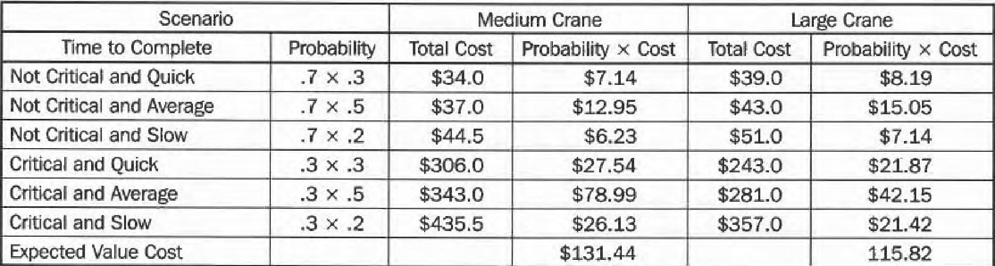
Chapter
03
Answer by Method 1: Payoff
Table 3.2: Payoff Table for Crane Size Selection
www.midocean.ae

Slide 19
Chapter
03
Payoff tables are sometimes an excellent way to present a simple decision situation. Most people use computer spreadsheets for the layout and calculations.
www.midocean.ae

Slide 20
Chapter
03
Decision Trees
Decision tree analysis is a standard calculation method in decision analysis. Decision trees can accommodate more complex problems than payoff tables. Trees are often non-symmetric and have subsequent decision points, which are difficult features to represent in a table. The tree diagram is the decision model and serves as a template for calculating expected values. Decision trees are flexible in expressing the logic of a complex decision. Chapter 5 and Chapter 6 feature decision tree analysis. Squares represent decision points, and circles represent chance events.
www.midocean.ae

Slide 21
Chapter
03
Figure 3.2 shows a decision tree analysis for the Crane Size problem. We can solve small problems easily without special software. Decision trees can quickly become enormous (hundreds or thousands of branches), and decision tree software is immensely helpful. An example decision tree program is DATA (Decision Analysis by TreeAge), and Figure 3.3 is a screen showing the solved tree.
www.midocean.ae

Slide 22
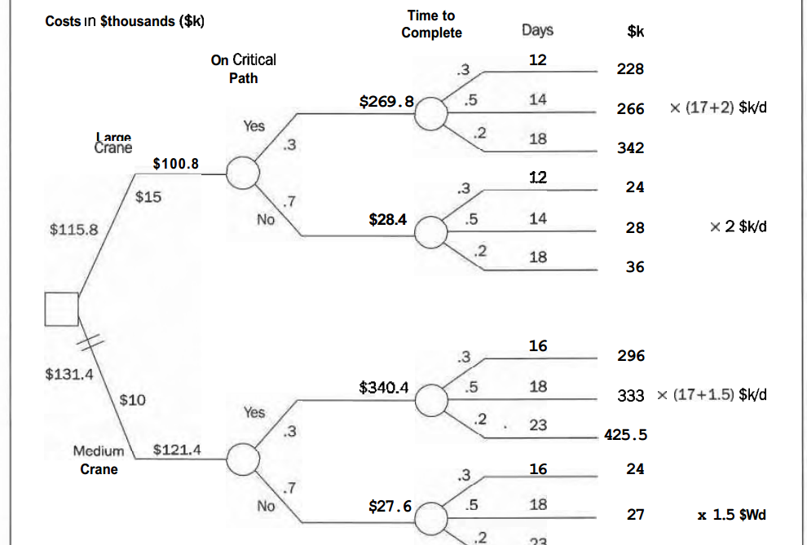
Chapter
Answer by Method : Decision tree
03
www.midocean.ae

Slide 23
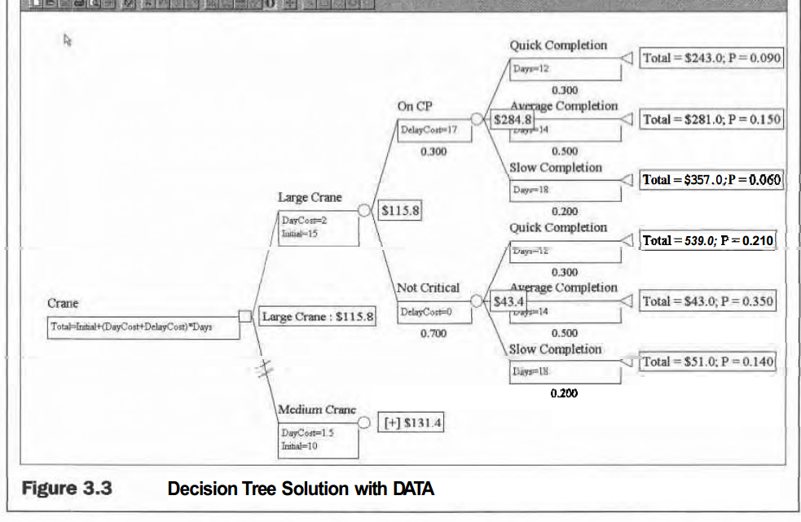
Chapter
03
www.midocean.ae

Slide 24
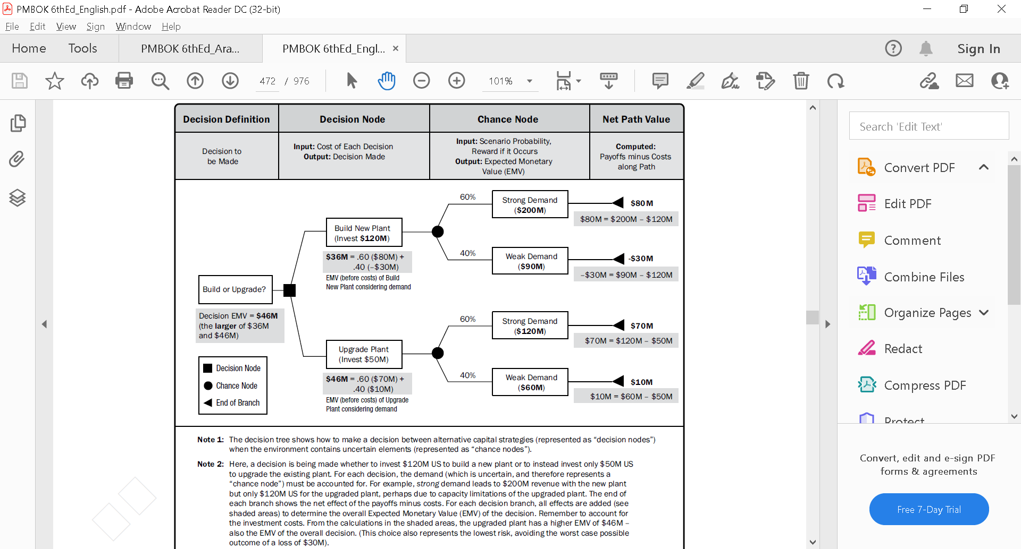
Chapter
Example 2: Decision Tree
03
www.midocean.ae

Slide 25
Chapter
03
Methods Summary
We have now seen two decision model formats: a payoff table and a decision tree. The payoff table works adequately in simple decision models involving a single decision point, several alternatives, and several discrete outcomes. Usually, the chance events in these tables apply symmetrically to every alternative. Decision trees are better able to represent sequences of chance events and subsequent decision points. A problem's structure is often different for each alternative, and decision trees handle this easily.
www.midocean.ae

Slide 26
Chapter
03
Recourse:
RISK and DECISION ANALYSIS in Projects
Second Edition
By: John Schuyler
From Chapter 3 in Book
(Lecture 3 & 4)
www.midocean.ae

Slide 27



Thank You

