Slide 1

Intro to Windows 10

Slide 2
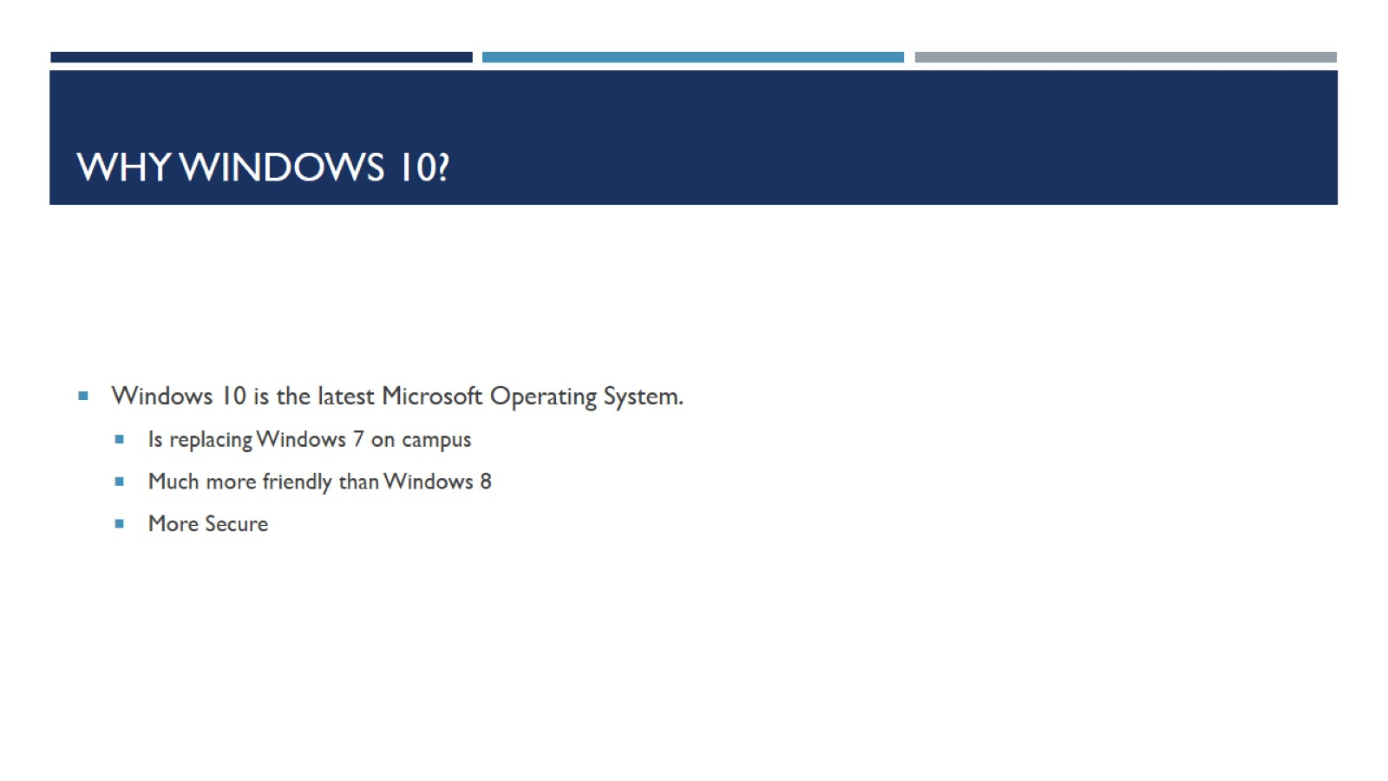
Why windows 10?

Slide 3
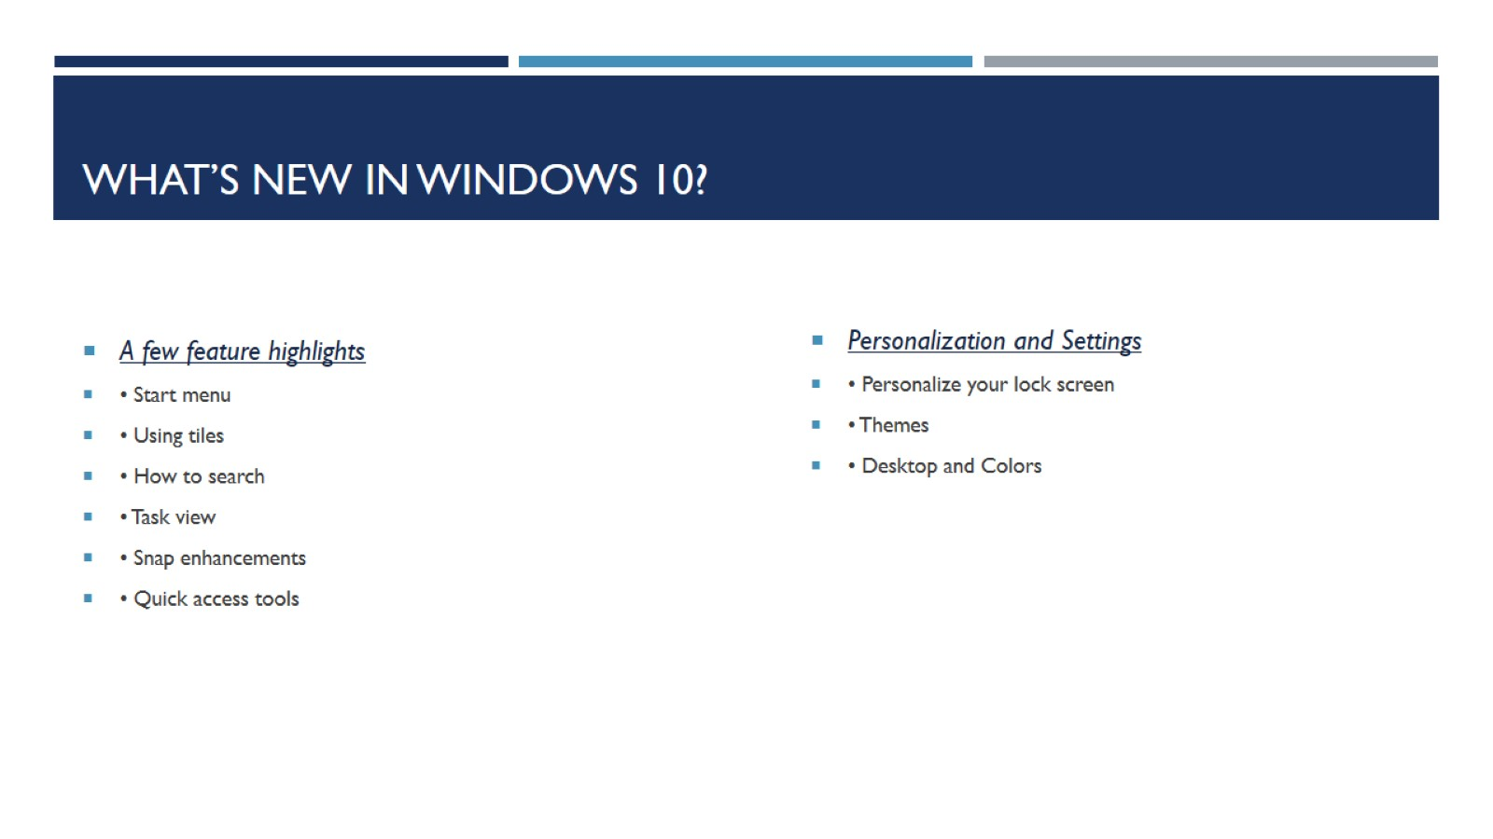
What’s New in windows 10?

Slide 4
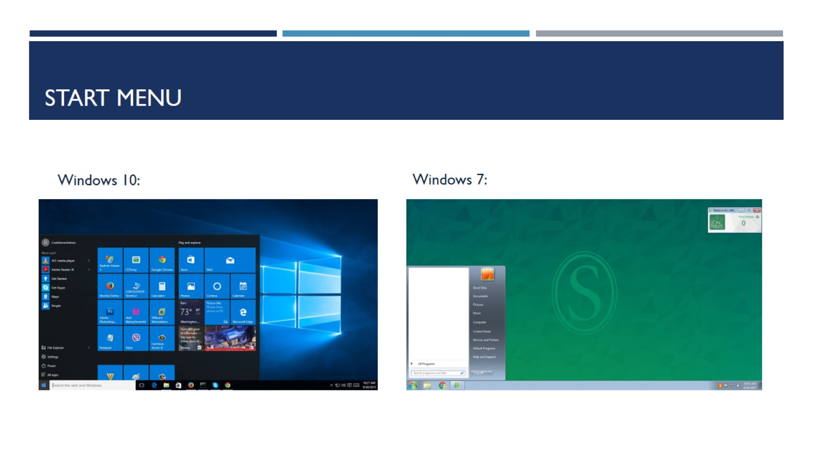
Start Menu

Slide 5
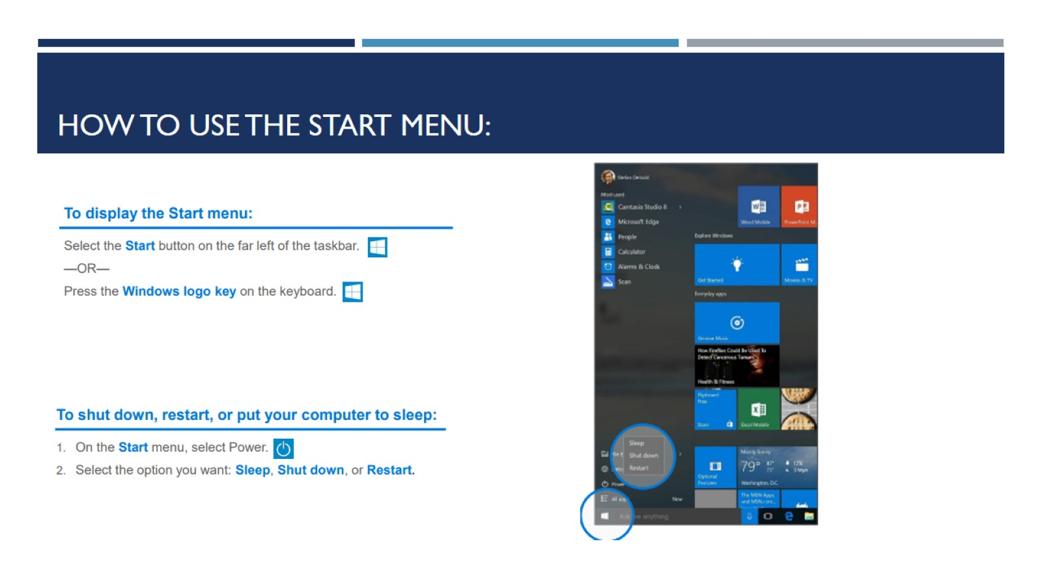
How to use the start menu:

Slide 6
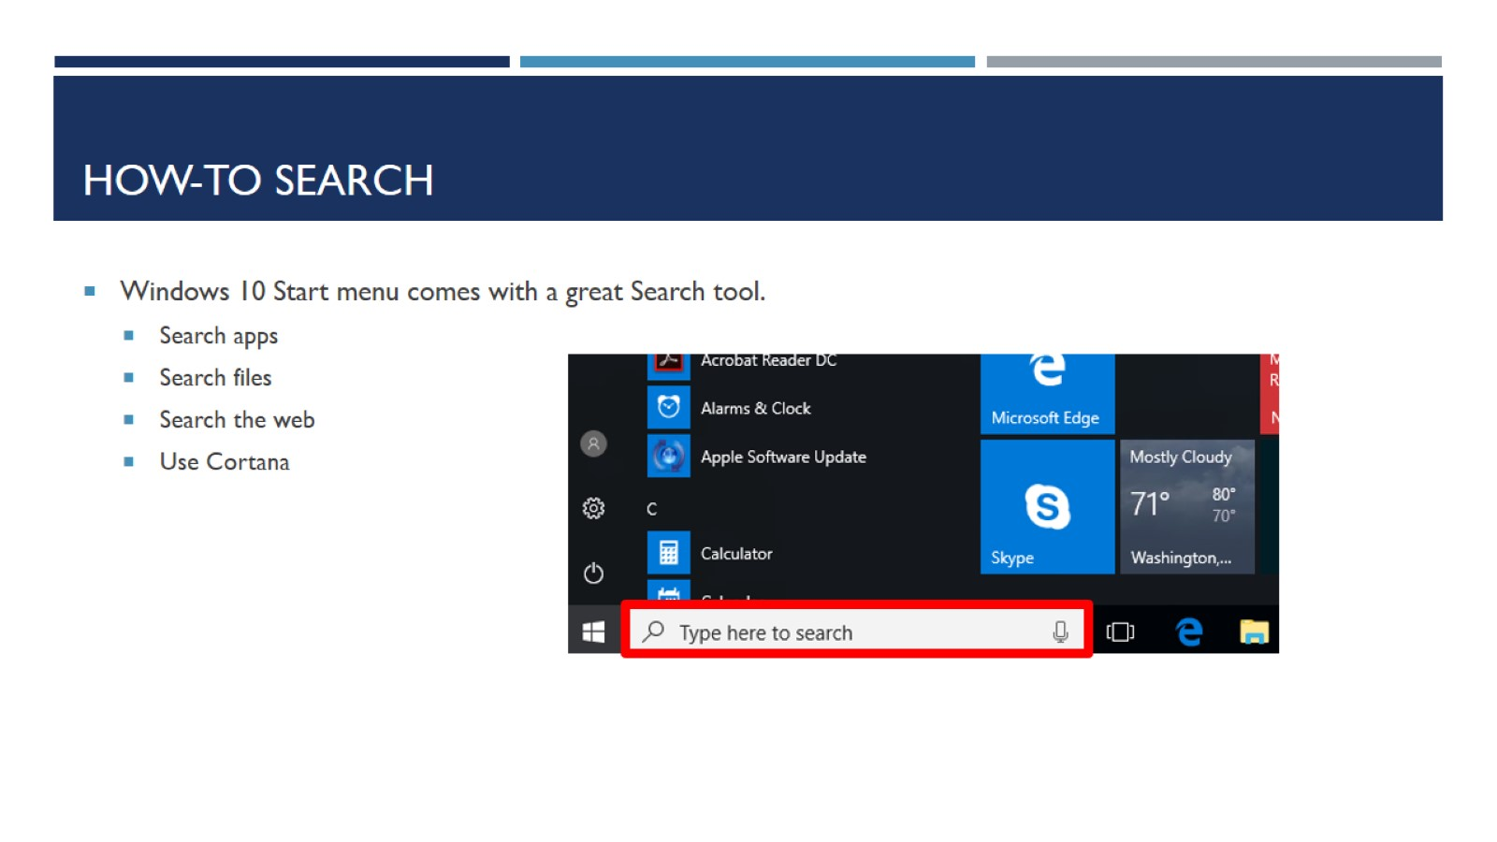
How-to Search

Slide 7
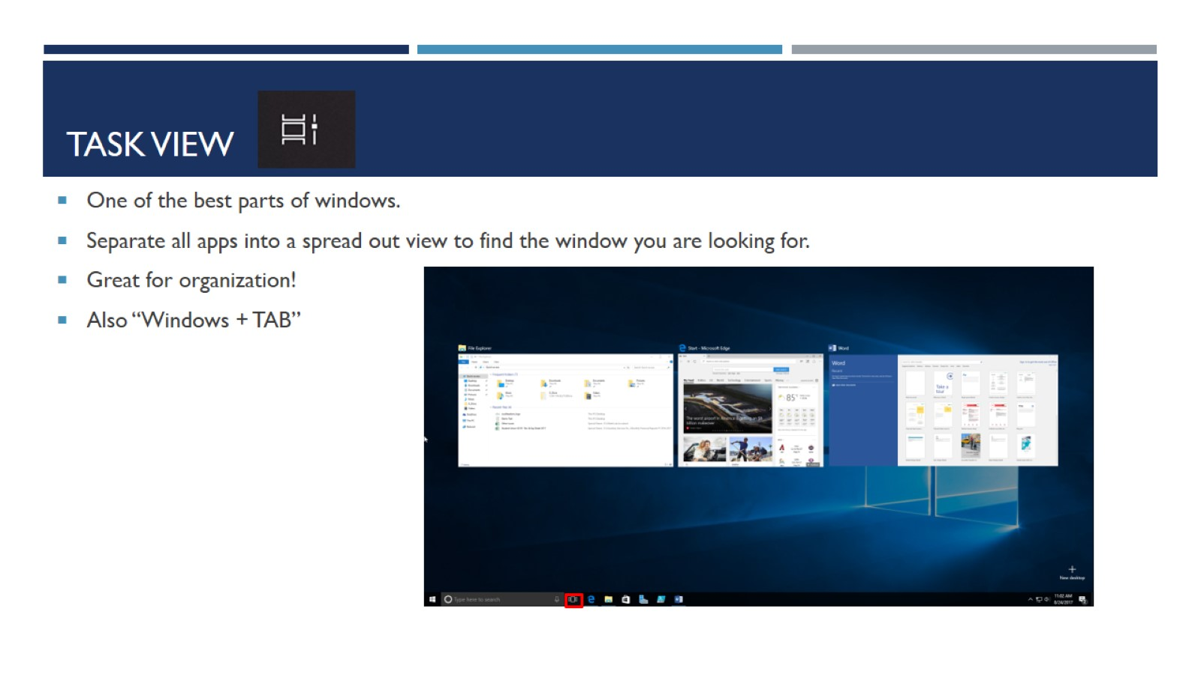
Task View

Slide 8
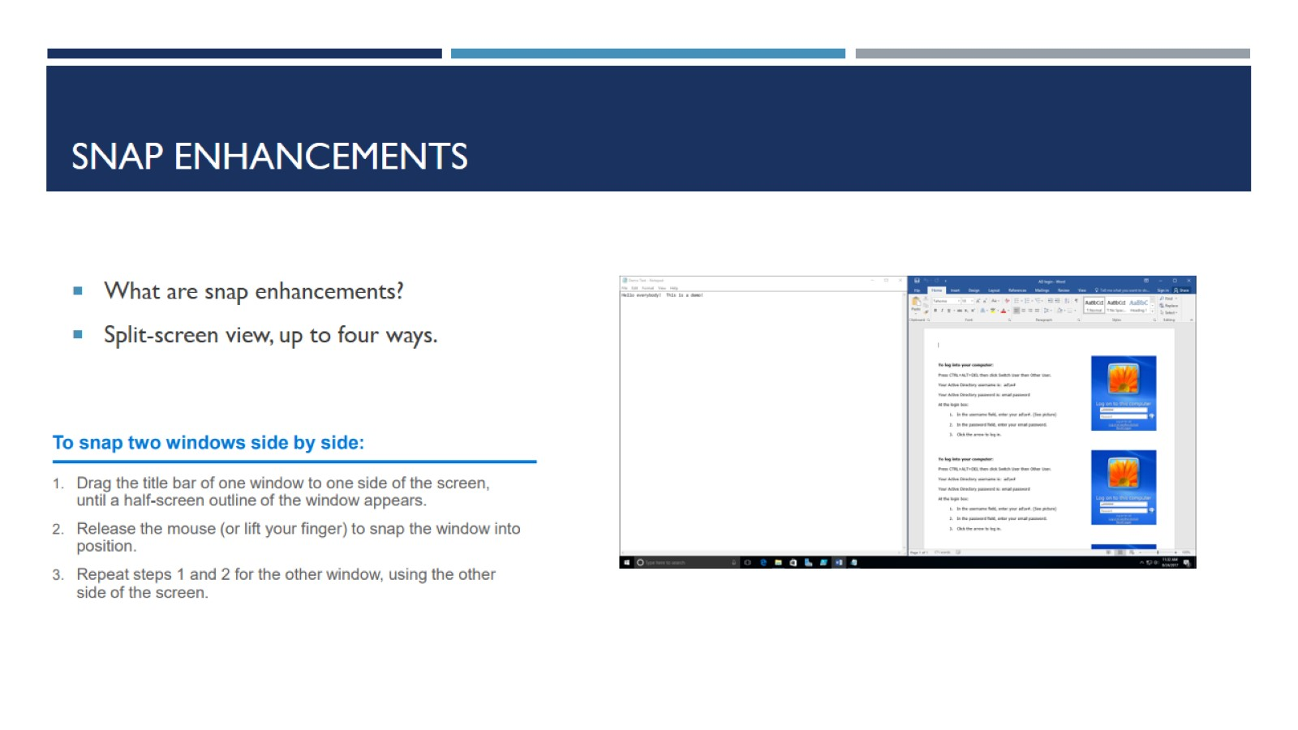
SnAp Enhancements

Slide 9
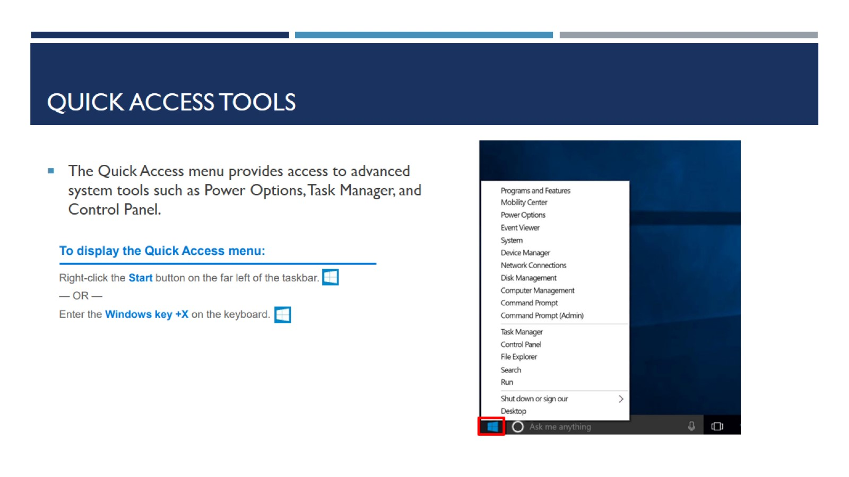
Quick Access Tools

Slide 10
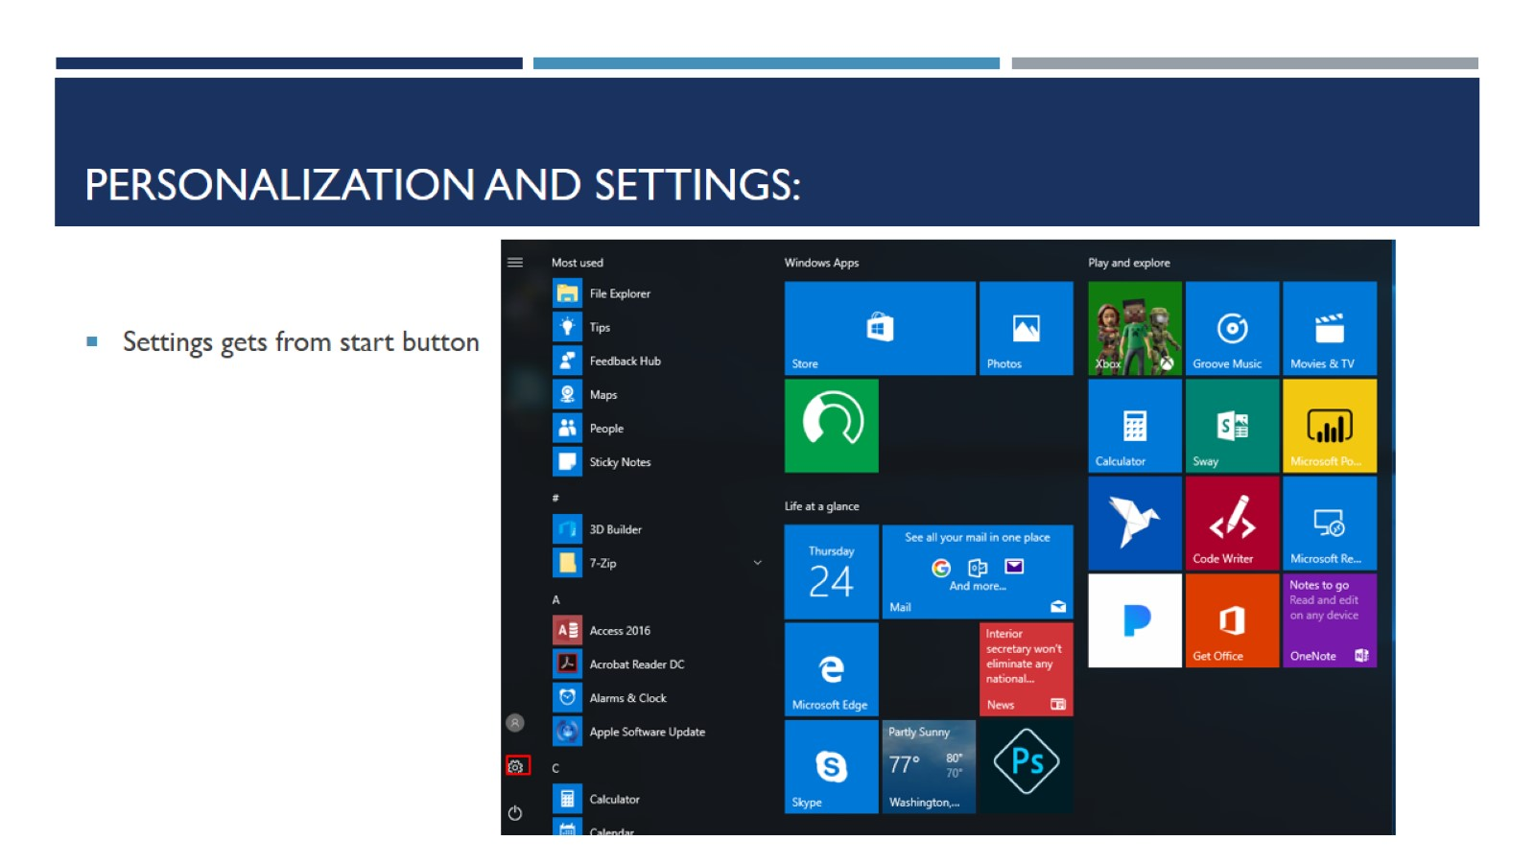
Personalization and Settings:

Slide 11
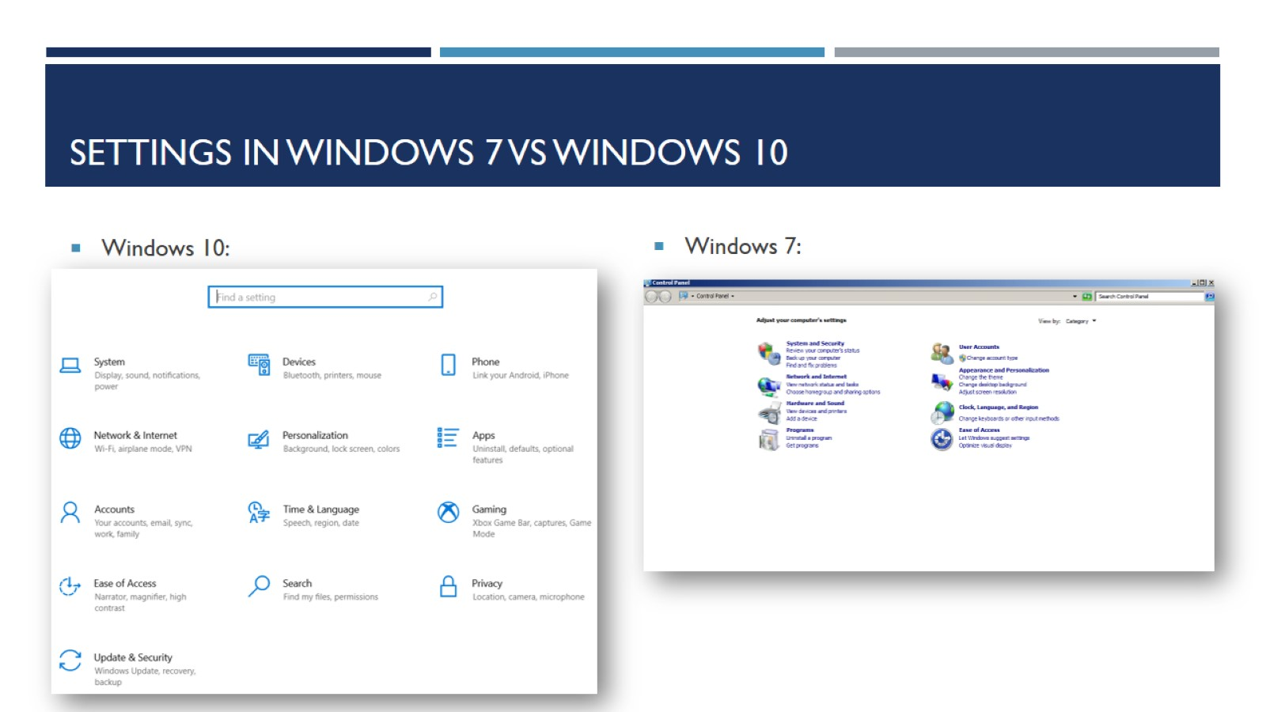
Settings in Windows 7 vs Windows 10

Slide 12
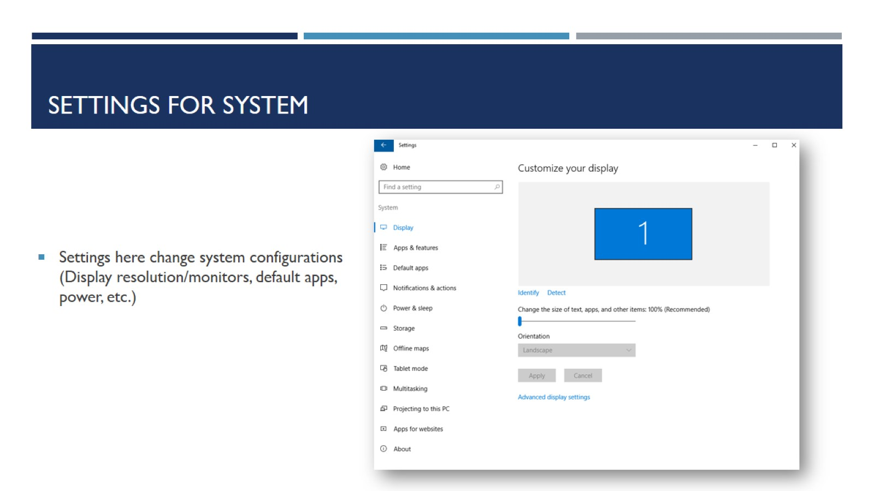
Settings for System

Slide 13
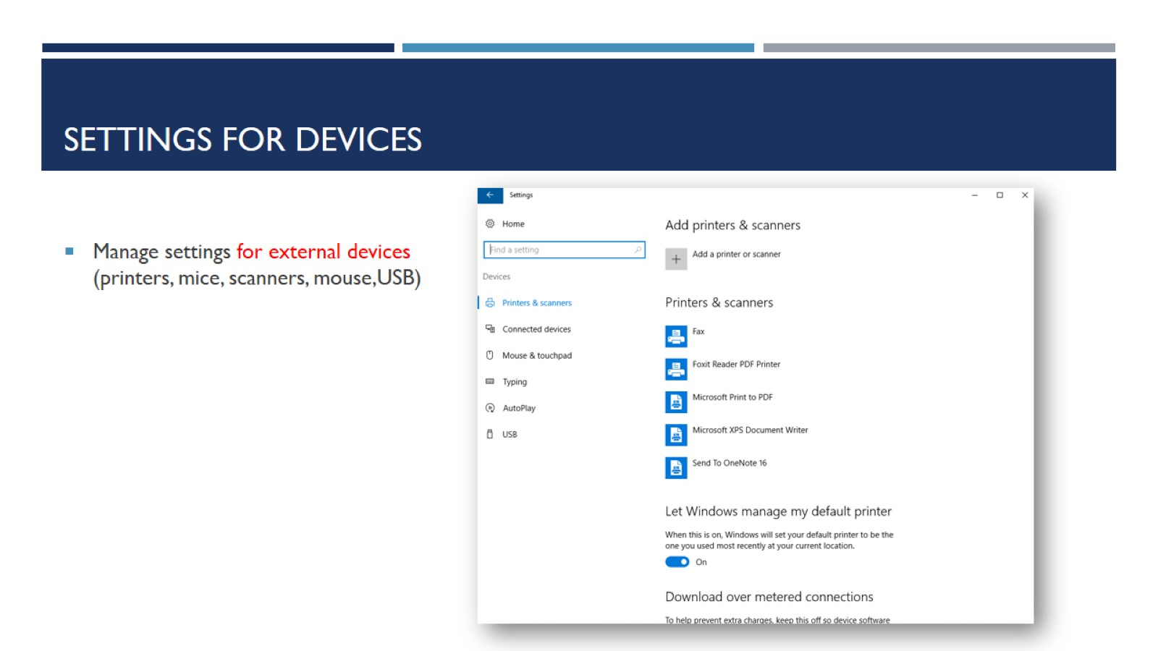
Settings for devices

Slide 14
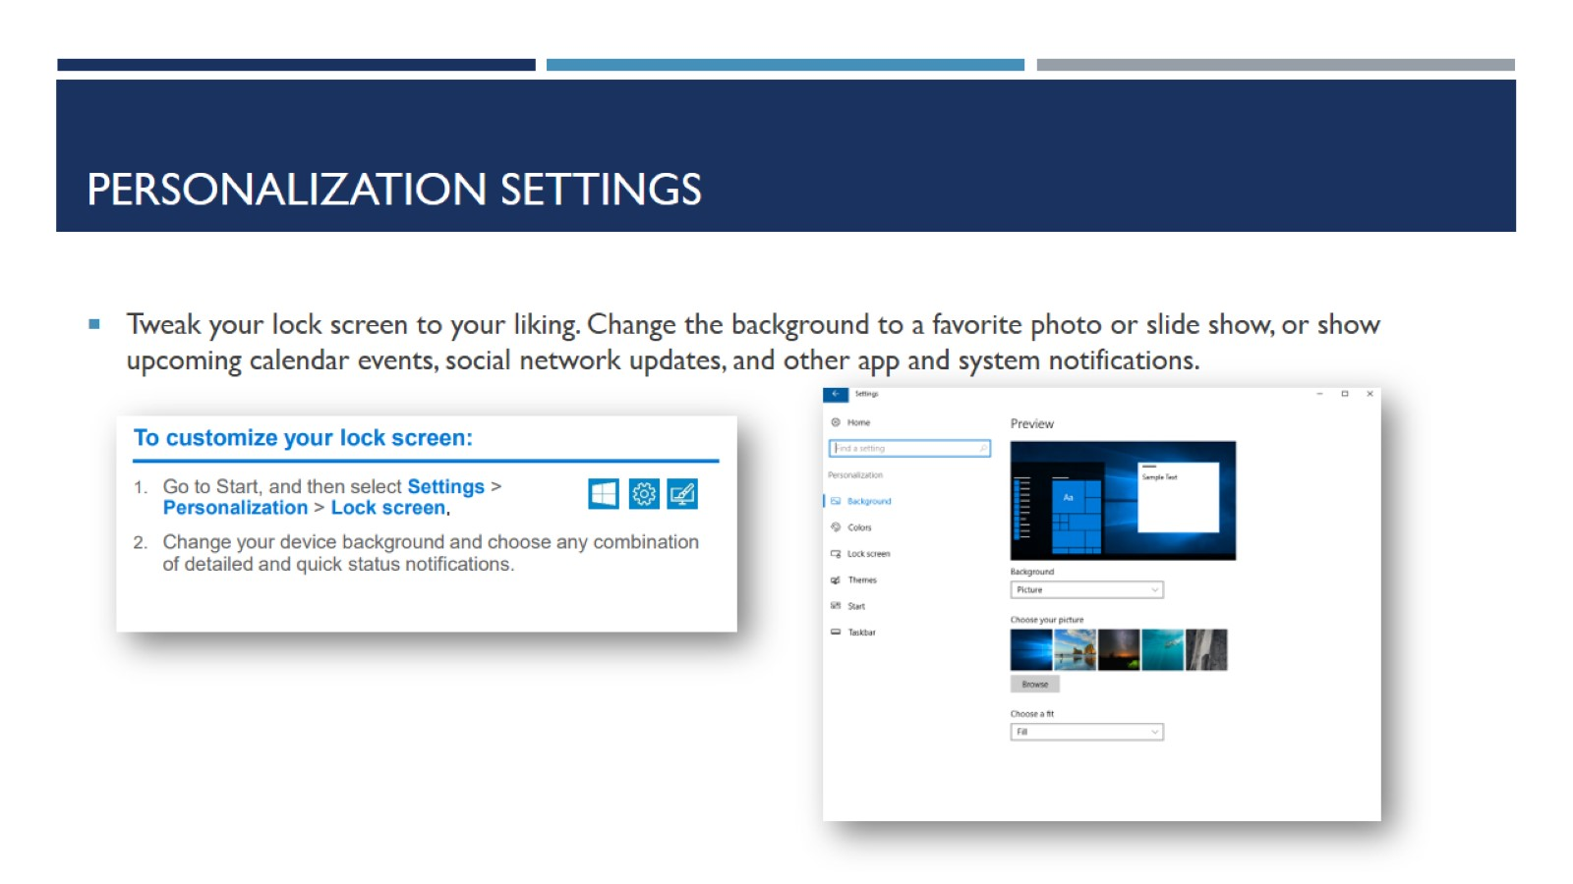
Personalization Settings

Slide 15
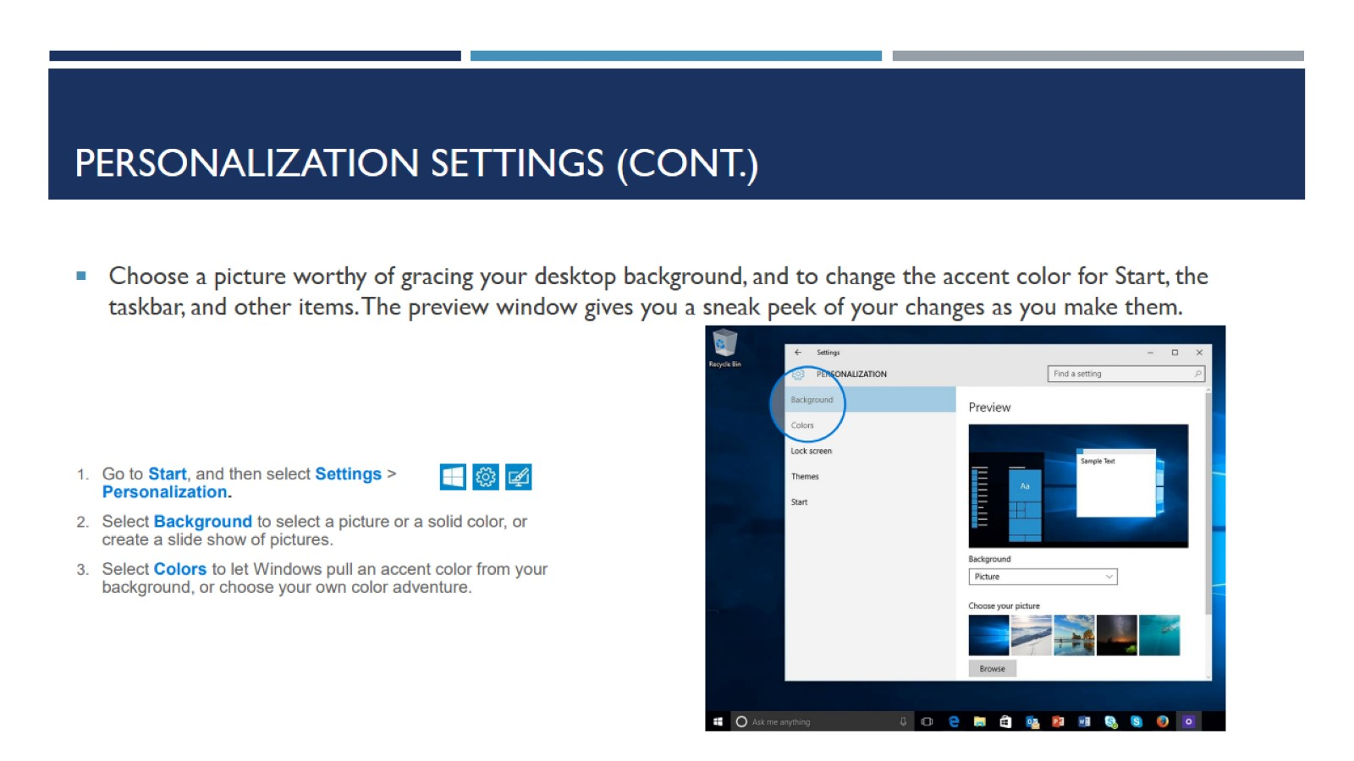
Personalization settings (cont.)

Slide 16
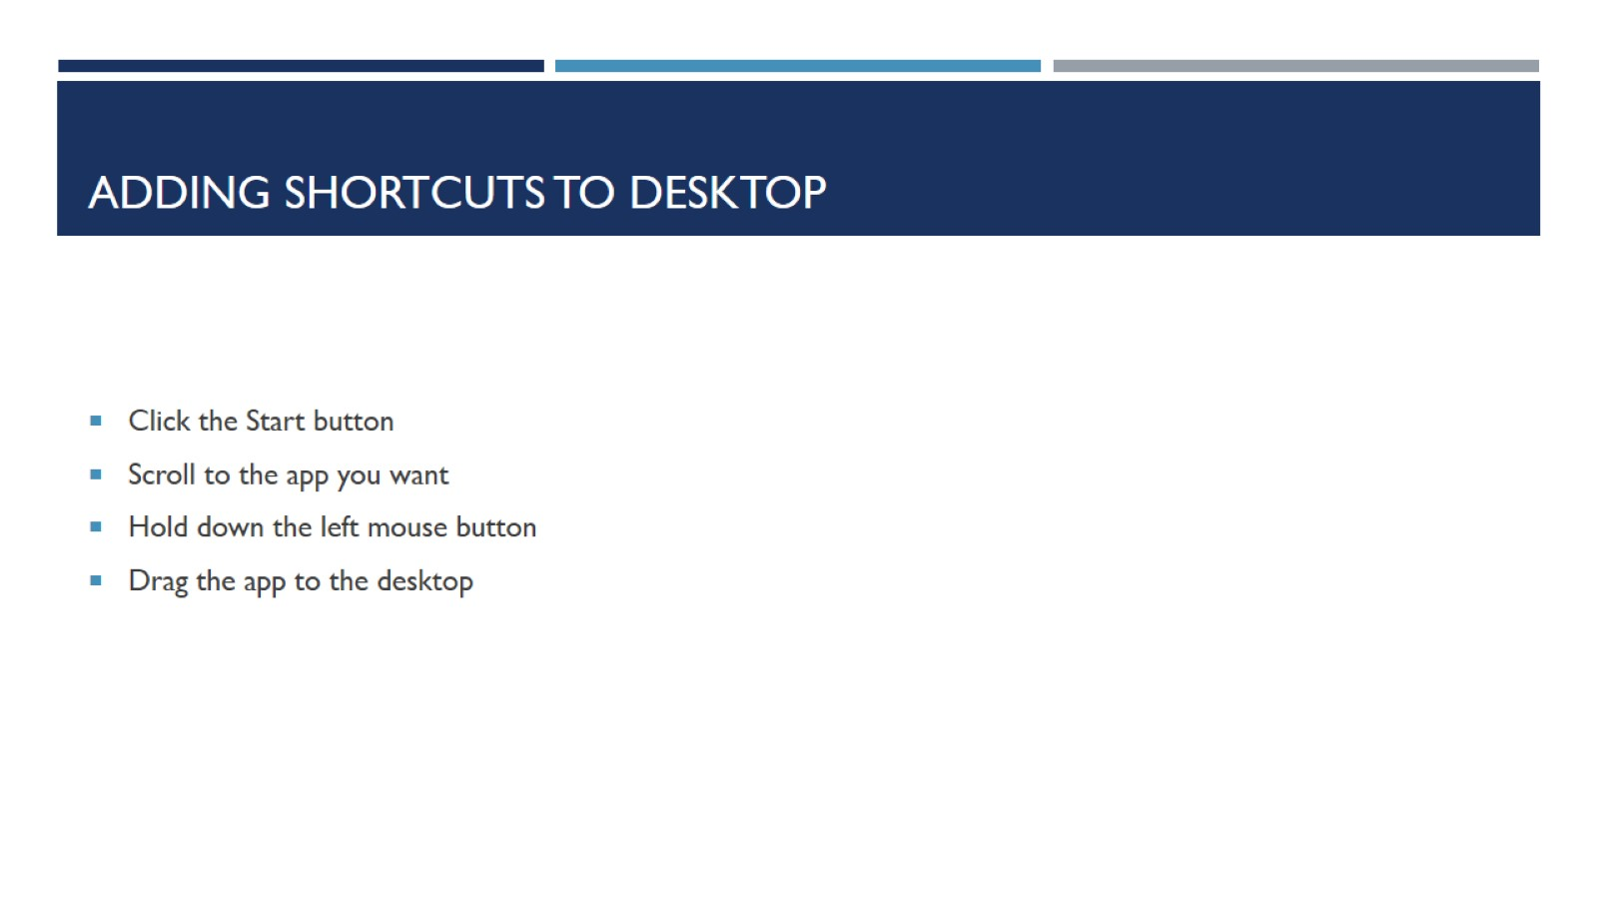
Adding Shortcuts to desktop

Slide 17
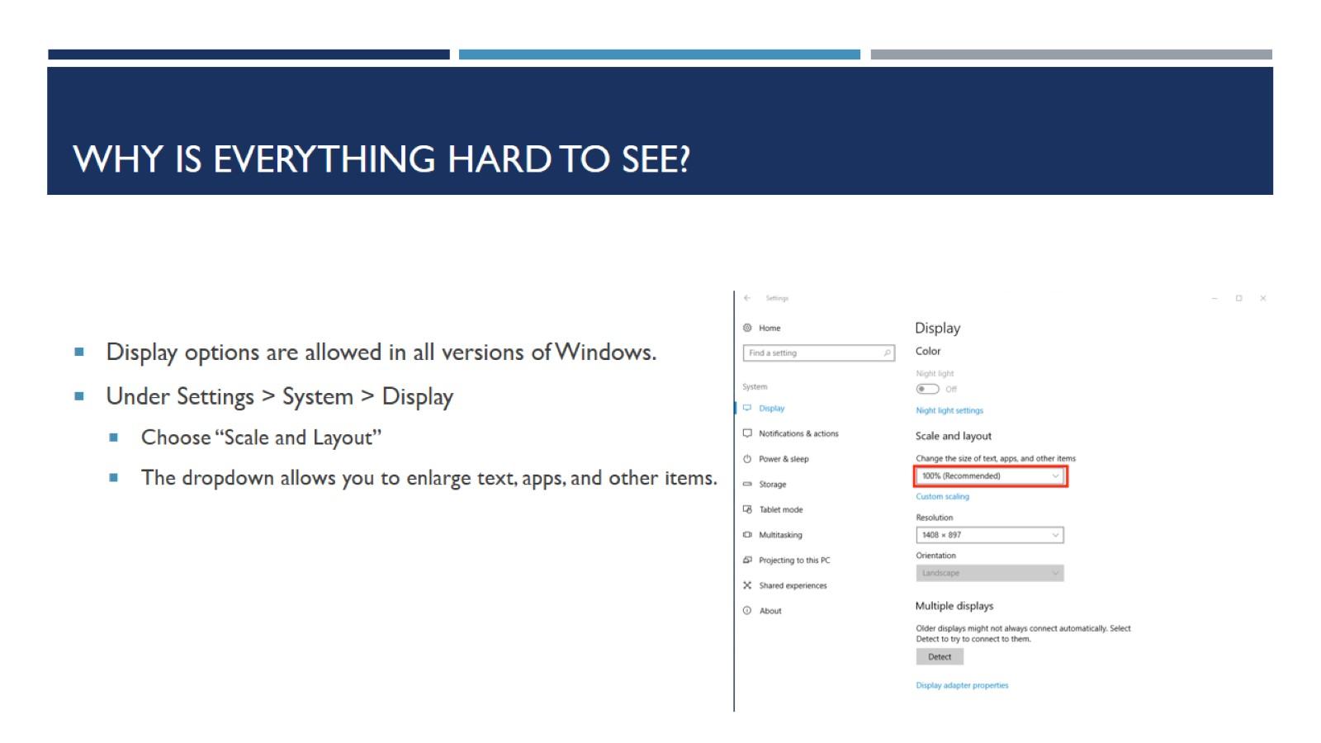
Why is everything hard to see?

Slide 18

Questions??

