Slide 1


Pay for performance
and employee benefits
Prepared by Dr. Sahar Ahmed
Week Nine
Lecture 8

Slide 2

Learning Outcome
1
Gain an awareness of the nature and types of compensation
Understand the different types of equity and their impact on employee behavior
Explain the nature of salary compression and its challenges
4
Develop an awareness of the advantages and disadvantages of pay for performance or incentive pay
Describe the legal issues that influence compensation
Understand the challenges inherent in setting executive compensation level

Slide 3
Importance of Compensation
2023 survey by Mercer
2022 study by Glassdoor
72% of employees survey cited their total rewards package as the primary driver of job satisfaction,
Total compensation and benefits offering was the highest-rated factor for job seekers, with 67% ranking it as 'very important' in their job search.
Studies show that companies with effective total rewards programs have 40% lower turnover rates compared to their peers.

Slide 4

Costco Case Study
While many companies were forced to cut costs due to economic uncertainty, Costco made a conscious decision to not lay off employees, reduce salaries, or decrease benefits.
Impact: This strategy proved successful for several reasons:
Maintained Employee Morale: By prioritizing employee well-being, Costco fostered a sense of security and loyalty among its workforce. This likely contributed to continued high employee engagement and productivity during a challenging time.
Positive Public Perception: Costco's commitment to its employees garnered significant positive publicity, potentially attracting new customers who value companies that treat their workers well.

Slide 5
Costco Case Study
Conclusion
In contrast to Costco, many retail companies were forced to reduce staff, cut salaries, or decrease benefits due to the pandemic's economic impact. This likely led to decreased employee morale and potentially higher turnover.
Overall: Costco's approach demonstrates the potential benefits of maintaining total rewards during economic downturns. It's important to note that this strategy may not be feasible for all companies depending on their financial situation and industry. However, it highlights the potential value of prioritizing employee well-being during challenging times.

Slide 6
Importance of total rewards
Attract, retain and motivate employees
01
Align employees contribution with organizational goals
02
Encourage high performance & Career development
03
Pay employees appropriately and fairly, while controlling total cost
04

Slide 7
Introduction
Compensation is a critical strategic tool for organizations. It significantly impacts employee recruitment, retention, and performance, ultimately influencing organizational success. However, it also represents a substantial operational expense, especially in labor-intensive industries.
The challenge lies in balancing cost-effectiveness with employee satisfaction and motivation. Organizations must design compensation packages that attract and retain talent while maintaining a competitive cost structure.

Slide 8
Introduction
Compensation strategies are evolving. Modern approaches prioritize performance over seniority, offer flexible benefits to cater to individual needs, and provide more frequent rewards. Moreover, compensation is becoming increasingly tied to organizational goals and tailored to individual employees.

Slide 9
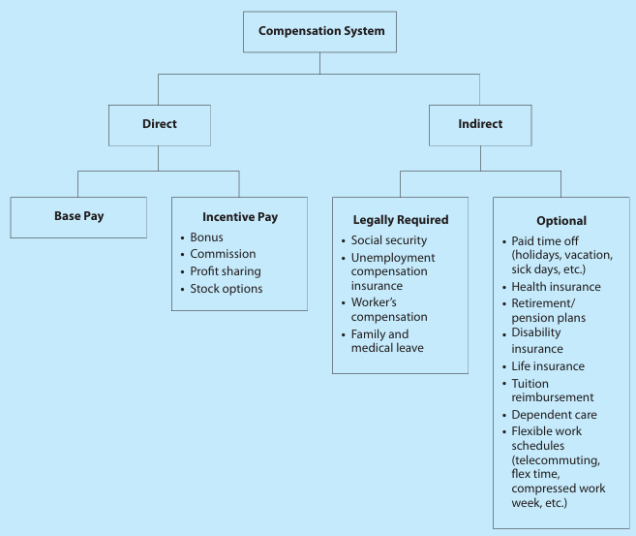
Basic Factors in Determining Pay Rates
Notes:
Employee compensation refers to all forms of pay going to employees and arising from their employment. It has two main components, direct financial payments (wages, salaries, incentives, commissions, and bonuses) and indirect financial payments (financial benefits like employer-paid insurance and vacations).
There are two basic ways to make direct financial payments to employees: base them on increments of time or on performance. Time-based pay is still the foundation of most employers pay plans.
Several factors determine the design of any pay plan: company strategy and policy, equity, legal, and union.

Slide 10
Basic Factors in Determining Pay Rates
comp
Employee compensation is the total package of financial rewards and benefits given to employees in exchange for their work. It comprises two main parts:
Direct financial payments: These are monetary rewards like wages, salaries, commissions, bonuses, and incentives. They can be based on time worked (hourly or salaried) or on performance (piecework or sales commissions).
Indirect payments (Benefits) : These are non-cash benefits like health insurance, paid vacations, and retirement plans.

Slide 11
Aligning Total Rewards with Strategy
comp
Creating an effective compensation plan involves considering several factors, including company strategy, equity, legal requirements, and union agreements.
A crucial aspect is aligning the compensation plan with the company's overall goals. This involves developing a total rewards strategy that includes not only traditional pay and benefits, but also other factors like job design, career growth, and employee recognition, that produces the employee behaviors the firm needs to support and achieve its competitive strategy.
Essentially, the goal is to create a compensation package that are consistent with the firm’s strategic aims and motivate employees to contribute to the company's success in line with its strategic objectives.

Slide 12
Jamba Juice: A Strategic Compensation Case Study
comp
Jamba Juice, a leading retailer of blended fruit smoothies, faced a significant challenge: attracting and retaining qualified managers in a highly competitive market. The company's location in the San Francisco Bay Area, a hub for technology companies offering lucrative compensation packages, exacerbated this issue.
To overcome these hurdles, Jamba implemented the J.U.I.C.E. Plan, a strategic compensation program designed to incentivize and retain its managerial talent. This plan offered general managers a percentage of store cash flow based on financial performance. To further encourage long-term commitment, Jamba introduced a retention account that allowed managers to share in store profits over a three-year period. Additionally, all managers received traditional stock options, and general managers were rewarded with cash bonuses for developing assistant managers.

Slide 13
Jamba Juice: A Strategic Compensation Case Study
comp
The J.U.I.C.E. Plan proved highly effective in reducing managerial turnover and enhancing employee morale. It not only helped Jamba compete with technology companies for talent but also attracted interest from potential employees, managers, and franchisees in international markets.
In essence, Jamba Juice's strategic compensation approach successfully addressed its talent retention challenges by offering a compelling package of short-term and long-term incentives, aligning employee goals with company objectives, and fostering a high-performance culture.

Slide 14
Jamba Juice: A Strategic Compensation Case Study
comp
Key elements of Jamba Juice's compensation strategy:
Performance-based incentives: Rewarding managers based on store performance.
Long-term commitment: Encouraging employee retention through the retention account and stock options.
Talent development: Investing in employee growth through cash bonuses for developing assistant managers.
Competitive compensation: Offering a package that is comparable to technology companies in the area.
By implementing the J.U.I.C.E. Plan, Jamba Juice demonstrated how a well-crafted compensation strategy can be a powerful tool for achieving business objectives and gaining a competitive advantage.

Slide 15
Equity and Pay Rates
comp
Equity theory posits that people strive for a balance between their inputs (effort, skills, etc.) and outputs (pay, benefits, etc.). If this balance is perceived to be unfair, it can lead to dissatisfaction and decreased motivation.
External equity focuses on how a company's pay rates compare to those in the external market for similar jobs.
Internal equity ensures fair pay comparisons within the company across different job roles.
Individual equity relates to the fairness of pay for individual employees based on their performance and contributions.
Procedural equity concerns the fairness of the processes used to determine pay, such as performance evaluation methods.

Slide 16
Employee Perceptions of Compensation Fairness
comp
Confidentiality around compensation can make it difficult for employees to gauge if they're being paid fairly compared to colleagues. However, these perceptions significantly impact their motivation, commitment, and performance.
Compensation as a Fairness Indicator: Even though salary isn't the only work benefit, it's often the basis on which employees judge fairness.
The Rise of Salary Comparison Tools: The internet offers a plethora of salary data websites. Popular examples include Salary.com and CareerJournal.com, which attract millions of visitors seeking salary comparisons.

Slide 17
Employee Perceptions of Compensation Fairness
comp
Challenges with Online Data: Much of this information might be inaccurate, outdated, or irrelevant to specific jobs. This confusion is further compounded by employers who fail to communicate their compensation policies clearly.
The Need for Transparency: With readily available salary data online, it's crucial for employers to develop a fair compensation system and effectively explain it to their employees.

Slide 18
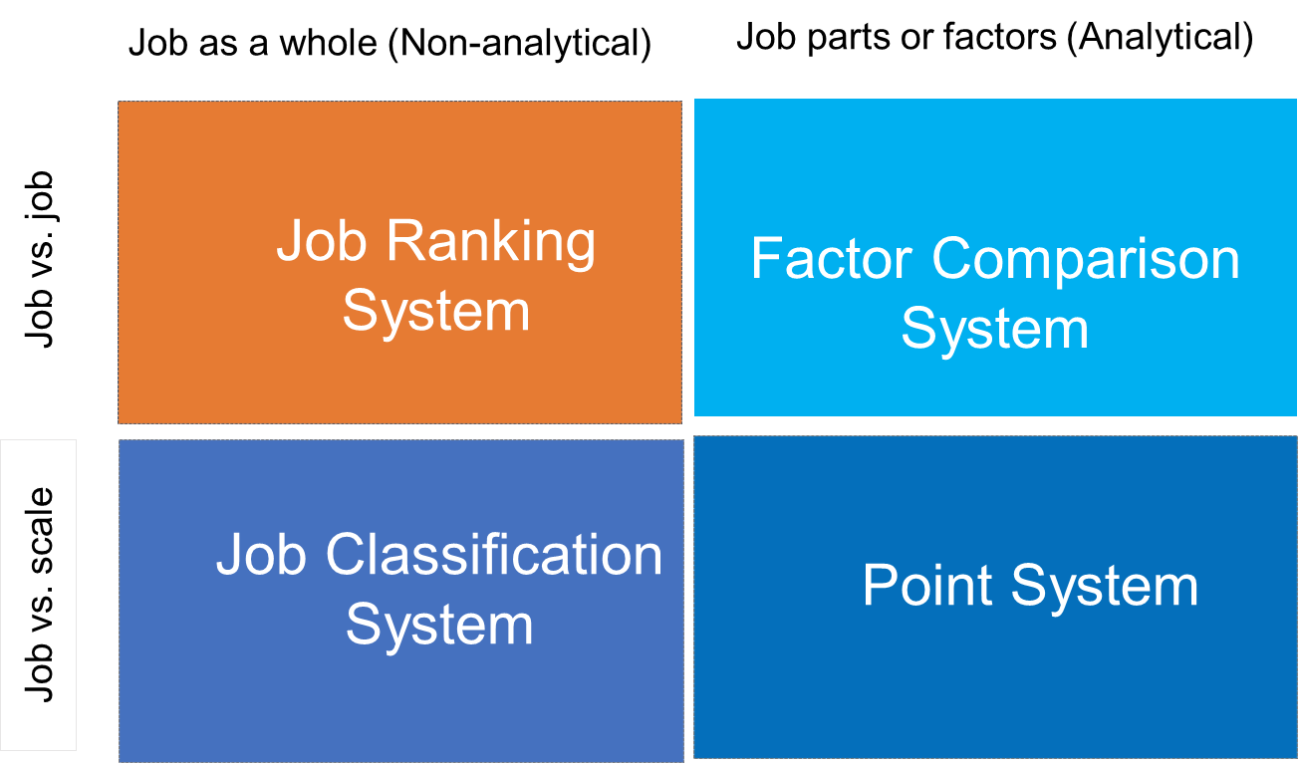
Job Evaluation Methods

Slide 19
Information Required
Context
Job
Organization Purpose
Job Purpose
Relationships
Org. Structure
Accountabilities
Pay Policy
Skills, Knowledge
Organizational Culture & Sector
Main Challenges
Dep. Structure

Slide 20








08
Review Periodically
07
Installing the programs
06
Classify jobs
05
Select Job evaluation methods
Job Evaluation Process
04
Analyze/prepare JDs
03
Choose Benchmarking Jobs
02
Assigning Committee
01
Gaining Acceptance

Slide 21
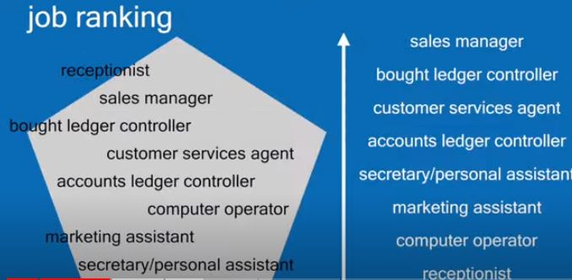
Job Evaluation Methods- Job Ranking
1- Job Ranking:
A simple method where jobs are ranked based on overall difficulty, suitable for - small organizations.

Slide 22
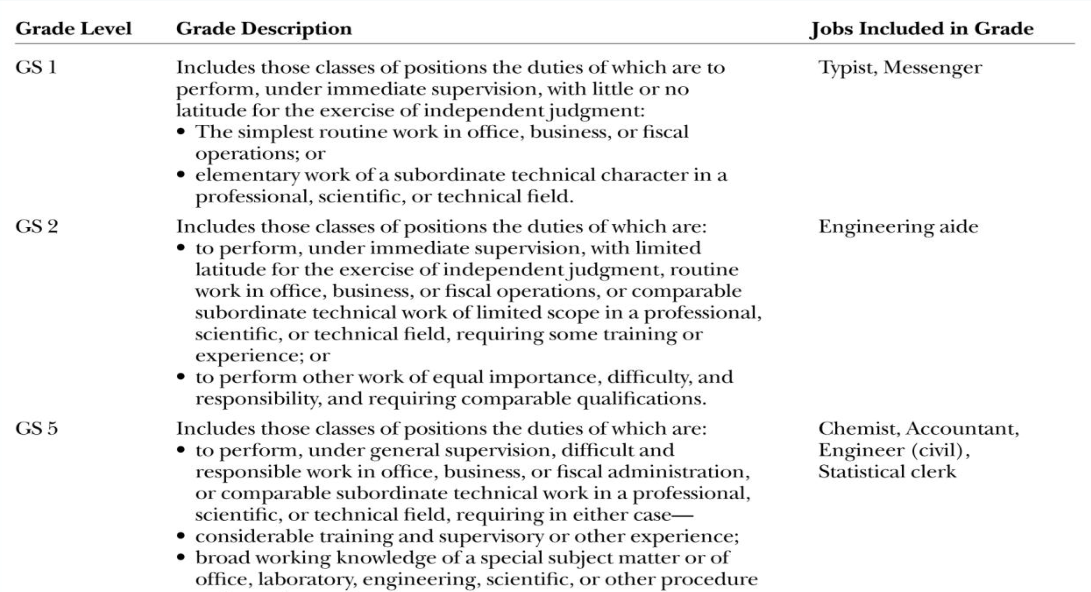
Job Evaluation Methods- Job Classification
2-Job Classification:
Groups similar jobs into classes or grades, offering a more structured approach than ranking.

Slide 23
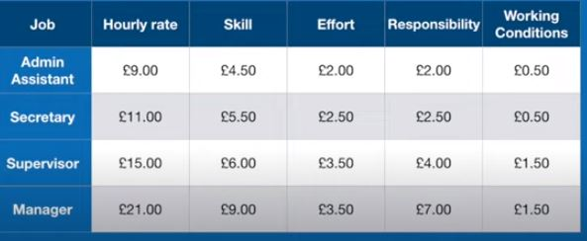
Job Evaluation Methods- Factor Comparison
3. Factor Comparison:
Compares jobs based on factors like responsibility, skills, and effort to determine relative pay.

Slide 24
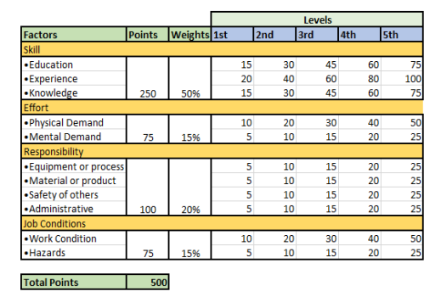
Job Evaluation Methods- Point Method
4. Point Method:
A quantitative method assigning points to job factors like skills, responsibilities, and working conditions to determine pay. The Hay Plan is a popular point system.

Slide 25
Choosing the right method
While point systems and factor comparison offer more precision, each method has strengths and limitations, the choice of method depends on the organization's size, complexity, and strategic goals.
Ultimately, the goal is to create a pay structure that employees perceive as fair and equitable.

Slide 26
Consequences of Inequity and Salary Compression
An inequitable compensation system can lead to serious consequences, including decreased morale, reduced productivity, and increased turnover. Organizations can choose from various methods to establish internal pay equity, each with its own advantages and drawbacks.
A growing concern is salary compression, where new hires earn more than experienced employees. This often occurs wen there is a minimal pay difference between employees with varying levels of experience, skills, or responsibilities. This can lead to decreased morale, turnover, and decreased productivity.

Slide 27
Consequences of Inequity and Salary Compression
Several factors can contribute to salary compression:
Market Pressures: To attract top talent in competitive markets, companies may offer higher starting salaries, compressing the pay gap between new and experienced employees.
Economic Conditions: Periods of economic downturn or inflation can erode the value of existing salaries, leading to compression.
Lack of Regular Salary Adjustments: Failing to adjust salaries to reflect market changes, promotions, or increased responsibilities can exacerbate the issue.
Internal Equity Issues: Inconsistent pay practices across departments or job roles can contribute to salary compression.

Slide 28
Strategies to mitigate the negative impact of salary compression
Regular Salary Reviews: Conduct annual or biannual salary reviews to ensure pay rates remain competitive and equitable.
Market Analysis: Regularly assess market rates for different positions to identify potential compression issues.
Targeted Salary Adjustments: Provide targeted salary increases to employees who are significantly undervalued compared to market rates.
Communication: Openly communicate compensation philosophy and practices to employees to build trust and transparency.

Slide 29
Strategies to mitigate the negative impact of salary compression
Career Development: Offer opportunities for career advancement and skill development to compensate for salary compression.
Performance-Based Pay: Implement performance-based pay systems to reward top performers and differentiate compensation based on contributions.
Budgeting for Salary Increases: Allocate sufficient funds for salary adjustments to prevent future compression.

Slide 30
External Equity: Comparing Pay with Competitors
External equity focuses on how an organization's pay compares to similar roles in other companies. There are three main pay strategies:
Lead Policy: Paying above-market rates to attract top talent. Requires operational efficiency or a unique product to offset higher labor costs.
Lag Policy: Paying below-market rates, often compensating with other benefits like career growth or work-life balance. Requires a deep understanding of employee preferences.
Market Policy: Matching competitor pay rates, focusing on non-pay factors to attract employees. Most companies adopt a market-level strategy to balance competitiveness and cost control.

Slide 31
Individual Equity: Pay for Performance
Individual equity focuses on how pay is distributed among employees holding the same job within an organization.
Several methods determine individual pay:
Seniority-based pay: Rewards length of service, not performance. Common in unionized environments and legally favored due to objectivity.
Merit pay: Ties pay increases to individual performance evaluations. Can be subjective and linked to overall performance management systems.
Incentive pay: Directly links compensation to individual, team, or organizational performance. Often tied to specific, measurable goals. Examples include commissions, profit-sharing, and stock options.

Slide 32
Individual Equity: Pay for Performance
Performance-Based Pay
A broader term encompassing any compensation system that ties pay to employee performance.
Includes both merit pay and incentive pay.
Can be based on individual, team, or organizational performance.
Merit pay, while tied to performance, is often seen as a more traditional approach where pay increases are added to the base salary and become a permanent part of compensation. Incentive pay, on the other hand, is typically a variable component that is earned based on specific performance criteria and does not necessarily become part of the base salary.

Slide 33
Challenges and Considerations in Performance-Based Pay
Cultural Barriers
Individualistic vs. Collectivist Cultures: Performance-based pay can be more effective in individualistic cultures that prioritize personal achievement. In collectivist cultures, where group harmony is valued, individual rewards might create tension.
Power Distance: In high power distance cultures, where there's a large gap between management and employees, performance-based pay might be perceived as unfair or challenging to implement.

Slide 34
Challenges and Considerations in Performance-Based Pay
Skill-Based Pay
Skill Identification: Determining the most critical skills for an organization can be complex and requires careful analysis.
Skill Assessment: Developing reliable methods to assess employee skills accurately is essential.
Skill Maintenance: Ensuring employees maintain and upgrade their skills requires ongoing training and development opportunities.
Pay Compression: If not managed carefully, skill-based pay can lead to pay compression when experienced employees with higher skill levels are paid similarly to newer employees with fewer skills.

Slide 35
Challenges and Considerations in Performance-Based Pay
Team-Based Pay
Free-Rider Problem: Addressing the issue of team members who contribute less than others is crucial for the success of the plan.
Team Composition: Effective team-based pay requires carefully selected and balanced teams.
Performance Measurement: Developing accurate and fair measures of team performance can be challenging.
Reward Distribution: Determining how to distribute rewards among team members equitably is essential.

Slide 36
Challenges and Considerations in Performance-Based Pay
Additional Considerations
Communication: Open and transparent communication about the performance-based pay system is vital for employee buy-in.
Performance Management: A robust performance management system is essential to support performance-based pay.
Equity: Ensuring fairness and equity in the distribution of rewards is crucial to prevent demotivation.
Flexibility: The system should be adaptable to changes in the business environment and employee needs.

Slide 37
Team-Based Incentive Pay at Children's Hospital Boston
Problem: Children's Hospital Boston's accounts receivable department was experiencing low morale and inefficiencies due to a poorly implemented new billing system. This resulted in a significantly delayed payment cycle, negatively impacting the hospital's cash flow.
Solution: To address these issues, the hospital introduced a team-based incentive plan. This plan linked employee performance directly to the department's financial success by focusing on reducing the average number of days it took to collect payments. Employees were empowered to set performance goals and were rewarded based on achieving specific targets.

Slide 38
Team-Based Incentive Pay at Children's Hospital Boston
Implementation:
Employee involvement: Employees were actively involved in developing the incentive plan, which fostered a sense of ownership and commitment.
Performance metrics: Clear and measurable goals were established, allowing employees to track their progress.
Reward structure: A tiered incentive system was implemented to motivate employees at different performance levels.
Results: The team-based incentive plan was highly successful. It not only improved employee morale and engagement but also significantly reduced the average collection period from over 100 days to the mid-60s within two years. This improvement in cash flow had a positive impact on the hospital's overall financial health. Additionally, the program helped to reduce employee turnover in the department.

Slide 39
Legal Issues in Compensation
Compensation systems must comply with various labor laws to avoid legal issues.
The Equal Pay Act mandates equal pay for equal work, regardless of gender, but it has limitations due to job segregation.
The concept of comparable worth aims to paying women and men equal wages for jobs of comparable value, even if the jobs are different
The Fair Labor Standards Act (FLSA) regulates minimum wage, overtime pay, and child labor. Its application to modern work arrangements, such as temporary workers and independent contractors, has led to legal complexities and significant litigation.
In summary, organizations must carefully consider legal requirements when designing and implementing compensation systems to avoid costly legal disputes and penalties.

Slide 40
Executive Compensation
One of the most striking aspects of executive compensation is the vast disparity between the earnings of top executives and average employees.
Several factors contribute to this phenomenon:
Shareholder Value Emphasis: A primary driver of executive compensation is the focus on maximizing shareholder value. To attract and retain top talent capable of delivering these results, companies often resort to lucrative compensation packages.
Industry Differences: The compensation of executives in industries like technology, finance, and pharmaceuticals tends to be higher than in other sectors due to higher levels of risk and potential reward.

Slide 41
Executive Compensation
Company Size and Performance: Larger, more profitable companies typically offer higher executive compensation packages.
Talent Scarcity: In industries with a limited pool of qualified executives, competition for top talent can drive up compensation.

Slide 42
Executive Compensation Components
Executive compensation packages typically include:
Base Salary: A fixed annual amount.
Annual Bonuses: Performance-based incentives tied to short-term goals.
Long-Term Incentives: Stock options, restricted stock, or performance-based stock awards linked to long-term company performance.
Benefits: Health insurance, retirement plans, and other perks.
The balance of these components varies depending on the company's strategy, industry, and performance.

Slide 43
Executive Compensation Controversies
Executive compensation has been subject to intense criticism due to:
Excessive Pay: The perceived disparity between executive pay and that of average employees has led to public outcry and regulatory scrutiny.
Performance Misalignment: Concerns have been raised about the lack of correlation between executive compensation and company performance.
Accounting Scandals: Instances where executives received substantial compensation despite company failures have eroded public trust.

Slide 44
Executive Compensation Controversies
Regulatory Response
To address these concerns, governments have implemented regulations such as:
Dodd-Frank Wall Street Reform and Consumer Protection Act: Introduced "clawback" provisions to recover excessive executive pay in case of financial restatements.

Slide 45
Trends in Executive Compensation
Increased focus on long-term performance: To align executive interests with shareholder value, companies are placing more emphasis on long-term incentives.
Clawback provisions: Becoming more common to protect shareholders from excessive pay in case of company failures.
Shareholder activism: Shareholders are exerting greater influence on executive compensation decisions through voting and engagement.

Slide 46

Rewards Transformation at Starbucks
The Challenge: Starbucks, has been recognized for its innovative approach to total rewards. In the early 2000s, as the company was rapidly expanding both domestically and internationally, Starbucks realized that its traditional total rewards strategy was no longer serving the needs of its diverse and growing workforce.
The company's goals were to:
Enhance employee attraction and retention by offering a more competitive and differentiated total rewards package.
Align the total rewards strategy with the company's mission, values, and culture of providing a superior employee experience.
Promote employee well-being and work-life balance to support higher levels
of engagement and productivity.

Slide 47
Rewards Transformation at Starbucks
Solution: After conducting extensive research and gathering feedback employees, the company made several strategic changes to its total rewards approach:
Expanded healthcare benefits:
Introduced equity-based compensation Offered tuition assistance: Starbucks launched the Starbucks College Achievement Plan
Enhanced work-life balance initiatives

Slide 48
Rewards Transformation at Starbucks
The impact
10% reduction in annual employee turnover
25% increase in employee engagement scores,
Improved brand perception and increased job applications from top-tier talent
Stronger financial performance,.

Slide 49
Conclusion
Compensation is a multifaceted strategic tool that significantly impacts an organization's ability to attract, retain, and motivate employees. It is influenced by various factors, including job roles, performance, market conditions, and legal regulations.
Effective compensation systems seek to balance internal equity (fairness within the organization), external equity (competitiveness with the market), and individual equity (fairness among employees in the same role). While seniority-based systems were once prevalent, modern organizations increasingly emphasize performance-based pay, including merit pay and incentive plans.

Slide 50
Conclusion
Direct Compensation
Direct compensation refers to monetary payments employees receive for their work. It comprises:
Base pay: The fixed amount of money employees earn for their job, usually paid on a regular basis (hourly, weekly, monthly, or annually).
Incentives: Variable pay linked to individual or organizational performance. This includes:
  Bonuses: Lump sum payments given in recognition of specific achievements or contributions.
  Commissions: Pay based on a percentage of sales or revenue generated.
  Profit-sharing: Employees receive a portion of the company's profits.
  Stock options: The right to purchase company shares at a predetermined price.

Slide 51
Conclusion
Indirect Compensation (Benefits)
Indirect compensation, also known as benefits, refers to non-monetary rewards provided to employees. These can be categorized into:
Legally Required Benefits:
  Social security
  Unemployment compensation
  Workers' compensation
  Family and Medical Leave Act (FMLA)
Optional Benefits:
  Paid time off (PTO) including holidays, vacation, sick leave, Health insurance, Retirement/pension plans, Disability insurance, Life insurance, Tuition reimbursement, Dependent care assistance
  Flexible work arrangements (telecommuting, flextime, compressed work weeks)

Slide 52
Conclusion
Executive compensation has become a focal point of public and regulatory scrutiny due to the widening gap between executive pay and that of average employees. Balancing the need to attract top talent with shareholder interests and ethical considerations is a complex challenge for organizations.
Legal frameworks, such as the Equal Pay Act and the Fair Labor Standards Act, play a crucial role in shaping compensation practices. Organizations must navigate these regulations to ensure compliance while maintaining competitive compensation packages.
Designing and implementing a successful compensation strategy requires a careful balance of various factors. Organizations must consider employee needs, organizational goals, market conditions, and legal requirements to create a system that is fair, equitable, and motivating.

Slide 53
Week
01
References
Main Reference
Mello A .Jeffrey (2011). Strategic Management of Human Resources (3rd ed.) South-Western Cengage Learning.
Additional Resources for extra reading.
Boselie, Paul (2014). Strategic Human Resource Management: A Balanced Approach .McGraw Hill Companies.
Millmor, Mike, Philip Lewis, and others (2007), Strategic Human Resource Management Contemporary issues. Ft Prentice Hall.

Slide 54



Thank You

