Slide 1


Prepared by Dr. Karim Ahmed
MKT631
Digital Analytics

Slide 2



MKT631
Digital Analytics
Lecture 8
Prepared by
Dr. Karim Ahmed

Slide 3
Lecture 8
The Art of
Analytics
Part 2

Slide 4
Lecture 8
Objectives:
Explore the six primary marketing objectives.
Determine the most relevant marketing objective for the analysis by evaluating specific business needs and using data-driven insights.
Create a detailed analysis plan around a chosen marketing objective, identifying key questions, data sources, and analytical techniques.
Understand various methods of data collection, including facilitated download sites, APIs, and web scraping, to gather relevant data for their marketing analysis.
www.midocean.ae

Slide 5
Lecture 8
Lecture Content:
The Six Marketing Objectives
Determining Your Marketing Objective
Building an Analysis Plan around Your Objective
Collecting Data
www.midocean.ae

Slide 6

Chapter
08
The Six Marketing Objectives
We may submit six Marketing Objectives that can serve as the focus for analysis and the objective of any campaign. Those six objectives are: stimulate demand, build awareness, influence consideration, improve the sales processes, reposition the brand, and increase loyalty.
The six Marketing Objectives simplify the underlying complex systems of consumer/brand connections. They’re true objectives that marketing can influence (i.e., they aren’t results but are marketing levers that will end in results), and – most importantly – they’re mutually exclusive from one another. Marketing Objectives, and their relative position to other categories of important objectives, are presented here in the following figure:
www.midocean.ae

Slide 7
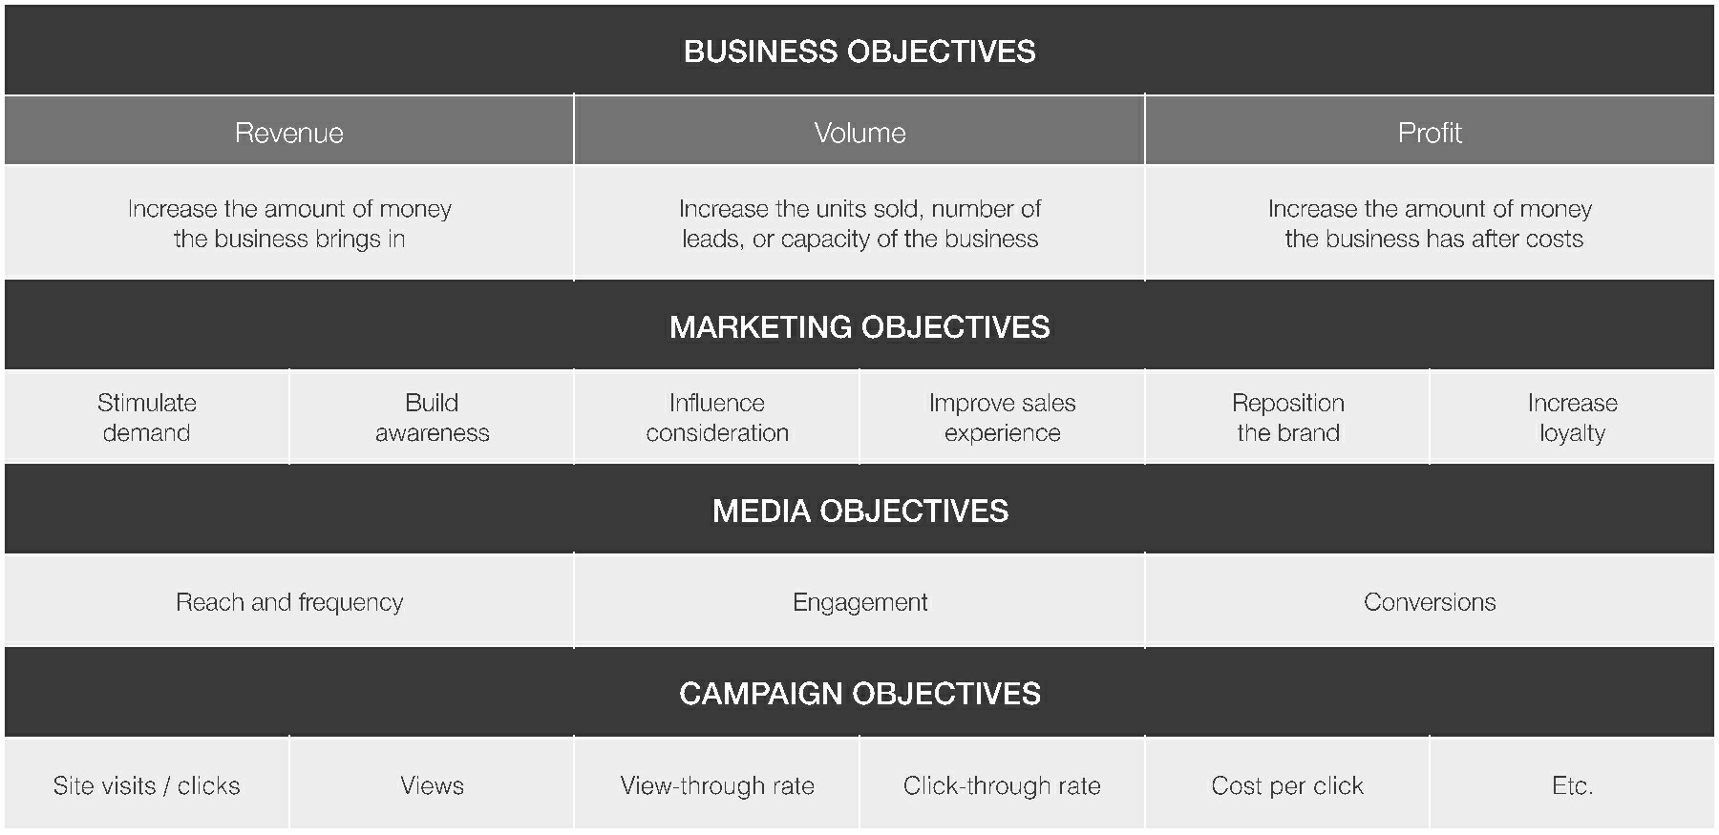
Chapter
08
The Six Marketing Objectives
www.midocean.ae

Slide 8
Chapter
08
The Six Marketing Objectives
3- Influencing Consideration
Consideration is the percent of consumers who have a positive perception of an advertiser’s brand or product. Like awareness, consideration can be measured in terms of the general population or against specific segments of the consumer base. It can also be measured in an aided way (“Which of the following products would you consider purchasing?”) or in an unaided way (“Which automobile brands would you consider purchasing?”). Consideration goes beyond awareness to measure consumers who are more than simply aware of the brand or product: They would purchase the item or would consider buying it. Consideration implies a deeper consumer/brand relationship than simple awareness.
www.midocean.ae

Slide 9
Chapter
08
The Six Marketing Objectives
3- Influencing Consideration
To that end, consumers have several layers of consideration. Each represents a different degree of affinity for the brand or product being measured. Basic consideration (“Would you consider buying this product?”) indicates the lowest level of consumer commitment to the brand. Favorability (“Which athletic shoe brand do you like most?” – also known as “preference”) implies greater brand affinity. Purchase intent (“The next time you buy a personal computer, which brand are you most likely to buy?”) measures the deepest degree of the consumer/brand relationship.
www.midocean.ae

Slide 10
Chapter
08
The Six Marketing Objectives
4- Improving the Sales Process
The sales process occurs when a consumer exchanges cash for an item. This can be seen clearly in a digital sense as the online checkout steps that follow placing an item in a digital shopping cart. Offline, the definition of the sales process can blur the lines between improving the sales process and the previous Marketing Objective of influencing consideration. Sales associates in many retail settings are now able to discuss product benefits, close sales, (i.e., influencing consideration) and check out consumers through the use of handheld point-of-sale (POS) systems (i.e., the sales process). Visiting an Apple Store anywhere will bring this concept to life, as Apple has been outfitting sales associates with handheld checkout devices for years.
www.midocean.ae

Slide 11
Chapter
08
The Six Marketing Objectives
4- Improving the Sales Process
Assessing the sales process is a study in measuring efficiency. In the online sense, cart abandonment rate (i.e., the percent of consumers who place items in their digital shopping carts, but then remove the items or cancel the sales process before completion) is an insightful way for a brand to reveal challenges in its sales process. Hidden delivery fees, taxes, and the inability for the company to deliver the product by the time a consumer needs it are all reasons why a brand’s sales process can be disrupted. Other challenges, such as confusing or frustrating checkout steps, can also affect a brand’s sales process.
www.midocean.ae

Slide 12
Chapter
08
The Six Marketing Objectives
5- Repositioning the Brand
Repositioning the brand is a relevant Marketing Objective when a brand fails to live up to the expectations its advertising sets. Infrequently, repositioning the brand can be an important pursuit when the product provides an unexpected benefit.
Post-purchase consumer response provides the best insight into the need for repositioning and is trackable through consumer surveys and product return rates.
www.midocean.ae

Slide 13
Chapter
08
The Six Marketing Objectives
5- Repositioning the Brand
One notable example of brand repositioning in the Middle East is the transformation of Emirates Airlines. While Emirates has consistently been a prominent airline, it made strategic moves to reposition itself as a global luxury brand, going beyond the conventional image of an airline.
Emirates embarked on an ambitious plan to upgrade its services, invest in state-of-the-art aircraft, and enhance the overall travel experience. The airline focused on providing luxurious amenities, spacious seating arrangements, and top-notch in-flight entertainment. Additionally, they introduced the iconic A380 aircraft, the world's largest passenger airplane, reinforcing the idea of opulence and exclusivity.
www.midocean.ae

Slide 14
Chapter
08
The Six Marketing Objectives
5- Repositioning the Brand
Emirates also engaged in high-profile sponsorships and partnerships, associating the brand with luxury events and experiences. For example, they became a major sponsor of premium sports events like the FIFA World Cup and established partnerships with luxury brands.
This strategic repositioning helped Emirates evolve from being a regional airline to a global luxury carrier. The unexpected benefit was the association of Emirates not only with efficient air travel but also with a premium and opulent lifestyle.
www.midocean.ae

Slide 15
Chapter
08
The Six Marketing Objectives
6- Growing Loyalty
Consumer loyalty for a brand or product is a fundamental component of a brand’s success. Measures of loyalty can range from the simple (e.g., the percent of people who own your product and buy that product again, or repeat purchase rate) to the sophisticated (e.g., the highly-tuned and complex calculations of lifetime customer values) to the apparent (e.g., social media mentions from people who experience the brand or product). Assessing loyalty for a brand seeks to quantify brand advocacy: the all-important, yet elusive, support for a brand that turns product owners into authentic word-of-mouth advertisements.
www.midocean.ae

Slide 16
Chapter
08
Determining Your Marketing Objective
www.midocean.ae

Slide 17
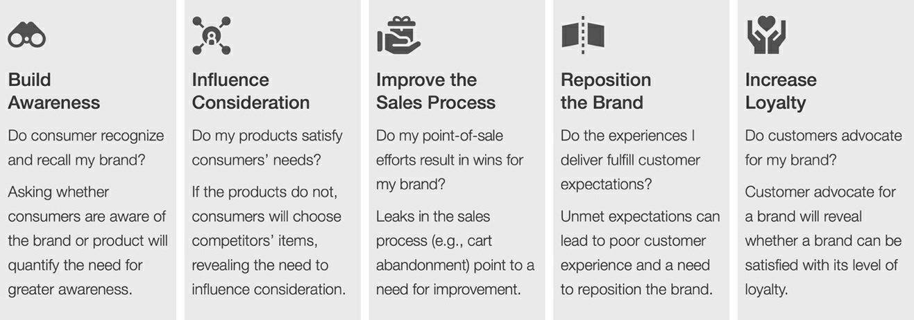
Chapter
08
Determining Your Marketing Objective
How can analysts determine whether their organizations struggle with one of the Marketing Objectives described above? Some simple questions and a bit of analysis will reveal relevant and irrelevant objectives.
www.midocean.ae

Slide 18
Chapter
08
Determining Your Marketing Objective
Do You Need More Awareness?
Effectively, the awareness a brand or product earns is reflected in the percentage of consumers who place that item on their Initial Consideration Set when the need is triggered. Asking whether consumers are aware of the brand or product will quantify the need for greater awareness.
www.midocean.ae

Slide 19
Chapter
08
Determining Your Marketing Objective
Do You Need More Awareness?
➔ Aggregated consumer search trends from Google Trends or other search trend tools
➔ Market share data from industry groups, investor services, and market research companies
➔ Product and brand awareness data from voice of the consumer survey tools
➔ Social media mentions from social listening or social media platform tools
www.midocean.ae

Slide 20
Chapter
08
Determining Your Marketing Objective
Do You Need to Better Influence Consumers?
For influence and consideration, analysts should investigate whether a brands’ products satisfy consumers’ needs. If the products don’t, this means consumers are choosing competitors’ products, revealing the need to better influence consideration. The analysis of nuanced data, typically collected through market surveys, can point to required solutions. These solutions can include more clear communication of product benefits, better understanding of consumers’ needs, and a stronger “challenger brand” position to steal market share away from a dominant brand in the category (think of the “Pepsi Challenge” head-to-head taste choice affront to market leader Coke).
www.midocean.ae

Slide 21
Chapter
08
Determining Your Marketing Objective
Do You Need to Better Influence Consumers?
The assessment of a brand’s need to influence consumers comes down to measuring shoppers who experience the brand during the active evaluation step of their decision journeys. The brand can approach these questions by collecting data from a variety of sources:
➔ Clickstream analysis (focused on how consumers navigate a website to obtain insight into key content as well as content deemed less valuable) from the advertiser’s website analytics or clickstream analysis tool
www.midocean.ae

Slide 22
Chapter
08
Determining Your Marketing Objective
Do You Need to Better Influence Consumers?
➔ A/B testing data to provide insight into consumer preferences from A/B testing or CRO tools
➔ Consumer needs data from the voice of the consumer survey tools
➔ Product and brand consideration, favorability, and purchase intent data from the voice of the consumer survey tools
➔ Social media sentiment data related to a brand from social listening, content analysis, or social media platform tools
www.midocean.ae

Slide 23
Chapter
08
Determining Your Marketing Objective
Do Your Sales Efforts Help or Hinder?
For the Marketing Objective, “Improve Sales Experience,” analysts must focus on the Moment of Purchase by investigating the sales process for leaks. As mentioned earlier in this lesson, cart abandonment rate is an effective way to quantify the need for changes to a brand’s online sales process. In-store customer surveys, observing consumers on their shopping trips (i.e., shop-alongs), and consumer focus groups are among the best ways to assess the efficiency and effectiveness of offline sales processes.
www.midocean.ae

Slide 24
Chapter
08
Determining Your Marketing Objective
Do Your Sales Efforts Help or Hinder?
The brand can approach these questions by collecting data from a variety of sources:
➔ A/B testing data to provide insight into the effectiveness of various versions of checkout process designs (e.g., messaging, number of steps, page layout, etc.) from A/B testing or CRO tools
➔ Checkout process data (e.g., cart abandonment data) from the advertiser’s e-commerce system or e-commerce partner
➔ Checkout satisfaction survey response data for consumers who buy the products and those who don’t use voice of the consumer survey tools
www.midocean.ae

Slide 25
Chapter
08
Determining Your Marketing Objective
Do Your Sales Efforts Help or Hinder?
The brand can approach these questions by collecting data from a variety of sources:
➔ Clickstream analysis (focused on experiences of consumers who convert and consumers who don’t convert) from the advertiser’s website analytics or clickstream analysis tool
➔ In-store customer surveys, shop-alongs, and focus group data for offline Moment of Purchase insights
www.midocean.ae

Slide 26
Chapter
08
Determining Your Marketing Objective
Do You Deliver on Expectations You’ve Set?
After consumers make their purchases, follow-up is typically the best way to provide the truest view into a need for repositioning the brand. Tracking product returns, monitoring social media, and other measures can also show how well a brand delivered on the expectations set during the decision journey.
The brand can approach these questions by collecting data from a variety of sources during the Post-purchase Experience:
➔ Customer satisfaction survey response data for consumers who buy the products using voice of the consumer survey tools
www.midocean.ae

Slide 27
Chapter
08
Determining Your Marketing Objective
Do You Deliver on Expectations You’ve Set?
➔ Net promoter score (NPS) data or market research companies
➔ Product return/refund data from the advertiser’s internal systems or an e-commerce partner
➔ Social media sentiment data related to an advertiser’s products (focused on consumer sentiment of posts that mention the products, implying they own the products or have experience with them) from social listening, content analysis, or social media platforms tools
➔ Other data collected related to the customer’s response to an advertiser’s products (e.g., customer service representative and help desk phone logs)
www.midocean.ae

Slide 28
Chapter
08
Determining Your Marketing Objective
Do Customers Advocate for Your Brand?
Investigating consumers who advocate for a brand will reveal whether a brand can be satisfied with its level of loyalty. Advocacy quantified through repeat purchase rates, positive social media mentions, and other means can help analysts assess whether the Marketing Objective, “grow loyalty,” represents a need.
The brand can approach these questions using many of the same data and sources collected to assess the Post-purchase Experience:
➔ Customer satisfaction survey response data from surveys sent to consumers who buy the products using voice of the consumer survey tools
www.midocean.ae

Slide 29
Chapter
08
Determining Your Marketing Objective
Do Customers Advocate for Your Brand?
➔ Social media sentiment data related to an advertiser’s products (again, product-level posts imply consumers own the products or have experience with them) from social listening, content analysis, or social media platform tools
➔ NPS data from an NPS partner or market research companies
➔ Repeat purchase rate from the advertiser’s internal systems or a CRM partner
www.midocean.ae

Slide 30
Chapter
08
Building an Analysis Plan around Your Objective
www.midocean.ae

Slide 31
Chapter
08
Building an Analysis Plan around Your Objective
With the Marketing Objective in hand, the final phase in the plan step is to create a clear, concise document that can help guide analysis journeys. The document format matters little. Analysts should adopt the visual framework that works best for them. However, it’s important that the document:
➔ Clearly identifies the Marketing Objective – This “North Star” truth will guide the analysis and must be succinct in the analysis plan.
www.midocean.ae

Slide 32
Chapter
08
Building an Analysis Plan around Your Objective
➔ Details the connection between the Marketing Objective and key questions – Identifying key questions that will logically advance the brand toward its Marketing Objective when answered is critical. These questions should be singular (i.e., eliminate the word “and” from all key questions) and distinct from one another.
➔ Clearly identifies the data to be collected and the source of those data – While the data and sources aren’t foolproof, setting them out as areas for exploration is important so that analysts use their time efficiently.
www.midocean.ae

Slide 33
Chapter
08
Building an Analysis Plan around Your Objective
We can say that designing a plan in a pyramid layout works best to meet these criteria, while allowing for quick modifications to plan elements later on. Analysts can ensure the key questions they pursue explore the full gamut of business challenges tied to their objectives by designing three types of questions: What? why? and how?
www.midocean.ae

Slide 34
Chapter
08
Building an Analysis Plan around Your Objective
Answers to “what” questions (e.g., “What is our brand’s current level of unaided awareness?”) will typically provide straightforward descriptive facts that can set the foundation of understanding an analyst needs to begin a more robust analysis. An analyst can get to the heart of the matter by answering a “why” question (e.g., “Why did some of our marketing efforts drive awareness while others didn’t?”) that provides the context, texture, and nuance required of a deeper analysis. Finally, solutions to “how” questions (e.g., “How can our marketing efforts affect awareness levels over the next 12 months?”) point to actions required to achieve the chosen objective.
www.midocean.ae

Slide 35
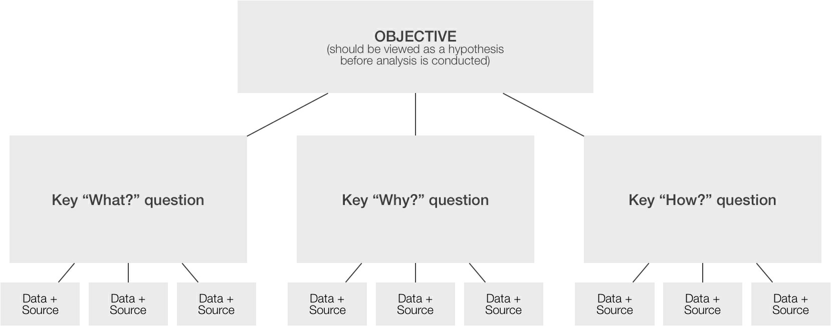
Chapter
08
Building an Analysis Plan around Your Objective
The pyramid layout for an analysis plan
www.midocean.ae

Slide 36
Chapter
08
Building an Analysis Plan around Your Objective
This line of investigation is rooted in the principle commonly known as “The Five W's and How.” The Five W’s and How is the idea that a complete report must provide answers to questions that start with the interrogative words, who? what? when? where? why? and how? The principle is commonly applied in journalism, law enforcement investigations, and research.
For marketing analysis, analysts should provide answers to what? why? And how? questions at a minimum to ensure a complete story. Analysts can expand their analyses to report on the other questions identified in the principle, as needed.
www.midocean.ae

Slide 37
Chapter
08
Collecting Data
www.midocean.ae

Slide 38
Chapter
08
Collecting Data
Accessing Facilitated Download Sites
Through facilitated downloads, a data owner provides a place for others to visit and collect data. These are tightly managed data releases. Typically, a user interface – often called a graphical user interface (GUI) – acts as an access point to this data. When logins are required, access to the data can be monitored and managed, allowing the data owner to determine the level of access. In this technique, we may include companies’ systems that house proprietary data and allow analysts to access the information. For example, when analysts collect first-party sales data from corporate accounting systems, they do so through facilitated downloads. Similarly, accessing Data Management Platform (DMP)-managed second- or third-party data is done through a facilitated DMP-designed download process.
www.midocean.ae

Slide 39
Chapter
08
Collecting Data
Accessing Facilitated Download Sites
Another example of a facilitated download is the way consumers can access U.S. Census Bureau data. As the principal agency of the U.S. Federal Statistical System responsible for producing data about the American people and economy, the U.S. Census Bureau built the Explore Census Data website (data.census.gov) to encourage access to this data. Analysts will find an easy-to-use and simply designed GUI that facilitates access to census data.
www.midocean.ae

Slide 40
Chapter
08
Collecting Data
Using APIs
A second approach for accessing data is using Application Programming Interfaces (APIs). APIs let computers connect to other computers to complete machine-to-machine data transfers. An API brings Google Maps data to restaurant websites, weather data to news sites, and real-time financial market information to investment websites. Analysts must understand scripting language and how to collect access tokens API owners grant to build API connections. While accessing data directly via APIs can be valuable, the time required to build those connections often outweighs the benefits.
www.midocean.ae

Slide 41
Chapter
08
Collecting Data
Using APIs
A number of data analysis tools have simplified API access for the analyst. Many tools described before, including Hootsuite, TweetReach, and Searchvolume.io, collect second-party data through API connections to social media networks and other data sources. These tools feature easy-to-use GUIs where analysts input criteria for the data they want to collect (e.g., keywords, date ranges, etc.). The tool builds the API query based on the analyst’s inputs, establishes the API connection and handles the necessary permissions/token requirements.
www.midocean.ae

Slide 42
Chapter
08
Collecting Data
Web Scraping
A third way analysts can access data is through web scraping, also known as “screen scraping,” “web data extraction,” and “web harvesting.” In the early days of the web, black hat analysts found and collected unique data treasures using web scraping. Open-source datasets and facilitated download sites have largely eliminated the need for web scraping, however.
www.midocean.ae

Slide 43
Chapter
08
Collecting Data
Web Scraping
Analysts are rarely required to build web scrapers in R or Python, or use tools like Parsehub (parsehub.com) to scrape data from websites. First, the time it takes to construct the code or configure the web scraping tool can be prohibitive. Second, so much data is now available from data owners, who have created data-sharing processes, that the need for scraping has been greatly reduced. Finally, and perhaps most importantly, if data isn’t available through a facilitated download site or an approved API, the owner likely doesn’t want to provide access to it. In our current environment of heightened data privacy concerns, it’s hard to think of reasons that justify the acquisition of data not intended to be collected.
www.midocean.ae

Slide 44
In this lecture, we discussed:
The Six Marketing Objectives
(Influencing Consideration - Improving the Sales Process - Repositioning the Brand
- Growing Loyalty)
Determining Your Marketing Objective
Building an Analysis Plan around Your Objective
Collecting Data
(Accessing Facilitated Download Sites - Using APIs - Web Scraping)
www.midocean.ae

Slide 45


Thank You

