Slide 1


Supply Chain Management
Prepared by Dr. Tarek Mohamed
MGM 660
Lecture 5

Slide 2


Network Design in the Supply Chain
Lecture 5
MGM 660
Prepared by
Dr. Tarek Mohamed

Slide 3

Course Agenda
Chapter
01
Understand the role of network design in a supply chain.
Identify factors influencing supply chain network design decisions.
Develop a framework for making network design decisions.
Use optimization for facility location and capacity
allocation decisions.
5. How AI supports supply chain network design

Slide 4
Network Design Decisions
Network Design in the Supply Chain
Supply chain network design refers to the strategic process of structuring a supply chain to optimize its efficiency and effectiveness in meeting business goals.
It involves determining the optimal number, location, and capacity of warehouses, distribution centers, manufacturing plants, and retail outlets, as well as the flow of products between them.

Slide 5
Network Design Decisions
Supply chain network design decisions include the assignment of facility role, location of manufacturing, storage, or transportation-related facilities. and the allocation of capacity and markets to each facility.
Supply chain network design decisions are classified as follow :
1. Facility role: What role should each facility play? What processes
are performed at each facility?
2. Facility location:
- Deciding where to place manufacturing plants, warehouses, and distribution
centers.
- Considerations: proximity to markets, suppliers, labor costs, taxes, and
transportation access.

Slide 6
Network Design Decisions
Supply chain network design decisions are classified as follow :
3. Capacity allocation: How much capacity should be allocated to each facility?
Determining how much production or storage capacity each facility should have.
Helps avoid under- or over-utilization of resources.
4. Market and supply allocation: What markets should each facility
serve? Which supply sources should feed each facility?
5. Transportation Strategy
Designing routes and selecting transportation modes (e.g., truck, rail, sea,
air).Aimed at minimizing costs and improving delivery times.

Slide 7
Network Design Decisions
Supply chain network design decisions are classified as follow :
6. Inventory Positioning
Deciding where in the network inventory should be stored and in what
quantities.
Affects responsiveness and carrying costs.
7. Supply and Demand
Allocation matching sources of supply to demand points in an efficient way.
Involves demand forecasting and load balancing across the network.

Slide 8
Network Design Decisions
Network design decisions have a significant impact on performance because they determine the supply chain configuration and set constraints within which the other supply chain.
Supply chain drivers can be used either to decrease supply chain cost or to increase responsiveness.
All network design decisions affect one another and must be made taking this fact into consideration.
Decisions concerning the role of each facility are significant because they determine the amount of flexibility the supply chain has in changing the way it meets demand.
For example, Toyota has plants located worldwide, in each market that it serves. Before 1997, each plant was capable of serving only its local market.

Slide 9
Objectives of Network Design
Cost Minimization: Reduce overall costs, including transportation, facility operations, and inventory holding.
Service Level Optimization: Ensure timely delivery to meet customer expectations.
Flexibility and Scalability: Build a network that can adapt to market changes and future growth.
Risk Management: Design a resilient supply chain that can withstand disruptions.

Slide 10
Network Design Decisions
Facility location decisions have a long-term impact on a supply chain’s performance because it is expensive to shut down a facility or move it to a different location.
A good location decision can help a supply chain be responsive while keeping its costs low.
For example, Toyota built its first U.S. assembly plant in Lexington, Kentucky, in 1988, and has continued to build new plants in the United States since then.
The U.S. plants proved profitable for Toyota when the yen strengthened, and cars produced in Japan were too expensive to be cost competitive with cars produced in the United States. Local plants allowed Toyota to be responsive to the U.S. Market while keeping costs low.

Slide 11
Steps in Network Design Process
Data Collection Gather data on demand, costs, suppliers, capacities, and service levels.
Model Development Use analytical or simulation models to evaluate design alternatives.
Scenario Analysis Test different “what-if” scenarios (e.g., demand surges, facility shutdowns).
Optimization Apply optimization techniques to select the best network configuration.
Implementation Translate the optimal design into action and monitor performance.

Slide 12
Factors Influencing
Network Design Decisions
Strategic factors
A firm’s competitive strategy has a significant impact on network design decisions within the supply chain.
Firms that focus on cost leadership tend to find the lowest cost location for their manufacturing facilities, even if that means locating far from the markets they serve.
Global supply chain networks can best support their strategic objectives with facilities in different countries playing different roles.
For example, Zara has production facilities in Europe as well as Asia.

Slide 13
Factors Influencing
Network Design Decisions
Technological factors
Characteristics of available production technologies have a significant impact on network design decisions.
If production technology displays significant economies of scale, a few high-capacity locations are most effective.
This is the case in the manufacture of computer chips, for which factories require a large investment, and the output is relatively inexpensive to transport.
In contrast, if facilities have lower fixed costs, many local facilities are preferred because this helps lower transportation costs.
For example, bottling plants for Coca-Cola do not have a high fixed cost. To reduce transportation costs, Coca-Cola sets up many bottling plants all over the world, each serving its local market.

Slide 14
Factors Influencing Network Design Decisions
Macroeconomic factors
Macroeconomic factors include taxes, tariffs, exchange rates, and shipping costs that are not internal to an individual firm.
As global trade has increased, macroeconomic factors have had a significant influence on the success or failure of supply chain networks.
Thus, it is imperative that firms take these factors into account when making network design decisions.

Slide 15
Factors Influencing
Network Design Decisions
Political Factors
The political stability of the country under consideration plays a significant role in location choice.
Companies prefer to locate facilities in politically stable countries where the rules of commerce and ownership are well defined. While political risk is hard to quantify.
There are some indices, such as the Global Political Risk Index that companies can use when investing in emerging markets.

Slide 16
Factors Influencing
Network Design Decisions
Infrastructure factors
The availability of good infrastructure is an important prerequisite to locating a facility in a given area.
Poor infrastructure adds to the cost of doing business from a given location.
Key infrastructure elements to be considered during network design include availability of sites and labor, proximity to transportation terminals, rail service, proximity to airports and seaports, highway access, congestion, and local utilities.

Slide 17
Factors Influencing
Network Design Decisions
Competitive factors
Companies must consider competitors’ strategy, size, and location when designing their supply chain networks.
A fundamental decision firms make is whether to locate their facilities close to or far from competitors.
The form of competition and factors such as raw material or labor availability influence this decision.

Slide 18
Factors Influencing Network Design Decisions
Competitive factors
Positive Externalities Between Firms
Positive externalities occur when the collocation of multiple firms benefits all of them.
Positive externalities lead to competitors locating close to each other.
For example, retail stores tend to locate close to each other because doing so increases overall demand, thus benefiting all parties.
By locating together in a mall, competing retail stores make it more convenient for customers, who need drive to only one location to find everything they are looking for.
This increases the total number of customers who visit the mall, increasing demand for all stores located there.

Slide 19
Factors Influencing
Network Design Decisions
Competitive factors
Locating to Split the Market
When there are no positive externalities, firms locate to be able to capture the largest possible share of the market.

Slide 20
Factors Influencing
Network Design Decisions
Customer Response Time and Local Presence
Firms that target customers who value a short response time must locate close to them.
Customers are unlikely to come to a convenience store if they have to travel a long distance to get there.
It is thus best for a convenience store chain to have many stores distributed in an area, so most people have a convenience store close to them.
In contrast, customers shop for larger quantity of goods at supermarkets and are willing to travel longer distances to get to one.

Slide 21
Factors Influencing
Network Design Decisions
Logistics and Facility Costs
Logistics and facility costs incurred within a supply chain change as the number of facilities, their location, and capacity allocation change.
Companies must consider inventory, transportation, and facility costs when designing their supply chain networks.
Inventory and facility costs increase as the number of facilities in a supply chain increases.

Slide 22
Factors Influencing
Network Design Decisions
Logistics and Facility Costs
Transportation costs decrease as the number of facilities increases.
If the number of facilities increases to the point at which
inbound economies of scale are lost, then transportation costs increase.
For example, with few facilities, Amazon has lower inventory and facility costs than Barnes & Noble, which has hundreds of stores. Barnes & Noble, however, has lower transportation costs.

Slide 23
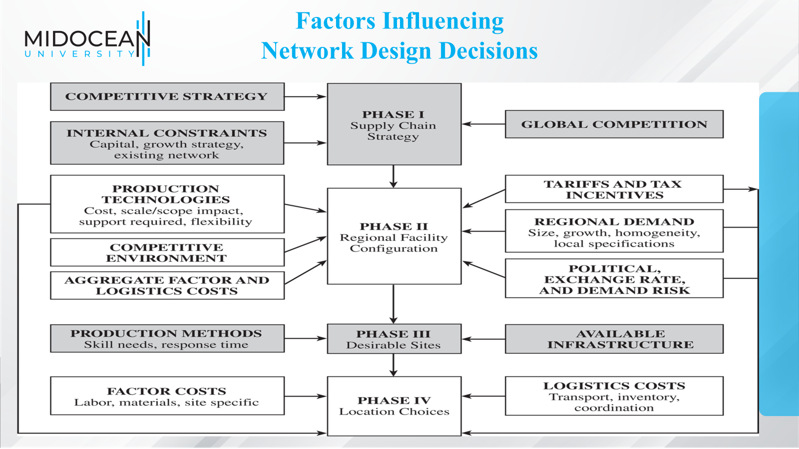

Slide 24
Framework for Network Design Decisions
Phase I: Define a Supply Chain Strategy/Design
The objective of the first phase of network design is to define a firm’s broad supply chain design.
This includes determining the stages in the supply chain and whether each supply chain function will be performed in-house or outsourced.
Phase I starts with a clear definition of the firm’s competitive strategy as the set of customer needs that the supply chain aims to satisfy.
The supply chain strategy then specifies what capabilities the supply chain network must have to support the competitive strategy.

Slide 25
Framework for Network Design Decisions
Phase I: Define a Supply Chain Strategy/Design
Next, managers must forecast the likely evolution of global competition and whether competitors in each market will be local or global players.
Managers must also identify constraints on available capital and whether growth will be accomplished by acquiring existing facilities, building new facilities, or partnering.
Based on the competitive strategy of the firm, its resulting supply chain strategy, an analysis of the competition, any economies of scale or scope, and any constraints, managers must determine the broad supply chain design for the firm.

Slide 26
Framework for Network Design Decisions
Phase II: Define the Regional Facility Configuration
The objective of the second phase of network design is to identify regions where facilities will be located, their potential roles, and their approximate capacity.
An analysis of Phase II starts with a forecast of the demand by country or region. Such a forecast must include a measure of the size of the demand and a determination of the homogeneity or variability of customer requirements across different regions.
Homogeneous requirements favor large consolidated facilities, whereas requirements that vary across countries favor flexible facilities or smaller, localized, dedicated facilities.

Slide 27
Framework for Network Design Decisions
Phase III: Select a Set of Desirable Potential Sites
The objective of Phase III is to select a set of desirable potential sites within each region where facilities are to be located.
Sites should be selected based on an analysis of infrastructure availability to support the desired production methodologies.
Hard infrastructure requirements include the availability of suppliers, transportation services, communication, utilities, and warehousing facilities.
Soft infrastructure requirements include the availability of a skilled workforce, workforce turnover, and the community receptivity to business and industry.

Slide 28
Framework for Network Design Decisions
Phase IV: Location Choices
The objective of Phase IV is to select, from among the potential sites, a precise location and capacity allocation for each facility.
The network is designed to maximize total profits, taking into account the expected margin and demand in each market, various logistics and facility costs, and the taxes and tariffs at each location.

Slide 29
Models for Facility Location and Capacity Allocation
A manager’s Goal when locating facilities and allocating capacity should be to maximize the overall profitability of the resulting supply chain network while providing customers with the appropriate responsiveness.
Revenues come from the sale of product, whereas costs arise from facilities, labor, transportation, material, and inventories.
The profits of the firm are also affected by taxes and tariffs.
Ideally, profits after tariffs and taxes should be maximized when designing a supply chain network.

Slide 30
Models for Facility Location and Capacity Allocation
A manager must consider many trade-offs during network design.
For example, building many facilities to serve local markets reduces transportation cost and provides a fast response time, but it increases the facility and inventory costs incurred by the firm.
Managers use network design models in two situations.
First, these models are used to decide on locations where facilities will be established and determine the capacity to be assigned to each facility. Managers must make this decision considering a time horizon over which locations and capacities will not be altered (typically in years).

Slide 31
Models for Facility Location and Capacity Allocation
Second, these models are used to assign current demand to the available facilities and identify lanes along which product will be transported.
Managers must consider this decision at least on an annual basis as demand, prices, exchange rates, and tariffs change
In both cases, the goal is to maximize the profit while satisfying customer needs

Slide 32
Models for Facility Location and Capacity Allocation
The following information ideally is available in making the design decision
  Location of supply sources and markets
  Location of potential facility sites
  Demand forecast by market
  Facility, labor, and material costs by site
  Transportation costs between each pair of sites
  Inventory costs by site and as a function of quantity
  Sale price of product in different regions
  Taxes and tariffs
  Desired response time and other service factors

Slide 33
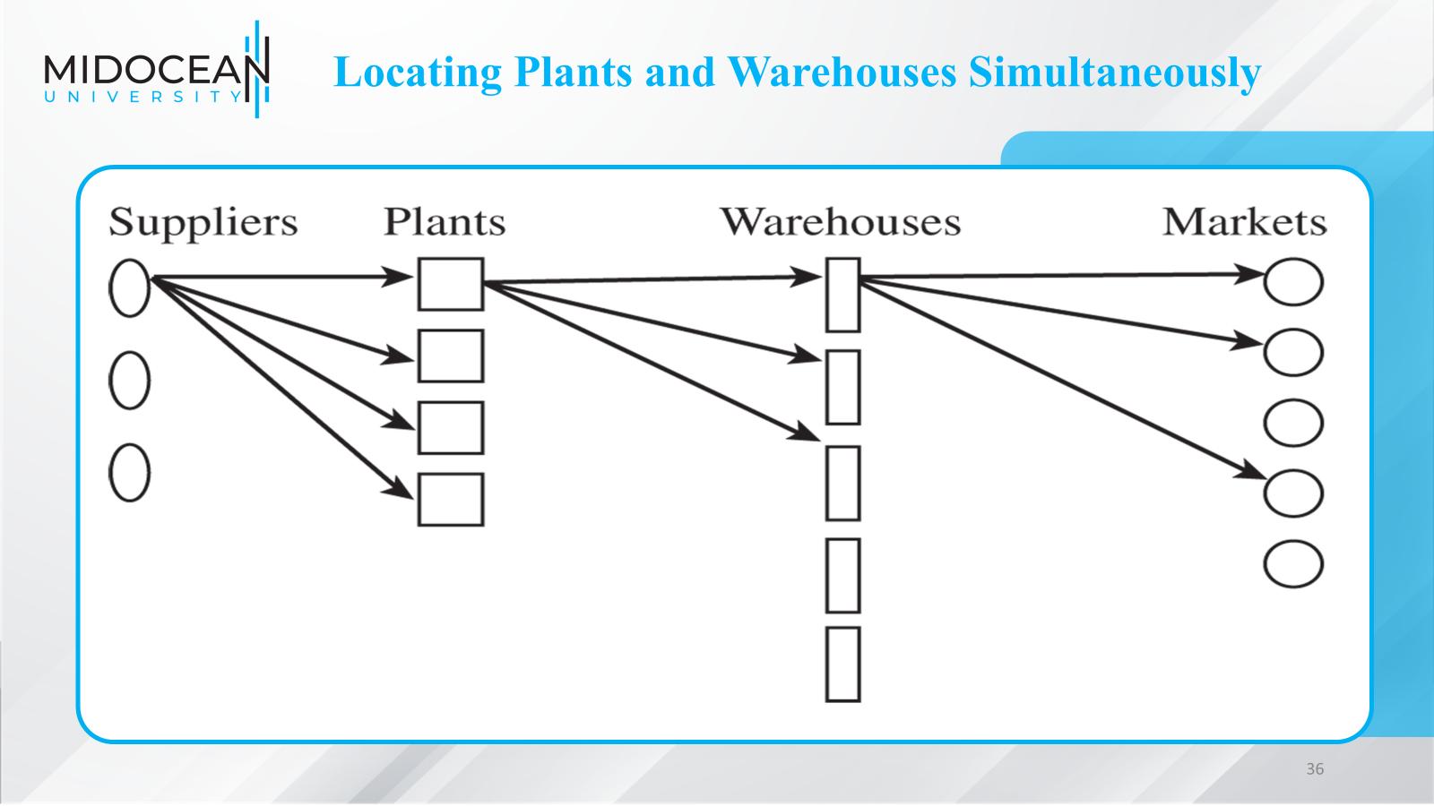

Slide 34
Locating Plants and Warehouses Simultaneously
Goal is to identify plant and warehouse locations and quantities shipped that minimize the total fixed and variable costs

Slide 35
Accounting for Taxes, Tariffs, and Customer Requirements
A supply chain network should maximize profits after tariffs and taxes while meeting customer service requirements modified objective and constraint

Slide 36
Challenges in Network Design
Dynamic customer expectations
Globalization and geopolitical risks
Volatile demand and supply conditions
Environmental sustainability goals
Regulatory compliance and trade policies

Slide 37
Making Network Design Decisions In Practice
Do not underestimate the life span of facilities.
It is important to think through the long-term consequences of facility decisions because facilities last a long time and have an enduring impact on a firm’s performance.
Managers must consider not only future demand and costs but also scenarios in which technology may change. Otherwise, facilities may become useless within a few years.
For example, an insurance company moved its clerical labor from one location
to another to lower costs.
With increasing automation, however, the need for clerical labor decreased significantly, and within a few years the facility was no longer needed.

Slide 38
Making Network Design Decisions In Practice
Do not gloss over the cultural implications.
Network design decisions regarding facility location and facility role have a significant impact on the culture of each facility and the firm.
The culture at a facility will be influenced by other facilities in its vicinity. Network designers can use this fact to influence the role of the new facility and the focus of people working there.
For example, when Ford Motor Company introduced the Lincoln Mark VIII model, management was faced with a dilemma. At that time, the Mark VIII shared a platform with the Mercury Cougar.

Slide 39
Making Network Design Decisions In Practice
Do not ignore quality-of-life issues.
The quality of life at selected facility locations has a significant impact on performance because it influences the available workforce and its morale.
In many instances, a firm may be better off selecting a higher-cost location if it provides a much better quality of life.
Failure to do so can have dire consequences. For example, an aerospace supplier decided to relocate an entire division to an area with a lower standard of living in order to reduce costs. Most of the marketing team, however, refused to relocate. As a result, customer relations deteriorated, and the company had a very difficult transition.
The effort to save costs hurt the company and effectively curtailed the firm’s status as a major player in its market

Slide 40
Making Network Design Decisions In Practice
Focus on tariffs and tax incentives when locating facilities.
Managers making facility location decisions should consider tariffs and tax incentives carefully. When considering international locations, it is astounding how often tax incentives drive the choice of location, often overcoming all of the other cost factors combined.
For instance, Ireland has developed a large high-tech industry by enticing companies with low taxes. Even within nations, local governments may offer generous packages of low to no taxes and free land when firms decide to locate facilities within their jurisdiction.
Toyota, BMW, and Mercedes have all chosen their facility locations in the United States due in large part to tax incentives offered by different states.

Slide 41
How AI supports Supply Chain Network Design
Artificial Intelligence (AI) supports Supply Chain Network Design by analyzing large amounts of data and helping organizations make better decisions about the structure and operation of their supply chains.
Benefits of AI in Supply Chain Network Design
Reduces total supply chain costs.
Improves customer service levels.
Enhances decision-making accuracy.
Increases supply chain flexibility and resilience.
Speeds up planning and optimization processes.

Slide 42
How AI supports Supply Chain Network Design
Keyways AI Supports Supply Chain Network Design:
Demand Forecasting
  AI predicts future customer demand using historical data, market trends, weather patterns, and customer behavior.
  Helps determine where inventory and facilities should be located.
Warehouse and Facility Location Optimization
  AI evaluates potential locations for warehouses, distribution centers, and manufacturing facilities.
  Considers factors such as transportation costs, customer proximity, labor availability, and service levels.
Transportation and Route Optimization
  AI identifies the most efficient transportation routes and delivery schedules.
  Reduces transportation costs and delivery times.

Slide 43
How AI supports Supply Chain Network Design
Inventory Optimization
  AI determines optimal inventory levels across the network.
  Minimizes stockouts and excess inventory.
Risk Management
  AI can identify potential disruptions such as supplier delays, natural disasters, or transportation bottlenecks.
  Helps companies develop contingency plans and build more resilient networks.
Scenario Analysis
  AI can simulate different network designs and evaluate their impact on cost, service, and efficiency.
  Supports strategic decision-making.
Real-Time Network Adjustments
  AI continuously monitors supply chain performance and recommends improvements based on real-time data.

Slide 44
Chapter
Summary of Learning Objectives
01
Understand the role of network design in a supply chain.
Identify factors influencing supply chain network design decisions.
Develop a framework for making network design decisions.
Use optimization for facility location and capacity
allocation decisions.
5. How AI supports Supply Chain Network Design

Slide 45
Essential Reference
Chopra, S., & Meindl, P. (2016). Global Edition. Pearson Education Limited Chapter 5.
Lysons, K., & Farrington, B. (2020). Procurement and supply chain management. Pearson UK.
Morris, P. W., & Pinto, J. K. (Eds.). (2007). The Wiley guide to project technology, supply chain, and procurement management (Vol. 4). John Wiley & Sons.
Schwalbe, K. (2015). Information technology project management. Cengage Learning.
Supply Chain Council

Slide 46

Thank You

