Slide 1


Slide 2
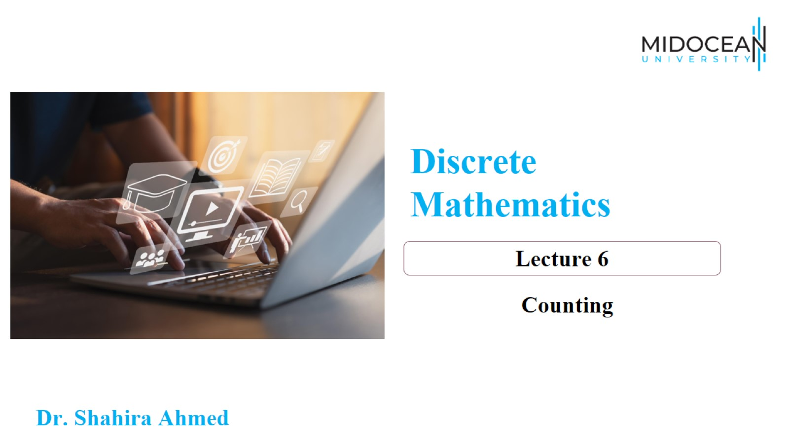

Slide 3
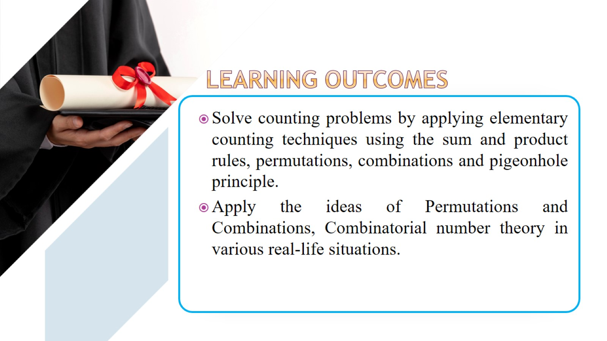

Slide 4
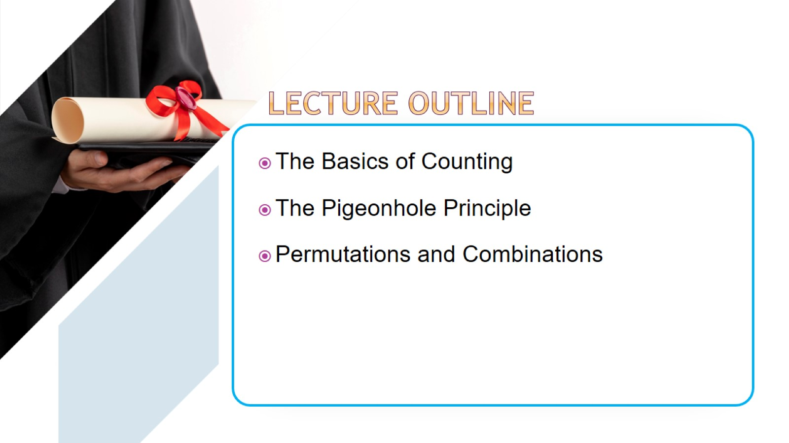

Slide 5
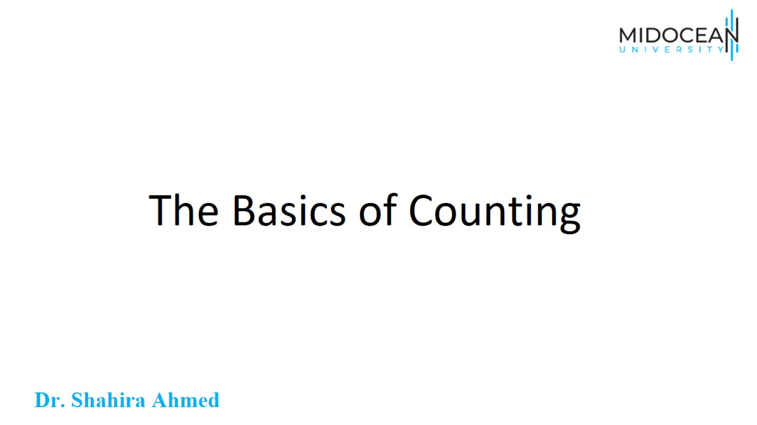
The Basics of Counting

Slide 6
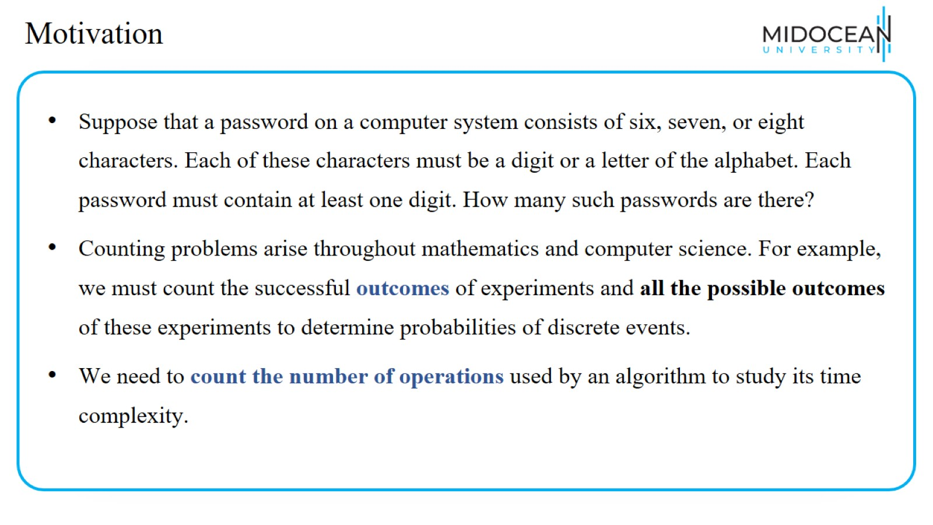
Motivation

Slide 7
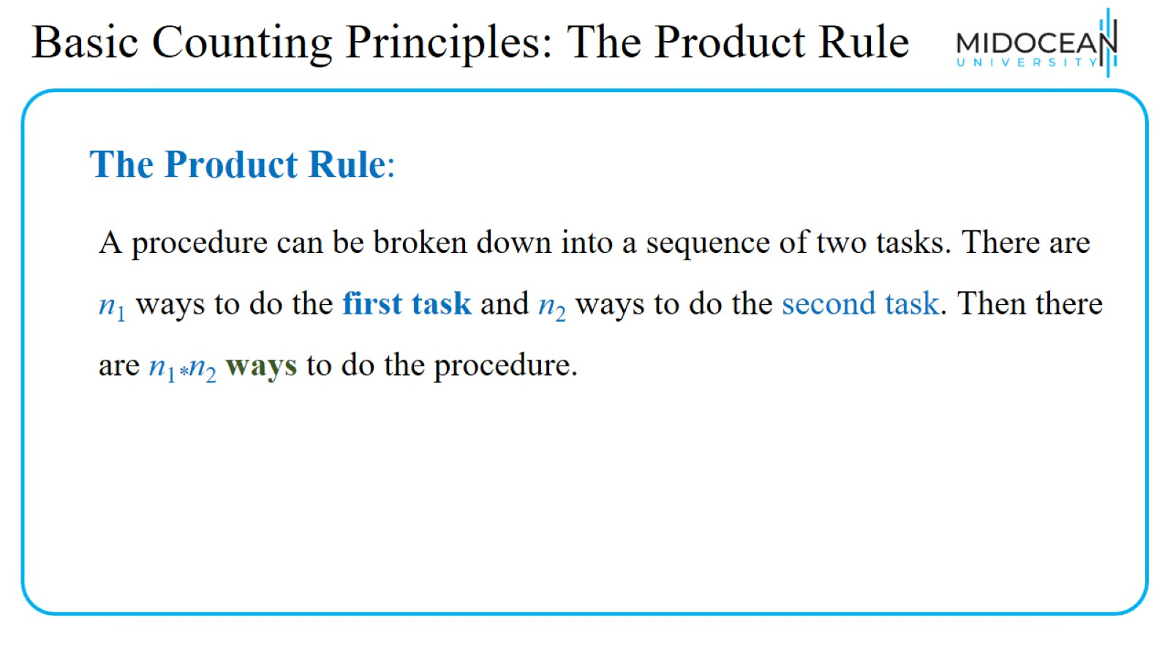
Basic Counting Principles: The Product Rule

Slide 8
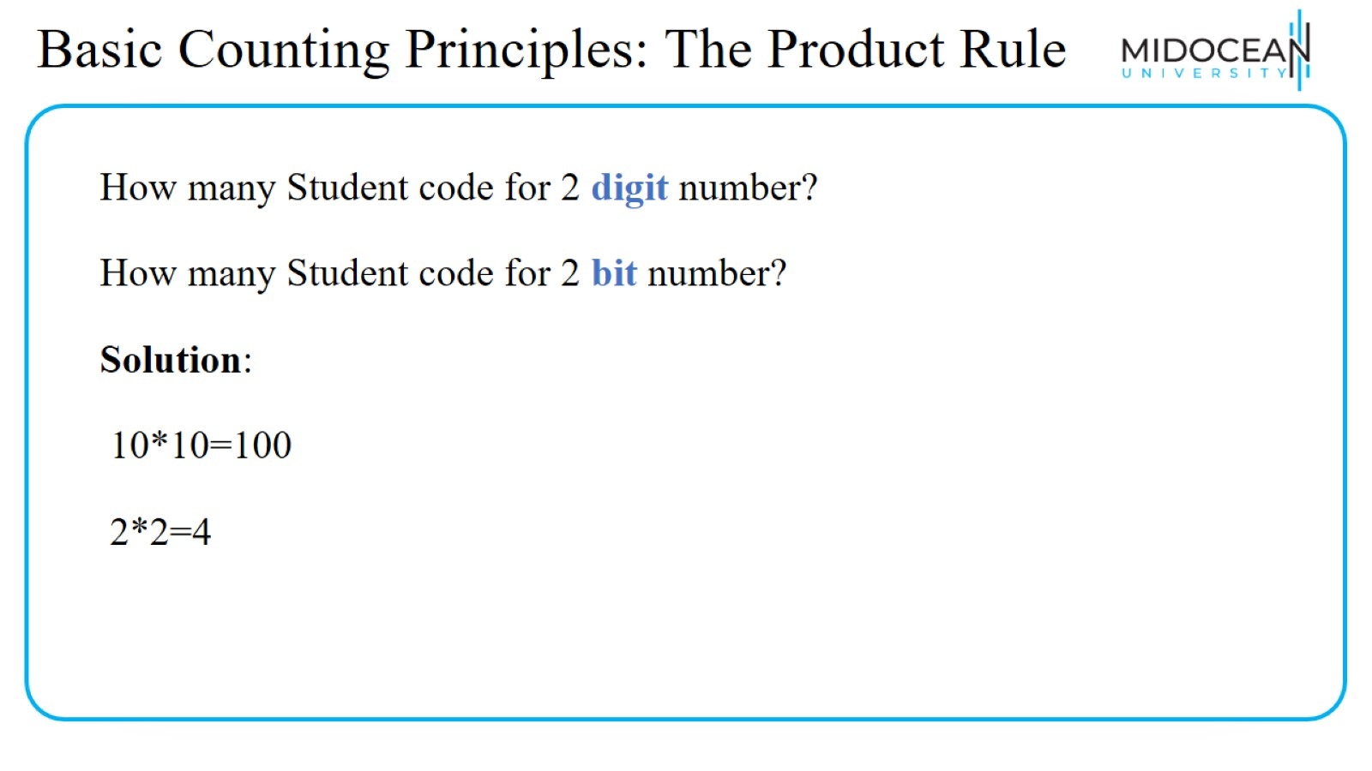
Basic Counting Principles: The Product Rule

Slide 9
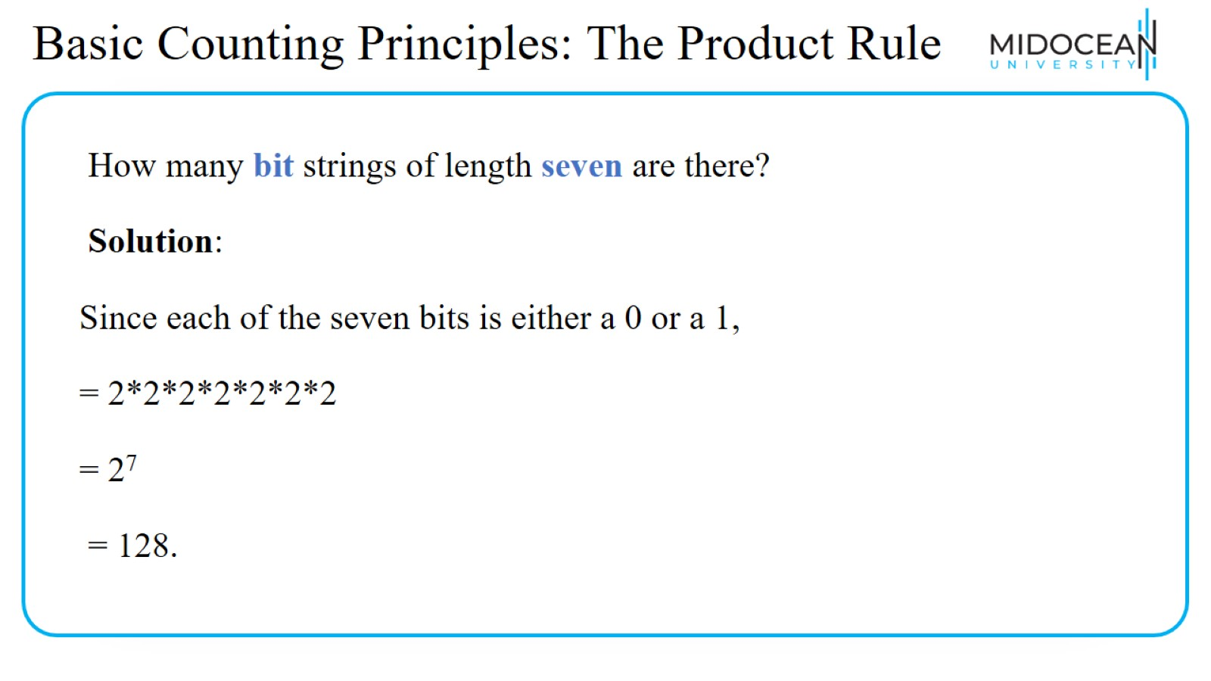
Basic Counting Principles: The Product Rule

Slide 10
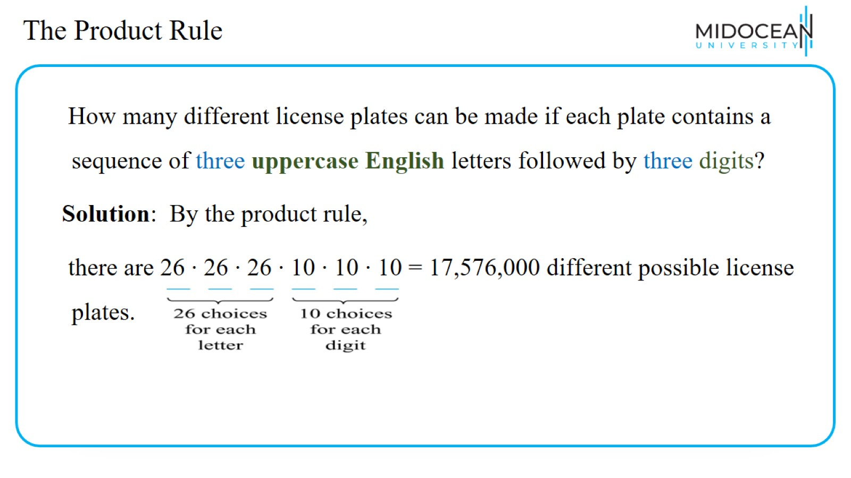
The Product Rule

Slide 11
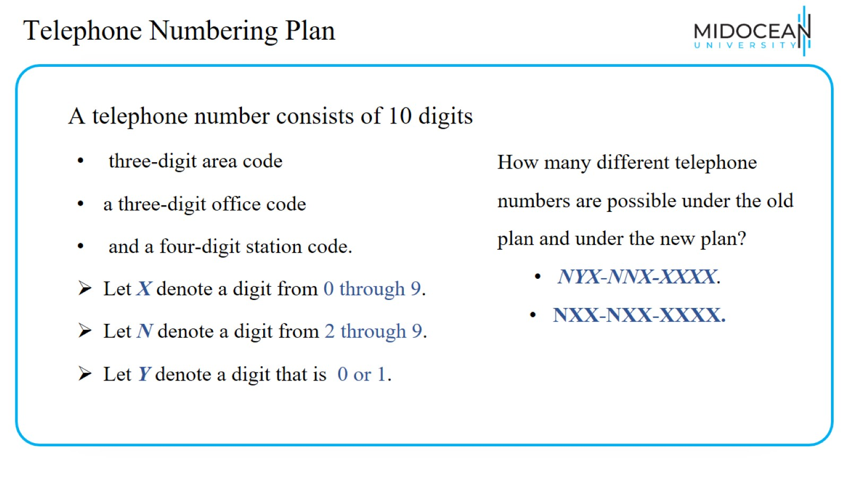
Telephone Numbering Plan

Slide 12
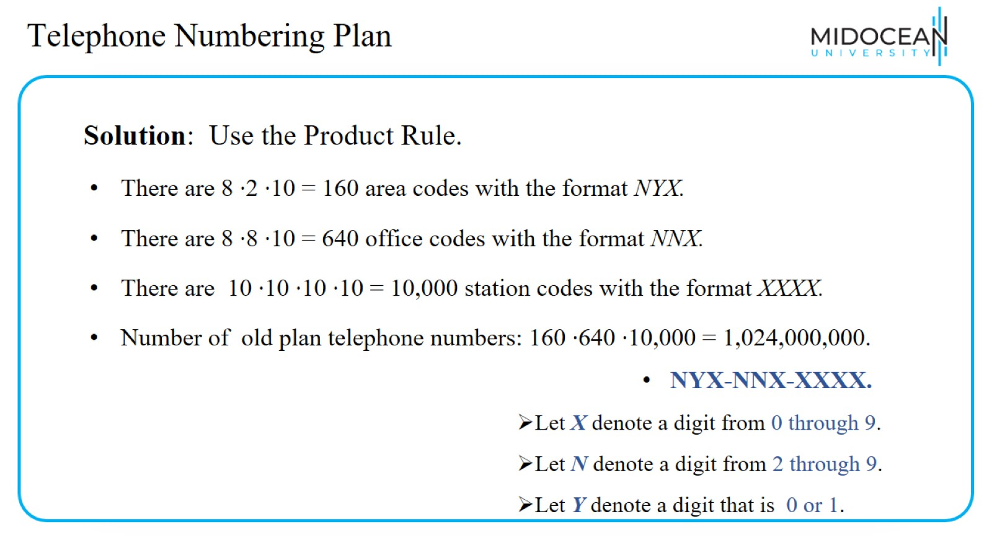
Telephone Numbering Plan

Slide 13
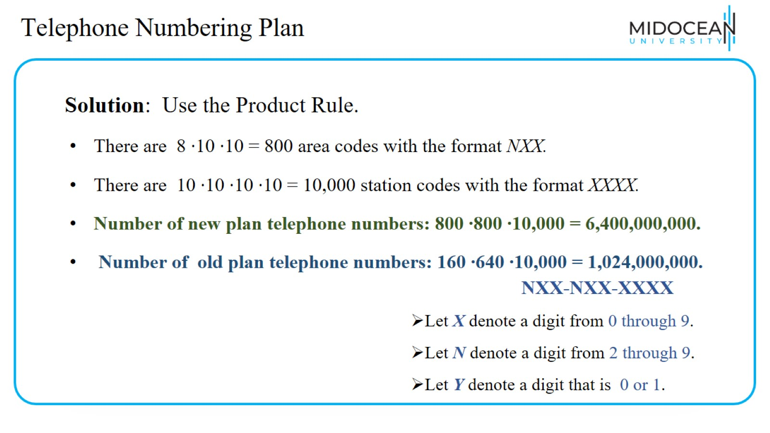
Telephone Numbering Plan

Slide 14
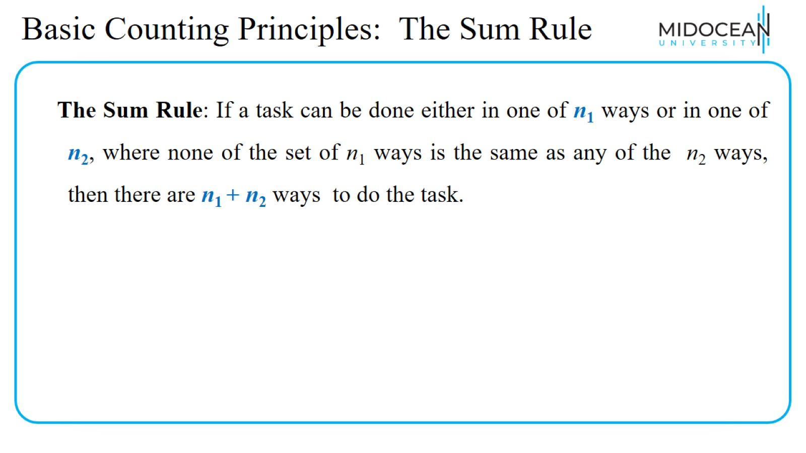
Basic Counting Principles: The Sum Rule

Slide 15
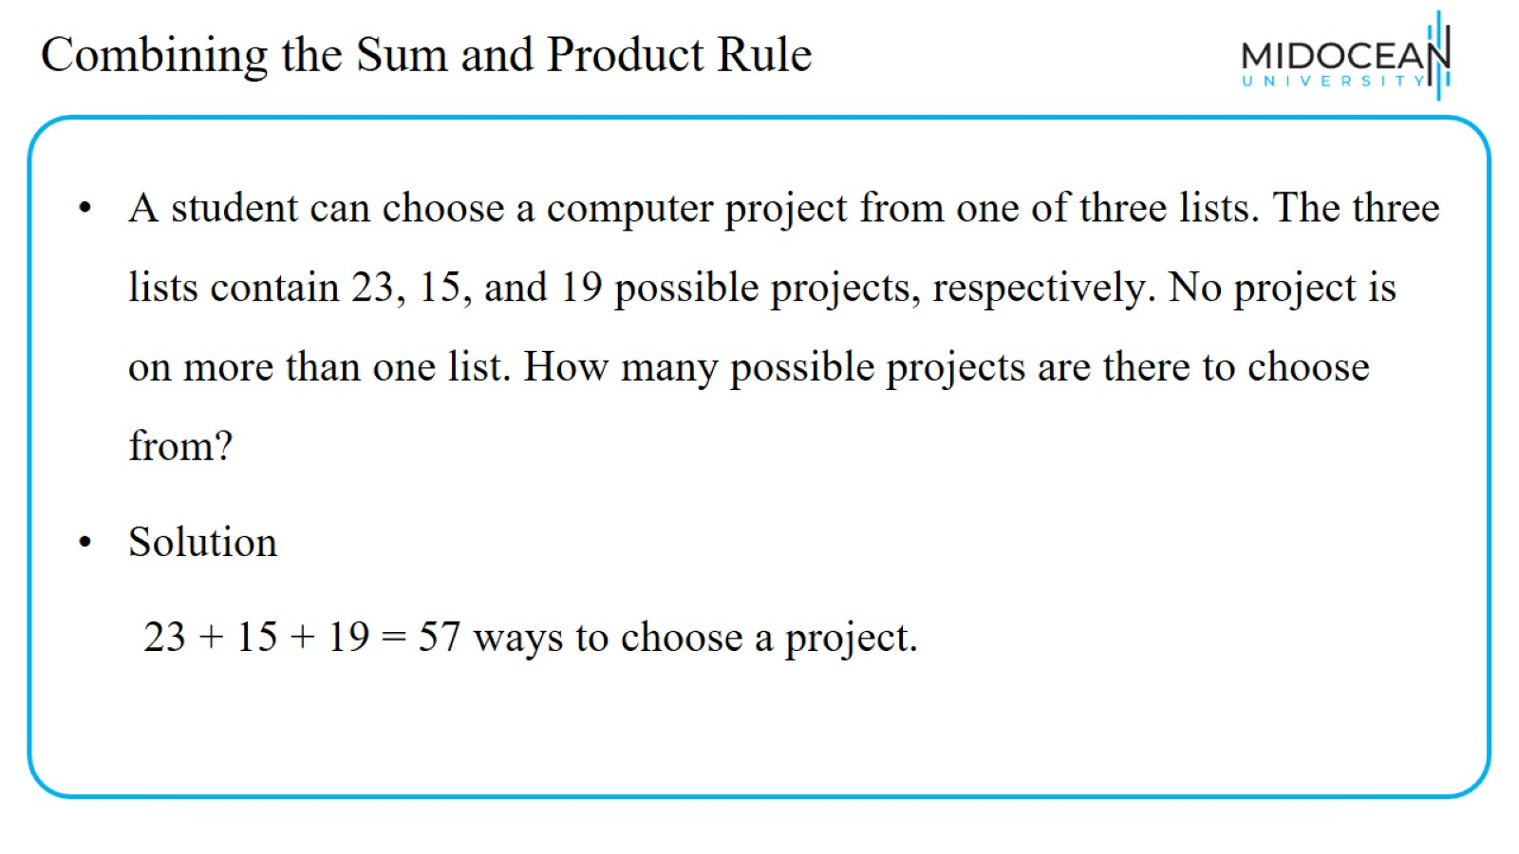
Combining the Sum and Product Rule

Slide 16
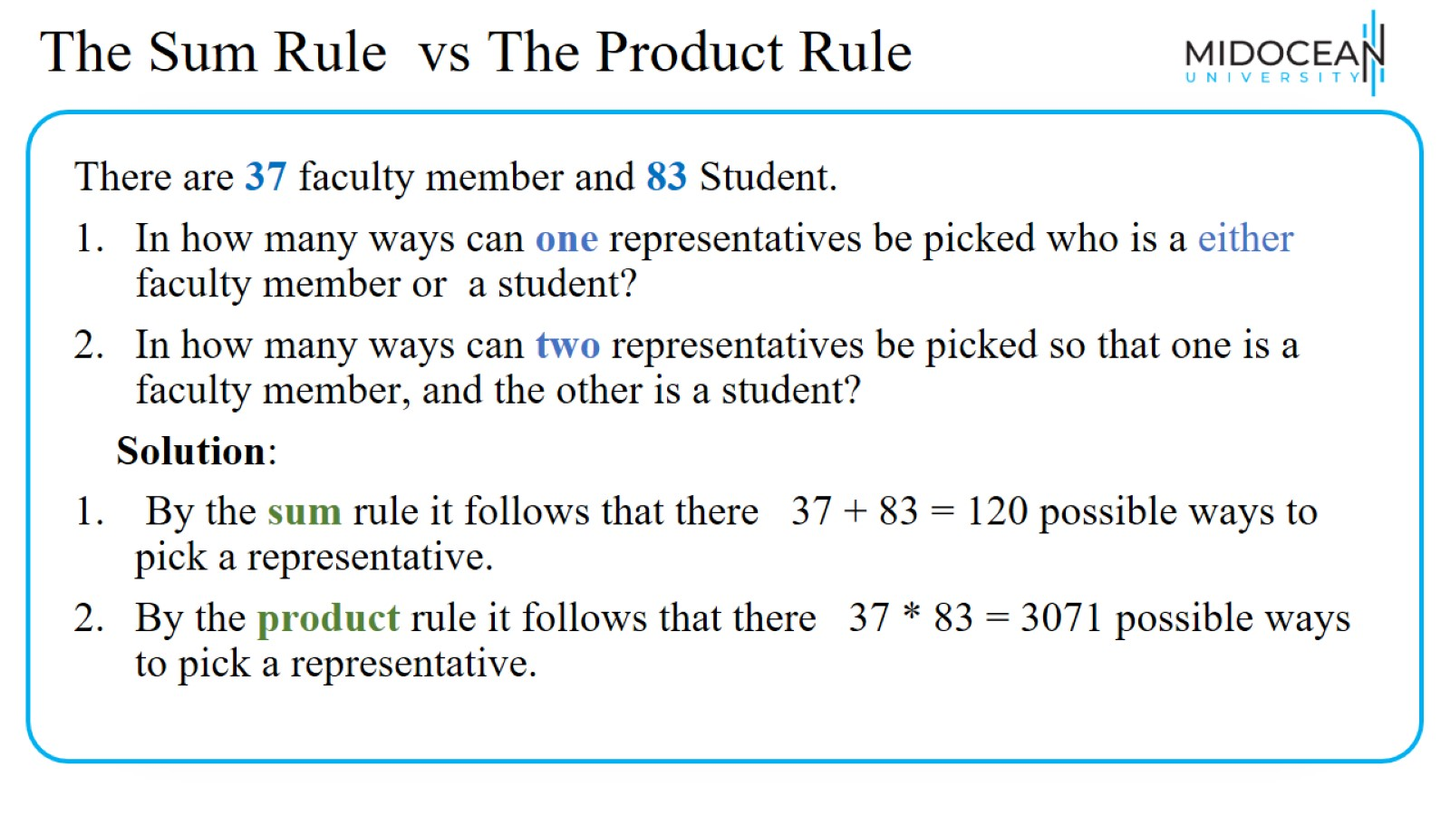
The Sum Rule vs The Product Rule

Slide 17
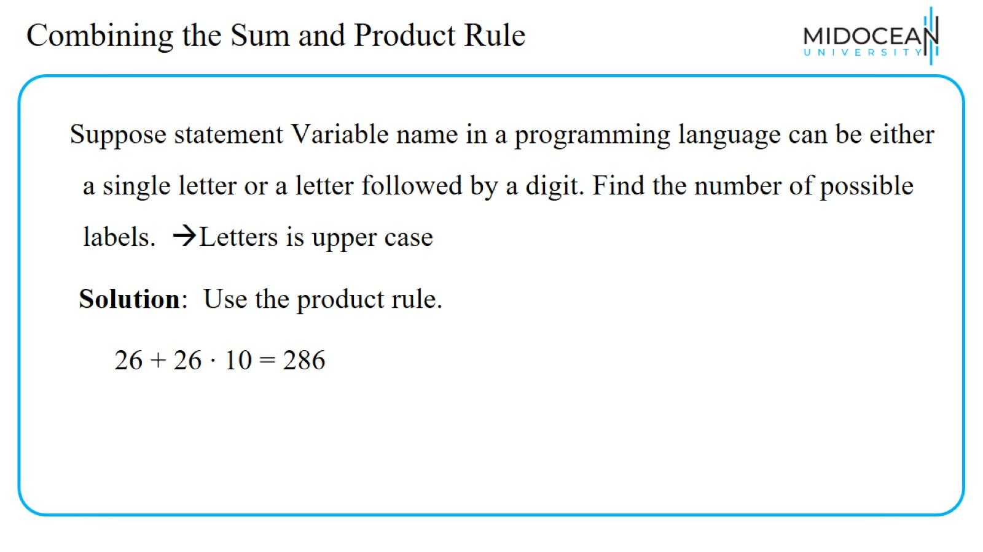
Combining the Sum and Product Rule

Slide 18
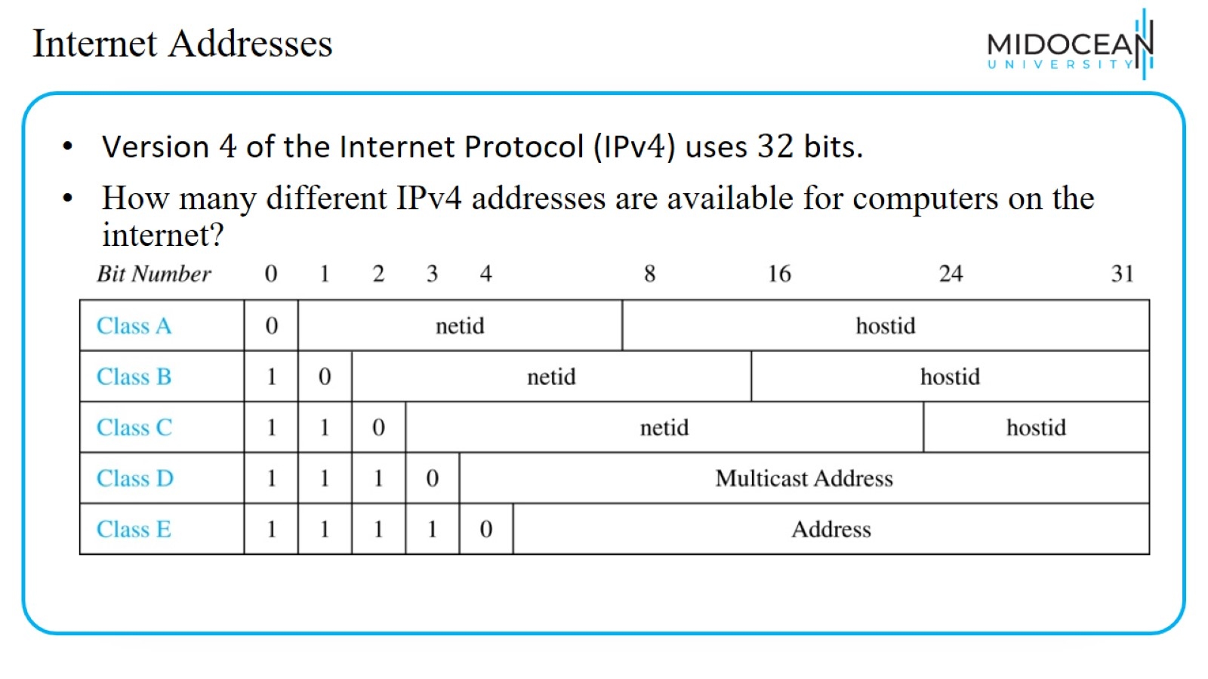
Internet Addresses

Slide 19
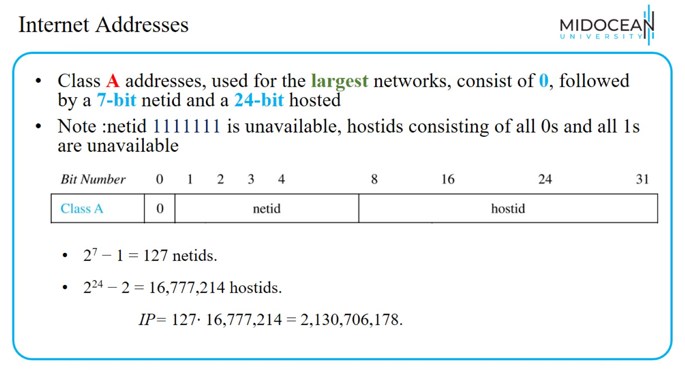
Internet Addresses

Slide 20
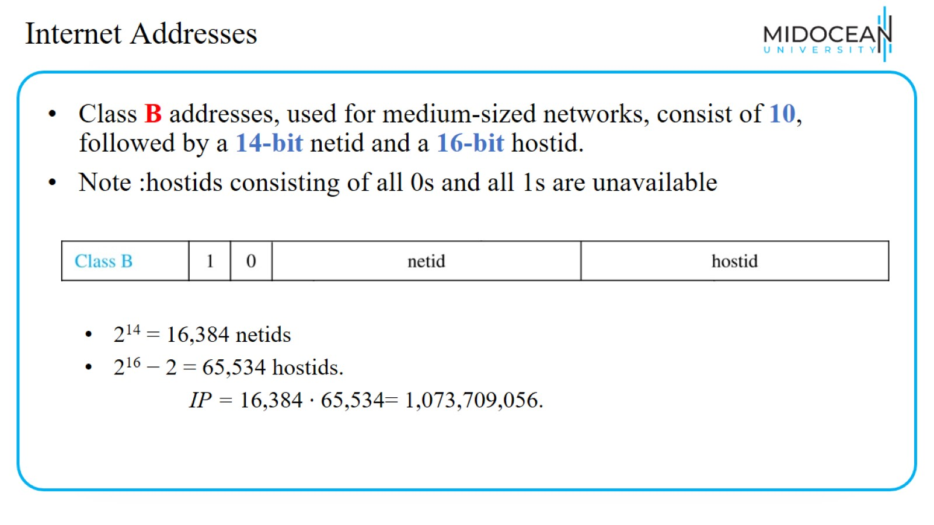
Internet Addresses

Slide 21
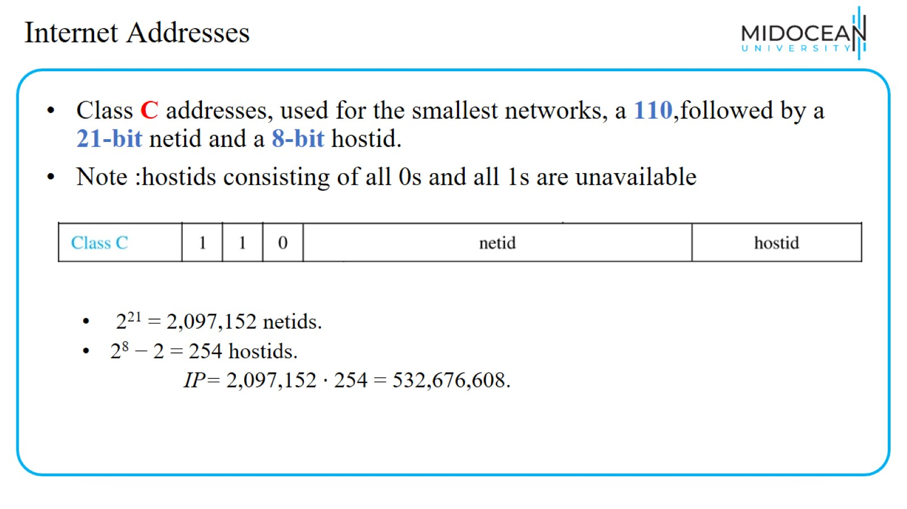
Internet Addresses

Slide 22
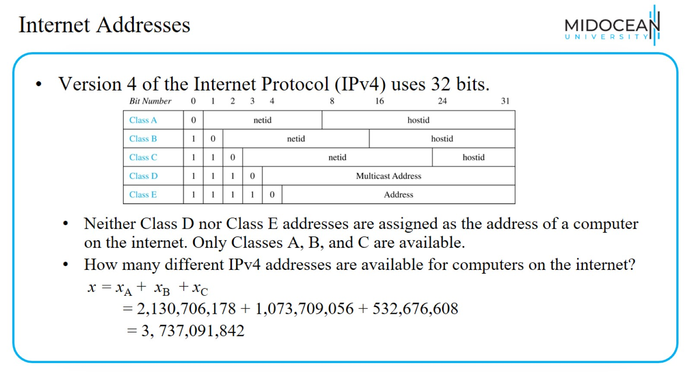
Internet Addresses

Slide 23
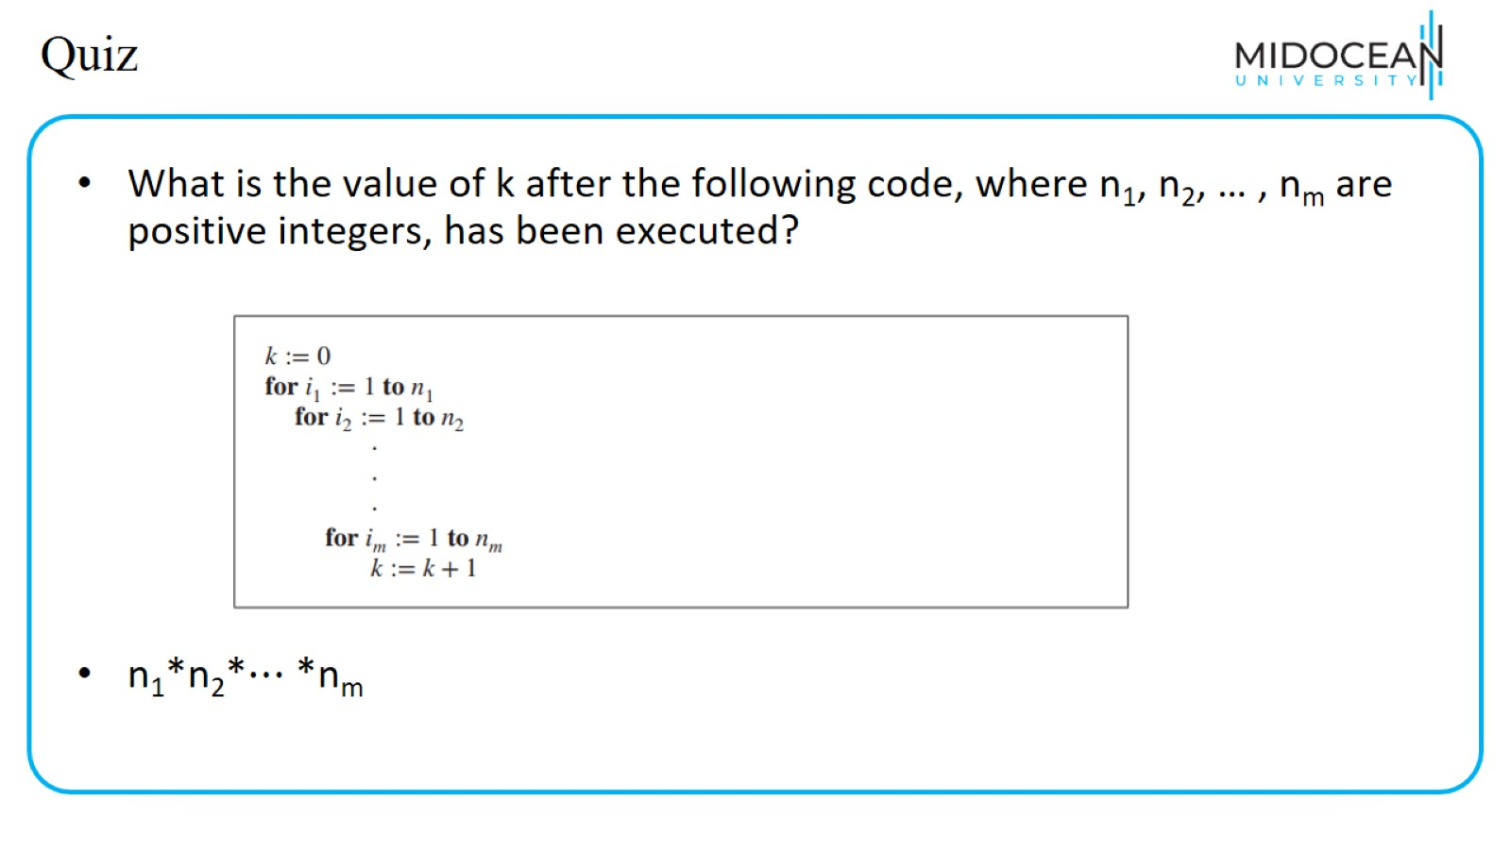
Quiz

Slide 24
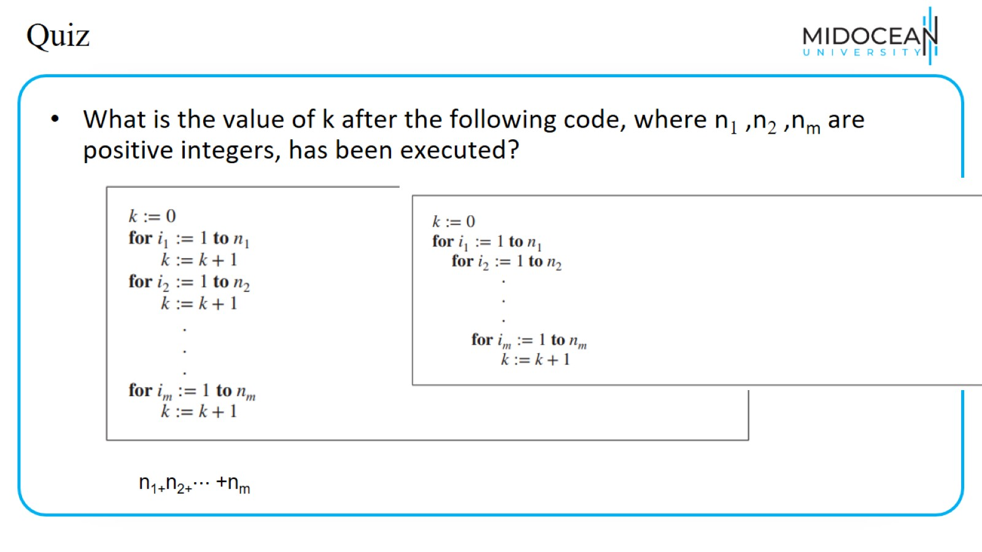
Quiz

Slide 25
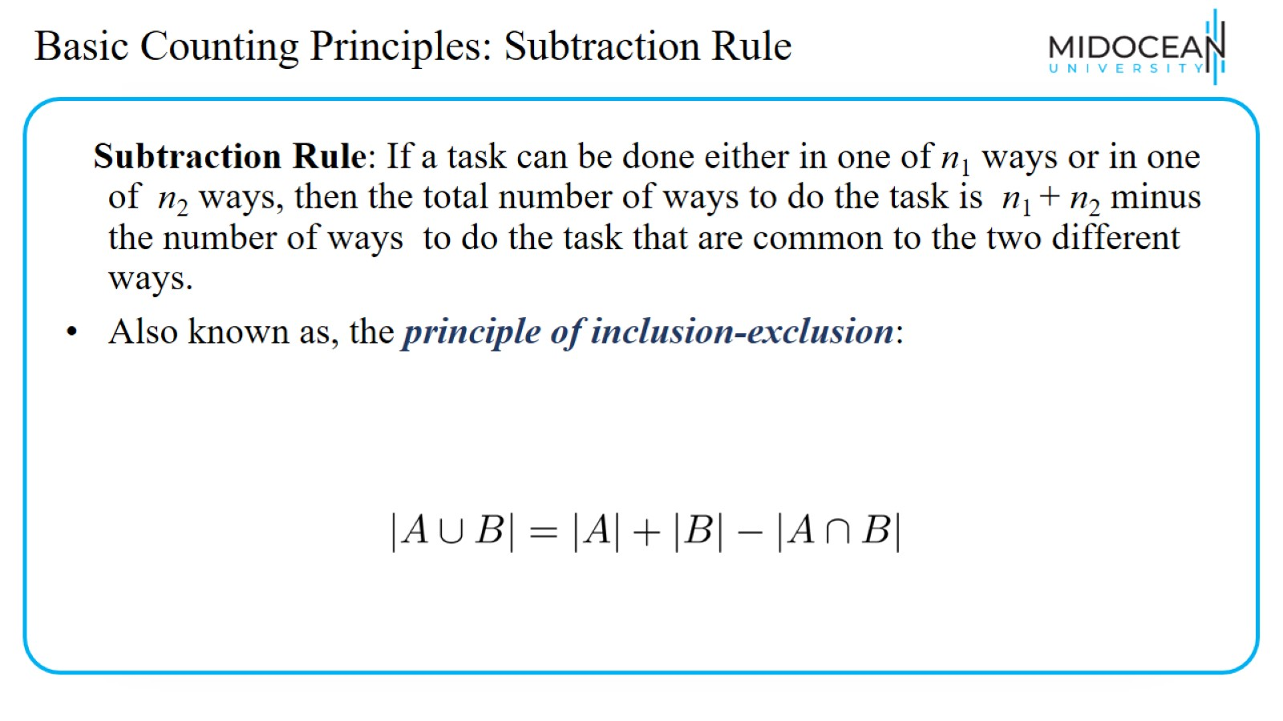
Basic Counting Principles: Subtraction Rule

Slide 26
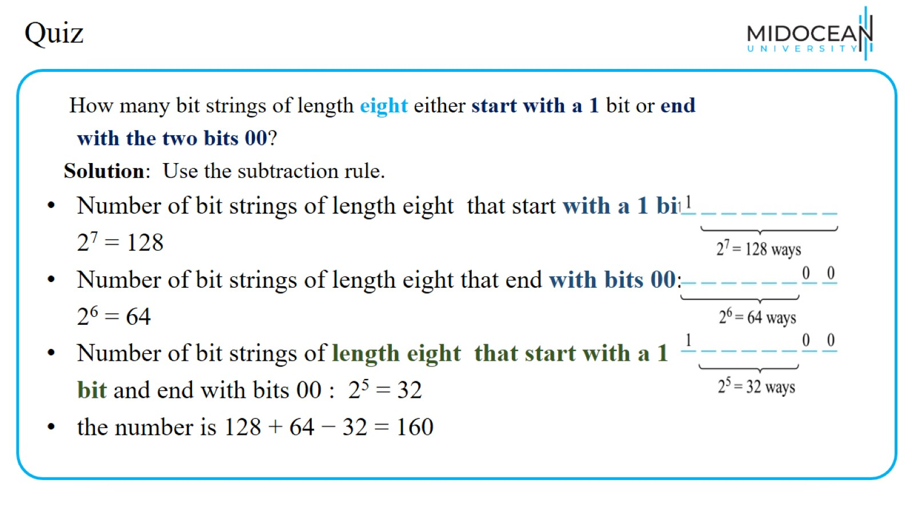
Quiz

Slide 27
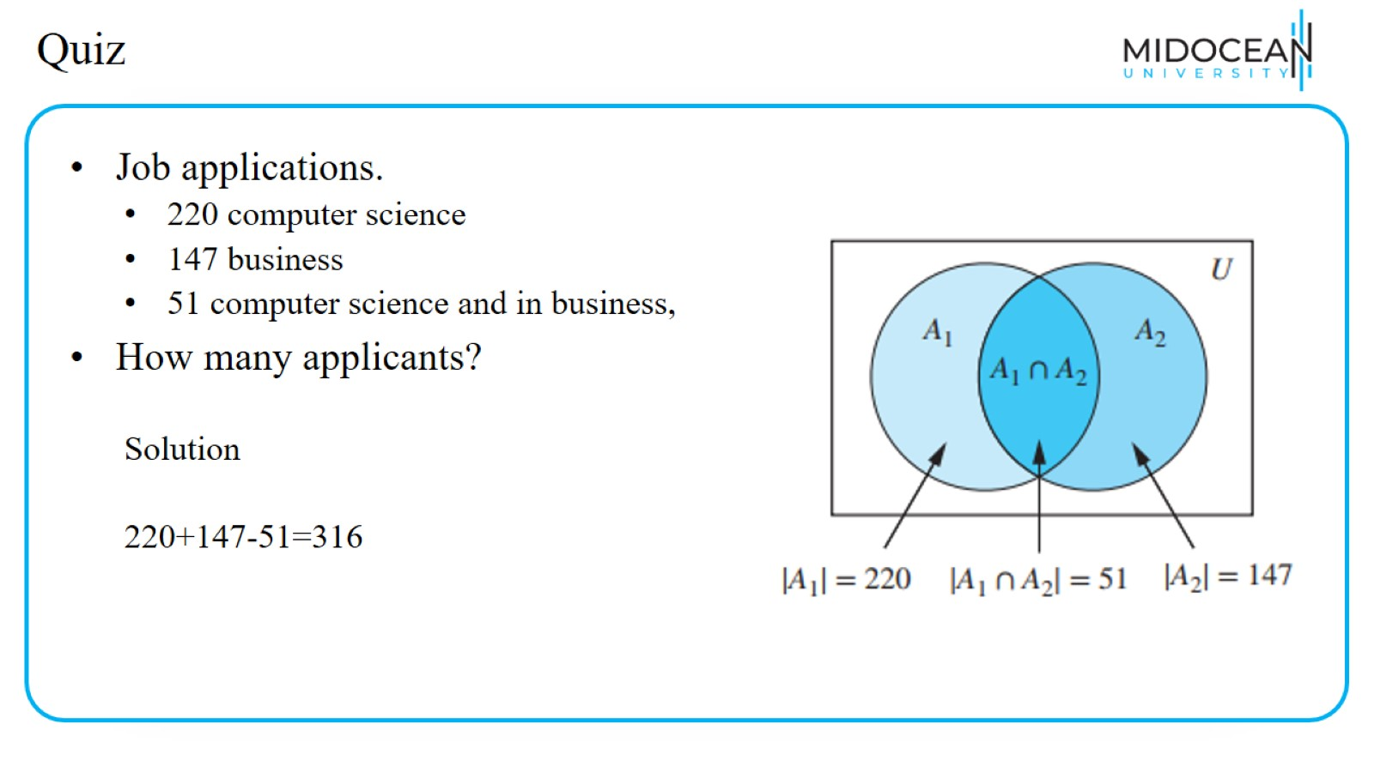
Quiz

Slide 28
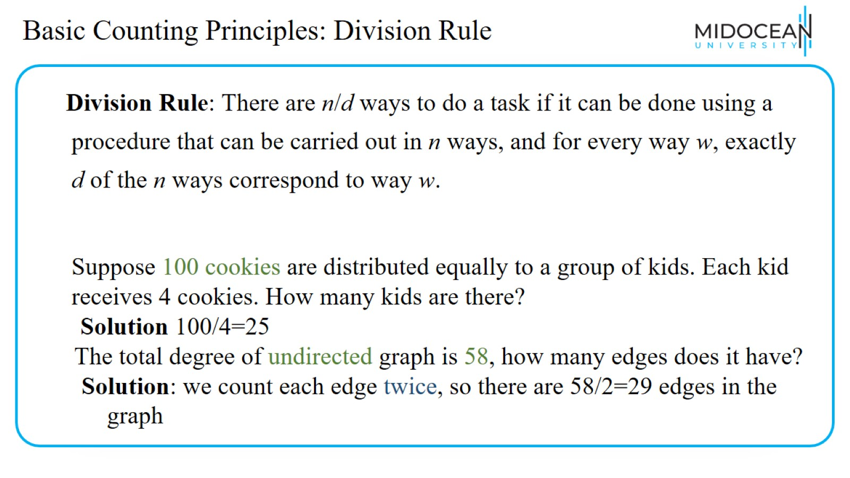
Basic Counting Principles: Division Rule

Slide 29
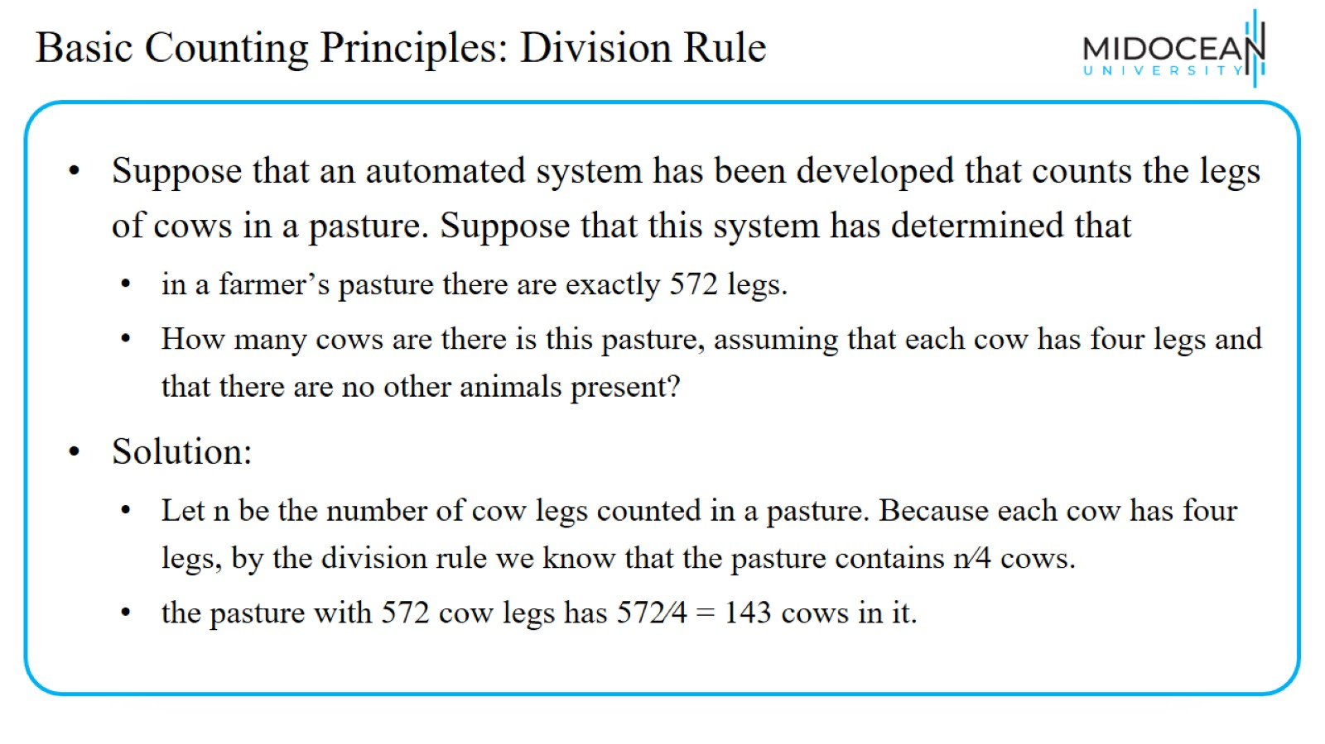
Basic Counting Principles: Division Rule

Slide 30
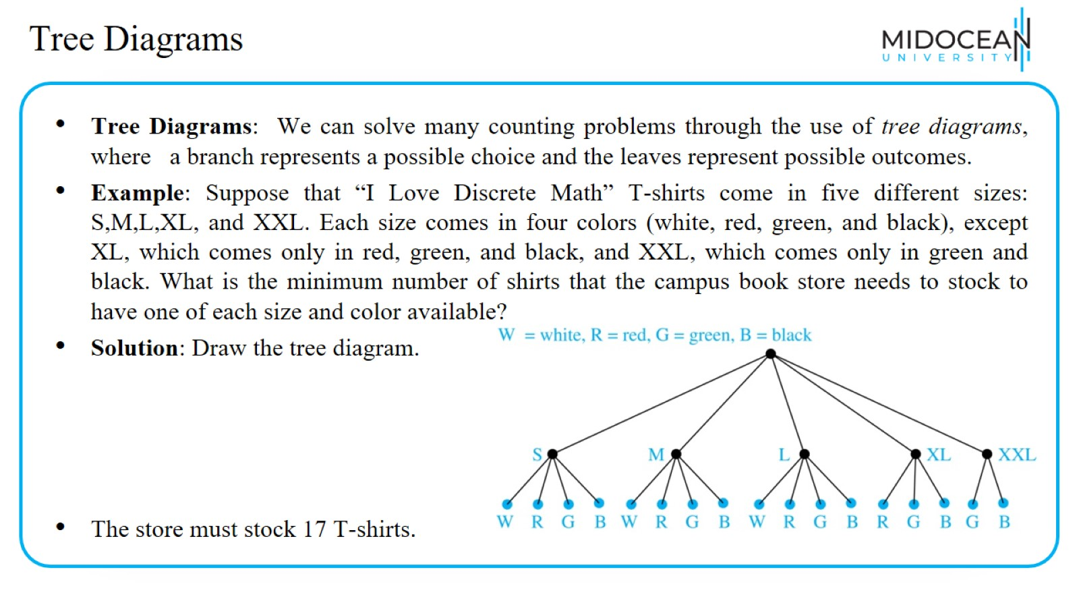
Tree Diagrams

Slide 31

The Pigeonhole Principle

Slide 32
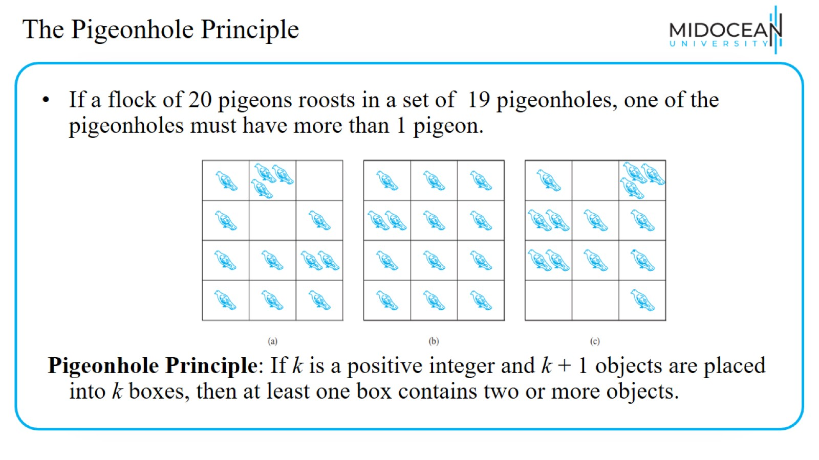
The Pigeonhole Principle

Slide 33
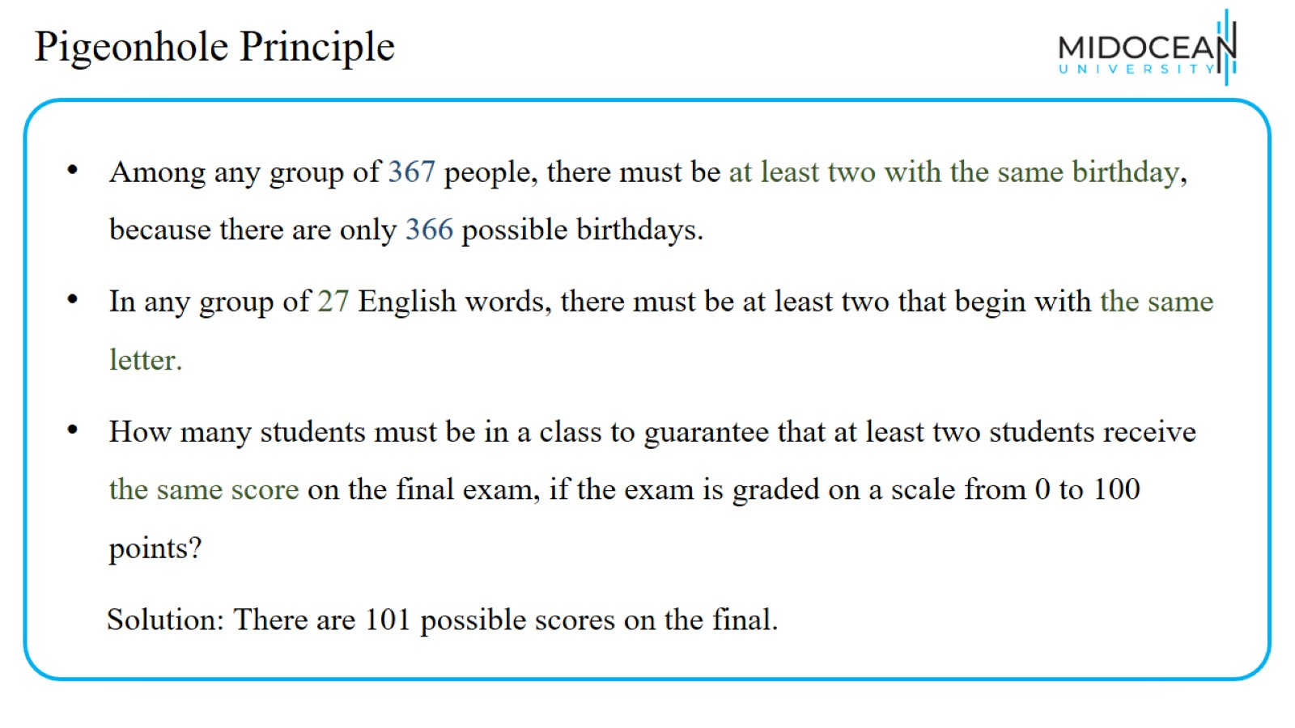
Pigeonhole Principle

Slide 34
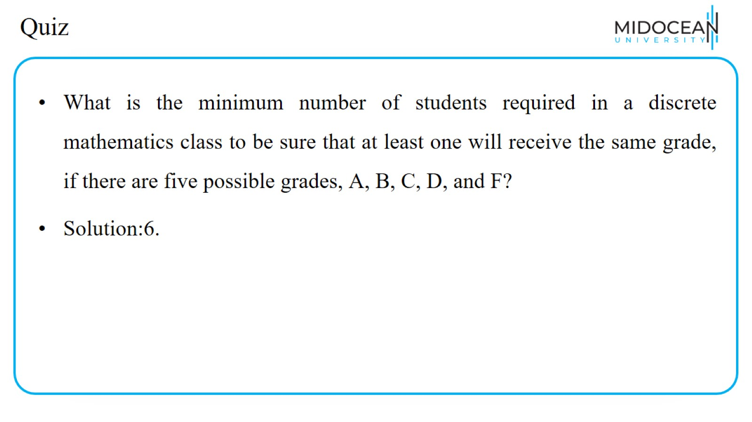
Quiz

Slide 35
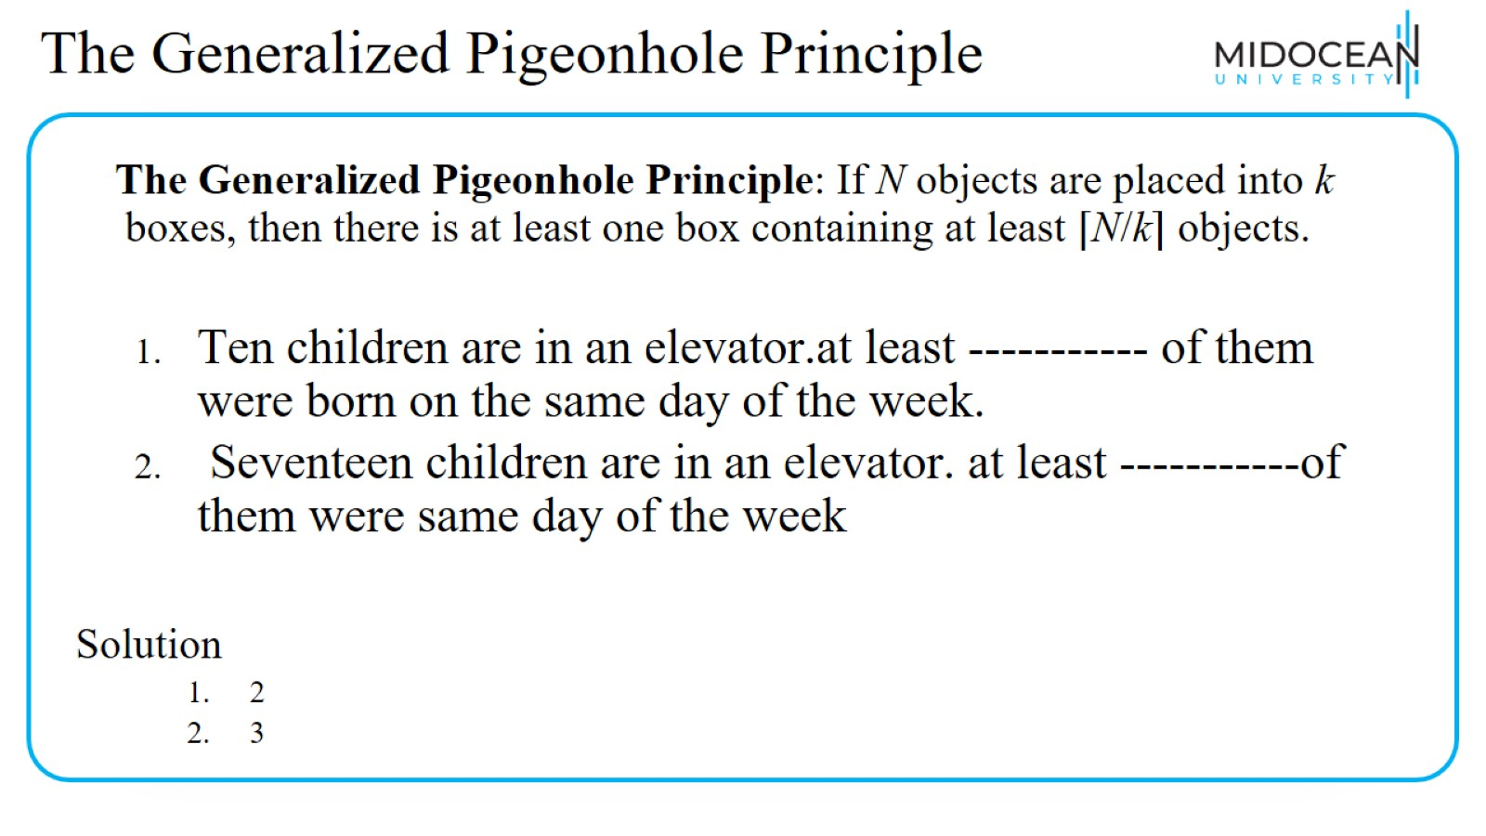
The Generalized Pigeonhole Principle

Slide 36
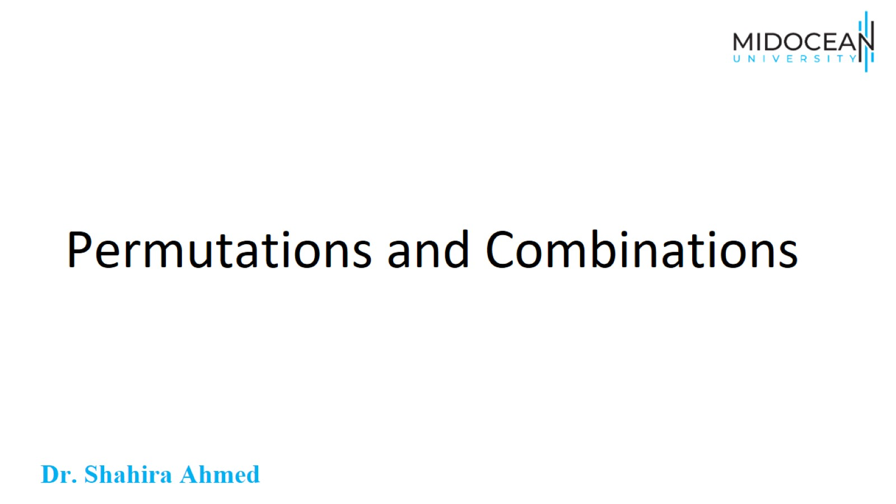
Permutations and Combinations

Slide 37
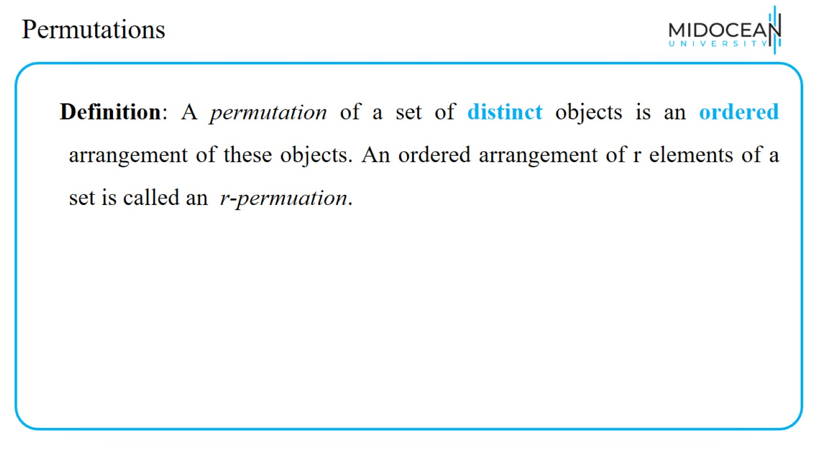
Permutations

Slide 38
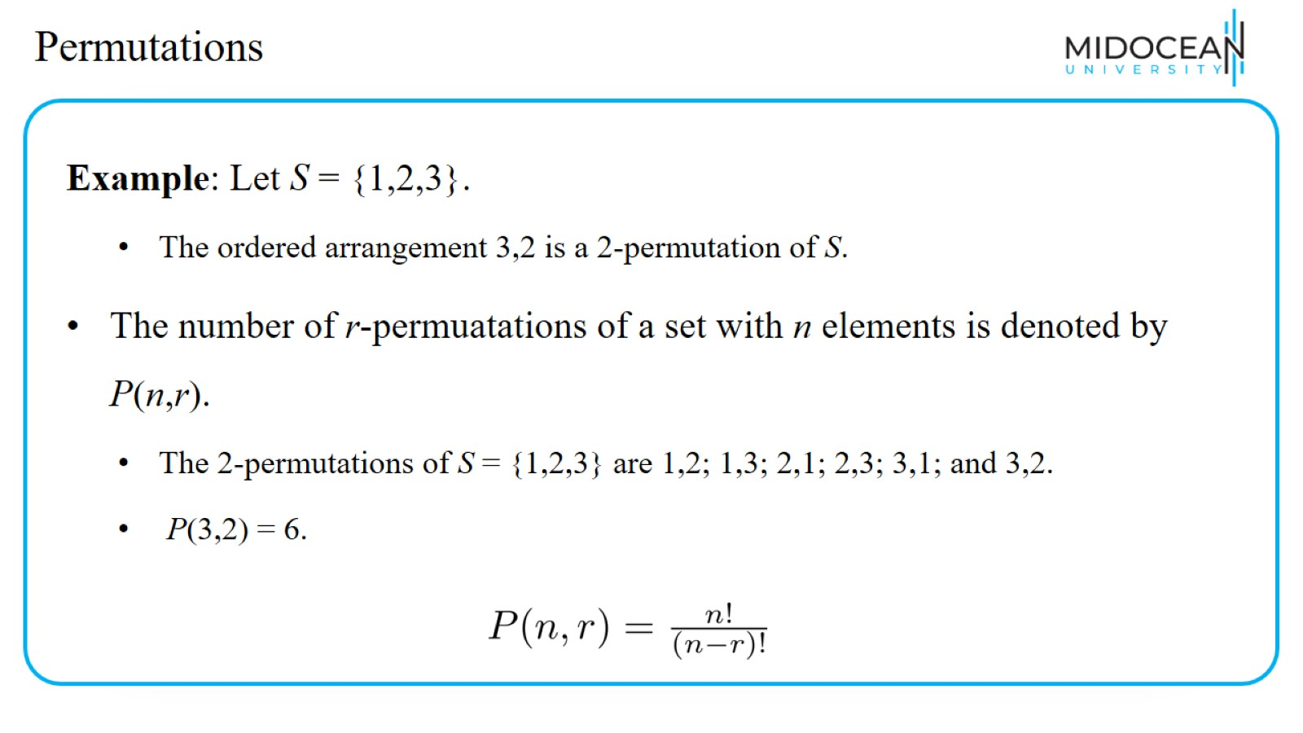
Permutations

Slide 39
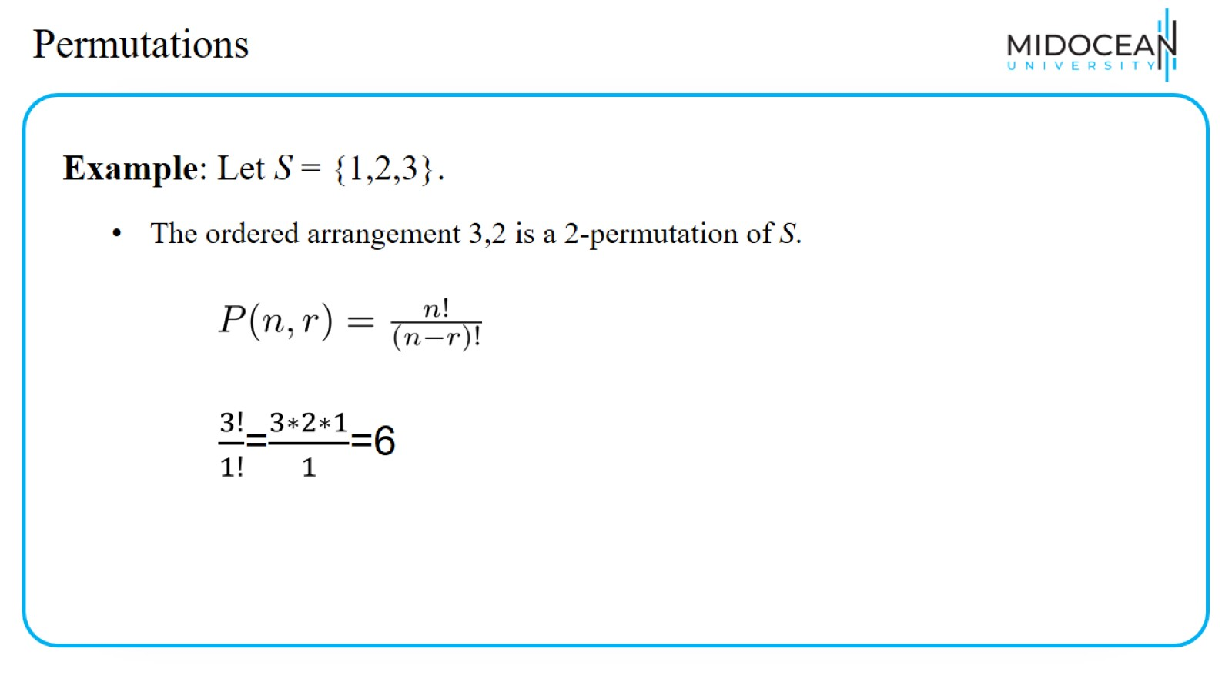
Permutations

Slide 40
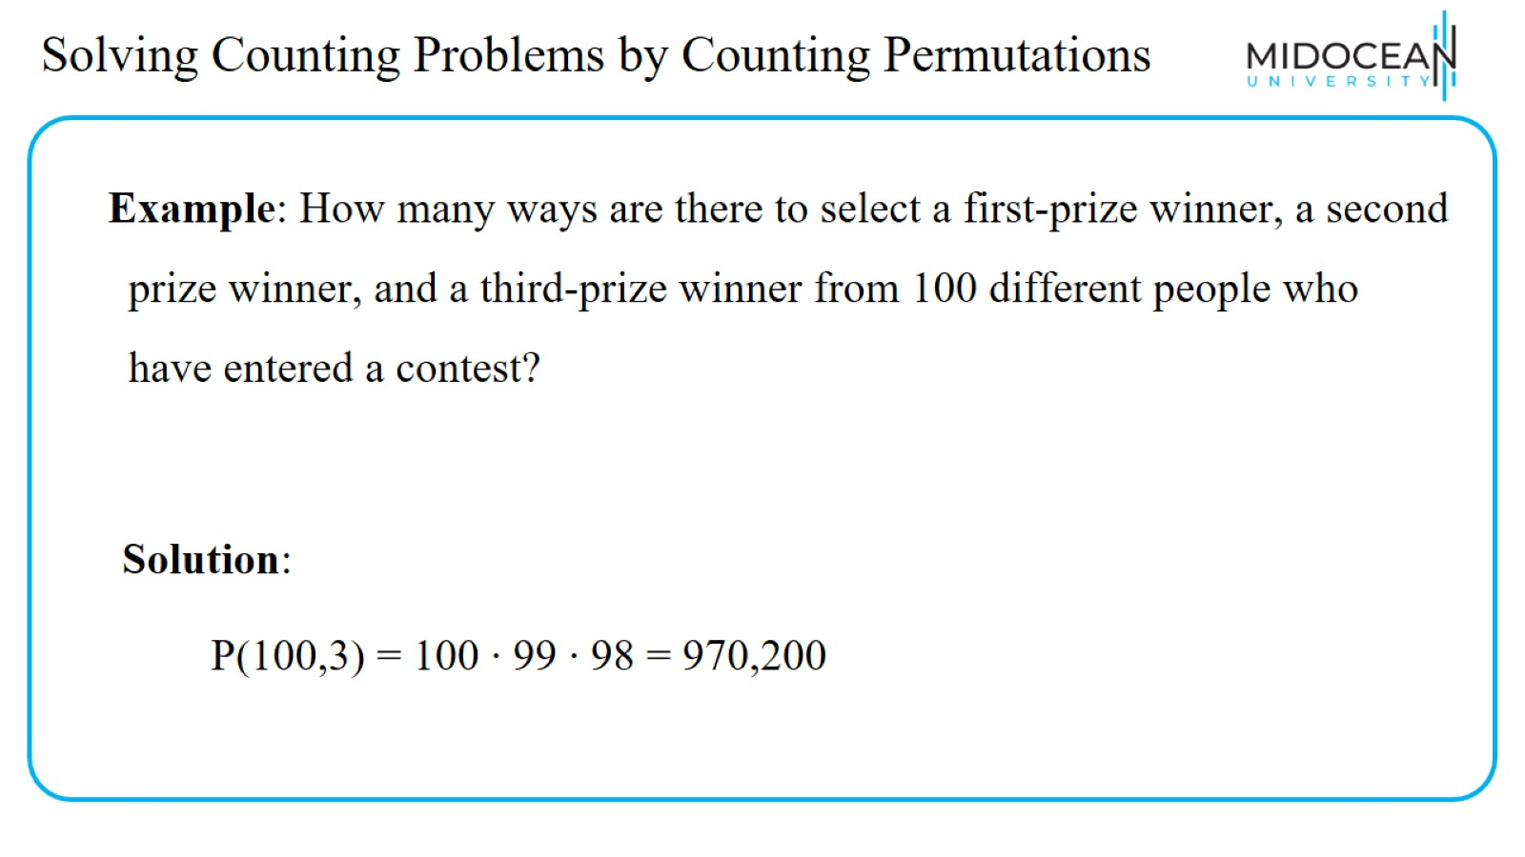
Solving Counting Problems by Counting Permutations

Slide 41
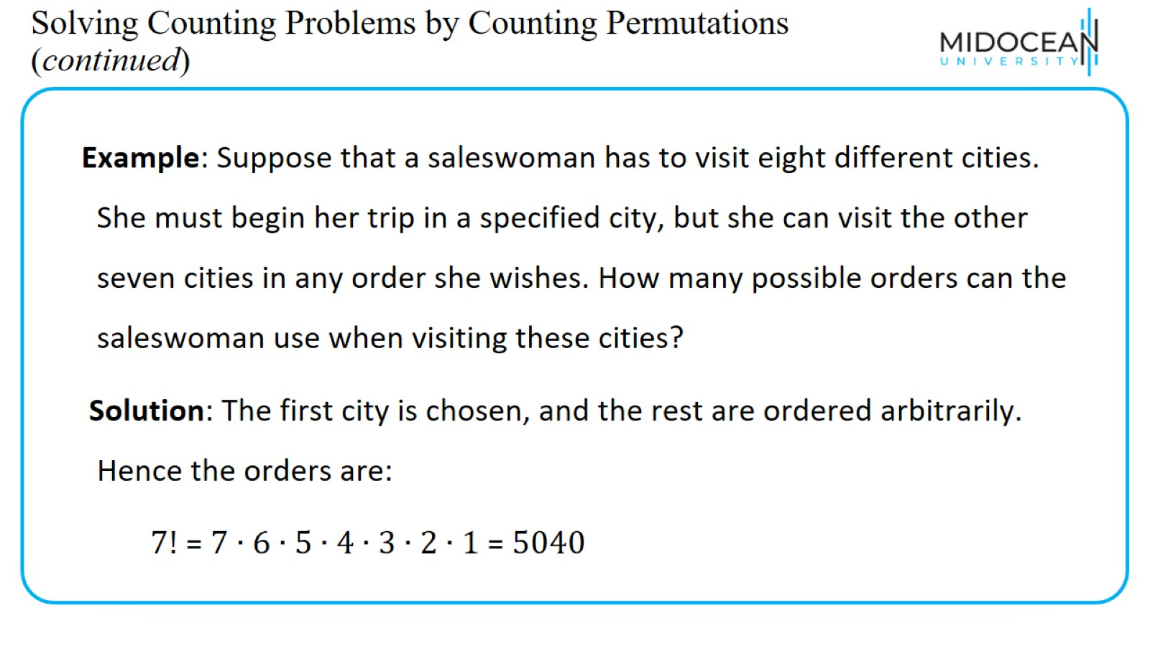
Solving Counting Problems by Counting Permutations (continued)

Slide 42
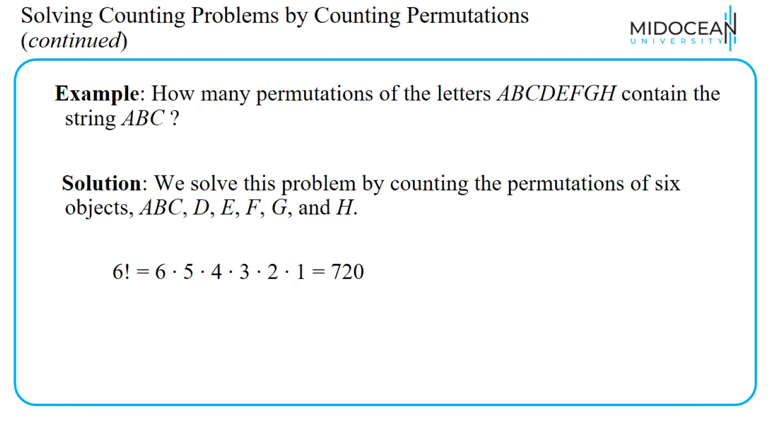
Solving Counting Problems by Counting Permutations (continued)

Slide 43
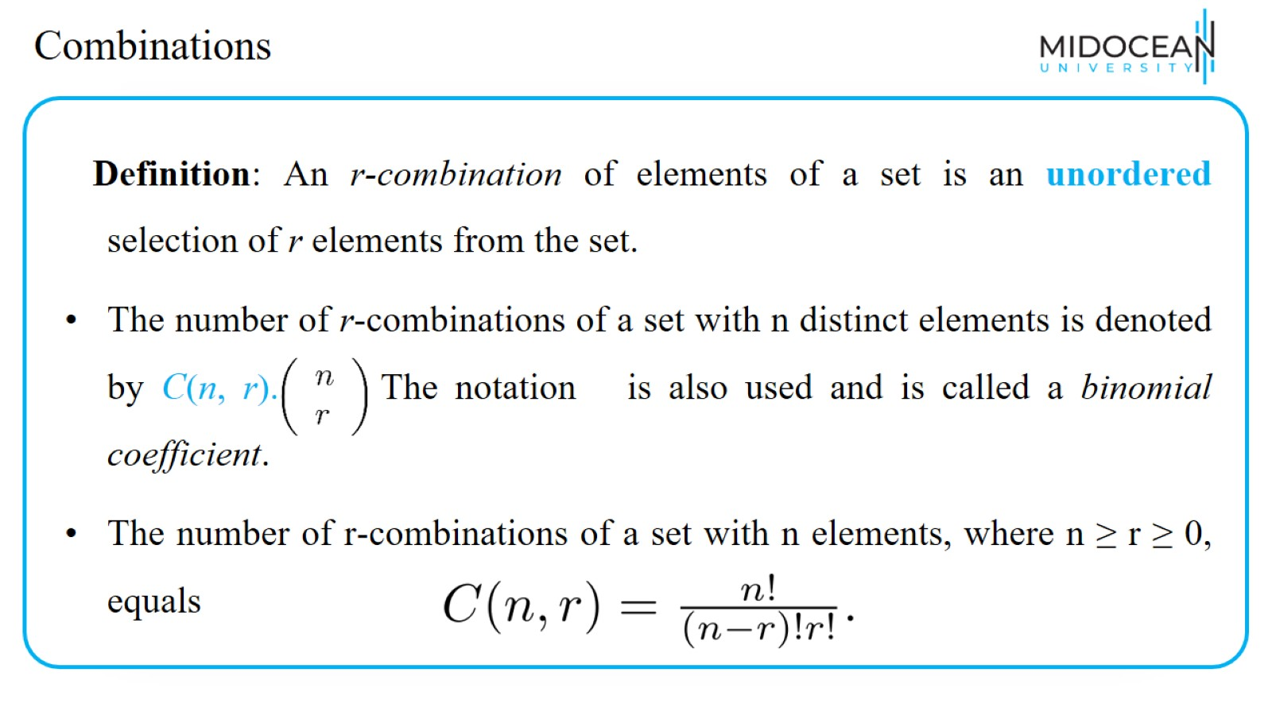
Combinations

Slide 44
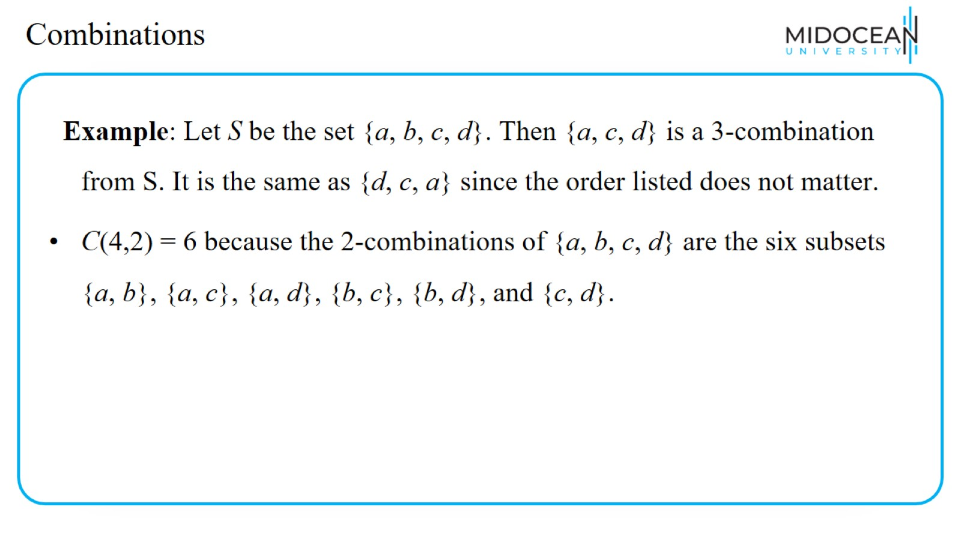
Combinations

Slide 45
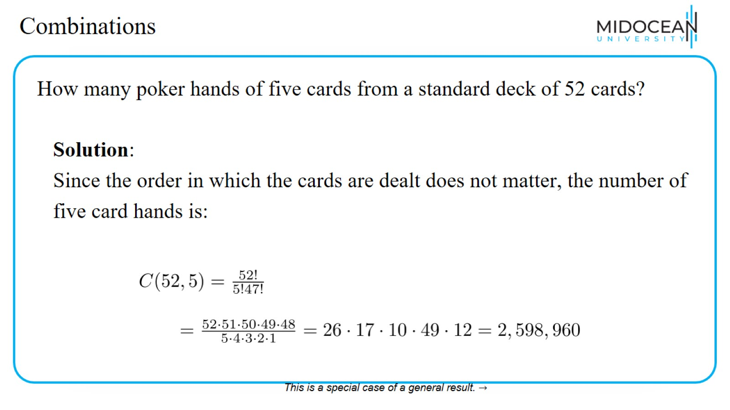
Combinations

Slide 46
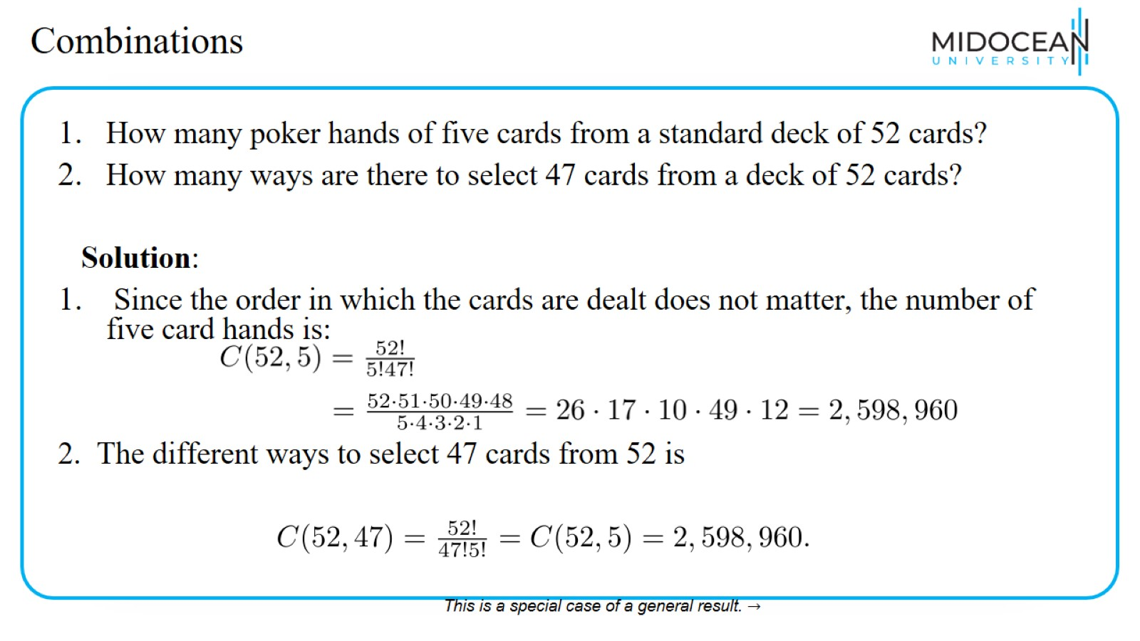
Combinations

Slide 47
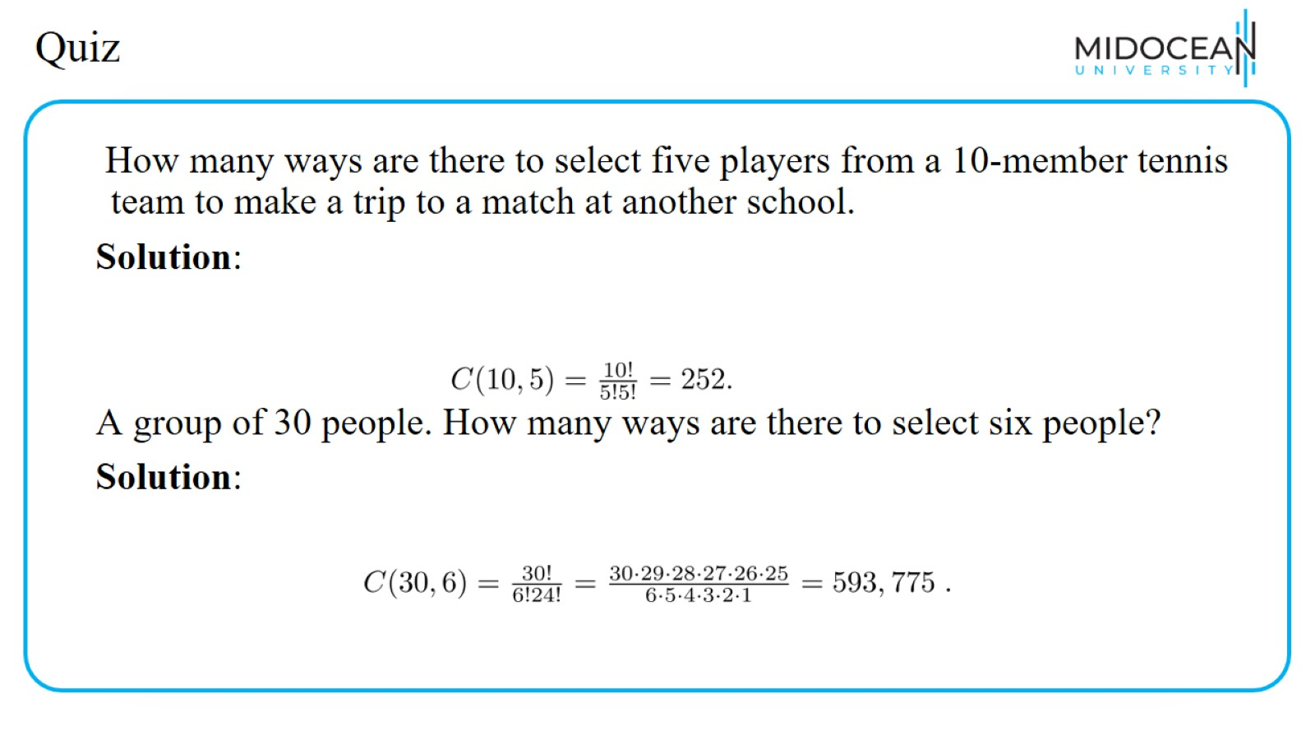
Quiz

Slide 48
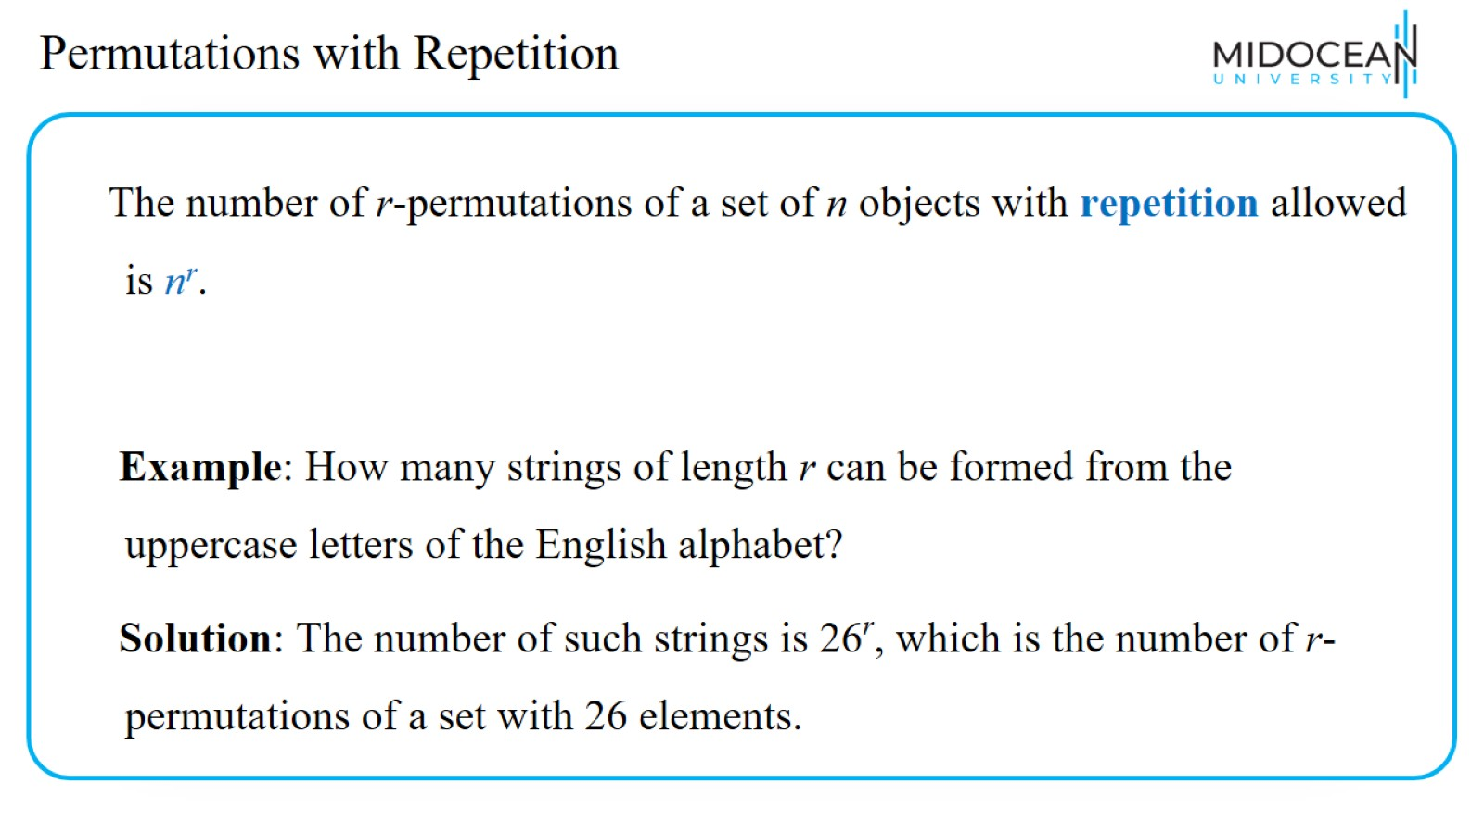
Permutations with Repetition

Slide 49
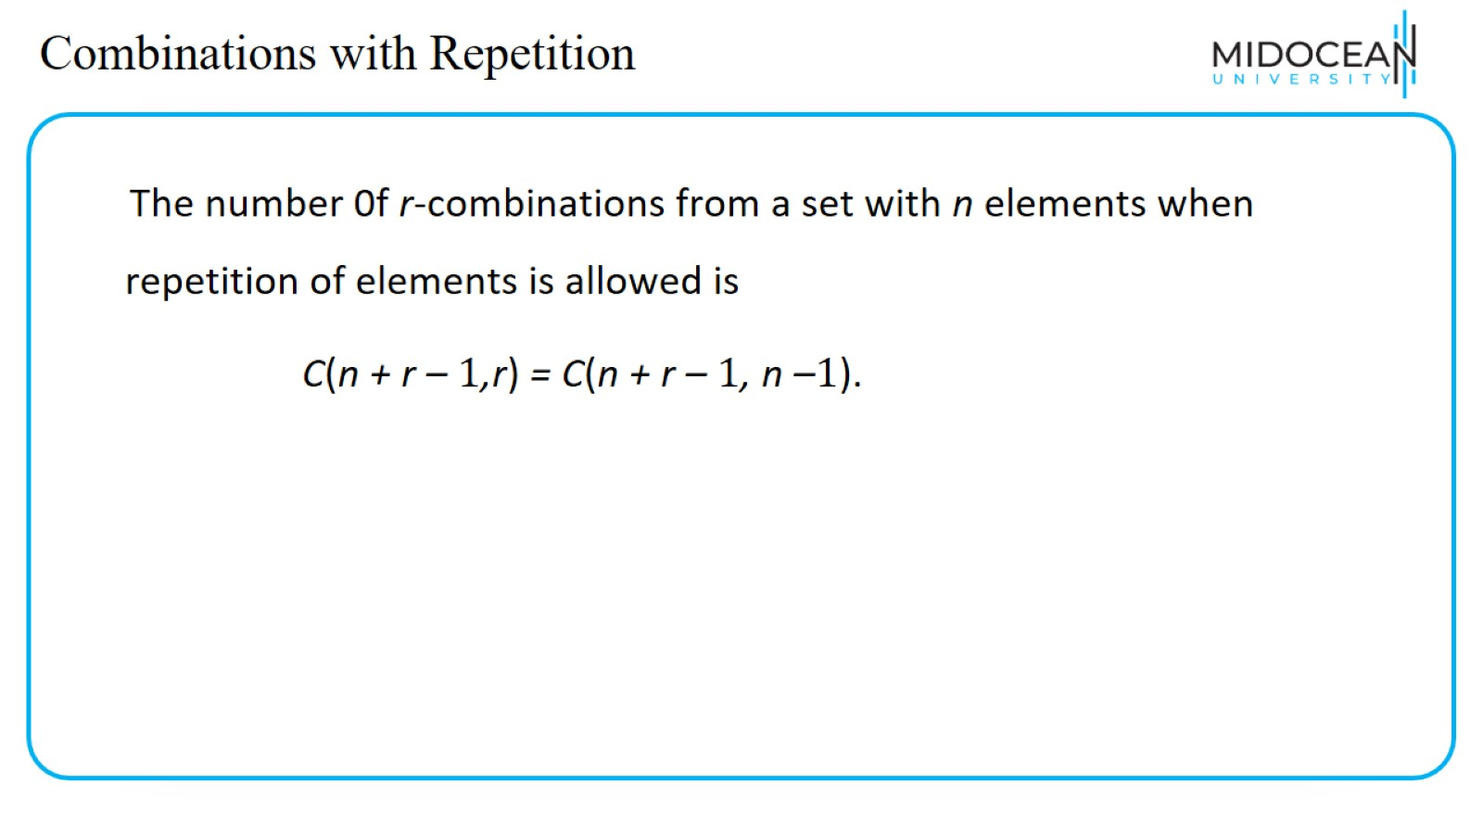
Combinations with Repetition

Slide 50
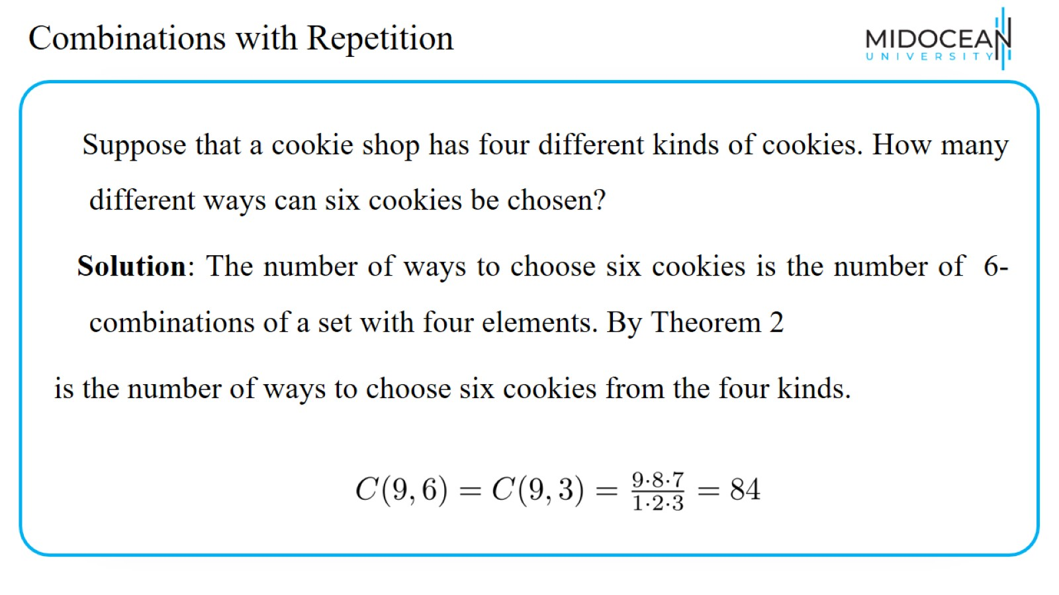
Combinations with Repetition

Slide 51
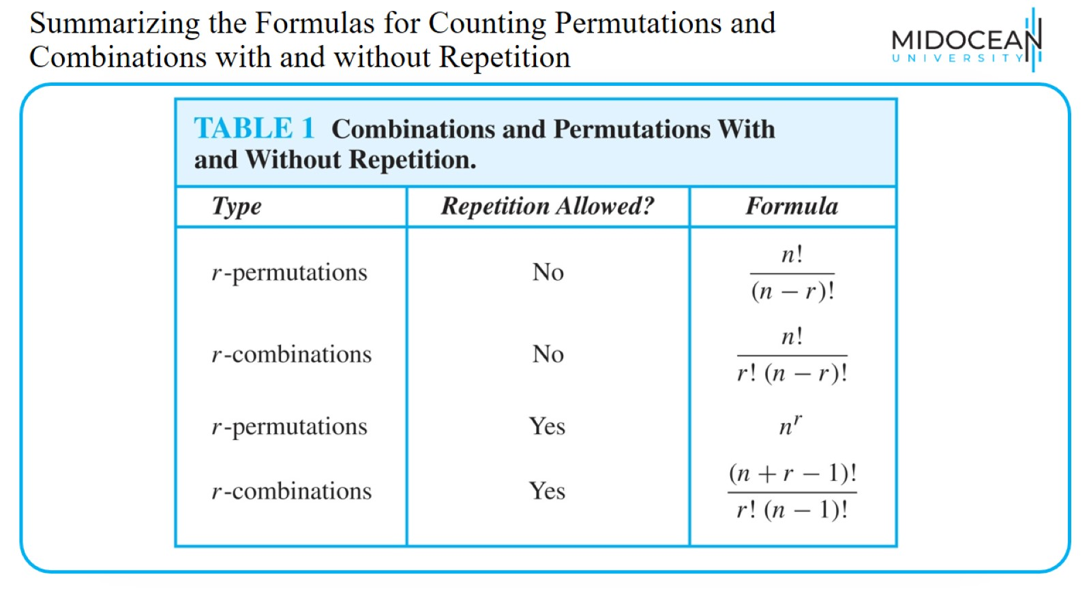
Summarizing the Formulas for Counting Permutations and Combinations with and without Repetition

Slide 52

Recap

Slide 53
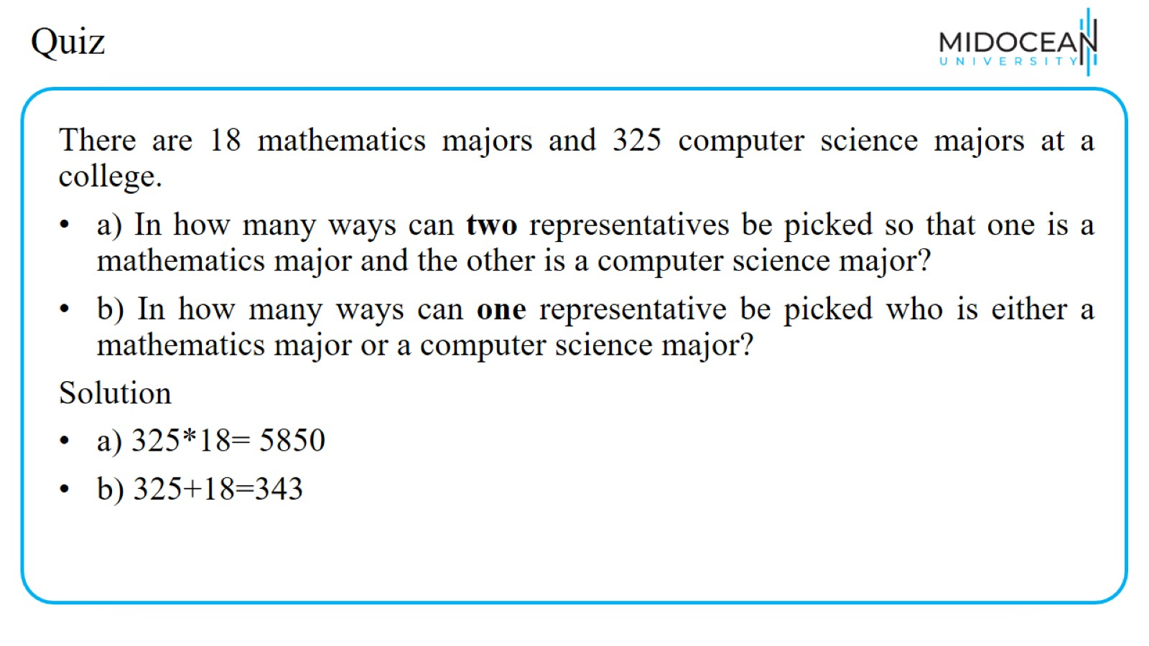
Quiz

Slide 54

Quiz

Slide 55

Quiz

Slide 56

Quiz

Slide 57

Quiz

Slide 58

Quiz

Slide 59

Quiz

Slide 60

Quiz

Slide 61

Quiz

Slide 62

Lecture Summary

Slide 63


