Slide 1


Introduction to economics
Chapter 9
Everyone’s Smart
University
Economic growth

Slide 2
The Nature of Growth
Economic growth refers to increases in the output of goods and services (real GDP)—an expansion of production possibilities.
Improvements in output may result from:
  Increased use of existing capacity
  OR
  Increases in that capacity itself
LO-1
Notes:
Economic growth refers to increases in the output of goods and services (real GDP) or an expansion of production possibilities. Economic growth means that real GDP is increasing. Such change comes from either an increase in the use of capacity or an increase in the capacity itself.

Slide 3
Short-Run Changes in Capacity Use
The easiest kind of growth comes from increased use of our productive capacity.
We do not always take full advantage of our productive capacity.
LO-1
Notes:
The easiest kind of growth comes from increased use of our productive capacity. We do not always take full advantage of our productive capacity. Productive capacity is not always at its highest.

Slide 4
Short-Run Changes
in Capacity Use
Productive capacity is illustrated by the production possibilities curve:
  Production possibilities are the alternative combinations of goods and services that could be produced in a given time period with all available resources and technology
LO-1
Notes:
Productive capacity is illustrated by the production possibilities curve. Production possibilities are the alternative combinations of goods and services that could be produced in a given time period with all available resources and technology. The production possibilities curve shows the maximum amounts of two goods that can be produced using an economy’s resources.

Slide 5
Long-Run Changes in Capacity
To achieve large and lasting increases in output, we must push our production possibilities outward.
Economists tend to define economic growth in terms of changes in potential GDP.
LO-1
Notes:
To achieve large and lasting increases in output, we must push our production possibilities outward. Economists tend to define economic growth in terms of changes in potential GDP. Potential GDP represents the maximum possible output.

Slide 6
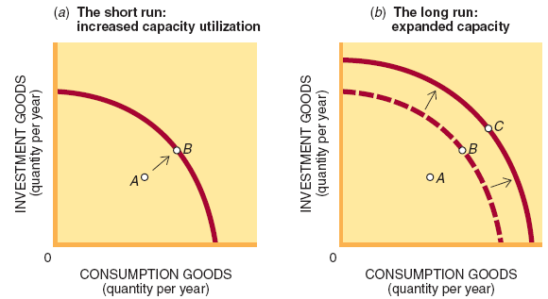
Figure 9.1

Slide 7
Aggregate Supply
Focus
Economic growth—sustained increases in total output—is possible only if the AS curve shifts rightward.
LO-1
Notes:
Economic growth, or sustained increases in total output, is possible only if the AS curve shifts rightward. An increase in aggregate supply will lead to an increase in GDP.

Slide 8
Nominal versus
Real GDP
Nominal GDP is the total value of goods and services produced within a nation’s borders, measured in current prices.
Real GDP is the inflation-adjusted value of GDP or the value of output measured in constant prices.
LO-1
Notes:
Nominal GDP is the total value of goods and services produced within a nation’s borders, measured in current prices. Real GDP is the inflation-adjusted value of GDP or the value of output measured in constant prices.

Slide 9
https://www.stats.gov.sa/sites/default/files/Gross%20Domestic%20Product%20annual%202020%20AR.pdf

Slide 10
The GDP Growth Rate
Growth rate is the percentage change in real GDP from one period to another.
The challenge for the future is to maintain higher rates of economic growth.
change in real GDP
Growth Rate
=
base period GDP
LO-1
Notes:
The growth rate is the percentage change in real GDP from one period to another. The challenge for the future is to maintain higher rates of economic growth. Increases in economic growth lead to higher standards of living, so growth is an important goal. The growth rate equals the change in real GDP divided by the base period GDP.

Slide 11
The GDP Growth Rate
The past decade saw a period of economic growth even with recessions in 2001 and 2008-09.
Population growth is not a guarantee of economic growth.
change in real GDP
Growth Rate
=
base period GDP
LO-1
Notes:
The past decade saw a period of economic growth even though we recessed in 2001 and 2008-09. Note that population growth is not a guarantee of economic growth.

Slide 12
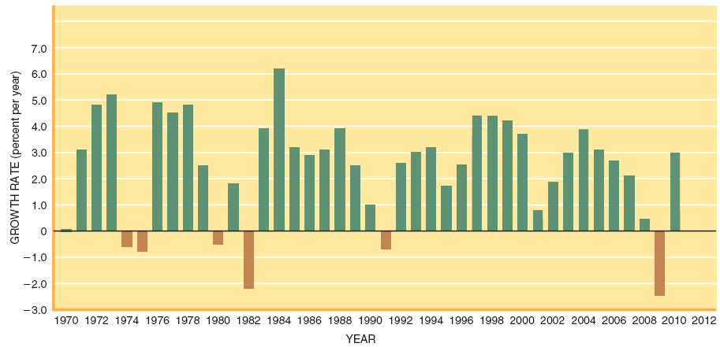
Figure 9.3

Slide 13
The Exponential
Process
Even one year of “low” growth implies lost output.
Economic growth is a continuing process where gains made in one year accumulate in future years.
This cumulative process is called an exponential process.
LO-1
Notes:
Even one year of “low” growth implies lost output. Economic growth is a continuing process where gains made in one year accumulate in future years. This cumulative process is called an exponential process.

Slide 14
GDP per Capita:
Measure of Living Standards
GDP per capita–total GDP divided by total population or average GDP.
Growth in GDP per capita is attained only when the growth of output exceeds population growth.
U.S. GDP per capita has more than doubled since Ronald Reagan was elected president.
LO-2
Notes:
GDP per capita is total GDP divided by total population; it is also called average GDP. Per capita simply means per person. Growth in GDP per capita is attained only when the growth of output exceeds population growth. U.S. GDP per capita has more than doubled since Ronald Reagan was elected president. This means that the average person has many more goods and services today than in the past.

Slide 15
GDP per Worker:
A Measure of Productivity
Average workers today produce nearly twice as much as their parents did.
The U.S. labor force grew faster than the population during the 1990s:
  The labor force includes all persons over age 16 who are either working for pay or actively seeking paid employment.
LO-2
Notes:
Average workers today produce nearly twice as much as their parents did. Workers today are much more productive than workers were years ago. The U.S. labor force grew faster than the population during the 1990s. The labor force includes all persons over age 16 who are either working for pay or actively seeking paid employment.

Slide 16
GDP per Worker:
A Measure of Productivity
The U.S. employment rate also increased:
  The employment rate is the proportion of the population that is employed.
LO-2
Notes:
The U.S. employment rate also increased. The employment rate is the proportion of the population that is employed. The employment rate is the opposite of the unemployment rate.

Slide 17
GDP per Worker:
A Measure of Productivity
If productivity is increasing, then per capita GDP is likely to rise as well.
  Productivity is output per unit of input, such as output per labor hour.
LO-2
Notes:
If productivity is increasing, then per capita GDP is likely to rise as well. Productivity is output per unit of input, such as output per labor hour. An increase in productivity often causes GDP to increase too.

Slide 18
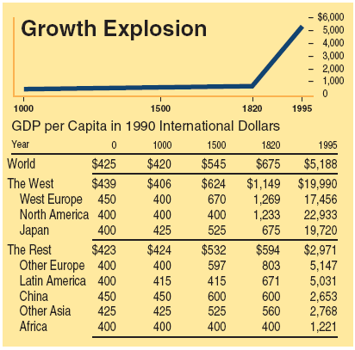
Figure 9.4

Slide 19
Sources of
Productivity Growth
The sources of productivity gains include:
  Higher skills
  More capital
  Improved management
  Technological advance
LO-3
Notes:
The sources of productivity gains include higher skills, more capital, improved management, and technological advance. These four things lead to improvements in productivity.

Slide 20
Labor Quality
As education and training levels rise, so does productivity.
LO-3
Notes:
As education and training levels rise, so does productivity. The U.S. has one of the most educated workforces in the world, and also one of the most productive.

Slide 21
Capital Investment
Capital investment is a prime determinant of both productivity and growth:
  Investment refers to expenditures on (production of) new plant and equipment (capital) in a given time period, plus changes in business inventories.
LO-3
Notes:
Capital investment is a prime determinant of both productivity and growth. Investment refers to expenditures on (production of) new plant and equipment (capital) in a given time period, plus changes in business inventories.

Slide 22
Management
Entrepreneurship and the quality of continuing management are major determinants of economic growth.
There is a potential conflict between short-term profits and long-term productivity gains.
Managers must develop personnel structures and incentives that make employees contribute to production.
LO-3
Notes:
Entrepreneurship and the quality of continuing management are major determinants of economic growth. There is a potential conflict between short-term profits and long-term productivity gains.

Slide 23
Research and
Development
Research and Development (R&D) is a broad concept that includes:
  Scientific research
  Product development
  Innovations in production technique
  Development of management improvements
LO-3
Notes:
Research and Development (R&D) is a broad concept that includes scientific research, product development, innovations in production technique, and development of management improvements. R&D is important to the long-term growth of the economy.

Slide 24
Policy Levers
Government policies can have a major impact on whether and how far the aggregate supply curve shifts.
LO-4
Notes:
Government policies can have a major impact on whether and how far the aggregate supply curve shifts.

Slide 25
Education and Training
Government policies that support education and training have a dual payoff:
  They stimulate the economy in the short run
  They increase the long-run capacity to produce
LO-4
Notes:
Government policies that support education and training have a dual payoff. They stimulate the economy in the short run, and they increase the long-run capacity to produce. Education and training provide large benefits to the economy.

Slide 26
Immigration Policy
The quality and quantity of labor are affected by immigration policy because:
  It is a direct contributor to an outward shift of our production possibilities
  Recent immigrants have much lower educational attainments than native-born Americans
LO-4
Notes:
The quality and quantity of labor are affected by immigration policy. It is a direct contributor to an outward shift of our production possibilities. Recent immigrants have much lower educational attainments than native-born Americans. An increase in immigration will lead to an increase in the production possibilities curve.

Slide 27
Investment Incentives
Tax policy is not only a staple of short-term stabilization policy, but a determinant of long-run growth as well.
The tax treatment of capital gains is one of the most debated supply-side policy levers.
LO-4
Notes:
Tax policy is not only a staple of short-term stabilization policy but a determinant of long-run growth as well. The tax treatment of capital gains is one of the most debated supply-side policy levers. Capital gains are increases in the value of assets such as stocks.

Slide 28
Savings Incentives
Supply-side economists favor tax incentives that encourage saving as well as greater tax incentives for investment:
  Saving is that part of disposable income not spent or income minus consumption.
  By 2006, the U.S. saving rate was negative as consumers were spending more than they were earning.
LO-4
Notes:
Supply-side economists favor tax incentives that encourage saving as well as greater tax incentives for investment. Saving is that part of disposable income not spent, or income minus consumption. Consumption plus saving equals disposable income. In 2006, U.S. consumers were spending more than they were earning; thus the saving rate was negative!

Slide 29
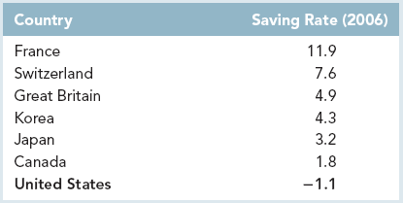
Saving Ratings

Slide 30
Government Finances
When government borrows to finance its spending, it dips into the nation’s savings pool.
Crowding out is a reduction in private-sector borrowing (and spending) caused by increased government borrowing.
LO-4
Notes:
When government borrows to finance its spending, it dips into the nation’s savings pool. Crowding out is a reduction in private-sector borrowing (and spending) caused by increased government borrowing. More government spending “crowds out” or decreases some investment spending.

Slide 31
Government Finances
Crowding in is an increase in private-sector borrowing (and spending) caused by decreased government borrowing.
Fiscal and monetary policies must be evaluated in terms of their impact not only on short-run aggregate demand but also on long-run aggregate supply.
LO-4
Notes:
Crowding in is an increase in private-sector borrowing (and spending) caused by decreased government borrowing. Fiscal and monetary policies must be evaluated in terms of their impact not only on short-run aggregate demand but also on long-run aggregate supply.

Slide 32
Deregulation
Government regulations impact aggregate supply by:
  Limiting the flexibility of producers to respond to changes in demand.
  Raising production costs.
LO-4
Notes:
Government regulations impact aggregate supply by limiting the flexibility of producers to respond to changes in demand and raising production costs. These are two ways that government regulation affects AS.

Slide 33
Factor Markets
Regulation of factor markets include:
  Minimum-wage laws
  Occupational Safety and Health Administration (OSHA) standards
LO-4
Notes:
The regulation of factor markets includes minimum-wage laws and Occupational Safety and Health Administration (OSHA) standards. More people would be hired without regulation. There are different ways that the government affects factor markets.

Slide 34
Product Markets
Regulation of product markets include:
  Transportation costs
  Food and drug standards
Regulation causes restricted supply
The basic contention of supply-side economists is that regulatory costs are too high.
LO-4
Notes:
The regulation of product markets includes transportation costs and food and drug standards. Regulation causes restricted supply. The basic contention of supply-side economists is that regulatory costs are too high. The government can also affect product markets.

Slide 35
Economic Freedom
Nations with the most economic freedom have the highest GDP per capita and grow the fastest.
LO-5
Notes:
Nations with the most economic freedom have the highest GDP per capita and grow the fastest. Economic freedom tends to increase GDP.

Slide 36
Is More Growth
Desirable?
More growth can lead to:
  Congestion
  Air pollution
  Depleted natural resources
The debate usually centers around the mix of goods and services being provided rather than the quantity of output.
LO-5
Notes:
Is more growth desirable? More growth can lead to congestion, air pollution, and depleted natural resources. The debate usually centers around the mix of goods and services being provided rather than the quantity of output. More growth may not necessarily be desirable as it can lead to several problems.

Slide 37
End chapter 9

