Slide 1

Loss control
Lecture 8
Everyone’s Smart
University
PMG510
Project Risk Management

Slide 2

Risk likelihood
Risk likelihood indicates how often a risk is expected to materialize.
Risk likelihood can be determined on an inherent basis for any particular risk, or can be determined at the current level of risk, paying regard to the control measures that are in place.
For hazard risks, previous history may be a good indication of how likely the risk is to occur.

Slide 3
Risk likelihood
An example of a control measure that has an effect on the magnitude of the risk but may have no effect on its likelihood is the use of seat belts in cars.

Slide 4
Risk magnitude
Reducing the magnitude of a hazard risk is very important. For hazard risks, magnitude is often referred to as the inherent severity of the risk should it materialize.
Reduction in overall hazard risk severity will be achieved by reducing both the impact and consequences when the adverse event occurs.

Slide 5
Hazard risks
The range of hazard risks where reducing the magnitude of the adverse event is important will include fraud, health and safety, property protection and efficient operation of IT systems, as well as incidents with the potential to cause damage to reputation.
When hazard risks materialize, actions need to be taken to reduce the magnitude of the event, as well as mitigate the impact and consequences.

Slide 6
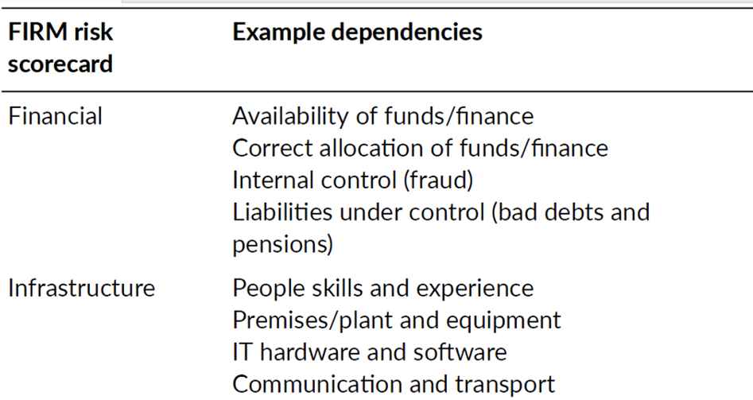
Hazard risks

Slide 7
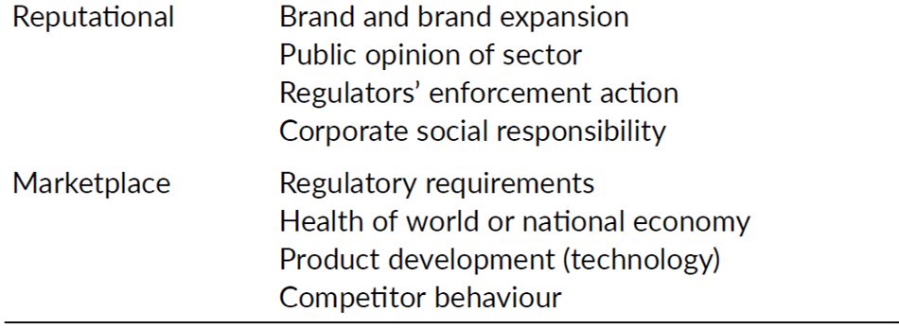
Hazard risks

Slide 8
Hazard risks
Although the main focus of managing hazard risks will be on loss prevention, successful management of hazard risks must also include consideration of damage limitation and cost containment.
An integrated approach to loss control is important because it will enable the organization to control both the likelihood and impact when a hazard risk materializes. In fact, loss control should be considered to be loss prevention plus damage limitation plus cost containment.

Slide 9
Hazard risks
Although the most important component of loss control is loss prevention, hazard risks can materialize despite the best efforts of organizations. Adequate assessment of hazard risks is vital, so that appropriate pre-planning of during-the-loss and post-loss actions can be undertaken.
Plans should be in place to ensure that the damage caused by the incident is kept to a minimum and the cost consequences of the event are also tightly controlled and contained.

Slide 10
Hazard risks
The figure below shows how a bow-tie can be used to illustrate the three components of loss control.
Before the event occurs, the organization will have controls in place to seek to achieve loss prevention. As the event is developing, steps should be in place to limit the damage that the event is causing. After the event, cost containment controls by way of business continuity and arrangements to reduce the cost of repair should be activated.

Slide 11
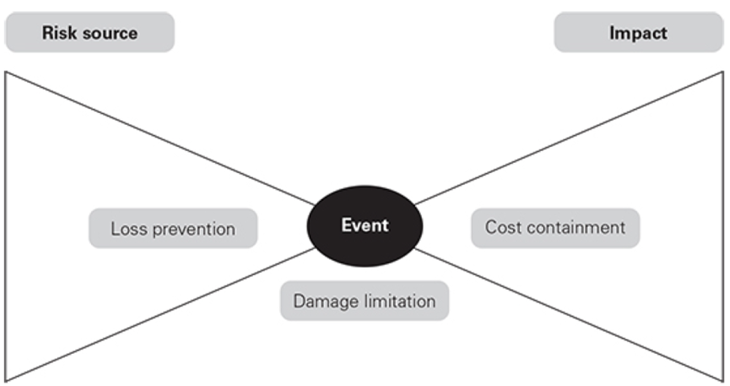
Hazard risks

Slide 12
Loss prevention
Another way of looking at loss control activities is that loss prevention is about reducing the likelihood of an adverse event occurring, although it will also be concerned with reducing the magnitude of an event that does occur.
Techniques for loss prevention will vary according to the type of hazard risk that is being considered. For health and safety risks, loss prevention is related to eliminating the activity completely or ensuring that, for example, hazardous chemicals are no longer used.

Slide 13
Loss prevention
For risks to buildings, loss prevention techniques involve such controls as the elimination of sources of ignition and the control, containment and segregation of flammable or combustible materials.
For fraud and theft risks, loss prevention techniques will include separation of responsibilities and security tagging of expensive items. Fraud prevention techniques may also involve pre-employment screening.

Slide 14
Damage limitation
Damage limitation in relation to fire hazards is well established. Although sprinkler systems are often considered to be a loss prevention measure, they are in fact the major control measure for ensuring that only limited damage occurs when a fire breaks out.
Accidents at work still occur, despite the considerable attention paid to health and safety standards and other loss prevention activities. Provision of adequate first aid arrangements is an obvious damage limitation activity and suitable first aid facilities are provided by most organizations. For some high-risk factory occupancies, emergency treatment arrangements and even medical facilities are provided on site.

Slide 15
Damage limitation
A simpler example is the provision of emergency eye-wash bottles in locations where hazardous chemicals are handled.

Slide 16
Cost containment
When a hazard risk materializes despite the efforts put into loss prevention and the efforts that have been put into damage limitation, there may well still be a need to contain the cost of the event.
For example, among the activities for minimizing costs associated with serious fires are detailed arrangements for salvage and arrangements for decontamination of specialist items that have suffered water or smoke damage.

Slide 17
Cost containment
The actions that will be taken to ensure that post-incident costs are minimized should all be set out in business continuity, disaster recovery and crisis management plans.
A further consideration relevant to cost containment after an incident is what insurance companies refer to as ‘increased cost of operation’. Most material damage/business interruption insurance policies will allow for payment of increased cost of operation.
This may arise when an organization has to sub-contract certain production activities, or has to undertake manufacturing work at another one of its factories, which may be located some distance away.

Slide 18
Cost containment
The actions that will be taken to ensure that post-incident costs are minimized should all be set out in business continuity, disaster recovery and crisis management plans.
A further consideration relevant to cost containment after an incident is what insurance companies refer to as ‘increased cost of operation’. Most material damage/business interruption insurance policies will allow for payment of increased cost of operation.
This may arise when an organization has to sub-contract certain production activities, or has to undertake manufacturing work at another one of its factories, which may be located some distance away.

Slide 19
Expected monetary value (EMV)
Expected monetary value (EMV) is a risk management technique to help quantify and compare risks in many aspects of the project. EMV is a quantitative risk analysis technique since it relies on specific numbers and quantities to perform the calculations, rather than high-level approximations like high, medium and low.

Slide 20
Expected monetary value (EMV)
EMV relies on two basic numbers.
  P – the probability that the risk will occur
  I – the impact to project if the risk occurs.
The risk contingency is calculated by multiplying the probability by the impact.

Slide 21
Expected monetary value (EMV)
Risk Contingency Budget:
When EMV technique is used for risks, a contingency budget can then be estimated to cover the impact on the project.
For example, let’s say that you have identified six risks to your project, as follows.

Slide 22
Expected monetary value (EMV)
RISK | P (RISK PROBABILITY) | I (COST IMPACT) | RISK CONTINGENCY P*IC
A | 0,8 | €10.000 | €8.000
B | 0,3 | €30.000 | €9.000
C | 0,5 | €8.000 | €4.000
D | 0,1 | €40.000 | €4.000
E | 0,3 | €20.000 | €6.000
F | 0,25 | €10.000 | €2.500
Total |  | €118.000 | €33.500

Slide 23
Expected monetary value (EMV)
Based on the identification of these six risks, the potential impact to your project is €118.000. However, you cannot ask for that level of risk contingency budget.
RISK | P (RISK PROBABILITY) | I (COST IMPACT) | RISK CONTINGENCY P*IC
A | 0,8 | €10.000 | €8.000
B | 0,3 | €30.000 | €9.000
C | 0,5 | €8.000 | €4.000
D | 0,1 | €40.000 | €4.000
E | 0,3 | €20.000 | €6.000
F | 0,25 | €10.000 | €2.500
Total |  | €118.000 | €33.500

Slide 24
Expected monetary value (EMV)
The only reason you would need that much money is if every risk occurred. Remember that the objective of risk management is to minimize the impact of risks
to your project. Therefore,
you would expect that
you will be able to
successfully manage most,
if not all of these risks.
RISK | P (RISK PROBABILITY) | I (COST IMPACT) | RISK CONTINGENCY P*IC
A | 0,8 | €10.000 | €8.000
B | 0,3 | €30.000 | €9.000
C | 0,5 | €8.000 | €4.000
D | 0,1 | €40.000 | €4.000
E | 0,3 | €20.000 | €6.000
F | 0,25 | €10.000 | €2.500
Total |  | €118.000 | €33.500

Slide 25
Expected monetary value (EMV)
The risk contingency budget should reflect the potential impact of the risk as well as the likelihood that the risk will occur. This is reflected in the last column.
Notice the total contingency request
for this project is €33.500, which
could be added to your budget as
risk contingency.
RISK | P (RISK PROBABILITY) | I (COST IMPACT) | RISK CONTINGENCY P*IC
A | 0,8 | €10.000 | €8.000
B | 0,3 | €30.000 | €9.000
C | 0,5 | €8.000 | €4.000
D | 0,1 | €40.000 | €4.000
E | 0,3 | €20.000 | €6.000
F | 0,25 | €10.000 | €2.500
Total |  | €118.000 | €33.500

