Slide 1


English Course- Advanced Level
Prepared by
Ahmed Soliman

Slide 2



Lecture 3
www.midocean.ae

Slide 3
Lecture Outline:
Warm-up: Tell about a place you have visited
Listening: Airport Announcement
Pronunciation: linking vowel to vowel
Grammar: Present Perfect Tense
Reading: The Bermuda Triangle
Speaking: Describe something important that you lost in the past.
www.midocean.ae

Slide 4
Warm-up
Tell about a place you have visited
www.midocean.ae

Slide 5
Listening
(Airport Announcement)
www.midocean.ae

Slide 6
Vocabulary and Sample Sentences
inclement (adjective): severe
– The game was canceled due to inclement weather.
crew (noun): an organized group of workers
The ship’s crew were very helpful during the cruise.
deice (verb): make or become free of frost or ice, defrost
– You need to deice the windshield this morning. It dropped below freezing last night.
overbook (verb): too many seats, for example, have been reserved in advance
– Airlines tend to overbook seats on their flights which can be an inconvenience to some passengers.
complimentary (adjective): free, gratuitous
This hotel provides a complimentary breakfast for all its guests.
board (noun): to get on an aircraft, ship, train, bus, etc.
– We should board the train at least ten minutes before departure.
www.midocean.ae

Slide 7
Listen to the recording and answer the questions.
https://www.esl-lab.com/academic-english/airport-announcement/
1- A ____ is probably making the announcement.
flight attendant
ticket agent
pilot
2- The ultimate destination of the flight is _____.
Caracas
Atlanta
Miami
www.midocean.ae

Slide 8
3- What change has been announced?
the gate number
the flight number
the arrival time
4- It's currently ______ outside.
raining
windy
snowing
www.midocean.ae

Slide 9
5- The plane will depart at _____.
4:05 p.m.
9:50 p.m.
8:45 p.m.
www.midocean.ae

Slide 10
Listening Script
Hello. Passengers of flight 17 bound for Caracas, with stops in Atlanta and Miami. The departure gate has been changed to 30B. Also, there will be a slight departure delay due to inclement weather outside. The ground crew is in the process of deicing the wings in preparation for departure. It also looks like the flight is slightly overbooked, so we are offering complimentary round-trip tickets to a few passengers willing to take a later flight. We should be boarding about a quarter to the hour. Thank you for your patience.
www.midocean.ae

Slide 11
Pronunciation
(linking vowel to vowel)
www.midocean.ae

Slide 12

www.midocean.ae

Slide 13
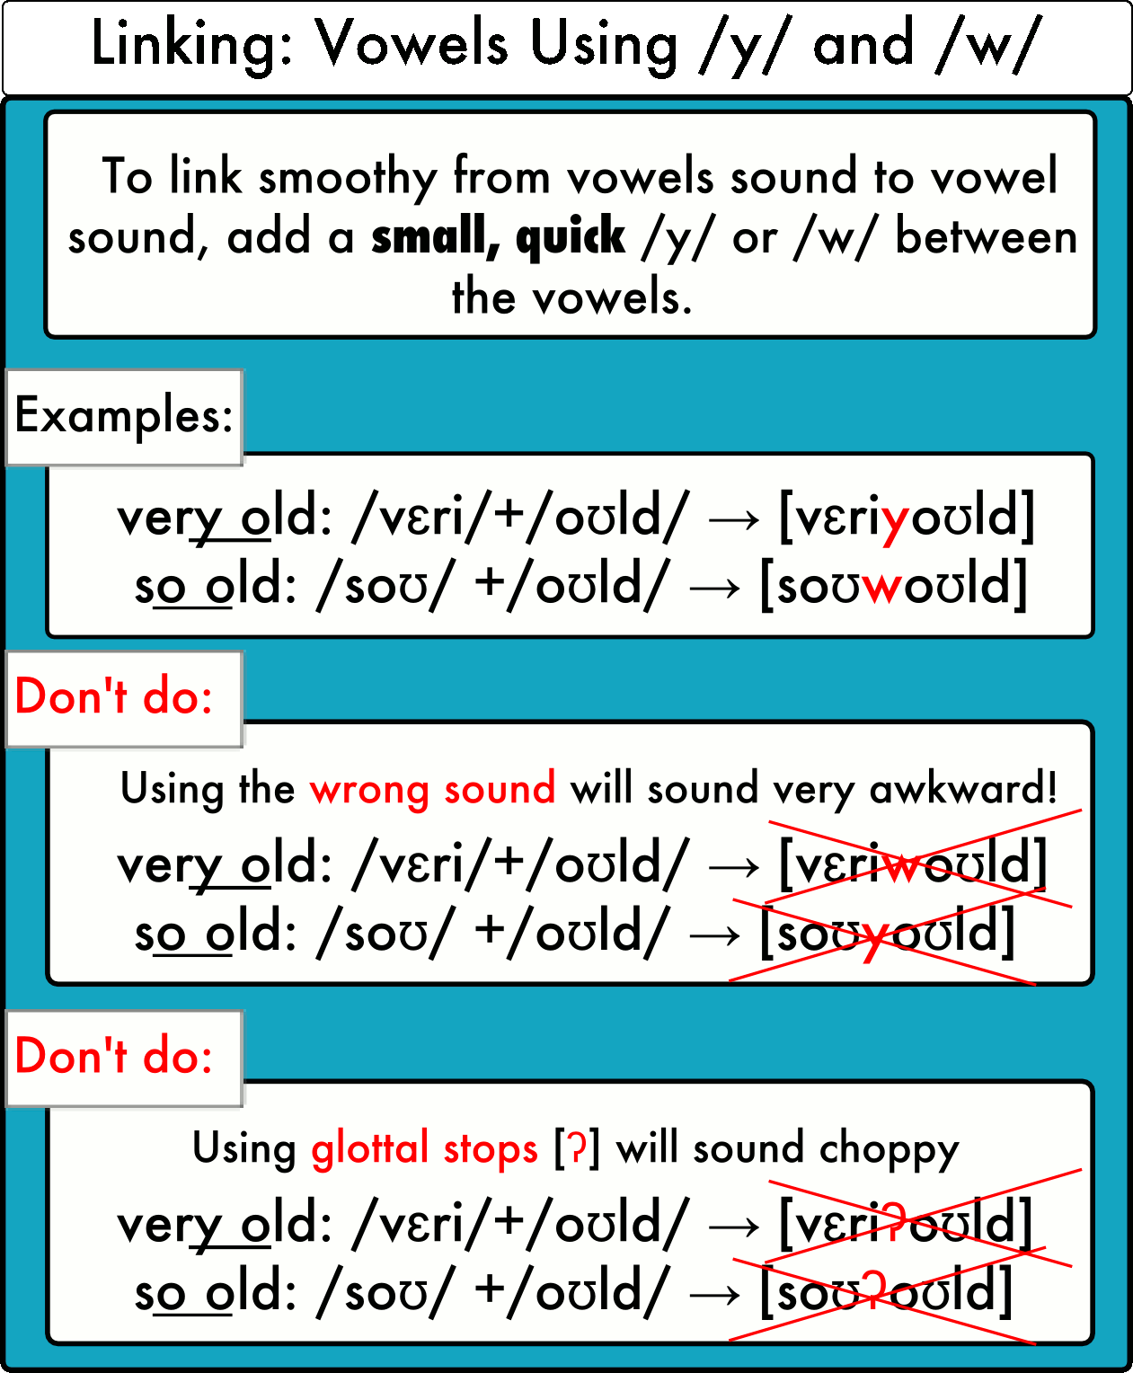
www.midocean.ae

Slide 14
Practice
https://pronuncian.com/linking-vowels-into-vowels
www.midocean.ae

Slide 15
Grammar
(Present Perfect Tense)
www.midocean.ae

Slide 16
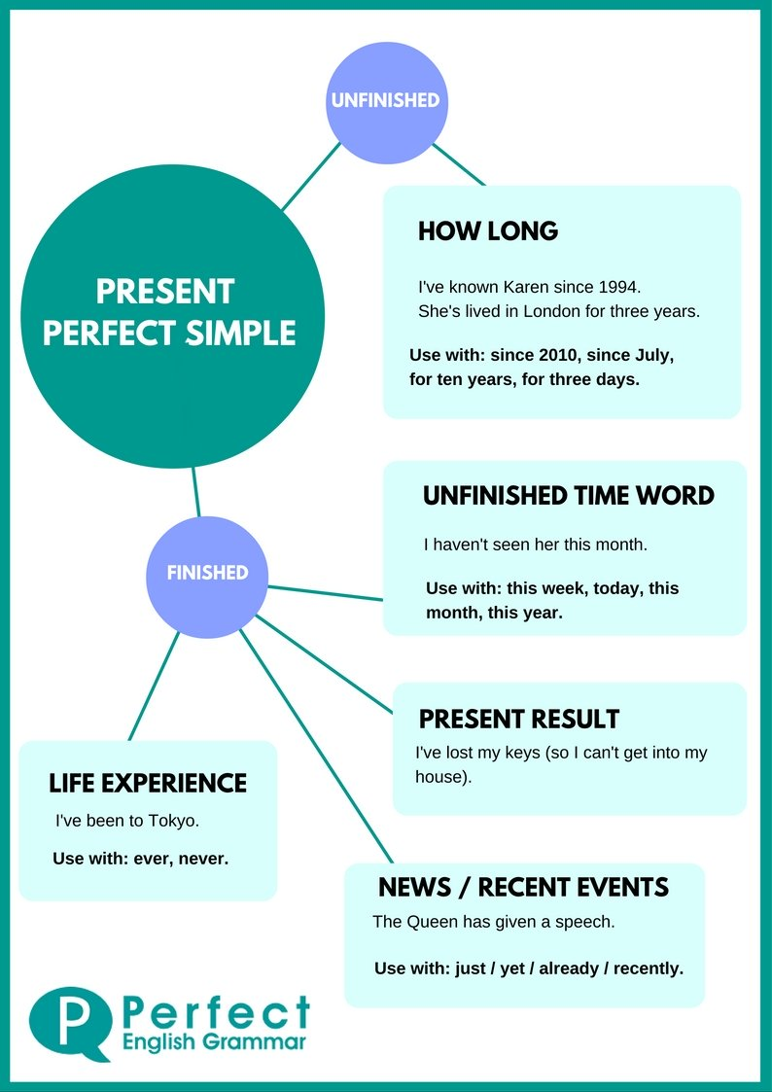
www.midocean.ae

Slide 17
Actions started in the past and continuing in the present
They haven't lived here for years.
She has worked in the bank for five years.
We have had the same car for ten years.
Have you played the piano since you were a child?
www.midocean.ae

Slide 18
When the time period referred to has not finished
I have worked hard this week.
It has rained a lot this year.
We haven't seen her today.
www.midocean.ae

Slide 19
Actions repeated in an unspecified period between the past and now.
They have seen that film six times
It has happened several times already.
She has visited them frequently.
We have eaten at that restaurant many times.
www.midocean.ae

Slide 20
Actions completed in the very recent past (+just)
Have you just finished work?
I have just eaten.
We have just seen her.
Has he just left?
www.midocean.ae

Slide 21
When the precise time of the action is not important or not known
Someone has eaten my soup!
Have you seen 'Gone with the Wind'?
She's studied Japanese, Russian, and English.
www.midocean.ae

Slide 22
The Form
Has
Subject + Have + P.P
They have seen that film six times
She has visited them frequently.
www.midocean.ae

Slide 23
Interrogative
Have / has + Subject + P.P?
Wh question + have / has + Subject + P.P?
Have you called your mom yet?
Has Anthony played basketball yet?
Have you travelled to Aswan?
Have you ever ridden a camel?
www.midocean.ae

Slide 24
Negative
Subject + hasn’t / haven’t + p.p.
They haven't lived here for years.
He hasn’t finished his homework yet.
www.midocean.ae

Slide 25
Reading
(The Bermuda Triangle)
www.midocean.ae

Slide 26
Read the following passage, and then choose the best answer
The legend of the mysterious Bermuda Triangle is one of the strangest of all sea stories. The Bermuda Triangle is a section of the Atlantic Ocean off the southeastern coast of Florida. A line drawn from Florida to Bermuda, then to Puerto Rico and back to Florida, forms a rough triangle. Within this triangle, or very near it, more than fifty ships and airplanes have vanished or disappeared.
The legend began in 1945, when five American Navy bombers vanished while flying over the area. They were flying during the day, under clear weather conditions. The commander of the five planes was talking to his base by radio. He announced that they seemed to be lost. After that, the planes were never
www.midocean.ae

Slide 27
3. In 1948, an airliner flying toward Miami vanished over the Triangle. A few months later, another plane disappeared. In 1950, still another airplane flew into the Triangle, never to be seen again. A ship named The Sandra sailed into the triangle and vanished. In 1953, another ship, sailing north of the Triangle, sent out distress signals that were suddenly cut off. Ships and planes were sent to search for the ship, but they never found it.
4- There have been many explanations for these mysterious happenings.Some people believe that there is a strange force at work in this part of the ocean. Some suggest there may be some kinds of `hole' in the triangle that ships and planes go through into another world. Others think that UFO's steal the planes, ships, and their crews, and take them away.
www.midocean.ae

Slide 28
5. Some people don't believe that there is anything extraordinary about the Bermuda Triangle. Thousands of ships and airplanes have passed through the Triangle without encountering trouble. The Triangle isn't the only place where ships and planes have vanished. Many ships have vanished all over the world's oceans. Many reasons exist for such things happening, such as sudden storms or seaquakes. These are just some of the dangers of going to sea. The Bermuda Triangle just happens to be a part of the sea where there have been many disasters. Whatever the reasons for these strange happenings, the legend of the Bermuda Triangle remains the strangest of all sea tales.
www.midocean.ae

Slide 29
Paragraph 1 is mainly talking .............................
a. about the location of Bermuda Triangle
b. why Bermuda Triangle is mysterious
c. why Bermuda Triangle is a legend
d. about ships and airplanes
2. The underlined word "bombers" in paragraph 2 probably means............
a. ships
b. airplanes
c. conditions
d. stories3.
www.midocean.ae

Slide 30
3. According to Paragraph 2, the total number of the American airplanes that disappeared in 1945 in Bermuda Triangle was................
a. 5
b. 4
c. 6
d. 7
4. The pronoun " it" in paragraph 2 refers to..................
a. The search plane
b. 1945
c. The five bombers
d. Radio
www.midocean.ae

Slide 31
5. Paragraph 3 is mainly talking about the .........................
a. why the ships and airplanes disappeared in Bermuda Triangle
b. the number of the ships and airplanes which disappeared in Bermuda Triangle
c. how ships and airplanes disappear in Bermuda Triangle
d. the ships and planes which were sent to search for the lost ones
6. The main idea of Paragraph 4 is........................
a. giving explanations why ships and airplanes disappear in Bermuda Triangle
b. there is a strange force at work in this part of the ocean
c. there may be some kinds of `hole' in the Triangle
d. UFO's steal the planes, ships, and their crews, and take them away
www.midocean.ae

Slide 32
Speaking
(Describe something important that you lost in the past.)
www.midocean.ae

Slide 33
•Describe something important that you lost in the past.
•What did you lose?
•How did you lose it?
•Where did you lose it?
•When did you lose it?
www.midocean.ae

Slide 34




Thank You

