Slide 1



Prepared by Dr. Mohamed Owies
(DGM 729)
Interaction Design
Lecture 9

Slide 2

Chapter 9
Evangelism Methods
Interaction Design

Slide 3

Lecture 9
Content
lecture 9 includes the following points:
Method 24
Bathroom UX
Method 25
Mini Case Studies
Method 26
Peer-to-Peer Learning Community
Method 27
Pyramid Evangelism
If You Only Do One Thing…

Slide 4

Lecture 9
Method 24 Bathroom UX
Bathroom UX is a technique for building awareness of user-centered design and keeping people interested in your work. Bathroom UX gets its name from the environment in which it is practiced—you guessed it, the bathroom. The idea is simple: get people where you have their captive attention (for example, on the inside of the bathroom stall door) and post bite-sized notices to create awareness for UX and promote what’s been going on (see Figure 9.1). Bathroom UX doesn’t have to happen exclusively in the bathroom, of course. The same approach can be used in elevators, stairwells, and heavily trafficked hallways.
The basic idea in all cases is to do a little informal promotion and awareness building.

Slide 5
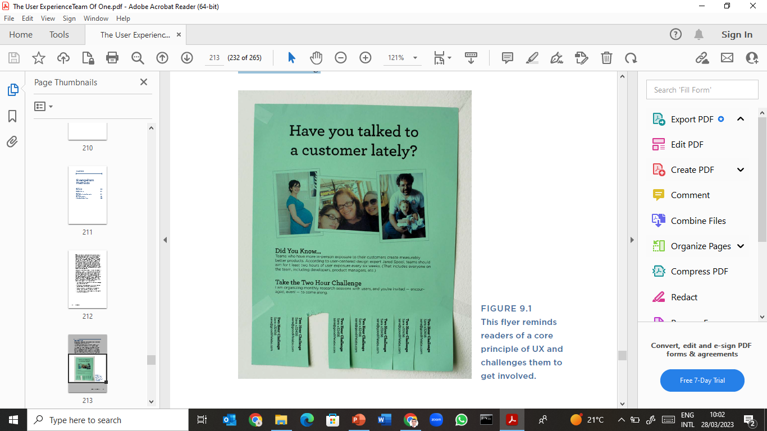
Lecture 9
Method 24 Bathroom UX
Figure 9.1
This flyer reminds readers of a core principle of UX and challenges them to get involved.

Slide 6
Lecture 9
Method 24 Bathroom UX
Use When
• You want to build awareness for UX quickly, creatively, and with minimal effort.
• You have recently completed some UX-related work that you’d like to showcase.
Try It Out
1. Think about your message.
One approach is to create a UX newsletter. Include some news from recent projects, their outcomes, and how to connect with you if people are interested in learning more. This is effective if you’re trying to build interest in UX services, and you work within an organization where you see lots of potential opportunities for UX. Another approach is to build awareness of UX resources.

Slide 7
Lecture 9
Method 24 Bathroom UX
That could be you. Or, if you have or know of a Web page or a place where people can go to learn more about UX, draw attention to that. Or you can use bathroom UX to simply educate people about new concepts. For example, what is user research and how does it differ from market research? In all cases, include some information about how to get in touch with you if someone is interested in learning more.
2. Make it fun to read.
Design a one-page flyer (or a few different types of flyers that work together to form a little campaign). Show your flyers to a friend to make sure that they make sense and cast you and UX in a flattering light.

Slide 8
Lecture 9
Method 24 Bathroom UX
That could be you. Or, if you have or know of a Web page or a place where people can go to learn more about UX, draw attention to that. Or you can use bathroom UX to simply educate people about new concepts. For example, what is user research and how does it differ from market research? In all cases, include some information about how to get in touch with you if someone is interested in learning more.
2. Make it fun to read.
Design a one-page flyer (or a few different types of flyers that work together to form a little campaign). Show your flyers to a friend to make sure that they make sense and cast you and UX in a flattering light.

Slide 9
Lecture 9
Method 24 Bathroom UX
3. Distribute.
Print a bunch of copies of your flyers and post them around the workplace. (Remember to clean up after yourself a week or two later by going around and removing any flyers that are still hanging.)
4. Repeat.
Plan to do this again once every few months. The UX avenger strikes again! A surprising location, plus a novel message will definitely get people’s attention.

Slide 10
Lecture 9
Tips and Tricks for Bathroom UX
Permission vs. forgiveness. Should you notify someone or get advance permission to do this? You will be the best judge of what’s acceptable where you work, but generally in this type of situation my motto is it’s better to ask forgiveness than get permission.
Don’t be shy. Capers like this elevate what you do from undercover UX to something that’s public and you’re proud of. That kind of exposure can be a little intimidating, especially if you’re the shy type.
Be patient. In contrast to the previous point, there’s also the possibility that your first foray into bathroom UX won’t suddenly have your phone ringing off the hook. Its intent is to begin to create awareness and familiarity with UX.

Slide 11
Lecture 9
Method 25 Mini Case Studies
A mini case study summarizes your work and turns it into compelling, bitesized stories that you can share with others. Mini case studies are good hygiene at the end of every project or sizable piece of UX work you’ve conducted. “Mini” is a strategic choice here. By focusing on the most bite-sized of stories, you create easy-to-remember, quick-to-tell, simple-to-share anecdotes. This also makes them easier for others to hear, understand, and make sense of.

Slide 12
Lecture 9
Method 25 Mini Case Studies
By keeping them mini, you also make less work for yourself, which means that you’re more likely to actually do them. If possible, see if you can tell the whole story in one page, like the mini case study in Figure 9.2. Then it’s easy to print or send this one page around. Or you can put all your mini case studies together in a presentation or a document, and it becomes a self-contained portfolio of your UX work.

Slide 13
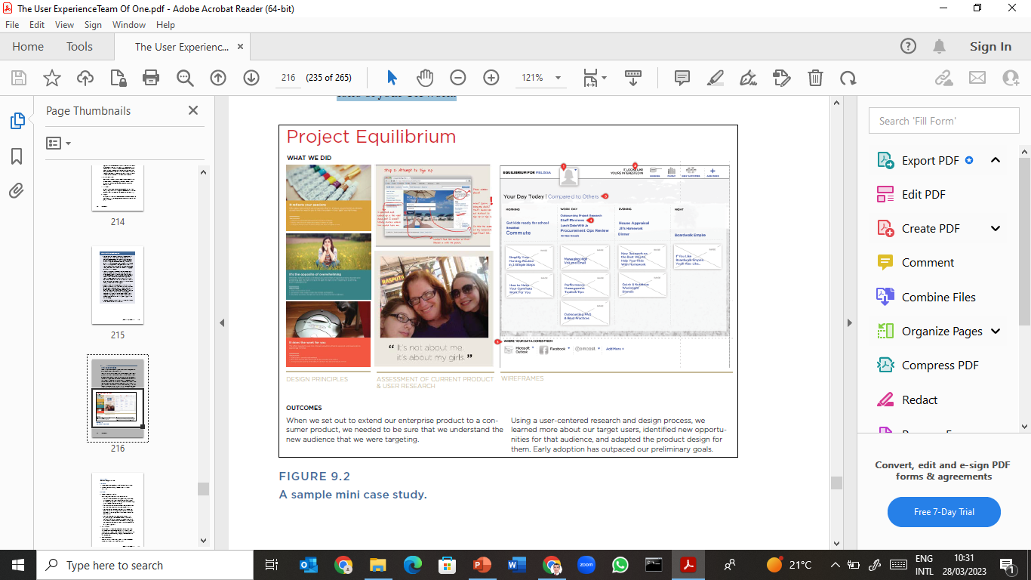
Lecture 9
Method 25 Mini Case Studies

Slide 14
Lecture 9
Method 25 Mini Case Studies
Use When
You need examples of past UX projects to share with colleagues.
You want to get better at explaining your work clearly and succinctly.
Try It Out
1. Ask yourself some questions.
For a given project, consider the following questions:
• What is a one or two-sentence description of the project goals? Try to think about the why, not the what. Instead of “redesign the website,” perhaps it could be to “help more customers sign up (and increase your conversion rates).”

Slide 15
Lecture 9
Method 25 Mini Case Studies
What did you do, and whom did you work with? Don’t think too hard about this. Keep it high level. Just a few bullets will do.
What was the impact of your work? If you have access to any quantitative measures of impact, that’s ideal here. If not, even anecdotal evidence of impact, such as customer or stakeholder quotes, is good.
What’s one interesting thing you learned in the course of the project? People love these kinds of details. They’re often described as the big “ah-ha’s.” If you can identify one or two, it makes your mini case study more interesting and makes people curious about what kind of ah-ha’s there might be to unearth in their project or product.

Slide 16
Lecture 9
Method 25 Mini Case Studies
2. Gather visuals.
Pull together three to five interesting, attractive images—either of the final design, or of some particularly visual working documents that were developed in the course of the project. Having a few pictures in your mini case study pulls people in and makes them more memorable.
3. Create a one-pager: Put your images and mini write-up into a nicely formatted document. Ideally, it should all fit within one page.
4. Memorize it: Try to commit your mini case study to memory, so you can easily share your story when the right opportunity arises. And, of course, be prepared to send along your document when someone expresses interest.

Slide 17
Lecture 9
Tips and Tricks for Mini Case Studies
Tell a simple story. When you do your mini write-up, try to think about it from the lay person’s perspective—or even better, the business person’s perspective. UX experts tend to be interested in craft and process, so it’s tempting to fill in a lot of details about the work that you did. But someone who is unfamiliar with UX is likely to have a more basic set of questions: What kind of problems does this solve? What kind of impact does it produce?
If you work remotely… This technique is great for remote practitioners because it produces an overview of your work that is self-explanatory and easy to share with people who are far away.

Slide 18
Lecture 9
Method 26 Peer-to-Peer Learning Community
A peer-to-peer learning community mobilizes support and knowledge within a community of interested colleagues.
While you may be the only one practicing UX where you work, you may find that engineers, product managers, marketers, and others are all at least nominally familiar with the concept and eager to learn more. Host a peer-to-peer learning community to create a voluntary forum for sharing information that also up-levels the knowledge of user experience within your organization (see Figure 9.3). One important aspect of a peer-to-peer learning community is that everyone is interested in learning, and no one claims to be an expert. This engenders a participatory, open attitude that invites people in.

Slide 19
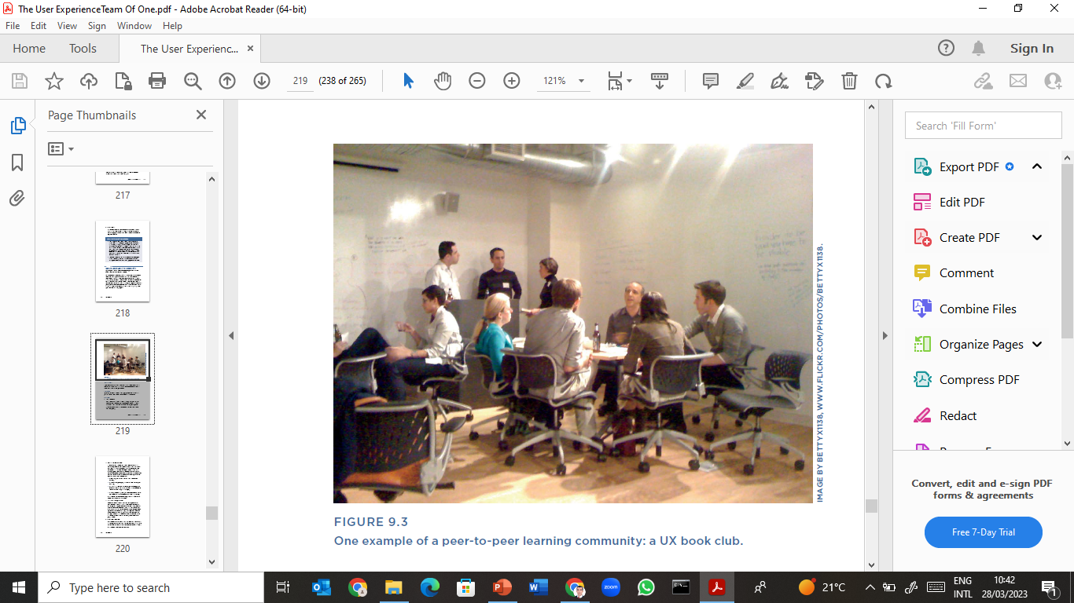
Lecture 9
Method 26 Peer-to-Peer Learning Community

Slide 20
Lecture 9
Method 26 Peer-to-Peer Learning Community
Use When
A peer-to-peer learning community is appropriate at any time, but is a particularly good idea once you’ve built some initial awareness.
Try It Out
1. Invite everyone.
Send out a broad invitation announcing the peer-to-peer learning community and inviting people to participate. Include a date and a time for a kick-off meeting, which ideally takes place in person (although remote and via video conference will work too, if that’s your only option).

Slide 21
Lecture 9
Method 26 Peer-to-Peer Learning Community
2. Agree on format and goals.
In the first meeting, discuss goals of the community. What is everyone hoping to learn or do? How much working knowledge of UX is there, and how much do people want to learn? Record this conversation on a whiteboard or flipchart. Also, discuss what format people are interested in following to foster learning. This could take a number of different form. Any of these models can work well—or even a combination of them—to give a group just enough structure and a reason to stay engaged.

Slide 22
Lecture 9
Method 26 Peer-to-Peer Learning Community
A book club (where everyone agrees to read and discuss a UX book)
A discussion list (where people can share interesting examples and links)
A brown bag or lunch-and-learn series (where outside presenters can be brought in, or community members can volunteer to research and share on specific UX topics)
A whitespace learning project (where the community decides to work together to design a solution to an interesting problem)
Finish the meeting by agreeing on a topic, format, frequency, and date for the next community meeting.

Slide 23
Lecture 9
Method 26 Peer-to-Peer Learning Community
3. Pick a leader and plan ahead.
Communities generally need organizers. That’s probably you, unless someone else has volunteered to organize it. You can also share responsibility, putting a new member of the group in charge week by week or month by month. If you agree to follow a format that requires some work in between meetings (for example, to find a presenter or organize an activity), be sure to plan for and block off enough time for adequate preparation. Even if your format is as simple as a book club, sending out one or two reminder emails in between meetings is a good idea, to keep the community in people’s minds.

Slide 24
Lecture 9
Method 26 Peer-to-Peer Learning Community
4. Meet. Learn. Have fun.
Pay attention to what’s working well, and what could benefit from a revised approach. Check in regularly with individual participants tosee that they’re getting value from the community. Continue to fine-tune and tinker with the format as needed.

Slide 25
Lecture 9
Method 26 Peer-to-Peer Learning Community
Tips and Tricks for Peer-to-Peer Learning Communities
Estimate and block off prep time. A common mistake with community efforts like this is underestimating the amount of time needed for organizing and administration. Try to make a realistic estimate up front of how many hours per week or month this will probably take, and be sure you’re in a position to make that commitment. If not, consider asking someone to be a co-organizer.

Slide 26
Lecture 9
Method 26 Peer-to-Peer Learning Community
Tips and Tricks for Peer-to-Peer Learning Communities
Give it a time limit. If you’re not sure if your organization has the appetite for an ongoing peer-to-peer learning community, consider pitching it as a fixed-length experiment (say, three to six months). That way, you’re not committing to do this forever, and there’s also some urgency for people to get involved, or else they’ll miss the opportunity.
If you work remotely… Keeping up momentum can be difficult when you lack the in-person element. A format such as an internal discussion list may work better in this case.

Slide 27
Lecture 9
Method 26 Peer-to-Peer Learning Community
Tips and Tricks for Peer-to-Peer Learning Communities
Give it a time limit. If you’re not sure if your organization has the appetite for an ongoing peer-to-peer learning community, consider pitching it as a fixed-length experiment (say, three to six months). That way, you’re not committing to do this forever, and there’s also some urgency for people to get involved, or else they’ll miss the opportunity.
If you work remotely… Keeping up momentum can be difficult when you lack the in-person element. A format such as an internal discussion list may work better in this case.

Slide 28
Lecture 9
Method 2 7 Pyramid Evangelism
Pyramid evangelism builds relationships and potential opportunities forUX in an organization.
The basic idea of pyramid evangelism is that you make it a priority to connect to people at every level of the organizational pyramid—at the base, in the middle, and even at the top. Instead of trying to win an executive over in one presentation, build an army of supporters throughout the organization. The approach is simple: Connect to people, introduce yourself if you haven’t met before, tell them that you’re interested in this thing called user experience, ask them about their own work, listen sincerely and carefully, and discuss any ways that you think UX could help.

Slide 29
Lecture 9
Method 2 7 Pyramid Evangelism
In addition to doing your regular job, have a parallel track of influence and education that’s always in the back of your mind, and seek out opportunities for one-on-one conversations to spread the word one person at a time. In pyramid evangelism, the lunch date is your most powerful weapon.

Slide 30
Lecture 9
Method 2 7 Pyramid Evangelism
Still, there are many ways to connect to people at various points in the pyramid, and the format that you use may depend in part on whom you’re connecting to. The goal when connecting to people at any level is to inspire them with interest in the user-centered design approach, and to find more opportunities to apply UX practices to improve the experiences that are being delivered by your organization.

Slide 31
Lecture 9
Method 2 7 Pyramid Evangelism
Use When
You’ve done the undercover UX thing and would like to start building a recognized UX role or practice.
Try It Out
• For people you feel comfortable approaching directly, the best format is usually a casual and social conversation. Ask people out to lunch, or a drink after work, or even a coffee break. Tell them that you’ve been working on some things that you’d like to talk with them about and you’d like their advice and input.

Slide 32
Lecture 9
Method 2 7 Pyramid Evangelism
Use When
You’ve done the undercover UX thing and would like to start building a recognized UX role or practice.
Try It Out
For people you feel comfortable approaching directly, the best format is usually a casual and social conversation.
Ask people out to lunch, or a drink after work, or even a coffee break. Tell them that you’ve been working on some things that you’d like to talk with them about and you’d like their advice and input.

Slide 33
Lecture 9
Method 2 7 Pyramid Evangelism
This works well with people who you already actually feel friendly and social with. It can also be surprisingly helpful with precisely the people that you feel least inclined to spend time with—that coworker who always seems grumpy, that person you’ve had some workplace tension with, and so on. Treat this as an opportunity to learn about their priorities and what they’re trying to accomplish.
This is less about pushing your perspective on them, and more about listening and offering to help where there’s good alignment between their needs and yours.

Slide 34
Lecture 9
Method 2 7 Pyramid Evangelism
For people who operate more at the “managing lots-of-stuff and always-busy” level, you can approach it like a sharing of capabilities and services.
Ask them if they’d be interested in learning a bit about some projects that you’ve been working on that use new kinds of techniques for product design. If yes, schedule a half hour or an hour for a brief presentation or walk-through of your work and approach. Leave time to discuss if they have any questions about any of it, or if they saw anything in your work that seems relevant to what they’re working on.

Slide 35
Lecture 9
Method 2 7 Pyramid Evangelism
For people at the most senior level in the organization, getting access to them and finding a way to connect your passion with their priorities may be understandably more daunting.
Two good paths for connecting with these kinds of people are 1) under the guise of sharing and briefing them on project work and 2) connecting with them through the people who work directly for them. In either case, you may need to work with other people in the pyramid—to get yourself invited to a project update meeting, for example, or to get to know people at lower levels and ask them to help you represent your message higher up in the organization.

Slide 36
Lecture 9
Method 2 7 Pyramid Evangelism
Tips and Tricks for Pyramid Evangelism
Give it time. Be patient with yourself and other people, and don’t necessarily expect that one conversation will be enough to win support and a home for UX. One of the most important lessons for UX teams of one is that a UX practice isn’t built by delivering great projects (although it certainly doesn’t hurt); it’s built through relationships, trust, and goodwill over time. If you arm yourself with that expectation from the beginning, you will have the endurance, patience, and flexibility to build a good idea into a flourishing practice.

Slide 37
Lecture 9
Method 2 7 Pyramid Evangelism
Tips and Tricks for Pyramid Evangelism
If you work remotely… It’s definitely easier to build relationships face-toface. If you’ll be meeting with other members of your team in person any time soon, think ahead about whom you’d like to meet with, and drop them a note in advance to set up a little extra time with them while you’re there.

Slide 38
Lecture 9
If You Only Do One Thing…
If You Only Do One Thing…
The methods in this chapter are all focused on building visibility and support for UX, whether that’s project-by-project, with “Mini Case Studies,” or moment-by-moment, with “Bathroom UX.” The ultimate goal of all these methods is to built rapport and good will with others who could be potential supporters of UX—or, in a word, to build relationships.

Slide 39
Lecture 9
If You Only Do One Thing…
If You Only Do One Thing…
So if you only have time to do one method, focus on building your relationships with pyramid evangelism. And if you don’t have time for the whole pyramid, start by identifying a few key supporters and ask them to lunch. It will lay the foundation for more work together in the future. Even more importantly, it will help you feel that even though you may be a UX team of one, you are certainly not alone.

Slide 40
Lecture 9
Thank You

