Slide 1


College of Management
Project Communications
Lecturer: Dr. Raef Baraka
PMG 112
Lecture 07

Slide 2

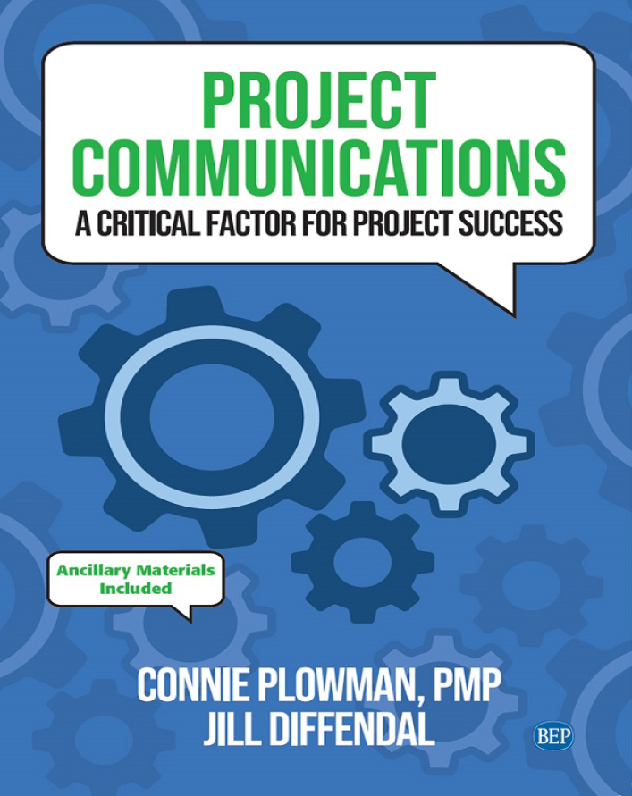
Reference Book:
Ch1: Introduction.
Ch2: Exploring Communication Theories.
Ch3: Knowing Your Audience.
Ch4: Starting with the Basics.
Ch5: Planning Project Communications.
Ch6: Managing and Monitoring Project Communications.
Ch7: Using Project Communication Tools.
Ch8: Communicating Change.
Ch9: Managing Conflict through Communication.
Ch10: Closing.

Slide 3
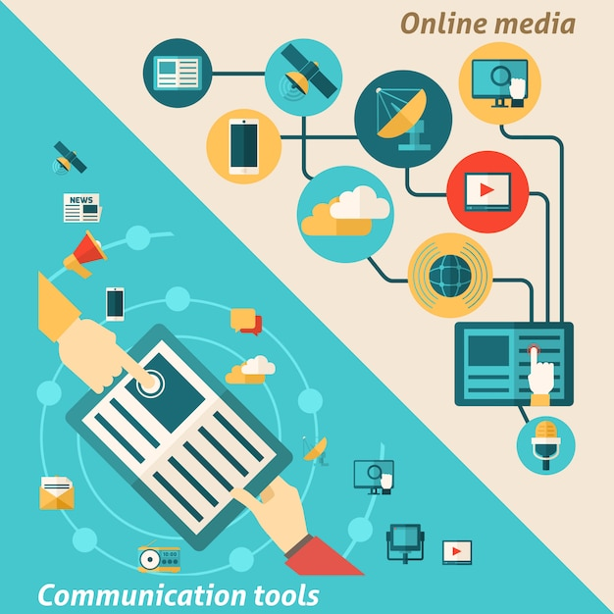
Chapter 7: Using Project Communication Tools
The purpose of this chapter is to help you:
Consider what goes into choosing the right communication tools for your project
Examine the purpose and benefits of different project communication tools
Understand the importance of being knowledgeable about whatever communication tools you use for your project.

Slide 4
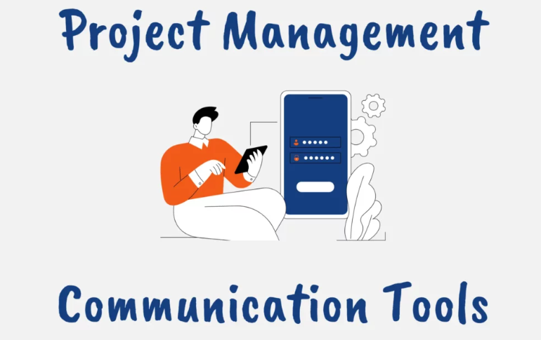
Using Project Communication Tools
The more elaborate our means of communication, the less we communicate.
—Joseph Priestley, 18th-century theologian, philosopher, chemist, grammarian, teacher

Slide 5
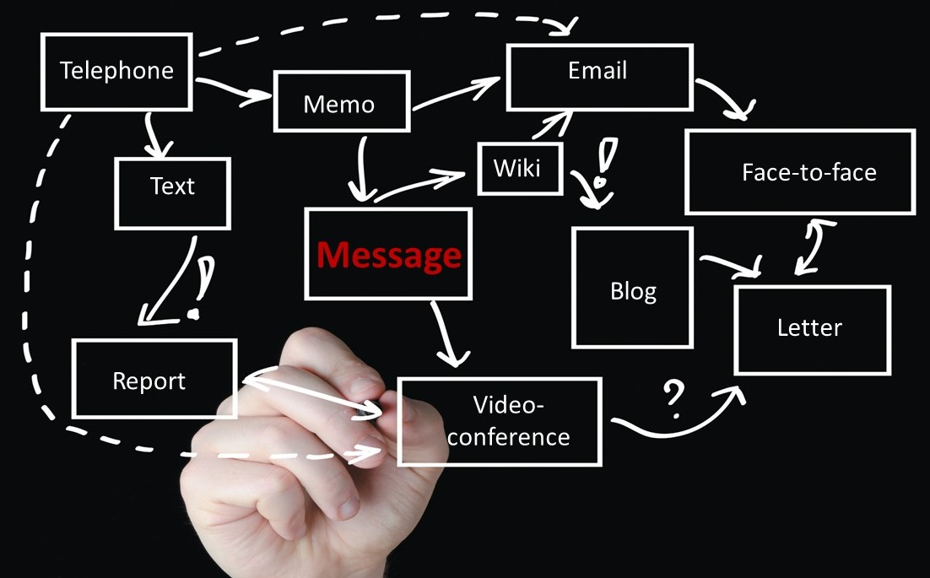
Using Project Communication Tools
Choosing the Right Communication Tool
Our emphasis in this section is on the process and importance of choosing the right tool, rather than focusing on specific, brand-name products or services.
The concept starts with WHY, then looks at HOW, and then answers WHAT.
Sinek describes the approach to organizational success, but we can use the same approach when selecting project communication tools
Dr. Raef Baraka

Slide 6
Managing and Monitoring Project Communications
Choosing the Right Communication Tool
Approaches for selecting project communication tools:
WHY—the reason or purpose. Why are we addressing this communication problem? Why is this an issue? Why is this important?
HOW—differentiating factors. How do the different features, capabilities, or uses address our project communication needs? How will this tool solve a need or enhance our project communication abilities?
WHAT—the product or mechanism. What project communication tool is the best solution? What result or change in our project communications do we expect to see?
Dr. Raef Baraka

Slide 7
Managing and Monitoring Project Communications
Choosing the Right Communication Tool
The Why
Usually, we start with the tool (the what) and even look at the features (the how), before we address the need (the why).
Suppose we get a new communications tool. We start using it. We then discover it does not meet our communication needs.
This creates even greater communication problems on the project:
  More misunderstandings,
  More frustration,
  More waste of time and resources, and
  More uncertainty
Dr. Raef Baraka

Slide 8
Managing and Monitoring Project Communications
Choosing the Right Communication Tool
The Why
How can we avoid this? By starting with the why!
  Why are we addressing this communication need?
  Why is this an issue?
  Why is this important to the project, team, and stakeholders?
Focus first on the why—the reason or the purpose.
Once these questions are answered, the next steps of how and what will logically follow
Dr. Raef Baraka

Slide 9
Managing and Monitoring Project Communications
Choosing the Right Communication Tool
The How
Next, establish a list of criteria based on your project needs, organization, team, budget, and other influencing factors.
Researchers recommend focusing “on the criteria that matter” when selecting the right product or tool. These criteria are the how—how the tool can accomplish the why.
Harrin provides a sample criteria list (as shown in Exhibit). This is an excellent place to begin. Take a look at the list and modify it to build your own set of selection criteria.
Dr. Raef Baraka

Slide 10
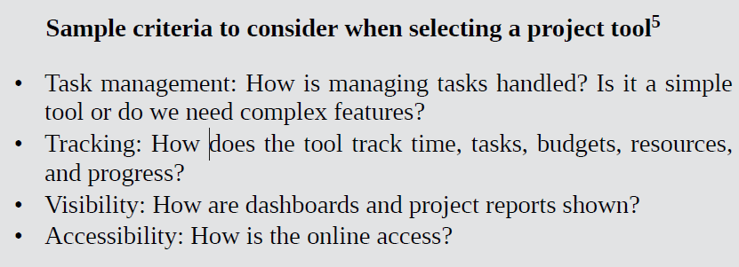
Using Project Communication Tools

Slide 11
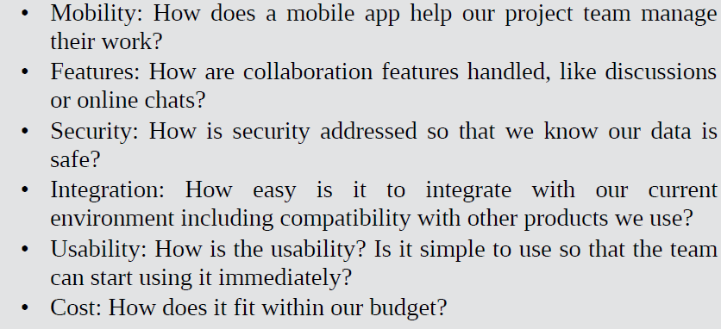
Using Project Communication Tools

Slide 12
Managing and Monitoring Project Communications
Choosing the Right Communication Tool
The How
Why is this important? A criteria list provides you with a focused roadmap for your selection process so that you don’t get off track with criteria that do not matter.
In evaluating tools, you also need to consider how the communication takes place—is it synchronous (meaning real-time or contemporaneous) or asynchronous (not interactive or not at the same time)? A combination of both synchronous and asynchronous communication tools is required for all types of project teams and stakeholders.
Next exhibit provides examples and considerations for both types.
Dr. Raef Baraka

Slide 13
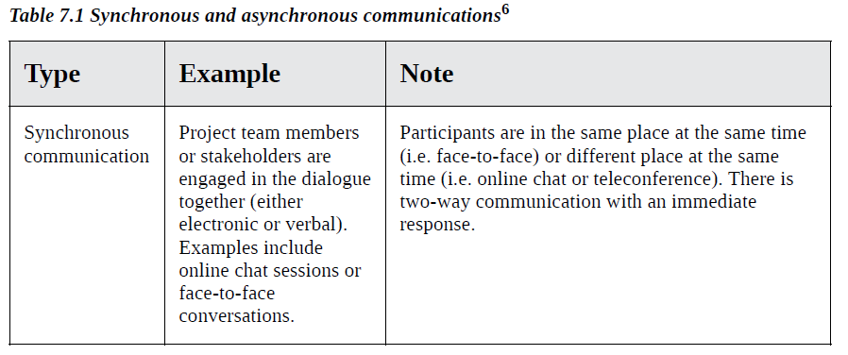
Using Project Communication Tools

Slide 14
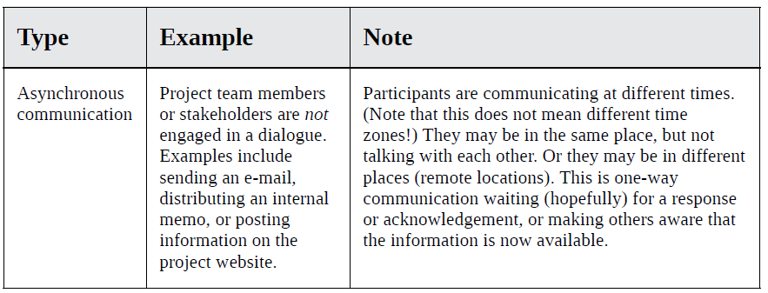
Using Project Communication Tools

Slide 15
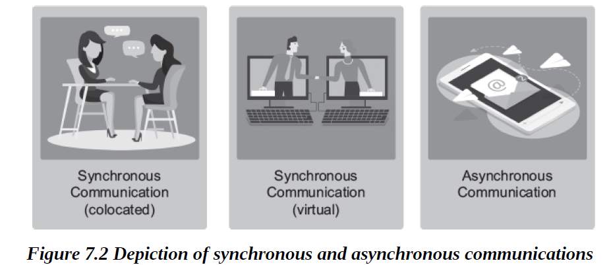
Using Project Communication Tools

Slide 16
Managing and Monitoring Project Communications
Choosing the Right Communication Tool
The How
Once you have established your criteria list and have considered the need for synchronous and asynchronous communications, the next step is to prioritize the criteria in order of importance.
Categorize the features into three groups:
  Group 1: Criteria you must have.
  Group 2: Criteria you would like to have.
  Group 3: Criteria you don’t need.
Dr. Raef Baraka

Slide 17
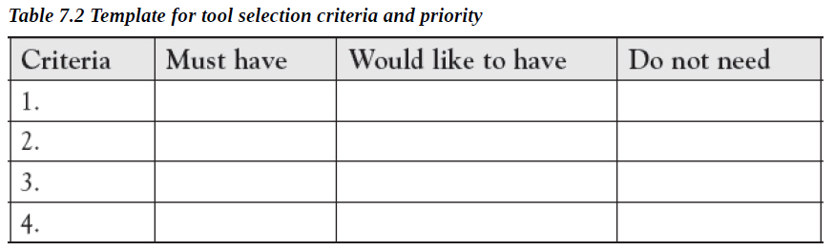
Using Project Communication Tools

Slide 18
Managing and Monitoring Project Communications
Choosing the Right Communication Tool
The How
Why categories of criteria are important?
Putting together a criteria list and establishing priorities before looking at the actual communication tools—regardless of the type of tool—will help you throughout the selection process and increase the probability of choosing and using the most effective tools that fit your project needs.
Dr. Raef Baraka

Slide 19
Managing and Monitoring Project Communications
Choosing the Right Communication Tool
The WHAT
Now that we have looked at the why and the how, it is time to look at the what—the actual project communication tools that you might consider.
The goal here is to find and select tools that can accomplish the why while meeting all of the criteria you have established in the how.
The next section provides an overview of several types of project communication tools for consideration.
Dr. Raef Baraka

Slide 20
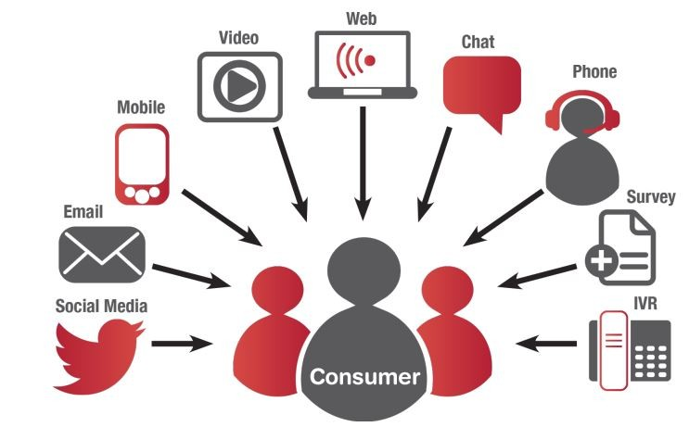
Communication Tools for Projects

Slide 21
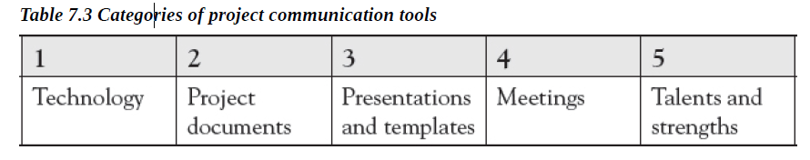
Managing and Monitoring Project Communications
Communication Tools for Projects
In managing projects and working with project teams and stakeholders, you should be using a collection of project communication tools.
Each tool in your collection has its own purpose and benefits. When it comes to project communications, there is no “one size fits all!
To get started, we will look at five general categories of project communication tools
Dr. Raef Baraka

Slide 22
Managing and Monitoring Project Communications
Technology
Choosing the most effective technology must be done carefully. This is not a simple process. It is “influenced by the organization’s budget, nature of the team task, and members’ access to various technologies.”
There is urgency. There is confidentiality. There is availability and compatibility. There is knowledge and ability. The process is not easy.
Dr. Raef Baraka

Slide 23
Managing and Monitoring Project Communications
Technology
Collaboration Software
collaboration software is “many different kinds of apps and services that handle everything from video conference calls to letting two people type on a document at the same time.
When a team needs to collaborate, use collaboration software tools that allow for interactive discussions (such as online chat rooms or instant messaging) or the ability to jointly work on the same document.
It will increase productivity with people working together, talking, and communicating (synchronous).
Dr. Raef Baraka

Slide 24
Managing and Monitoring Project Communications
Technology
Collaboration Software
When information needs to be shared, collaboration websites provide a resource for storing, communicating, and sharing project information (asynchronous).
The benefit is that the project team and authorized stakeholders can use the website—at their convenience—to access the most current information on the project.
In addition, collaboration tools today are very robust and can be especially useful for teams who are not collocated.
They also cut down significantly on e-mail clutter.
Dr. Raef Baraka

Slide 25
Managing and Monitoring Project Communications
Technology
Video Conferencing
The value of using a video conferencing tool as a communication method is that you can see everyone. Consider it another form of face-to-face meeting. You benefit from verbal communication, as well as seeing the nonverbal communication of gestures, body language, reactions, or level of participation.
Furthermore, you can share a screen to show participants documents, presentations, videos, and other information which can facilitate even greater understanding and collaboration
Dr. Raef Baraka

Slide 26

Managing and Monitoring Project Communications
Technology
Video Conferencing
The chat feature within many video conferencing tools provides an added mechanism for asking questions, getting clarification, and engaging online with other participants.
The downside of video conferencing is that not everyone has the required bandwidth, or some may have difficulty accessing it or may not know how to use it effectively.
Dr. Raef Baraka

Slide 27
Managing and Monitoring Project Communications
Technology
Teleconferencing
Conducting a phone meeting, or teleconference, among people who are not collocated is another communication tool.
The benefit is that it is easier to schedule as it involves less complicated technology than a video conference call.
Many teleconferencing and video conferencing tools also allow the meeting to be recorded so that absent team members can listen to it at a later time.
Dr. Raef Baraka

Slide 28
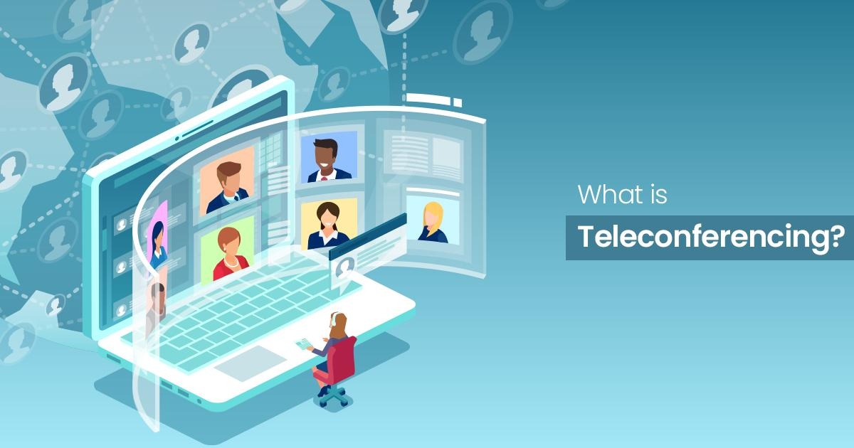
Managing and Monitoring Project Communications
Technology
Teleconferencing
Teleconferencing requires an excellent facilitator to manage the conversation so that participants are not talking all at the same time and the conversation (and agenda topics) keeps moving forward.
A downside of these tools is that you can only hear the participants; you cannot see them
Dr. Raef Baraka

Slide 29
Managing and Monitoring Project Communications
Technology
E-mail
While e-mail is part of our daily routine, it is considered one-way communication (asynchronous). You send a message. Then you wait. And wait. And wait until you get a response, if any.
E-mail should be used for documenting conversations, not conducting conversations. The benefit of email is that it provides you with project documentation. The downside of email is urgency (others may not respond as quickly as you need) and understanding (the tone of your written message may be different from the tone of how your message is read).
Dr. Raef Baraka

Slide 30

Managing and Monitoring Project Communications
Technology
E-mail
In working on projects, look for tools that enable a two-way dialogue, not one-way.
Remember: Just because you hit the “send” button on an e-mail does not mean that you have actually communicated
Dr. Raef Baraka

Slide 31
Managing and Monitoring Project Communications
Technology
Social Media
Using social media tools to communicate in a project is becoming more prevalent. Social media provides an avenue for sharing project information with stakeholders in a public, low-cost, and easily accessible way.
This can be beneficial in large projects that affect members of the broader external community as a means to provide them with current information about the project status and how it affects them as it progresses.
Dr. Raef Baraka

Slide 32

Managing and Monitoring Project Communications
Technology
Social Media
It also provides stakeholders with a means of providing feedback and can be measured
through engagement metrics available on many social platforms.
However, social media is not the right tool for every project and every stakeholder group. Carefully consider the why, how, and what of using social media as a tool, and ensure it satisfies your tool selection criteria before moving forward.
Dr. Raef Baraka

Slide 33
Managing and Monitoring Project Communications
Project Documents
Project Reports
The report is simply for documentation purposes. Just because we wrote it, it doesn’t mean that people read it! If you know there is information in the report that certain stakeholders need to know, communicate it separately. At a minimum, when you send the report, add an introductory note that uses bullet points to highlight specific aspects of the report you want to ensure they see. The benefit of project reports is that critical project information has been documented. The challenge: making sure that project reports, decision logs, issue logs, and other reports have a purpose and are being used
Dr. Raef Baraka

Slide 34
Managing and Monitoring Project Communications
Project Documents
Project Schedule
The project schedule is highly detailed and communicates the tasks, milestones, planned and actual start/end dates, durations, dependencies, resources, and other detailed information. It brings the pieces (information) from other sections of the project plan into one place—the schedule.
To improve your project communications, consider printing the project schedule as a large wall chart, or post it on a virtual team wall. As you start doing the work on the project, mark your project schedule in different colors.
Dr. Raef Baraka

Slide 35
Managing and Monitoring Project Communications
Project Documents
Project Schedule
When a task is late, communicate this by highlighting the task in a bright color with a large arrow or circle.
When a task is completed early, communicate this by highlighting the task on the schedule in a different bright color and adding an icon (star, exclamation point, etc.).
The benefit of having a marked-up project schedule that is visible to everyone is communicating progress, problems, and commitment.
Dr. Raef Baraka

Slide 36
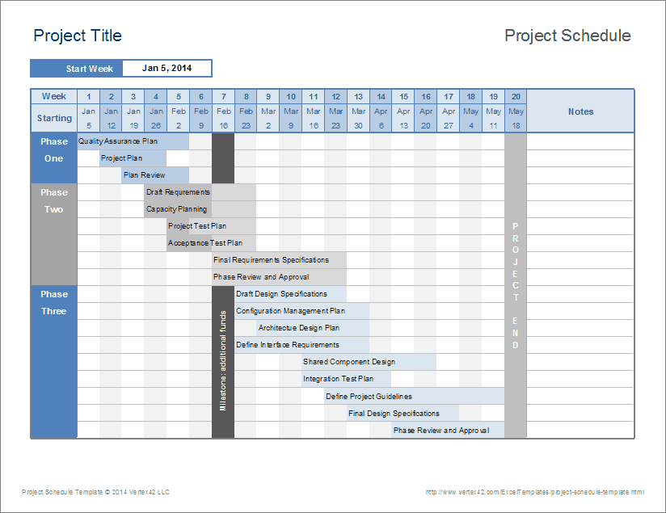
Managing and Monitoring Project Communications
Dr. Raef Baraka

Slide 37
Managing and Monitoring Project Communications
Project Documents
Milestone Schedule
By definition, a milestone schedule is “a type of schedule that presents milestones with
planned dates. Notice the difference in the level of detail in the milestone schedule.
The benefit of using a milestone schedule as a communication tool is that sometimes key stakeholders, project sponsors, or management may only want a high-level view (or summary) of the status of key milestones, or points in time. Consider using a milestone schedule for communicating in these situations
Dr. Raef Baraka

Slide 38
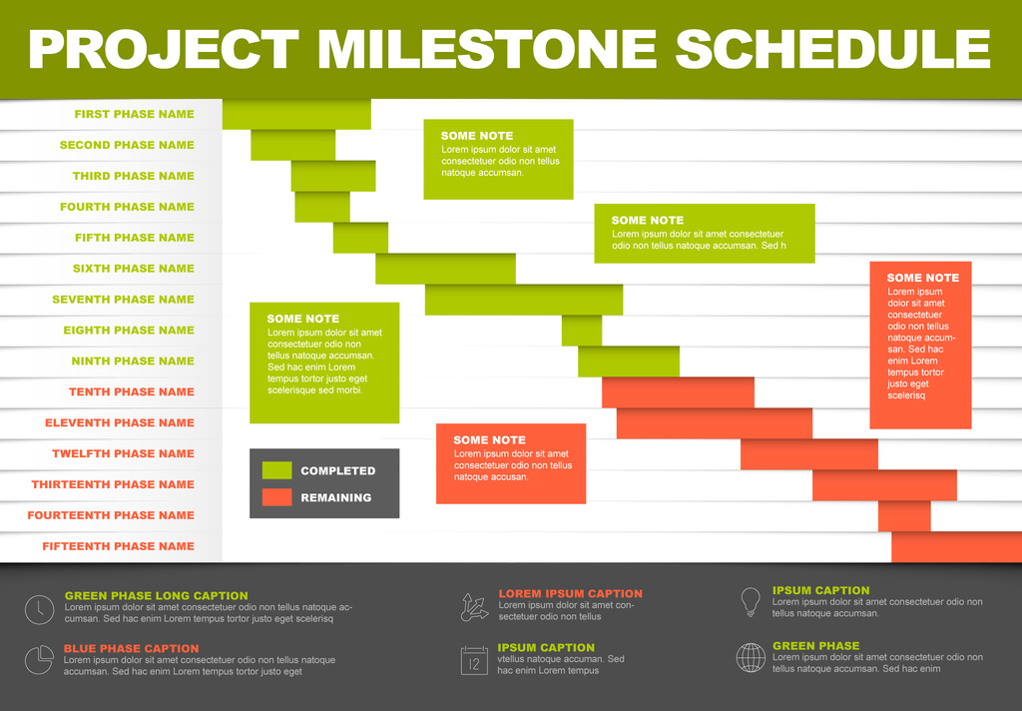
Managing and Monitoring Project Communications
Dr. Raef Baraka

Slide 39
Managing and Monitoring Project Communications
Project Documents
Status Reports
Status reports allow us to communicate project progress at regular intervals. Whether your document is called a status report, project update, or some other name, it is a vital communication tool. Without it, how would you know that progress is being made on the project?
The frequency and formality of communicating project status will depend on your project. This should be documented in your team’s operating principles.
Dr. Raef Baraka

Slide 40
Managing and Monitoring Project Communications
Project Documents
Status Reports
Status reports do not need to be complicated. They should be easy to read and preferably a maximum of one page (depending on the size and complexity of the project). Using a template ensures that a constant format and consistent information is being communicated.
Make sure that your stakeholders are receiving current information in the status reports and not getting status reports with outdated details.
The timing of your status report distribution should be outlined in your project communications management plan. The benefit in consistently using status reports is that they help answer the question, “Where are we on the project?” for everyone involved.
Dr. Raef Baraka

Slide 41
Managing and Monitoring Project Communications
Presentations and Templates
Presentations
Tools such as face-to-face presentations, interactive webinars, podcasts, or videos provide an excellent opportunity for communicating project information. This is a time to use your presentation skills and facilitation techniques when presenting key project information.
Graphs, charts, photographs, and stories can create very powerful and impactful images.
The benefit is that you can engage the audience (see Chapter 3) and reduce uncertainty (see Chapter 2) by directly addressing any project questions or concerns.
Dr. Raef Baraka

Slide 42
Managing and Monitoring Project Communications
Presentations and Templates
Templates
There is a template or form for just about everything! Don’t spend your time creating a form from a blank sheet of paper or screen.
Find a template, modify it, then use the same template for similar interactions. The benefit in using a template is that it provides consistent messaging and branding to support your project communication.
Spend your time on the communication content, and not on creating, designing, and redesigning a form.
Dr. Raef Baraka

Slide 43
Managing and Monitoring Project Communications
Meetings
Face-to-Face Meetings
Invest the time and money to have at least one face-to-face meeting for a project team, especially at the beginning of the project.
Face-to-face meetings are critical for all teams. Research shows that “when teams are unable to meet face-to-face—even once—they are less able to handle cultural differences and to understand and appreciate one another.”
Dr. Raef Baraka

Slide 44
Managing and Monitoring Project Communications
Meetings
Face-to-Face Meetings
Don’t underestimate the power and benefits of face-to-face meetings.
They are crucial to project and team success!
The downside of face-to-face meetings is the difficulty in getting everyone scheduled to attend at the same time, and the costs that may be associated with them.
However, there are greater costs when face-to-face meetings are not held
Dr. Raef Baraka

Slide 45
Managing and Monitoring Project Communications
Meetings
Stand-Up Meetings
Quick stand-up meetings are also an excellent communication tool, especially for agile project teams.
Stand-up meetings are just that: participants stand. They do not sit down.
The meeting is short and focused. In agile practice, stand-up meetings typically occur daily and last no longer than 15 minutes.
In traditional or hybrid teams, these meetings may occur weekly and last longer.
Dr. Raef Baraka

Slide 46
Managing and Monitoring Project Communications
Meetings
Stand-Up Meetings
Regardless of the duration, the benefit of stand-up meetings is that they are consistent, short, and focused.
It is an opportunity to quickly identify problems, prioritize items, and provide support where needed.
Make sure that you have established ground rules for your stand-up meetings
Dr. Raef Baraka

Slide 47
Managing and Monitoring Project Communications
Meetings
Meeting Outcomes
When working with teams and conducting meetings, it is essential to communicate the meeting outcomes, goals, or intentions.
Meeting outcomes should address the intended goal for the meeting and expectations of what will be accomplished by the end of the meeting.
Include the meeting outcomes on the meeting agenda and distribute the agenda well in advance of the meeting time. The benefit of clearly stating meeting outcomes is that everyone knows that their time and input are valued and respected, and can come prepared for focused discussions.
Dr. Raef Baraka

Slide 48



Thank You

