Slide 1




Social Media and Crises
Lecture 2
DGM 730
Understanding Types of Crisis
Prepared by
Dr. Doaa Rady

Slide 2

Lecture
02
Introduction
Lecture outline
  Understanding Types of Crisis
  Conventional crises which now play-out differently
  What is a Crisis?
  Types of crisis
  Crisis created by use of social media by customers, citizens or employees
  ‘Own goals’ triggered by organizations misuse of social media
  The importance of speed of response
  Conclusion
  Recommended References

Slide 3
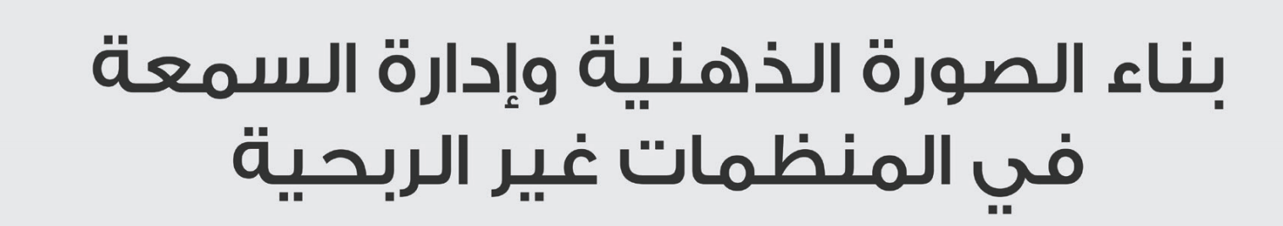
Lecture
02
Introduction
هذا الكتاب للقراءة فقط وللاستزادة ليس للاختبارات وليس ضمن المقرر

Slide 4

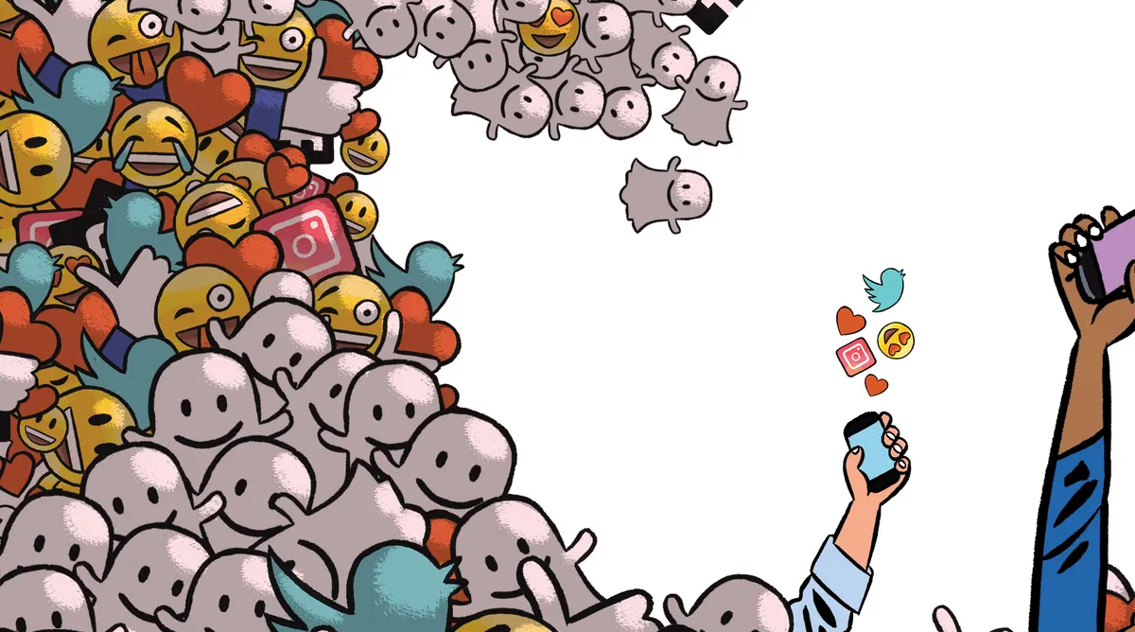
‘Own goals’ triggered by organizations misuse of social media

Slide 5
Lecture
02
Misuse of social media
Social Media Misuse
Some misuses that are associated with the social media are:
    Defamation التشهير
    False and unreliable informationمعلومات خاطئة وغير موثوقة
    Cyberbullyingالتنمر الإلكتروني
    Loss of Privacyفقدان الخصوصية
    Fraudاحتيال

Slide 6
Lecture
02
Misuse of social media
Social Media Etiquette
Take a break before you post: If you are angry about something don’t jump straight on social media and tell the whole world about it. Take some time to cool down and consider if it’s even worth posting.
Consider the rules of the platform: Before posting anything understand the rules of the social media platform and ensure your posts conform to the accepted guidelines.
Keep it professional: Don’t make disparaging comments that could bring a person or an entity into disrepute. You can still be conversational and personal with your posts but make sure they are appropriate.
Show respect: If you treat other users of social media with respect you will be treated with respect in return. Social media is a communication tool to allow you to share discussions with people all over the world.

Slide 7

Lecture
02
Video: Social Media Etiquette

Slide 8
Lecture
02
The importance of speed of response
In Reputation Management, John Doorley and Helio Fred Garcia outline the broad characteristics of social media. They emphasize authenticityأصلية, transparency, decentralization of authorityلامركزية السلطة, speed, and collaborationالتعاون as primary characteristics.
With the proper approach, these characteristics can be beneficial conduitsقنوات مفيدة for immediate reach and accessibility to stakeholders. However, in a crisis, they can be an asset ميزة or a liability مسئولية قانونية.

Slide 9

Lecture
02
Video: Reputation management

Slide 10
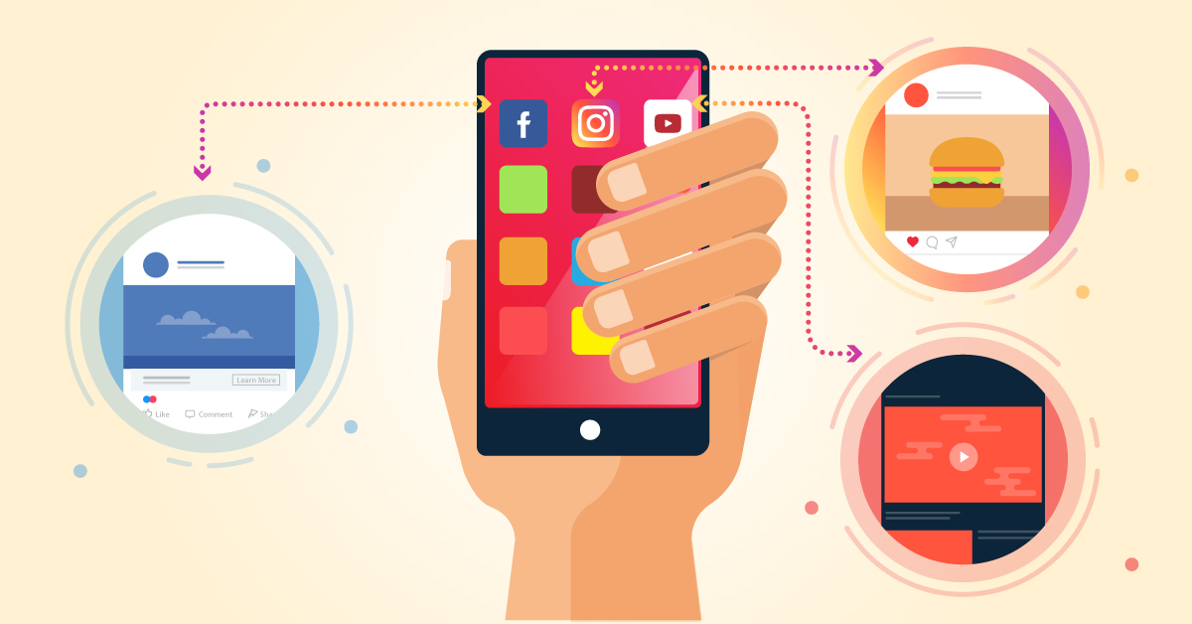
How Social Media Transforms the Way We Live & Do Business?
Live Session
EXRTA
SLIDES
(JUST READ)

Slide 11
Lecture
02
How Social Media Transforms the Way We Live & Do Business
• One in eight couples married in the United States met online.
• If Facebook were a country, it would be the world’s third largest.
• A New Linkedin member joins every second.
• Every minute, 24 hours of video is uploaded onto YouTube.
• If Wikipedia were a book, it would be 2.25 million pages long
and take 23 years to read.
• 78% of consumers trust peer reviews. Only 14% trust advertisements.
• E-readers have exceeded traditional book sales.
• Kindergarteners learn on iPads now, not chalkboards.
Live Session
EXRTA
SLIDES
(JUST READ)

Slide 12

Lecture
02
How Social Media Transforms the Way We Live & Do Business
So, there is a new playing field—social media—and new rules of the game: analysis, action, and communication, all at high speed.
Yet the realities of people’s reasonable expectations and the basic rules guiding crisis behavior and communication have not changed.
14 years ago, but now?
Video For Extra info:
Erik Qualman vividly portrays the change in the way people connect in the YouTube video
https://www.youtube.com/watch?v=H6k65C0fS5Q
Live Session
EXRTA
SLIDES
(JUST READ)

Slide 13

Lecture
02
Questions

Slide 14
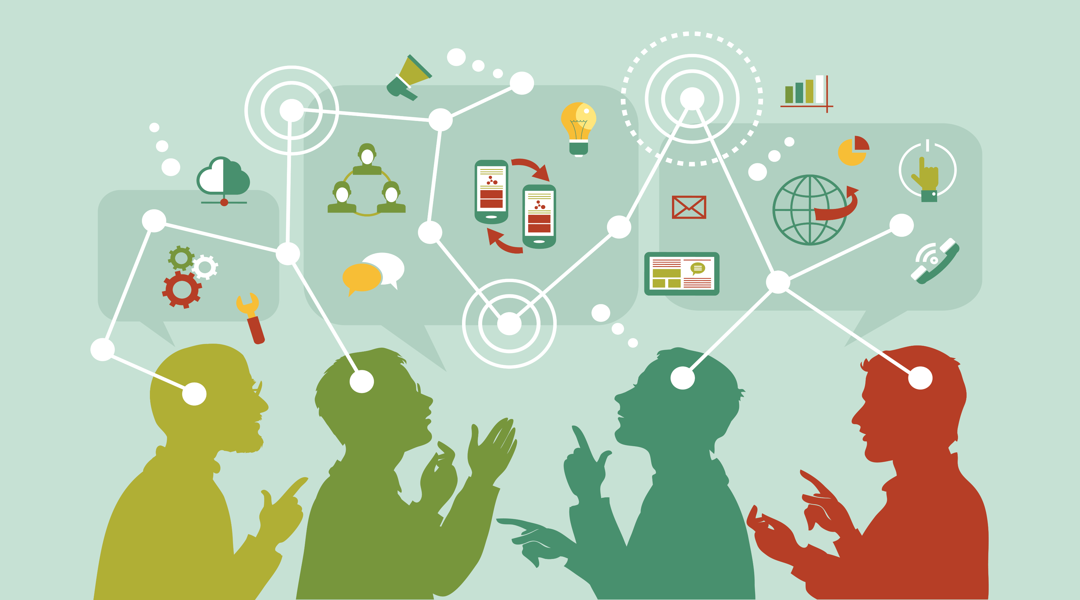
Conventional crises which now play-out differently
التقليدية

Slide 15
Lecture
02
Conventional crises which now play-out differently
Crisis situations are sudden and unexpected events that hold with them a reputational threat for organizations. Communication has changed remarkably since the rapid growth of internet.
Internet has brought a completely new way of communicating especially after the expansion and growing popularity of social media platforms. These platforms offer for their users a chance to be more interactive, publish and consume content more freely.

Slide 16
Lecture
02
Conventional crises which now play-out differently
Whenever an organization is faced with a crisis, it is facing a major threat towards its operations. During a crisis an organization needs to find out the best way to communicate with the public to manage the situation. Nowadays this includes operating in social media platforms.
Today’s social media tools are bringing rapid change to organizational communication and public relations. These technologies have shifted the emphasis of internet services from being consumption-based towards becoming interactive and collaborative, creating new opportunities for interaction between organizations and publics.

Slide 17
Lecture
02
Conventional crises which now play-out differently
The social media platform has taken over the way we communicate, do business and form relationships. A good number of business organizations have pages on social networks as they advertise, sell and offer customer services using these platforms. The new online communication platforms make matters difficult in exceptional ways with respect to the kinds of information they avail for يستفيدون منهobservers to make conclusions from impressions drawn. This has brought forth varied speculative and theoretical issues in academics, social, business and politics.
Social media can be defined as online applications, platforms and media which aim to facilitate interactions, collaborations and the sharing of content.

Slide 18
Lecture
02
Conventional crises which now play-out differently
Social media or social networking platforms are defined as “web-based services that allow individuals to (1) construct a public or semi-public profile within a bounded system, (2) articulate a list of other users with whom they share a connection, and (3) view and traverse their list of connections and those made by others within the system.”
This definition explains that these platforms have the feature of interactivity amongst everyone in it. The users of these platforms are the ones who create and publish content and follow and comment on each other’s actions. From the organization’s point of view these are the platforms that have created them an opportunity to open discussion with the stakeholders and also collect data straight from them.

Slide 19
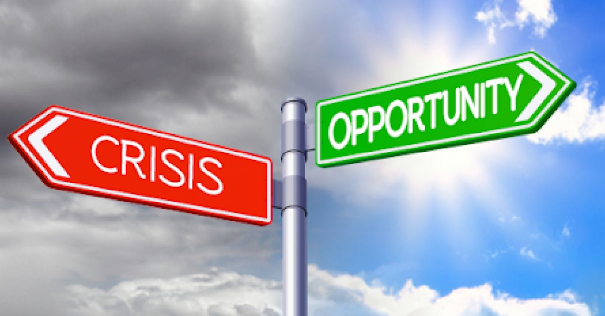
What is a Crisis?

Slide 20
Lecture
02
What is a Crisis?
{ Crises have existed as long as civilization itself }
Crises are defined as sudden and unexpected events that will have a negative impact or a clear threat to organizations operations, image and core values.
Even though they are rather rare, when these occur, in the worst-case scenario these can lead to a major disturbance in operations.
Crisis Management is a process by which an organization deals with a disruptive and unexpected event that threatens to harm the organization or its stakeholders. The study of crisis management originated with large-scale industrial and environmental disasters in the 1980s. It is the most important process in public relations.

Slide 21
Lecture
02
What is a Crisis?
Crisis Management is indispensable لا غني عنه in humanity because it is believed that no human being/ organization can be good at everything. Organizations may be very good at something’s and at the same time be a complete novice مبتدئat something else. When faced with the same problem, different organizations have different ideas on how to solve that problem. It is for this reason that every organization should have a PR department that deals with crisis management.

Slide 22
Lecture
02
What is a Crisis?
Crisis management is literally managing the ongoing situation. إدارة الوضع المستمر Crisis situations can be divided into three stages which are pre-crisis stage, crisis and the post-crisis stage. For any crisis management the first and most important step is to save lives.
One of the challenges faces leaders is time—time to assess the situation, time to react, and time to repair.
Now, the age of the instant crisis has arrived. Companies, nonprofit organizations (NGOs), governments, and high-profile individuals often seem unable to cope. The ingredients include speed, pervasivenessانتشار, and huge numbers. Example: Verizon adds a $2 charge, and one-hour later 100,000 signatures appear on a Twitter petition.

Slide 23
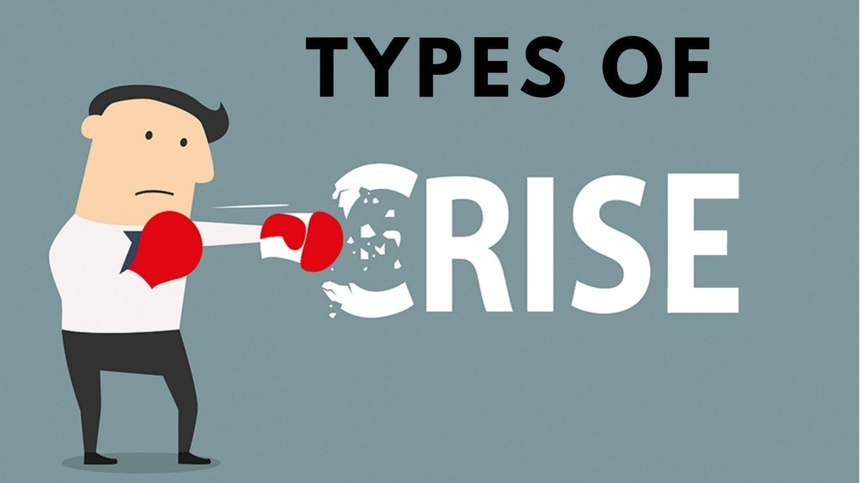
Types of Crises

Slide 24
Lecture
02
Types of crisis
1) Natural Crisis:
Disturbances in the environment and nature lead to natural crisis.
Such events are generally beyond the control of human beings.
Tornadoes, Earthquakes, Hurricanes, Landslides, Tsunamis, Flood, Drought all result in natural disaster.
2) Technological crisis:
Technological crisis arises as a result of failure in technology. Problems in the overall systems lead to technological crisis.
Breakdown of machine, corrupted software and so on give rise to technological crisis.

Slide 25
Lecture
02
Types of crisis
3) Confrontation Crisis: أزمة المواجهة
Confrontation crises arise when employees fight amongst themselves. Individuals do not agree to each other and eventually depend on nonproductive acts like boycotts المقاطعه, strikes for indefinite periods and so on.
In such a type of crisis, employees disobey superiors; give them ultimatums and force them to accept their demands.
Internal disputes النزاعات, ineffective communication and lack of coordination غياب التنسيق give rise to confrontation crisis.
4) Crisis of Malevolence: أزمة الحقد/ أنشطة سيئة
Organizations face crisis of malevolence when some notorious employees الموظفين سيئي السمعة take the help of criminal activities and extreme steps to fulfill their demands. Acts like kidnapping company’s officials, false rumors شائعات كاذبةall lead to crisis of malevolence.
الإنذارات

Slide 26
Lecture
02
Types of crises
5) Crisis of Organizational Misdeeds: أزمة المخالفات التنظيمية
Crises of organizational misdeeds arise when management takes certain decisions knowing the harmful consequences of the same towards the stakeholders and external parties.
In such cases, superiors ignore the after effects يتجاهل الرؤساء الآثار اللاحقةof strategies and implement the same for quick results.
Crisis of organizational misdeeds can be classified into following three types:
  Crisis of Skewed Management Values سوء الإدارة/ أزمة القيم الإدارية المنحرفة arises when management supports short term growth and ignores broader issues.
  Crisis of Deceptionأزمة الخداع: Organizations face crisis of deception when management purposely tampers data and information. Management makes fake promises and wrong commitments to the customers. Communicating wrong information about the organization and products lead to crisis of deception.
  Crisis of Management Misconduct أزمة سوء السلوك الإداري: Organizations face crisis of management misconduct when management indulges in deliberate acts of illegality like accepting bribes الرشوة , passing on confidential information المعلومات السريةand so on.
تتخذ الإدارة قرارات معينة مع العلم بالعواقب الضارة لذلك تجاه أصحاب المصلحة والأطراف الخارجية.

Slide 27
Lecture
02
Types of crisis
6) Crisis due to Workplace Violence: أزمة بسبب العنف في مكان العمل
Such a type of crisis arises when employees are indulged in violent acts such as beating employees, superiors in the office premises itself.
7) Crisis Due to Rumors: أزمة بسبب الشائعات
Spreading false rumors about the organization and brand lead to crisis. Employees must not spread anything which would tarnish the image of their organization.
8) Bankruptcy: إفلاس
A crisis also arises when organizations fail to pay their creditors and other parties.
Lack of fund leads to crisis.

Slide 28
Lecture
02
Types of crisis
9) Sudden Crisis: أزمة مفاجئة
As the name suggests, such situations arise all of a sudden and on an extremely short notice.
Managers do not get warning signals and such a situation is in most cases beyond anyone’s control.
10) Smoldering Crisis: أزمة مشتعلة
Neglecting minor issues in the beginning lead to smoldering crisis later.
Managers often can foresee crisis توقع الأزمة, but they should not ignore the same and wait for someone else to take action.
Warn the employees immediately to avoid such a situation.

Slide 29
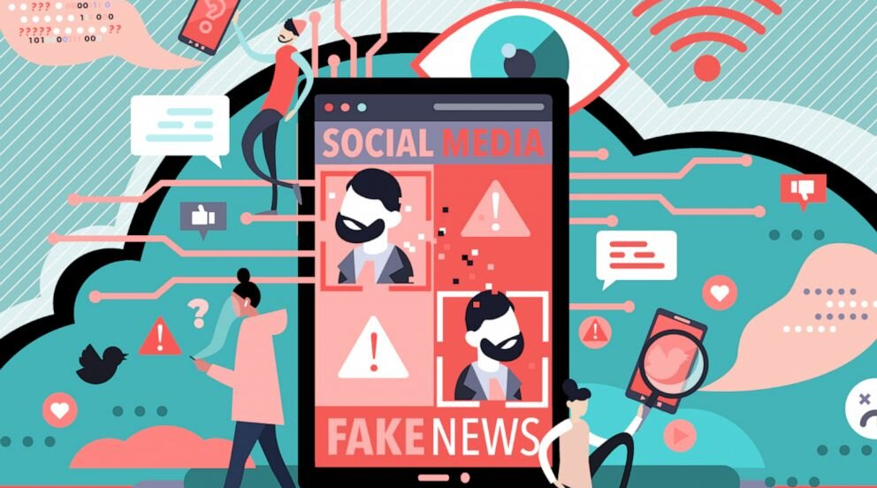
Crisis created by use of social media

Slide 30
Lecture
02
Crisis created by use of social media
The power of online media means that today’s crises emerge at lightning speed, and spread further and faster than ever before. Social media also imposes higher standards of transparency. Incidents which could previously be kept under wraps are now much more likely to become public knowledge (sometimes even before the organization itself is fully aware of them).
To put it simply, a crisis fueled by social media is not something you want to face unprepared. Social media poses internal and external risks, both of which could have a potentially devastating effect on your organization's reputation and bottom line.

Slide 31
Lecture
02
Crisis created by use of social media
You can no longer avoid these risks by not having a social media presence. Whether you’re engaging or not, many of your stakeholders are on social media, including your employees, customers, competitors and, of course, the traditional media.
If you have been in your position for over five years, there is an 85% chance you have faced at least one major corporate reputation crisis.*
إذا كنت في منصبك لأكثر من خمس سنوات، فهناك احتمال بنسبة 85% أنك واجهت أزمة كبرى واحدة على الأقل تتعلق بسمعة الشركة
*Source: Oxford Metrica, Aon Reputation Review 2011

Slide 32
Lecture
02
Crisis created by use of social media
Your reputation is more important than ever
The asset value of corporate reputation has increased significantly over recent years, but so did the associated risks. Indeed, reputational risk was identified as the greatest risk facing global companies, even higher than regulatory, human capital, IT, market and credit risk.
تحديد المخاطر المتعلقة بالسمعة باعتبارها أكبر المخاطر التي تواجه الشركات العالمية، حتى أنها أعلى من المخاطر التنظيمية ومخاطر رأس المال البشري وتكنولوجيا المعلومات والسوق والائتمان.
أعضاء مجلس الإدارة

Slide 33
Lecture
02
Crisis created by use of social media
Regardless of what started it or how it started, a crisis will almost always find its way online. According to a 2011 report of the Federation of European Risk Management Associations, reputational risk from social media is cited as a material risk by 50% of risk managers and a bigger cause for concern than cyber attack.
وفقًا لتقرير صدر عام 2011 عن اتحاد جمعيات إدارة المخاطر الأوروبية، تم الاستشهاد بمخاطر السمعة الناجمة عن وسائل التواصل الاجتماعي باعتبارها خطرًا ماديًا من قبل 50٪ من مديري المخاطر وسببًا أكبر للقلق من الهجمات السيبرانية.
So, how is a social media - fueled crisis different?

Slide 34
Lecture
02
Crisis created by use of social media
Increased Frequency زيادة التردد/ التكرار
With social media, people are creating and sharing more information than ever before. As more information about the organization is created and shared in social media the frequency of reputational crises has also increased. The greater transparency provided by social media is another reason why the frequency of crises has increased.

Slide 35
Lecture
02
Crisis created by use of social media
Staggering Speed سرعة مذهلة
Sharing information with your entire friend network and followers is only one click away. There are 2.85 billion active Facebook users, each of them having many friends. Equally, Twitter has incredible reach, with opinion formers and journalists over-represented amongst its users. A reputation-damaging scandal can spread in a matter of minutes.
يمكن أن تنتشر الفضيحة التي تضر بالسمعة في غضون دقائق.

Slide 36
Lecture
02
Crisis created by use of social media
Global Reach الوصول العالمي
What happens at a local level doesn’t stay local anymore. A company’s failure to provide proper work conditions in one isolated factory in China can become the talk of London and New York the next day (if not sooner).
Total Visibility الرؤية الكاملة
Investors, factory workers and all your stakeholders now have free access to information about your company, its suppliers and customers. And that information is no longer controlled by you: it is created by third parties.

Slide 37
Lecture
02
Crisis created by use of social media
Easy recollection of the crisis سهولة تذكر الأزمة
They used to say that today’s newspaper is tomorrow’s fish and chip paper. Not any more. Long after the crisis has passed, a simple Google search for your Company’s name will bring back all the articles and posts related to the controversial issues.
More Measurability المزيد من قابلية القياس
On the plus side, in the online space everything can be measured and scaled. You can more easily assess the dimensions of a crisis in order to deliver a proportionate response استجابة متناسبة. It also helps with post-crisis review so that you can put plans in place to prevent similar events from occurring again.

Slide 38
Lecture
02
Crisis created by use of social media
More interaction مزيد من التفاعل
Social Media can facilitate instant dialogue with concerned stakeholders. Addressing concerns quickly, empathetically and directly can go a long way towards defusing a crisis situation and having a positive impact on how the company is viewed.

Slide 39
Lecture
02
Crisis created by use of social media
When the crisis is triggered by events happening off-line
A crisis is often triggered by unforeseen events happening off-line. These events may concern a specific department or business unit, one of its suppliers: a work-related accident can start an enquiry on the work conditions provided by the organization; rude treatment of a customer can cause a sudden burst of accumulated dissatisfaction with the company. Regardless of the cause, once the issue is picked up in social media, it will be amplified thousands of times.

Slide 40
Lecture
02
Crisis created by use of social media
Case Study

Slide 41
Lecture
02
Crisis created by use of social media
social media has created a completely new environment for reputation management. Updating your reputational risk assessment is essential if you are to be fully prepared for the new risk landscape. Simply put, social media makes crises both more likely and potentially more damaging.
By conducting regular reputational risk assessments companies become aware of the problem areas that could escalate into a crisis. Monitoring the social web for mentions of keywords related to these risks and setting up alerts when conversations around these topics increase can be a way to catch and address issues before they escalate into a full-blown crisis.

Slide 42
Lecture
02
Crisis created by use of social media
When the crisis is ‘purely social’
Social Media and the new mobile technologies have created a whole new class of reputational crises. No off-line event triggers these incidents; they arise in the online space, often because of the organization's own actions on social media. As you will see below, ‘purely social’ incidents and can be as dangerous to the company’s reputation as those triggered by offline events.
Internal causes
Your employees can be your organization's worst enemy. Many reputational crises are triggered by employees’ actions on social media, either on the company’s accounts or on their personal profiles.

Slide 43
Lecture
02
Crisis created by use of social media
Careless posting on the organization's accounts
When an employee creates and manages the organization's social media account from their own personal account, mixing up messages can happen quite easily. There are many instances of accidental or inappropriate posting, which have caused great embarrassment and significant damage to an organization's reputation.

Slide 44
Lecture
02
Crisis created by use of social media
تم طرده

Slide 45
Lecture
02
Crisis created by use of social media
Password and login details are often shared between multiple employees in order for them to access the company’s social media accounts.
If an inappropriate post goes out, tracing who is responsible can be almost impossible, especially if a large team is manning the social media accounts of the company and multiple marketing agencies have username and password access.

Slide 46
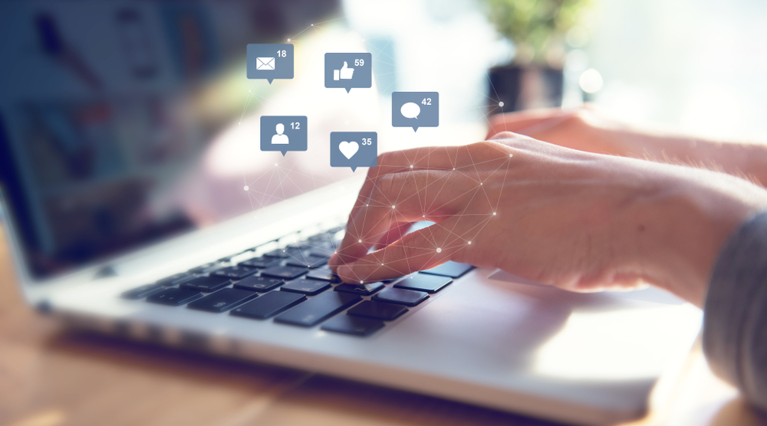
The importance of speed of response

Slide 47
Lecture
02
The importance of speed of response
In Reputation Management, John Doorley and Helio Fred Garcia outline the broad characteristics of social media. They emphasize authenticity, transparency, decentralization of authority, speed, and collaboration as primary characteristics.
With the proper approach, these characteristics can be beneficial conduits قنوات مفيدة for immediate reach and accessibility to stakeholders. However, in a crisis, they can be an asset or a liability أصل أو التزام.
في كتاب "إدارة السمعة"، يوضح جون دورلي وهيليو فريد جارسيا الخصائص العامة لوسائل التواصل الاجتماعي. وهي تؤكد على الأصالة والشفافية ولامركزية السلطة والسرعة والتعاون كخصائص أساسية.

Slide 48
Lecture
02
The importance of speed of response
“Speed is a defining element of social media and a characteristic that presents challenges for organizations in reputation management. The pace at which information is shared and propagated انتشرت in social media is faster and broader than older forms of communication.”
Social trend means people use technologies to get the things they need from each other, rather than from traditional institutions like corporations.
(Definition by The Groundswell Co. https://groundswell.io/)
يعني الاتجاه الاجتماعي أن الناس يستخدمون التقنيات للحصول على الأشياء التي يحتاجونها من بعضهم البعض، وليس من المؤسسات التقليدية مثل الشركات.

Slide 49
Lecture
02
The importance of speed of response
Li and Bernoff craft their argument in relation to online user profiles as demonstrated in the Figure. The majority of users (70%) are listed as “spectators” مشاهدون—meaning they use social media sites as a viable source of information. “Spectators” solicit the opinions of their friendsيطلب المشاهدون آراء أصدقائهم via Facebook prior to making a purchase rather than consulting a company’s site.
This suggests that public relations and communication professionals need to monitor and embrace the company to guide conversations, behaviors, and potentially gain some advantage in the social media territory.
يستخدمون مواقع التواصل الاجتماعي كمصدر فعال للمعلومات

Slide 50
Lecture
02

Slide 51
Lecture
02
Conclusion
Lecture Topic
  Understanding Types of Crisis
  Conventional crises which now play-out differently
  What is a Crisis?
  Types of crisis
  Crisis created by use of social media by customers, citizens or employees
  ‘Own goals’ triggered by organizations misuse of social media
  The importance of speed of response

Slide 52
Lecture
02
Recommended Reference
Mzyece, N. (2020). An Assessment on the Effects of Social Media on Crisis Management in Telecommunication Companies in Zambia (Doctoral dissertation, Cavendish University). http://155.0.3.194:8080/jspui/bitstream/123456789/626/1/An%20Assessment%20on%20the%20Effects%20of%20Social%20Media%20on%20Crisis%20Management%20in%20Telecommunication%20Companies%20in%20Zambia.pdf
Capozzi, L. (2013). Crisis management in the age of Social Media. Business Expert Press. https://core.ac.uk/download/pdf/326763005.pdf
Social Media Misuse Definition. Law Insider. (n.d.). https://www.lawinsider.com/dictionary/social-media-misuse
Miles, K. (2020, January 30). How social media misuse can affect your business. FranchiseED. https://www.franchise-ed.org.au/franchising/franchise-marketing/how-social-media-misuse-can-affect-your-business/
Types of Crisis. Types of crisis. (n.d.). https://www.managementstudyguide.com/types-of-crisis.htm
LawSikho. (2016, May 17). How can social media be misused. iPleaders. https://blog.ipleaders.in/can-social-media-misused/
Social Media LinkedIn. (n.d.). How do you evaluate and learn from a social media crisis?. 6 Steps to Evaluate and Learn from a Social Media Crisis. https://www.linkedin.com/advice/0/how-do-you-evaluate-learn-from-social-media-crisis

Slide 53


Thank You

