Slide 1



Decision Gate Discipline for Programs
Prepared by Dr. Sami Alzahrani
Lecture 8
PMG 665
Program and Portfolio Management
Lecture 8

Slide 2


Introduction
Chapter
08
Introduction
This chapter describes the rationale for decision gates, how a program manager should prepare for them, and how to execute decision gate reviews for maximum success.

Slide 3
Introduction
Chapter
08
Introduction
One of the greatest challenges for any program is to remain aligned to organizational strategic direction. One of the primary tools for maintaining program alignment to organizational strategic direction is the decision gate. Exercising the discipline to properly pass through decision gates is therefore one of the key factors for program success and program management excellence.

Slide 4
Introduction
Chapter
08
What are the top five benefits of using decision gates?
There are a number of benefits associated with the decision gate process. Here are the top five:
-Risk mitigation
-Better resource management
-Project success
-Flexibility
-Improved collaboration

Slide 5
Introduction
Chapter
08
What are the top five benefits of using decision gates?
Risk mitigation
The gating process keeps all employees on task, while also eliminating any unplanned or ad hoc edits to the end product. With so many stakeholders involved throughout a project lifecycle, preventing any unnecessary deviations reduces risk substantially for large organizations.

Slide 6
Introduction
Chapter
08
What are the top five benefits of using decision gates?
Better resource management
With its inbuilt review phases, there is ample opportunity to re-deploy resources if a project has not met certain requirements. Ultimately, this means businesses can use their people more productively, while minimizing any needless wastage of resources.

Slide 7
Introduction
Chapter
08
What are the top five benefits of using decision gates?
Project success
The decision gates process is useful for guiding employees to work on the right task at the right time. Often, organizations undertake new projects without an appropriate business case or justification, leading to common problems like overspend and vastly increased project scopes.
With decision gates, projects are closely monitored at all stages, ensuring the project meets its critical goals with limited change. Regular checkpoint assessments mean that any issues and risks are flagged at the earliest opportunity and allows them to be acted on accordingly.

Slide 8
Introduction
Chapter
08
What are the top five benefits of using decision gates?
Flexibility
decision gates methodology is flexible, meaning it can be adjusted to a variety of circumstances within an organization. Any one organization can implement a variety of decision gates setups to suit the needs of their various departments or business processes.
decision gates can also be scaled easily. Organization can start with a simple model, applied to a single department or type of project. Over time, the model can be built to handle projects with an increasing complexity.

Slide 9
Introduction
Chapter
08
What are the top five benefits of using decision gates?
Improved collaboration
Working on projects with large teams in a variety of locations can be tricky – but the decision gates process is built to not only withstand this strain, but to also actively encourage collaboration internally (between cross-functional teams) and externally (with partners).

Slide 10
The role of decision gates
Chapter
08
The role of decision gates
No one likes accountability. It seems a pesky annoyance, which distracts the program manager from the actual execution of the program. Constantly preparing status reports, data for accounting, and stakeholder presentations does not seem to add any value to the program, and meetings consume valuable time.

Slide 11
The role of decision gates
Chapter
08
The role of decision gates
As it has been aptly said, meetings are events where minutes are kept, and hours are lost. Decision gates are particularly noisome since they have a greater formality and are directed at a high-level audience of management, which may make seemingly capricious decisions regarding the very fate of the program.

Slide 12
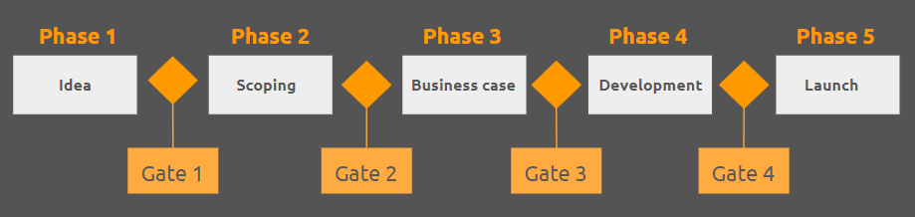
The role of decision gates
Chapter
08
What does the decision gates process look like?

Slide 13
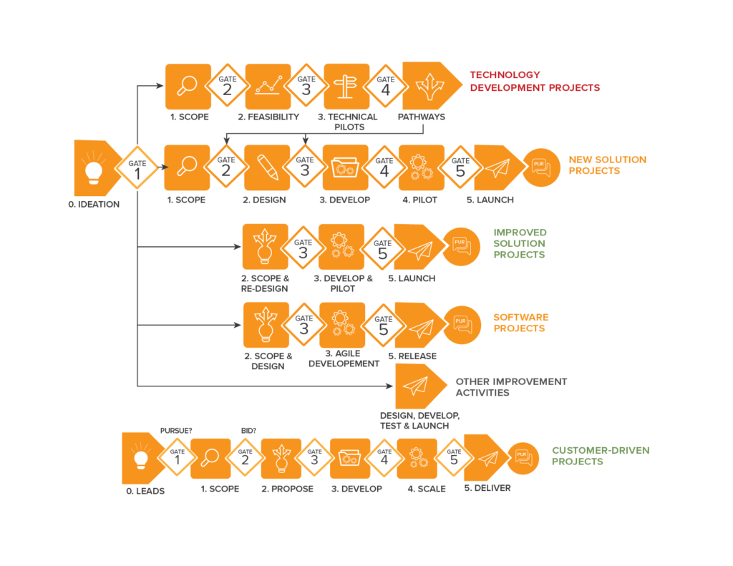
The role of decision gates
Chapter
08
What does the decision gates process look like?

Slide 14
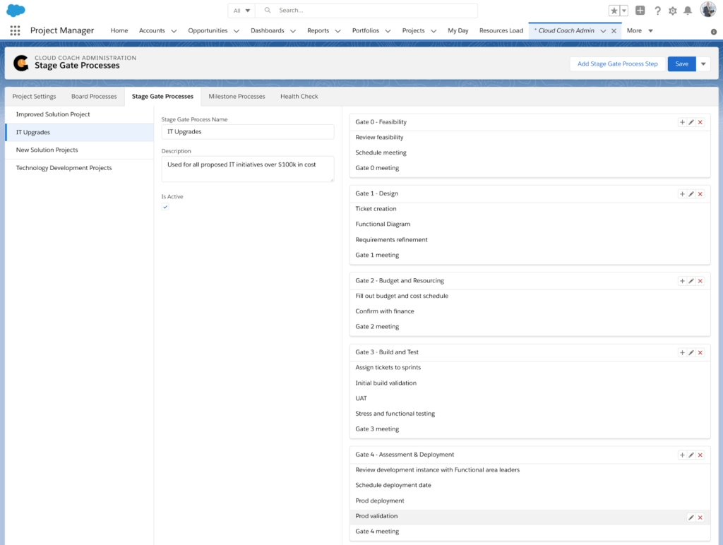
The role of decision gates
Chapter
08
What does the decision gates process look like?

Slide 15
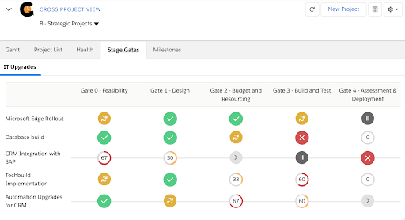
The role of decision gates
Chapter
08
What does the decision gates process look like?

Slide 16
Scheduling
Chapter
08
Scheduling
Decision gates are usually scheduled based on work to be completed for a decision gate (achieving a particular milestone) or upon a time period (such as monthly, quarterly, or annually.) Depending on the duration and scope of the program, quarterly reviews might provide a reasonable timeline for decision gates. In that case, each quarterly review is an excellent time for the sponsor to ensure the program is aligned to strategic objectives and should still continue execution.

Slide 17
Scheduling
Chapter
08
Scheduling
If based on work completed, that work should align with natural phases of a program. For example, in a large construction program, there may be decision gates associated with concept approval, site selection, architectural design, environmental, regulatory and demographic studies, site preparation, construction completion, and occupancy certification.

Slide 18
Scheduling
Chapter
08
Scheduling
Example1:
In a product development for a program, there may be decision gates at concept approval, market research, design completion, manufacturing readiness, market readiness, and first shipment.

Slide 19
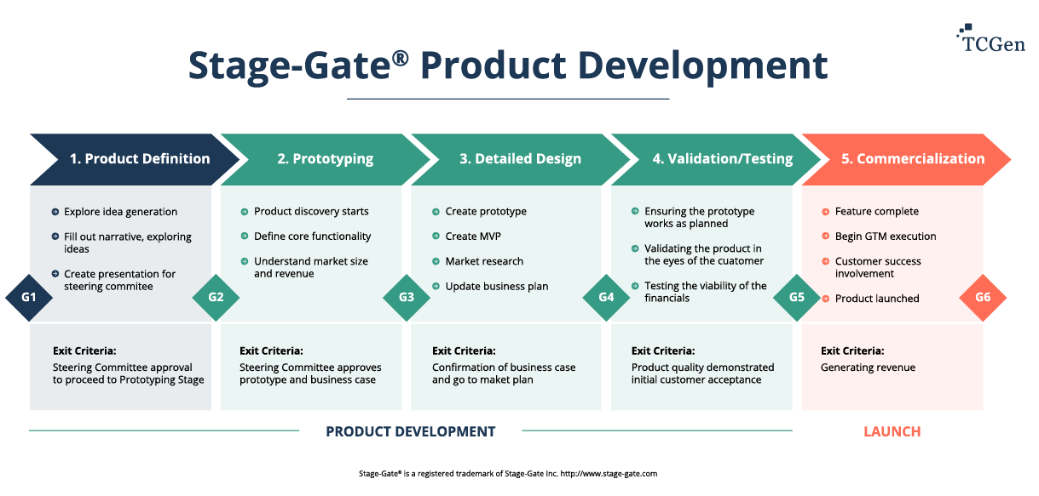
Scheduling
Chapter
08
Scheduling
Example 2:

Slide 20
Scheduling
Chapter
08
Scheduling
Some programs may have more esoteric scheduling, such as around seasonal changes or around industry events. A program to open a new mining or drilling site in Alaska (which has only about three months of effective working time each year) may schedule a fall decision gate to coincide with acquiring leases on claims identified during the summer, a winter decision gate to review equipment purchases and preparation,

Slide 21
Scheduling
Chapter
08
Scheduling
a spring decision gate to review hiring and shipping of equipment to location, and a summer decision gate as a “go/no-go” to begin production during the working season. Some industries are closely tied to trade shows or to the Christmas shopping season, so that decision gate reviews are scheduled at appropriate times leading up to trade shows or to historically significant marketing seasons.

Slide 22
Planning for decision gates
Chapter
08
Planning of decision gates
Decision gate topics and cadence should be part of the original program management plan. When the program charter is created, it should refer to the decision gates in general terms, but the program management plan should include specific decisions to be made, documents and key indicators to be reviewed, and timing or triggers for the decision gates.

Slide 23
Planning for decision gates
Chapter
08
Planning of decision gates
The program manager should approach the decision gate fully prepared. All relevant information should be accumulated and reviewed prior to the meeting. Information to be gathered includes work progress information for subsidiary projects, milestones accomplished, and benefits realized. Each program will also have specialized information related to that industry or program.

Slide 24
Planning for decision gates
Chapter
08
Planning of decision gates
For example, a construction program might include environmental study results, a product development program may include market research data, and a technology research program may include research papers and patent search data.
Standard project documents (such as the risk register, dependency map, decision register, program Gantt chart, and roadmap) should be updated and available on-hand for quick reference if needed.

Slide 25
Planning for decision gates
Chapter
08
Planning of decision gates
Preparing for a decision gate is also a good time to review the stakeholder register and stakeholder map. All stakeholders with decision authority should be involved in the decision gate. There should be only one meeting, and everyone should be at that meeting, or their delegate with decision authority should be present.

Slide 26
Planning for decision gates
Chapter
08
Planning of decision gates
This would certainly include the program sponsor, project managers who lead critical projects recently completed or in-flight, and any stakeholders with actual decision authority for this phase. If the program includes extensive financial or regulatory requirements, it may be wise to have accounting or legal representatives present.

Slide 27
Planning for decision gates
Chapter
08
Planning of decision gates
However, it is a good idea to limit the attendance at a decision gate meeting to only those with decision authority. Having too many interested parties at the meeting may introduce unneeded complications. Get input in advance from everyone who should be consulted—but only invite those absolutely necessary to the formal meeting.

Slide 28
Planning for decision gates
Chapter
08
Planning of decision gates
The decision at the gate should be merely a formal confirmation of the outcome for which the program manager has already prepared. This approach may seem ‘Machiavellian’, but it is only common sense. Decision-making management is an important subset of stakeholder management. The program manager should never be surprised or ambushed in a meeting if properly prepared.

Slide 29
Chapter
08
Content of the decision gate presentation
Complete transparency of program status should always be a goal of the program manager. To be completely transparent, all the data in a decision gate presentation must be complete, correct, and honest. Issues or problems should not be withheld, and any negative impact should be acknowledged. However, a program manager should never approach a decision gate with a negative issue unresolved or at least with a solution prepared.

Slide 30
Chapter
08
Content of the decision gate presentation
At a minimum, a decision gate presentation should include a report of program progress to date. This may be based on a variety of metrics. The cost performance index (CPI) and schedule performance index (SPI) are relevant industry-standard measures of performance. However, it should not be assumed that organizational management will understand or appreciate these measures if they are simply referred to by their acronyms.

Slide 31
Chapter
08
Content of the decision gate presentation
Changes to projects, programs, or objectives should also be discussed. Properly executed, these changes will have gone through a change control process and can be clearly documented as to scope and purpose. The rationale for the changes and their impact on the program should be carefully explored.

Slide 32
Chapter
08
Content of the decision gate presentation
Issues and challenges faced should also be covered. It is likely that if there have been issues in the current phase, managers may have heard of the issue but not the resolution. The decision gate presentation is the program manager’s opportunity to present these issues in the manner best suited to the program manager’s goals.

Slide 33
Chapter
08
Content of the decision gate presentation
The risk register should also be updated and reviewed at the decision gate. This is the best time to review the status of each risk, determine which risks may have passed, and identify new risks that may have developed. Re-approval of the risk mitigation plan should be a step in the decision to continue.

Slide 34
Passing through decision gates
Chapter
08
Passing through decision gates
A true professional will complete presentation preparation far enough in advance to allow practicing it several times. Some mistakes or awkward phrases will be found only when an oral presentation is rehearsed. Preferably rehearse alone first, then in front of a sympathetic audience, such as with peers or members of the program core team. If several people must present, it is important to rehearse together to practice hand-offs and timing.

Slide 35
Passing through decision gates
Chapter
08
Passing through decision gates
The program manager should observe what is standard for a particular organization and decide how long to schedule the meeting. Then the data to be presented should be digested to fit the time available. Going longer than the organizational culture normally allows may cause decision makers to become bored or irritated, which may result in an adverse outcome. A meeting shorter than the cultural norm may make decision makers feel rushed, or that they are being ‘railroaded’ into a decision. Knowing the audience should include knowing what they will consider ‘just right.’

Slide 36
Passing through decision gates
Chapter
08
Passing through decision gates
Finally, the program manager should concisely state the decision and formally ask for the decision to close the current phase and begin the next one. That decision should be expressed as a simple “yes” or “no.” Anything more complex information risks ambiguity. If possible, have the sponsor and other decision makers physically sign off on the decision.

Slide 37
Passing through decision gates
Chapter
08
Passing through decision gates
At a minimum, the decision and names of the decision makers should be recorded in the meeting minutes, and they should be published immediately and be available in all forums, which are appropriate. Team members and all stakeholders should be included in communication of the decision. If the program uses a decision register (and it should!) then the date, the decision, and deciders should be recorded there.

Slide 38
Passing through decision gates
Chapter
08
Passing through decision gates
Passing through a gate should also trigger re-baselining of schedules and budgets. All relevant documents (such as the risk register, change log, program management plan, etc.) should be under change control, but should be re-baselined if there are any changes as a result of the work done during the phase or the decision gate.

Slide 39
Decision gates as a business process
Chapter
08
Decision gates as business process
Business process experts typically are united on only a few things, but they do agree that for a process to be consistently successful, it must be:
• Measurable
• Repeatable
• Documented
• Formal

Slide 40
Decision gates as a business process
Chapter
08
Decision gates as business process
Having and using a formal, disciplined decision gate process improves the chances of program success and ensures stakeholders stay informed and satisfied with program progress. More consequentially, it contributes to the success of the organization by ensuring continuous alignment of the program with the organization’s strategic objectives.

Slide 41
Chapter
08
Decision in templates
For this reason, it is a good idea to create or employ an organizational template, which prescribes what content is necessary in a decision gate review. However, complete devotion to a template is the sign of a novice. Always customize the presentation to the current need.

Slide 42
Chapter
08
Reference
Reference
Program Management: A Life Cycle Approach
by Ginger Levin, PMP, PgMP
Chapter 12

