Slide 1


Communication Skills
Prepared by Dr. Merna
CMM201
Lecture 5

Slide 2
Section two
Interviewing
Lecture
Following up
Section one
Negotiating
Exploring
Researching
Applying Resume
www.midocean.ae

Slide 3
The Job-Seeking Process
What is the job-seeking process?
Seeking a job is a multifaceted process that is part research, part performance, and part roller-coaster ride.
The job-seeking process involves six stages
Exploring,
Interviewing,
Researching,
Following up,
Applying,
Negotiating,
www.midocean.ae

Slide 4
Section one
www.midocean.ae

Slide 5
Exploring

Slide 6
Stage One: Exploring
The exploring stage begins with you, the job seeker. During this stage, you will need to explore both yourself and potential careers.
Self-Exploration
Career-Exploration
www.midocean.ae

Slide 7
Stage One: Exploring
Self-Exploration
It means to know yourself!
Take time to explore your goals and priorities.
Here are just a few questions you should consider:
What are you best at?
What do you enjoy doing the most?
What motivates you?
What salary range do you need to live the lifestyle you desire?
Is a family-friendly career a priority for you?
Would you prefer to work in a large or small organization?
www.midocean.ae

Slide 8
Stage One: Exploring
Self-Exploration
It means to know yourself!
A list of what you do not like in your life& yourself
A list of what you want to be or have
An action plan
www.midocean.ae

Slide 9
Stage One: Exploring
Career-Exploration
Career exploration requires you to:
Research opportunities in your major that correspond with your goals and priorities.
Do some investigating.
Interview several people in that line of work and find out what the job involves.
Ask questions that will help you determine if this career lines up with your goals and priorities.
Try shadowing someone in the field for a week or two.
Seek an internship that will allow you to develop a clearer understanding of this career choice.
www.midocean.ae

Slide 10
Researching
www.midocean.ae

Slide 11
Stage Two: Researching
The researching stage of the job-seeking process comprises two components:
Researching openings
Researching potential employers
www.midocean.ae

Slide 12
Stage Two: Researching
Researching openings
Mistakes you might make when researching for a job
Not Utilizing Career Guidance Resources
Most colleges have career guidance offices with beneficial resources for the students. It is advisable that you seek help from such offices because they have dedicated professionals who are ready to guide you through your career challenges.
www.midocean.ae

Slide 13
Stage Two: Researching
Researching openings
Mistakes you might make when researching for a job
Not searching in the right places
Most graduates research for jobs in the yellow websites (non-real websites) because they have a lack experiences in searching right and well.
So, Begin by asking help from:
Career planning centers or career services, career placements, career development, or career consulting.
Job fairs
www.midocean.ae

Slide 14
Stage Two: Researching
Researching openings
Mistakes you might make when researching for a job
Not understanding the market value
Every graduate should research and assess their market value in order to fit in the marketplace. It is advisable that you understand the data before attending any single interview. You can consider learning new skill sets that will put your market value at a higher rate.
www.midocean.ae

Slide 15
Stage Two: Researching
Researching openings
Mistakes you might make when researching for a job
Not preparing for Job interview
Many graduates make the mistake of not preparing well enough for their job interviews. It is critical to ensure that you are well-prepared and that you have researched everything you need to know about the employer.
www.midocean.ae

Slide 16
Stage Two: Researching
Researching potential employers
Before Applying steps
Think about this stage of the job-seeking process as job researching, not job searching. You are not simply searching for vacant positions. You are researching positions and companies to find the right fit between your skills and desires and their needs and opportunities.
take a few moments to research the position and the company. This research not only will help you determine if you truly wish to apply for this position with this organization but also will help you down the line when you customize your résumé and prepare for your interview.
www.midocean.ae

Slide 17
Stage Two: Researching
Researching potential employers
Before Applying steps
Begin by researching their websites, but remember that the purpose of company websites is to make the organization look appealing, so you do not want to end your research there.
Interview anyone who works for the organization in question or has a similar type of position with a different organization for insights.
Other sources of information that may be helpful include the Chamber of Commerce, Better Business Bureau reports, the College Placement Annual, Public libraries and career centers have valuable information about employers, including companies’ annual reports to shareholders, reports kept by local chambers of commerce, trade journals, and business indexes.
www.midocean.ae

Slide 18
Applying Résumés
www.midocean.ae

Slide 19
Stage Three: Applying Résumés
Once you have researched a place you would like to consider for employment, it is time to turn your attention to résumés and cover letters.
Characteristics of good Résumé
Highlighting your skill set.
Shows how you fit this position and this organization and highlights the skills you possess relevant to the skills required by the position for which you are applying.
Select a format that will highlight your strengths and downplay your weaknesses.
Customize your résumé to each position and organization.
Should be no more than two pages and must be visually appealing.
www.midocean.ae

Slide 20
Stage Three: Applying Résumés
Types Résumé
Chronological
This is the most common form and probably the easiest to prepare.
The chronological résumé emphasizes employment and/or experience history, listing elements in reverse chronological order (i.e., your most recent experience first).
This format is especially useful to new graduates or those with limited work experience.
www.midocean.ae

Slide 21
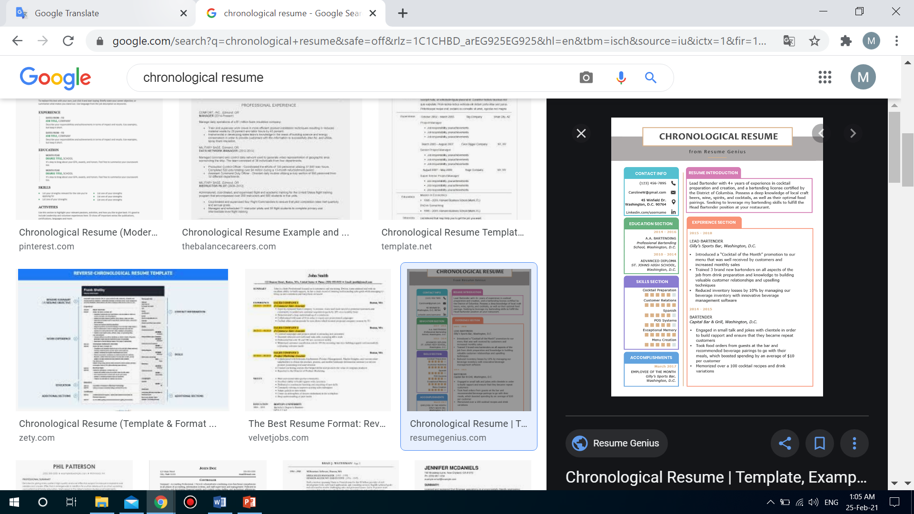
Types Résumé
Stage Three: Applying Résumés
Chronological
www.midocean.ae

Slide 22
Stage Three: Applying Résumés
Types Résumé
Functional (skill-based)
This functional résumé emphasizes skills and attributes that can be applied to a variety of employment situations.
Your skills are broken down into categories that quickly communicate to employers what you can do for them.
This format is useful for candidates without direct employment-related experience or for those who wish to work in fields unrelated to their academic major.
www.midocean.ae

Slide 23
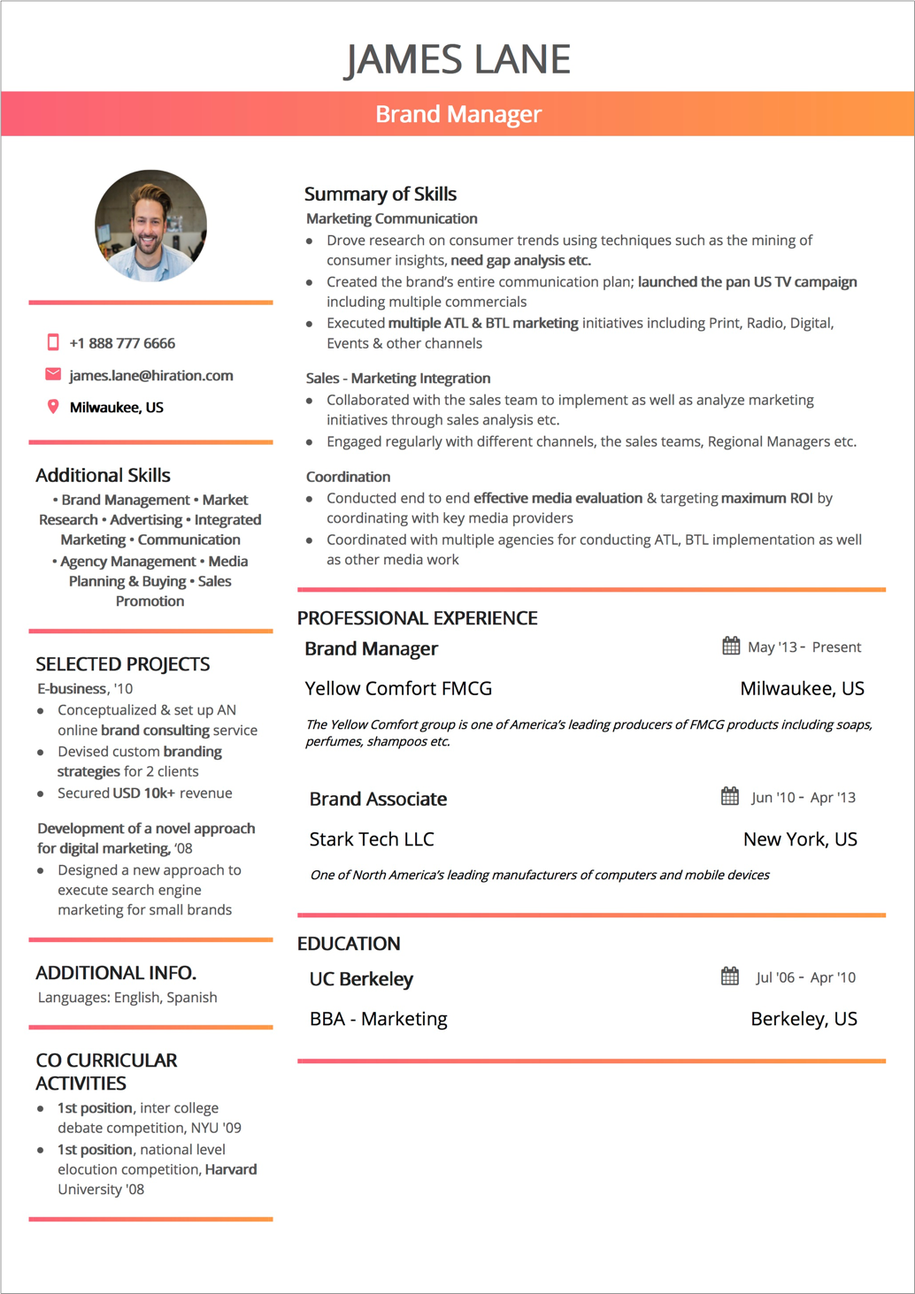
Stage Three: Applying Résumés
Types Résumé
Functional (skill-based)
www.midocean.ae

Slide 24
Stage Three: Applying Résumés
Types Résumé
Combination
For many candidates, a combination of elements from the chronological and functional résumé formats works best.
www.midocean.ae

Slide 25
Stage Three: Applying Résumés
Section of Résumé
Contact information
Begin your generic résumé by listing your contact information.
You should include your name, address, phone number, and e-mail address.
You should make certain the address you provide will be valid throughout your job search. Believe it or not, many prospective job seekers are taken out of the running due to problems with their contact information.
www.midocean.ae

Slide 26
Stage Three: Applying Résumés
Section of Résumé
Contact information
An e-mail address such as “partygirl2010” is going to land your résumé in the trash. Addresses like these are unprofessional as well.
Choose an e-mail address related to your name, and be certain to check your e-mail account regularly.
It’s also important to make sure there is nothing in cyberspace that you would not want your future employer to see. What comes up when you “Google” your name? What information can be found on your Facebook and Instagram accounts? If you think prospective employers don’t bother to check these sites, you’re wrong. Not only do employers use Google and Yahoo to run background checks on potential employees; they also check Facebook, Twitter, and other forms of social media.
www.midocean.ae

Slide 27
Stage Three: Applying Résumés
Section of Résumé
Objective and summary
An objective is a one- or two-sentence declarative statement about your career goals.
The benefit of including an objective is debatable. Some people argue it can be beneficial and has been a résumé standard for years.
Others argue that since the objective is clear (to obtain the position), there is no need to waste space stating the obvious. Many résumés have moved away from the objective to a summary of skills and traits.
www.midocean.ae

Slide 28
Stage Three: Applying Résumés
Section of Résumé
Objective and summary
Example 1:
Highly motivated individual and a certified digital marketer with strong SEO and SEM skills, attention to detail, and a solid online marketing background looking to obtain a position of SEO Specialist with XYZ company.
Example 2:
An MBA with specialization in online marketing, working knowledge of Google Analytics and Adwords, and 4 years experience in developing and managing marketing campaigns seek the role of Online Marketing Manager with ABC Inc. to provide thought leadership and implement best practices for digital marketing.
www.midocean.ae

Slide 29
Stage Three: Applying Résumés
Section of Résumé
Education
If you’re a recent college graduate, your education is, in all likelihood, the most important thing you want future employers to consider, So your education section should be displayed prominently.
Include the name of any college or university from which you have graduated or that you are currently attending.
Don’t list high school education or high school accomplishments.
List the name of your degree and your major (e.g., bachelor of science in biology).
www.midocean.ae

Slide 30

Stage Three: Applying Résumés
Section of Résumé
Education
You may also wish to state a minor if you have one. Include the date of graduation.
You may also wish to list some relevant courses. For the purposes of the generic résumé, list all the courses you think may be relevant during your job-seeking process.
If your GPA is a 3.0 or higher, include it.
You can narrow the list during the customizing step.
www.midocean.ae

Slide 31
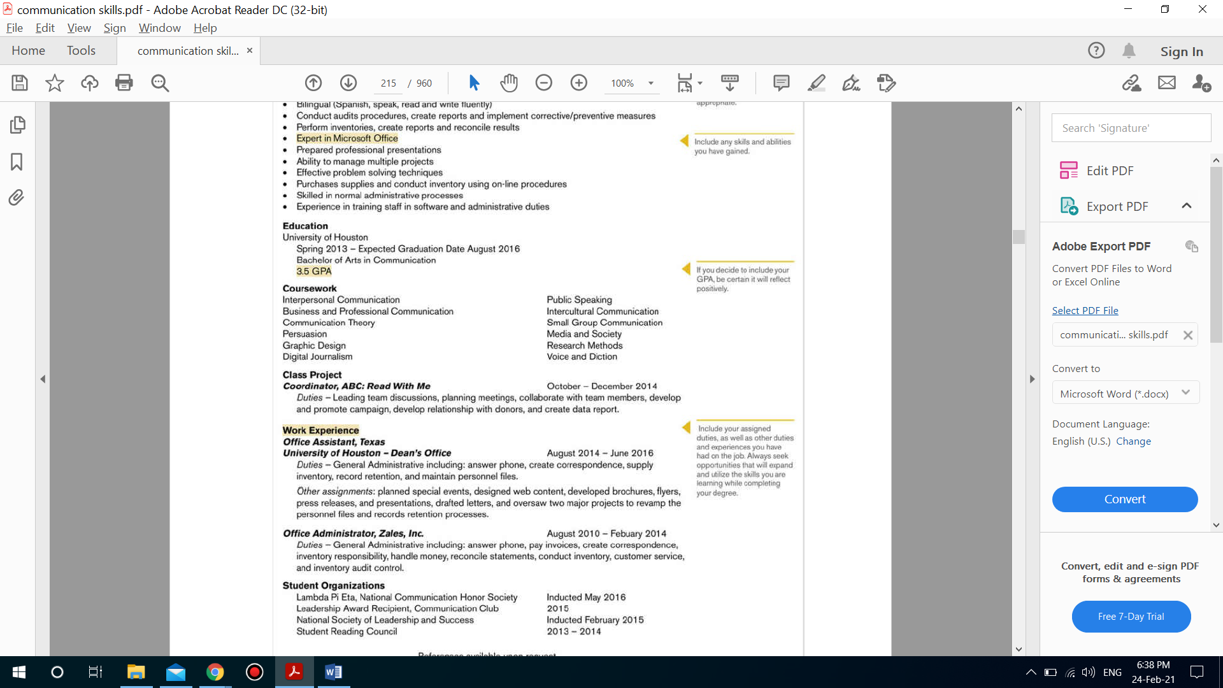
Stage Three: Applying Résumés
Section of Résumé
Education
www.midocean.ae

Slide 32
Stage Three: Applying Résumés
Section of Résumé
Experience
A section on experience is a standard part of the résumé.
As you advance in your career, you will most likely label this section as employment experience, which will take precedence over your education.
Yet, for most college graduates, including relevant experience, not just employment experience, is more beneficial. Using the general title “Relevant Experience” allows you to incorporate a broader range of information.
www.midocean.ae

Slide 33
Stage Three: Applying Résumés
Section of Résumé
Experience
In this section, you can list the following:
Relevant employment history
Relevant class projects
Internships
Relevant work
Volunteering
www.midocean.ae

Slide 34
Stage Three: Applying Résumés
Section of Résumé
Skills
Hard skills,
are those of your skills that you’ve acquired through deliberate effort. They can be learned, taught, and measured. Examples of hard skills include English, Spanish, HTML, copywriting, data analysis, SEO, SEM, and others.
Soft skills,
on the other hand, are closely tied to one’s personality traits. They arise from your previous experiences and the environment you grew up in. These could be your leadership, communication, or other interpersonal skills. Examples of soft skills include: problem-solving, negotiating, multitasking, time management, presenting, and others.
www.midocean.ae

Slide 35
Stage Three: Applying Résumés
Section of Résumé
Employment Experience
If you’ve been lucky enough to work at a job that’s relevant to the position you’re seeking, prominently display that experience and your job duties. For most college graduates, however, this will not be the case.
In this situation, list the class projects, your internship, and your work with the Sociology Club under “Relevant Experience,” as previously discussed. Give some details about each experience
Then you can simply list your places of employment, job titles, and employment dates later in the résumé in a section titled “Employment Experience,” “Employment History,” or “Work History.”
www.midocean.ae

Slide 36
Stage Three: Applying Résumés
Section of Résumé
Employment Experience
If your work history is not directly related to the position you are pursuing,
list the place of employment, job title, employment dates, and some skills you acquired at this job. Even if the job is not directly related to your career, you likely gained or honed some skill(s) that will make you a more appealing applicant.
www.midocean.ae

Slide 37
Stage Three: Applying Résumés
Section of Résumé
Awards
Include an awards and honors section only if you have multiple listings and they are relevant to the position.
If you have Academic awards and honors.
Hobbies
As for hobbies, do not put a hobbies and interests section in your résumé. If you do have a hobby or interest directly relevant to the position, work it into your résumé as a skill or experience. Otherwise, leave it out.
www.midocean.ae

Slide 38
Stage Three: Applying Résumés
Section of Résumé
References
References should not be listed on your résumé. You can make a note about references at the bottom of the page (e.g., “References available on request”)
www.midocean.ae

Slide 39
Stage Three: Applying Résumés
How to Customize your Résumé
Begin with the generic résumé you have already developed.
Identifying the information that is most relevant to this position.
During the first round of cuts, delete all the information that is not relevant to the position.
If the remaining information does not fit on two pages, go back and eliminate the information that is least relevant to the position.
www.midocean.ae

Slide 40
Stage Three: Applying Résumés
Creating visual Appeal
Although résumés can come in a variety of different forms, all résumés should be visually appealing and utilize a parallel structure.
In terms of visual appeal, you need to include:
A balance between text and white space. Too much white space indicates a lack of qualifications. On the flip side, too much information jammed on a page does not make you look more qualified. Instead, it makes your résumé difficult to read, which makes you less appealing.
Remember, a résumé is a snapshot. You can’t include every detail of your life, so make sure to include the information that is most relevant to this position at this organization.
www.midocean.ae

Slide 41
Stage Three: Applying Résumés
Creating visual Appeal
In terms of visual appeal, you need to include:
The font you select for the text of the résumé should be 12 point—no less than 11 point if you need more space—for easy reading.
When selecting a font, you want to stick with standard fonts such as Arial, Helvetica, and Times New Roman to ensure easy electronic transfer.
As for parallel structure, decide on a heading system, and keep it consistent throughout the résumé. If your first major heading is bold, 14 point, and all capitals, then all major headings should be bold, 14 point, and all capitals.
www.midocean.ae

Slide 42
Stage Three: Applying Résumés
Creating visual Appeal
In terms of visual appeal, you need to include:
The use of a parallel structure can also be applied to your word choices. For example, when listing your duties/work experience, use active verbs. In addition, you may utilize a list of bulleted duties/skills.
Whichever format you select, remember to use that format throughout that section of the résumé.
It’s also critical to edit résumés, applications, and cover letters carefully.
Make it a habit to check, double-check, and triple-check.
Spelling errors seem to jump off the page at potential employers. If you want to be considered for an interview, your résumé can contain no spelling errors.
www.midocean.ae

Slide 43
Stage Three: Applying Résumés
Developing Electronic and Scannable Résumés and Online
Applications Back in the day, résumés and cover letters were either mailed or hand-delivered to organizations. Today, organizations are requesting that résumés be submitted electronically or that the information traditionally found in a résumé be submitted via an online application.
When it comes to submitting electronic or scannable résumés, you must take into your consecration the following:
Electronic résumés should be prepared in common programs, such as Microsoft Word.
Scannable résumés should be simplistic; so avoid any decorative fonts or graphics.
For electronic applications, you’ll most likely be cutting information from your résumé and pasting it into the application. the information presented should still be concise and relevant.
www.midocean.ae

Slide 44
Section Two
www.midocean.ae

Slide 45
Interviewing
Before
www.midocean.ae

Slide 46
Interviewing
Although securing an interview is an exciting milestone in the job-seeking process, you’re still several steps away from being hired. To land the position, you must do two important tasks:
Preparing
Practicing
www.midocean.ae

Slide 47
Interviewing
Message
Preparing
Appearance
Bad news
“YOU CAN NOT KNOW ALL THE QUESTIONS”.
Good news
WE CAN GUESS CORRECTLEY
www.midocean.ae

Slide 48
Interviewing
Preparing your Message
What should you know to prepare your message?
Your résumé and cover letter.
Your skills
The qualifications you have
The job posting
The company info
The qualifications the job requires
In the end, you should be ready to discuss specific examples, stories, and experiences that are relevant to the position.
www.midocean.ae

Slide 49
Interviewing
Preparing your Message
Anticipating Questions
You can never be 100% certain about what’s going to be asked during the interview, but you can make some educated guesses.
Be certain to practice both behavioral questions and traditional questions. Behavioral questions explore how you have handled past situations and ask you to respond to hypothetical situations.
www.midocean.ae

Slide 50
Interviewing
Preparing your Message
Traditional questions include some of the old standards listed below:
Tell me a little about yourself.
Why did you apply for this position?
What are your strengths? What are your weaknesses?
What are three words that describe you?
What makes you qualified for this position? Why should we hire you?
What are your short-term goals? What are your long-term goals?
Do you have any questions for us?
www.midocean.ae

Slide 51
Interviewing
Preparing your Message
Scripting Answers
The purpose of practicing is not to guess the exact questions that will be asked—it’s to learn to professionally present important information about your qualifications for the position and your fit in the organization.
Criteria of Scripting Answers
Directly answer the question.
Back up your answer with a specific example, that supports your answer.
Connect the answer back to the company and/or the position.
www.midocean.ae

Slide 52
Interviewing
Preparing your Appearance
Clothes
Your interviewing attire is in a sense a uniform that identifies you as a professional. The main piece in an interviewing uniform is the standard business suit.
For men, that suit includes a jacket and pants.
For women, it includes a jacket and skirt. Many female students question the necessity of wearing a skirt. For better or worse, even in the 21st century, the standard interviewing uniform for women is the suit with a skirt.
www.midocean.ae

Slide 53

Interviewing
Preparing your Appearance
Colors
Black, dark gray or dark blue.
Brands
Interviewers do not expect to see new college graduates in expensive, designer-label suits, nor do they expect to see them in ill-fitting suits. When purchasing your suit, the fit is extremely important.
www.midocean.ae

Slide 54
Interviewing
Preparing your Appearance
Shoes & Socks
Jewelry
Shoes should be black. Shocks should be dark, over-the-calf dress socks that correspond with the outfit.
Both men and women should carry a briefcase, portfolio, or some sort of professional bag. Under no circumstances is it acceptable to carry your backpack.
Jewelry
For women, the rule of thumb for women is no more than five pieces of jewelry. Those five pieces consist of a watch, a pair of earrings (counts as two pieces), a necklace, and a wedding/engagement ring. The earrings should be small posts, and the necklace should be very simple.
For men, Men should keep a two-piece rule in mind for jewelry: one watch, as long as it appears professional with the suit, and one ring, such as a wedding band.
www.midocean.ae

Slide 55
Interviewing
Practicing Answers
Mock
Reading questions and thinking through the answers is an effective way to begin practicing, but to be fully prepared, you must take part in mock interviews. Enlist the help of family members and friends to run through questions with you. Have different people take different approaches to the interview. Have some mock interviewers smile and give you a lot of feedback. Have others be stern and cold and provide little feedback.
www.midocean.ae

Slide 56
Interviewing
Practicing Answers
Video Recording
Prepare for your mock interview video just as you would prepare for a real interview.
Think through the questions you are likely to be asked, and prepare answers for them.
Bring all the energy to your mock interview video you would bring to a real one.
The second you enter the room to sit down before the camera recording your mock interview, your interview has begun. Focus on making a good impression in the way you greet your interviewer and shake her hand, take your seat, present your resume and respond to questions. Ignore the camera completely, and avoid looking directly at it. Instead focus all your energy and attention on your interviewer.
www.midocean.ae

Slide 57
Interviewing
Practicing Answers
Video Recording
Watch your mock interview video
The value of a recorded mock interview is that you get to see yourself through neutral eyes. Start by turning down the audio on your video and just watch yourself. Take a look at what you're wearing, and see if it looks as good when you're sitting down as it did when you looked at yourself standing before your bathroom mirror.
www.midocean.ae

Slide 58
Interviewing
During
www.midocean.ae

Slide 59
Interviewing
Once you arrived,
Arrive for the interview at least 10 minutes early.
Treat everyone from the parking attendant to the receptionist to the CEO with the same level of professionalism and respect.
While you wait,
The way you sit in the lobby, the way you greet the receptionist and the interviewer, and the way you wait, will all have an impact on whether you are going to be considered for the job. Be friendly and pleasant, but not overbearing. If you need to wait, sit quietly (no phone calls) and patiently.
Once you meet the interviewer,
Shake hands with the interviewer. Your handshake should be firm - not sticky or wimpy.
www.midocean.ae

Slide 60
Interviewing
Once you enter the room,
Your Posture:
When you take your seat, be sure to sit up straight and avoid slouching.
You can lean forward a little to show your interest. The goal here is to appear natural, confident, and enthusiastic.
Avoid any body language that could be construed as showing disinterest or desperation.
Don’t lean back (you’ll look too relaxed or lethargic) or fidget (you’ll look nervous or immature) and don’t invade your interviewer’s personal space (you’ll look like a stalker).
Keep the social space (4 to 12 feet), which is the distance at which we usually talk to strangers or conduct business.
www.midocean.ae

Slide 61
Interviewing
Once you enter the room,
Your hands and feet
Keep your feet on the floor and your hands positioned naturally. If you’re not sure what to do with your hands, keep them folded loosely in your lap or on the tabletop.
Your eye contact
Maintain eye contact in a natural way. Just don’t stare fixedly at your interviewer. That can seem creepy or robotic. Listen carefully and smile and nod as appropriate.
At the end of the interview,
Once the interview is over, when you thank your interviewer politely for her time, shake her hand professionally and smile. On your way out, say goodbye to the receptionist or anyone else you spoke to during the interview.
www.midocean.ae

Slide 62
Interviewing
Questions,
Illegal Questions.
According to the Civil Rights Act, employers may not consider race, color, religion, sex, national origin, disability, or age when hiring or promoting employees. Therefore, they legally can’t ask questions related to these categories.
If you faced this situation, what should you do?
First, you answer their questions
Second, you answer the question and then ask why that question was asked at the first place.
Third, you just simply tell them that it is illegal to ask such questions or how this question can be related to the job posting?
www.midocean.ae

Slide 63
Interviewing
Questions,
Salary Questions.
Although you should never bring up the issue of salary prior to being offered the position, you should be prepared in case the interviewer asks about your salary expectations.
To prepare, you need to:
Research the appropriate pay for the position you are seeking. Be sure to examine pay-scale variations related to credentials, experience, and location.
How to answer?
Diplomatic answer: “I expect a salary that is competitive in this market.”
Specific answer: give a range starting with the employer’s probable salary and ending with a little above what you are willing to accept.
www.midocean.ae

Slide 64
Interviewing
Types of interview
Face-to-face interviews
Face-to-face interviews also come in a variety of formats, which include the following:
The standard one on-one interview,
Panel interviews,
Interviews with multiple interviewees.
A series of one-on-one interviews,
The same rules that apply in the standard one-on-one interview apply in each of these settings, but keep a few things in mind for each context.
www.midocean.ae

Slide 65
Interviewing
Types of interview
Face-to-face interviews
Take care of,
In a series of one-on-one interviews, you may feel as though you are repeating yourself. But remember, each interviewer is hearing your information for the first time, so not only it is okay to repeat yourself, it is necessary.
In a panel of interviewers, always acknowledge the person who asks the question but address your answer to (and make eye contact with) the entire group when responding.
In an interview with other interviewees, always treat your competition with respect and professionalism. The way you treat the other candidates is indeed part of how you will be assessed.
www.midocean.ae

Slide 66
Interviewing
Types of interview
Zoom interviews
Use the mute button
Keeping yourself on mute as they speak can help your interviewer feel more focused on what they want to tell you.
Look into the camera while speaking
Maintaining eye contact with your interviewer is a sign of confidence and respect. Look into the camera as you are speaking. This creates the illusion that you are looking at them rather than yourself or the screen.
Choose a professional background
Choose an area that is tidy and free of clutter. Make sure your background is sparse rather than busy and only has professional-looking items in the background. Setting up in front of a blank wall or a few tasteful decorations shows that you are organized and pay attention to detail.
www.midocean.ae

Slide 67
Interviewing
Types of interview
Zoom interviews
Find a brightly lit room
Setting your interview space facing a window that lets in a lot of natural lighting is a great way to make yourself more visible. Your interviewer needs to be able to see your body language and facial expressions during your Zoom interview.
Silence your phone
Before your Zoom interview, silence your phone and put it away. This way, you can focus on the interview rather than a text message or phone call.
Find a good internet connection
Test out your connection where you plan to sit during your interview. Moreover, make sure you are connected to the internet during the interview.
www.midocean.ae

Slide 68
Interviewing
Types of interview
Zoom interviews
Use appropriate body language
One benefit of using video chat rather than a phone call is that you get to see each other's body language. During your interview, sit up tall with your hands in your lap and your feet on the floor. While you speak, you may use your hands as well if that's natural for you. As your interviewer speaks, use nonverbal cues such as nodding and smiling to show that you are listening.
Ask your interviewer questions
Make sure to listen throughout your interview so you only ask questions about topics the interviewer hasn't covered yet. Appropriate questions could be about the company's culture, this role's responsibilities or what the interviewer enjoys most about the company.
www.midocean.ae

Slide 69
Following-up
www.midocean.ae

Slide 70
Following-up
Thank you email
Your first step should be to send a thank you email to the interviewers within two days of the interview.
Following up email
You should send a follow up email in case you have never heard from the company within 14 days of the interview.
Here are a few pointers:
Address the person you are emailing by their first name
Mention the job title of the role you're following up about and the date you interviewed to refresh their memory
Confirm that you're still interested in the position and that you are eager to hear about next steps
Finally, ask for an update
www.midocean.ae

Slide 71
Negotiating
www.midocean.ae

Slide 72
Negotiation
Definition
Negotiation skills refers to the ability to bring about agreement on a decision through discussion, so as to achieve win-win situation.
Before you negotiate, you need to:
Research salary norms, as well as benefits and other perks, for the industry, the region, and this organization.
Evaluate the offer by taking into account the entire compensation package, not just the salary.
www.midocean.ae

Slide 73
Negotiation
How to Negotiate?
Help them understand why you deserve what you’re requesting.
It’s not enough for them to like you. They also have to believe you’re worth the offer you want. Never let your proposal speak for itself—always tell the story that goes with it.
Make it clear they can get you.
People won’t want to expend political or social capital to get approval for a strong or improved offer if they suspect that at the end of the day, you’re still going to say, “No, thanks.” If you intend to negotiate for a better package, make it clear that you’re serious about working for this employer.
Understand the person across the table.
Companies don’t negotiate; people do. And before you can influence the person sitting opposite you, you have to understand her. What are her interests and individual concerns?
www.midocean.ae

Slide 74
Negotiation
How to Negotiate?
Understand their constraints.
They may like you. They may think you deserve everything you want. But they still may not give it to you. Why? Because they may have certain ironclad constraints, such as salary caps, that no amount of negotiation can loosen. Your job is to figure out where they’re flexible and where they’re not.
Be prepared for tough questions.
Many job candidates have been hit with difficult questions they were hoping not to face: Do you have any other offers? If we make you an offer tomorrow, will you say yes? Are we your top choice? If you’re unprepared, you might say something inelegantly evasive or, worse, untrue. My advice is to never lie in a negotiation.
Pick the most important issues to Negotiate.
Don’t simply mention all the things you want—A, B, C, and D; also signal the relative importance of each to you. Otherwise, may pick the two things you value least, because they’re pretty easy to give you, and feel like meeting you halfway.
www.midocean.ae

Slide 75
Negotiation
How to Negotiate?
Consider the whole deal.
Sadly, to many people, “negotiating a job offer” and “negotiating a salary” are synonymous. But much of your satisfaction from the job will come from other factors you can negotiate—perhaps even more easily than salary. Focus on the value of the entire deal: responsibilities, location, travel, flexibility in work hours, opportunities for growth and promotion, perks, support for continued education, and so forth.
www.midocean.ae

Slide 76
Negotiation
Remember
What’s not negotiable today may be negotiable tomorrow.
Leave a good impression even if you declined the offer
www.midocean.ae

Slide 77



Thank You

