Slide 1
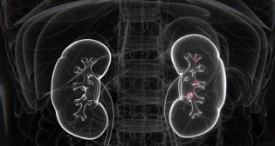
Thesis Defense
Deep Learning for Detection and Classification of Kidney Tumors and Cancer
Presented By:
Faisal Almokayed
ID No. 253001589
Supervisor:
Dr. Mohamed Eassa
Midocean University . College of Informatics . Comoros
Meshaal Almutairi
ID No. 252000278

Slide 2
Agenda
01
Introduction
02
06
Methodology
Problem Statement
07
Results and Discussion
03
Related Work
04
08
Conclusion and Future Work
Research Gap
05
Objectives

Slide 3
01 Introduction

Slide 4



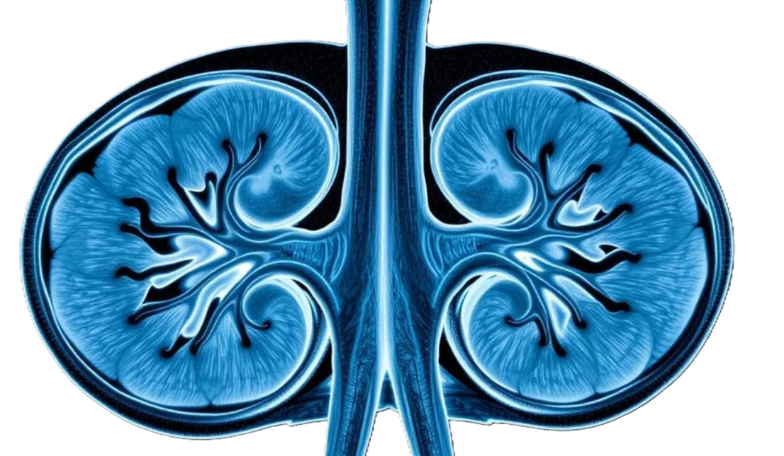
Introduction
Kidney Tumors Global concerns
434,840
155,953
~ 90%
14th
New kidney cancer cases worldwide in 2022
Deaths attributed to kidney cancer in 2022
of kidney malignancies are renal cell carcinoma
most frequent cancer globally (10th in men)
Predicted burden by 2050
+72% in new cases
+96% in deaths
Diagnostic capacity is not expected to grow at the same rate. Early detection improves survival, which is the core case for automated detection and classification.

Slide 5
02 Problem Statement

Slide 6
Problem Statement
1
Diagnostic Challenges
2
Clinical Burden
3
Accurate Subtype Classification
Diagnosis and classification remain difficult.
Manual interpretation of CT images is subject to errors.
Tumor subtypes often appear visually similar with blurry boundaries and overlapping characteristics.
Small renal masses (SRMs) are especially hard to differentiate between cystic, benign, and malignant lesions.
Raises radiologists' workload and fatigue-related mistakes.
Multi-phase CT interpretation introduces inter-observer variability.
Limited access to skilled radiologists in low-resource regions delays diagnosis.
Correct identification for tumor subtype is essential for treatment.
Aggressive subtypes require immediate intervention, while others need just monitoring.
Manual diagnostic workflows frequently depend on invasive confirmation methods, adding complexity and potential risk to the process.

Slide 7
03 Related Work

Slide 8
Related Work
Fifteen Recent Studies on Kidney CT Classification (1 of 2)
Author | Technique Used | Accuracy | Key Notes | Limitations
Islam et al. (2022) | VGG-16, ResNet-50, Swin Transformer | 96% ResNet50; 99.30% (Swin) | Compared multiple backbones on the same task | Lower accuracy for plain ResNet-50; no attention mechanism used
Bhandari et al. (2023) | Lightweight custom CNN + LIME + SHAP explainability | 99.52% | Lightweight design with built-in explainability (LIME/SHAP) | Custom CNN with limited depth; single dataset evaluation
Bingol et al. (2023) | 29-layer CNN + Relief feature selection | 99.37% | Used feature selection to reduce redundant CNN features | Relies on hand crafted feature selection; no attention-based refinement
Qian. (2025) | DenseNet121 (standard, no augmentation) | 93.51% | Baseline DenseNet121 without augmentation or class balancing | Lower accuracy; susceptible to class imbalance, no augmentation
Almuayqil et al. (2024) | KidneyNet (8-layer custom CNN) | 99.88% / 99.92% | Lightweight custom CNN tailored to the same Kaggle dataset | Shallow 8-layer architecture; limited capacity for complex cases

Slide 9
Related Work
Fifteen Recent Studies on Kidney CT Classification (2 of 2)
Author | Technique Used | Accuracy | Key Notes | Limitations
Pimpalkar et al. (2025) | VGG16, ResNet50, InceptionV3 with hyperparameter optimization | 99.96% | Hyperparameter optimized ensemble of three pretrained CNNs | Higher computational cost from multi-model optimization
Obaid et al. (2025) | DarkNet53 + multi-model ensemble fusion | 99.69% | DarkNet53 backbone fused with an ensemble of models | Ensemble approach increases inference complexity and resource needs
El-Hag et al. (2025) | EfficientNet-B2 + specular free preprocessing | 98.27% | Added specular-free preprocessing stage before EfficientNet-B2 | Lower accuracy than CBAM based models; preprocessing adds overhead
Maçin et al. (2025) | KidneyNeXt (depthwise separable CNN, | 99.96% | Depthwise separable convolutions for a lightweight footprint | Trade off between efficiency and fine-grained discriminative power
Khan et al. (2025) | ConvNeXt + EfficientNetV2B0 + selective data trimming | 99.73% | Combined ConvNeXt and EfficientNetV2B0 with selective data trimming | Data trimming may discard informative borderline samples

Slide 10
04 Research Gap

Slide 11
Research Gap
1
Focused mainly on binary classification, not multi-class kidney CT classification.
2
Models lack multi-phase CT integration and fail across imaging variations.
3
Most approaches provide limited explainability which may reduce clinical trust.
4
No prior work combines CBAM attention, focal loss, and Grad-CAM for multi-class
kidney CT classification.

Slide 12
05 Objectives

Slide 13
Project Objectives and Contribution
Overall aim: to develop and evaluate a deep learning system that automatically detects and classifies kidney abnormalities on CT images, improving diagnostic efficiency, accuracy and support for early intervention.
01
Develop an attention-based deep learning framework that extracts richer features from Kidney CT images and localizes abnormal regions.
02
Deliver multi-class classification capability that separates normal tissue from cyst, stone and tumor, underlining subtype clinical significance.
03
Assess the framework against different evaluation metrics like accuracy, sensitivity, specificity, F1-score and area under the ROC curve.
04
Explainability through Grad-CAM visualizations, which supports radiologist trust andadoption.
05
Offering a practical AI tool that can reduce radiologist workload and support kidney cancer management domain.

Slide 14
06 Methodology

Slide 15
The Proposed Framework Overview
01
Input Acquisition: CT kidney images (Normal, Cyst, Tumor, Stone) in JPEG from Kaggle dataset.
02
Preprocessing Pipeline: RGB conversion, CLAHE, Resizing, Normalization.
03
Stratified Data and Data Augmentation: Flip, Rotation, Random brightness, Resized crop, and Cutout.
04
Feature Extraction: Each model extracts features from CT images separately (ResNet50, EfficientNetB4 and MobileNetV3).
05
Attention Module: CBAM channel and spatial attention to keep focus on relevant kidney regions.
06
Classification Head and Output: Linear, ReLU, Fully connected layer, classification (4 classes: Normal, Cyst, Tumor, or Stone).

Slide 16
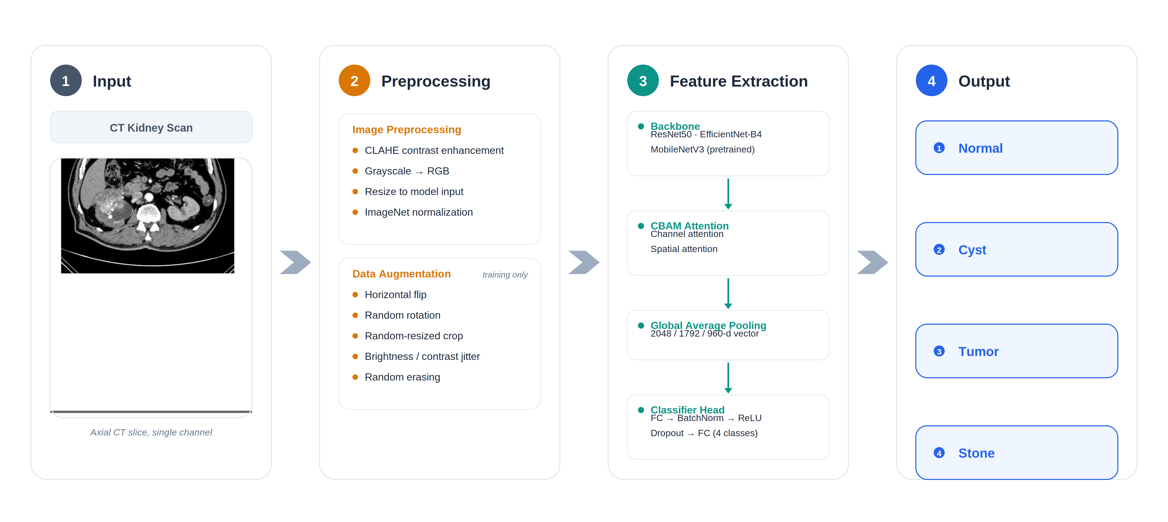
The Proposed Classification Framework Overview
Proposed kidney CT image classification framework

Slide 17
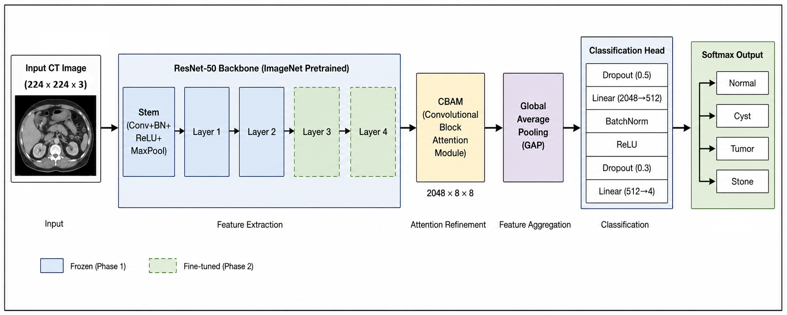
The Proposed Framework ResNet50 Overview

Slide 18
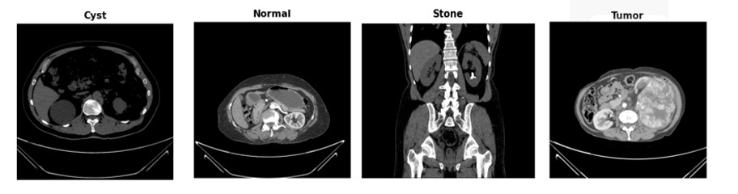
Dataset
Kaggle CT KIDNEY DATASET - 12,446 Images
Class | Number of Images | % Dataset | Description
Normal | 5,077 | 40.8% | Healthy kidney; no lesions or calcifications
Cyst | 3,709 | 29.8% | Fluid-filled renal cysts of varying size
Tumor | 2,283 | 18.3% | Solid renal masses including Renal Cell Carcinoma (RCC) subtypes
Stone | 1,377 | 11.1% | Calcified hyperattenuating lesions; smallest class
Total | 12,446 | 100% | Mixed axial and coronal CT acquisitions

Slide 19
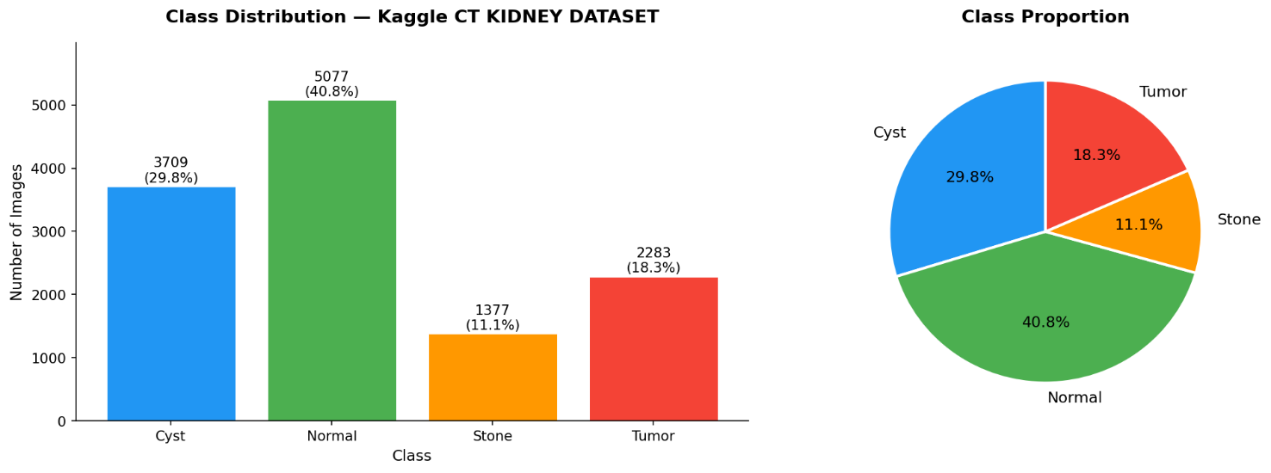
Class Distribution and Imbalance Problem
3.7 : 1
Stratified splitting preserves this distribution across the training, validation and test subsets, so reported test performance reflects a realistically imbalanced population rather than an artificially balanced one.
Ratio between the largest class (Normal, 5,077) and the smallest (Stone, 1,377)
Why this matters
Training minimizes total loss by favoring the majority Normal class.
The Stone class is most at risk.
This imbalance mirrors real radiology practice, so it is considered rather than removed
Addressed with class weights (inverse frequency), and focal loss (γ = 2.0).
Per-class distribution of the CT KIDNEY DATASET

Slide 20
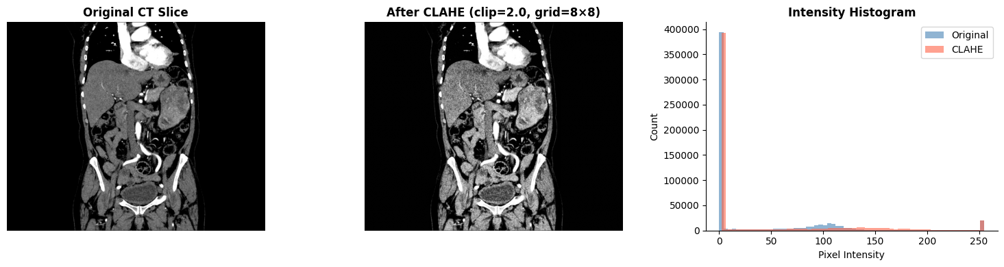
Preprocessing
Four Stages Preprocessing Pipeline
01
02
03
04
Grayscale to RGB
CLAHE enhancement
Resizing
Normalization
Single channel CT values are duplicated across three channels so ImageNet pre-trained backbones can be reused.
Contrast Limited Adaptive Histogram Equalization, clip limit 2.0 and 8×8 tile grid, improves visibility of small lesions and stones.
Bilinear resizing to 380×380 for EfficientNet-B4 and 224×224 for ResNet-50 and MobileNetV3.
Pixel intensities are normalised with ImageNet mean and standard deviation values.
Sample images before and after CLAHE

Slide 21
Dataset Split (Stratified 70 / 10 / 20)
8,712
1,244
2,490
The dataset was stratified and divided into
70% Training set: Used to learn model parameters.
10% Validation set: Used for hyperparameter tuning and monitoring overfitting.
20% Testing set: Used for final, unbiased performance evaluation.
Training set
Validation set
Test set
Subset | Cyst | Normal | Stone | Tumor
Training | 2,596 | 3,554 | 964 | 1,598
Validation | 371 | 507 | 138 | 228
Test | 742 | 1,016 | 275 | 457
Stratification preserves the original class proportions in every subset, so no class is over or under represented in evaluation.

Slide 22
Data Augmentation
Augmentation applied to the training set only
Augmentation technique | Parameters
Random horizontal flip | p = 0.5
Random rotation | ±15°
Random brightness / contrast jitter | factor 0.2
Random resized crop | scale 0.85 – 1.0
Random erasing (Cutout) | p = 0.1, scale 0.02 – 0.1

Slide 23
Three Backbones Under an Identical Pipeline
PROPOSED
COMPARATIVE
LIGHTWEIGHT
ResNet-50 + CBAM
Input 224 × 224
Params ~ 25.6 M
EfficientNet-B4 + CBAM
Input 380 × 380
Params ~19 M
MobileNetV3 + CBAM
Input 224 × 224
Params ~5.4 M
50 layers bottleneck residual network
Skip connections solve vanishing gradients
Stages up to 3 frozen; stage 4 + head fine-tuned
Best accuracy and training stability
Compound scaling of depth, width, resolution
MBConv stages 0 to 6 frozen; 7 and 8 fine-tuned
Highest input resolution of the three
Depthwise separable convolutions
Hard swish activations, squeeze and excitation
Fastest inference, smallest footprint
Weakest on the minority Stone class
All three share the same preprocessing, augmentation, CBAM placement and classification head, so differences in performance are attributable to the backbone alone.

Slide 24
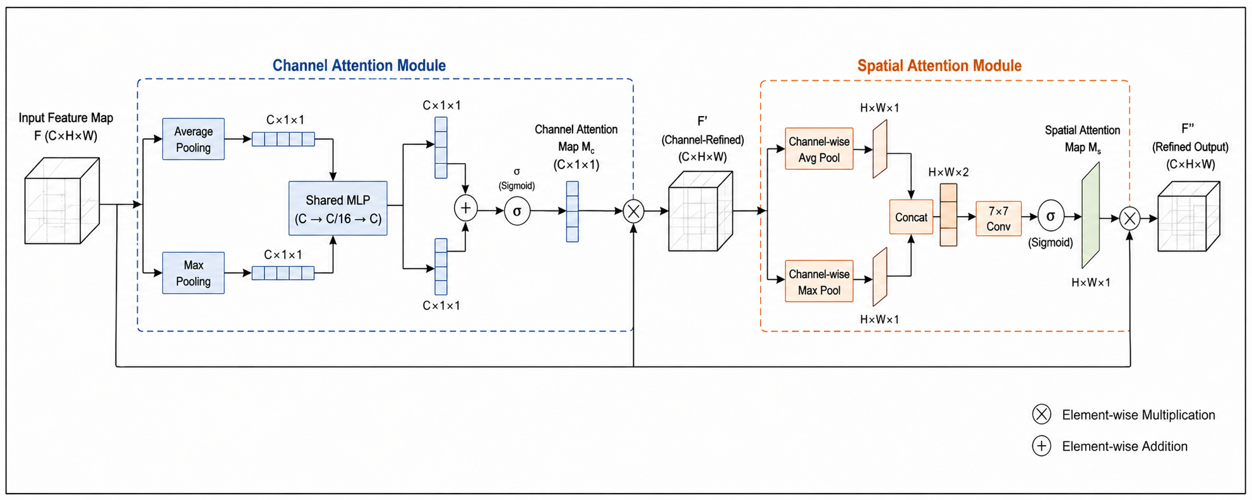
CBAM Attention Module
Channel Attention (What to Look At)
Learns which feature channels are important.
Highlights meaningful patterns (edges, textures, intensities).
Suppresses irrelevant channels.
Produces a channel attention map.
Spatial Attention (Where to Look)
Learns where the important regions are in the image.
Focuses on tumor boundaries, cyst walls, stone hyperattenuation.
Produces a spatial attention map.
CBAM adds Channel Attention and Spatial Attention to the backbone.
Helps the model focus on clinically relevant kidney regions.
Suppresses background noise and irrelevant structures.
Enhances feature localization for tumors, cyst walls, and stones.
Improves multi-class classification accuracy and reduces false positives.
CBAM adds under 2% extra parameters and stays end to end trainable.
CBAM attention module

Slide 25
Training Strategy
Hyperparameter | Value
Input size for EfficientNet-B4 | 380 × 380 px
Input size for ResNet-50 / MobileNetV3 | 224 × 224 px
Batch size | 32
Initial learning rate | 1 × 10⁻⁴
Optimizer | AdamW
Weight decay (L2) | 1 × 10⁻⁵
LR scheduler | Cosine annealing w/ warm restarts
Dropout (head layers 1 / 2) | 0.50 / 0.30
FC hidden dimension | 512
Focal loss gamma (γ) | 2.0
Class weight strategy | Inverse frequency
PHASE 1: 5 to 10 EPOCHS
Frozen backbone warm-up
The backbone is frozen while only the CBAM block and the custom classifier head train, letting the new layers adapt without disturbing the pretrained ImageNet filters.
PHASE 2: UP TO 40 EPOCHS
Joint fine tuning
Last 2 top layers / blocks unfrozen alongside CBAM and the head, trained jointly at a lower learning rate after a 5 epoch linear warm up.
Early stopping monitors validation loss with a patience of 8 epochs; the checkpoint with the lowest validation loss is the one evaluated on the test set.
Training hyperparameters

Slide 26
Experimental Environment
01
Programming environment: Python 3.10, PyTorch 2.1.0, Torchvision 0.16.0, OpenCV 4.8.0 for CLAHE preprocessing, scikit-learn 1.3.0 for evaluation metrics, and Grad-CAM visualizations via pytorch-grad-cam 1.4.8.
02
Hardware configuration: NVIDIA A100 80 GB GPU, CUDA 12.1 with cuDNN 8.9, running in a Kaggle Notebook environment with 30 GB RAM.
03
Training runtime: batch size 32, 50 total epochs, approximately 1 hour 30 minutes of wall-clock training time.
04
Reproducibility: fixed random seeds (seed = 42) applied to Python, NumPy, and PyTorch; all checkpoints, logs, and Grad-CAM outputs are stored for full reproducibility.

Slide 27
07 Results and Discussion

Slide 28
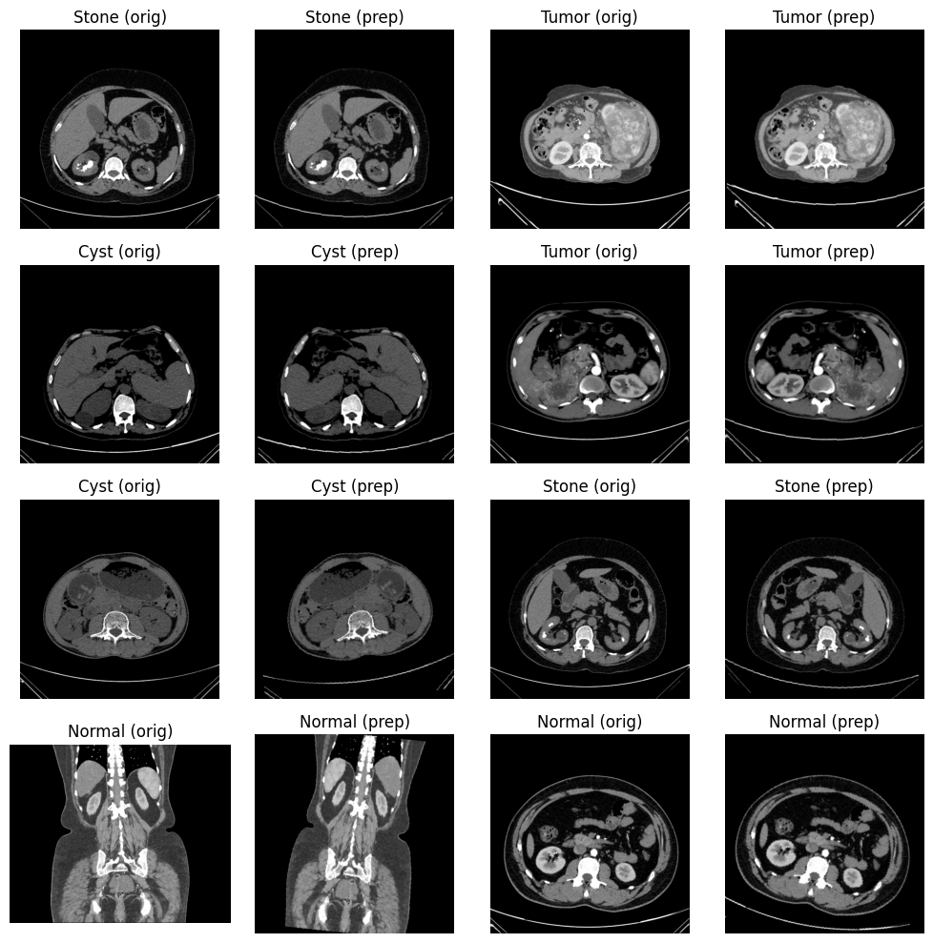
Preprocessing Results
What preprocessing achieves
Heterogeneous source resolutions are standardized to a single input size
Local contrast enhancement makes low-density lesions and small stones visible
Intensity statistics are aligned with the ImageNet distribution the backbones expect
Clean, consistent inputs reduce the burden on the network to learn away acquisition noise
12,446
380² / 224²
images processed
standardised input sizes
2.0
8 × 8
CLAHE clip limit
CLAHE tile grid
Sample images before and after preprocessing
24

Slide 29
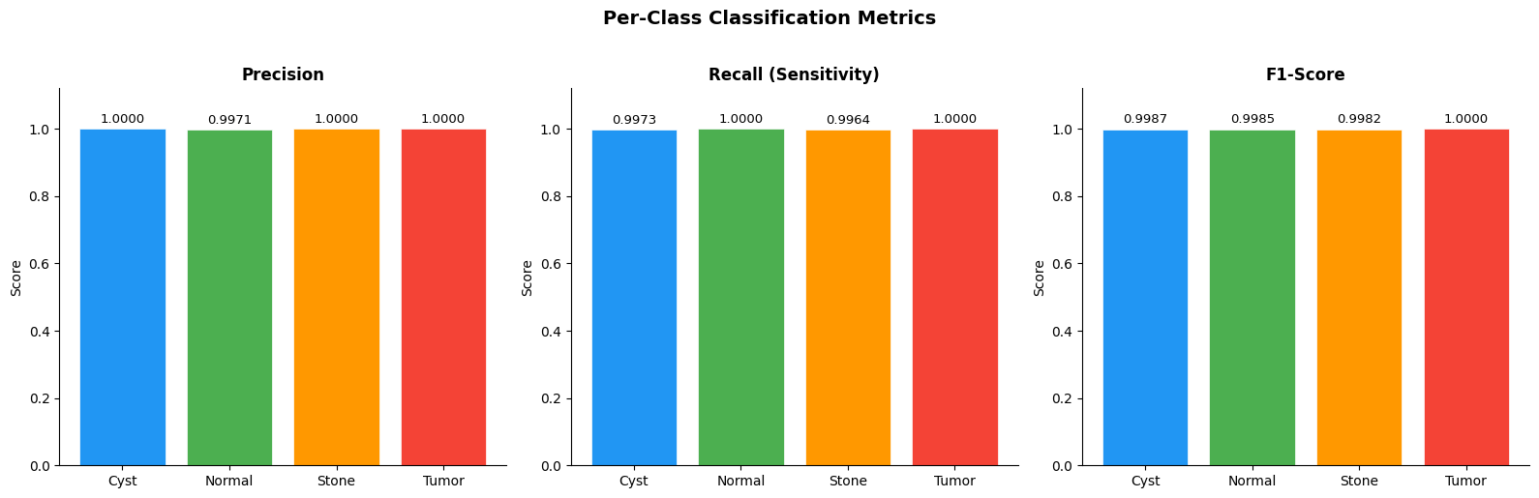
ResNet-50 with CBAM Results
Per-Class Classification Metrics
Class | Precision | Recall | F1-score | Support
Cyst | 1.0000 | 0.9973 | 0.9987 | 742
Normal | 0.9971 | 1.0000 | 0.9985 | 1,016
Stone | 1.0000 | 0.9964 | 0.9982 | 275
Tumor | 1.0000 | 1.0000 | 1.0000 | 457
Accuracy | - | - | 0.9988 | 2,490
Macro avg | 0.9993 | 0.9984 | 0.9988 | 2,490
Weighted avg | 0.9988 | 0.9988 | 0.9988 | 2,490
99.88%
Overall test accuracy
0.9988
Macro F1-score
1.0000
Macro AUC-ROC
Tumor class: perfect precision, recall and F1. No tumour case was missed and none falsely flagged, the most clinically consequential outcome.

Slide 30
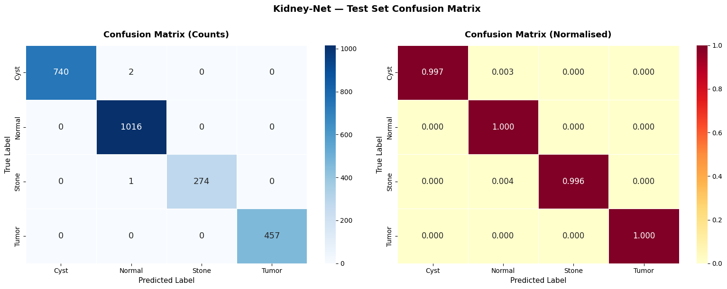
ResNet-50 with CBAM Results
Confusion Matrix
Reading the matrix
Near perfect diagonal dominance across all four classes
Only three errors in 2,490 test images
All three errors fall towards Normal a conservative failure direction
Zero false negatives for Tumor, the clinically critical requirement
Confusion matrix (absolute counts and row-normalised)
Normal
Tumor
Cyst
Stone
1,016 / 1,016
457 / 457
740 / 742
274 / 275
No misclassification at all
Perfect discrimination of malignant cases
2 cases confused with Normal
1 case confused with Normal

Slide 31
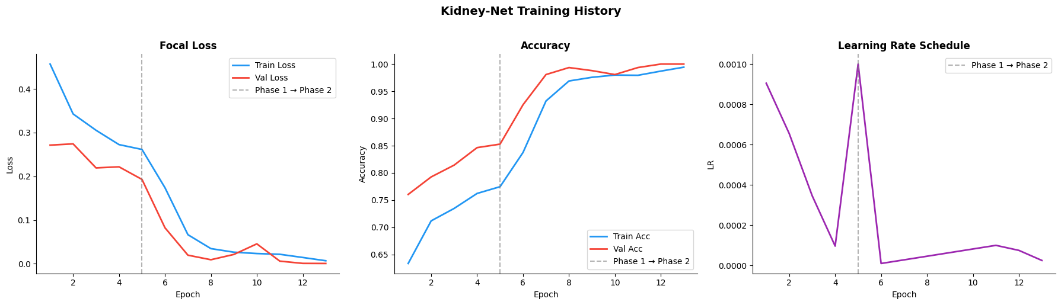
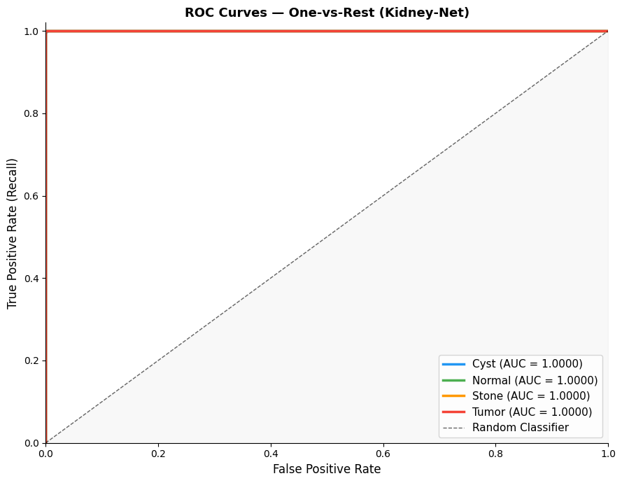
ResNet-50 with CBAM Results
Training Convergence and ROC Analysis
Training history: focal loss, accuracy and learning-rate schedule
Convergence behavior
Focal loss falls steadily on both training and validation curves.
Minimal train validation divergence: no overfitting signature.
Warm-up followed by cosine decay visible in the LR schedule.
Best validation loss of 0.0006 at the selected checkpoint.
Per-class ROC (one-vs-rest)
AUC = 1.0000
All four curves hug the top-left corner. Cyst and Stone normally the hardest pair to separate radiographically, are also perfectly separable in the learned feature space, direct evidence that CBAM refinement is doing useful work.
Per-class ROC curves
27

Slide 32

EfficientNet-B4 with CBAM
Per-Class Metrics
Class | Precision | Recall | F1-score | Support
Cyst | 0.9959 | 0.9811 | 0.9885 | 742
Normal | 0.9980 | 0.9764 | 0.9871 | 1,016
Stone | 0.9223 | 0.9927 | 0.9562 | 275
Tumor | 0.9723 | 0.9978 | 0.9849 | 457
Accuracy | - | - | 0.9835 | 2,490
Macro avg | 0.9721 | 0.9870 | 0.9792 | 2,490
Weighted avg | 0.9843 | 0.9835 | 0.9837 | 2,490
Confusion matrix, EfficientNet-B4 and CBAM
Summary
Overall accuracy 98.35%, macro F1 0.9792
Macro AUC-ROC 0.9997, excellent separability despite lower accuracy
Misclassification concentrated in the Normal class drifting toward Cyst, Stone and Tumor
Highest computational cost per image of the three models
Stone precision drops to 0.9223, the weakest cell in the table. Despite the highest input resolution (380 × 380), EfficientNet-B4 over predicts the Stone class, generating false positives that ResNet-50 avoids entirely.

Slide 33
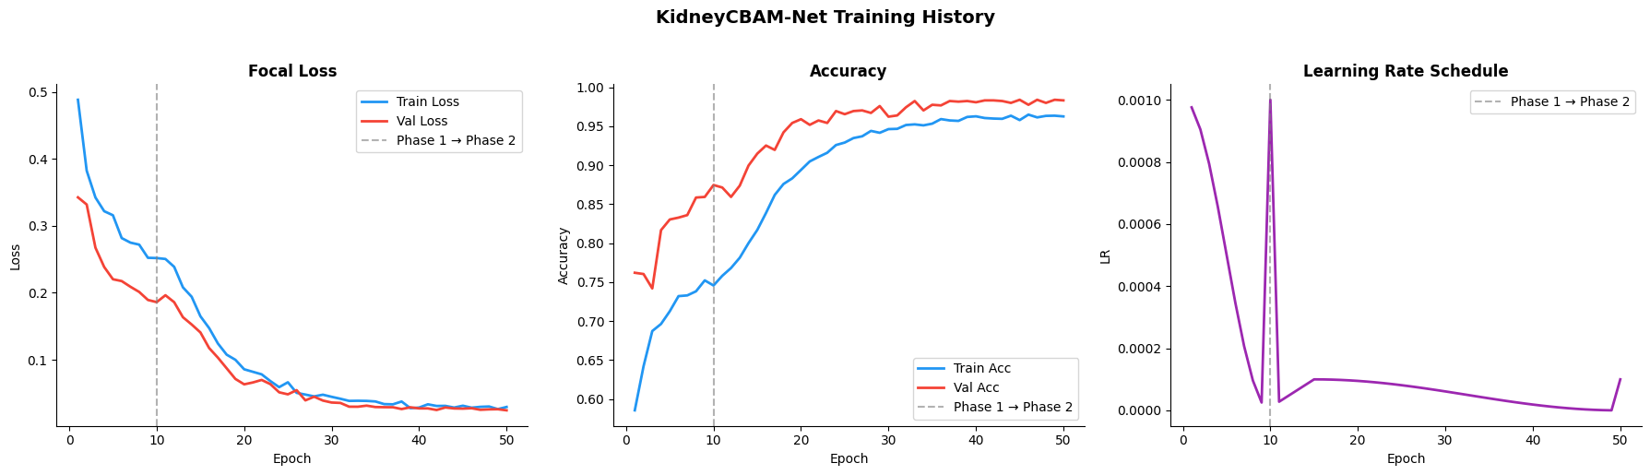
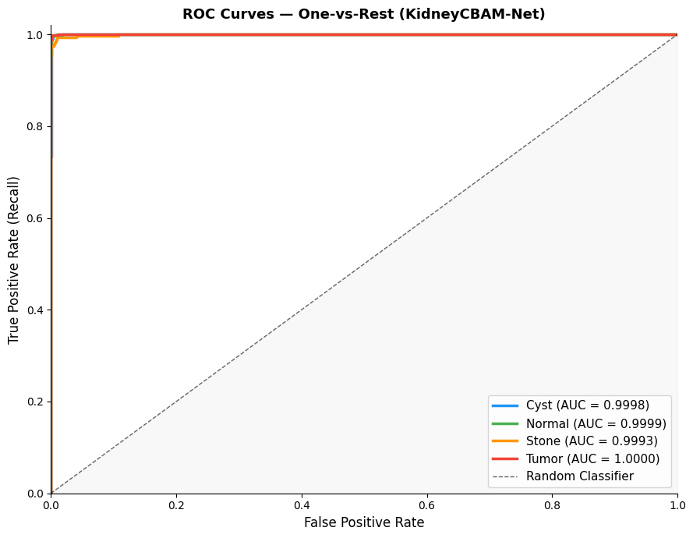
EfficientNet-B4 with CBAM
Convergence and ROC
Training history for the EfficientNet-B4 + CBAM model
Convergence behaviour
Per-class ROC (one-vs-rest)
Focal loss decreases on both training and validation sets
Accuracy rises with minimal divergence between the two curves
Efficient learning without an overfitting signature
Best validation loss of 0.0318, the highest of the three models
AUC > 0.9993
Near-perfect AUC for all four classes, with a macro AUC of 0.9997. Separability in the feature space is excellent even though the decision thresholds produce more misclassification than ResNet-50.
Per-class ROC curves

Slide 34

MobileNetV3 with CBAM
Per-Class Metrics
Class | Precision | Recall | F1-score | Support
Cyst | 0.9973 | 0.9865 | 0.9919 | 742
Normal | 1.0000 | 0.9833 | 0.9916 | 1,016
Stone | 0.9786 | 0.9964 | 0.9874 | 275
Tumor | 0.9560 | 0.9978 | 0.9764 | 457
Accuracy | - | - | 0.9884 | 2,490
Macro avg | 0.9830 | 0.9910 | 0.9868 | 2,490
Weighted avg | 0.9887 | 0.9884 | 0.9884 | 2,490
Confusion matrix, MobileNetV3 + CBAM
Summary
Per-class metrics for MobileNetV3 + CBAM
Overall accuracy 98.84%, macro F1 0.9868
Macro AUC-ROC 0.9998 with only ~5.4 M parameters
Correct counts: Cyst 732, Normal 999, Stone 274, Tumor 456
The strongest candidate for edge or resource-constrained deployment
Tumor precision falls to 0.9560, a lightweight backbone flags non tumor tissue as tumour more often. Recall stays high at 0.9978, so the trade off is extra false alarms rather than missed cancers.

Slide 35
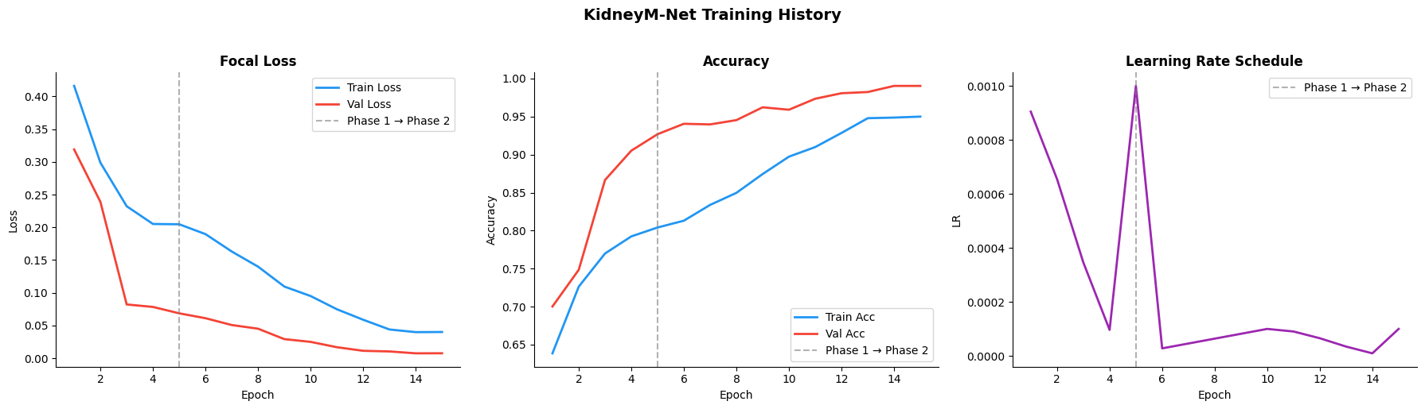

MobileNetV3 with CBAM
Convergence and ROC
Training history for the MobileNetV3 + CBAM model
Convergence behaviour
Per-class ROC (one-vs-rest)
Stable convergence on both training and validation curves
No overfitting despite the far smaller parameter budget
Best validation loss of 0.0075 between ResNet-50 and EfficientNet-B4
Fastest wall clock training and inference of the three models
AUC > 0.9994
A macro AUC of 0.9998 from a 5.4 M-parameter network is the strongest argument in this thesis for edge deployment: near-identical separability at roughly one-fifth the model size.
Per-class ROC curves

Slide 36
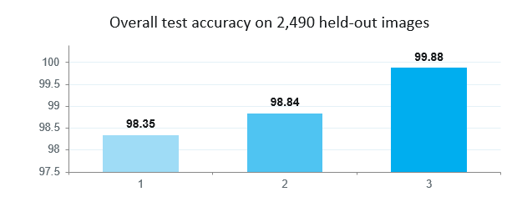
Models Comparison
Which Backbone Wins, and Why
Interpretation
ResNet-50 wins on every metric despite the lowest input resolution (224 × 224) representational power, not pixel count, drives performance here
Best validation loss differs by two orders of magnitude (0.0006 vs 0.0318), indicating a far better-conditioned optimum
EfficientNet-B4 (~19 M params) gains nothing from its 380 × 380 input on this task
MobileNetV3 (~5.4 M params) is the efficiency winner but its shallow features limit fine cyst versus tumor discrimination
CBAM compatibility is strong for ResNet-50 and EfficientNet-B4, moderate for MobileNetV3's lightweight structure
Model | Accuracy | Macro F1 | Best val loss | Macro AUC
EfficientNet-B4 + CBAM | 98.35% | 0.9794 | 0.0318 | 0.9997
MobileNetV3 + CBAM | 98.84% | 0.9868 | 0.0075 | 0.9998
ResNet-50 + CBAM | 99.88% | 0.9988 | 0.0006 | 1.0000
Selected: ResNet-50 and CBAM; best accuracy / stability / clinical reliability trade-off
Comparison of deep learning models for kidney CT classification
32

Slide 37
Proposed Framework Against Related Work
Author | Technique used | Accuracy
Qian | DenseNet121 (no augmentation) | 93.51%
Islam et al. | VGG-16 / ResNet-50 / Swin Transformer | 96.00% – 99.30%
El-Hag et al. | EfficientNet-B2 + specular-free preprocessing | 98.27%
Bingol et al. | 29-layer CNN + Relief feature selection | 99.37%
Bhandari et al. | Lightweight CNN + LIME + SHAP | 99.52%
Obaid et al. | DarkNet53 + ensemble fusion | 99.69%
Khan et al. | ConvNeXt + EfficientNetV2B0 (6.2 M params) | 99.73%
Almuayqil et al. | KidneyNet (8-layer custom CNN) | 99.88%
Maçin et al. | KidneyNeXt (depthwise separable CNN) | 99.96%
Pimpalkar et al. | VGG16 / ResNet50 / InceptionV3 + HPO | 99.96%
Proposed methodology | ResNet-50 + CBAM, class-weighted focal loss, Grad-CAM | 99.88%
Comparative analysis with related classification work

Slide 38
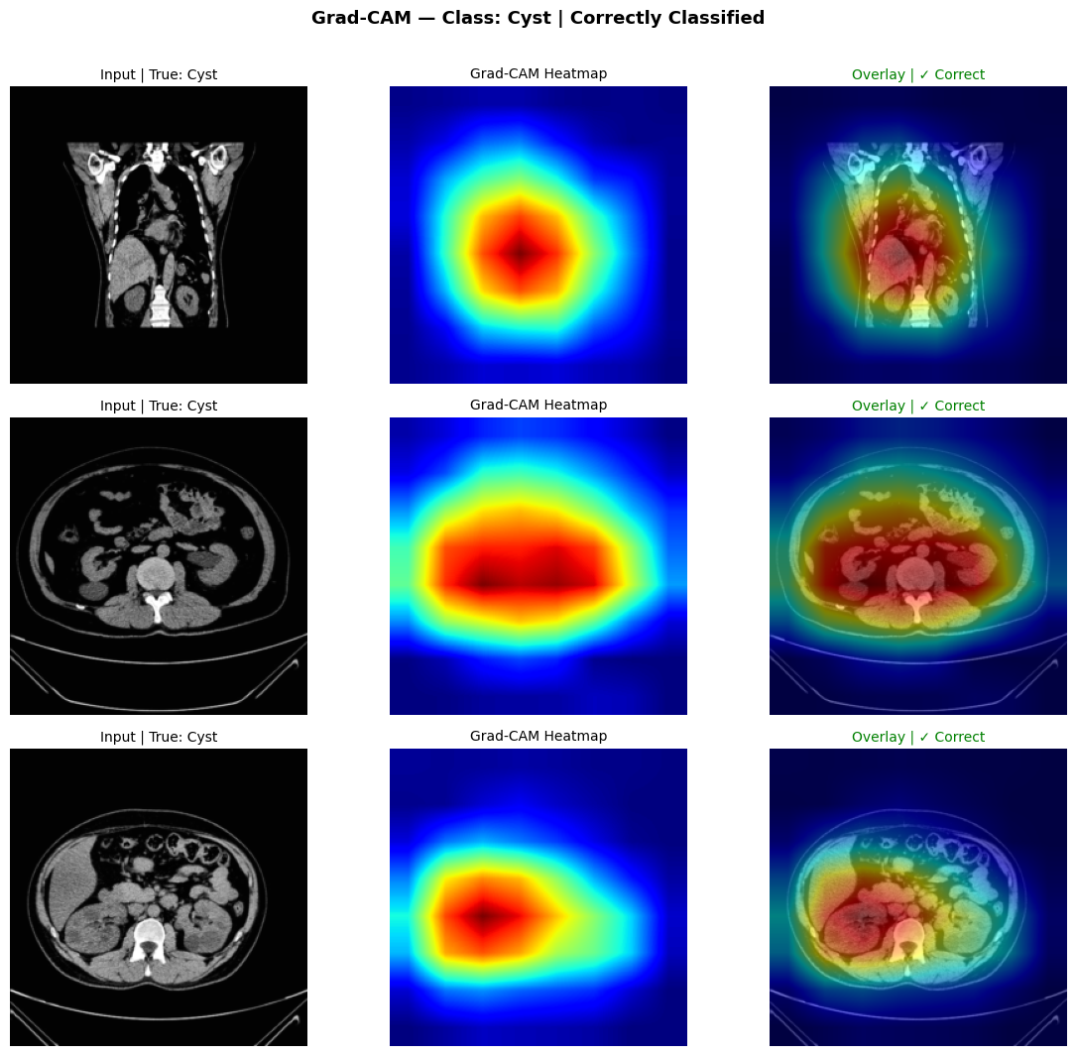
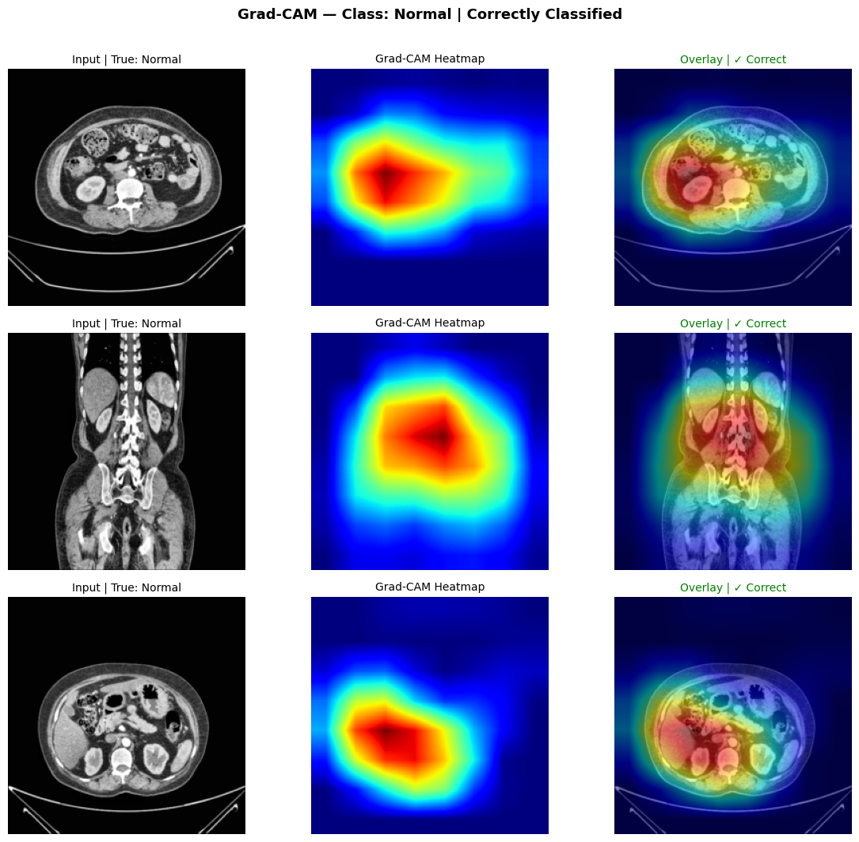
Grad-CAM
What the Model Actually Looks At
Reading the heat maps
Red and yellow regions drove the prediction; blue regions were effectively ignored
High activation consistently clusters on renal lesion borders
Background tissue and image artefacts receive little weight
Every displayed sample is labelled "Correct" in the overlay
Confirms CBAM is steering the network toward the radiological region of interest
Grad-CAM activation maps: Cyst and Normal classes
Why this matters to the committee: Grad-CAM converts a high accuracy number into clinical evidence. It demonstrates the model is learning pathological features rather than dataset shortcuts, the precondition for any decision-support tool a radiologist would trust.

Slide 39
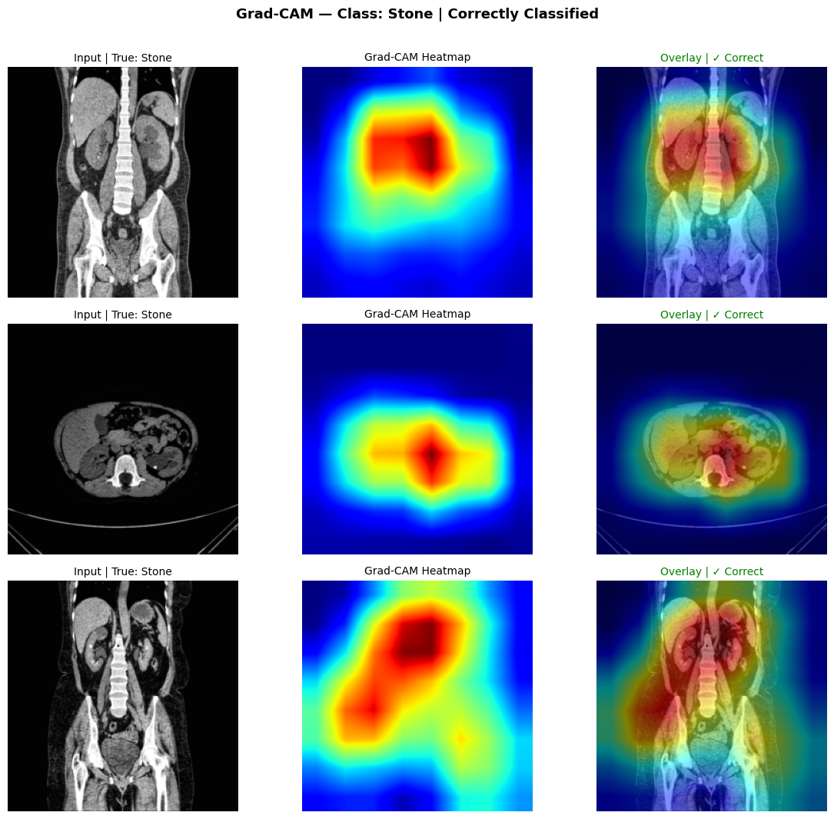
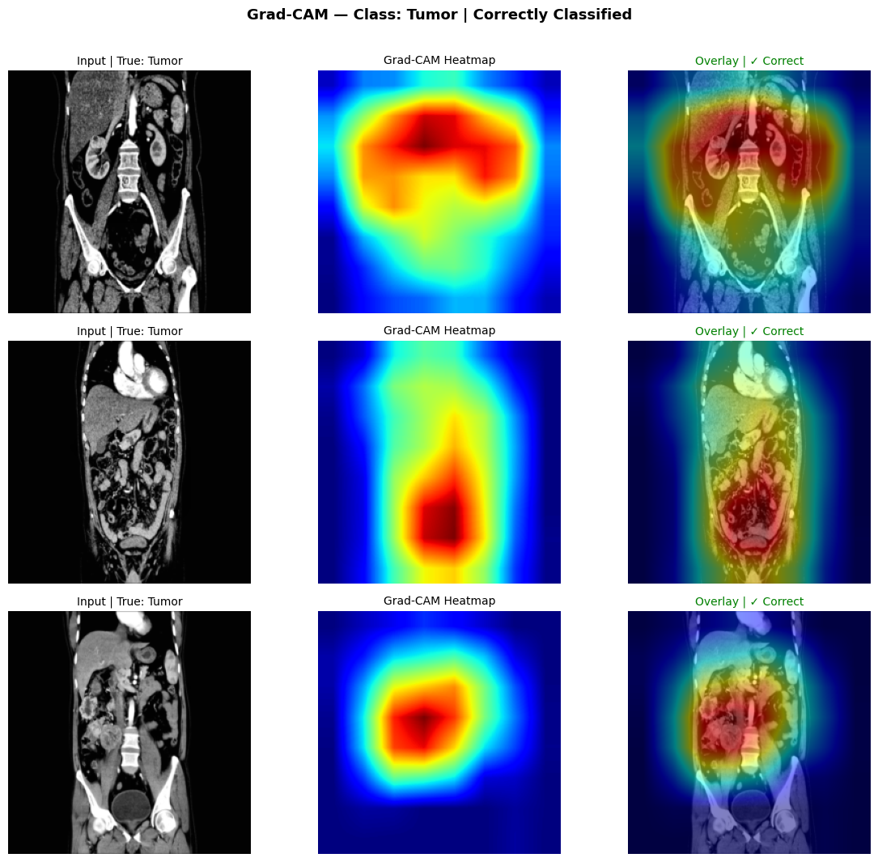
Grad-CAM
Across the Pathological Classes
The two classes that matter most
Stone: activation concentrates tightly on the hyperattenuating calcification, not on surrounding bone
Tumor: activation spreads over the solid mass and its margin, matching how a radiologist assesses a lesion
These are the minority and the clinically critical class respectively
Consistent, lesion-centred attention across both supports the claim that high accuracy is not a dataset artefact
Grad-CAM activation maps: Stone and Tumor classes
Grad-CAM was generated for all four classes on correctly classified samples. Activation aligned with radiological structures in every case, which the thesis presents as evidence of transparency, interpretability and clinical trustworthiness for a real decision-support deployment.

Slide 40
Discussion
1
Attention drives the gain
2
Near-perfect separability
3
Imbalance handled, not hidden
CBAM refines features toward diagnostically relevant regions, which is precisely what separates visually similar classes such as cyst versus tumour where intensity differences are small.
A macro AUC of 1.0000 across all four one-vs-rest curves indicates the learned feature space separates classes cleanly, not merely that a threshold happened to be well placed.
Macro F1 (0.9988) equals weighted F1 (0.9988), so the score is not being propped up by the majority Normal class.
4
Simplicity beats complexity
5
Interpretability is built in
!
The main caveat
Comparable or better performance than ensembles, transformer stacks and hybrid CNNs, using a single standard backbone plus a lightweight attention block.
Grad-CAM is native to the architecture rather than a bolt-on, so explanations cost no additional inference pipeline.
All results come from one public dataset. Scanner variation, acquisition protocols and patient demographics in real clinical practice remain untested.

Slide 41
08 Conclusion and Future Work

Slide 42
Conclusion
This thesis developed and validated an automatic deep learning system for detecting and classifying kidney abnormalities on CT images across four clinically relevant classes.
1
A complete, reproducible pipeline
CLAHE-based enhancement, normalisation, resizing, stratified augmentation and a stratified 70/10/20 split delivered clean, consistent inputs to every model.
2
A controlled three-model comparison
ResNet-50, EfficientNet-B4 and MobileNetV3 were trained under identical conditions, making performance differences attributable to architecture alone.
3
Top performance from ResNet-50 + CBAM
99.88% accuracy, macro F1 0.9988, Cohen's Kappa 0.9983 and macro AUC-ROC 1.0000, with zero false negatives on the Tumor class.
4
Demonstrated interpretability
Grad-CAM confirmed that predictions rest on renal lesions rather than background artefacts, supporting clinical trustworthiness.
5
Competitive with the state of the art
Performance matches or exceeds recent published work on the same benchmark while keeping the architecture simple and efficient.
Overall, combining residual learning with attention yields a kidney CT classification system that is simultaneously accurate, stable and explainable, well suited to assisting radiologists and reducing unnecessary clinical interventions.

Slide 43
Limitations and Future Work
ACKNOWLEDGED LIMITATIONS
FUTURE WORK
Single public dataset, no multi-centre or multi-scanner validation
1
Multi centre validation
Validate on clinical data from multiple institutions to establish real generalisation.
Cropped, pre-isolated kidney images rather than whole-abdomen clinical slices
2
Multi-phase CT
Extend the system to arterial, venous and delayed phases for richer enhancement information.
Four-class labels only; RCC subtypes (clear cell, papillary, chromophobe) are not separated
3
Segmentation integration
Add a U-Net-style branch to localise and delineate lesions, not only classify them.
Classification without lesion localisation or burden quantification
4
Clinical decision support
Deploy inside a real CDSS and evaluate impact on radiologist workflow and reporting time.
No prospective evaluation against radiologist reads or inference-latency testing
5
Hybrid transformer designs
Investigate CNN transformer hybrids for further gains in fine-grained discrimination.

Slide 44

Thank You
Faisal Almokayed
253001589@st.midocean.edu.km
Meshaal Almutairi
252000278@st.midocean.edu.km

