Slide 1

Organizational Behavior
Prepared by Dr. Walid K. El Leithy
Lecture 4
ORG 123
Organizational Behavior

Slide 2

Chapter
04
Motivation Concepts and Applications
This chapter will enable you to:
Describe the key elements of motivation.
Identify four early theories of motivation and evaluate their applicability today.
Compare contemporary theories of motivation.
Identify the motivational theories of equity and expectancy.

Slide 3
Chapter
04
Motivation Concepts and Applications
5. Describe the job characteristics model and evaluate the way it motivates by changing the work environment.
Compare and contrast the main ways jobs can be redesigned.
Identify alternative work arrangements and employee involvement measures and show how they might motivate employees.

Slide 4
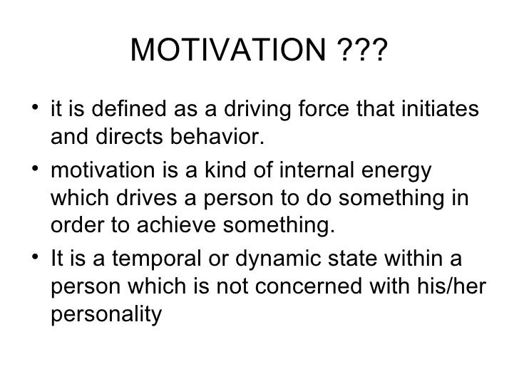
Chapter
04
Defining Motivation

Slide 5
Chapter
04
Defining Motivation
Motivation is the processes that account for an individual’s intensity, direction, and persistence of effort toward attaining a goal—specifically, an organizational goal.
Three key elements:
  Intensity: how hard a person tries.
  Direction: effort that is channeled
  toward, and consistent with,
  organizational goals.
  Persistence: how long a person
  can maintain effort.

Slide 6
Chapter
04
Early Theories of Motivation
These early theories may not be valid, but they do form the basis for contemporary theories and are still used by practicing managers:
  Maslow’s Hierarchy of Needs Theory
  Alderfer’s ERG (Existence, Relatedness, and Growth)
  McGregor’s Theory X and Theory Y
  McClelland’s Theory of Needs

Slide 7

Chapter
04
Maslow’s Hierarchy of Needs

Slide 8
Chapter
04
Maslow’s Hierarchy of Needs
Physiological needs: Air, water, food, shelter, sleep, clothing.
Safety needs: Personal security, employment
Social needs: Love and belonging, family, sense of connection.
Esteem needs: Respect, self esteem, status, recognition.
Self Actualization needs: Drive to become the most that one can be.

Slide 9
Chapter
04
Maslow’s Hierarchy of Needs
Level of human needs | Applying it to Business
Physiological | Acceptable pay and working conditions
Safety | Job security/ clear job role and description / health and safety protection/ insurance
Social | Working in teams
Esteem | Status/ job title/Authority/trust/ recognition for achievement
Self actualization | Promotion opportunities/ challenging work/ job enrichment

Slide 10
Chapter
04
Alderfer’s ERG Theory
A reworking of Maslow to fit empirical research.
Three groups of core needs:
  Existence (Maslow: physiological and safety)
  Relatedness (Maslow: social and status)
  Growth (Maslow: esteem and self-actualization)
  Removed the hierarchical assumption.
    Can be motivated by all three at once.
  Popular, but not accurate, theory.

Slide 11
Chapter
04
McGregor’s Theory X and Theory Y
Two distinct views of human beings: Theory X (basically negative) and Theory Y (positive).
  Managers that were studied used a set of assumptions based on their view.
  The assumptions molded their behavior toward employees.
Theory X
Workers have little ambition
Dislike work
Theory Y
Workers are self-directed
Enjoy work
Avoid responsibility
Accept responsibility

Slide 12
Chapter
04
McClelland’s Four Needs Theory
The American psychologist David McClelland studied the way in which people satisfy their needs. What motivates people and what motivators are learned? According to David McClelland, people have motivating drivers that are directly linked to need regardless of age, gender, culture or race. As a result of the McClelland Motivation Theory, David McClelland identified four types of motivational need:
Need for Achievement (nAch)
  The drive to excel, to achieve in relation to a set of standards, to strive to succeed.
Need for Power (nPow)
  The need to make others behave in a way that they would not have behaved otherwise.

Slide 13
Chapter
04
McClelland’s Four Needs Theory
Need for Affiliation (nAff)
The desire for friendly and close interpersonal relationships.
People have varying levels of each of the three needs. Hard to measure.
Need for avoidance
People have fear of failure, fear of rejection and even fear of success. By avoiding situations that may trigger these fears, they think to have found a safe solution.

Slide 14
Chapter
04
Performance Predictions for High nAch
People with a high need for achievement are likely to:
  prefer to undertake activities with a 50/50 chance of success, avoiding very low- or high-risk situations;
  be motivated in jobs that offer high degree of personal responsibility, feedback, and moderate risk;
  not necessarily make good managers—too personal a focus (most good general managers do NOT have a high nAch);
  need high level of nPow and low nAff for managerial success.
Good research support, but it is not a very practical theory.

Slide 15
Chapter
04
HERZBERG’S TWO-FACTOR THEORY
Frederick Herzberg’s well known Two-Factor Theory was designed in year 1959. Based on two hundred engineers and accountant feedback collected in the USA regarding their personal feelings towards their working environments. Herzberg defined two sets of factors in deciding employees working attitudes and level of performance, named Motivation & Hygiene Factors.
He classified his theory in to 2 factors:
Motivators: factors that directly motivate people to work harder.
Hygiene: factors that can demotivate if not present but do not actually motivate employees to work harder

Slide 16
Chapter
04
HERZBERG’S TWO-FACTOR THEORY
Herzberg felt that satisfied employees would be productive employees. Herzberg’s theory is sometimes called the two-factor theory. These factors are hygiene factors and motivators. Hygiene factors are often referred to as ‘dissatisfiers’. These are elements in the workplace that could make employees unhappy, such as excessive company bureaucracy or an autocratic working environment, pay, working environment and relationship with colleagues. However, the existence of these elements cannot make employees motivated, only the non existence can make them unhappy and unmotivated. While motivators are like opportunities for promotion, self improvement, job design ( job enlargement- job enrichment- empowerment)

Slide 17
Chapter
04
HERZBERG’S TWO-FACTOR THEORY
Two Factor Theory states that there are certain factors in the workplace that cause job satisfaction, while a separate set of factors cause dissatisfaction.
HERZBERG’S THEORY RESTS ON 2 ASSUMPTIONS
1) Being satisfied with one’s job is equivalent to being motivated; “a satisfied worker is a motivated worker”
2.) Job satisfaction and dissatisfaction are separate concepts with unique determinants based on work with accountants and engineers

Slide 18
Chapter
04
DETERMINANTS OF JOB SATISFACTION ARE MOTIVATOR FACTORS:
Work itself, responsibility  Recognition  Achievement  Advancement  Personal Growth  Promotion

Slide 19
Chapter
04
DETERMINANTS OF JOB DISSATISFACTION ARE HYGIENE FACTORS:
Pay Benefits  Working conditions  Job Security  Quality of supervision  Company policy  Relationships with co-workers -Relationship with Boss -Relationship with Peers

Slide 20
Chapter
04
Contemporary Theories of Motivation
There are several current theories of motivation:
  Self- Determination Theory
  Goal-Setting Theory
    Management by Objectives (MBO)
  Self-Efficacy Theory
    Also known as Social Cognitive Theory or Social Learning Theory
  Reinforcement Theory
  Equity Theory
  Expectancy Theory

Slide 21
Chapter
04
Self- Determination Theory
Which proposes that people prefer to feel they have control over their actions, so anything that makes a previously enjoyed task feel more like an obligation than a freely chosen activity will undermine motivation.

Slide 22
Chapter
04
Locke’s Goal-Setting Theory
Basic premise:
Specific and difficult goals, with self-generated feedback, lead to higher performance.
Difficult goals:
  Focus and direct attention.
  Energize the person to work harder.
  Difficulty increases persistence.
  Force people to be more effective and efficient.

Slide 23
Chapter
04
Locke’s Goal-Setting Theory
But why are people motivated by difficult goals? First, challenging goals get our attention and thus tend to help us focus. Second, difficult goals energize us because we have to work harder to attain them.
Third, when goals are difficult, people persist in trying to attain them. Finally, difficult goals lead us to discover strategies that help us perform the job or task more effectively.

Slide 24
Chapter
04
Implementation: Management by Objectives
MBO is a systematic way to utilize goal-setting.
Goals must be:
    tangible;
    verifiable;
    measurable;
Corporate goals are broken down into smaller, more specific goals at each level of organization.
Four common ingredients to MBO programs are:
    goal specificity;
    participative decision making;
    explicit time period;
    performance feedback.

Slide 25
Chapter
04
Bandura’s Self-Efficacy Theory
Self-Efficacy: An individual’s belief that he or she is capable of performing a task.
  Higher efficacy is related to:
    greater confidence;
    greater persistence in the face of difficulties;
    better response to negative feedback (work harder).
  Self-Efficacy complements Goal-Setting Theory.
Increased Confidence
Given Hard Goal
Higher Performance
Higher Self-Set Goal

Slide 26
Chapter
04
Increasing Self-Efficacy
Enactive mastery
  that is, gaining relevant experience with the task or job. If you’ve been able to do the job successfully in the past, you’re more confident you’ll be able to do it in the future.
Vicarious modeling
Vicarious modeling is most effective when you see yourself as similar to the person you are observing
  Increasing confidence by watching others perform the task.
  Most effective when observer perceives the model to be similar to him- or herself.

Slide 27
Chapter
04
Increasing Self-Efficacy
Verbal persuasion
  becoming more confident because someone convinces you that you have the skills necessary to be successful. Motivational speakers use this tactic.

Slide 28
Chapter
04
Reinforcement Theory
Similar to Goal-Setting Theory, but focused on a behavioral approach rather than a cognitive one.
  Behavior is environmentally caused.
  Thought (internal cogitative event) is not important—Feelings, attitudes, and expectations are ignored.
  Behavior is controlled by its consequences—reinforcers.
  Is not a motivational theory but a means of analysis of behavior.
  Reinforcement strongly influences behavior but is not likely to be the sole cause.

Slide 29
Chapter
04
Adams’ Equity Theory
Employees compare their ratios of outcomes-to-inputs of relevant others.
  When ratios are equal: state of equity exists—there is no tension as the situation is considered fair.
  When ratios are unequal: tension exists due to unfairness.
    Underrewarded states cause anger.
    Overrewarded states cause guilt.
  Tension motivates people to act to bring their situation into equity.

Slide 30
Chapter
04
Equity Theory’s ‘Relevant Others’
Can be four different scenarios:
Self-inside
  The person’s experience in a different job
  in the same organization.
Self-outside
  The person’s experience in a different job in a different organization.
Other-inside
  Another individual or group within the organization.
Other-outside
  Another individual or group outside of the organization.

Slide 31
Chapter
04
Reactions to Inequity (cont’d)
Propositions relating to inequitable pay:
  Paid by time:
– Overrewarded employees produce more.
– Underrewarded employees produce less with low quality.
  Paid by quality
– Overrewarded employees give higher quality.
– Underrewarded employees make more of low quality.

Slide 32
Chapter
04
Justice and Equity Theory
Organizational Justice
Distributive Justice
Procedural Justice
Interactional Justice
Fairness of outcome
Fairness of outcome process
Being treated with dignity and respect

Slide 33
Chapter
04
Justice and Equity Theory
In social psychology, distributive justice is defined as perceived fairness of how rewards and costs are shared by (distributed across) group members.
Procedural justice (or procedural fairness) is defined as the fairness of processes used by those in positions of authority to reach specific outcomes or decisions. Example: If a company has a strict tardiness policy, with specific punishments if employees are repeatedly late, that policy must apply to every person at every level.

Slide 34
Chapter
04
Justice and Equity Theory
Interactional justice focuses on the way in which an individual is treated when decisions are made; individuals feel they are being treated fairly when employers provide explanations for decisions and treat employees with dignity, respect, and sensitivity

Slide 35
Chapter
04
Vroom’s Expectancy Theory
Expectancy theory argues that the strength of our tendency to act a certain way depends on the strength of our expectation of a given outcome and its attractiveness.
In more practical terms, employees will be motivated to exert a high level of effort when they believe it will lead to a good performance appraisal; that a good appraisal will lead to organizational rewards such as bonuses, salary increases, or promotions; and that the rewards will satisfy the employees’ personal goals.

Slide 36
Chapter
04
Vroom’s Expectancy Theory
1. Effort–performance relationship. The probability perceived by the individual that exerting a given amount of effort will lead to performance.
2. Performance–reward relationship. The degree to which the individual believes performing at a particular level will lead to the attainment of a desired outcome.
3. Rewards–personal goals relationship. The degree to which organizational rewards satisfy an individual’s personal goals or needs and the attractiveness of those potential rewards for the individual.

Slide 37
Chapter
04
Motivation by Job Design: The JCM
The Job Characteristics Model (JCM) is Hackman and Oldham’s concept that any job can be described through five core job dimensions:
  Skill variety: Requirements for different tasks in the job.
  Task identity: Completion of a whole piece of work.
  Task significance: The job’s impact on others.
  Autonomy: Level of discretion in decision making.
  Feedback: Amount of direct and clear information on performance.

Slide 38
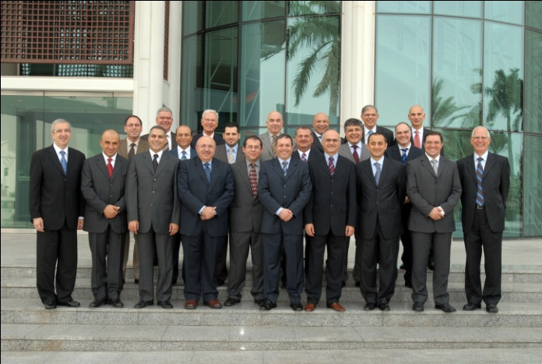
Chapter
04
Motivation by Job Design: The JCM (cont’d)
  The way elements in a job are organized
  (job design) impacts motivation,
  satisfaction, and performance.
Job design:
Various training organizations such as Meirc Training & Consulting, pictured, offer courses in how best to use job design to develop employees’ skills and motivation.

Slide 39

Chapter
04
The Job Characteristics Model

Slide 40
Chapter
04
How Can Jobs Be Redesigned?
Job Rotation
  The periodic shifting of a worker from one task to another.
Job enlargement
  The horizontal expansion of jobs. The definition of job enlargement is adding additional activities within the same level to an existing role. This means that a person will do more, different activities in their current job. For example, an employee who will now also manage her own planning where this was formerly done by her manager.
Job enrichment
  The vertical expansion of jobs.

Slide 41
Chapter
04
How Can Jobs Be Redesigned?
Job enrichment
  The vertical expansion of jobs. Job enrichment expands the task set that you perform, and the skills that you can develop. This makes for more stimulating and interesting work, and adds variety, challenge and depth to your daily routine. Enriched jobs give you more freedom, independence and responsibility.

Slide 42
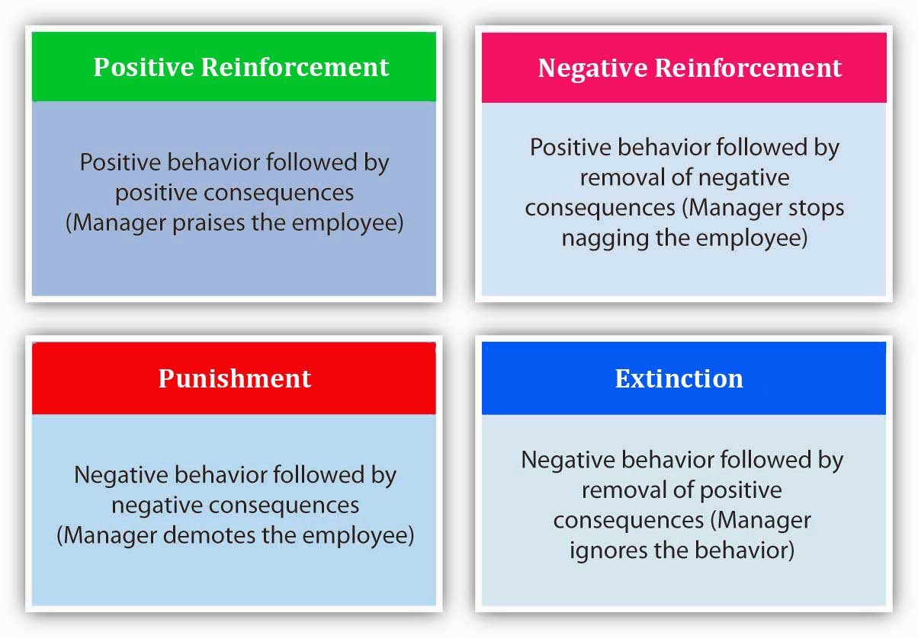
Chapter
04
Reinforcement Theory of Motivation
Reinforcement Theory of motivation aims at achieving the desired level of motivation among the employees by means of reinforcement, punishment and extinction. Reinforcement approach, which can be both positive and negative, is used to reinforce the desired behavior.

Slide 43
Chapter
04
Summary and Managerial Implications
Need Theories (Maslow, Alderfer, McClelland, Herzberg)
  Well known, but not very good predictors of behavior.
Goal-Setting Theory
  While limited in scope, good predictor.
Reinforcement Theory
  Powerful predictor in many work areas.
Equity Theory
  Best known for research in organizational justice.

Slide 44
Chapter
04
Summary and Managerial Implications
Expectancy Theory
  Good predictor of performance variables but shares many of the assumptions as rational decision making.
To Motivate Employees
  Recognize individual differences.
  Use goals and feedback.
  Allow employees to participate in decisions that affect them.
  Link rewards to performance.
  Check the reward system for equity.

