Slide 1


Communication skills
CMM201
Prepared by Dr. Merna Emad
Written documents
Lecture 10

Slide 2
Section 2
Written communication excellence strategies & Skills
Lecture
Section 1
Written Communication Types

Slide 3
Section One

Slide 4
Written Communication Types

Slide 5
Written Communication Types
What would you do if you were hired for a new position that required you to communicate in a variety of styles and formats? Written communication can challenge professionals entering a variety of positions, regardless of industry.
Definition
The Written Communication refers to the process of conveying a message through the written symbols. In other words, any message exchanged between two or more persons that make use of written words is called as written communication.

Slide 6
Written Communication Types
The importance of written communication
Official documents, memos, e-mails, and other forms of written communication reveal something about you as a professional;
Important policies, requests, and organizational procedures are conveyed through written communication;
Proposals, employee terminations, media relations, and the like are achieved with written communication;
Written communication must be present in order to achieve professional excellence. To address these important topics.

Slide 7
Written Communication Types
In the sections that follow, we cover the following types of written communication:
Business letters,
Employee reviews,
Recommendation letters,
Memos,
Proposals and Reports,
Planning documents,
E-mail.

Slide 8
Written Communication Types
Business letters,
Have you ever received a letter that did not keep your attention? What reaction do you have when your name is misspelled in a document?
Why Business Letters are important?
They serve as a formal method of communication between people.
They provide valuable information on business-related matters.
They are used as a reference material to future transactions.
Properly written letters give a positive impression of a company or individual.
Retailers and agents also distribute new information to clients through formal letters.
Letters enhance an organization’s image and reputation and maintain ethical business values.

Slide 9
Written Communication Types
Employee reviews,
An employee review form is a formal document with questions and discussion points that examines your efficiency and productivity. Companies may also use an employee review form to commend you on outstanding work. Occasionally, organizations will use review forms with a team to outline how they are performing.
What is the importance of Employee Reviews?
They give the employee the opportunity to better understand expectations, standards and rules.
They give the manager an opportunity to ‘get to know’ the employee better.
They give the employee the opportunity to learn what behaviors and attitudes they need to improve or modify.
They send a message to the employee that you care about their performance as well as them as a person.
They can help you chart a better course for the future of the employee.

Slide 10
Written Communication Types
Employee reviews,
Types of forms for employee review
Scale review
Employers rate a list of qualities and expectations on a numbered scale, for example, of 1 (unsatisfactory) to 5 (exceptional). Each item might also include a comments section where you or your supervisor can discuss any details that impact the score.
Peer review
These employee reviews will likely contain many of the same questions about your personal qualities and work habits as a scale review.
Self-assessment
With this type of review, you will be more responsible for leading the review conversation with your employer. Many self-assessments have open-ended questions about your performance, including, “What are my main accomplishments for the year and how do they line up with my objectives?”

Slide 11
Written Communication Types
Recommendation letters,
A form of written communication used to provide a documented reference for students and professionals.
A recommendation letter is designed to testify to the skills and abilities. When you review samples of recommendation letters, you will notice that the basic format is as follows:
Opening - Introduce yourself and explain your relationship to the applicant.
Body - Give examples of the applicant's best qualities, being as specific as possible. Put the most important qualities first.
Conclusion - End your recommendation with a paragraph that includes a positive statement about the applicant and offers your future assistance if necessary.

Slide 12
Written Communication Types
Memos,
Memos (the word memo is short for memorandum) are another type of written communication used in professional settings. They are typically short notes or updates distributed in business.
Importance of Memo
Issuing Orders and Instructions: Through memo superiors issue orders, instructions, advices etc. to their subordinates. Therefore, it is regarded as the means of carrying orders of superiors to the subordinates.
Informing Any Change in Policy: Organizations use memo to inform any change in policy to its various internal parties.
Providing and Seeking Suggestions and Recommendations: Through memo superiors provide advice and suggestions to their subordinates. Again, by writing memo superiors can seek suggestions and recommendations on any matter from their subordinates.

Slide 13
Written Communication Types
Memos,
Importance of Memo
Requesting For Help: Organizational people should cooperate each other in performing their activities. For obtaining such cooperation and help, they can write memo to each other.
Requesting For Information: Managers need information for preparing plans and taking decisions. For obtaining such information they generally write memos to the concerned internal parties seeking required information.
Informing Decisions: Generally, decisions are taken by the top executives. Later on, these are circulated in the whole organizations. Memo is used to carry the decisions to the concerned internal parties.
Using as Reference in Future: Since memo is a written document, it can be preserved and used as reference in internal parties.

Slide 14
Written Communication Types
Proposals and Reports,
Proposals are used in many business and professional settings to propose products and services to potential clients. The proposal describes what the client can expect from the communication assessment.
Components of proposals
Abstract/Summary
The abstract is the most important component of the proposal. Spend time developing the best possible title. If the length is not mandated, it should be no longer than one half to one page maximum.

Slide 15
Written Communication Types
Proposals and Reports,
Components of proposals
Statement of Need
What is the issue that you are addressing and why does it matter?
Why is what you propose necessary? What is the void in Knowledge?
Who benefits?
Why hasn't this issue been addressed sufficiently in the past? Who else is working in this field, what have they done, and why isn't that enough? Demonstrate your knowledge of the field.
Provide convincing evidence that what you are proposing does not duplicate other work.

Slide 16
Written Communication Types
Proposals and Reports,
Components of proposals
Project Activity, Methodology and Outcomes
Why did you choose to address the issue in the manner that you have? Are there other approaches? If so, why aren't they appropriate to the situation?
What are the specific activities involved? Who will do them?
Evaluation
Outline clearly the methodology that you will use to assess the projects success.

Slide 17
Written Communication Types
Proposals and Reports,
Reports are used to summarize both quantitative data (characterized by numbers, percentages, statistics, and surveys) and qualitative data (characterized by actual words, phrases, responses to open-ended questions, and interviews).
The importance of Reports:
Business reports are valuable and essential tools for any enterprise regardless of size or industry. They provide a means to track and analyze the performance and overall health of the business (e.g., customer service, employee satisfaction, employee morale).while identifying areas for improvement and opportunities for growth.

Slide 18
Written Communication Types
Proposals and Reports,
Components of proposals
Title page
Table of contents
Executive summary
An executive summary is a brief overview of a report that is designed to give the reader a quick preview of the report's contents. Its purpose is to present the key points of a report in one place.
Introduction
briefly describe the context and background to the research
describe the change, problem or issue to be reported on
define the specific objectives and purpose of the report
indicate the overall answer to the problem explored in the report

Slide 19
Written Communication Types
Proposals and Reports,
Components of proposals
Discussion
This is the main body of the report and it has two key purposes:
to explain the conclusions
to justify the recommendations
Conclusion
Recommendations
References

Slide 20
Written Communication Types
Planning documents,
Planning documents are forms of written communication usually presented with maps and other visual designs to lay out a broader vision of where the company is going and what specific strategies will be used in the near future.
When to do it?
Once the organization knows its strengths and weaknesses, business leaders often engage in strategic planning—the development of a plan that emphasizes goals, initiatives, strategies, and targets utilized to help employees strive for a shared vision and commitment to the organization’s core values.

Slide 21
Written Communication Types
E-mail.
People working in businesses and professional organizations increasingly rely on their email systems to communicate with colleagues and accomplish their work).
Key Points | Practical Tips
Slow down | • Effective communication and good writing take time, so take the time to formulate your thoughts and figure out exactly what you want to say. • If you’re struggling to find the time, block out time on your calendar to devote solely to e-mail.
Always have a beginning, middle, and end. | • An e-mail introduction should always start with a greeting, and then follow with the nature of the e-mail (i.e., a friendly greeting, or a preface to why you’re e-mailing the person). • An e-mail body should always include all the information that the recipient needs to accomplish whatever you are asking of him or her (i.e., contextual information, details, or data), and it should be presented in a logical, reasonable manner.

Slide 22
E-mail.
Written Communication Types
Key Points | Practical Tips
Proofread and fact check. | • An e-mail conclusion should always include some sort of action plan (i.e., reminding the recipient of any deadlines), as well as a final greeting and full signature.
Think about how you would feel if it went public | • Imagine how you would feel or respond if your e-mail was seen by anyone other than its recipient (i.e., your boss). • Picturing these scenarios will help ensure that your e-mail sounds respectful and professional and is an accurate representation of how you want the world to see you.

Slide 23
Section Two

Slide 24
Written communication excellence strategies & Skills

Slide 25
Striving for Written Communication Excellence
So how do you develop excellence in written communication? In this section, we review some strategies that will help your development:
Message structure,
Message clarity,
Message presentation.

Slide 26
Striving for Written Communication Excellence
Message structure,
Excellent written communication begins with
A clear general purpose,
A clear specific purpose or thesis,
And clear organization.
Begin by asking yourself,
“What is the purpose of this written communication?
Am I presenting new information?
Am I clarifying?
Am I requesting?
Am I persuading?”

Slide 27
Striving for Written Communication Excellence
Message Clarity,
To maximize message clarity, you must evaluate your audience and avoid generalities.
As with all forms of communication, excellence in written communication requires you to
Evaluate your audience.
Ask yourself, “Who will read this written document?” In many cases, you will have both a primary audience—the person or persons the message is addressed to—and a secondary audience—other readers who may need or use this information. Keep all readers in mind as you draft your message.

Slide 28
Striving for Written Communication Excellence
Message Clarity,
To maximize message clarity, you must evaluate your audience and avoid generalities.
As with all forms of communication, excellence in written communication requires you to
Consider details
Such as the reader’s place in the organization (supervisor, employee, customer), his or her level of understanding (both educational level and experience in your industry), and the amount of interest in and involvement with the topic at hand.
Using specific language
As opposed to general language. General language is usually characterized as vague statements that can easily be misunderstood, whereas specific language makes precise references.

Slide 29
Striving for Written Communication Excellence
Message Presentation,
In addition to considering message structure and message clarity, you must consider message presentation. Unlike spoken communication, there is a lasting visual element to your written communication. Message presentation refers to that visual component.
Carelessly written communication will send the message that you are a careless employee or leader.
With spelling and grammar check,
As well as good old-fashioned proofreading,
Misspellings (mistakes in spelling),
In addition, grammar errors (sentence fragments, inappropriate use of punctuation, and the like).

Slide 30
Striving for Written Communication Excellence
Three types of message communication
There are many different written communication channels in business. However, no matter the channel, the content of the message sent is either transactional, instructional or informational.
Transactional written communication
A transactional message is sent to get results. It can be a quick clarification, a request for a meeting, or asking for a favor. The whole point is to get a response from the person the message was sent to, or from the person with the best information.
Informational written communication
Informational written communication includes the sender delivering a message for the receiver’s benefit. Since this is less dependent on the receiver, there is no response needed. If the receiver has questions or concerns, that would bring the conversation back to transactional communication.

Slide 31
Striving for Written Communication Excellence
Three types of message communication
There are many different written communication channels in business. However, no matter the channel, the content of the message sent is either transactional, instructional or informational.
Instructional written communication
Instructional written communication gives receivers directions for a specific task. If the receiver is required to take action, it is important to make these messages detailed and easy to understand. Certain people may not know as much as others on the topic at hand, so including the basics is always necessary. The goal is to educate the audience about something they need to know and might have to apply later on.

Slide 32
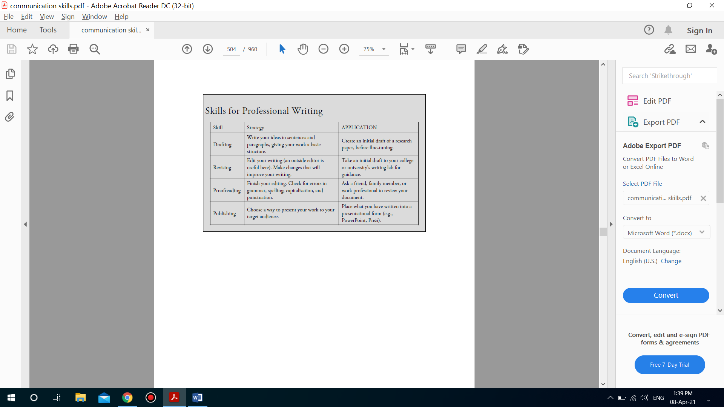
Striving for Written Communication Excellence
Written communication skills

Slide 33



Thank You

