Slide 1


Slide 2


Slide 3
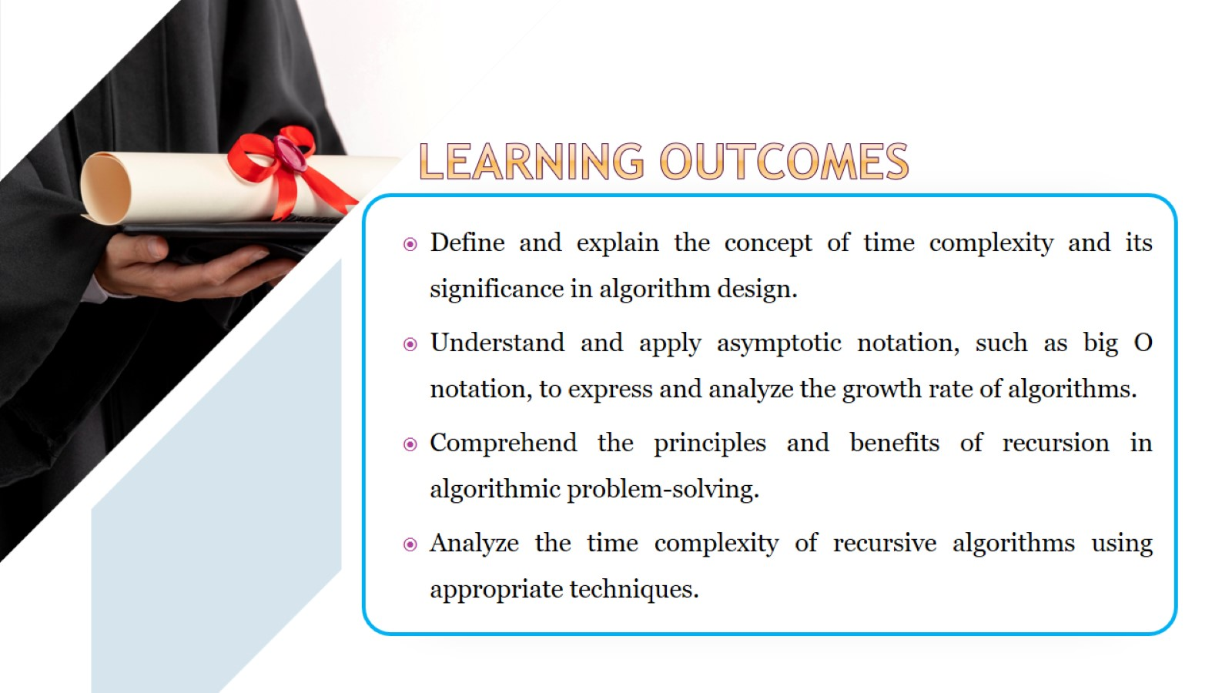

Slide 4
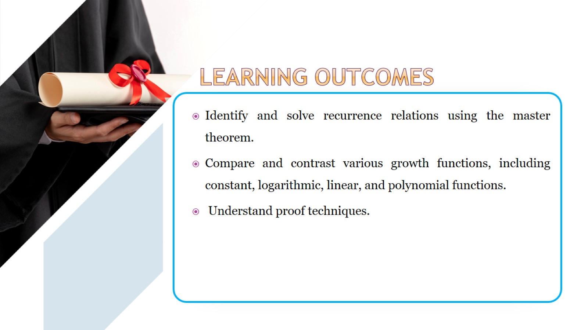

Slide 5
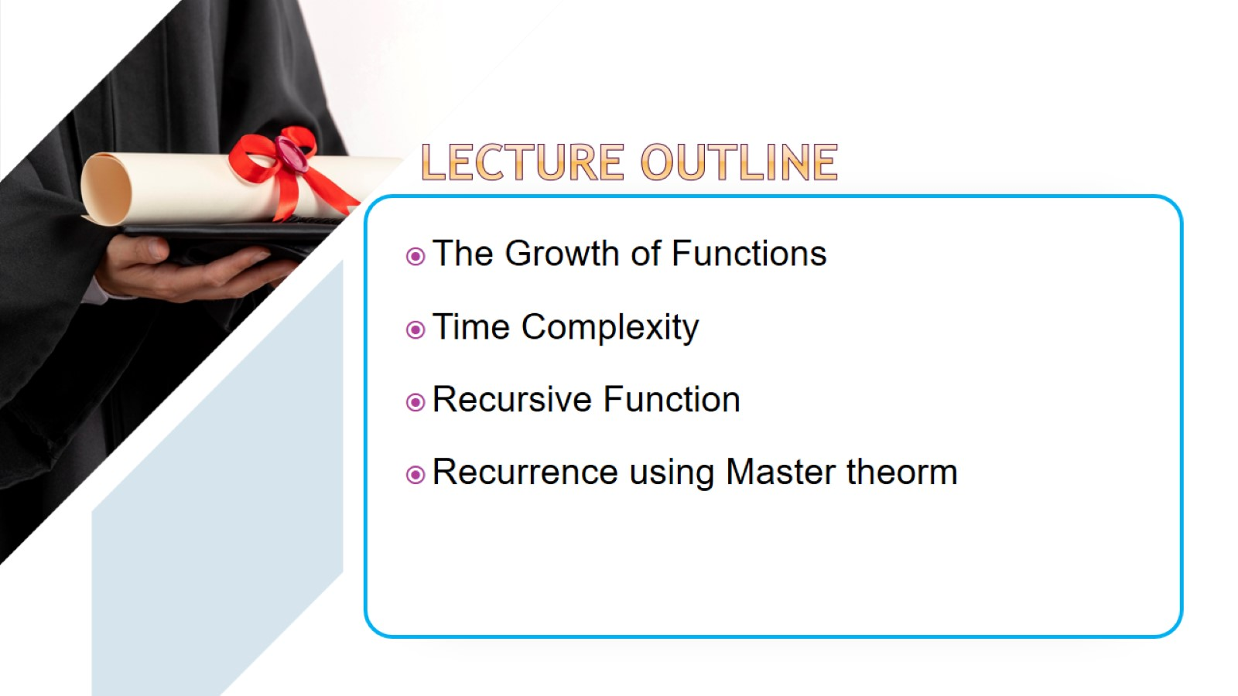

Slide 6
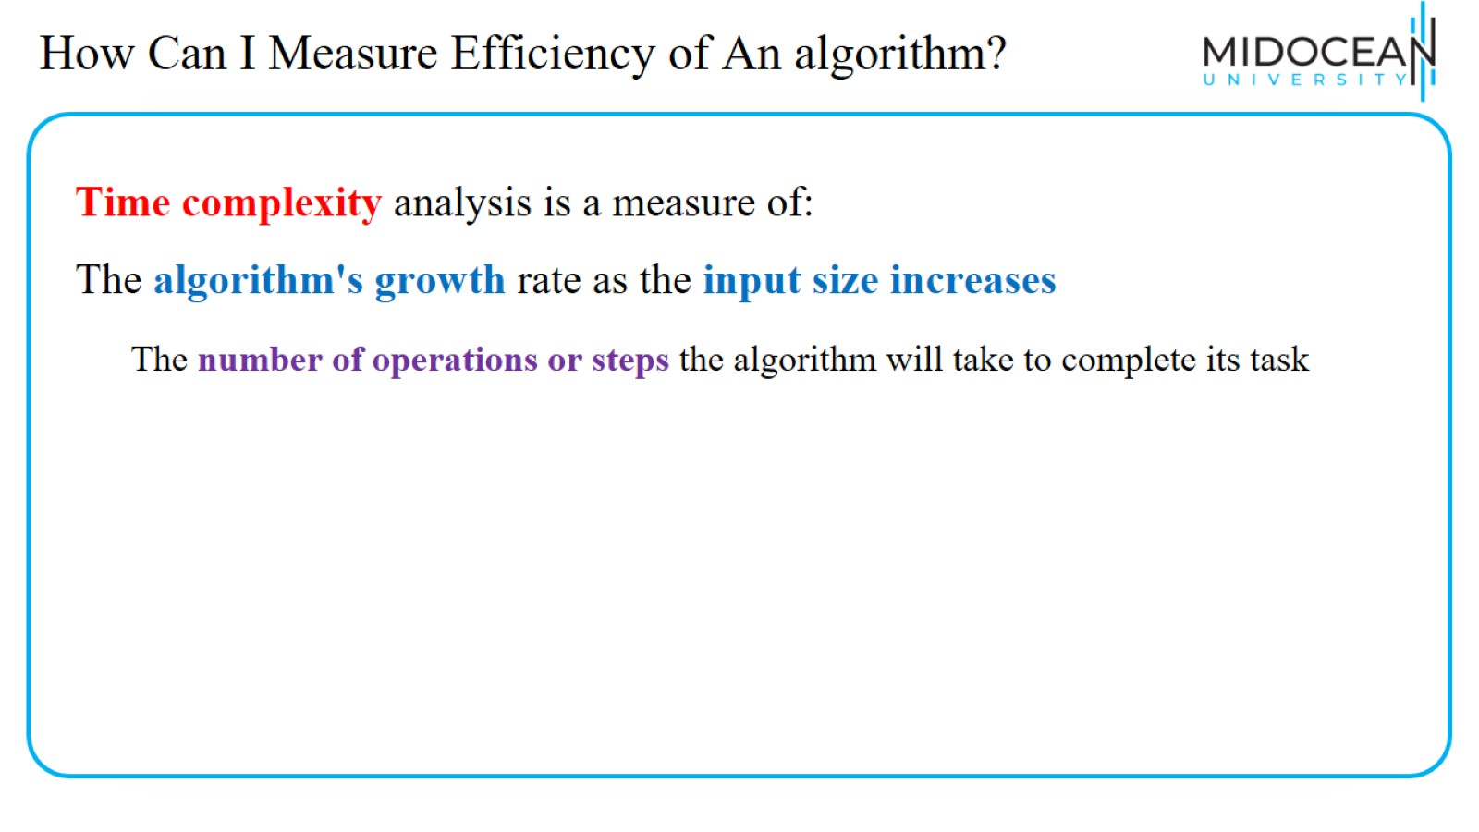
How Can I Measure Efficiency of An algorithm?

Slide 7
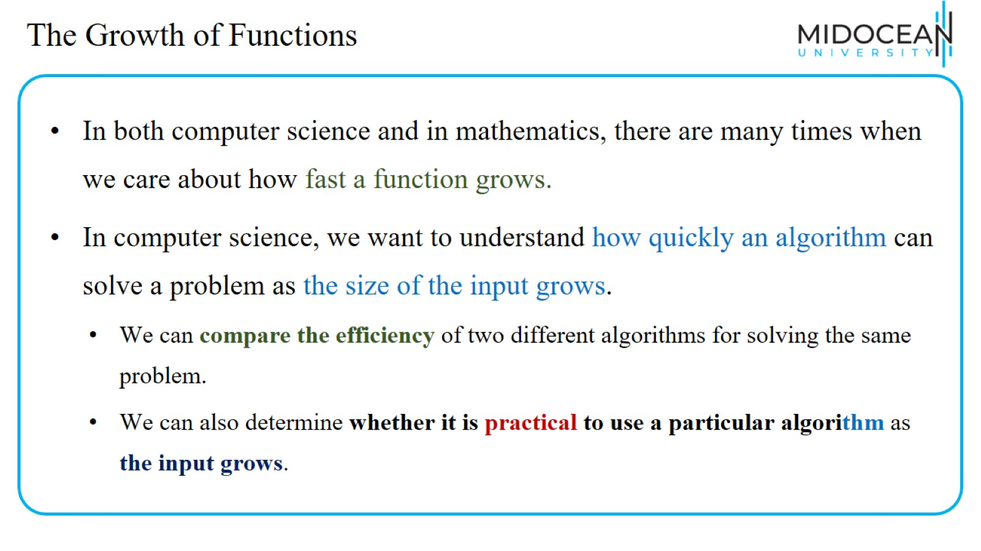
The Growth of Functions

Slide 8
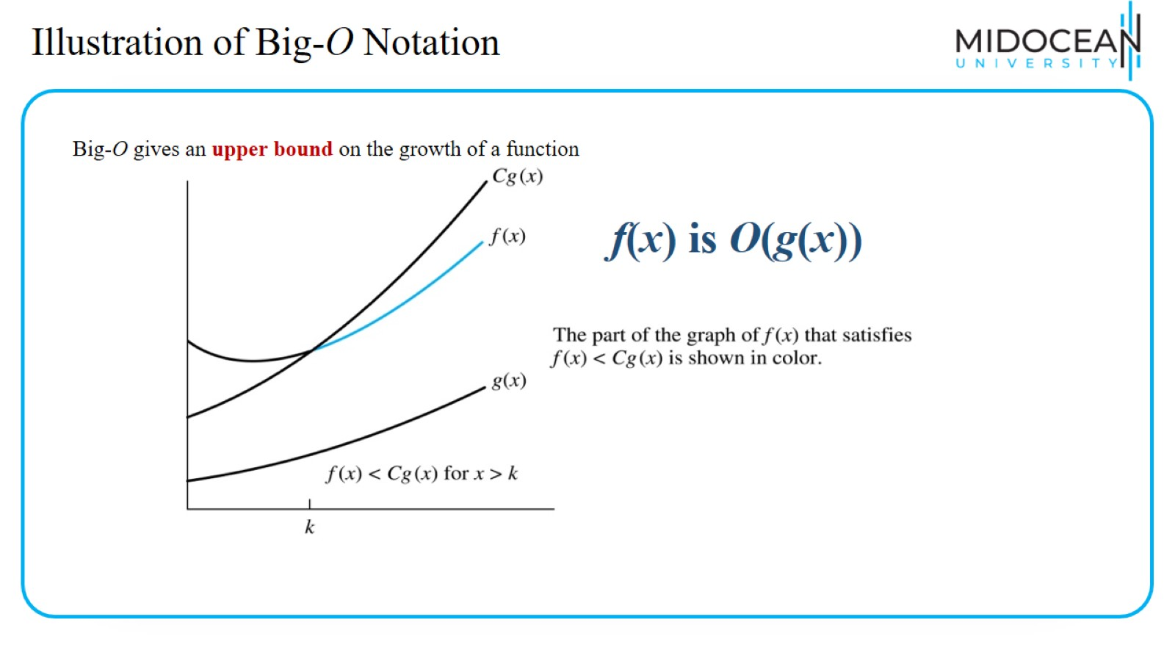
Illustration of Big-O Notation

Slide 9
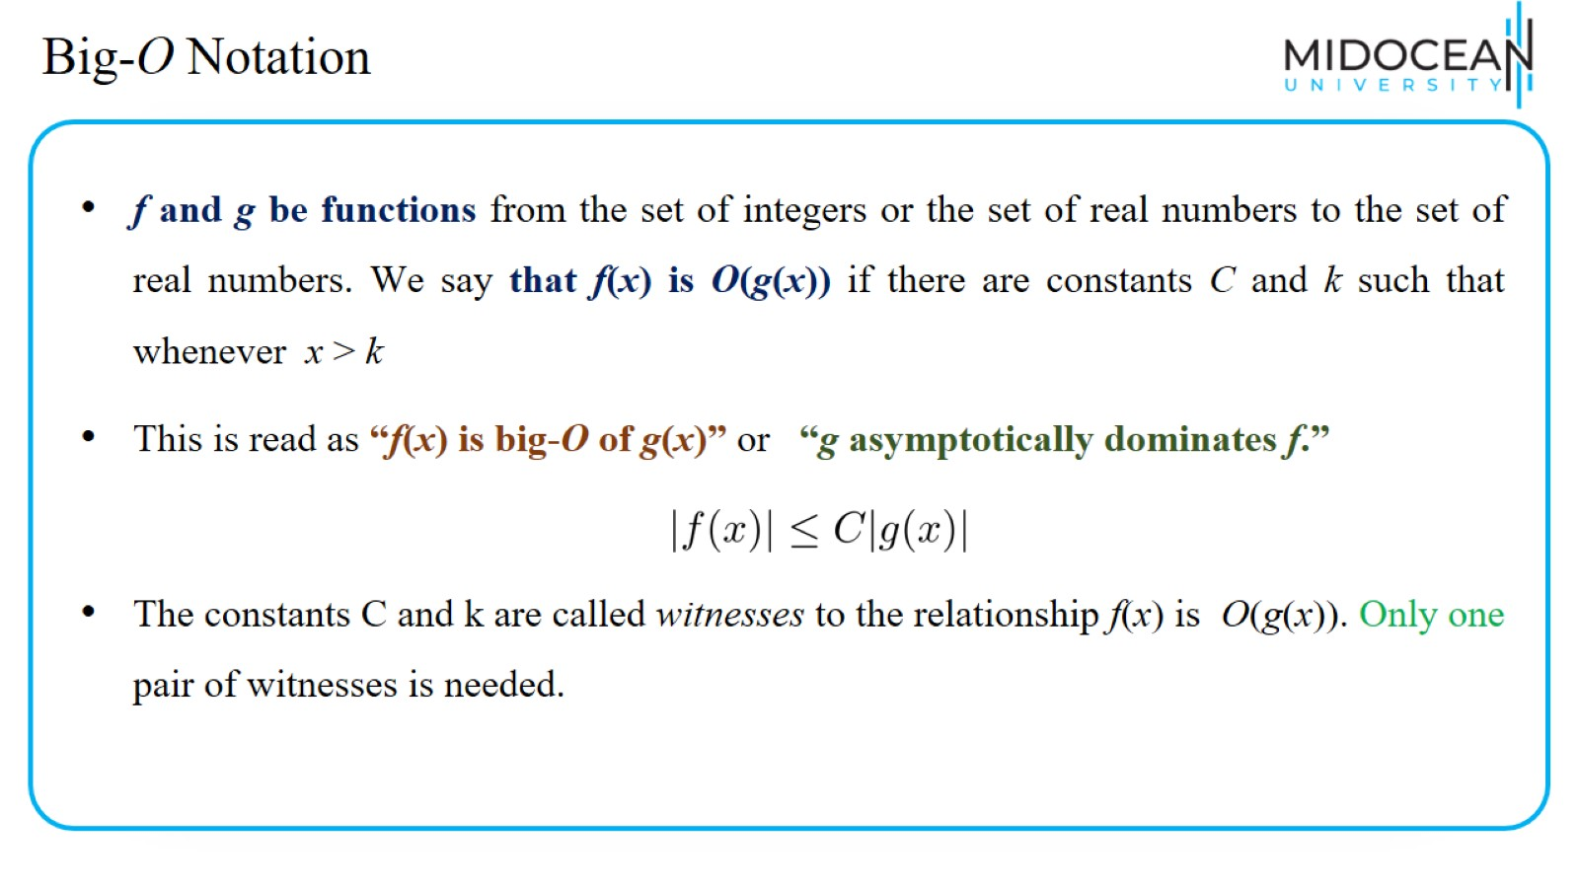
Big-O Notation

Slide 10
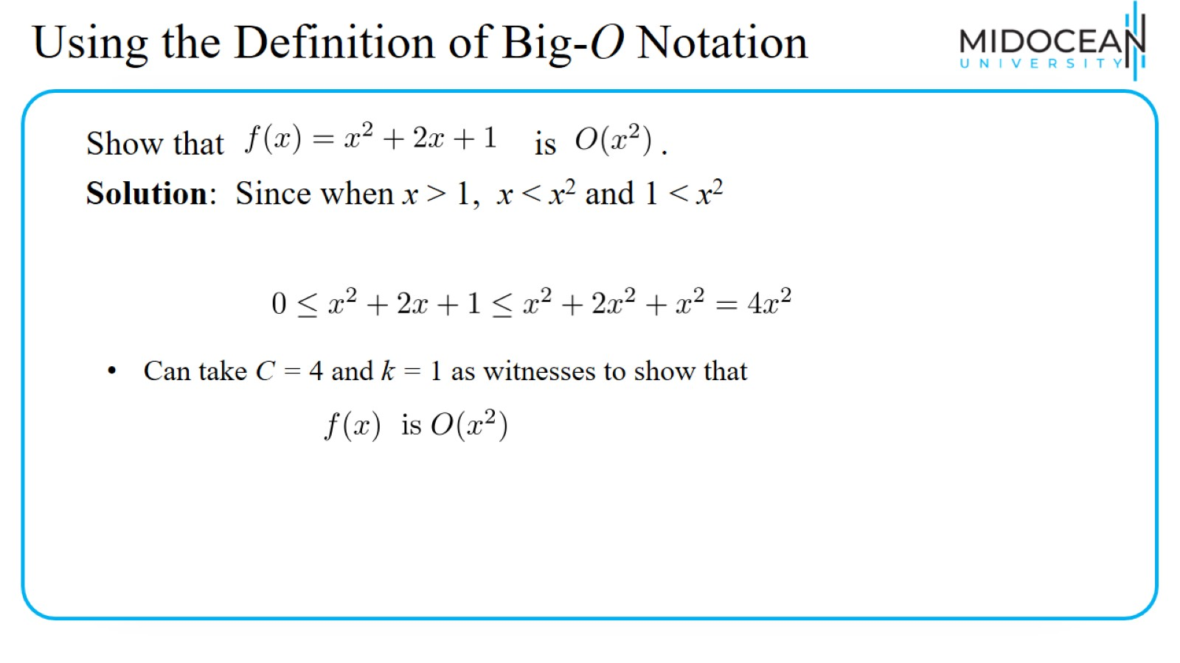
Using the Definition of Big-O Notation

Slide 11
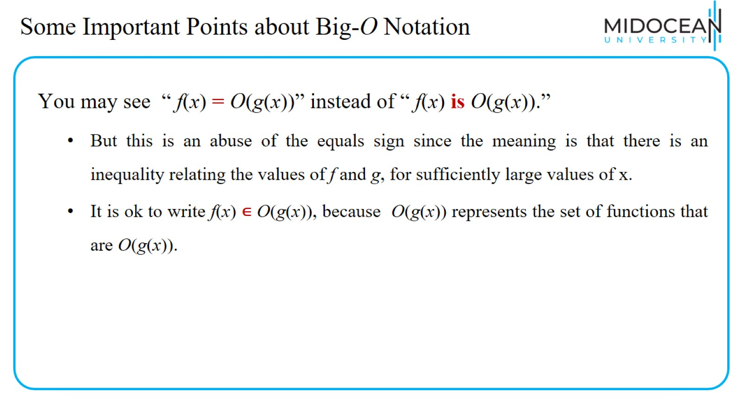
Some Important Points about Big-O Notation

Slide 12
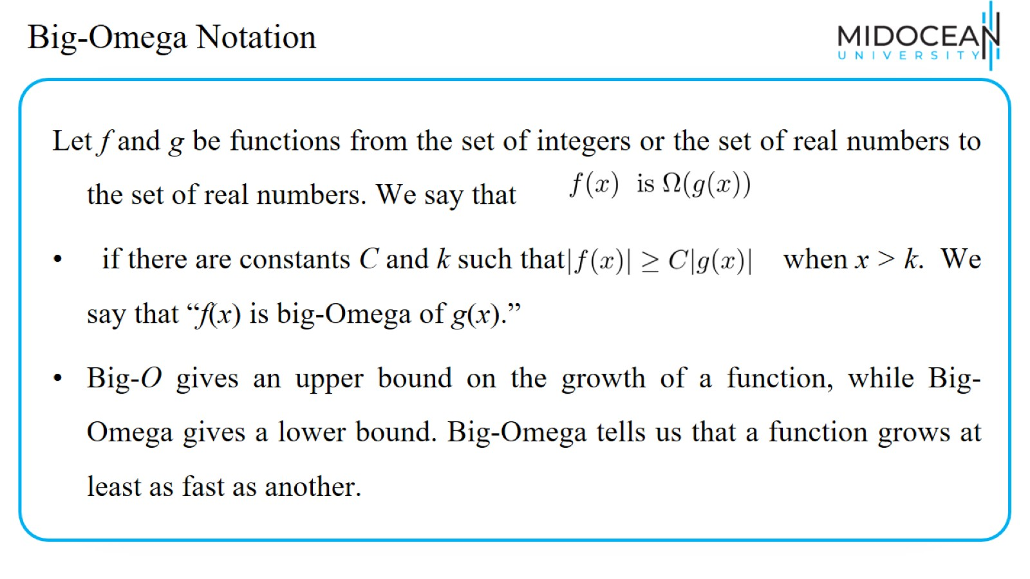
Big-Omega Notation

Slide 13
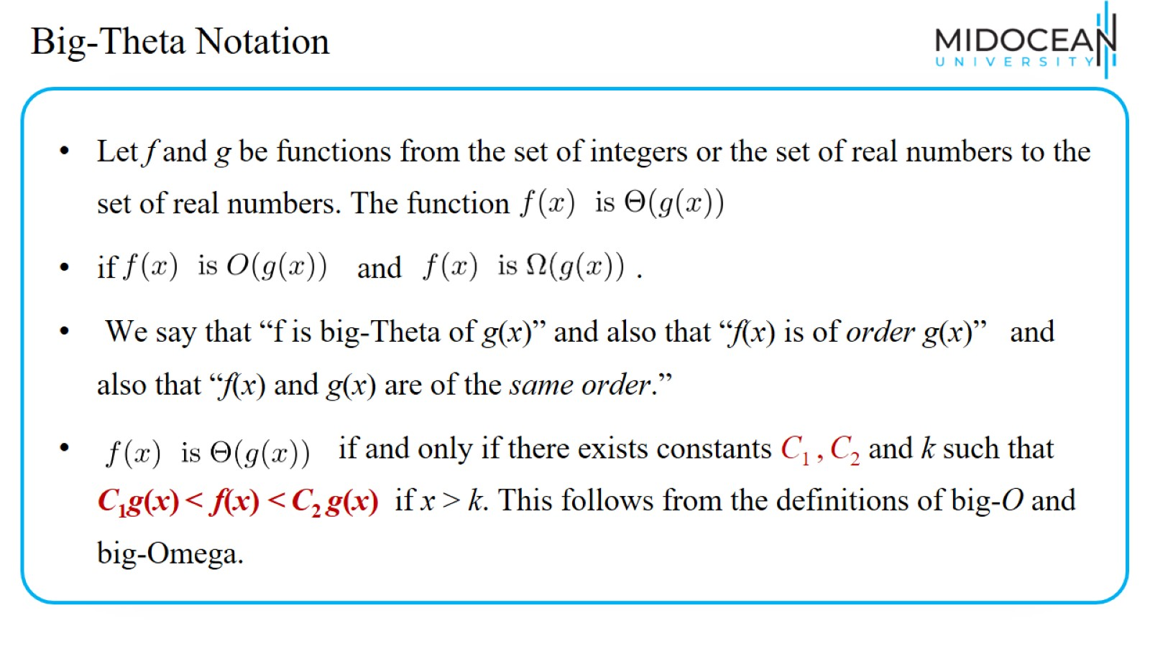
Big-Theta Notation

Slide 14
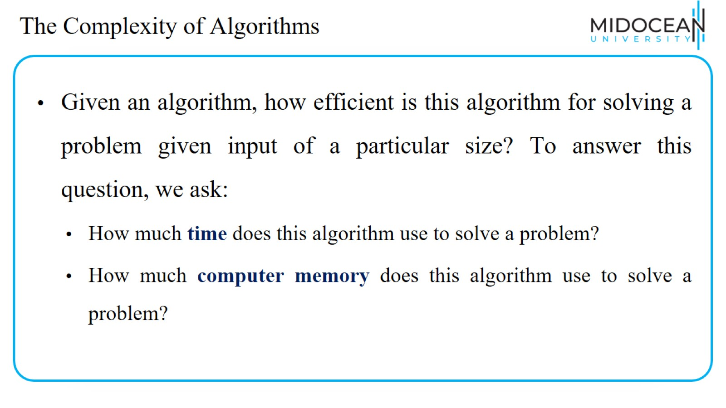
The Complexity of Algorithms

Slide 15
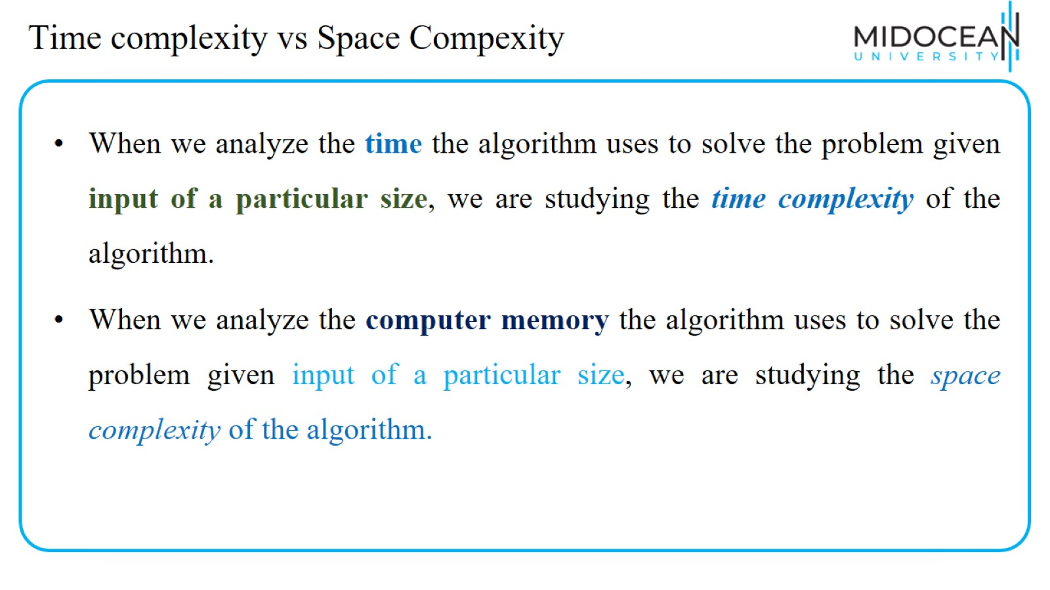
Time complexity vs Space Compexity

Slide 16
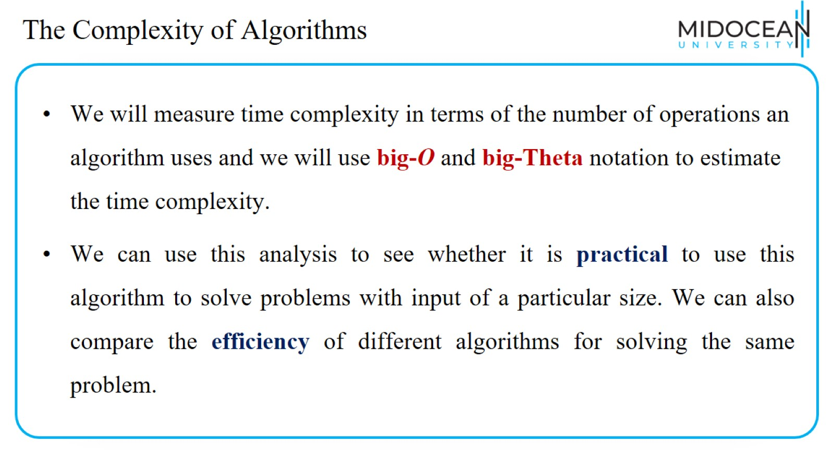
The Complexity of Algorithms

Slide 17
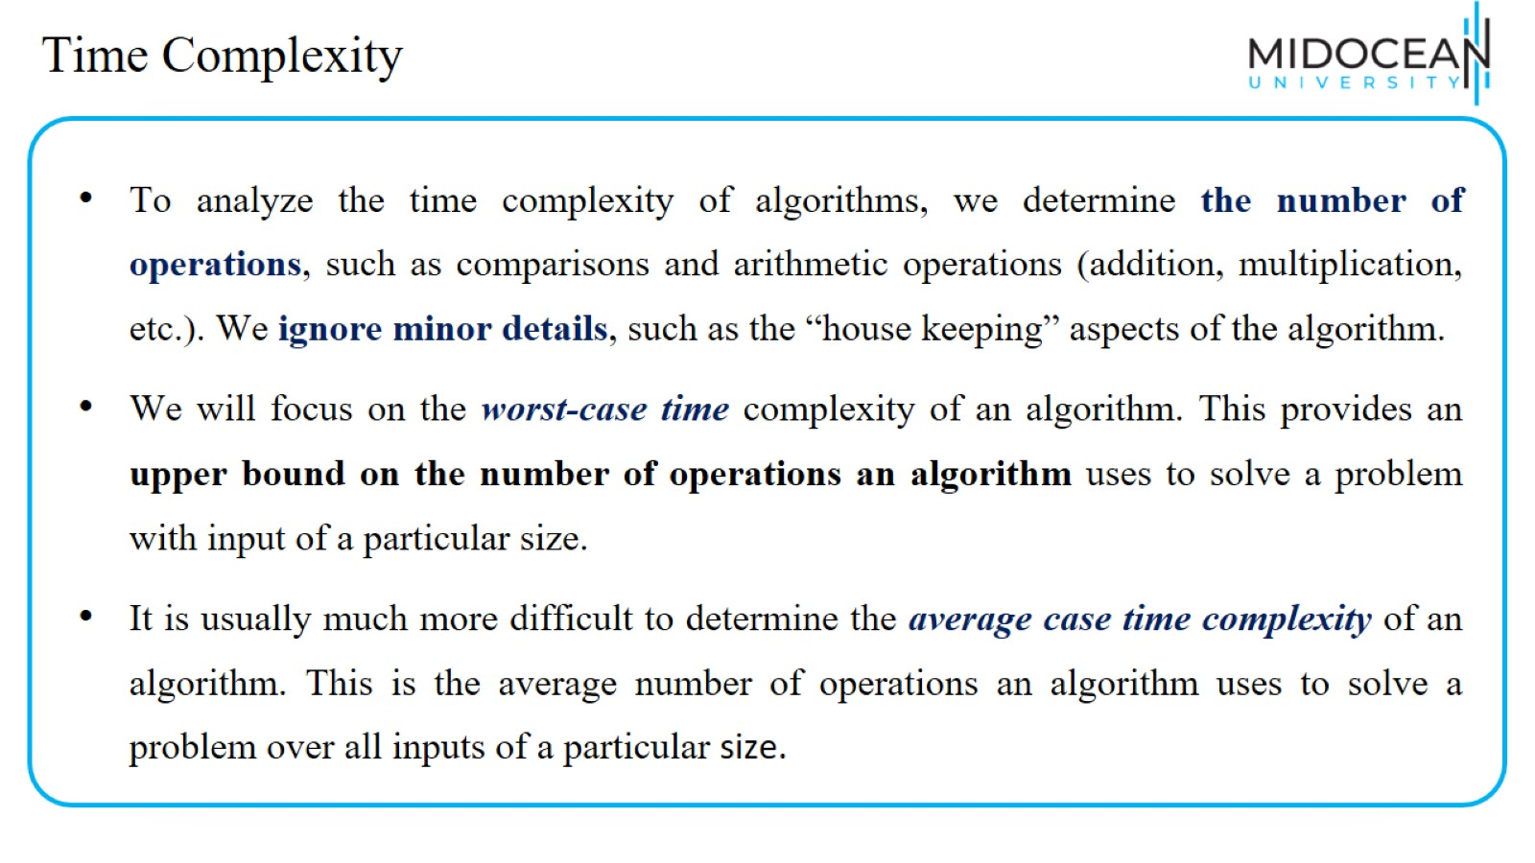
Time Complexity

Slide 18
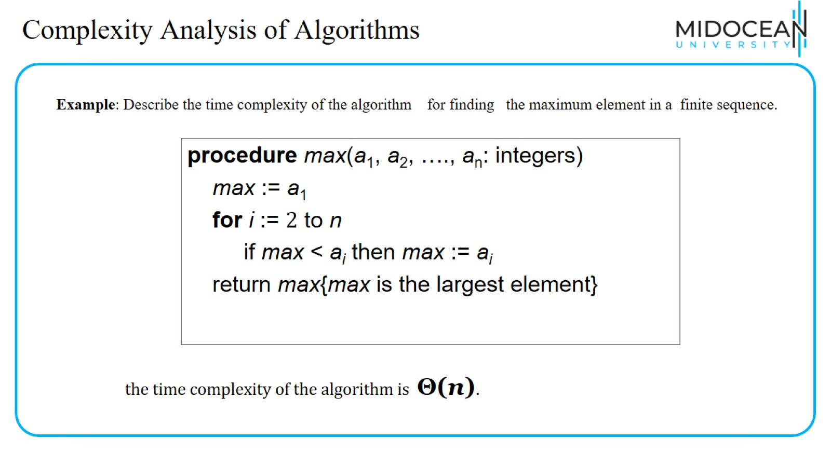
Complexity Analysis of Algorithms

Slide 19
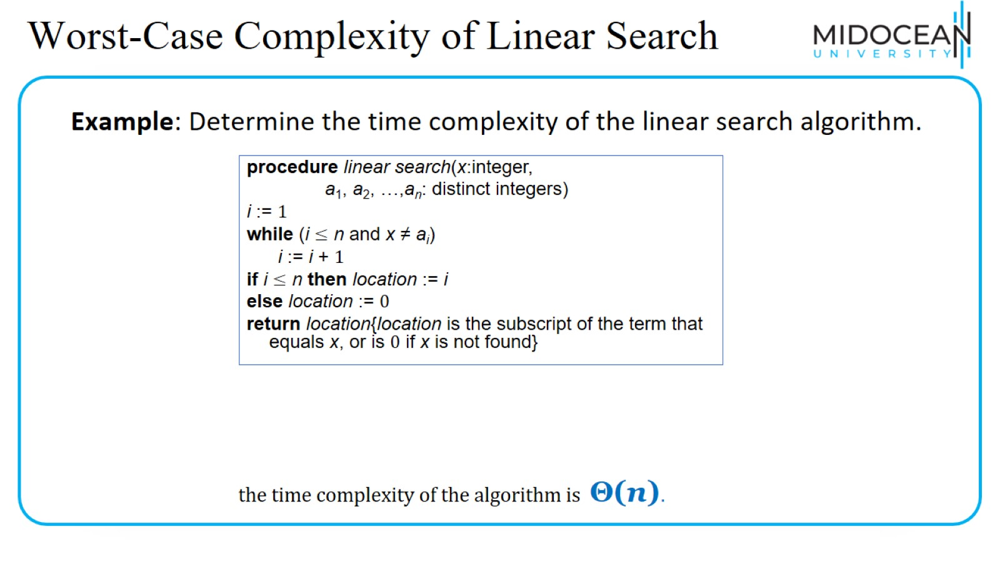
Worst-Case Complexity of Linear Search

Slide 20
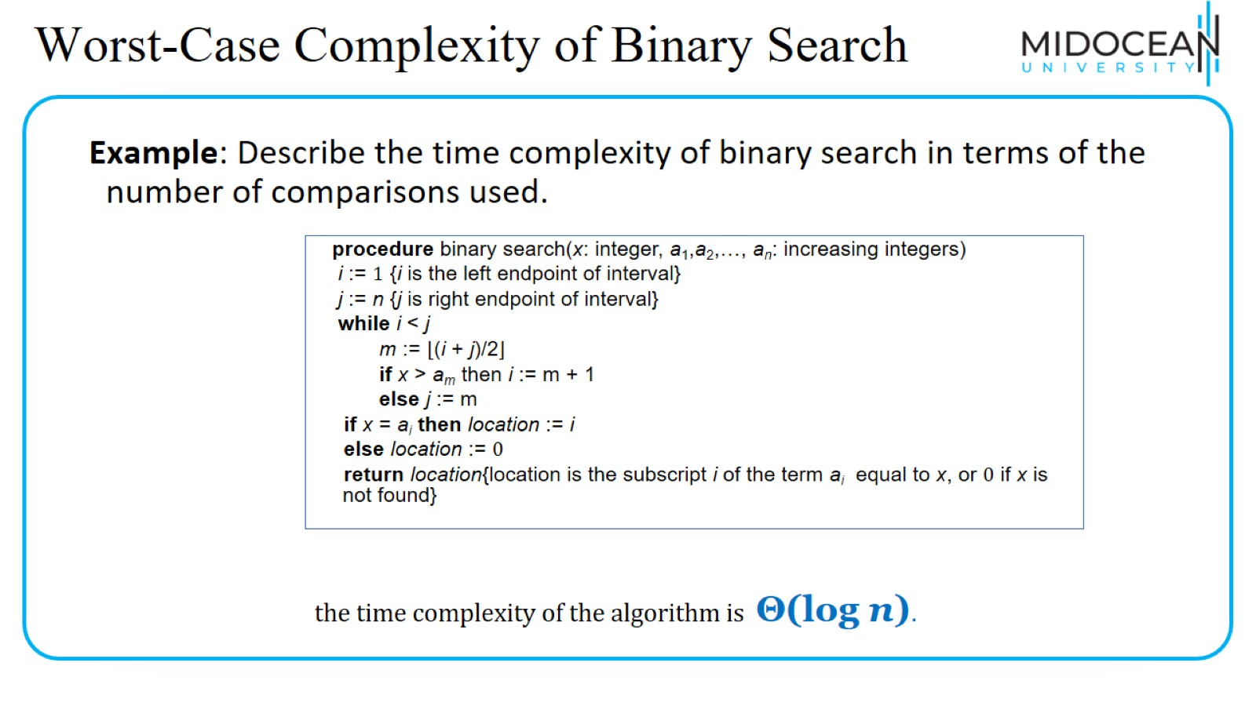
Worst-Case Complexity of Binary Search

Slide 21
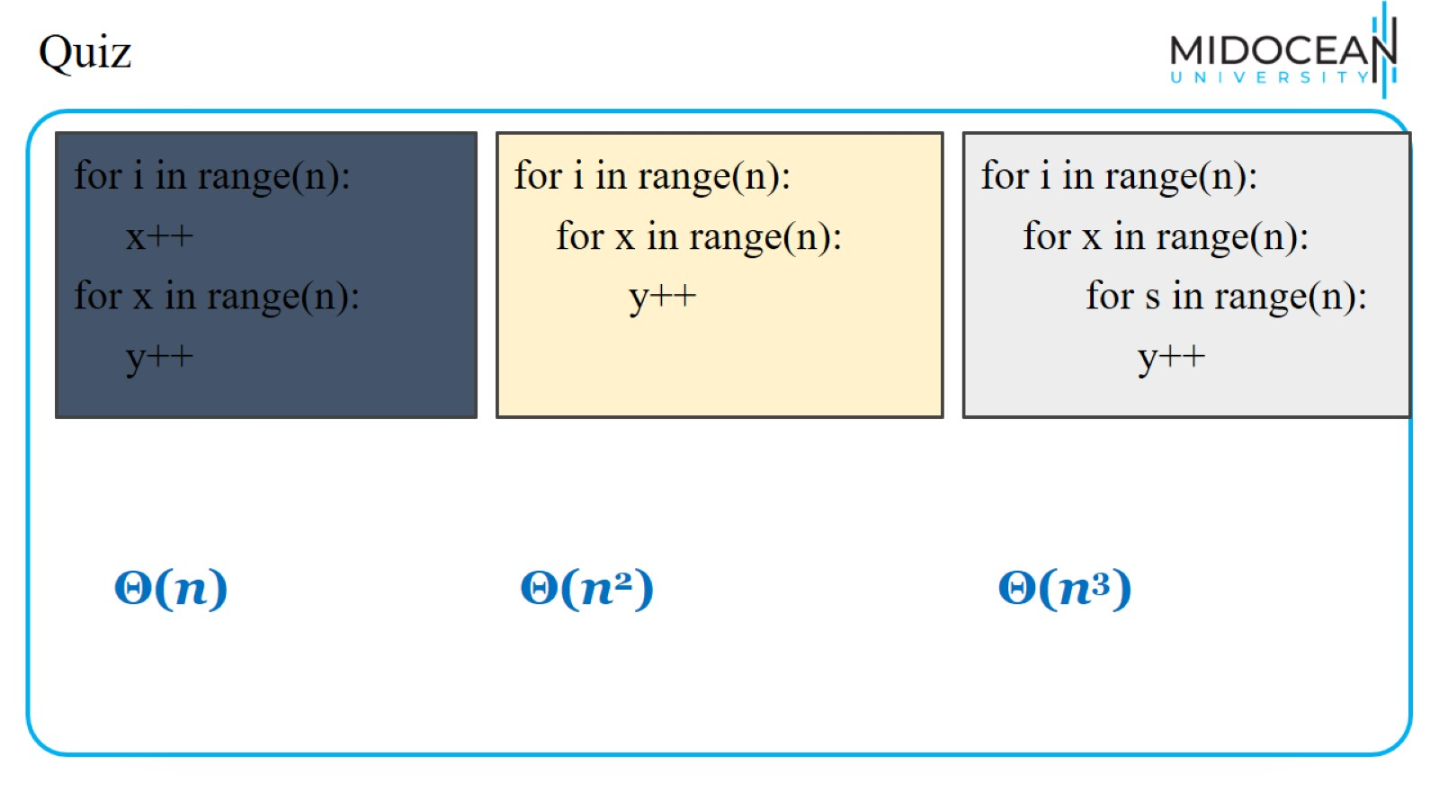
Quiz

Slide 22
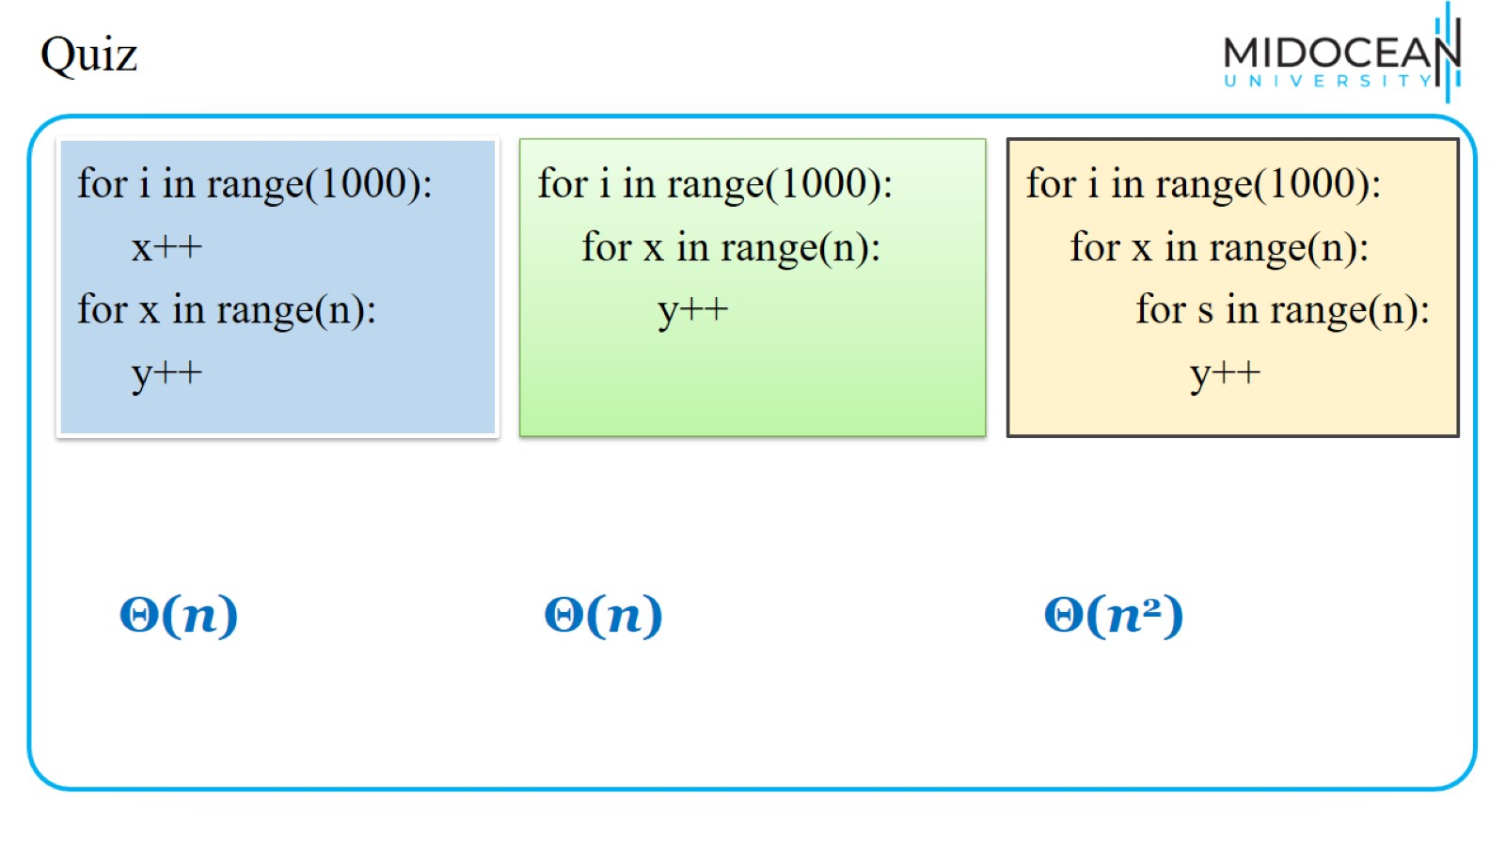
Quiz

Slide 23

Quiz

Slide 24
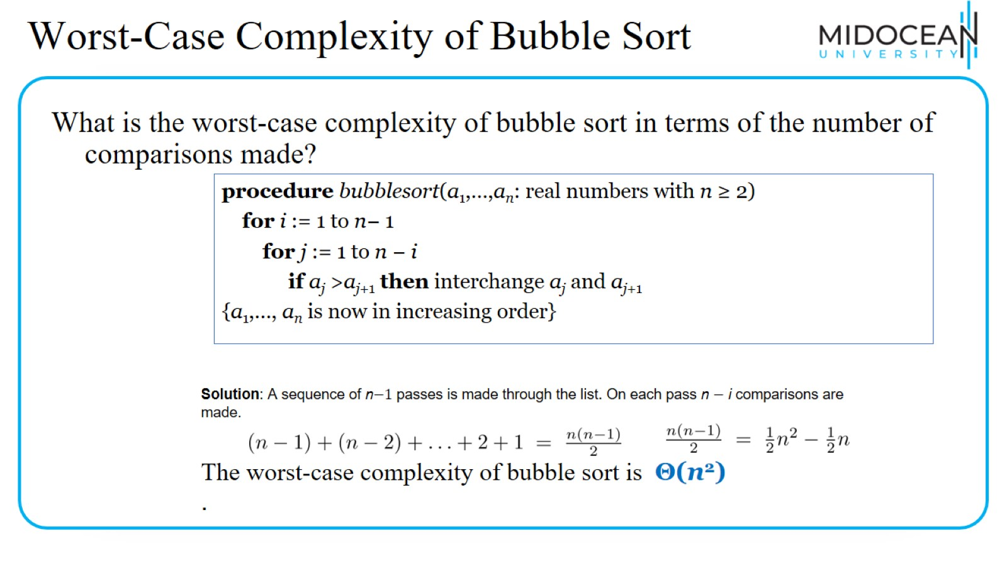
Worst-Case Complexity of Bubble Sort

Slide 25
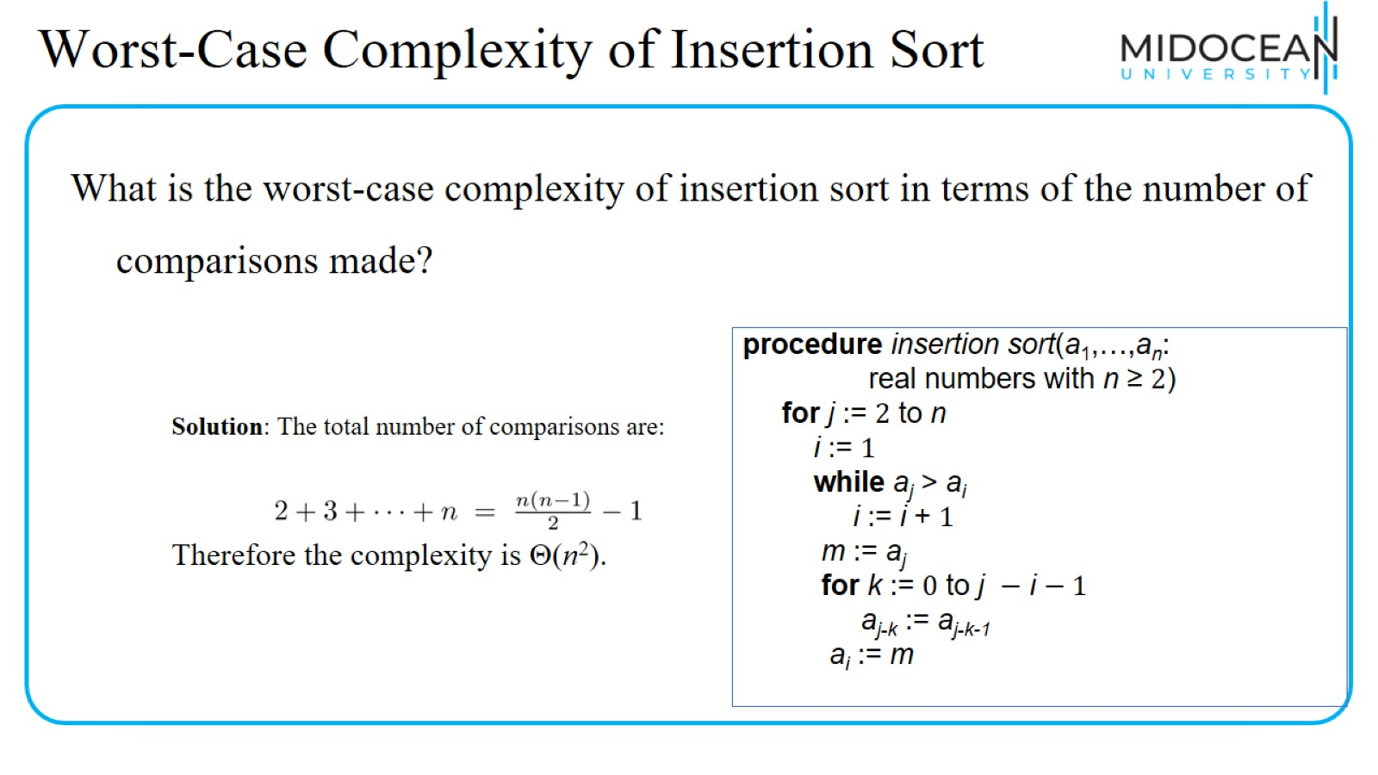
Worst-Case Complexity of Insertion Sort

Slide 26
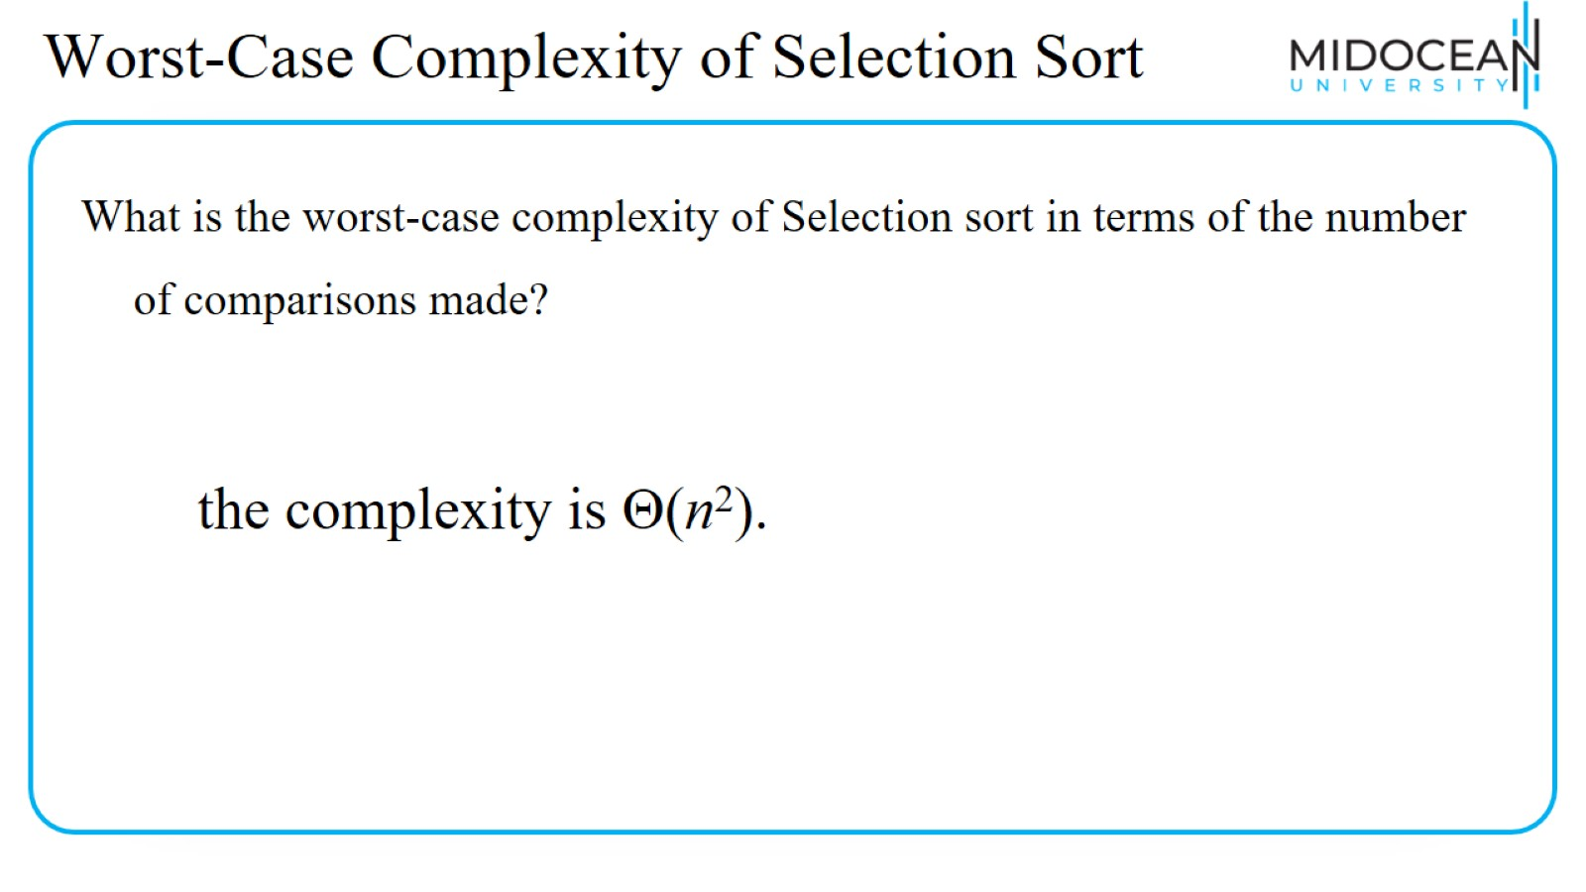
Worst-Case Complexity of Selection Sort

Slide 27
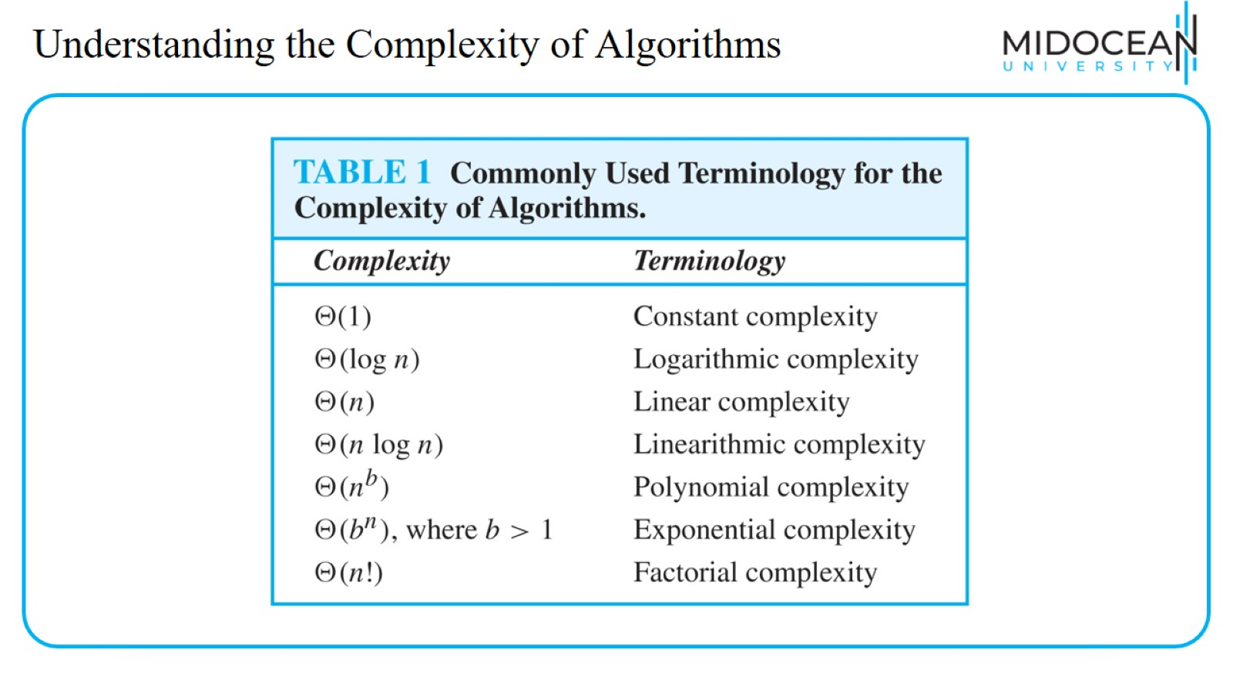
Understanding the Complexity of Algorithms

Slide 28
Understanding the Complexity of Algorithms

Slide 29
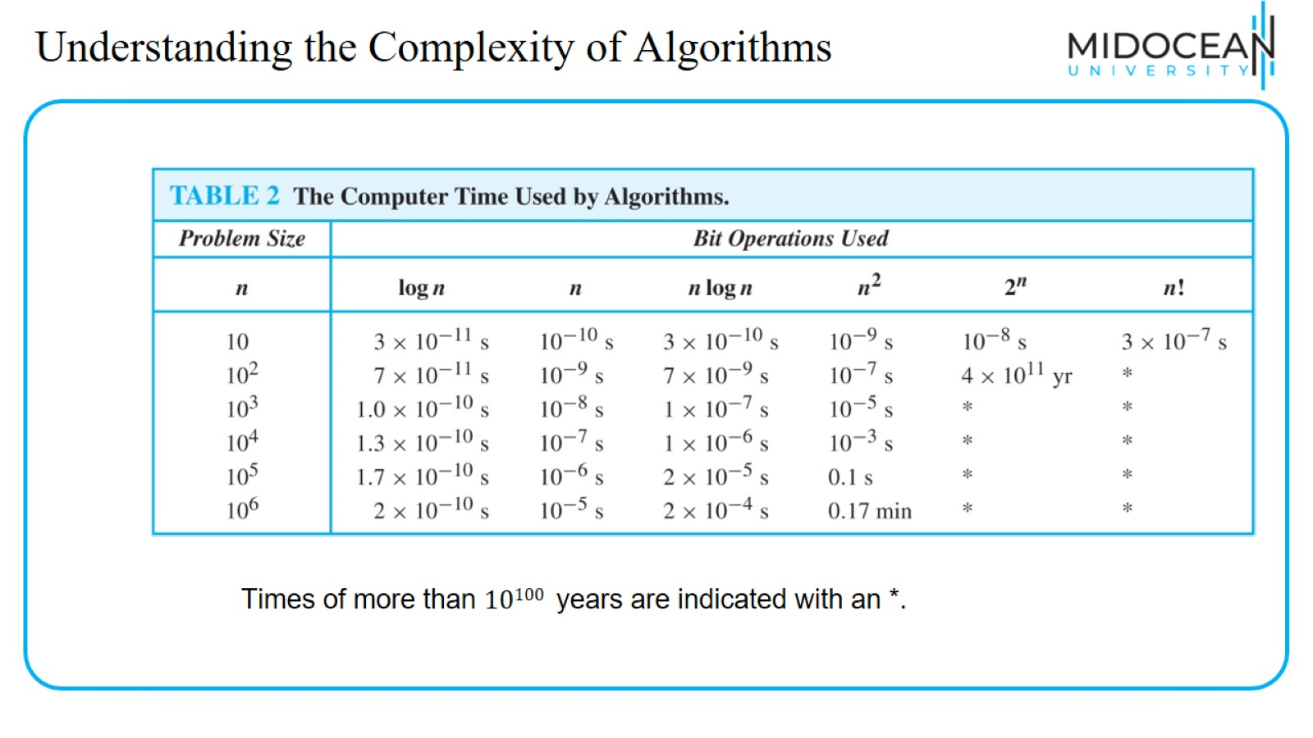
Understanding the Complexity of Algorithms

Slide 30
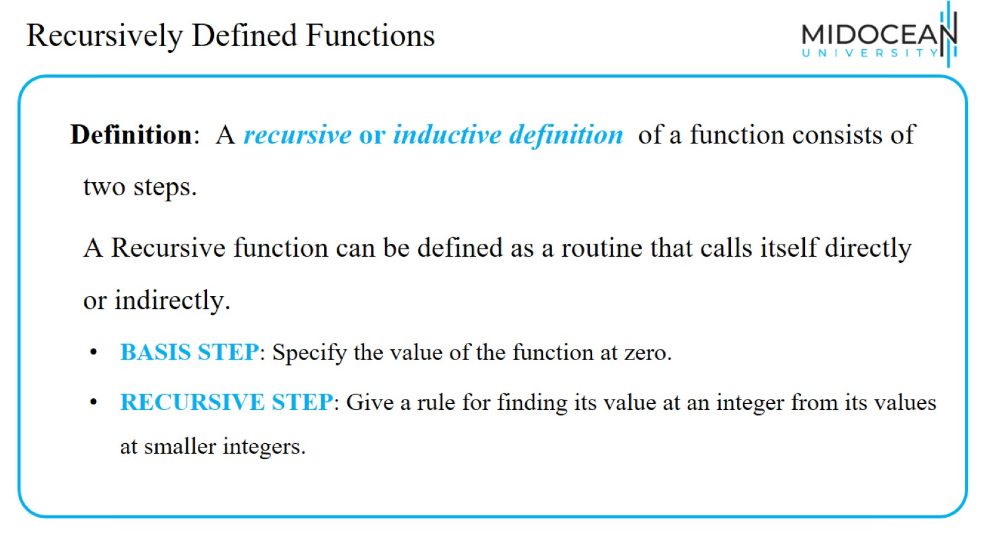
Recursively Defined Functions

Slide 31
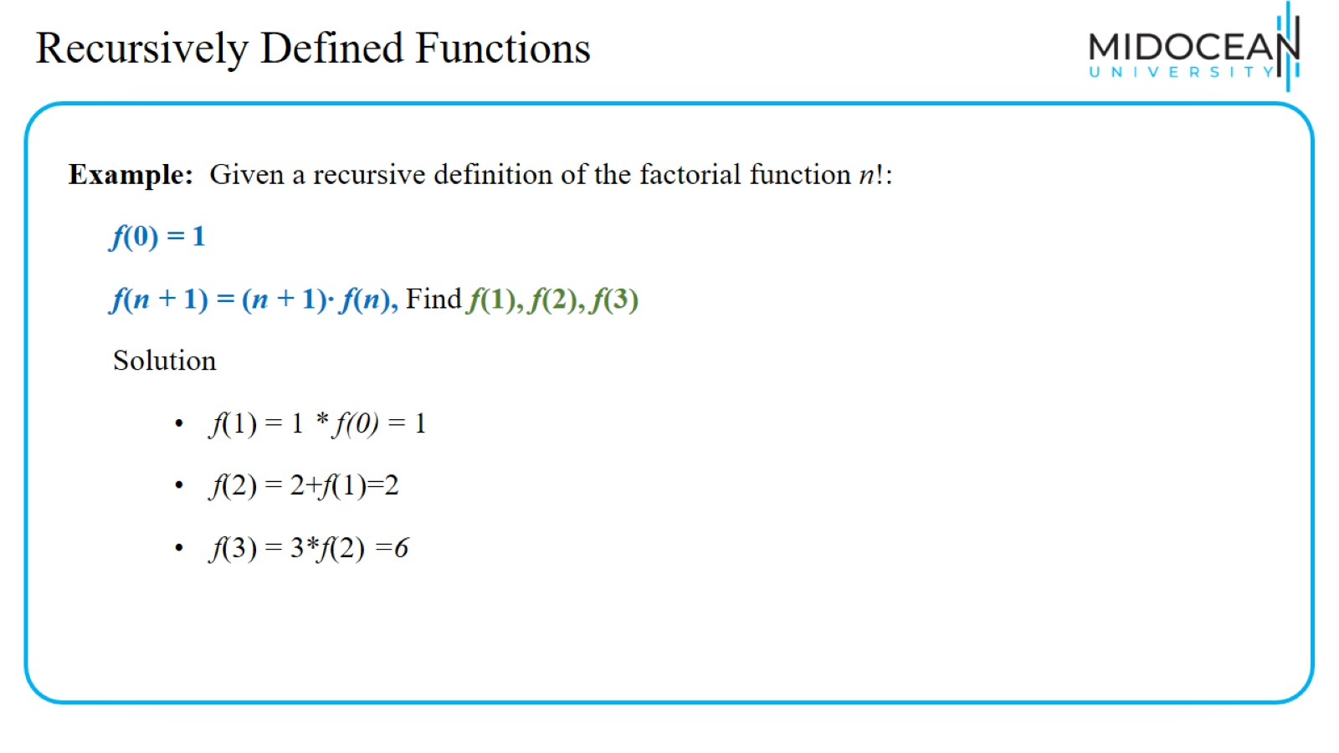
Recursively Defined Functions

Slide 32
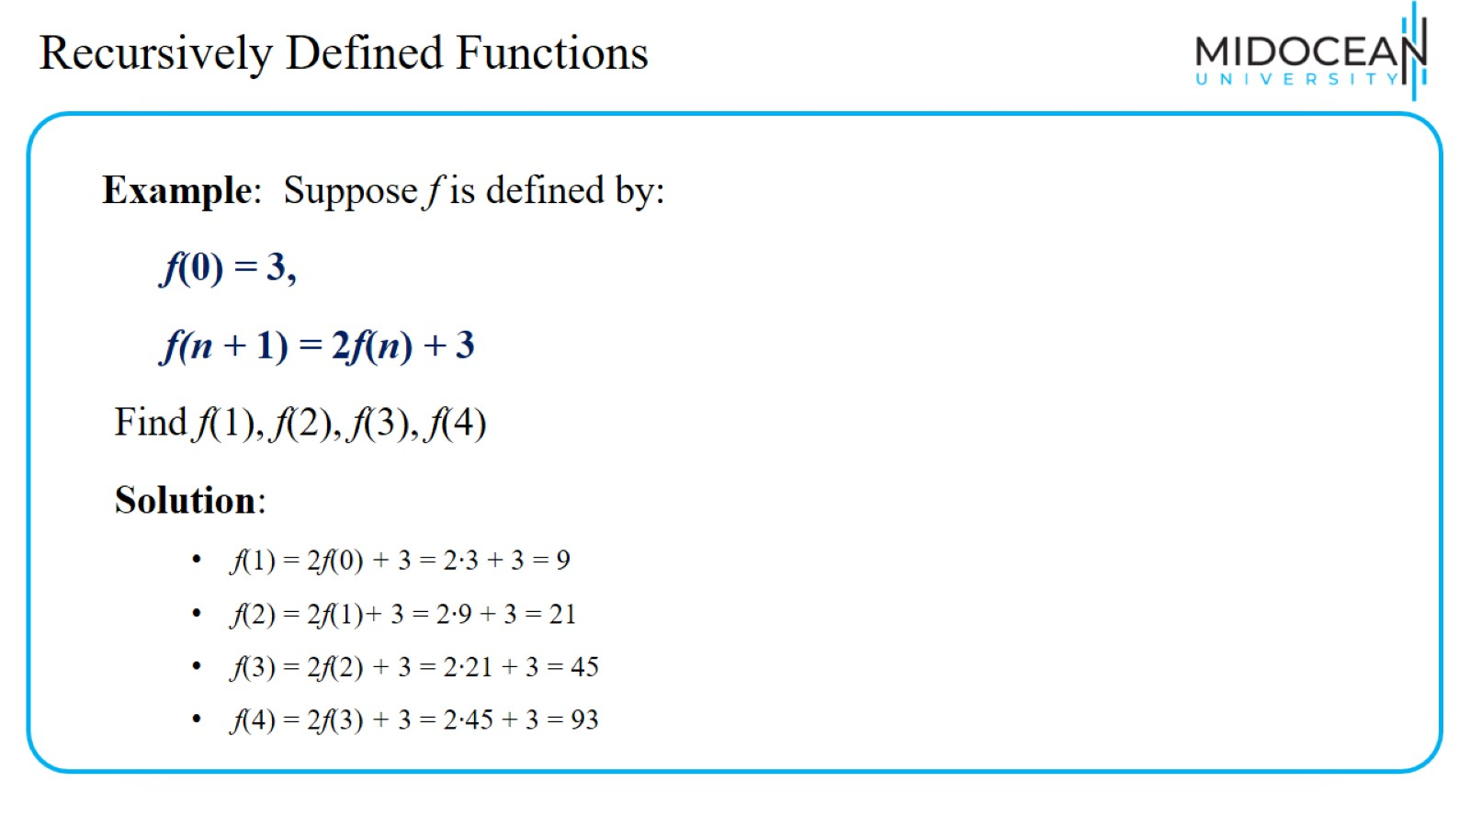
Recursively Defined Functions

Slide 33
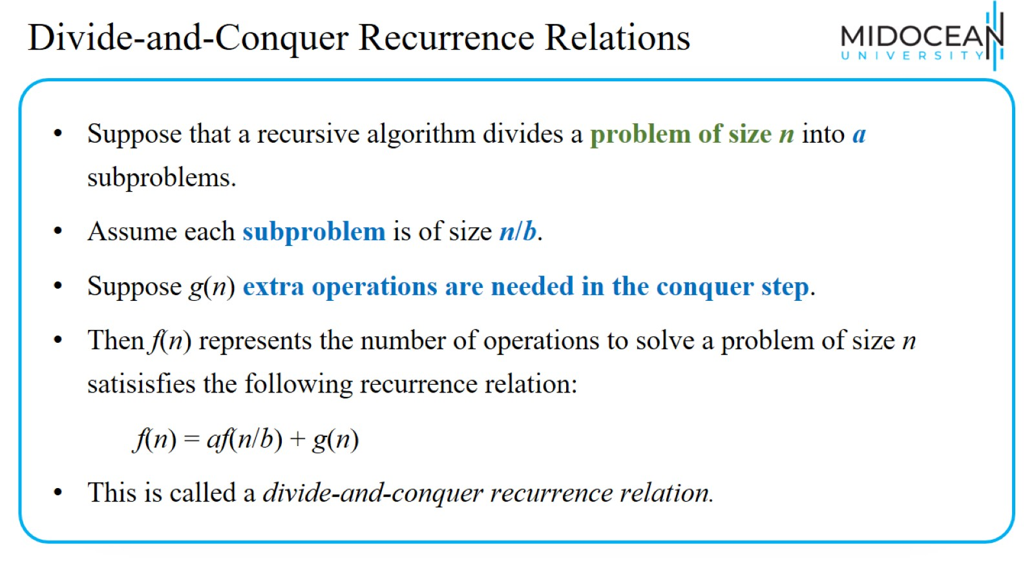
Divide-and-Conquer Recurrence Relations

Slide 34
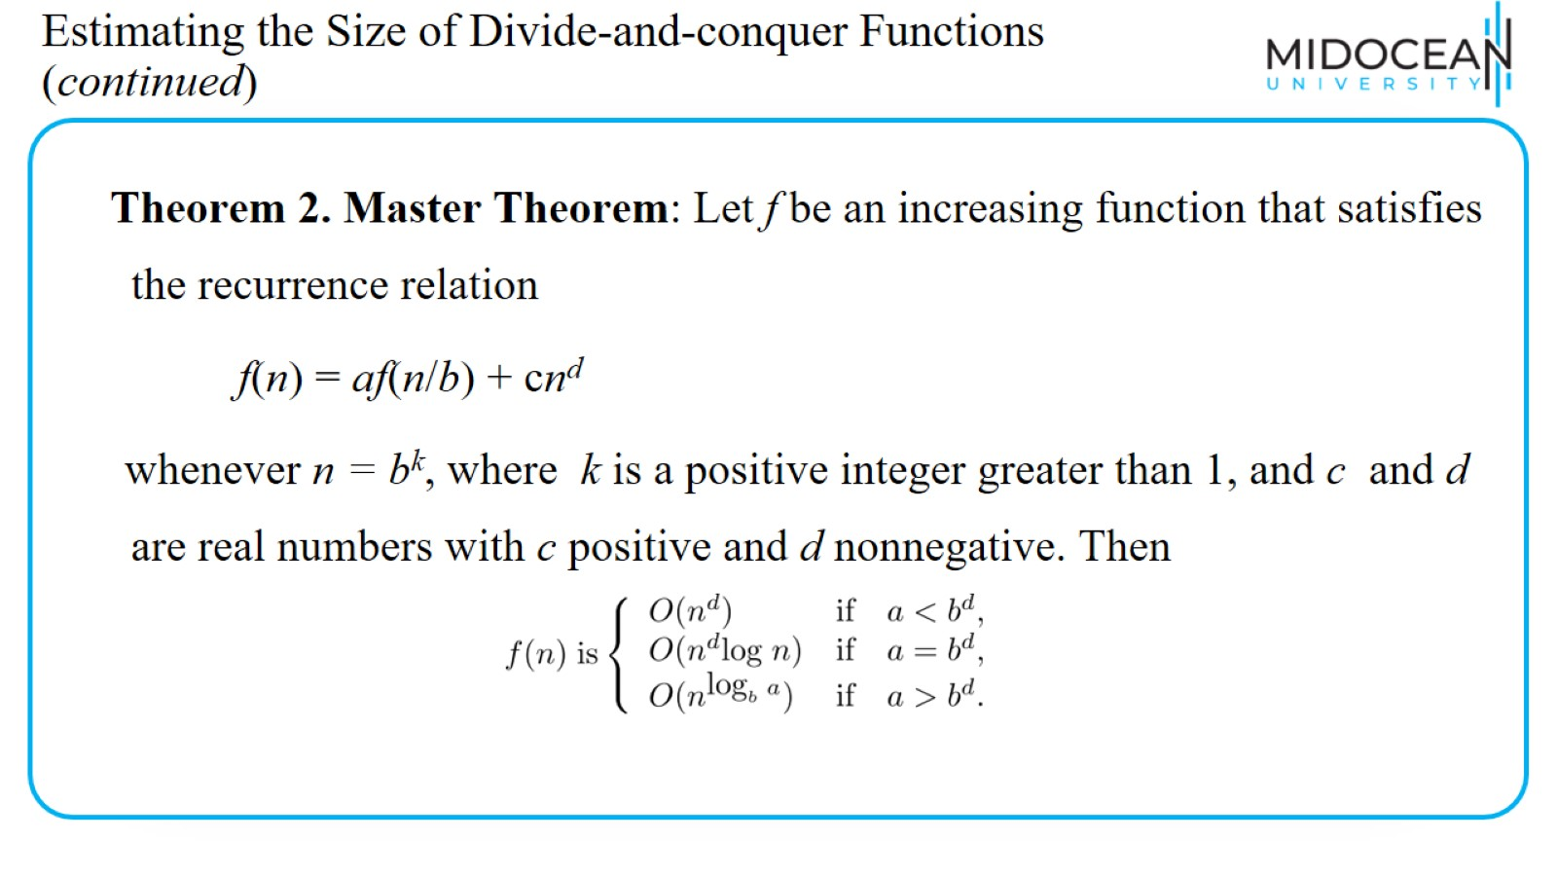
Estimating the Size of Divide-and-conquer Functions (continued)

Slide 35
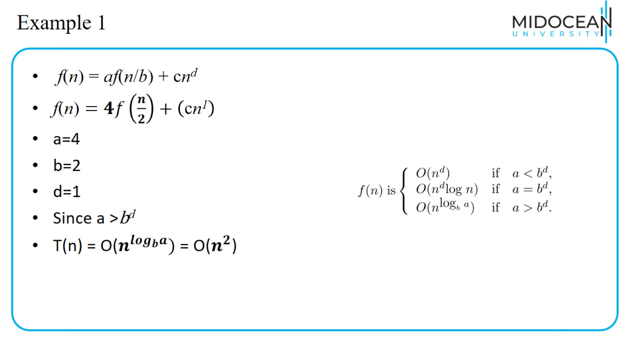
Example 1

Slide 36
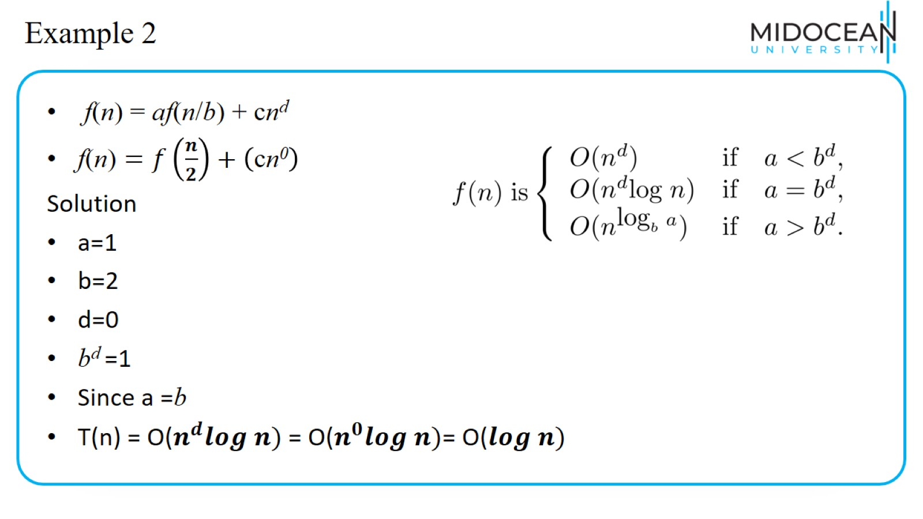
Example 2

Slide 37
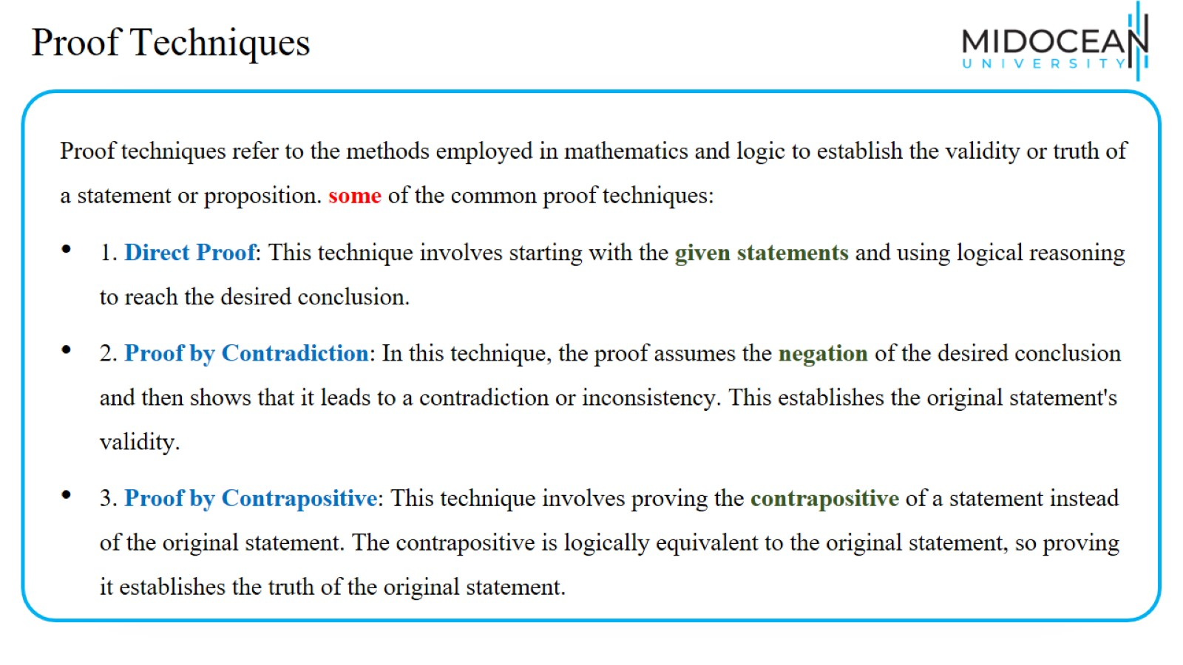
Proof Techniques

Slide 38
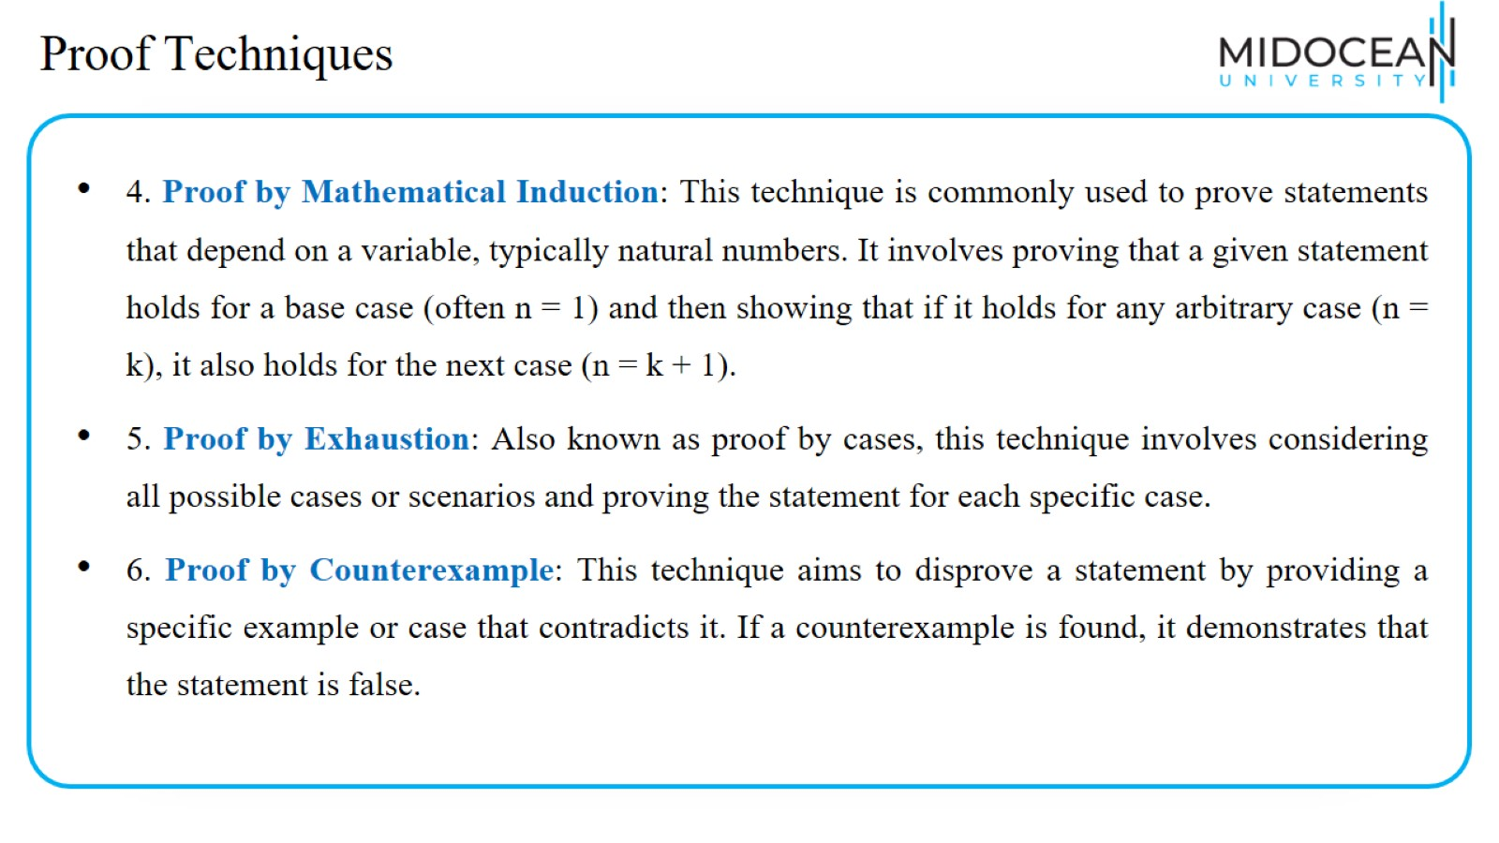
Proof Techniques

Slide 39
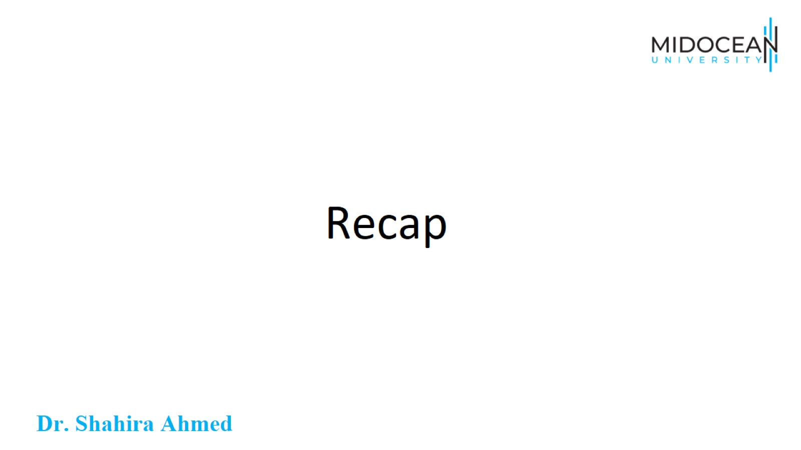
Recap

Slide 40
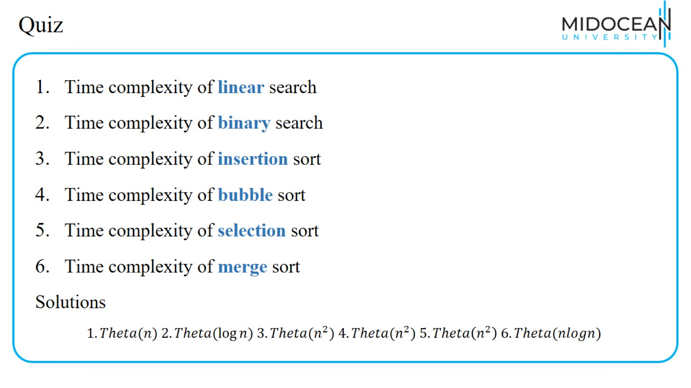
Quiz

Slide 41
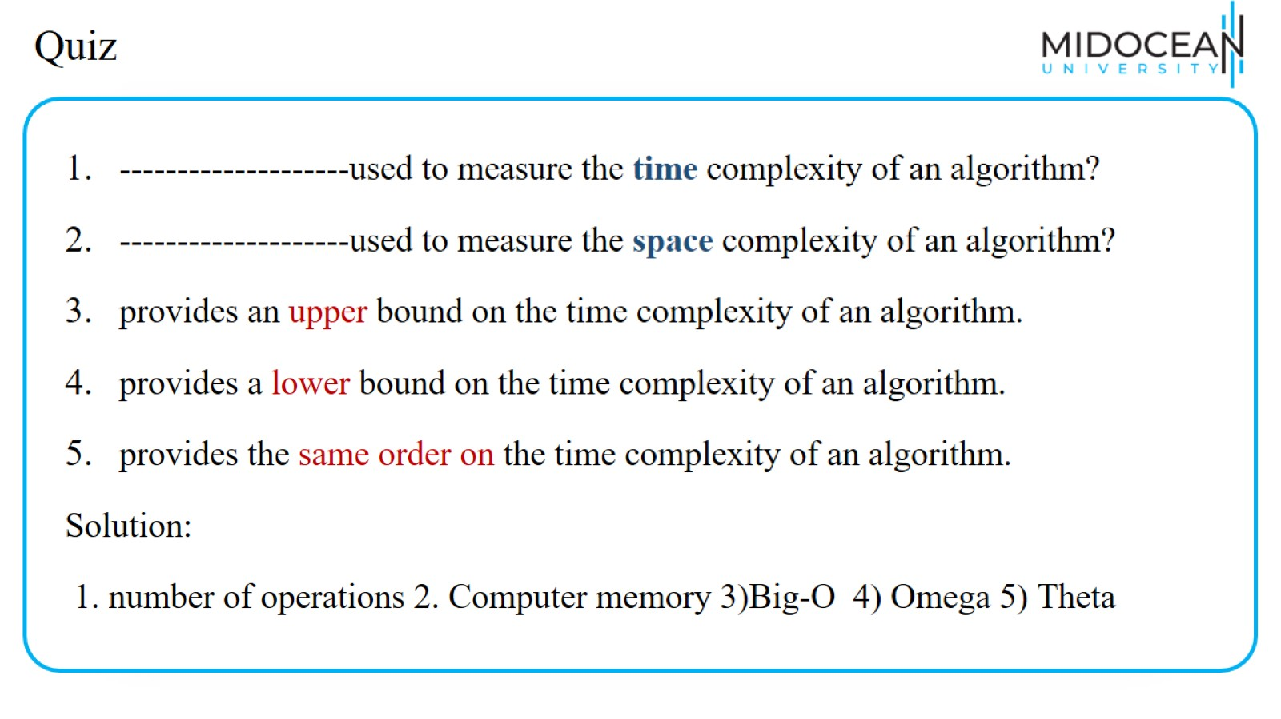
Quiz

Slide 42
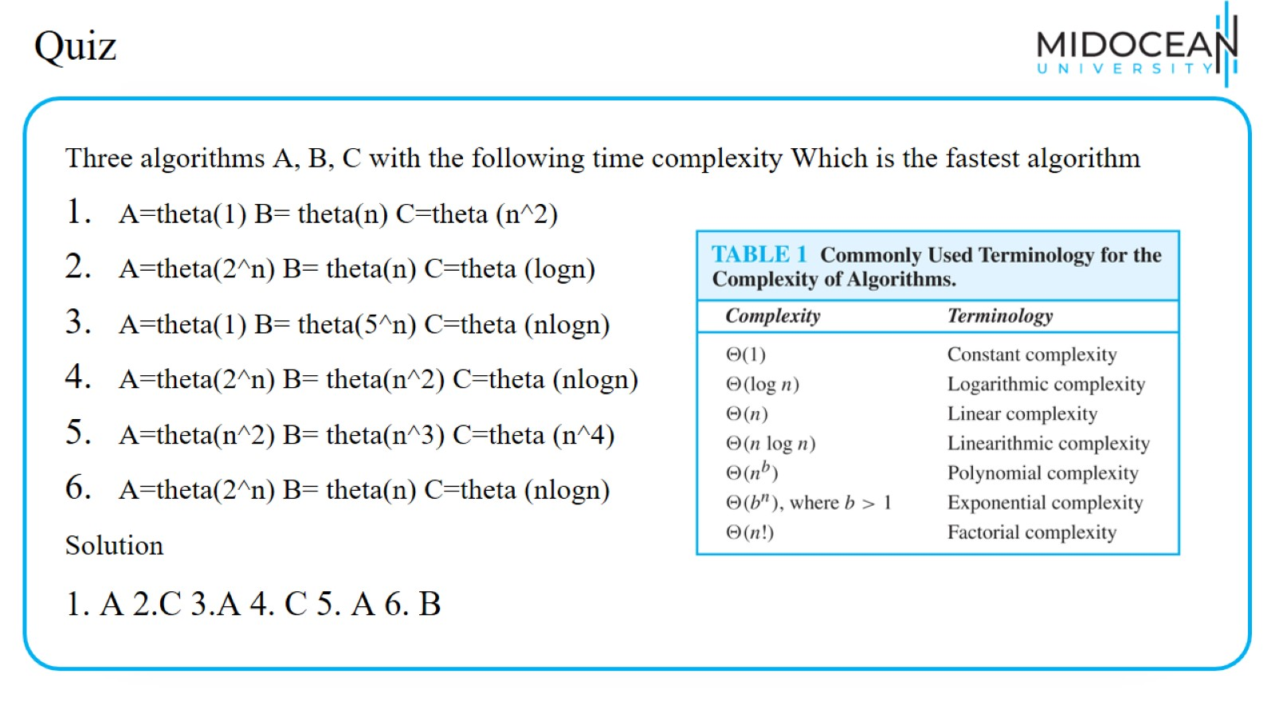
Quiz

Slide 43
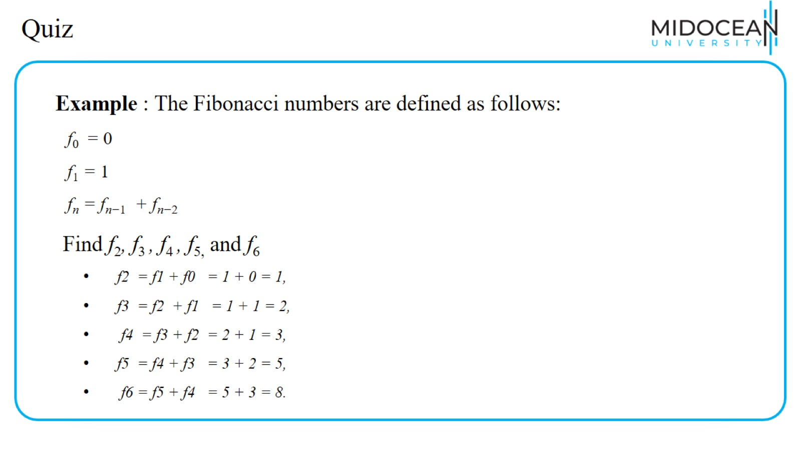
Quiz

Slide 44
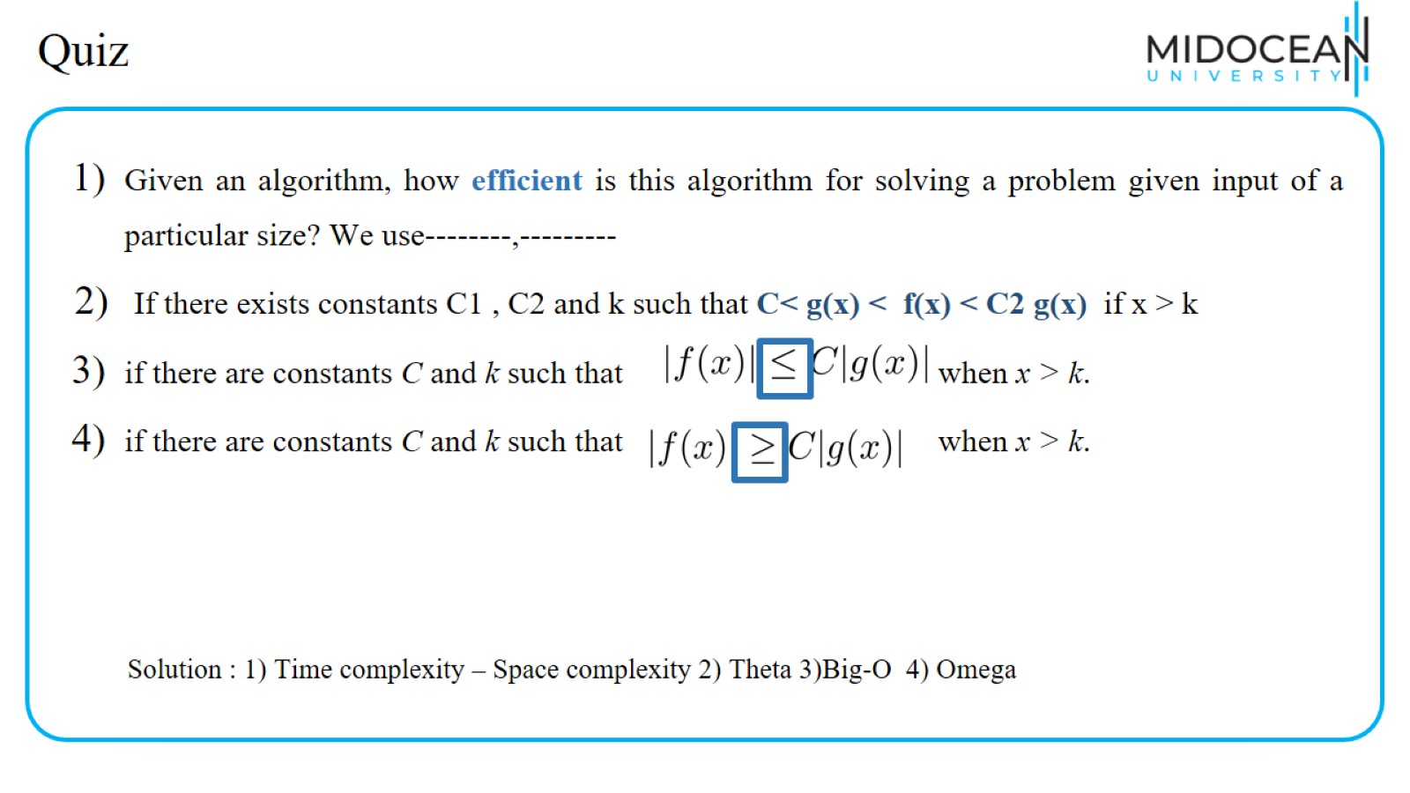
Quiz

Slide 45
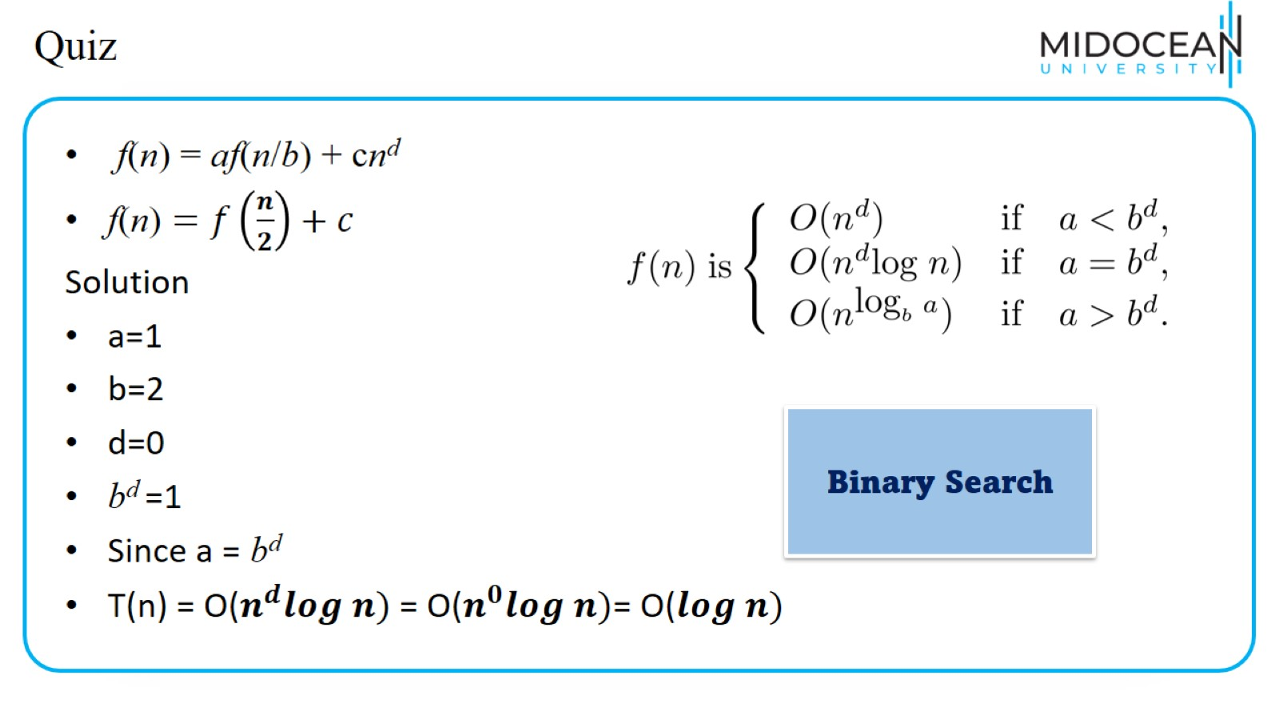
Quiz

Slide 46
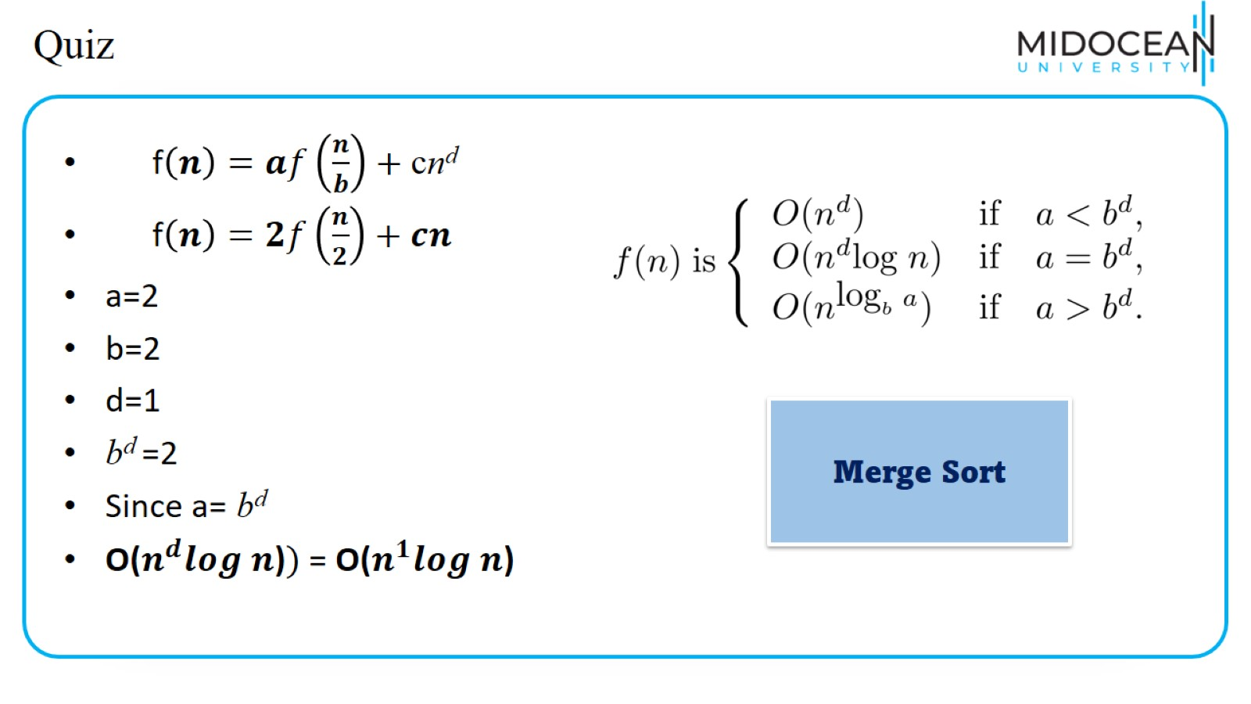
Quiz

Slide 47
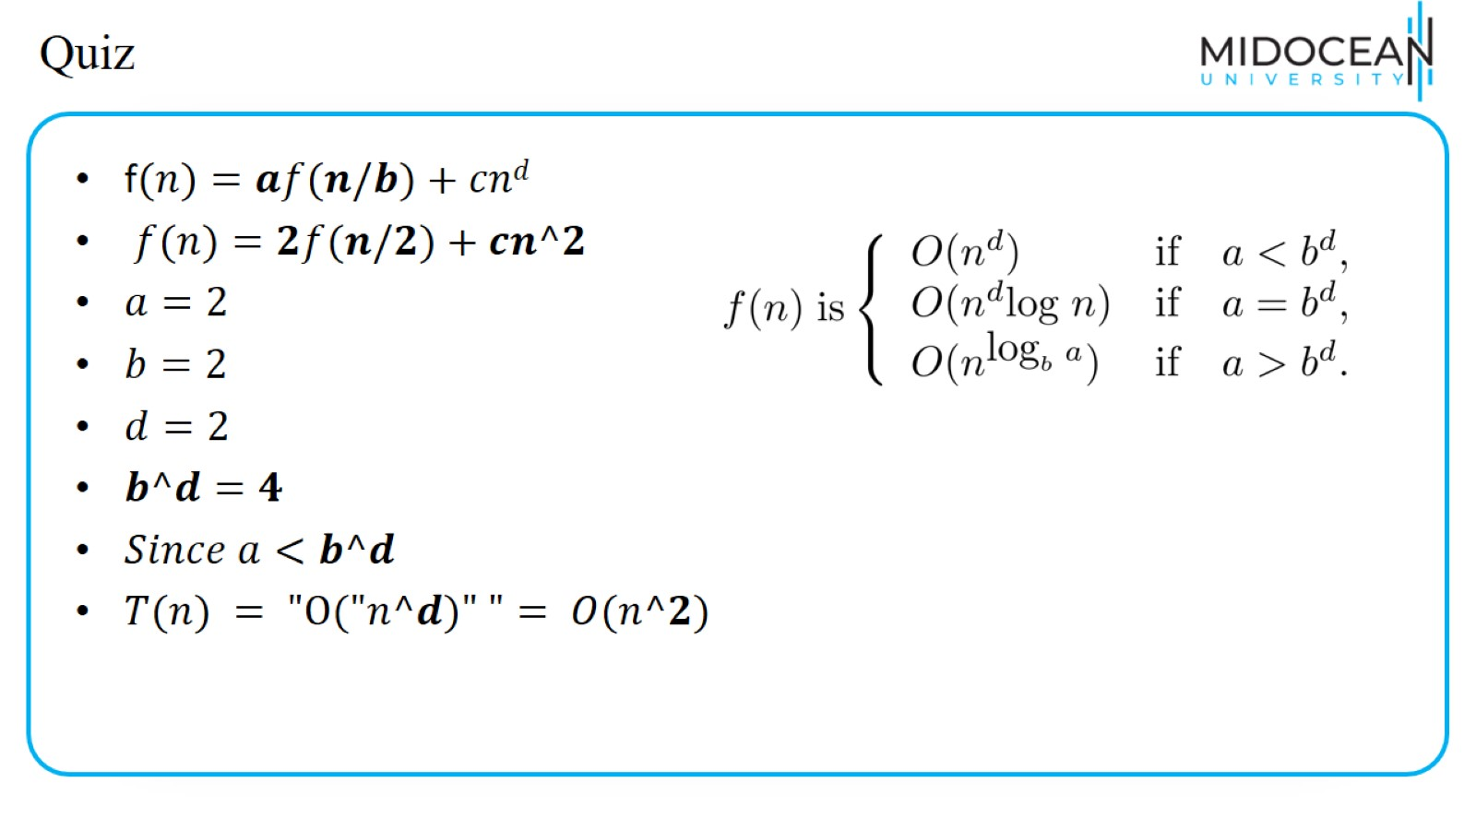
Quiz

Slide 48
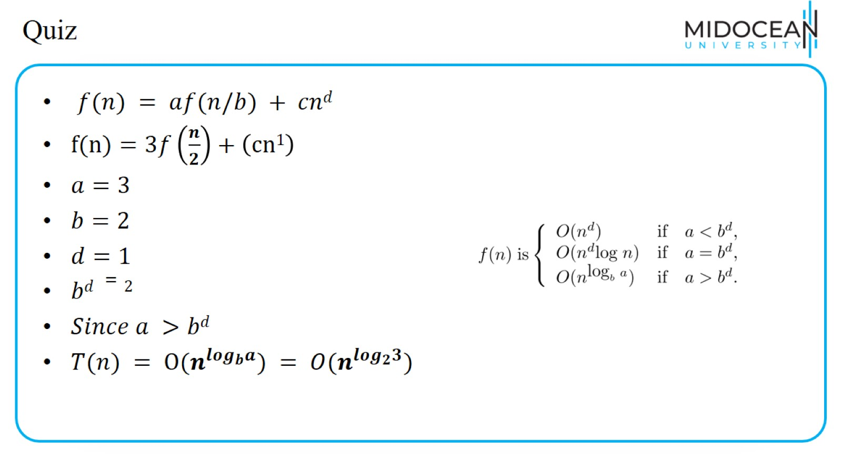
Quiz

Slide 49
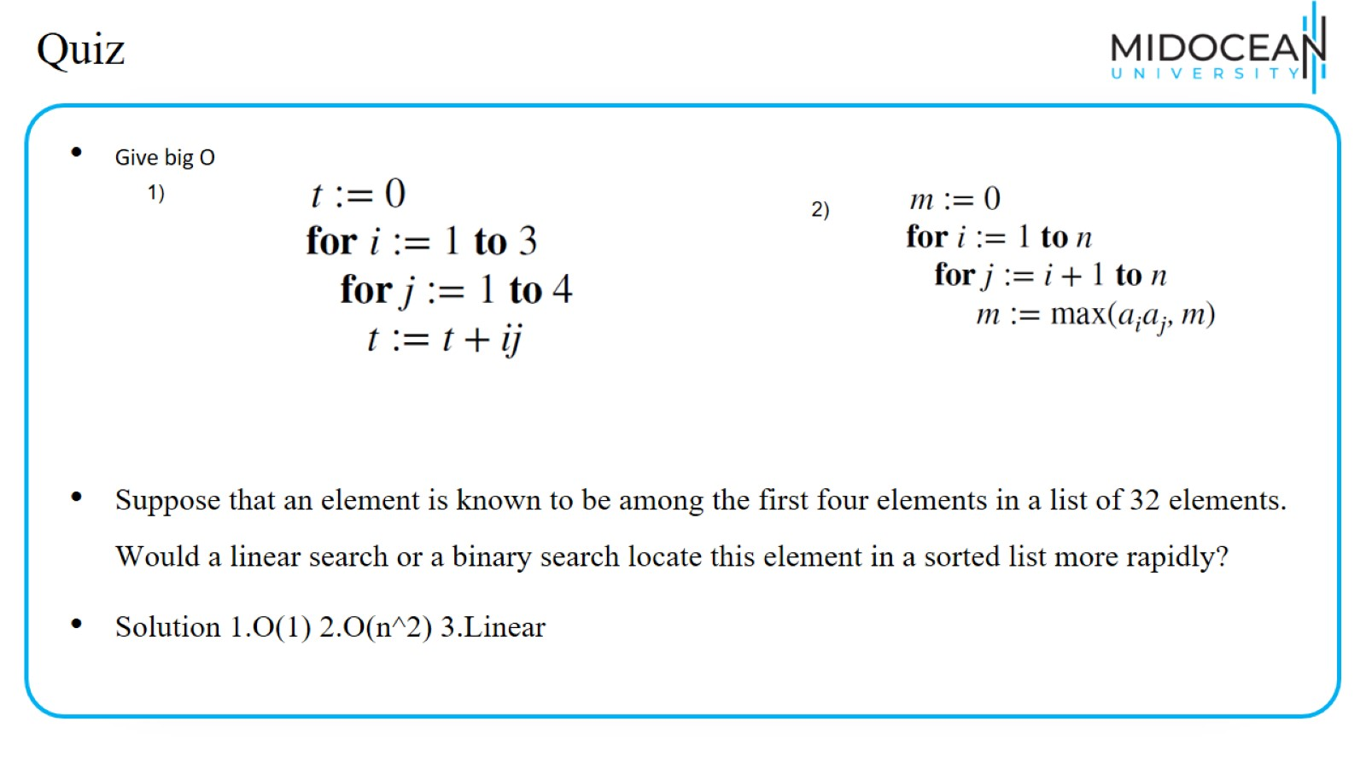
Quiz

Slide 50
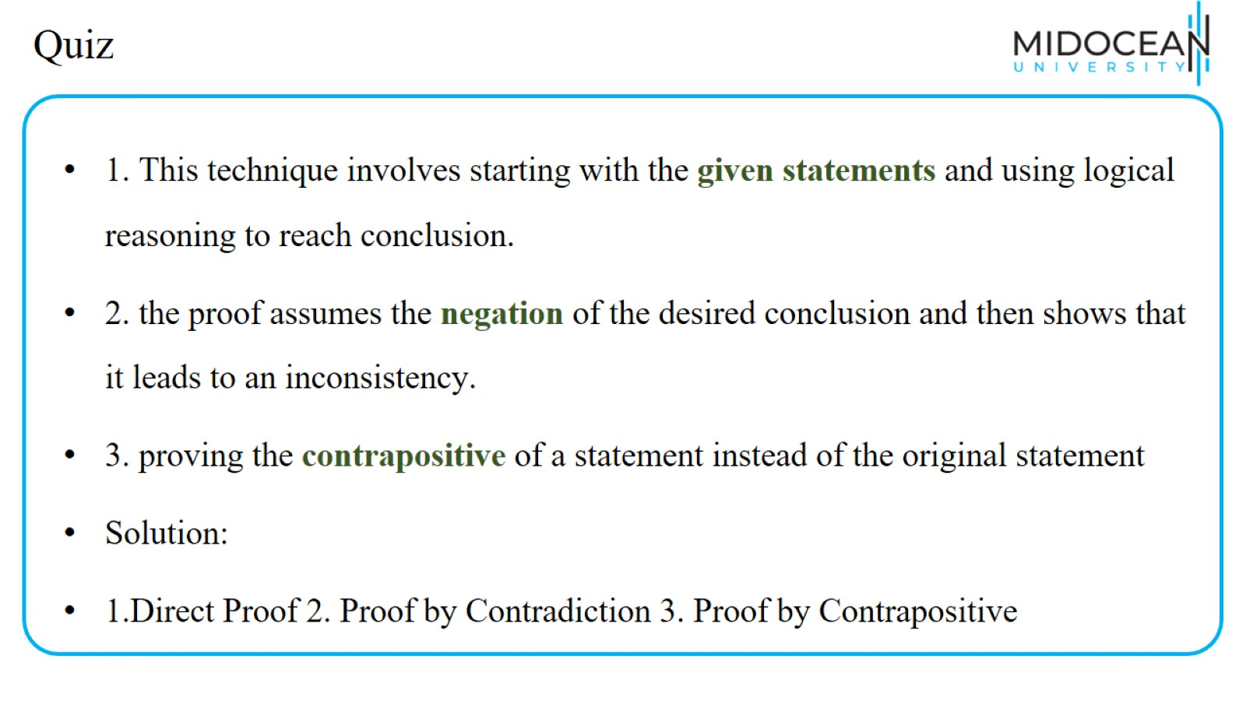
Quiz

Slide 51
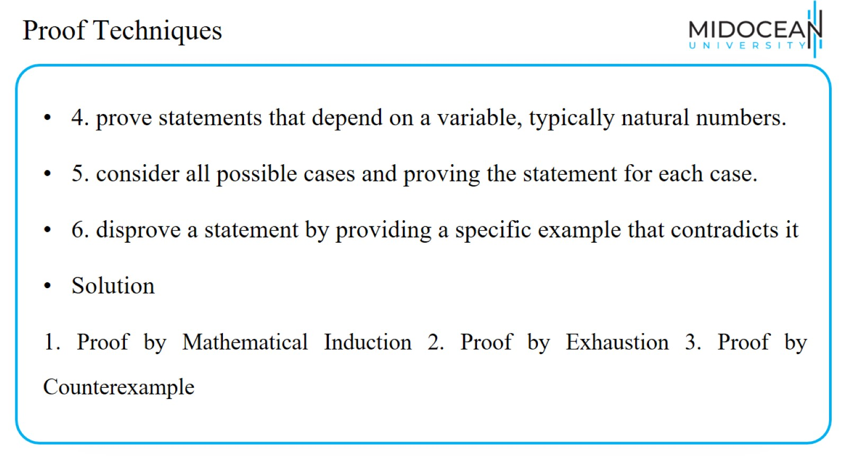
Proof Techniques

Slide 52


